Slide 1
PHY 711 Classical Mechanics and Mathematical Methods
10-10:50 AM MWF in Olin 103
Notes on Lecture 14 -- Chap. 6 (F & W)
Extensions of Hamiltonian formalism
Virial theorem
Canonical transformations
Hamilton-Jacobi formalism
Notes:
In this lecture we will discuss a variety of identities and methods and historically important ideas related to Hamiltonian and Lagrangian mechanics.

Slide 2
Your questions –
From Sam -- My question in the slides for tomorrow pertains to you calling S the "action". I am having trouble understanding what this actually represents.

Slide 3
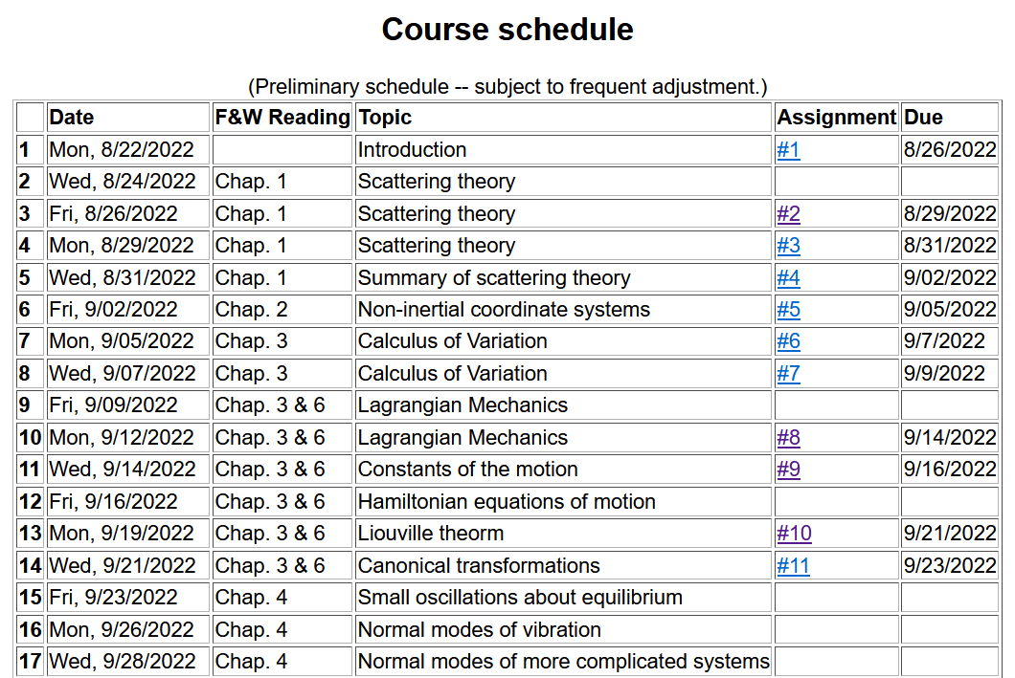
Notes:
Note that the schedule shows that this lecture will wrap up Chapters 3 and 6. There is a new homework assignment from the textbook. On Friday we will start discussing Chap. 4 and apply Lagrangian and Hamiltonian mechanics to small oscillations.

Slide 5
Opportunities for Physics Research Part III Experimental & Theoretical/Computational Condensed Matter Physics
-- Thursday’s Colloquium --
Featuring the laboratories/groups of Oana Jurchescu,
Stephen Winter, Timo Thonhauser, and Natalie Holzwarth
September 22, 2022 at 4 PM in Olin 101

Slide 6
Virial theorem (Rudolf Clausius ~ 1870)
Note that this implies that the motion is periodic or bounded (not for all systems).
When it is true --
Notes:
The “virial theorem” is a useful identity for studying some mechanical systems.

Slide 7
Examples of the Virial Theorem
Premise true because of periodicity.
Notes:
Examples.

Slide 8
Examples of the Virial Theorem
centripetal acceleration
gravitational force
Premise true because of periodicity.
Notes:
Another example.

Slide 9
Hamiltonian formalism and the canonical equations of motion:
In the next slides we will consider finding different coordinates and momenta that can also describe the system. Why?
Because we can
Because it might be useful
Notes:
Review for a general Hamiltonian system. The question is what would happen if we change coordinates?

Slide 10
Notion of “Canonical” generalized coordinate transformations
Note that because of the way we set up the problem we can always add such a term.
Notes:
Thinking about changing the coordinates – indicated with lower case and larger case symbols.

Slide 11
Some details --
Notes:
Some details.

Slide 12
Some relations between old and new variables:
Notes:
More details.

Slide 13
Notes:
Relationship between new Hamiltonian and original Hamiltonian.

Slide 14
Note that it is conceivable that if we were extraordinarily clever, we could find all of the constants of the motion!
Possible solution – Hamilton-Jacobi theory:
Notes:
Focusing on finding the constants of motion.

Slide 15
Notes:
Deriving equations for identifying constants of motion.

Slide 16
0
0
0
Notes:
Details of derivation.

Slide 17
0
0
0
Notes:
More details.

Slide 18
Differential equation for S:
Does this look familiar?
Notes:
Hamilton-Jacobi using harmonic oscillator example.

Slide 19
Continued:
Notes:
Hamilton-Jacobi equations for harmonic oscillator.

Slide 20
Continued:
Notes:
Continued.

Slide 21
Another example of Hamilton Jacobi equations
Notes:
Another example of using the Hamilton-Jacobi equations.

Slide 22
Notes:
Continued.

Slide 23
Check action:
Agrees with Hamilton-Jacobi analysis.
Notes:
More details.

Slide 25
What do you think of Hamilton-Jacobi method
Historically important
Hysterical
Painful
Might be useful
The next 3 slides contain important equations that you will hopefully remember for this material contained in Chapters 3 & 6 of Fetter and Walecka. On Friday we will start with Chapter 4 and discuss one of the many applications of these ideas – the case of small oscillations near equilibrium.

Slide 26
Recap --
Lagrangian picture
Hamiltonian picture
Notes:
Summary of what we have learned.

Slide 27
Notes:
More summary.

Slide 28
Recipe for constructing the Hamiltonian and analyzing the equations of motion
Notes:
Recipe to remember.

