Slide 1
PHY 711 Classical Mechanics and Mathematical Methods
10-10:50 AM MWF in Olin 103
Discussion for Lecture 15 – Chap. 4 (F & W)
Analysis of motion near equilibrium
Small oscillations about equilibrium
Normal modes of vibration
Notes:
In this lecture we will analyze systems near equilibrium. This system represents a lot of physical systems and has a rich toolbox of mathematical formalisms.

Slide 2
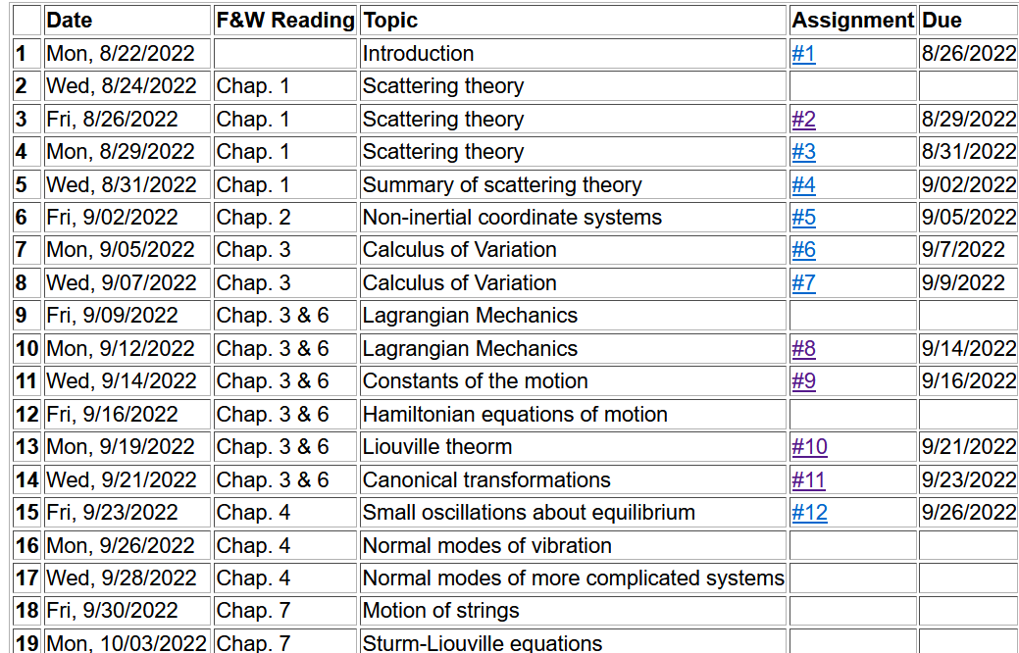
Notes:
We are starting the material covered in Chap. 4. The assigned homework is due on Friday.

Slide 3
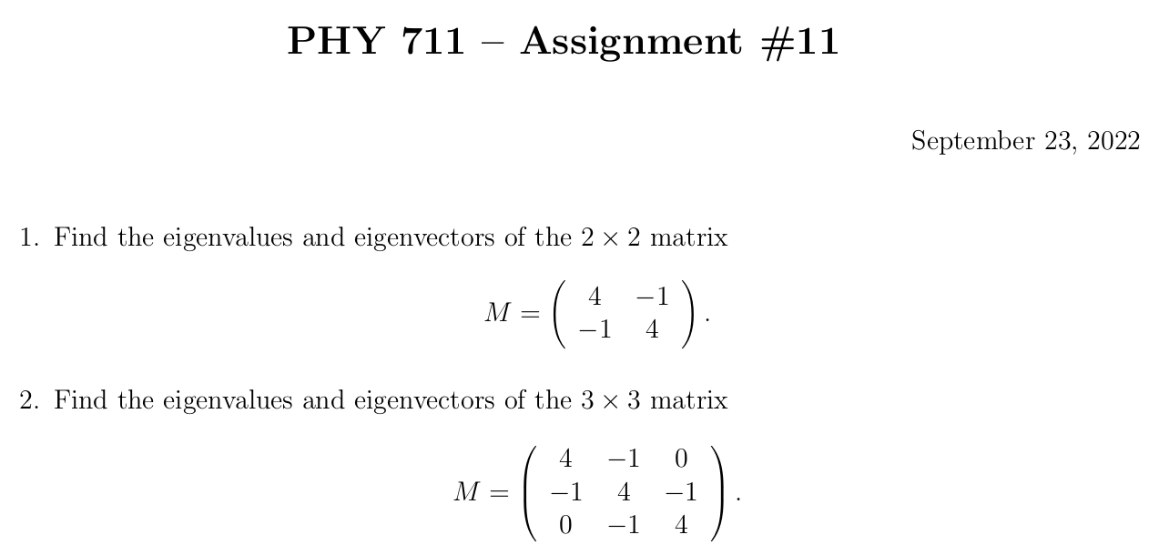
Note that you may compute these by hand and/or using Maple or Mathematica.
Notes:
This is the homework problem.

Slide 4
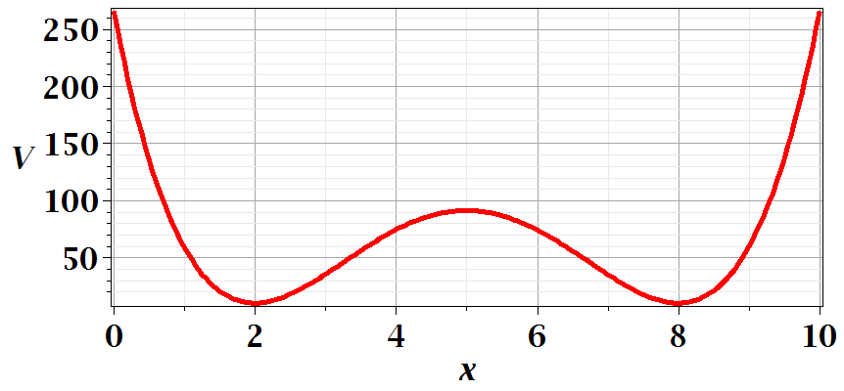
Motivation for studying small oscillations – many interacting systems have stable and meta-stable configurations which are well approximated by:
Notes:
This is a plot for an arbitrary one dimensional potential function showing two stable equilibria near x=2 and x=8.

Slide 5
Notes:
Lagrangian analysis and general solution.

Slide 6
Example – linear molecule
m₁
m₂
m₃
Notes:
A more complicated example with 3 masses connected with springs.

Slide 7
Notes:
Analyzing the equations of motion.

Slide 8
Notes:
Coupled differential equation and tricks for solution.

Slide 9
Notes:
Resulting linear equations also written in matrix form.

Slide 10
Notes:
The original equations are not symmetric. With this transformation, we can make the equations take a symmetric form.

Slide 11
Digression:
Notes:
Digression on linear algebra theory.

Slide 12
Digression on matrices -- continued
Eigenvalues of a matrix are “invariant” under a similarity transformation
Notes:
Similarity transformations used to analyze our system.

Slide 13
Example of transformation:
Notes:
Details for our case..

Slide 14
Notes:
More details for our case.

Slide 16
m₁
m₂
m₃
m₁
m₂
m₃
m₁
m₂
m₃
Notes:
Visualization of the solution for our case.

Slide 17
Notes:
The general solution will depend on initial values or boundary values.

Slide 18
Comment on solving for eigenvalues and eigenvectors – while it is reasonable to find these analytically for 2x2 or 3x3 matrices, it is prudent to use Maple or Mathematica for larger systems.
Maple example
Mathematica example

Slide 19
Additional digression on matrix properties
Singular value decomposition
Notes:
An unrelated digression that may be useful – singular value decomposition.

Slide 20
Singular value decomposition -- continued
Notes:
Digression continued.

Slide 21
Consider an extended system of masses and springs:
m
m
m
Notes:
Another example; this one is in your textbook.

Slide 22
Notes:
Details for N masses.

Slide 23
Can solve as an eigenvalue problem --
Notes:
Form of matrix equations. Remaining slides will be discussed on Monday.

Slide 24
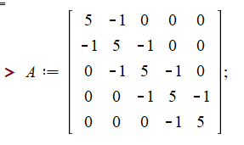
Notes:
Finding eigenvalues with Maple.

Slide 25
This example also has an algebraic solution --
Notes:
Analytic methods for this highly symmetric case.

Slide 26
Notes:
Setting the boundary values.

Slide 27
Notes:
Boundary conditions continued.

Slide 28
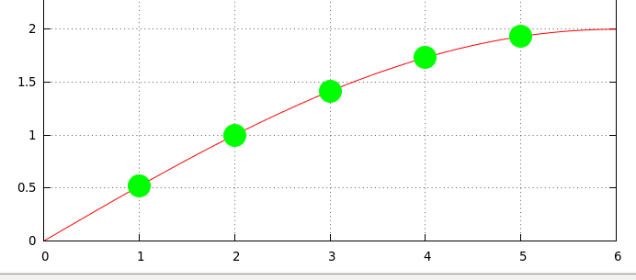
Notes:
Plot of the results.

