Slide 1
PHY 711 Classical Mechanics and Mathematical Methods
10-10:50 AM MWF in Olin 103
Discussion on Lecture 17: Chap. 4 (F&W)
Normal Mode Analysis
Normal modes for finite 2 and 3 dimensional systems
Normal modes for extended systems
Notes:
In this lecture, we will extend our normal mode analysis to more complicated systems.

Slide 2
Opportunities for Physics Research Part IV Theoretical/Computational Biophysics and Gravitational Physics
Featuring the groups of Fred Salsbury and Sam Cho,
Greg Cook, Paul Anderson, and Eric Carlson
September 29, 2022 at 4 PM in Olin 101

Slide 3
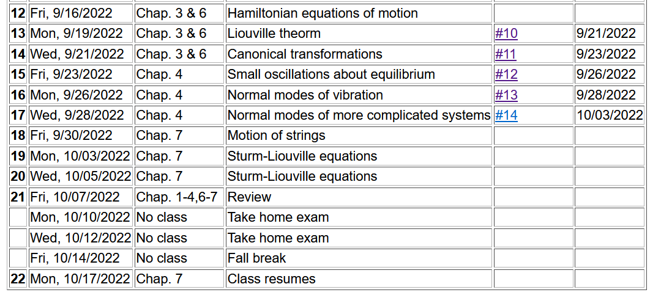
Notes:
This is the last lecture for Chap. 4. On Friday we will continue to discuss vibrations in extended one dimensional motion as covered in Chap. 7.

Slide 4
Notes:
Homework due Monday.

Slide 5
Recap from previous lecture --
Consider an infinite system of masses and springs now with two kinds of masses:
m
M
m
M
m
m
Notes:
Now consider a slight modification of the previous example where masses are alternately m and M with labels x and y.

Slide 6
Note that 2qa is an unknown parameter.
Does this form seem reasonable?
Notes:
In this case, we can analyze the system by considering different amplitudes for the m and M masses. The resulting coupled equations can be written in matrix form.

Slide 7
Comment on notation --
m
M
m
M
m
m
Using 2qa as our unknown parameter is a convenient choice so that we can easily relate our solution to the m=M case.

Slide 8
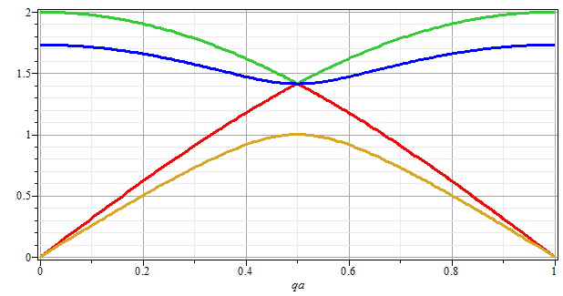
Note that for m=M, we obtain the same normal modes as before. Is this reassuring?
No
Yes
ω
qa/π
Notes:
Plotting the solutions for the frequencies as a function of qa.

Slide 9
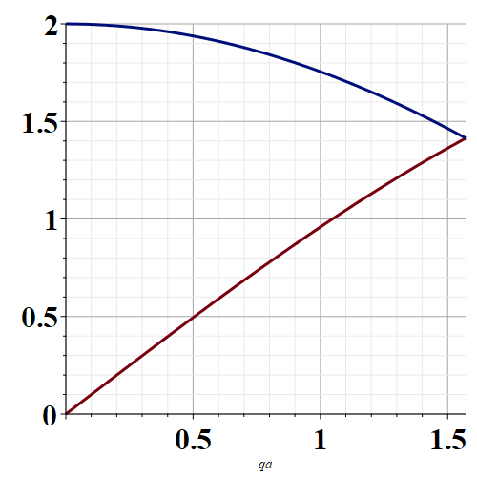
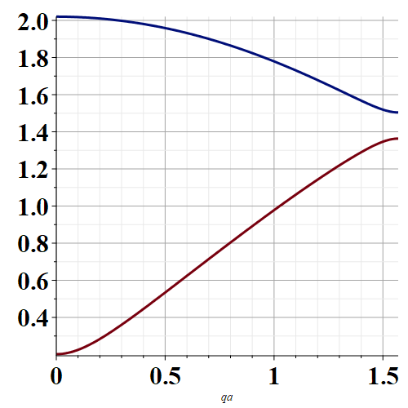
Note that for every qa, there are 2 modes.
m=M
m≠M
qa
qa
Plotting only distinct frequencies 0< qa < π/2

Slide 10
Eigenvectors:
Notes:
Some details about the solutions.

Slide 11
Now consider a potential system in 2 dimensions near its equilibrium point --
V(x,y)
Notes:
Returning to the finite systems, consider equilibria in two dimensions as shown.

Slide 12
Example – normal modes of a system with the symmetry of an equilateral triangle
3
u₃
m
k
k
u₂
1
2
u₁
k
m
m
Notes:
Specifically, we will consider 3 masses in an equilateral triangle configuration as shown.

Slide 13
Example – normal modes of a system with the symmetry of an equilateral triangle -- continued
3
u₃
u₂
1
2
u₁
Notes:
We need to consider displacements from equilibrium in the x-y plane. Keeping only linear terms in the displacements we wind up with a simple relationship to analyze.

Slide 14
negligible
Note that this analysis of the leading term is true in 1, 2, and 3 dimensions.

Slide 15
Example – normal modes of a system with the symmetry of an equilateral triangle -- continued
3
u₃
u₂
1
2
u₁
Notes:
We need to consider displacements from equilibrium in the x-y plane. Keeping only linear terms in the displacements we wind up with a simple relationship to analyze.

Slide 16
Example – normal modes of a system with the symmetry of an equilateral triangle -- continued
Notes:
Analyzing the 3 displacements for the equilateral triangle geometry, we find these equations.

Slide 17
Some details for this case of the equilateral triangle --
3
u₃
m
k
k
u₂
1
2
u₁
k
m
m

Slide 18
Example – normal modes of a system with the symmetry of an equilateral triangle -- continued
= ω²
Notes:
The results is a 6x6 matrix problem to find eigenvalues and eigenvectors.

Slide 19
Example – normal modes of a system with the symmetry of an equilateral triangle -- continued
With help from Maple
3
u₃
m
k
k
u₂
1
2
u₁
k
m
m
Notes:
Results from Maple. We have 6 eigenvalues and 3 non-zero modes for this case.

Slide 20
3
u₃
What can you say about the 3 zero frequency modes?
m
k
k
u₂
1
2
What can you say about the 3 non-zero frequency modes?
u₁
k
m
m

Slide 21
More general treatment of atomic system near equilibrium
Notes:
Some equations for extended systems.

Slide 22
Notes:
More euqations.

Slide 23
q maps distinct configurations of periodic states.

Slide 24
Notes:
More equations.

Slide 25
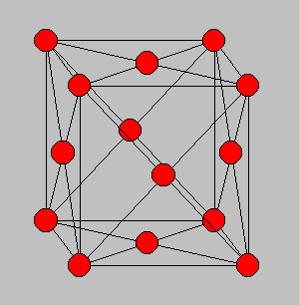
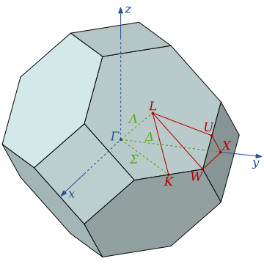
3-dimensional periodic lattices
Example – face-centered-cubic unit cell (Al or Ni)
Diagram of atom positions
Diagram of q-space ν(q)
Notes:
Interesting extensions to a 3-dimensional crystalline system.

Slide 26
From: PRB 59 3395 (1999); Mishin et. al. ν(q)
Note that for each q, there are 3 frequencies.
Notes:
Results of normal modes from experiment and simulations for face centered cubic Al (left) and Ni (right). Interestingly, the phonon frequency patterns are similar for these very different materials.

Slide 27
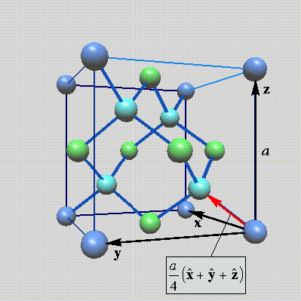
Lattice vibrations for 3-dimensional lattice
Example: diamond lattice
Ref: http://phycomp.technion.ac.il/~nika/diamond_structure.html
Notes:
Another example – diamond.

Slide 28
B. P. Pandy and B. Dayal, J. Phys. C. Solid State Phys. 6 2943 (1973)
Notes:
Results for diamond from simulation and experiment.

Slide 29
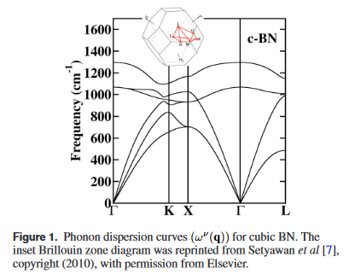
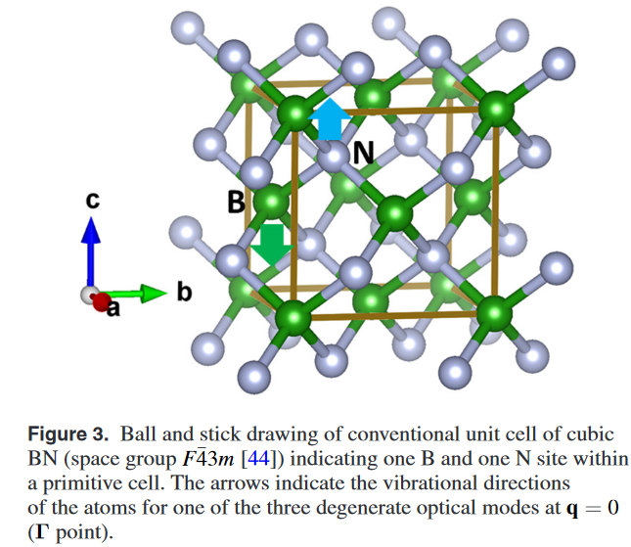
Examples of phonon spectra of two forms of boron nitride
Cubic structure

Slide 30
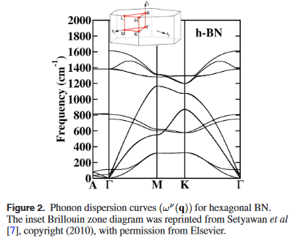
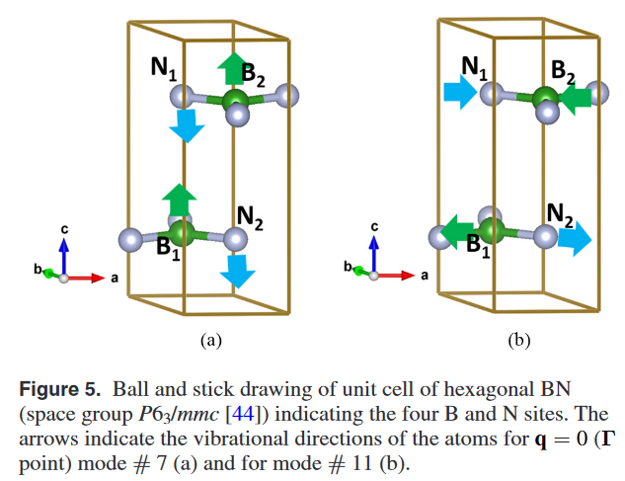
Examples of phonon spectra of two forms of boron nitride
Hexagonal structure

