Slide 1
PHY 711 Classical Mechanics and Mathematical Methods
10-10:50 AM MWF in Olin 103
Notes for Lecture 18: Chap. 7 (F&W)
Mechanical motion of a continuous string
Comments on linear vs. non-linear differential equations – considering beyond harmonic oscillations
Back to linear analyses -- masses coupled by springs ⬅➔mass continuum coupled by string
Mechanics one-dimensional continuous system
The wave equation
Notes:
The one dimensional motion of a large number masses interconnected with springs provides a model of longitudinal motions of a continuous elastic spring and related topics covered in Chapter 7 of your textbook

Slide 2
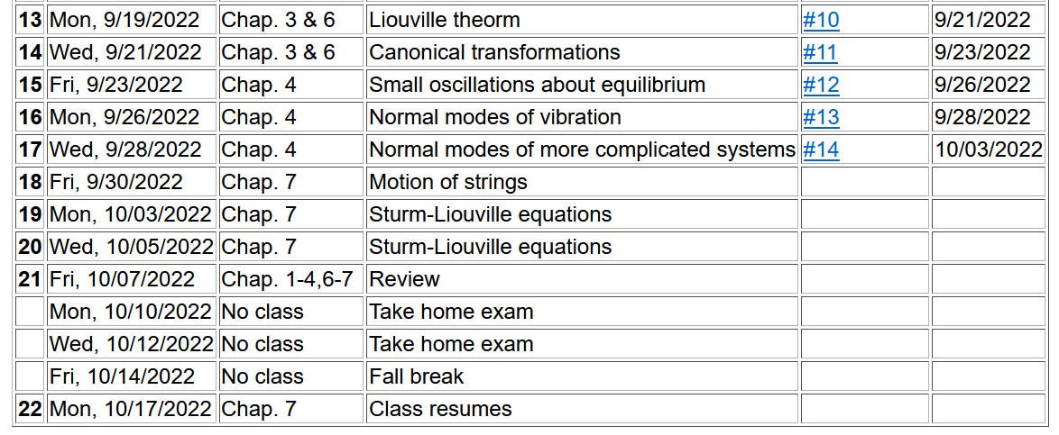
Notes:
Start reading Chapter 7.

Slide 3
Digression – comment on linear vs non-linear equations
Notes:
Digression on the special properties of linear equations in contrast to complications for non-linear equations.

Slide 4
Notes:
An example of the effects of non-linearity.

Slide 5
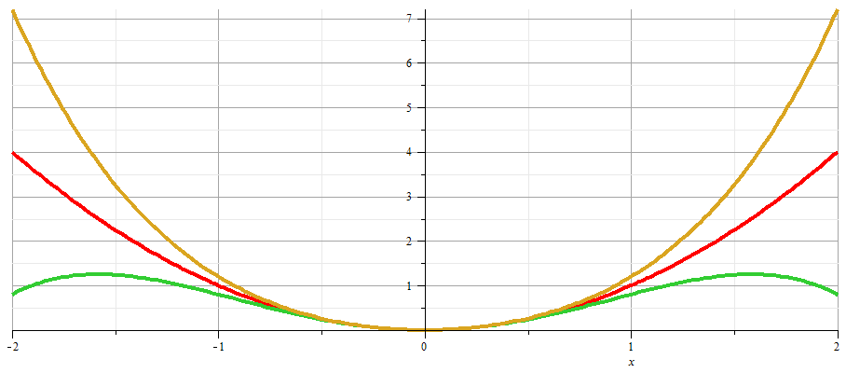
x
Notes:
Plot of nonlinear potentials.

Slide 6
Notes:
Approximate solution to example non-linear equation.

Slide 7
Notes:
Non-linear equation continued.

Slide 8
Notes:
More details.

Slide 9
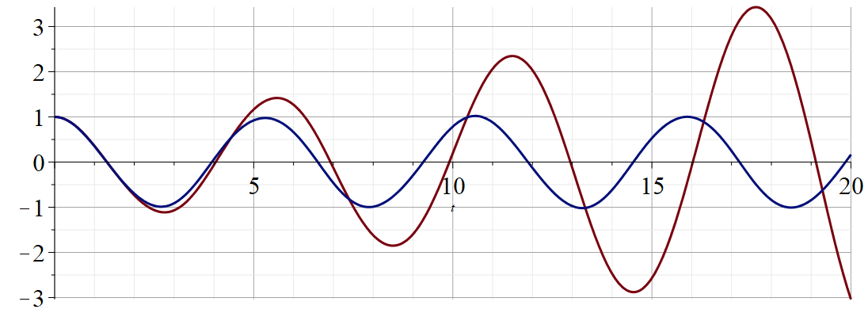
Regrouped expansion
x
t
Original perturbation expansion
Numerical solution according to Maple
Notes:
Plot of results.

Slide 10
Back to linear equations –
Longitudinal case: a system of masses and springs:
m
m
m
Notes:
Showing how the case of the extended mass and spring system approximates the continuous elastic string.

Slide 11
system parameter with units of (velocity)²
Notes:
Regrouping constants in terms of spring constant times increment of length and mass per unit length which combine to give a squared velocity for the longitudinal case. For the transverse case, string tension is involved.

Slide 12
More details

Slide 13
More details
Transverse case
τ₁
θ₁
y+Δy
θ₂
y
τ₂
x
x+Δx

Slide 14
Transverse displacement:
τ
μ(x,t)
Notes:
The diagram shows how the y component of the net tension contributes to the transverse motion.

Slide 15
Notes:
It is possible to adapt the Lagrangian formalism to this continuous system.

Slide 16
Notes:
The continuum version of the Euler-Lagrange equations result in the wave equation for this example.

Slide 17
Note that this is an example of a partial differential equation
Notes:
In the next several slides we will discuss solutions to the wave equation. Note that the one dimensional wave equation has some special properties.

Slide 18
These functions would be given
Notes:
This method by D’Alembert is based on the special property of the wave equation.

Slide 19
Notes:
D’Alembert’s method continued.

Slide 20
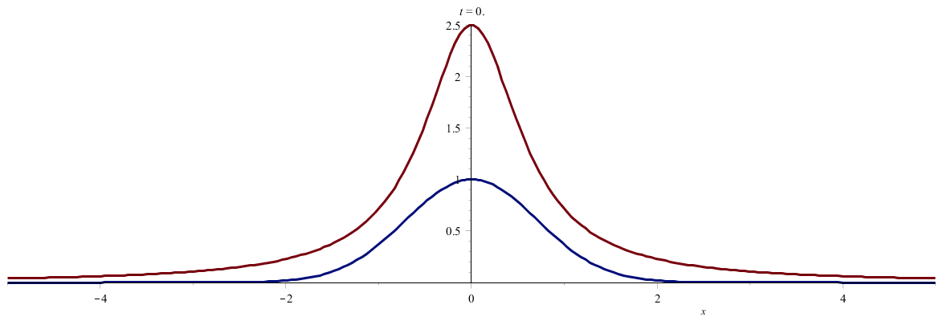
Notes:
An example. (Use slide show to see animation.)

Slide 21
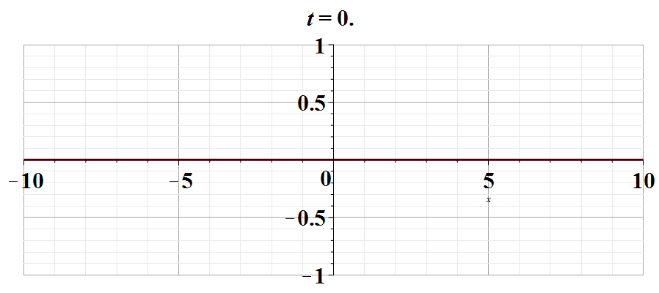
Notes:
Another example. Use slide show to see animation.

