Slide 1
PHY 711 Classical Mechanics and Mathematical Methods
10-10:50 AM MWF in Olin 103
Notes on Lecture 20 – Chap. 7 (F&W)
Properties of Sturm-Liouville equations
Eigenfunctions of Sturm-Liouville equation
Notion of the completeness property of eigenvalue expansions
Green’s function solution methods
Notes:
In this lecture, we follow the textbook to use the example of the one-dimensional wave equation to discuss ordinary differential equations more generally and develop some solution methods.

Slide 2
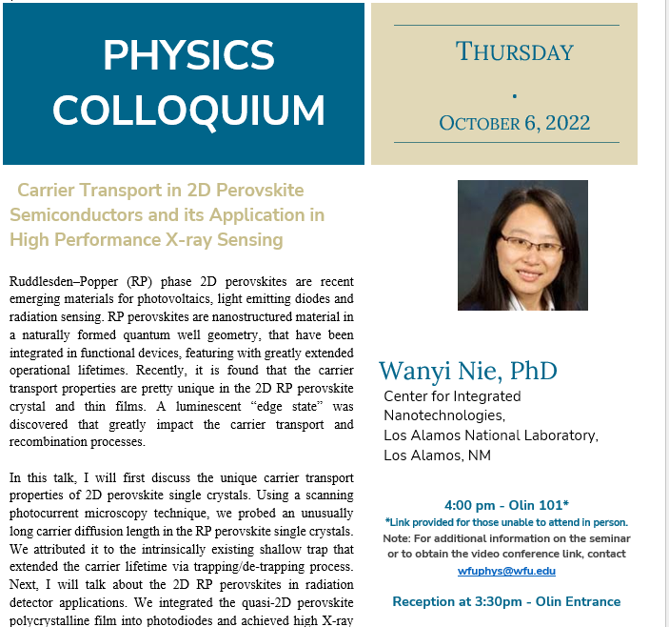

Slide 3
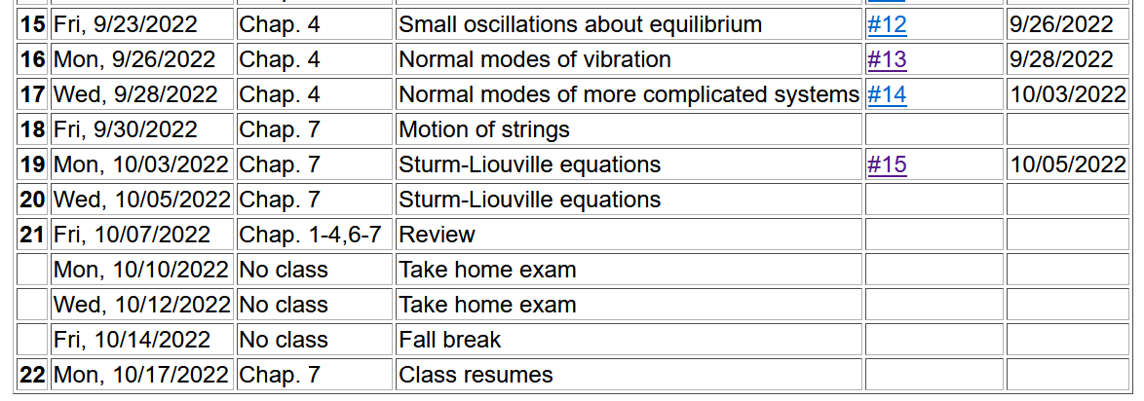
Notes:
Expected schedule for the next weeks…

Slide 4
The wave equation and related linear PDE’s
Notes:
Generalization of the wave equation. Equations in this class are separable in the time variables and the spatial variable satisfies a generalized eigenvalue problem of this form.

Slide 5
Linear second-order ordinary differential equations
Sturm-Liouville equations
given functions
applied force
When applicable, it is assumed that the form of the applied force is known.
solution to be determined
Homogenous problem: F(x)=0
Notes:
We will sometimes want to generalize even further with an “inhomogeneous” term such as an applied force.

Slide 6
Examples of Sturm-Liouville eigenvalue equations --
Notes:
For now, we will focus on eigenvalues of the homogeneous equations.

Slide 7
Solution methods of Sturm-Liouville equations (assume all functions and constants are real):
This leads to: ➔
Notes:
The eigenfunctions of these equations have very useful properties such as completeness.

Slide 8
Comment on orthogonality of eigenfunctions
Notes:
Orthogonality of eigenfunctions.

Slide 9
Comment on orthogonality of eigenfunctions -- continued
Vanishes for various boundary conditions at x=a and x=b
Notes:
Orthogonality continued.

Slide 10
Comment on orthogonality of eigenfunctions -- continued
Notes:
Orthogonality continued.

Slide 11
Comment on “completeness”
It can be shown that for any reasonable function h(x), defined within the interval a < x <b, we can expand that function as a linear combination of the eigenfunctions f_{n}(x)
These ideas lead to the notion that the set of eigenfunctions f_{n}(x) form a ``complete'' set in the sense of ``spanning'' the space of all functions in the interval
a < x <b, as summarized by the statement:
Notes:
Notion of completeness.

Slide 12
Comment on “completeness” -- continued
Notes:
Notion of completeness and practical applications.

Slide 13
This is the completeness property of the eigenfunctions. How many terms are needed for the expansion, depends on both the function h(x) and on the eigenfunctions f_{n}(x).

Slide 14
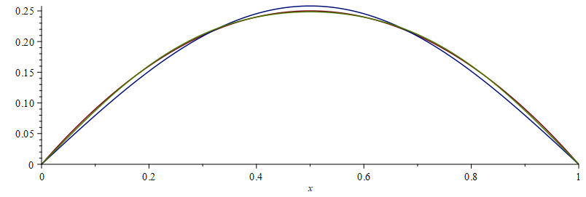
⬅ 1 term
⬅ 2 or more terms

Slide 15
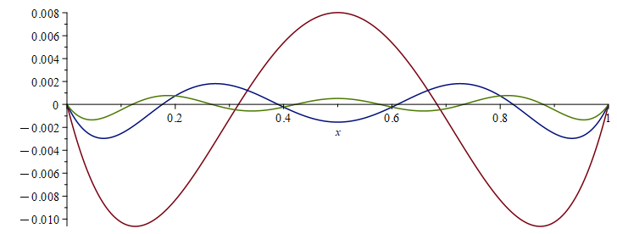
Plot of functions
⬅ 1 term
⬅ 2 or more terms
Plot of error in expansion
⬅ 1 term
⬅ 2 terms
⬅ 3 terms

Slide 16
Variational approximation to lowest eigenvalue
In general, there are several techniques to determine the eigenvalues λ_{n} and eigenfunctions f_{n}(x). When it is not possible to find the ``exact'' functions, there are several powerful approximation techniques. For example, the lowest eigenvalue can be approximated by minimizing the function
where is a variable function which satisfies the
correct boundary values. The ``proof'' of this inequality is
based on the notion that can in principle be expanded
in terms of the (unknown) exact eigenfunctions f_{n}(x):
where the coefficients C_{n} can be
assumed to be real.
Notes:
A very useful property of eigenfunctions .

Slide 17
Estimation of the lowest eigenvalue – continued:
From the eigenfunction equation, we know that
It follows that:
Notes:
Proof of theorem continued.

Slide 18
Rayleigh-Ritz method of estimating the lowest eigenvalue
Notes:
Example of the Rayleigh Ritz method.

Slide 19
A generally useful solution method -- Green’s function approach
Recall:
Notes:
The following slides present solution methods for differential equations involving the use of eigenvalues.

Slide 20
Solution to inhomogeneous problem by using Green’s functions
Solution to homogeneous problem
Notes:
From a knowledge of the Green’s function we can find solutions of related inhomogeneous equations.

Slide 21
Example Sturm-Liouville problem:
Notes:
Example.

Slide 22
Notes:
Solution using eigenfunctions.

Slide 23
Notes:
Continued.

Slide 24
Notes:
In this case, the solution simplifies.

Slide 25
Notes:
Another method of finding a Green’s function.

Slide 26
General method of constructing Green’s functions using homogeneous solution
Notes:
Green’s function based on homogeneous solutions (not eigenfuntions).

Slide 27
Notes:
Some details.

Slide 28
Notes:
More details. To be continued.

