Slide 1
PHY 711 Classical Mechanics and Mathematical Methods
10-10:50 AM MWF in Olin 103
Notes on Lecture 21 –
Review of Chap. 1-4,6-7 in F&W
Comments on Take-home exam
Review of specific topics

Slide 2
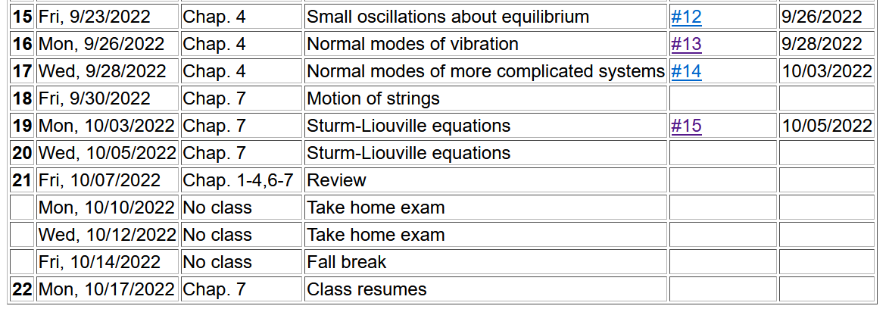
Exam due

Slide 3
Comments about the exam
It must be your own work, under the honor code
Please make sure that the grader can read your answers.
Grading is based on the correct answer AND the correct reasoning to arrive at the correct answer. Full credit is obtained only with both. Partial credit also benefits from clear reasoning and results.
Please meet with me only (in person today or by email after today) if you have questions about the exam.

Slide 4
Comments on exam
The purpose of the exam is to help with your understanding of the material
In accordance with the honor code, the solutions you hand in must be your own work. That is, if you have any questions, please consult with me, but no one else.
You will get credit for the reasoning and derivations as well as for the right answer, including Mathematica, Maple, etc work sheets.
This is an open “book” exam which means that you can consult your textbook and lecture notes as long as you cite them. (Of course, if you find a source that works out the same problem, hopefully you will refrain from looking at that…).
It is often helpful approach problems in more than one way – recalling that undergraduate physics is still true.

Slide 5
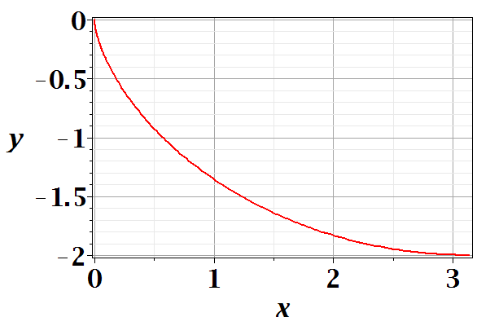
Brachistochrone problem: (solved by Newton in 1696)
http://mathworld.wolfram.com/BrachistochroneProblem.html
A particle of weight mg travels frictionlessly down a path of shape y(x). What is the shape of the path y(x) that minimizes the travel time from
y(0)=0 to y(π)=-2 ?

Slide 6
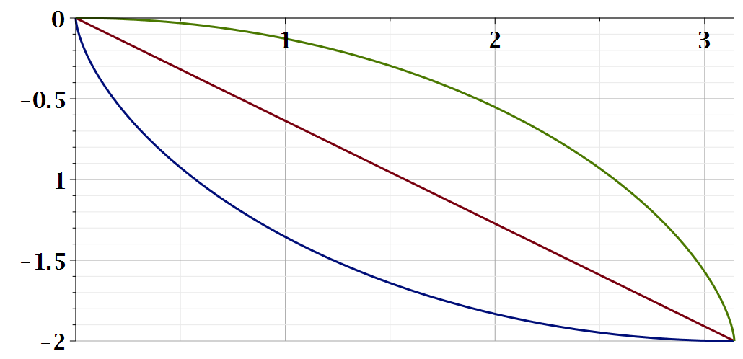
Vote for your favorite path
x
y
Which gives the shortest time?
Green
Red
Blue

Slide 8
Question – why this choice?
Answer – because the answer will be more beautiful. (Be sure that was not my cleverness.)

Slide 9
Parametric equations for Brachistochrone:

Slide 10
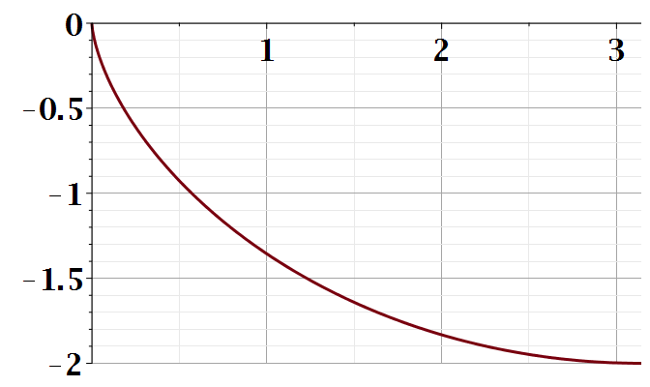
Parametric plot --
plot([theta-sin(theta), cos(theta)-1, theta = 0 .. Pi])
y
x

Slide 11
Checking the results
T=infinite
T=5.2668
T=4.4429

Slide 12
Some comments on perturbation theory –
Perturbation theory methods are useful for solving differential equations when some of the contributions are well known but other “smaller” contributions are also present. The concept is used in many contexts although the details vary.
➔solve for y₀(t)
➔solve for y₁(t)

Slide 13
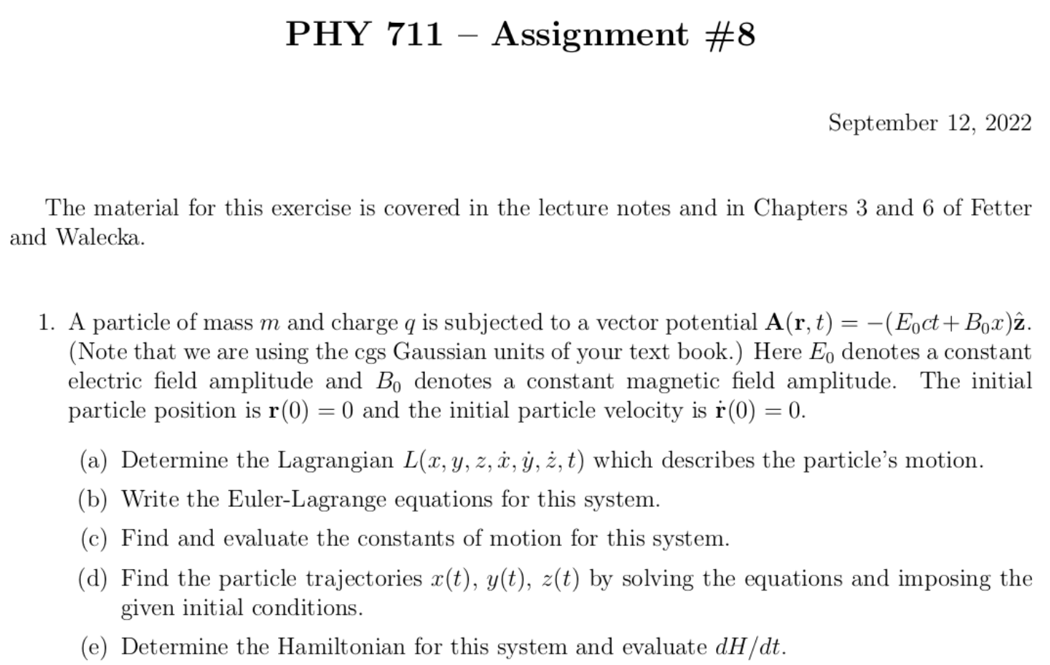

Slide 14
Steps for tackling a problem –
What are the basic concepts the apply to this problem.
Write down the fundamental equations
Solve
Check.
In this case, we expect that we should use the Lagrangian formalism and thus we need to know how to represent electric and magnetic fields in the Lagrangian.

Slide 16
Is this correct?

Slide 18
Comment on solving equations of motion
Use these two equations to decouple x(t) and z(t)

