Slide 1
PHY 711 Classical Mechanics and Mathematical Methods
10-10:50 AM MWF in Olin 103
Notes on Lecture 22 – Chap. 7 (F&W)
Solutions of differential equations
Green’s function solution methods based on eigenfunction expansions
Green’s function solution methods based on solutions of the homogeneous equations
Notes:
In this lecture, we will continue our discussion of one dimensional ordinary differential equations.

Slide 2
Notes:
The schedule continues to cover material in Chap. 7

Slide 3
Your questions –
From Sam -- I am still not quite understanding how the Rayleigh Ritz method works. It seems that after the cancellations of the expectation values on top and bottom, you should be left with the sum of lambda n over all n, and while that is greater than lambda 0, I don't get how it approximates it.

Slide 4
Review – Sturm-Liouville equations defined over a range of x.
Note that, because Sturm-Liouville operator is Hermitian, the eigenvalues are real and the eigenfunctions are orthogonal. In the last lecture, we argued that the eigenfunctions form a “complete” set over the range of x defined for the particular system.
Notes:
Review of the class problems considered.

Slide 5
Eigenvalues and eigenfunctions of Sturm-Liouville equations
Notes:
General properties.

Slide 6
Variation approximation to lowest eigenvalue
In general, there are several techniques to determine the eigenvalues λ_{n} and eigenfunctions f_{n}(x). When it is not possible to find the ``exact'' functions, there are several powerful approximation techniques. For example, the lowest eigenvalue can be approximated by minimizing the function
where is a variable function which satisfies the
correct boundary values. The ``proof'' of this inequality is
based on the notion that can in principle be expanded
in terms of the (unknown) exact eigenfunctions f_{n}(x):
where the coefficients C_{n} can be
assumed to be real.
Notes:
Comment on the Raleigh-Ritz approximation for the lowest eigenvalues.

Slide 7
Estimation of the lowest eigenvalue – continued:
From the eigenfunction equation, we know that
It follows that:
Notes:
Proof of the Rayleigh-Ritz theorem.

Slide 8
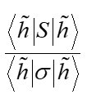
Some additional comments --
0
1

Slide 9
Rayleigh-Ritz method of estimating the lowest eigenvalue
Notes:
Review of example from last lecture.

Slide 10
Rayleigh-Ritz method of estimating the lowest eigenvalue
Another example – this time with a variable parameter
Notes:
Another example.

Slide 11
Recap -- Rayleigh-Ritz method of estimating the lowest eigenvalue
Exact answer
Do you think that there is a reason for getting the correct answer from this method?
Chance only
Skill
Notes:
In this case, the minimization process yield’s the exact answer.

Slide 12
Solution to inhomogeneous problem by using Green’s functions
Solution to homogeneous problem
Notes:
From a knowledge of the Green’s function we can find solutions of related inhomogeneous equations.

Slide 13
Solution to homogeneous problem
What is the homogeneous equation psi_0(x)?
In this lecture, we will discuss several methods of finding this Green’s function. This topic will also
appear in PHY 712

Slide 14
How do we arrive at the formal solution?

Slide 15
Using complete set of eigenfunctions to form Green’s function --
Recall:
By construction
Notes:
The following slides present solution methods for differential equations involving the use of eigenvalues.

Slide 16
Example Sturm-Liouville problem:
Notes:
Example.

Slide 17
Notes:
Solution using eigenfunctions appropriate for this example.

Slide 18
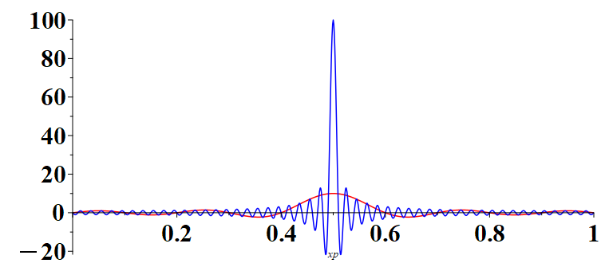
x=1/2, L=1
N=100
N=10
x’→

Slide 19
Notes:
Continued.

Slide 20
Notes:
In this case, the solution simplifies.

Slide 21
Another method of constructing Green’s functions -- using two solutions to the homogeneous problem
Notes:
Green’s function based on homogeneous solutions (not eigenfuntions).

Slide 22
Some details:
Notes:
Some details.

Slide 23
Note that the integral has to be performed in two parts. While the eigenfunction expansion method can be generalized to 2 and 3 dimensions, this method only works for one dimension.
Notes:
More details.

Slide 24
(Actually the algebra is painful). But, hurray! Same result as before.
Notes:
Another method of finding a Green’s function.

Slide 25
Notes:
Another example, this time taken from electrostatics.

Slide 26
Notes:
Solutions for a particular charge distribution.

Slide 27
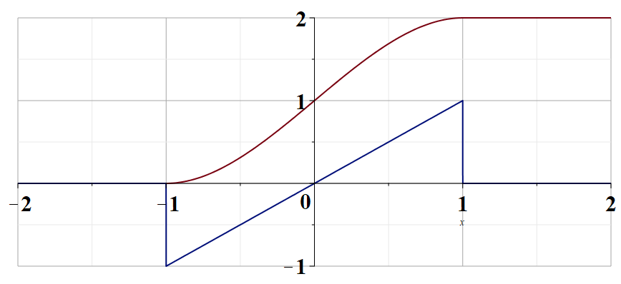
Notes:
Plot of the change distribution and of the electrostatic potential.

