Slide 1
PHY 711 Classical Mechanics and Mathematical Methods
10-10:50 AM MWF in Olin 103
Notes for Lecture 23: Chap. 7
& App. A-D (F&W)
Generalization of the one dimensional wave equation ➔ various mathematical problems and techniques including:
Fourier transforms
Laplace transforms
Complex variables
Contour integrals
Notes:
In this lecture we will start to cover various useful mathematical techniques.

Slide 2
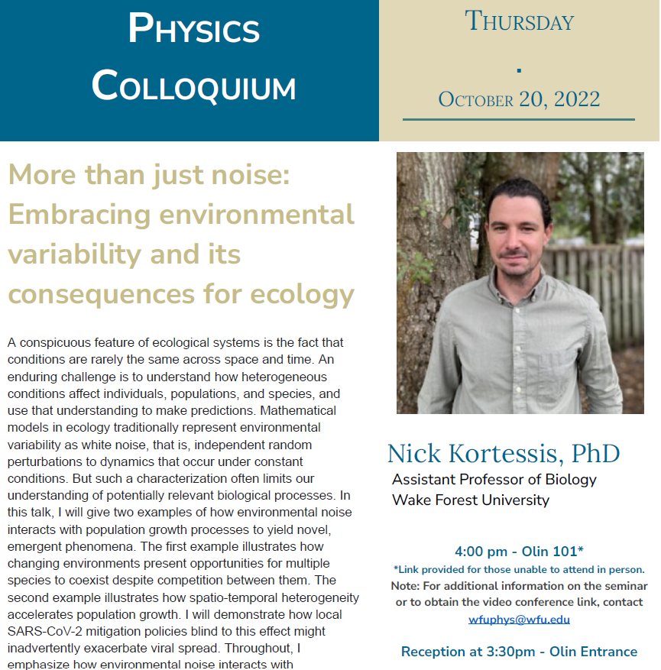

Slide 3
Notes:
This is the schedule. You will receive an email containing the mid term exam. It will be due next Monday.

Slide 4
Review – Sturm-Liouville equations defined over a range of x.
Note that, because Sturm-Liouville operator is Hermitian, the eigenvalues are real and the eigenfunctions are orthogonal. In the last lecture, we argued that the eigenfunctions form a “complete” set over the range of x defined for the particular system.
Notes:
Review of the Sturm Liouville equations.

Slide 5
Notes:
Specializing to the simplest case.

Slide 6
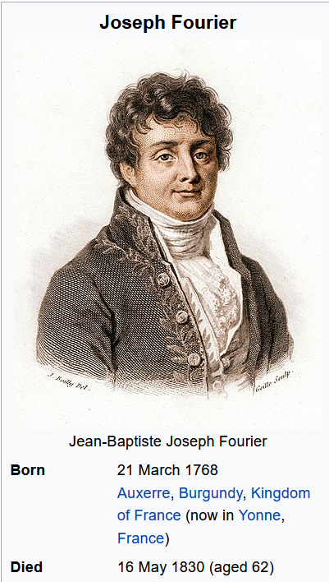

Slide 8
Example
x

Slide 9
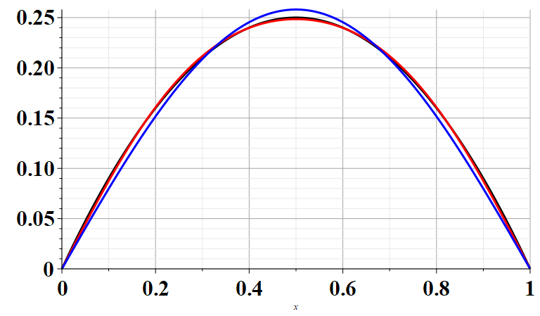
Example
x

Slide 10
Note that this analysis can also apply to time dependent functions. In the remainder of the lecture, we will consider time dependent functions.

Slide 11
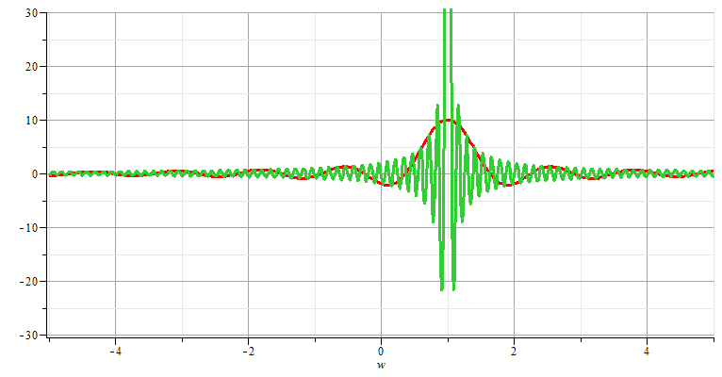
Generalization to infinite range -- Fourier transforms

Slide 12
Note: The location of the 2π factor varies among texts.

Slide 13
Note that for an infinite time range, the Fourier transform is continuous in both time and frequency.

Slide 14
Use of Fourier transforms to solve wave equation

Slide 15
Use of Fourier transforms to solve wave equation -- continued
Note that at this point, we do not know the coefficients A_{n}; however, it clear that the solutions are consistent with D’Alembert’s analysis of the wave equation.

Slide 19
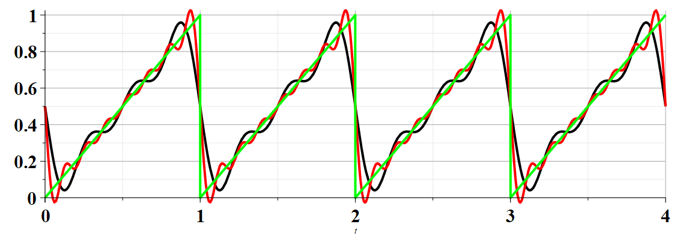
Example:

Slide 20
Summary –
Find discrete frequencies ω for functions f(t) over finite time domain of for functions f(t) which are periodic: f(t)=f(t+nT)
➔Numerically, there is an advantage of tabulating double discrete Fourier transforms (discrete in ω and in t).

Slide 21
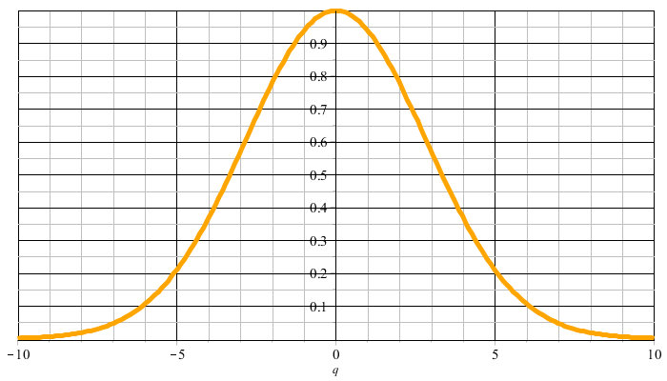
Example:
f(t)
t
F(νΩ)
νΩ

Slide 22
F(νΩ)
νΩ
ν=M
νΩ
ν=-M

Slide 23
Constructed frequency periodic function --

Slide 25
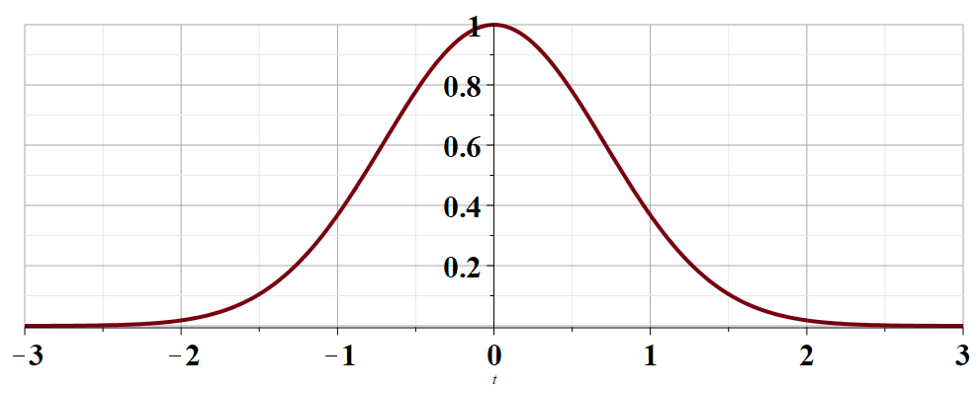
t →

Slide 28
Cooley-Tukey algorithm: J. W. Cooley and J. W. Tukey, “An algorithm for machine calculation of complex Fourier series” Math. Computation 19, 297-301 (1965)

Slide 29
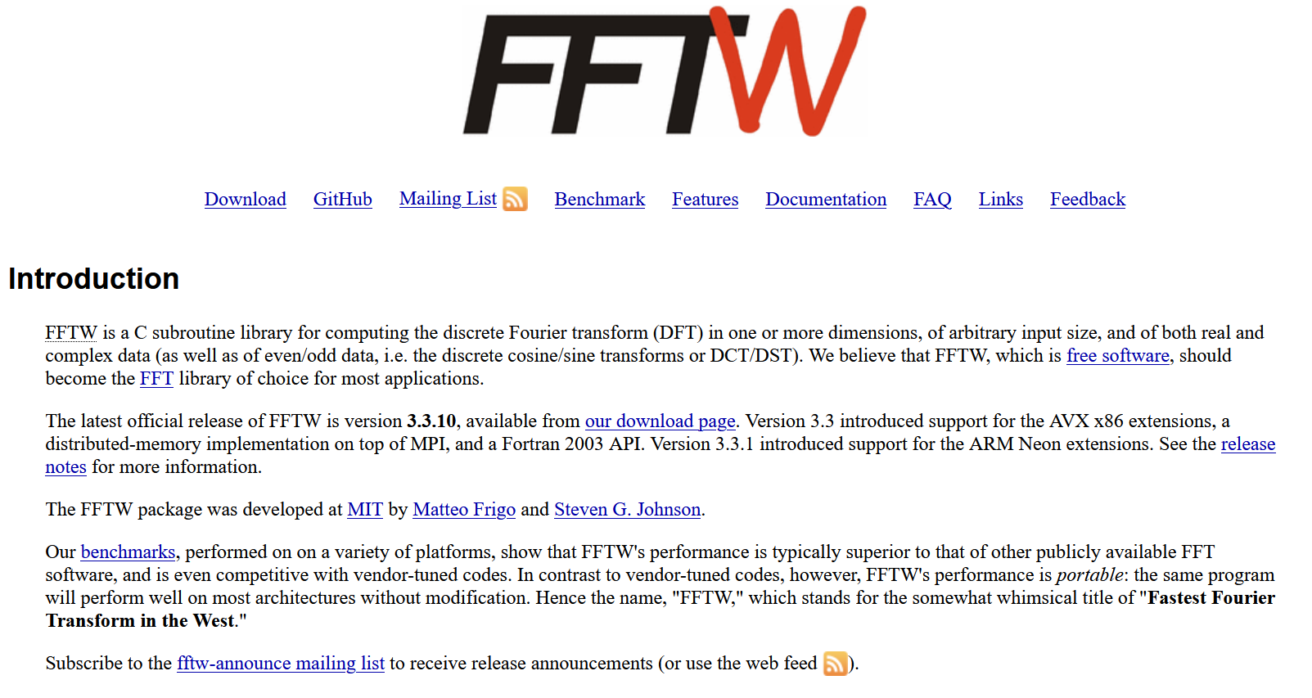
http://www.fftw.org/

Slide 30
Fourier series and Fourier transforms are useful for solving and analyzing a wide variety of functions, also beyond the Sturm-Liouville context.
In the next several slides we will consider a related concept – the Laplace transform.
Notes:
We now consider another technique that is uses to solve initial value equations.

Slide 31
Notes:
A quick introduction to Laplace transform methods.

Slide 32
Notes:
An example.

Slide 33
Notes:
Some details.

Slide 34
Does this result look familiar?
Yes
No
Notes:
More details.

Slide 35
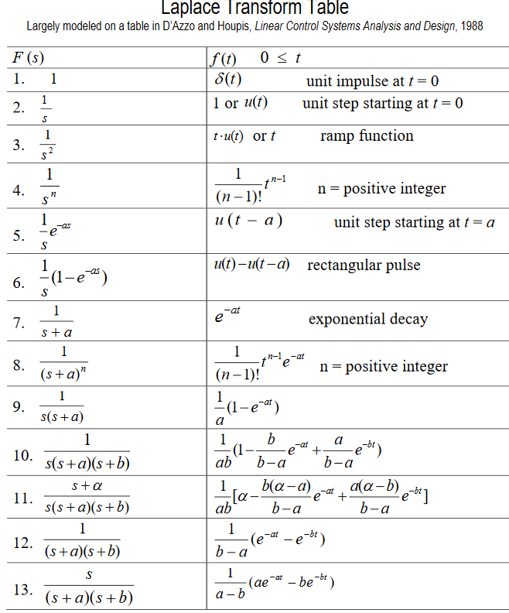
Table of Laplace transforms
https://www.dartmouth.edu/~sullivan/22files/New%20Laplace%20Transform%20Table.pdf
Notes:
Table of transforms for simple functions.

Slide 36
In order to evaluate these integrals, we need to use complex analysis.
Notes:
Mathematical treatment of general case.

Slide 37
In general – to calculate inverse Laplace transforms, we need to introduce concepts of complex numbers and contour integration
Complex numbers
Notes:
Introduction to properties of complex numbers. To be continued next time.

