Slide 1
PHY 711 Classical Mechanics and Mathematical Methods
10-10:50 AM MWF in Olin 103
Notes for Lecture 23: Chap. 7
& App. A-D (F&W)
Generalization of the one dimensional wave equation ➔ various mathematical problems and techniques including:
Fourier transforms
Laplace transforms
Complex variables
Contour integrals
Notes:
In this lecture we will start to cover various useful mathematical techniques.

Slide 2
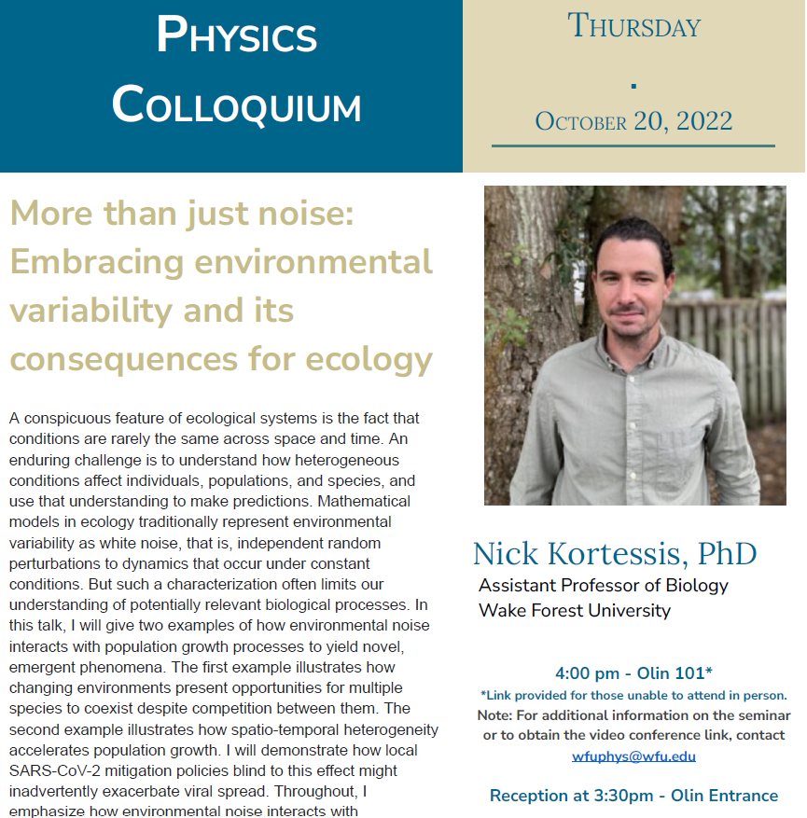

Slide 3
Notes:
This is the schedule. You will receive an email containing the mid term exam. It will be due next Monday.

Slide 4
Your questions:
From Athul -- I've doubts about how An is expressed in slides 9 and 10. Are they the same? Also, if f(X) is imaginary can we use the same equations in the theorems for FT, and if we use algorithms for FFT will they treat them as real or imaginary?
From Banasree -- Can you please explain a little bit about how we can get normalized eigenfunctions in different cases?
I didn’t understand why we had to do the backward transform.

Slide 5
Review – Sturm-Liouville equations defined over a range of x.
Note that, because Sturm-Liouville operator is Hermitian, the eigenvalues are real and the eigenfunctions are orthogonal. In the last lecture, we argued that the eigenfunctions form a “complete” set over the range of x defined for the particular system.
Notes:
Review of the Sturm Liouville equations.

Slide 6
Notes:
Specializing to the simplest case.

Slide 8
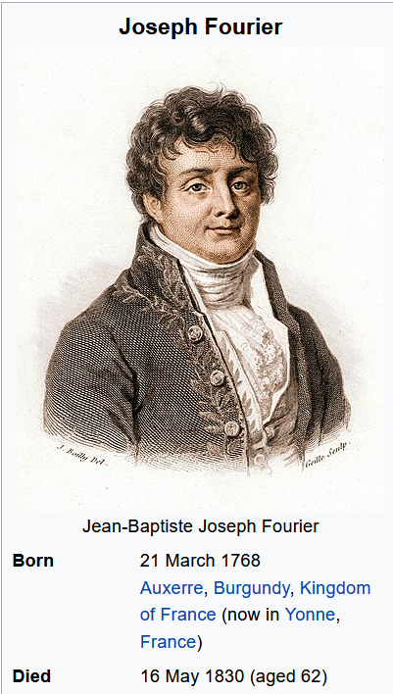

Slide 10
Example
x

Slide 11
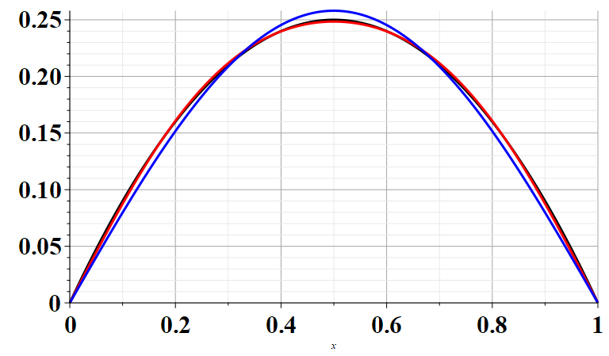
Example
x

Slide 12
Note that this analysis can also apply to time dependent functions. In the remainder of the lecture, we will consider time dependent functions.

Slide 13
Comment on complex functions –
We can also treat complex functions, typically separately considering the real and imaginary parts.

Slide 14
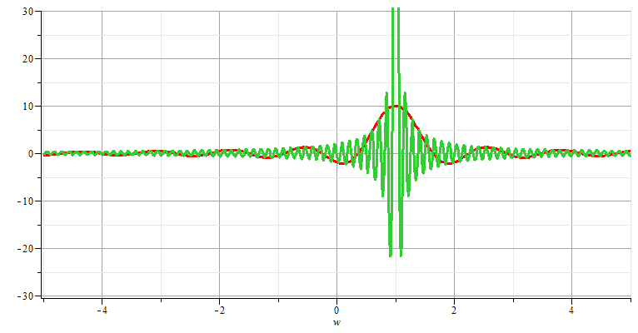
Generalization to infinite range -- Fourier transforms

Slide 15
Note: The location of the 2π factor varies among texts.

Slide 16
Question about forward and backward transforms –
Comment – Nomenclature for forward and backward can be confusing, but the point is that if we know the time dependence, we can determine the frequency dependence and if we know the frequency dependence, we can determine the time dependence.

Slide 17
Note that for an infinite time range, the Fourier transform is continuous in both time and frequency.

Slide 18
Use of Fourier transforms to solve wave equation

Slide 19
Use of Fourier transforms to solve wave equation -- continued
Note that at this point, we do not know the coefficients A_{n}; however, it clear that the solutions are consistent with D’Alembert’s analysis of the wave equation.

Slide 23
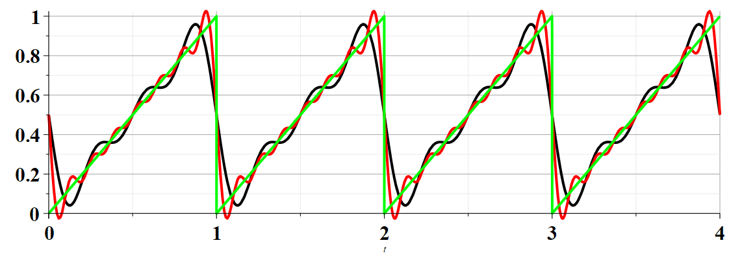
Example:

Slide 24
Summary –
Find discrete frequencies ω for functions f(t) over finite time domain of for functions f(t) which are periodic: f(t)=f(t+nT)
➔Numerically, there is an advantage of tabulating double discrete Fourier transforms (discrete in ω and in t).

Slide 25
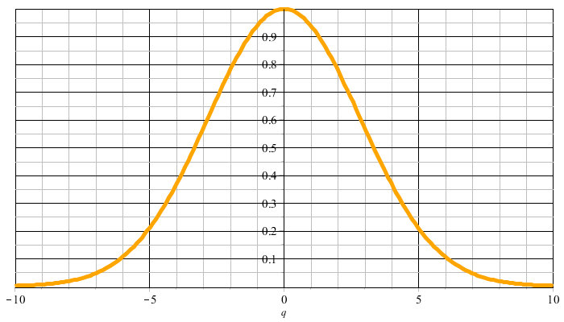
Example:
f(t)
t
F(νΩ)
νΩ

Slide 26
F(νΩ)
νΩ
ν=M
νΩ
ν=-M

Slide 27
Constructed frequency periodic function --

Slide 29
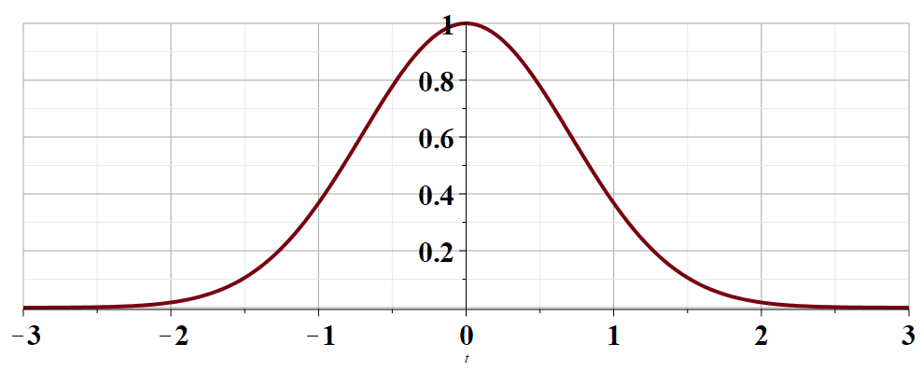
t →

Slide 32
Cooley-Tukey algorithm: J. W. Cooley and J. W. Tukey, “An algorithm for machine calculation of complex Fourier series” Math. Computation 19, 297-301 (1965)

Slide 33
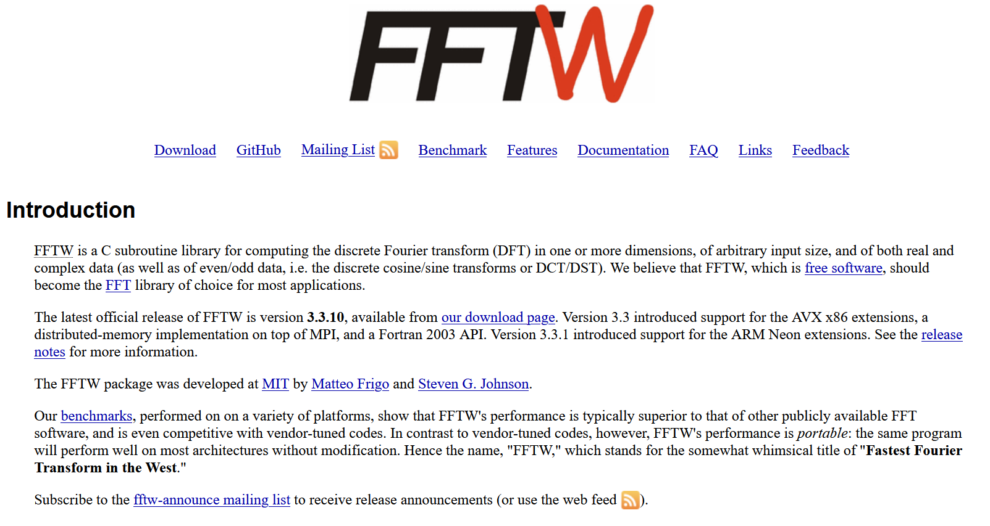
http://www.fftw.org/

Slide 34
Only got to this slide --
Fourier series and Fourier transforms are useful for solving and analyzing a wide variety of functions, also beyond the Sturm-Liouville context.
In the next several slides we will consider a related concept – the Laplace transform.
Notes:
We now consider another technique that is uses to solve initial value equations.

Slide 35
Notes:
A quick introduction to Laplace transform methods.

Slide 36
Notes:
An example.

Slide 37
Notes:
Some details.

Slide 38
Does this result look familiar?
Yes
No
Notes:
More details.

Slide 39
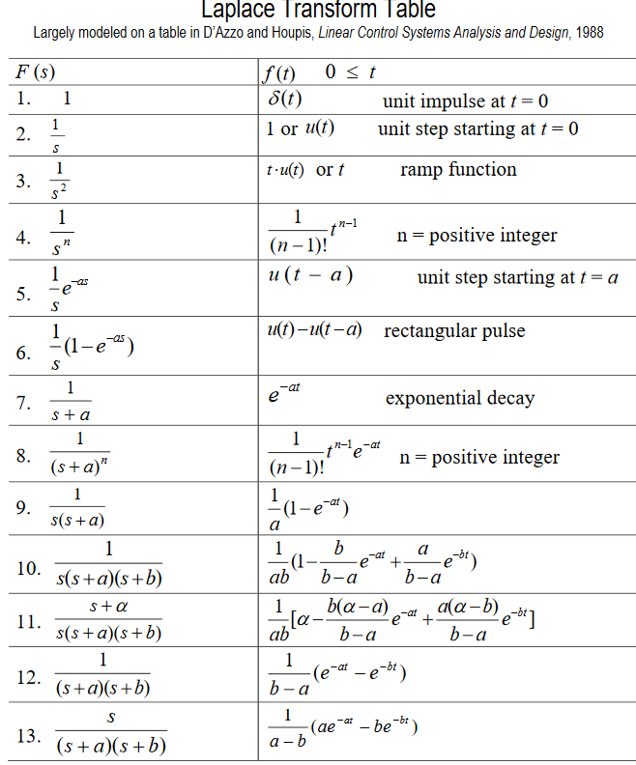
Table of Laplace transforms
https://www.dartmouth.edu/~sullivan/22files/New%20Laplace%20Transform%20Table.pdf
Notes:
Table of transforms for simple functions.

Slide 40
In order to evaluate these integrals, we need to use complex analysis.
Notes:
Mathematical treatment of general case.

Slide 41
In general – to calculate inverse Laplace transforms, we need to introduce concepts of complex numbers and contour integration
Complex numbers
Notes:
Introduction to properties of complex numbers. To be continued next time.

