Slide 1
PHY 711 Classical Mechanics and Mathematical Methods
10-10:50 AM MWF in Olin 103
Notes for Lecture 24: Chap. 7
& App. A-D (F&W)
Generalization of the one dimensional wave equation ➔ various mathematical problems and techniques including:
Fourier transforms
Laplace transforms (very briefly)
Complex variables
Contour integrals
Notes:
In this lecture, we will focus on the mathematics of complex variables.

Slide 2
Notes:
No new homework while working on mid term exam.

Slide 3
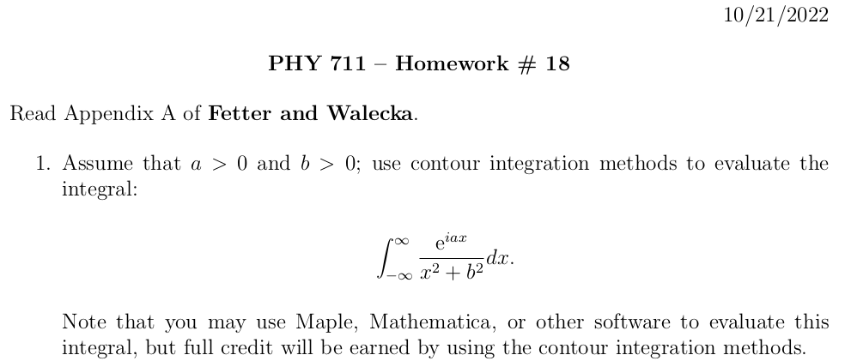

Slide 4
Your questions
From Athul -- In slide 15, is it an example of analytic or non analytic functions? I might be missing something but I don't understand how different functions produce almost similar solutions in later slides.

Slide 5
A brief introduction to Laplace transforms --

Slide 9
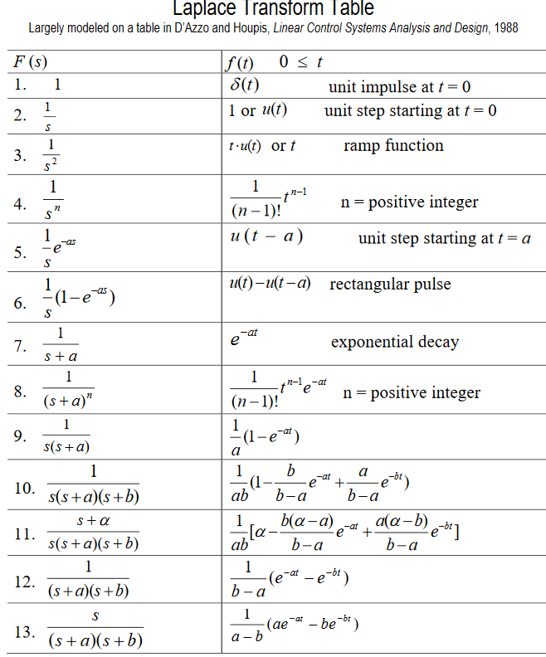
Table of Laplace transforms
https://www.dartmouth.edu/~sullivan/22files/New%20Laplace%20Transform%20Table.pdf

Slide 10
In order to evaluate these integrals, we need to use complex analysis.

Slide 11
In general – to calculate inverse Laplace transforms, we need to introduce concepts of complex numbers and contour integration
Introduction to complex variables
Basic properties
Notion of an analytic complex function
Cauchy integral theory
Analytic functions and functions with poles
Evaluating integrals of functions in the complex plane
Notes:
We will review/introduce the basic ideas associated with complex variables.

Slide 12
Complex numbers
Functions of complex variables
Derivatives:
Cauchy-Riemann equations
Notes:
First we consider the basic definitions and representations of a complex number. Then we consider a function of complex numbers. The Cauchy relationships follow from the notion that a function that is differentiable in the complex plane must have consistent partial derivatives along the real and imaginary axes.

Slide 13
Analytic function
Examples of analytic functions
Notes:
Notion of an analytic function and an example that satisfies the conditions.

Slide 14
Examples of non-analytic functions
Notes:
Examples of non-analytic functions. Special property of contour integrals about a function with a simple “pole”.

Slide 15
Integration does not include z_{p}
Integration does include z_{p}

Slide 16
No contribution
C
Notes:
Contributions to a closed contour from various contributions.

Slide 17
In the following examples m=1
Notes:
Residue theorem

Slide 18
Example:
Im(z)
Re(z)
Note:
m=1
Notes:
Example of a contour integral using the residue theorem.

Slide 19
Some details:
Question – Could we have chosen the contour in the lower half plane?
a. Yes b. No
Notes:
Some details.

Slide 20
Another example:
Note:
m=1
Im(z)
Re(z)
Notes:
Another example.

Slide 21
Question – Could we have chosen the contour in the lower half plane?
a. Yes b. No
Notes:
Some details.

Slide 22
Another example:
Im(z)
ia
Re(z)
10/30/2017
PHY 711 Fall 2017 -- Lecture 25
22
Notes:
Another example

Slide 23
Notes:
More details.

Slide 24
Im(z)
Re(z)

Slide 25
Notes:
Another example from the Drude model.

Slide 26
Cauchy integral theorem for analytic function f(z):
Notes:
Another useful theorem from Cauchy.

Slide 27
Example
Im(z)
Re(z)
Notes:
Considering real and imaginary parts.

Slide 28
Example -- continued
Im(z)
Re(z)
Notes:
Real and imaginary parts for Cauchy’s integral relation.

Slide 29
Example -- continued
Im(z’)
x
Re(z’)
Notes:
Detail of how to evaluate the point x=x’ in terms of the principal parts integral.

Slide 30
Im(z’)
x
Re(z’)
Notes:
Some details.

Slide 31
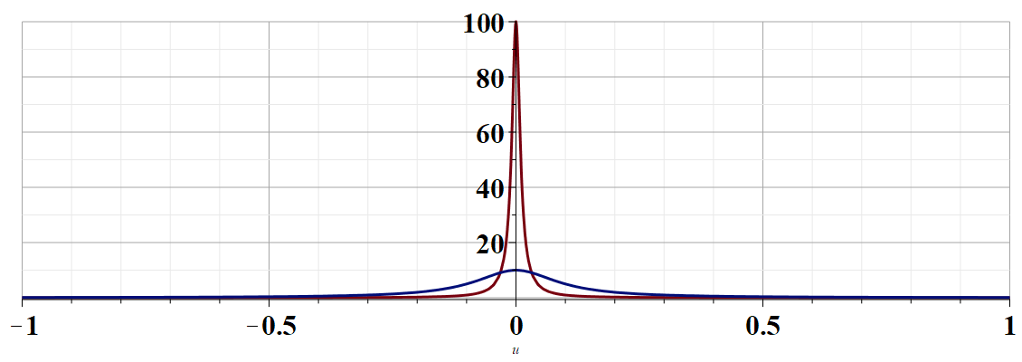
More details --
u
Notes:
Justification of the delta function result.

Slide 32
Example -- continued
Kramers-Kronig relationships
Notes:
Final result relating real and imaginary parts of complex function.

Slide 33
Comment on evaluating principal parts integrals
y’
x’
Notes:
Some details.

Slide 34
b(x’)
-2L
-L
L
2L
x’
Notes:
Simple example for complex function.

Slide 35
Notes:
For given imaginary function, this is the form of the real function.

Slide 36
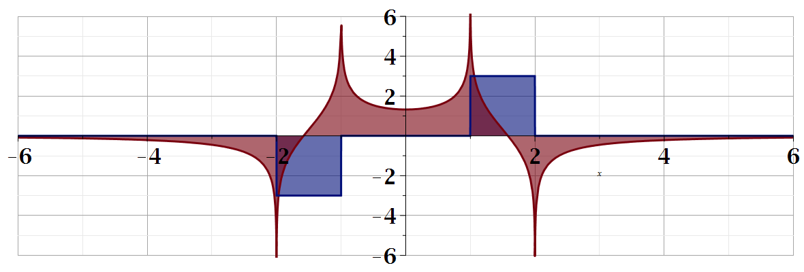
For our example:
b(x)
a(x)
Notes:
Summary of results.

Slide 37
Summary
?
Notes:
Summary.

Slide 38
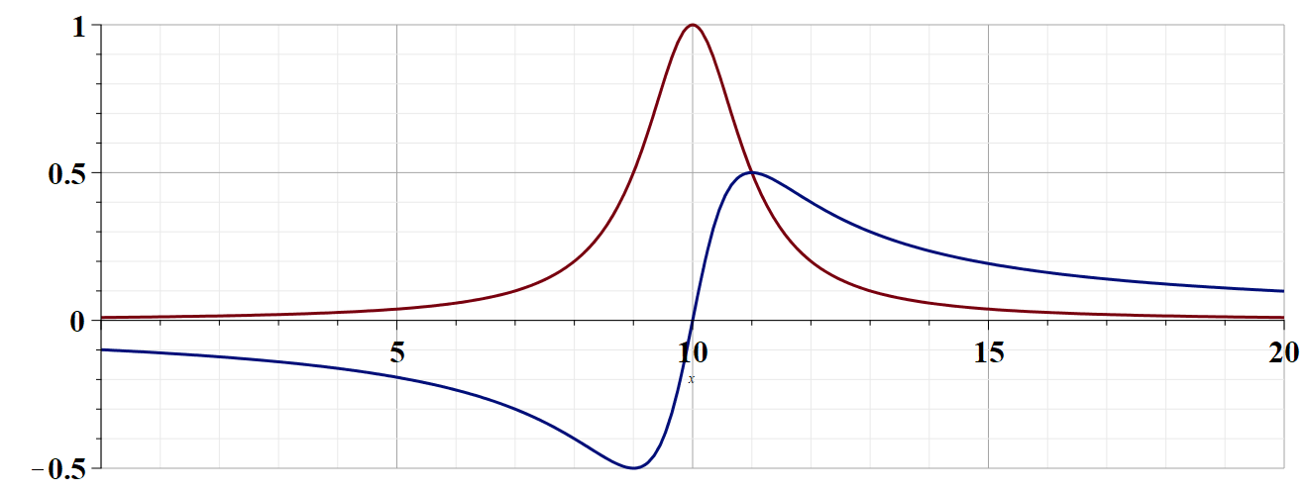

Slide 39
Continued:

