Slide 1
PHY 711 Classical Mechanics and Mathematical Methods
10-10:50 AM MWF in Olin 103
Lecture 2 – Chap 1 in F&W
Two particle interactions and scattering theory
Announcements – Physics Colloquium – Thurs. @ 4 PM
Brief comment about “quiz”
One-on-one meetings and/or office hours
Your questions
Systematic discussion of the concept of “scattering theory”
Notes:
In this lecture, we will review the basic physics of two interacting particles. When the particles are not in a bound orbit, their motion may be assessed in terms of scattering. Scattering is a very powerful analysis tool that often allows for the comparison of theory and experiment.

Slide 2
4 PM Thursday in Olin 101 and by zoom
Reception and Refreshments in Olin Lobby at 3:30 PM
Summer research presentations by undergraduate students – Part 1
Welcoming overview, announcements, and information

Slide 4
Comment on one-on-one meetings and office hours
Encourage scheduled or spontaneous one-on-one or group discussions on course material, software issues, etc. etc.
Can use office hours or other times (Open Door)

Slide 5
Your questions –
From Lee -- ..question regarding the "hard sphere," two particle potential. Is this similar to the subatomic (quark) potential? I tried to visualize this, and potentials for subatomic particles came to mind.
From Katie –
1. Could you further explain the math on the slide where you define V_eff(r) and talk about the special cases as well (such as when r goes to infinity)?
2. Also can you explain the differential cross section and how we determine that for different cases?
3. Can we go over the logic behind the steps in the example problem with the collision of hard spheres? I understand the math that is shown on the slide just would like a further explanation of how it was determined.
From Evan -- On slide # 11, there is a graph showing potential energy diagrams for a two particle interaction. Are the blue and green curves just examples of what could possibly be seen from such an interaction or is it an example of a more specific scenario? Also, why is it more meaningful to show V(r)/V0 on the y-axis as opposed to simply V(r)?

Slide 6
Questions continued –
From Sam -- ..is the r^2 (dtheta/dt)^2 term that arises in the energy of the target particle a result of rotational energy? Also, in the preclass assessment the derivative of the definite integral (1st question), you plug in the bounds of the integral to the equation for x, adding the upper bound term and subtracting the lower bound term, in addition to taking the derivative with respect to t and then integrating. I am having trouble understanding why this is a necessary step mathematically.
From Zezong -- At the end of the slide you listed several assumptions we have to make about the scattering process analysis. I wonder in real experiments, to what extent these make a difference for the results.

Slide 7
Comment on quiz questions
1.
3.
Notes:
These are solutions to the “assessment” exercise. It will help us figure out which mathematical methods should be usefully reviewed in this class. Most of you had particular trouble with the geometric series. It may be one of those things that you will want to remember to look up when you need it, rather than an important concept.

Slide 8
Some more details on Question #1:
Note that you can integrate first and then
take the derivative and you should get the same answer
A more systematic discussion of these and other mathematical details will be discussed throughout the course.

Slide 9
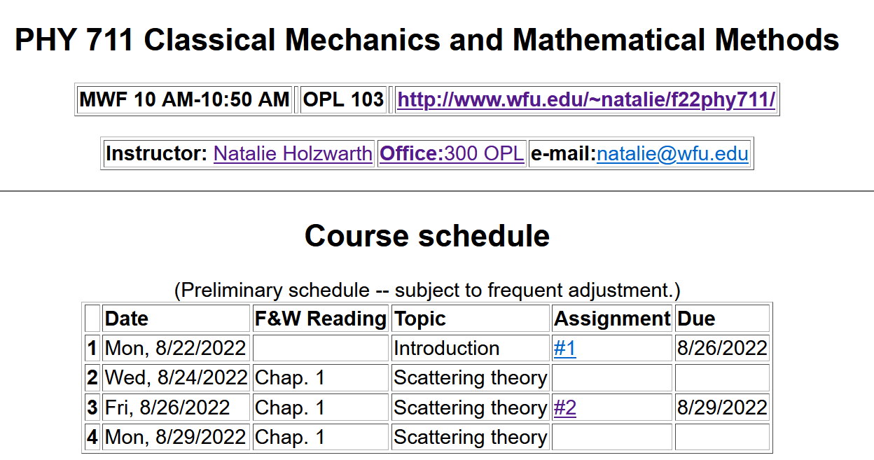
Notes:
This is an image of the webpage with the schedule and the homework assignment.

Slide 10
Introduction to the analysis of the energy and forces between two particles --

Slide 11
First consider fundamental picture of particle interactions
Classical mechanics of a conservative 2-particle system.
y
1
2
r₁
r₂
x
For this discussion, we will assume that V(r)=V(r) (a central potential).
Notes:
First consider the basic particle interactions which govern their motion.

Slide 12
Digression on two particles in one dimension –
from the qualifier exam:
Note that linear momentum and energy is conserved.
Also note that when we do our analysis we assume that the energy is kinetic energy.
v₀

Slide 13
Energy is conserved:
1
2
Note that while V(r) determines the trajectory, in scattering theory, we perform our evaluations where V(r)=0.
r₁
r₂
For a central potential V(r)=V(r), angular momentum is conserved.
For the moment we also make the simplifying assumption that m₂>>m₁ so that particle 1 dominates the motion.
Notes:
The last assumption is being made for convenience. We will consider the center of mass and relative motion much more carefully later.

Slide 14
Typical two-particle interactions –
Notes:
These represent typical particle interactions. Only the Coulomb or gravitational forms are precisely found in nature. The others serve as convenient models.

Slide 15
More details of two particle interaction potentials
This means that the interaction only depends on the distance between the particles and not on the angle between them. This would typically be true of the particles are infinitesimal points without any internal structure such as two infinitesimal charged particles or two infinitesimal masses separated by a distance r:
Example – Interaction between a proton and an electron. Note we are treating the interactions with classical mechanics; in some cases, quantum effects are non-trivial.

Slide 16
Other examples of central potentials --
Example
Two marbles
Two Ar atoms
Note that sub-atomic particles might be modeled this way???
Particle physics has lots of clever ideas…
Note – not all systems are described by “central” potentials. Some counter examples:
Molecules (internal degrees of freedom)
Systems with more than two particles such as crystals

Slide 17
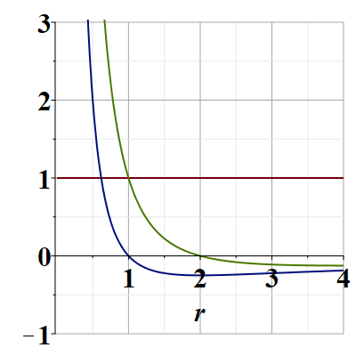
Representative plots of V(r) –
two different possibilities:
Why plot in scaled units?
It is often convenient…
V(r)/V₀
E/V₀
Note that particles are not bound; can reach infinite separation
Distances of closest approach
Why?
Notes:
Potential energy diagram showing important aspects of the particle trajectory.

Slide 18
Some more details --
z
r(t₁)
θ(t₁)
y
x

Slide 19
Comment on spherical polar coordinates
z
r(t₁)
θ(t₁)
y
x

Slide 20
Comments continued --
This is useful because L is a constant for each trajectory.
V_{eff}(r)

Slide 21
What is the impact parameter?
Briefly, a convenient distance that depends on the conserved energy and angular momentum of the process.
b
b

Slide 22
Which of the following are true:
The particle moves in a plane.
For any interparticle potential the trajectory can be determined/calculated.
Only for a few special interparticle potential forms can the trajectory be determined.
Why should we care about this?
We shouldn’t really care.
It is only of academic interest
It is of academic interest but can be measured.
Many experiments can be analyzed in terms of the particle trajectory.
Notes:
What do you think about these?

Slide 23
Scattering theory:
detector
Notes:
This is the ideal configuration of a scattering experiment.

Slide 24
Scattering theory:
detector
Some reasons that scattering theory is useful:
It allows comparison between measurement and theory
The analysis depends on knowledge of the scattering particles when they are far apart
The scattering results depend on the interparticle interactions

Slide 25
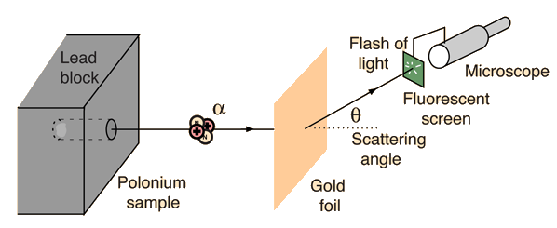
Example: Diagram of Rutherford scattering experiment
http://hyperphysics.phy-astr.gsu.edu/hbase/rutsca.html
Notes:
This illustrates the setup of the famous Rutherford scattering experiment.

Slide 26
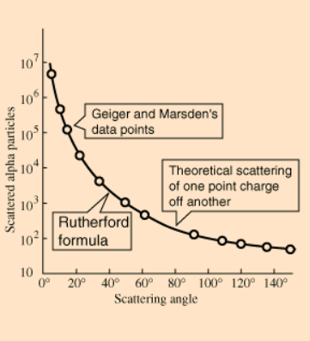
Graph of data from scattering experiment
From website: http://hyperphysics.phy-astr.gsu.edu/hbase/Nuclear/rutsca2.html
Notes:
Reconstruction experimental data from the Rutherford experiment.

Slide 27
Standardization of scattering experiments --
Impact parameter: b
b
Figure from Marion & Thorton, Classical Dynamics
Notes:
Some details of scattering geometry and analysis.

Slide 28
Note: The notion of cross section is common to many areas of physics including classical mechanics, quantum mechanics, optics, etc. Only in the classical mechanics can we calculate it from a knowledge of the particle trajectory as it relates to the scattering geometry.
b
Figure from Marion & Thorton, Classical Dynamics
Note: We are assuming that the process is isotropic in ϕ
Notes:
More details.

Slide 29
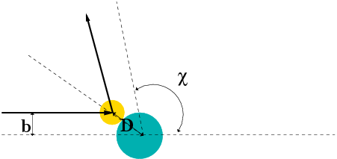
Simple example – collision of hard spheres having mutual radius D; very large target mass
Microscopic view:
Notes:
Illustration of the analysis for the scattering of a hard sphere on a massive hard sphere.

Slide 30
Simple example – collision of hard spheres -- continued
Hard sphere:
Notes:
Total cross section versus partical cross section.

Slide 31
More details of hard sphere scattering –
Hidden in the analysis are assumptions about the scattering process such as:
No external forces ➔ linear momentum is conserved
No dissipative phenomena ➔ energy is conserved
No torque on the system ➔ angular momentum is conserved
Target particle is much more massive than scattering particle
Other assumptions??
Note that for quantum mechanical hard spheres at low energy the total cross section is 4 times as large.
Notes:
Some questions and comments. The discussion of scattering theory will be continued next time.

