Slide 1
PHY 711 Classical Mechanics and Mathematical Methods
10-10:50 AM MWF in Olin 103
Notes on Lecture 32: Chap. 9 of F&W
Linear and non-linear sound waves
Summary of linear sound phonenmena
Introduction to non-linear effects
Analysis of instability – shock phenomena
Notes:
In this lecture, we will consider traveling wave solutions to the sound wave equations.

Slide 3
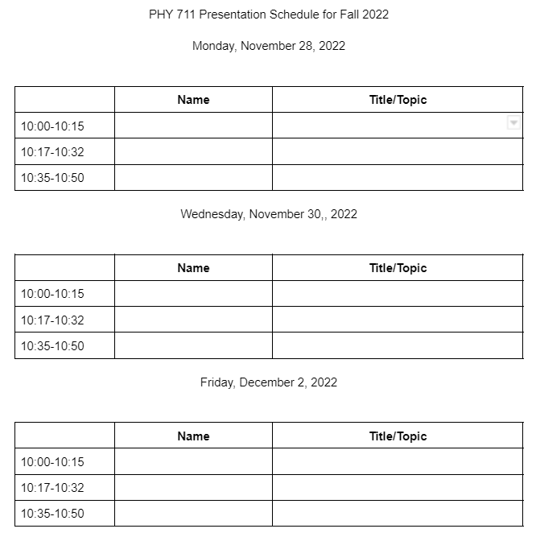
Signup with name and topic at 9 AM on Friday 11/11/2022

Slide 4
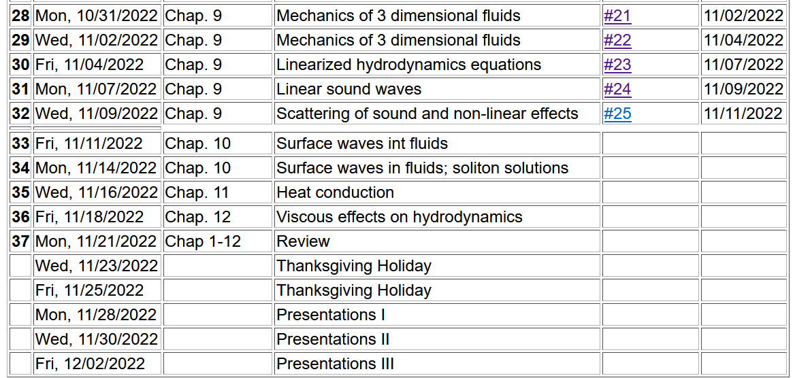
Notes:
Schedule.

Slide 5
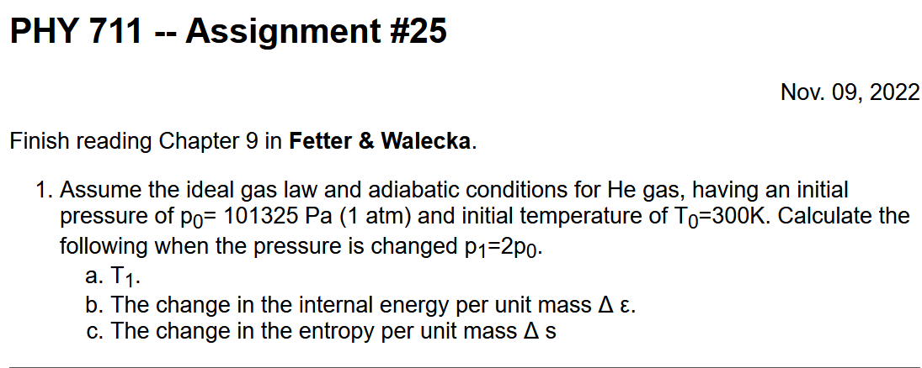

Slide 6
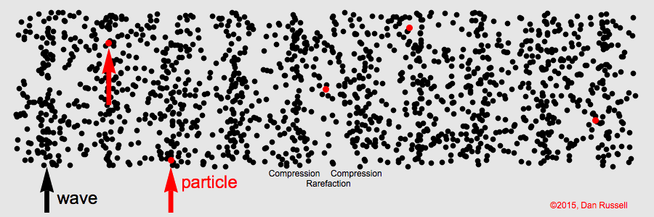
Visualization of longitudinal wave motion
From the website:
https://www.acs.psu.edu/drussell/Demos/waves/wavemotion.html

Slide 7
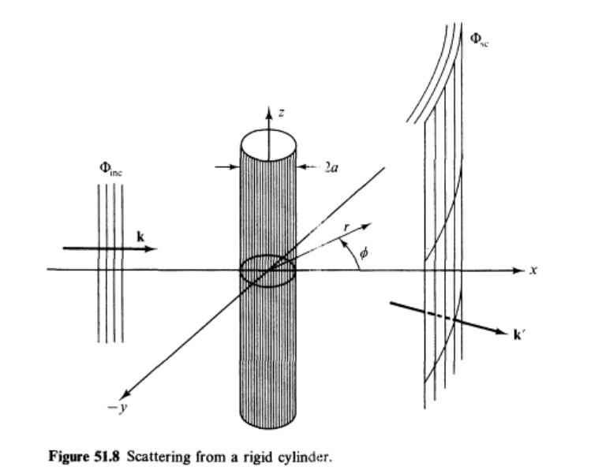
Continuing to discuss linear sound waves –
Scattering from a rigid cylinder
Figure from Fetter and Walecka pg. 337
Notes:
Now consider the case of a plane wave of sound, scattering off of a cylindrical object. Can you think of a physical situation for this model?

Slide 8
Example of cylindrical scattering objects --
Suppose a trumpeter is playing near the columns. Maximal scattering occurs when
a. Facing toward the column b. Facing away from the column.

Slide 9
Scattering of sound waves –
for example, from a rigid cylinder
Notes:
Analysis of the scattering wave using cylindrical coordinates.

Slide 10
Notes:
In this case we expect a cylindrical wave that can be represented in terms of Bessel and Neumann functions, or more conveniently in terms of Hankel functions H. Satisfying the boundary values on the surface of the scattering cylinder, we find the coefficients of the expression.

Slide 11
Notes:
Using the asymptotic form of the Hankel functions we can analyze the results further.

Slide 12
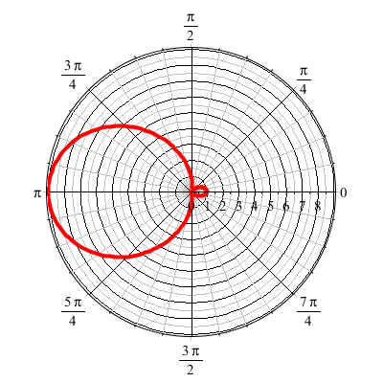
For ka << 1
Notes:
Defining the appropriate scattering cross section, we can analyze the results further. For ka<<1 (long wavelengths, low frequencies) we find that most of the sound is scattered backwards from the propagation direction.

Slide 13
Revisiting the trumpeter question --
Conclusion – be careful when choosing a place to play your trumpet --

Slide 14
Now consider some non-linear effects in sound
Examples?
We will consider the simple case –
One dimension for motion
Fluid is assumed to be an ideal gas
Adiabatic conditions
All variables will be expressed in terms of the density ρ(x,t)

Slide 15
Effects of nonlinearities in fluid equations
-- one dimensional case
Notes:
Review of basic equations, specializing in one spatial dimension.

Slide 16
Notes:
Decoupling the variables.

Slide 17
Digression – What is gamma?

Slide 18
Notes:
More analysis.

Slide 19
Notes:
Further derivations.

Slide 20
Notes:
Using adiabatic relationships.

Slide 21
Notes:
Analysis of fluid velocity from a knowledge of the wave velocity.

Slide 22
Traveling wave solution:
Notes:
Analysis for a traveling wave.

Slide 23
Traveling wave solution -- continued:
Notes:
Checking the linear result

Slide 24
Some details

Slide 25
Traveling wave solution -- full non-linear case:
w
Notes:
Analysis of how to visualize the traveling wave solution.

Slide 26
Visualization continued:
Notes:
More details.

Slide 27
Summary
Notes:
Summary.

Slide 28
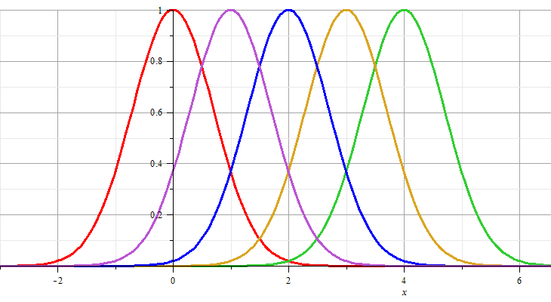
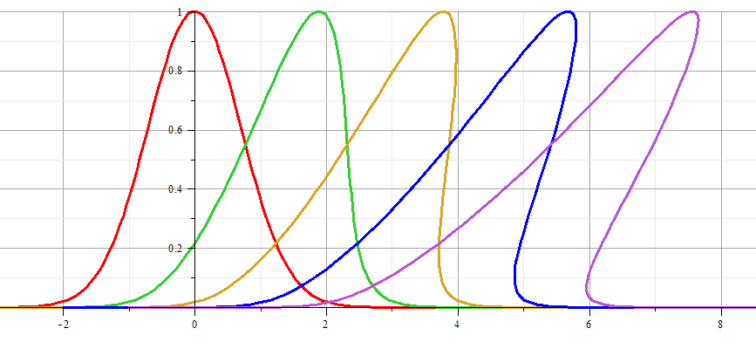
Linear wave:
Non-linear wave:
Notes:
Example visualization.

Slide 29
Linear wave
Non-linear wave
Notes:
Animations from Maple.

Slide 30
Analysis of shock wave
Plots of δρ
Solution becomes unphysical
shock
Notes:
Note that the vertical axis represents the longitudinal wave displacement. When this displacement becomes multivalued for a given coordinate x as shown, the solution becomes unphysical. At this point we need to consider the analysis in a different way.

Slide 31
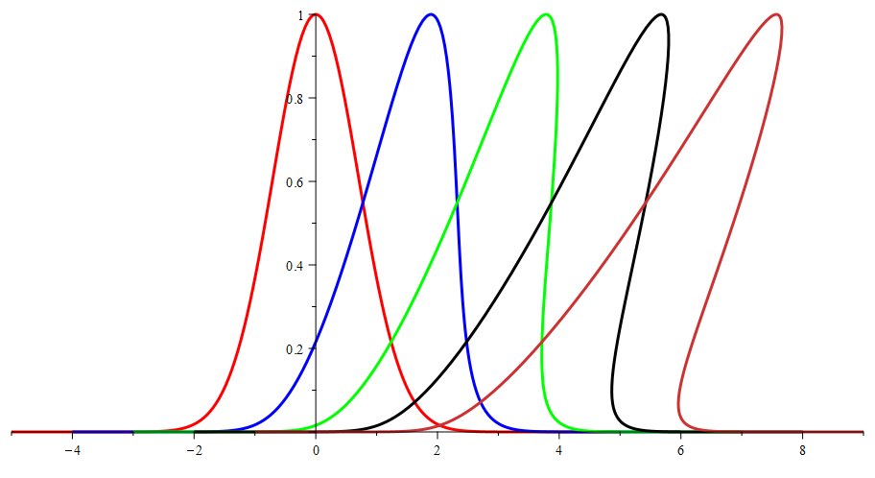
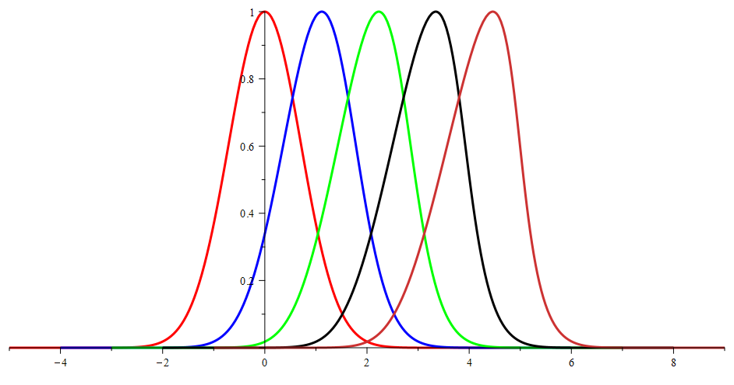
Effects of amplitude of δρ
Large amplitude
Smaller amplitude

Slide 32
Analysis of shock wave – assumed to moving at velocity u
After shock
t₂
δρ₂, δv₂, δp₂
Before shock
t₁
δρ₁, δv₁, δp₁
Shock front
x
u
Note that in this case u is assumed to be a given parameter of the system.
Notes:
Your textbook discusses the shock wave analysis. Here we assume that there is a region (blue) where the analysis fails, but assumes that we can properly analyze the physics before and after the shock. The notation given here is similar to that given in your text.

Slide 33
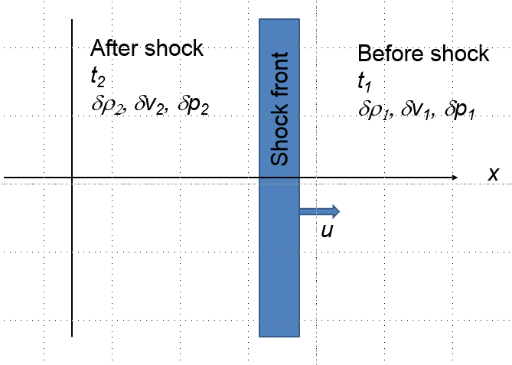
Analysis of shock wave – continued
While analysis in the shock region is complicated, we can use conservation laws to analyze regions 1 and 2
Notes:
Some of the details of the analysis before and after the shock event.

Slide 34
Analysis of shock wave – continued
While analysis in the shock region is complicated, we can use conservation laws to analyze regions 1 and 2
Notes:
Analyzing the equations.

Slide 35
Analysis of shock wave – continued
For adiabatic ideal gas, also considering energy and momentum conservation:
ρ₂/ρ₁
For γ=1.5
p₂/p₁
Notes:
Analyzing ratio of the density after and before the shock wave.

Slide 36
Analysis of shock wave – continued
For adiabatic ideal gas, entropy considerations::
Notes:
Analyzing the entropy before and after the shock wave. In general, many more relationships can be analyzed. Consult your textbook for more details.

