Slide 1
PHY 711 Classical Mechanics and Mathematical Methods
10-10:50 AM MWF in Olin 103
Notes on Lecture 33:
Chapter 10 in F & W: Surface waves
Water waves in a channel
Wave-like solutions; wave speed
Notes:
In today’s lecture we will investigate transverse waves at the surface of a channel of water.

Slide 2
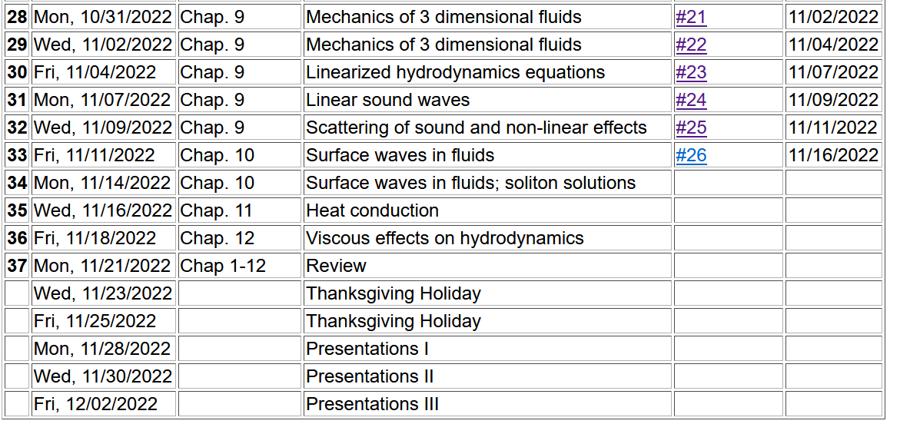
Notes:
Update to schedule including a homework dealing with today’s topic.

Slide 3
Note that some of the ideas are discussed in today’s lecture.

Slide 4
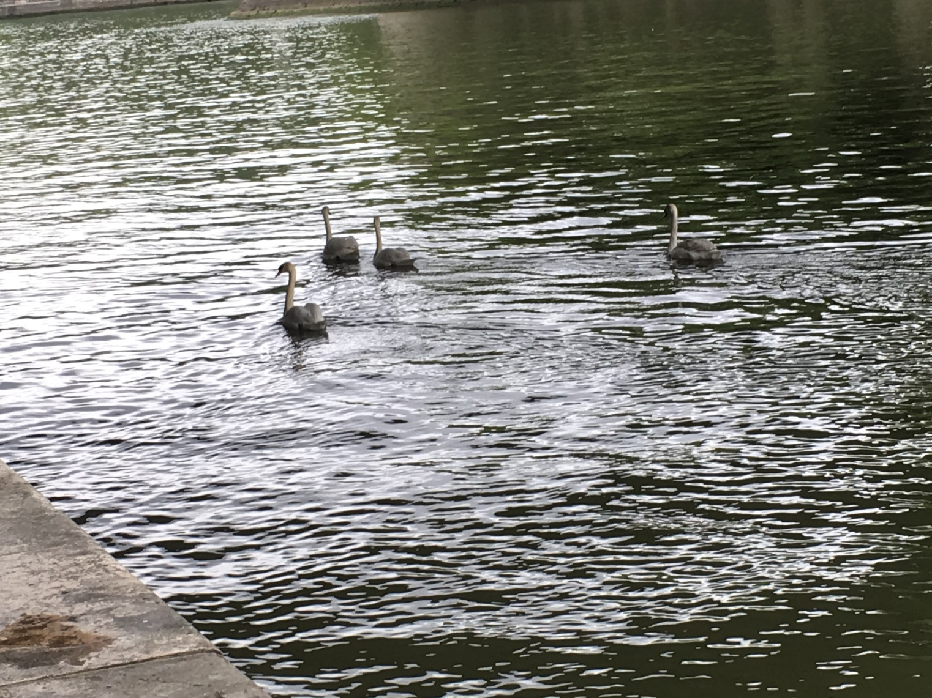
Reference: Chapter 10 of Fetter and Walecka
Physics of incompressible fluids and their surfaces

Slide 5
Consider a container of water with average height h and surface h+ζ(x,y,t); (h ⬅➔ z₀ on some of the slides)
p₀
ζ
z
h
y
x
Notes:
Defining the system and the notation.

Slide 6
Why do we not consider ρ_{air} in this analysis?
Because it is a reasonable approximation
Because it simplifies the analysis
Both of the above

Slide 7
within the water
Notes:
Hydrodynamic equations for this case.

Slide 8
Consider a surface ζ(x,t) wave moving in the x-direction in a channel of width b(x) and height h(x):
ζ(x,t)
v(x,t)
v(x+dx,t)
h(x)
b(x)
dx
Notes:
Considering an increment along the propagation direction including the effects of the continuity equation.

Slide 9
Some details
ζ(x,t)
v(x,t)
v(x+dx,t)
h(x)
b(x)
dx
Here, we are assuming that ρ is constant

Slide 10
ζ(x,t)
v(x,t)
v(x+dx,t)
h(x)
(A special case sometimes found at a beach.)
b(x)
dx
Notes:
Some details for the homework problem which is a special case.

Slide 11
Example continued
Notes:
More details pertaining to the homework problem.

Slide 13
Example continued
Notes:
Continued.

Slide 14
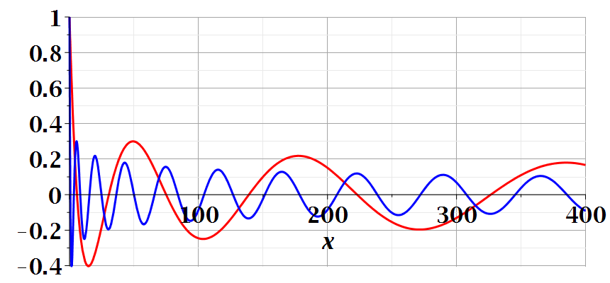
Notes:
Continued.

Slide 15
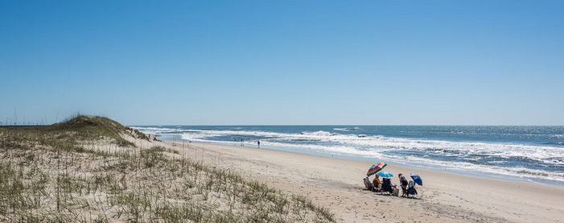
Imagine watching the waves at a beach – can you visualize the configuration for the surface wave pattern to approximation this situation?
Long flat beach
Beach in which average water level increases
Beach in which average water level decreases

Slide 16
A simplier example:
ζ(x,t)
v(x,t)
v(x+dx,t)
h(x)
b(x)
dx
Special case, where b and h are constant --
Notes:
A simpler example.

Slide 17
Example with b and h constant -- continued
dζ(x,y,t)/dt
z₀
v(x,y,t)
v(x+dx,y+dy,t)
Notes:
Considering the surface height.

Slide 18
For uniform channel:
Notes:
For the simple case, we find the wave equation for the surface height. In the following slides, we will find a more complete solution depends on the wavelength the of surface wave.

Slide 19
More details: -- recall setup --
Consider a container of water with average height h and surface h+ζ(x,y,t)
p₀
ζ
z
h
y
x
Notes:
Some details for the more general case.

Slide 20
Equations describing fluid itself (without boundaries)
Notes:
Considering the case of irrotational flow.

Slide 21
p₀
ζ
z
h
y
x
(We have absorbed p₀ in “constant”)
Notes:
Considering the equations within the wave and at the surface.

Slide 22
Full equations:
(We have absorbed p₀ in “constant”)
Linearized equations:
Notes:
Taking the linear limit.

Slide 23
For simplicity, keep only linear terms and assume that horizontal variation is only along x:
Notes:
Solution for the linear equations.

Slide 24
For simplicity, keep only linear terms and assume that horizontal variation is only along x – continued:
Notes:
An expression for c.

Slide 25
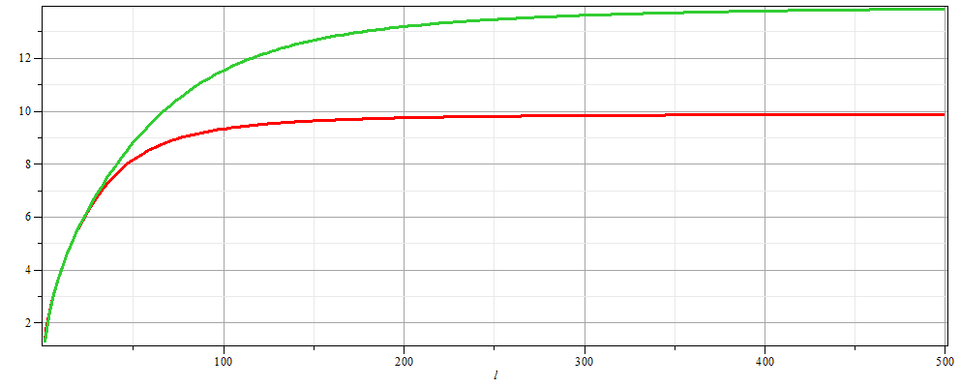
For simplicity, keep only linear terms and assume that horizontal variation is only along x – continued:
h=20 m
c
h=10 m
λ
Notes:
Evaluating c as a function of wavelength.

Slide 26
For simplicity, keep only linear terms and assume that horizontal variation is only along x – continued:
Notes:
Form of the surface wave form.

Slide 27
General problem
including
non-linearities
p₀
ζ
z
h
y
x
Notes:
Introducing the equations beyond the linear approximation that we will cover next time.

