Slide 1
PHY 711 Classical Mechanics and Mathematical Methods
10-10:50 AM MWF in Olin 103
Plan for Lecture 37
Review of topics covered in this course
Mathematical methods
Classical mechanics concepts

Slide 2
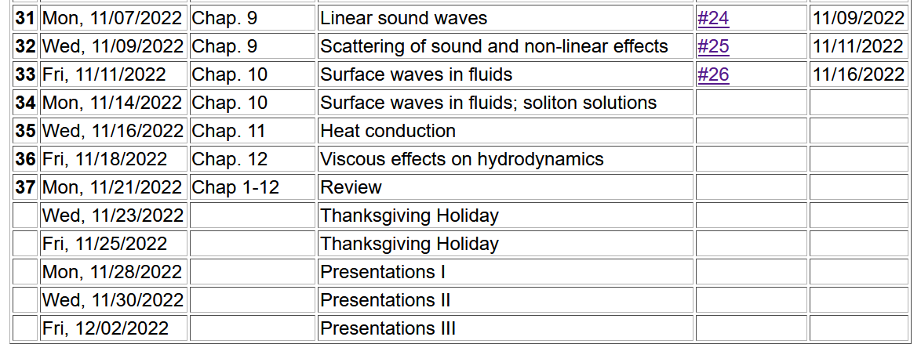
2

Slide 3
Comments on take-home final –
Similar to mid-term in form
Available: Fri. Dec. 2, 2022
Due: Mon. Dec. 12, 2022
(before 11 AM)
Grading based on correct answer and reasoning.
Make sure that your work is legible
Include Mathematica, Maple, Wolfram, Matlab work if appropriate

Slide 4
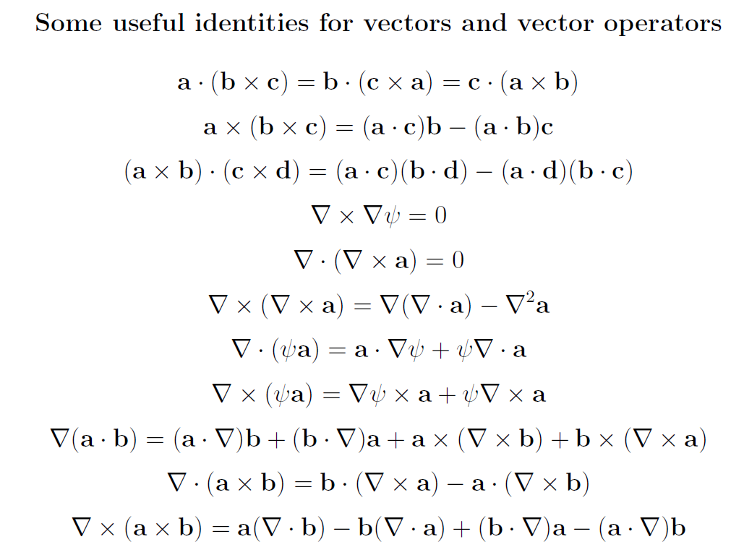
Review of mathematical methods

Slide 5
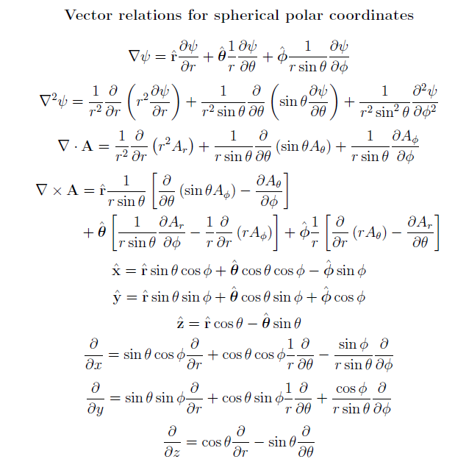

Slide 6
https://dlmf.nist.gov/

Slide 7
Example – special functions

Slide 8
Complex numbers
Functions of complex variables
Derivatives:
Cauchy-Riemann equations

Slide 9
Analytic function
➔A closed integral of an analytic function is zero.
However:

Slide 10
Contour integration methods --
No contribution
C

Slide 12
Fourier transforms --
Note: The location of the 2π factor varies among texts.

Slide 14
Doubly discrete Fourier Transforms
➔Fast Fourier Transforms (FFT)

Slide 15
Notions of eigenvalues and eigenvectors
In the context of linear algebra --
In the context of Sturm-Liouville differential equations --

Slide 16
Notions of eigenvalues and eigenvectors -- continued

Slide 17
Calculus of variation – a method to find a function (y(x)) which optimizes a particular integral relationship.
Euler-Lagrange equation

Slide 18
Lagrangian in the presence of electromagnetic forces

Slide 19
Recipe for constructing the Hamiltonian and analyzing the equations of motion
Note that the equations of motion should yield equivalent trajectories for the Lagrangian and Hamiltonian formulations.

Slide 20
Mechanics topics
Scattering theory
Lagrangian mechanics
Hamiltonian mechanics
Liouville theorem
Rigid body motion
Normal modes of oscillation about equilibrium
Wave motion
Fluid mechanics (ideal or including viscosity; linear and nonlinear)
Heat conduction
Elasticity
Note: The following review slides are necessarily brief. Please refer to the original “Extra” lecture slides for details. Please email: natalie@wfu.edu with any corrections/suggestions

Slide 21
Scattering theory
Note: The notion of cross section is common to many areas of physics including classical mechanics, quantum mechanics, optics, etc. Only in the classical mechanics can we calculate it from a knowledge of the particle trajectory as it relates to the scattering geometry.
b
Figure from Marion & Thorton, Classical Dynamics
Note: We are assuming that the process is isotropic in φ

Slide 22
Lagrangian mechanics

Slide 23
Recipe for constructing the Hamiltonian and analyzing the equations of motion

Slide 24
Question – When can you bypass the 5 step derivation process and directly write the Hamiltonian of the system as
Only when Natalie Holzwarth is not looking
When you have a simple system that has no explicit velocity and/or time dependence
Usually

Slide 25
Important tool for analyzing Lagrangian and/or Hamiltonian systems -- finding constants of the motion
In Lagrangian formulation --

Slide 26
Constants of the motion in the Hamiltonian formulation

Slide 27
Question – Why use this fancy formalism when simple conservation of energy or momentum intuitively apply?
You should use your intuition whenever possible.
You should never trust your intuition.
The equations should be consistent with correct intuitive solutions and also reveal additional solutions (perhaps beyond intuition)

Slide 28
Liouville’s Theorem (1838)
The density of representative points in phase space corresponding to the motion of a system of particles remains constant during the motion.

Slide 29
Rigid body motion
In a reference frame attached to the object, there are 3 moments of inertia and 3 distinct principal axes
Representation of rotational kinetic energy:

Slide 30
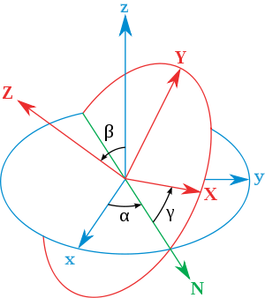
Euler’s transformation between body fixed and inertial reference frames
x
y
y
x

Slide 31
Normal modes of vibration -- potential in 2 and more dimensions
V(x,y)

Slide 32
Example – normal modes of a system with the symmetry of an equilateral triangle -- continued
3
u₃
u₂
1
2
u₁

Slide 33
Example – normal modes of a system with the symmetry of an equilateral triangle -- continued

Slide 34
Example – normal modes of a system with the symmetry of an equilateral triangle -- continued
= ω²

Slide 35
Discrete particle interactions → continuous media →
The wave equation

Slide 36
Mechanical motion of fluids
Newton’s equations for fluids
Use Euler formulation; following “particles” of fluid
Viscosity contributions

Slide 37
Fluid mechanics of incompressible fluid plus surface
Non-linear effects in surface waves:
p₀
ζ
z
h
y
z=0
x

Slide 38
Example of solving coupled equations
Lagrangian equations of motion for a Lorentz force

