Slide 1
PHY 711 Classical Mechanics and Mathematical Methods
10-10:50 AM MWF in Olin 103
Lecture notes for Lecture 4
Scattering analysis in the center of mass reference frame – Chap 1 F&W
Review of scattering ideas.
In center of mass frame, analytical evaluation of the differential scattering cross section in general and for Rutherford scattering.
Notes:
In this lecture, we will focus on the analysis in the center of mass frame which contains the basic physics of the interparticle interaction. The main example will be that of the famous Rutherford scattering experiment.

Slide 2
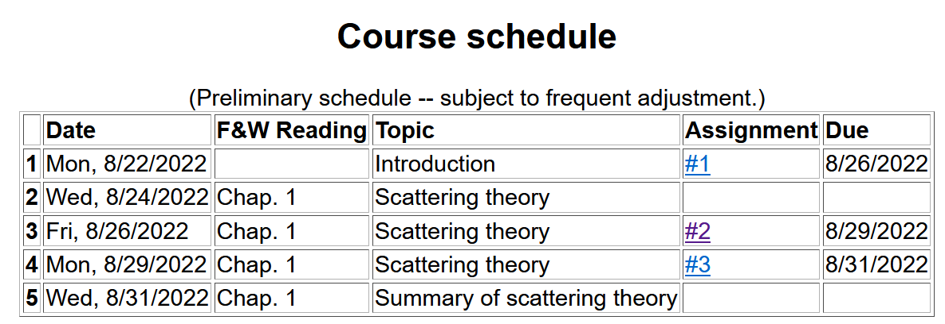

Slide 3
Reviewing – scattering in the laboratory
Figure from F&W:
detector
Notes:
This and the next several slides summarize the experimental scattering geometry.

Slide 4
b
Figure from Marion & Thorton, Classical Dynamics
Note that the same formula applies to the center of mass analysis.
Notes:
More review.

Slide 5
constants
vary in time
For scattering analysis only need to know trajectory before and after
the collision.
Notes:
Recall that the system of interest can be expressed in terms of constants and the particle separation r(t).

Slide 6
Some details --
Relationship between center of mass and laboratory frames of reference. At and time t, the following relationships apply --

Slide 7
More details
Since r(t) represents motion in a plane, we will analyze the system in that plane and use polar coordinates.

Slide 8
Clarification –
Energy of the center mass motion
Energy within the center of mass reference frame
Note that the “center of mass”
motion is in some sense trivial and we tend to focus E_{rel} (often written E) for analysis.

Slide 9
➔

Slide 10
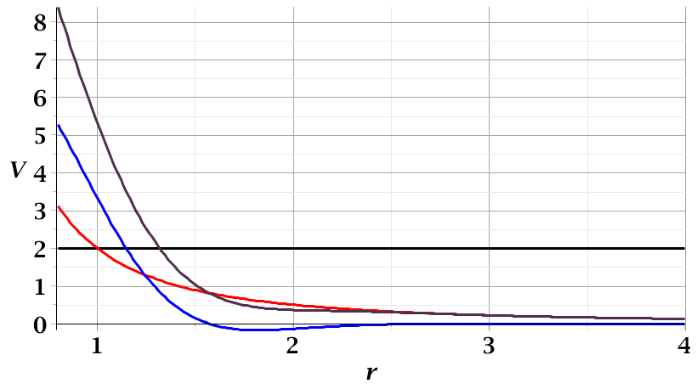
For a continuous potential interaction in center of mass reference frame:
Need to relate these parameters to differential cross section
E_{rel}
r_{min}

Slide 11
r(χ)
χ_{m}
χ
➔Need to find an equation for r(χ)
r_{min}
center of scattering.

Slide 12
How is this related to scattering?
➔
χ_{max}
χ_{max}
θ
Note that here θ is used for the scattering angle

Slide 13
Note that we have used ψ to denote the scattering angle in the center of mass frame, but your textbook uses θ (which we had used to denote the scattering angle in the lab frame). In this lecture our analysis is entirely in the center of mass frame and some of the equations use θ to denote the scattering angle.

Slide 14
Evaluation of constants far from scattering center --
r(t)
r_{min}
Notes:
Relating the constants of the problems to values determined when the particles are very far apart.

Slide 15
Notes:
Up to now we are expressing the trajectory as a function of time t. For this analysis however, we would like to find the trajectory as a function of the angle \chi. The relationship of the constant angular momentum to the \chi and time variables allows us to find r(\chi).

Slide 16
Notes:
Lots of algebra ….

Slide 17
Notation switch –
Notes: χ
Text: φ
Notes:
This shows the relationship of the analysis of r(\phi) to the scattering event. The insert is a diagram from the textbook.

Slide 18
Notes:
The scattering process involves the aspects of the trajectory at large separations.

Slide 19
Notes:
When r=rmin, \phi=0. \phi increases to a maximum value.

Slide 20
Relationship between χ_{max} and θ:
Using the diagram from your text, θ represents the scattering angle in the center of mass frame and φ is used instead of χ.
Notes:
Problem with consistent notation. Here we are using the textbook’s definition of theta which is OK if the target mass is infinite.

Slide 21
Notes:
The last equation is a convenient change of variables.

Slide 22
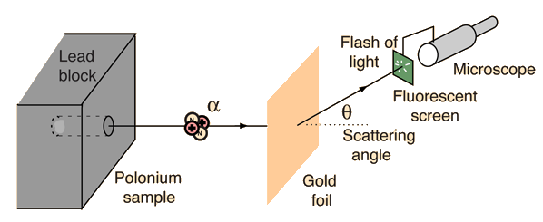
Example: Diagram of Rutherford scattering experiment
http://hyperphysics.phy-astr.gsu.edu/hbase/rutsca.html
Notes:
Here we use a diagram from the web about the Rutherford geometry.

Slide 23
Notes:
Summary of all of the equations and then specializing to the Coulomb interaction form.

Slide 24
Notes:
In this case, the integrals can all be evaluated analytically and simplify to this famous result.

Slide 25
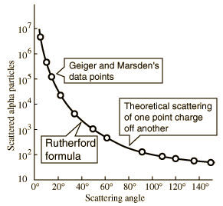
What happens as
θ →0?
From webpage: http://hyperphysics.phy-astr.gsu.edu/hbase/nuclear/rutsca2.html#c3
Notes:
Reconstructed data taken from the web.

Slide 26
Original experiment performed with α particles on gold
Question –
What do you think happens for θ →0?
Big trouble; need to make sure experiment is designed to avoid that case.
No problem
Physics is altered in that case and nothing explodes.
Rare event and rarely causes trouble.
Notes:
Evaluation of constant for this case.

Slide 27
Recap of equations for scattering cross section in the center of mass frame of reference
Notes:
Recap of the equations. This equation allows us to fine b(theta).

Slide 28
Digression– In general, it is possible to determine the trajectory r(χ) --

Slide 29
For the Rutherford case --

Slide 30
For the Rutherford case --

Slide 31
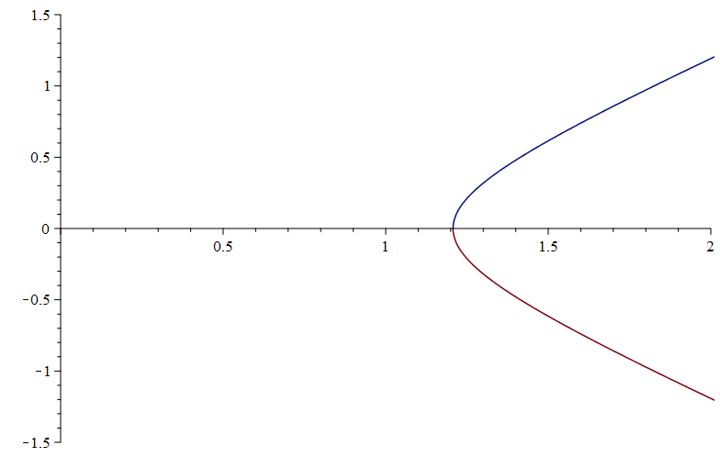
For the Rutherford case --
y
x
Visualization of trajectory in x-y plane --

