Slide 1
PHY 711 Classical Mechanics and Mathematical Methods
10-10:50 AM MWF in Olin 103
Notes for Lecture 5
Review of classical mechanical
scattering theory – Chap 1 F&W
Some numerical considerations
Discussion questions
Review

Slide 2
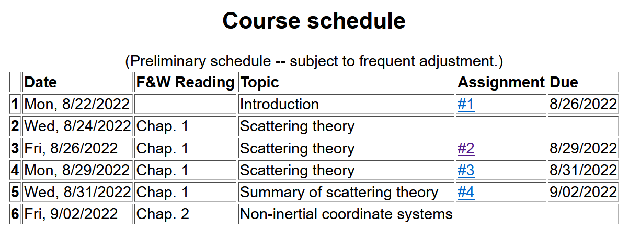

Slide 3
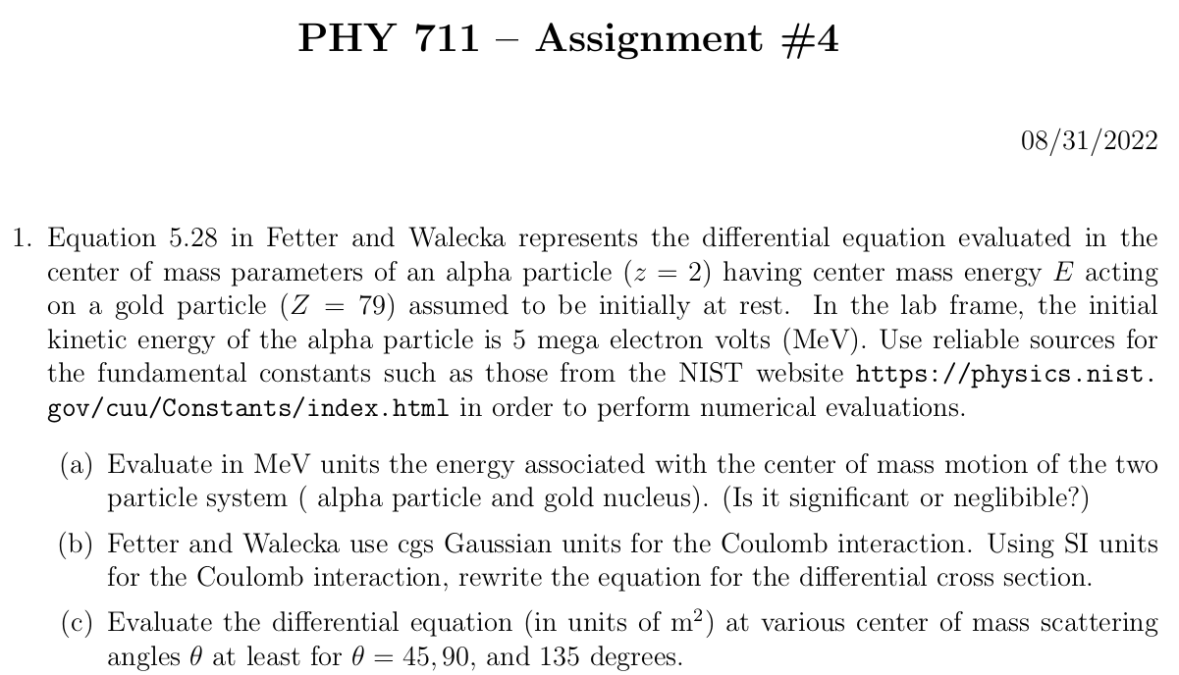

Slide 4
Comments on numerical evaluations
Fetter and Walecka like many older textbooks use cgs Gaussian units (centimeters, grams, seconds plus miscellaneous factors of 4π) while “modern” texts use SI units (meters, kilograms, seconds plus other miscellaneous factors of 4πε₀)
Coulomb force between ze and Ze at separation r:

Slide 5
Comments on numerical evaluations -- continued
MeV is a convenient unit of energy related to SI unit of Joules
1 eV=1.602176634x10⁻¹⁹ J
1 MeV= 10⁶ eV=1.602176634x10⁻¹³ J
More generally a reliable source for fundamental constants is available at the NIST website https://physics.nist.gov/cuu/Constants/index.html

Slide 7
What constants will you need to know?
What units will your answer have?

Slide 8
Reviewing – scattering in the laboratory
Figure from F&W:
detector

Slide 9
Comment about angularly dependent interaction potentials V(r)
Comments -- These certainly occur in nature and are important. However, the equations we have used here have to be modified. The experimental set up will be the same, but the differential cross section will depend both on θ and φ.
detector

Slide 10
detector
Note that this diagram implies a repulsive interaction. How would it look if the interaction was attractive?

Slide 11
Close up of repulsive interaction
Relationship between χ_{max} and θ:
Using the diagram from your text, θ represents the scattering angle in the center of mass frame and φ is used instead of χ.
Notes:
Problem with consistent notation. Here we are using the textbook’s definition of theta which is OK if the target mass is infinite.

Slide 12
More details
Since r(t) represents motion in a plane, we will analyze the system in that plane and use polar coordinates.

Slide 13
Clarification –
Energy of the center mass motion
Energy within the center of mass reference frame
In the following slides E_{rel} is written E

Slide 14
➔

Slide 15
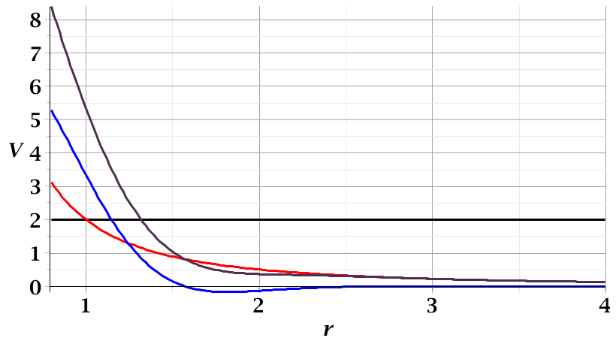
For a continuous potential interaction in center of mass reference frame:
Need to relate these parameters to differential cross section
E_{rel}
r_{min}

Slide 16
r(χ)
χ_{m}
χ
➔Need to find an equation for r(χ)
r_{min}
center of scattering.

Slide 17
How is this related to scattering?
➔
χ_{max}
χ_{max}
θ
Note that here θ is used for the scattering angle

Slide 18
Note that we have use ψ to denote the scattering angle in the center of mass frame, but your textbook uses θ (which we had used to denote the scattering angle in the lab frame). In this lecture our analysis is entirely in the center of mass frame and some of the equations use θ to denote the scattering angle.

Slide 19
Evaluation of constants far from scattering center --
r(t)
r_{min}
Notes:
Relating the constants of the problems to values determined when the particles are very far apart.

Slide 20
Notes:
Up to now we are expressing the trajectory as a function of time t. For this analysis however, we would like to find the trajectory as a function of the angle \phi. The relationship of the constant angular momentum to the \phi and time variables allows us to find r(\phi).

Slide 21
Notes:
Lots of algebra ….

Slide 22
Notes:
The scattering process involves the aspects of the trajectory at large separations.

Slide 23
Notes:
When r=rmin, \phi=0. \phi increases to a maximum value.

Slide 24
General equations for central potential V(r)
Notes:
The last equation is a convenient change of variables.

Slide 25
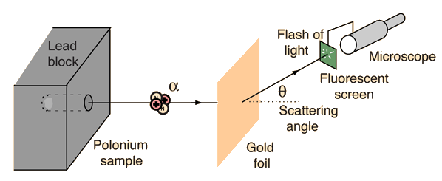
Example: Diagram of Rutherford scattering experiment
http://hyperphysics.phy-astr.gsu.edu/hbase/rutsca.html
Notes:
Here we use a diagram from the web about the Rutherford geometry.

Slide 26
Notes:
Summary of all of the equations and then specializing to the Coulomb interaction form.

Slide 27
Notes:
In this case, the integrals can all be evaluated analytically and simplify to this famous result.

Slide 28
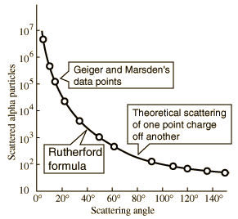
What happens as
θ →0?
From webpage: http://hyperphysics.phy-astr.gsu.edu/hbase/nuclear/rutsca2.html#c3
Notes:
Reconstructed data taken from the web.

Slide 29
Original experiment performed with α particles on gold
(in SI units)
Notes:
Evaluation of constant for this case.

Slide 31
Transformation between lab and center of mass results:
Differential cross sections in different reference frames – continued:
For elastic scattering

