Slide 1
PHY 711 Classical Mechanics and Mathematical Methods
10-10:50 AM MWF in Olin 103
Notes for Lecture 5
Review of classical mechanical
scattering theory – Chap 1 F&W
Overview
Some numerical considerations
Discussion questions
Review

Slide 2
Physics Colloquium Thursday, September 1, 2022
4 PM in Olin 101
Refreshments at 3:30 PM in Olin Lobby

Slide 3
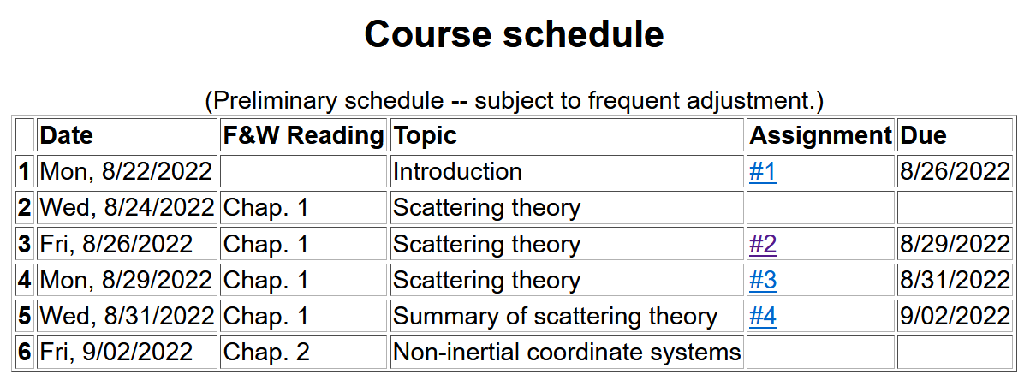

Slide 4
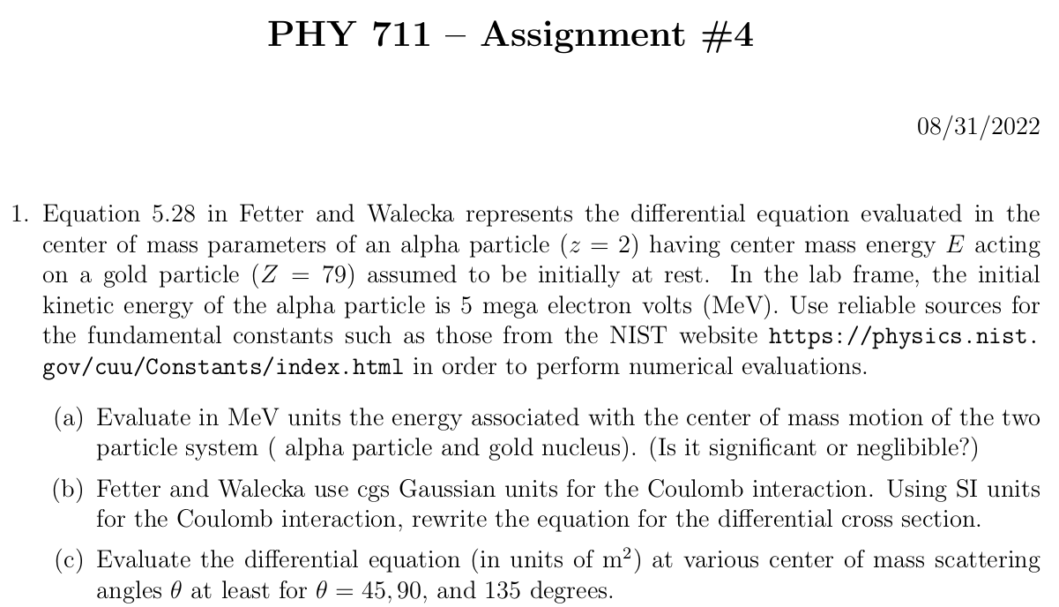

Slide 5
Your questions –
From Sam -- If one particle in a 2 particle pair is stationary, doesn't the kinetic energy related to the center of mass have to be the same as the energy of particle one in the lab frame? I looked ahead to Friday's hw and was slightly confused.
From Lee -- Could you please remind me of what K (kappa) represents in the Rutherford scattering equations (near the end of your presentation)?
From Zezong -- The notes say there are relatively few forms of (1/u ) for which the integral has an analytic result, does it mean in real life it is relatively easy to find numerical results in most cases?

Slide 6
Comments on numerical evaluations
Fetter and Walecka like many older textbooks use cgs Gaussian units (centimeters, grams, seconds plus miscellaneous factors of 4π) while “modern” texts use SI units (meters, kilograms, seconds plus other miscellaneous factors of 4πε₀)
Coulomb force between ze and Ze at separation r:

Slide 7
Comments on numerical evaluations -- continued
MeV is a convenient unit of energy related to SI unit of Joules
1 eV=1.602176634x10⁻¹⁹ J
1 MeV= 10⁶ eV=1.602176634x10⁻¹³ J
More generally a reliable source for fundamental constants is available at the NIST website https://physics.nist.gov/cuu/Constants/index.html

Slide 9
What constants will you need to know?
What units will your answer have?

Slide 10
Reviewing – scattering in the laboratory
Figure from F&W:
detector

Slide 11
Comment about angularly dependent interaction potentials V(r)
Comments -- These certainly occur in nature and are important. However, the equations we have used here have to be modified. The experimental set up will be the same, but the differential cross section will depend both on θ and φ.
detector

Slide 12
detector
Note that this diagram implies a repulsive interaction. How would it look if the interaction was attractive?

Slide 13
Close up of repulsive interaction
Relationship between χ_{max} and θ:
Using the diagram from your text, θ represents the scattering angle in the center of mass frame and φ is used instead of χ.
Notes:
Problem with consistent notation. Here we are using the textbook’s definition of theta which is OK if the target mass is infinite.

Slide 14
More details
Since r(t) represents motion in a plane, we will analyze the system in that plane and use polar coordinates.

Slide 15
Some details

Slide 16
Clarification –
Energy of the center mass motion
Energy within the center of mass reference frame
In the following slides E_{rel} is written E

Slide 17
➔

Slide 18
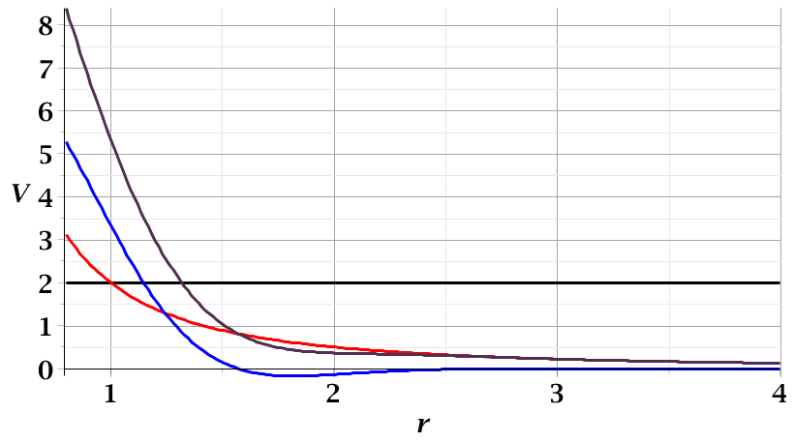
For a continuous potential interaction in center of mass reference frame:
Need to relate these parameters to differential cross section
E_{rel}
r_{min}

Slide 19
r(χ)
χ_{m}
χ
➔Need to find an equation for r(χ)
r_{min}
center of scattering.

Slide 20
How is this related to scattering?
➔
χ_{max}
χ_{max}
θ
Note that here θ is used for the scattering angle

Slide 21
Note that we have use ψ to denote the scattering angle in the center of mass frame, but your textbook uses θ (which we had used to denote the scattering angle in the lab frame). In this lecture our analysis is entirely in the center of mass frame and some of the equations use θ to denote the scattering angle.

Slide 22
Evaluation of constants far from scattering center --
r(t)
r_{min}
Notes:
Relating the constants of the problems to values determined when the particles are very far apart.

Slide 23
Notes:
Up to now we are expressing the trajectory as a function of time t. For this analysis however, we would like to find the trajectory as a function of the angle \phi. The relationship of the constant angular momentum to the \phi and time variables allows us to find r(\phi).

Slide 24
Notes:
Lots of algebra ….

Slide 25
Notes:
The scattering process involves the aspects of the trajectory at large separations.

Slide 26
Notes:
When r=rmin, \phi=0. \phi increases to a maximum value.

Slide 27
General equations for central potential V(r)
Notes:
The last equation is a convenient change of variables.

Slide 28
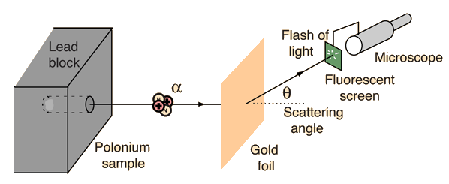
Example: Diagram of Rutherford scattering experiment
http://hyperphysics.phy-astr.gsu.edu/hbase/rutsca.html
Notes:
Here we use a diagram from the web about the Rutherford geometry.

Slide 29
Notes:
Summary of all of the equations and then specializing to the Coulomb interaction form.

Slide 30
Some details –

Slide 31
Notes:
In this case, the integrals can all be evaluated analytically and simplify to this famous result.

Slide 32
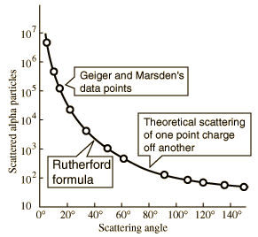
What happens as
θ →0?
From webpage: http://hyperphysics.phy-astr.gsu.edu/hbase/nuclear/rutsca2.html#c3
Notes:
Reconstructed data taken from the web.

Slide 33
Original experiment performed with α particles on gold
(in SI units)
Notes:
Evaluation of constant for this case.

Slide 34
More generally, it is possible to use numerical integration methods (with care) to evaluate b(θ).

Slide 35
Transformation between lab and center of mass results:
Differential cross sections in different reference frames – continued:
For elastic scattering

