Slide 1
PHY 711 Classical Mechanics and Mathematical Methods
10-10:50 AM MWF in Olin 103
Discussion of Lecture 9 – Chap. 3 F & W
Calculus of variation applied to classical mechanics
Hamilton’s principle
D’Alembert’s principle
Lagrange’s equation in generalized coordinates
Notes:
In this lecture, we will continue to develop notions of the calculations of variation and to start to show how they may be applied to classical mechanics.

Slide 2
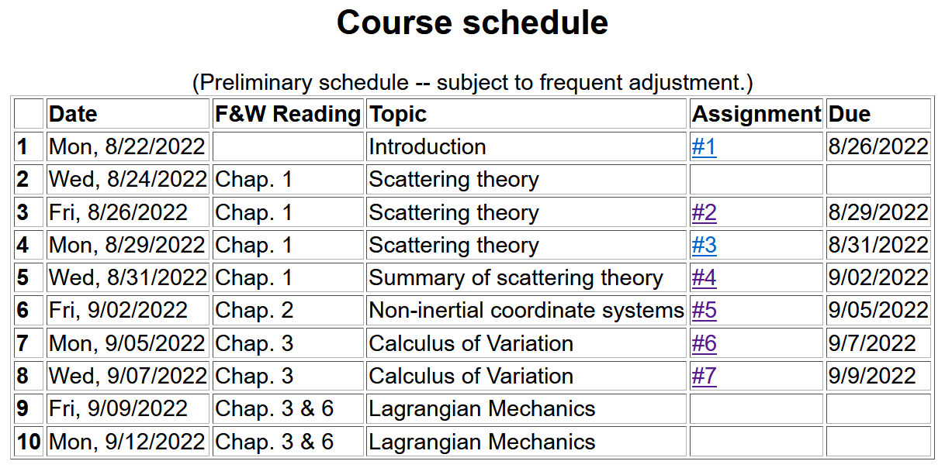
Notes:
There is one homework problem for this lecture.

Slide 3
Summary of equations from calculus of variation --
Notes:
Summary again.

Slide 4
Application to particle dynamics
Notes:
We will now start to apply this mathematics to the physics of motion. Here we map the variables that will apply. A is called “action”. L is called “Lagrangian”.

Slide 5
Application to particle dynamics
Hamilton’s principle states that the dynamical trajectory of a system is given by the path that extremizes the action integral
Simple example: vertical trajectory of particle of mass m subject to constant downward acceleration a=-g.
Note that we have not yet justified this!
Notes:
Here we will show how Newton’s laws can be written in terms of the Lagrangian formalism.

Slide 6
http://www-history.mcs.st-and.ac.uk/Biographies/Hamilton.html
(1805–1865)
Notes:
In addition to Euler and Lagrange, we need to thank Hamilton as well.

Slide 7
https://irishpostalheritagegpo.wordpress.com/2017/06/08/william-rowan-hamilton-irish-mathematician-and-scientist/

Slide 8
Potential energy
Kinetic energy
Notes:
First we will show that it works with these relationships and then we will justify how this might work.

Slide 9
Perhaps looks familiar?
Notes:
Action is sometimes A and sometimes S.

Slide 10
Notes:
Checking the minimization.

Slide 11
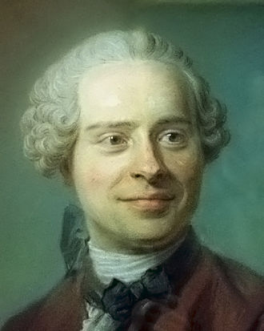
Jean d’Alembert 1717-1783
French mathematician and philosopher
“Deriving” Lagrangian mechanics from Newton’s laws.
Notes:
Previously we introduced the Lagrangian function without justification. Here we follow a “derivation” attributed to d’Alembert.

Slide 12
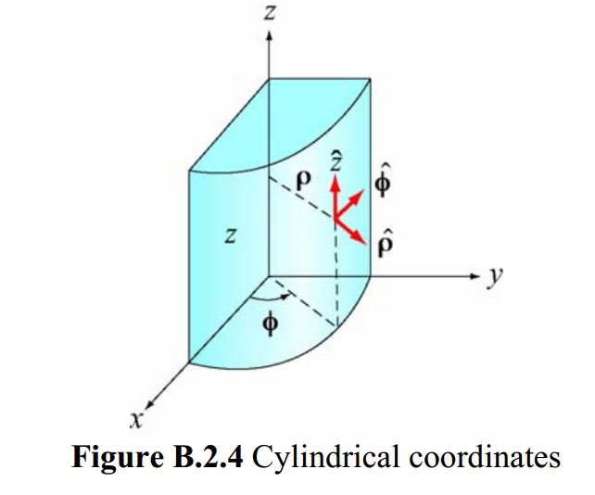
Cylindrical coordinates
(Figure taken from 8.02 handout from MIT.)
Notes:
The derivation is based on the notion of “generalized” coordinates which can be Cartesian coordinates or one of the many transformed coordinates, or even more “general” coordinates.

Slide 13
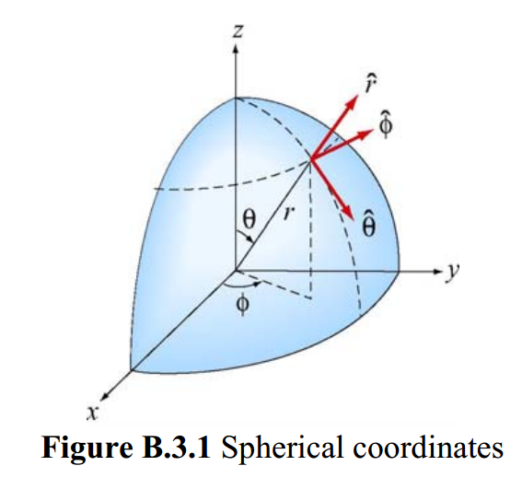
Spherical coordinates
(Figure taken from 8.02 handout from MIT.)
Notes:
Another example of transformed coordinates.

Slide 14
D’Alembert’s principle:
Notes:
Here we start the derivation following D’Alembert’s arguments. x_{i} denotes the cartesian coordinate while q denotes the “generalized” coordinate. In this slide we consider the potential energy terms.

Slide 15
You might ask why we need “generalized” coordinates. In fact, Cartesian coordinates are often just fine, but using the more flexible possibilities reveals important aspects of the formalism. Cartesian coordinates are a special case of generalized coordinates.

Slide 16
Summary up to now --

Slide 17
Notes:
Continuing the derivations we consider the kinetic energy contributions.

Slide 18
Some details
You may be still wondering why we need to introduce “generalized” coordinates when cartesian coordinates are an example. What the generalized coordinates allow us to show is that

Slide 19
Notes:
Continuing the derivation.

Slide 20
Notes:
Summary of results from D’Alembert’s analysis.

Slide 21
Notes:
Form of derived Lagrangian provided that the potential does not depend on velocity.

Slide 22
➔Hamilton’s principle from the “backwards” application of the Euler-Lagrange equations --
Notes:
Having shown that the Euler-Lagrangian equations are consistent with Newton’s equations of motion, we can then infer that the integral of the Lagrangian is optimized as is consistent with Hamilton’s principle.

Slide 23
Example:
d
θ
Notes:
Example of using the Lagrangian formalism for a simple pendulum.

Slide 24
Notes:
Another example of Lagrangian formalism that we will encounter when we examine rigid body motion.

Slide 25
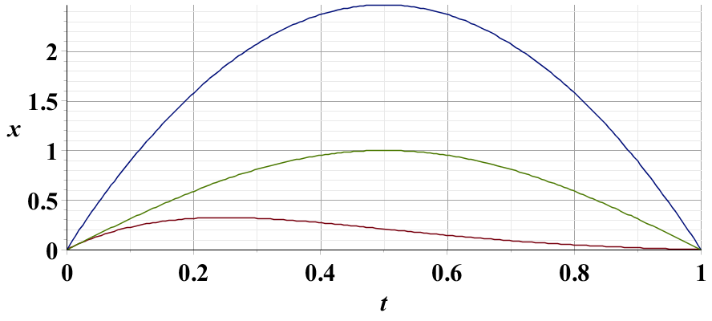
Example – simple harmonic oscillator
x₁
x₂
x₃
Notes:
Harmonic oscillator example. Here we again demonstrate the physical trajectory has the smallest “action”.

Slide 26
Summary –
Hamilton’s principle:
Notes:
Recipe for Lagrangian mechanics.

Slide 27
Note: in “proof” of Hamilton’s principle:
Why do we need velocity dependent forces?
Friction is sometimes represented as a velocity dependent force. (difficult to treat with Lagrangian mechanics.)
Lorentz force on a moving charged particle in the presence of a magnetic field.
Notes:
Important restriction.

Slide 28
Lorentz forces:
Note: Here we are using cartesian coordinates for convenience.
Notes:
While Lagrangian mechanics cannot treat all velocity dependent forces, it is possible to extend the analysis for the case of the Lorentz force. This material is treated in Chapter 6, Section 33 of your textbook. We are following the textbook’s units of cgs Gaussian units. We will discuss this material on Monday.

