Slide 1
Li₃BO₃ and Li₃BN₂: Computational Study of Structural and Electrolyte Properties of Pure and Doped Crystals
Yan Li¹, Zachary D. Hood², Natalie A. W. Holzwarth¹
¹Department of Physics, Wake Forest University, Winston-Salem, NC 27109, USA
²Applied Materials Division, Argonne National Laboratory, Argonne, IL 60439, USA
APS March Meeting 2021
Session E61: Energy Research -- Energy Storage I

Slide 2
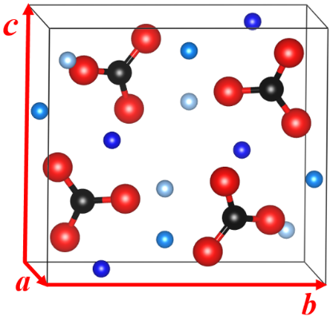
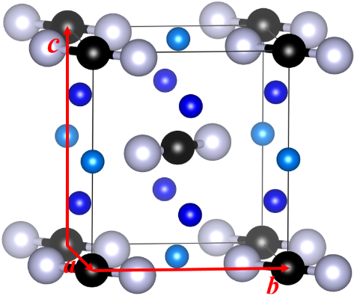
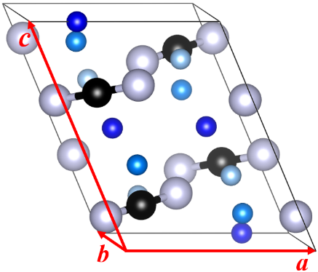
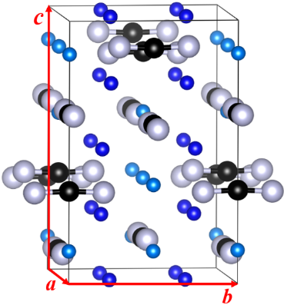
Outlines
Inequiv. Li
B
O
N
Li₃BO₃
Monoclinic P2₁/c (#14)¹
4 formula units / unit cell
α-Li₃BN₂
Tetragonal P4₂/mnm (#136)²
2 formula units / unit cell
β-Li₃BN₂
Monoclinic P2₁/c (#14)²
4 formula units / unit cell
γ-Li₃BN₂
Tetragonal I4₁/amd (#141)³
8 formula units / unit cell
Focuses of this presentation:
Structure correction for α-Li₃BN₂
Electrolyte properties of pure and doped Li₃BO₃ and β-Li₃BN₂ crystals
Stability analysis of the ideal interfaces of pure Li₃BO₃ and β-Li₃BN₂ with Li metal anode
¹Stewner, Acta Crystallogr. section B. 27, 904 (1971)
²Yamane et al., J. Solid State Chem. 71, 1-11 (1987)
³Pinkerton and Herbst, J. Appl. Phys. 99, 113523 (2016)

Slide 3
Summary of computational methods
Density Functional Theory (DFT) and Density Functional Perturbation Theory (DFPT) with the modified Perdew-Burke-Ernzerhof generalized gradient approximation¹ (PBEsol GGA)
The projector augmented wave (PAW) formalism using ABINIT (https://www.abinit.org) & QUANTUM ESPRESSO (http://www.quantum-espresso.org)
Datasets generated by ATOMPAW code available at http://pwpaw.wfu.edu
Visualization software: XCrySDen, VESTA
Space-group analysis: FINDSYM
X-ray diffraction: Mercury
¹Perdew et al., Phys. Rev. L. 100, 136406 (2008)

Slide 4
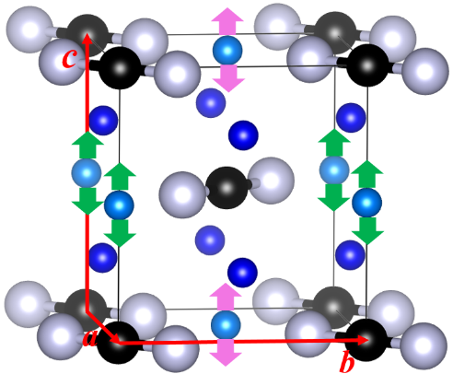
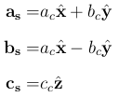
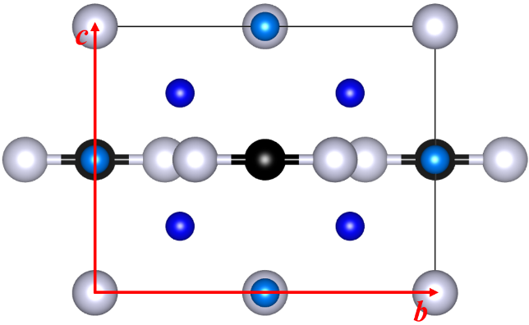
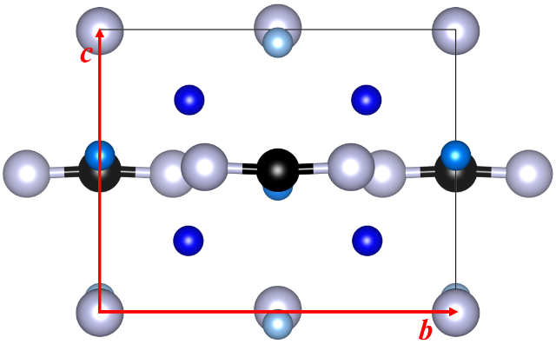
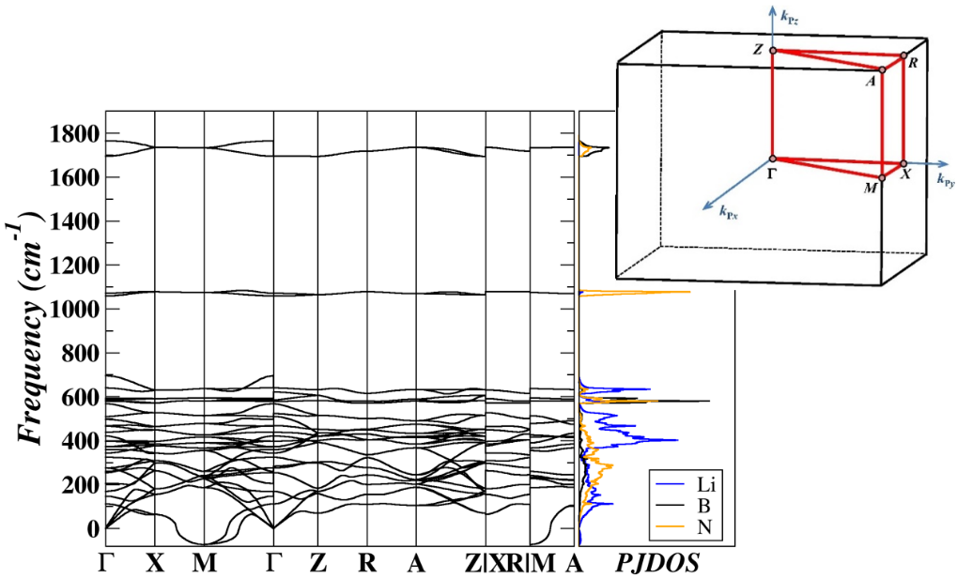
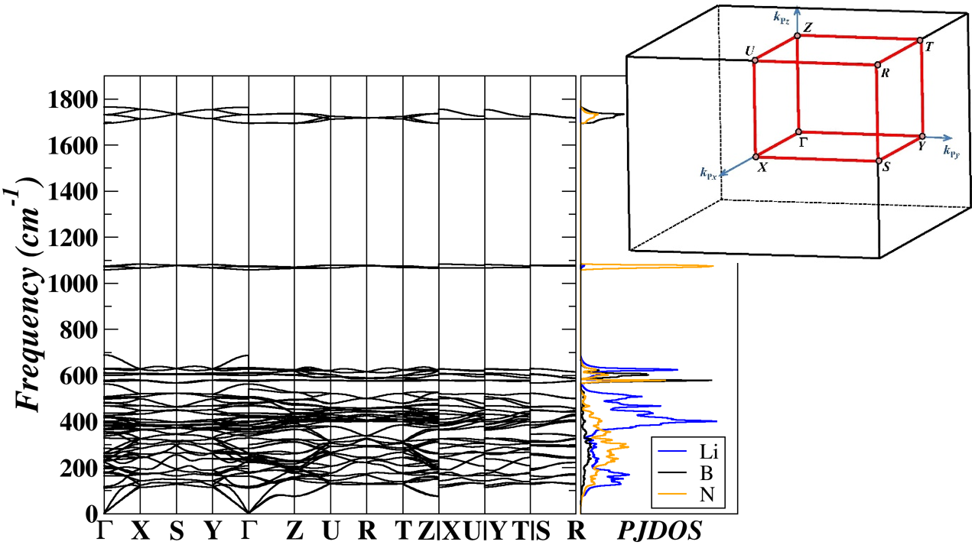
Corrected α phase of Li₃BN₂
Li(8g)
Li(4d)
Distort b-type Li ions along c
Li(2b)
Li(2a)
Li(2b)
Modes #1&2 at M (0.5, 0.5, 0)
Super tetragonal P4₂/mnm
Orthorhombic Pmmn
Reported α-Li₃BN₂ in the P4₂/mnm structure
New α-Li₃BN₂ in the Pmmn structure
Brillouin zone diagrams: Hinuma et al., Comp. Mat. Sci. 128, 140-184 (2017)

Slide 5
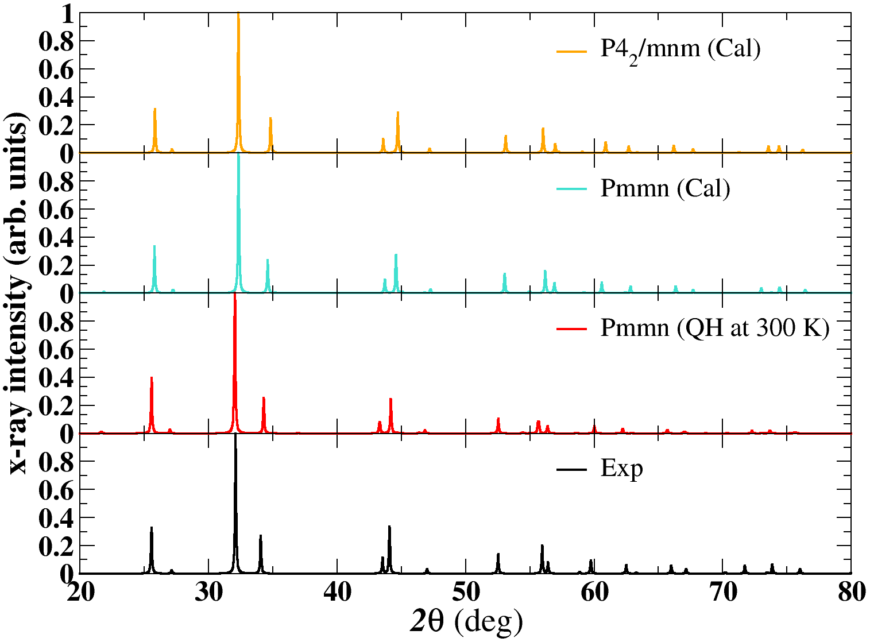
Harmonic vs. Quasi-harmonic
Comparison of simulated and experimental x-ray diffraction (λ = 1.54056 A° ) patterns.
Exp: Yamane et al., J. Solid State Chem. 71, 1-11 (1987)

Slide 6
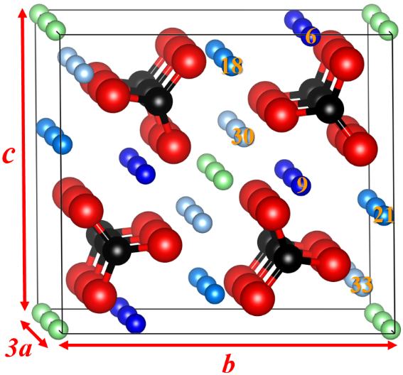
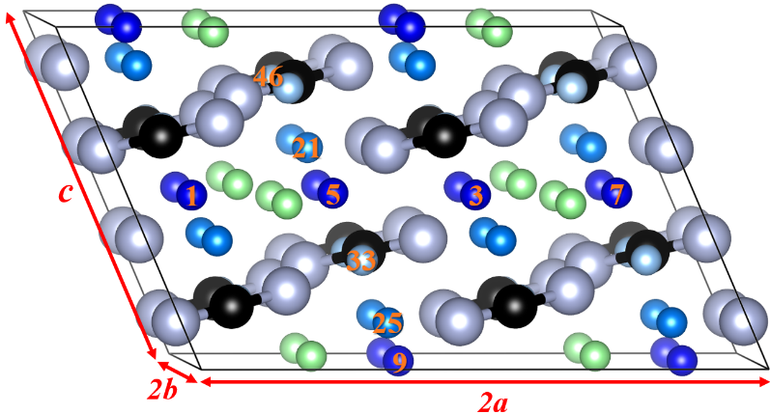
Defect models for monoclinic Li₃BO₃ and β-Li₃BN₂
Inequiv. host Li
interstitial Li
Metastable interstitial defects (green balls):
Li₃BO₃: Wyckoff sites 2b with coordinates (0.5, 0.5, 0.5); E_{f} = 1.25 eV
Li₃BN₂: Wyckoff sites 4e with coordinates (0.560, 0.279, 0.978); E_{f} = 1.23 eV
Models of Li-deficient structures:
Pure crystal with an ideal Li vacancy created by removing a Li ion and compensating with a uniform charge of the opposite sign -- I-vac
F-doped crystal with the stoichiometry of Li_{3-x}BO_{3-x}F_{x} (x = 1/12) -- F-doped
C-doped crystal with the stoichiometry of Li_{3-x}B_{1-x}C_{x}N₂ (x = 1/16) -- C-doped
3x1x1 supercell of Li₃BO₃ (P2₁/c)
Stability analysis:
2x2x1 supercell of β-Li₃BN₂ (P2₁/c)

Slide 7
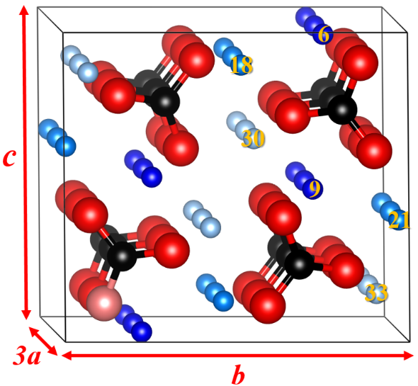
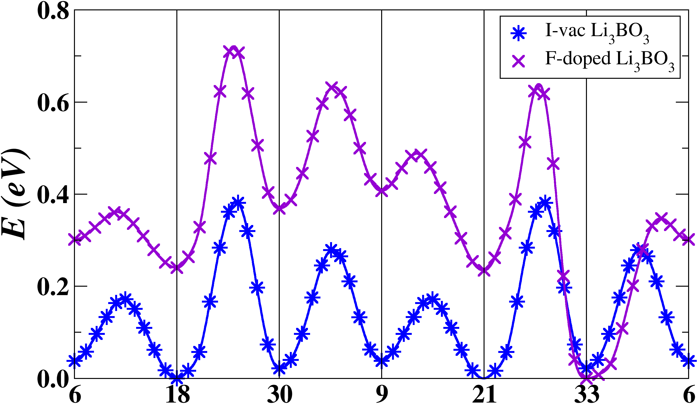
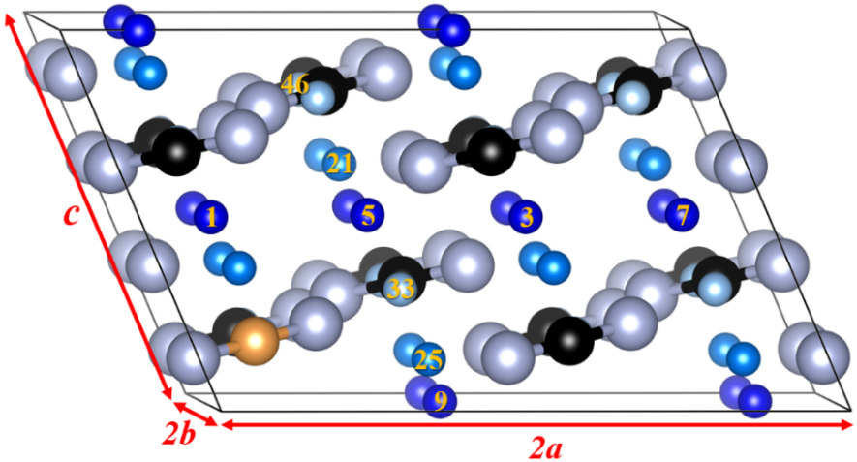
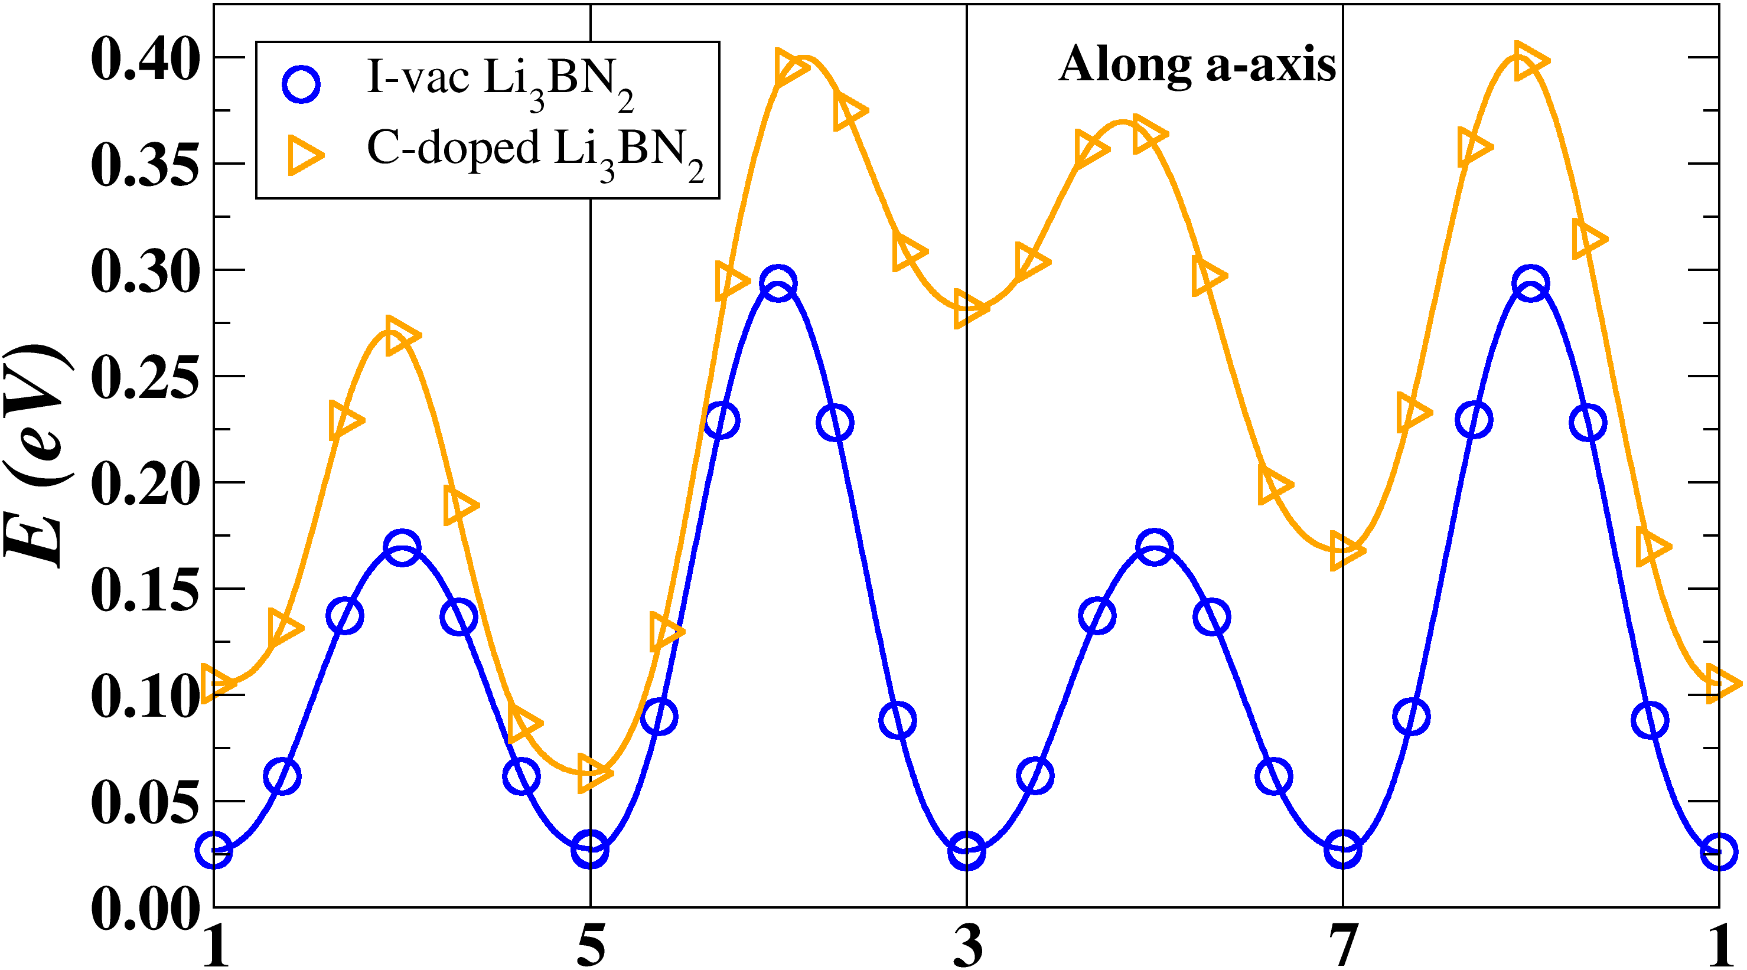
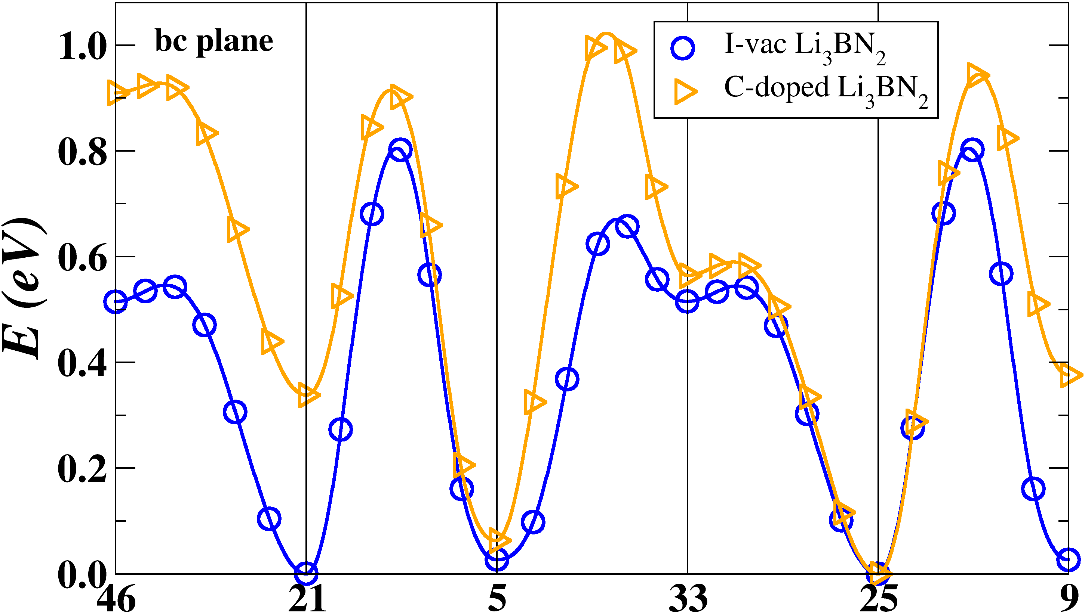
Li ion vacancy migration analysis via Elastic Band Method^{1,2}
Inequiv. Li
For I-vac and doped crystals:
For perfect crystals:
F
Recall E_{f} = 1.25 eV for Li₃BO₃ and 1.23 eV for Li₃BN₂.
Li₃BO₃
C
Li₃BN₂
¹Jónsson et al., in Classical and Quantum Dynamics in Condensed Phase Simulations, edited by B. J. Berne, G. Ciccotti, and D. F. Coker (World Scientific, Singapore, 1998)
²Henkelman et al., J. Chem. Phys. 113, 9901-9904 (2000)

Slide 8
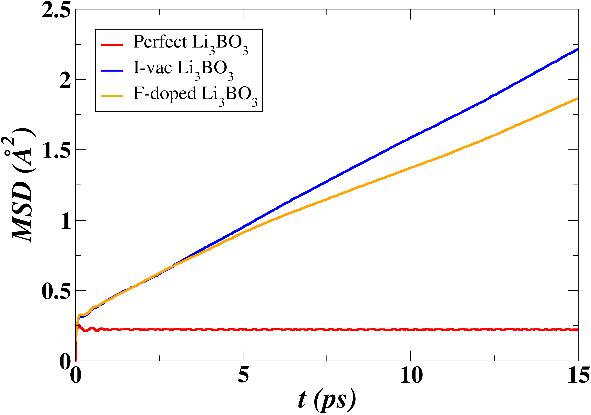
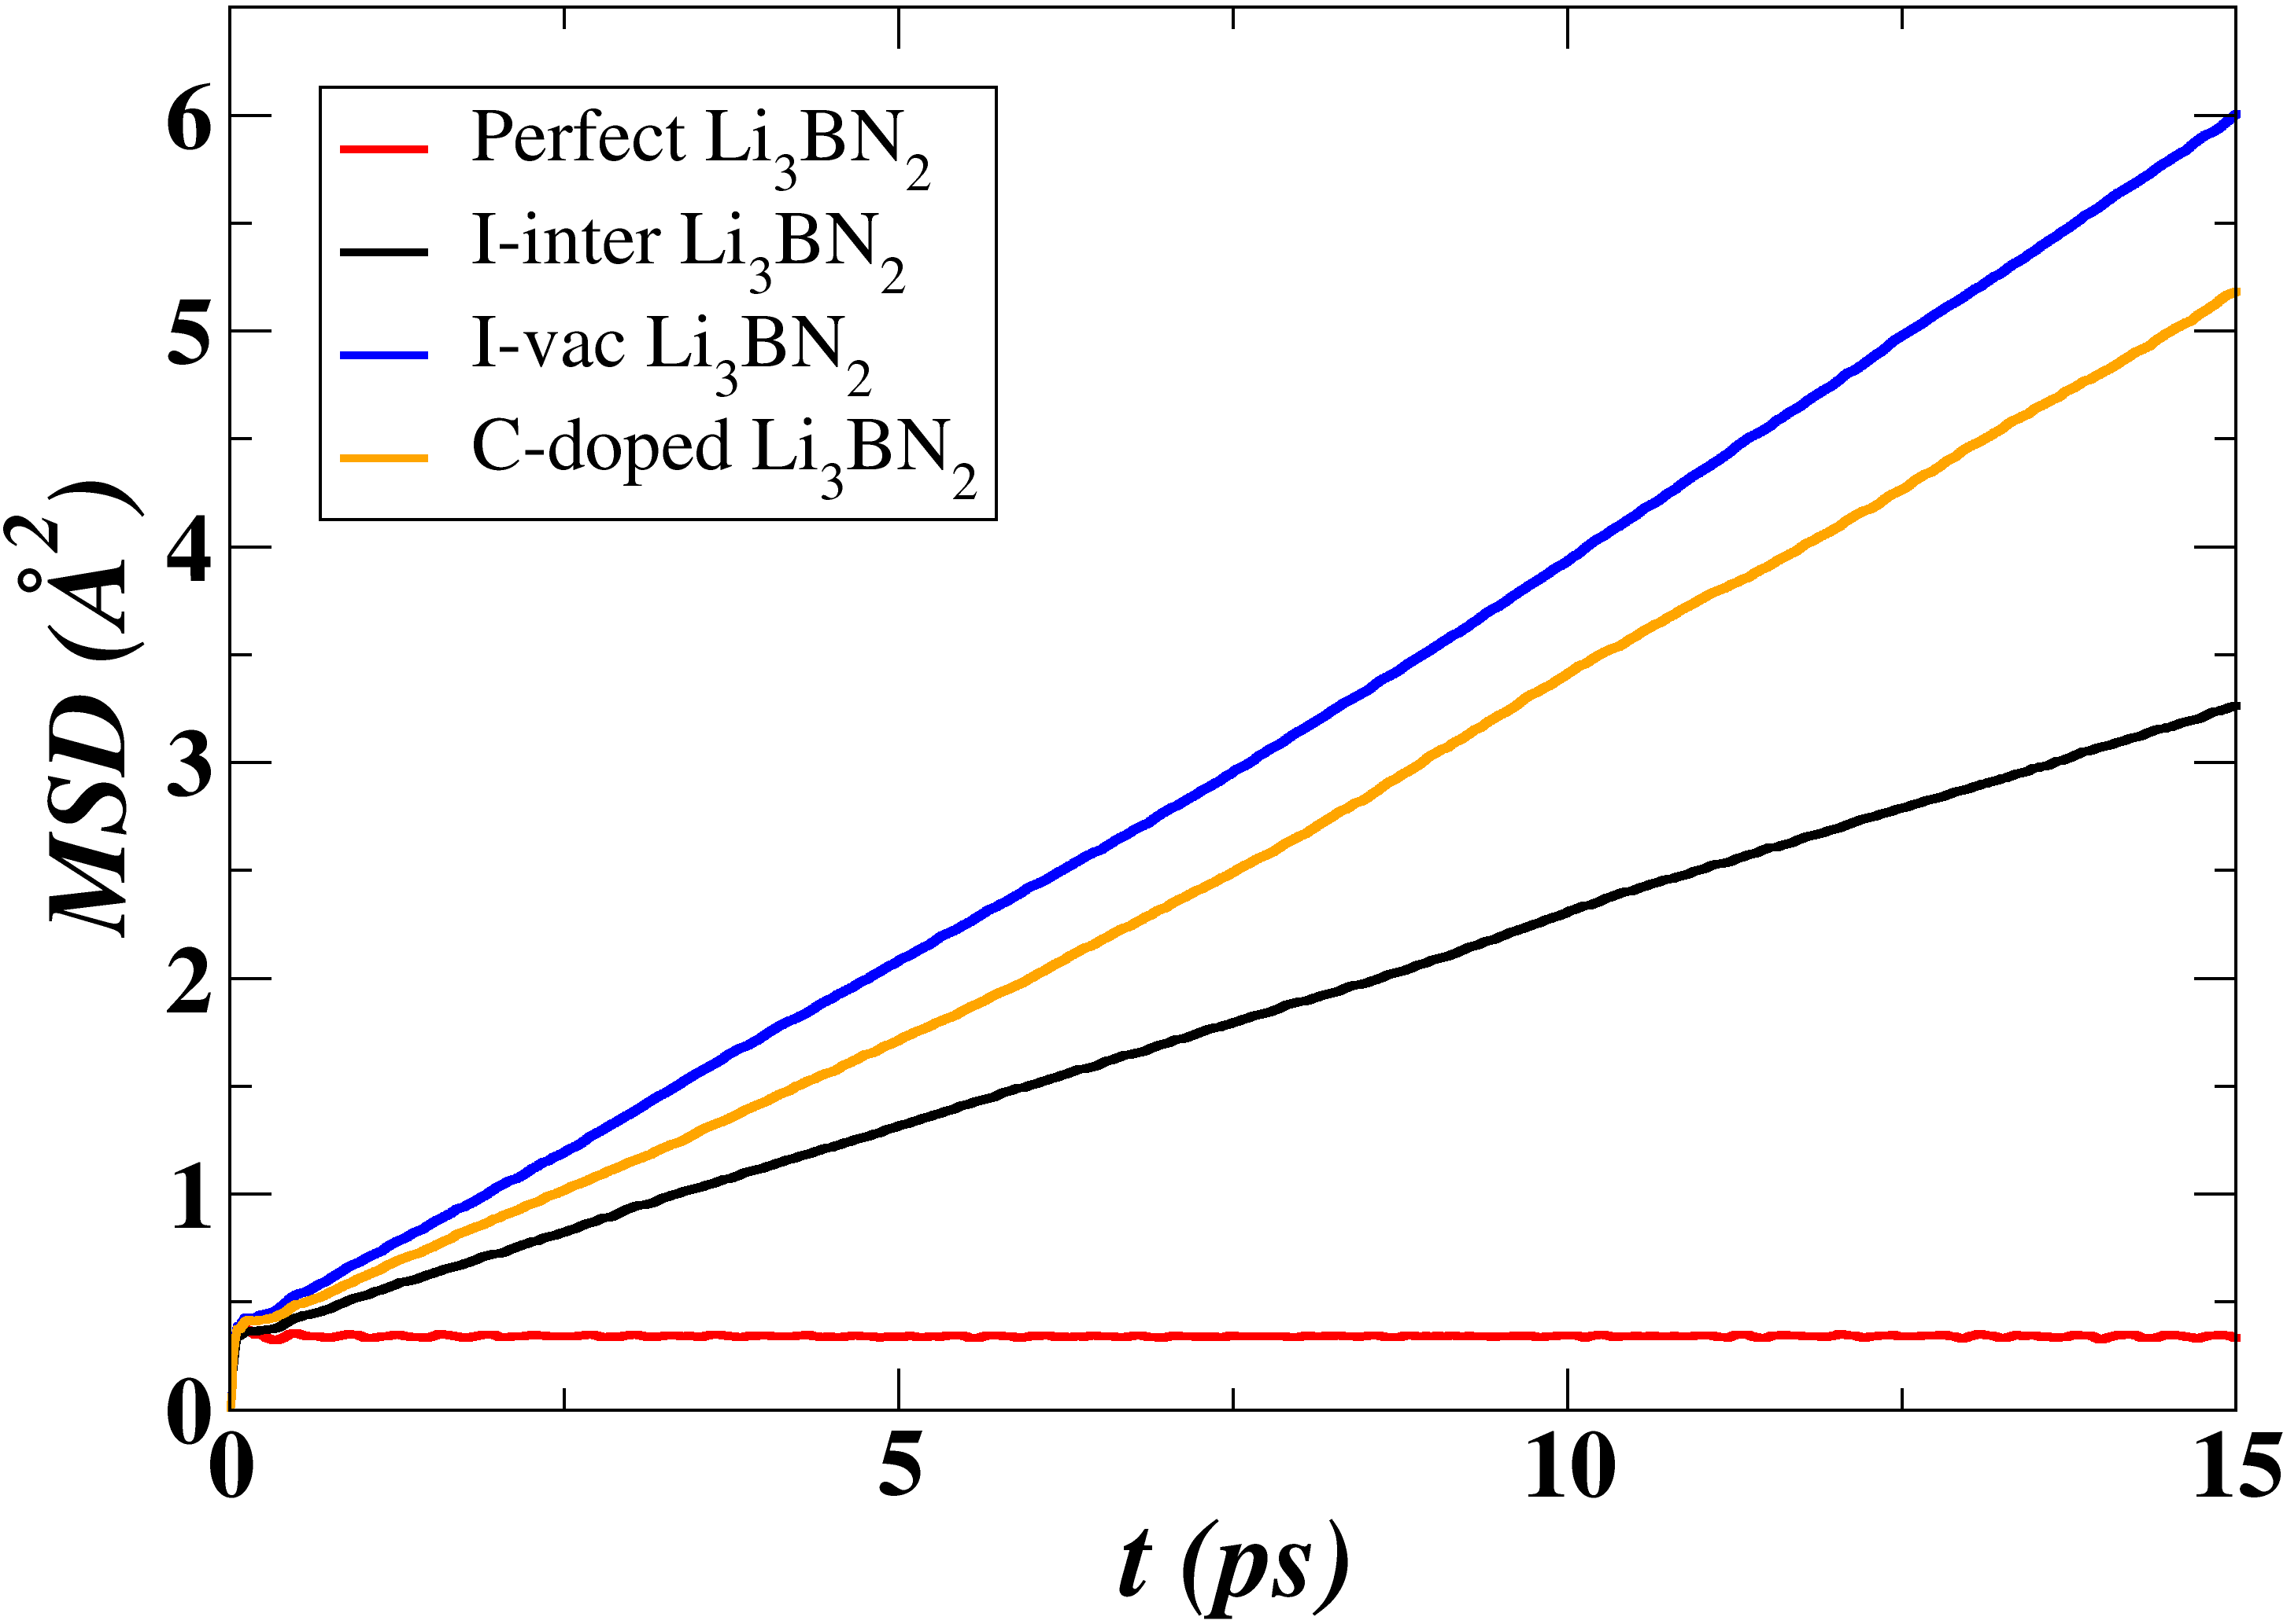
Molecular dynamics simulations
NVE ensemble
998 K
1254 K
996 K
1261 K
1259 K
968 K
1272 K

Slide 9
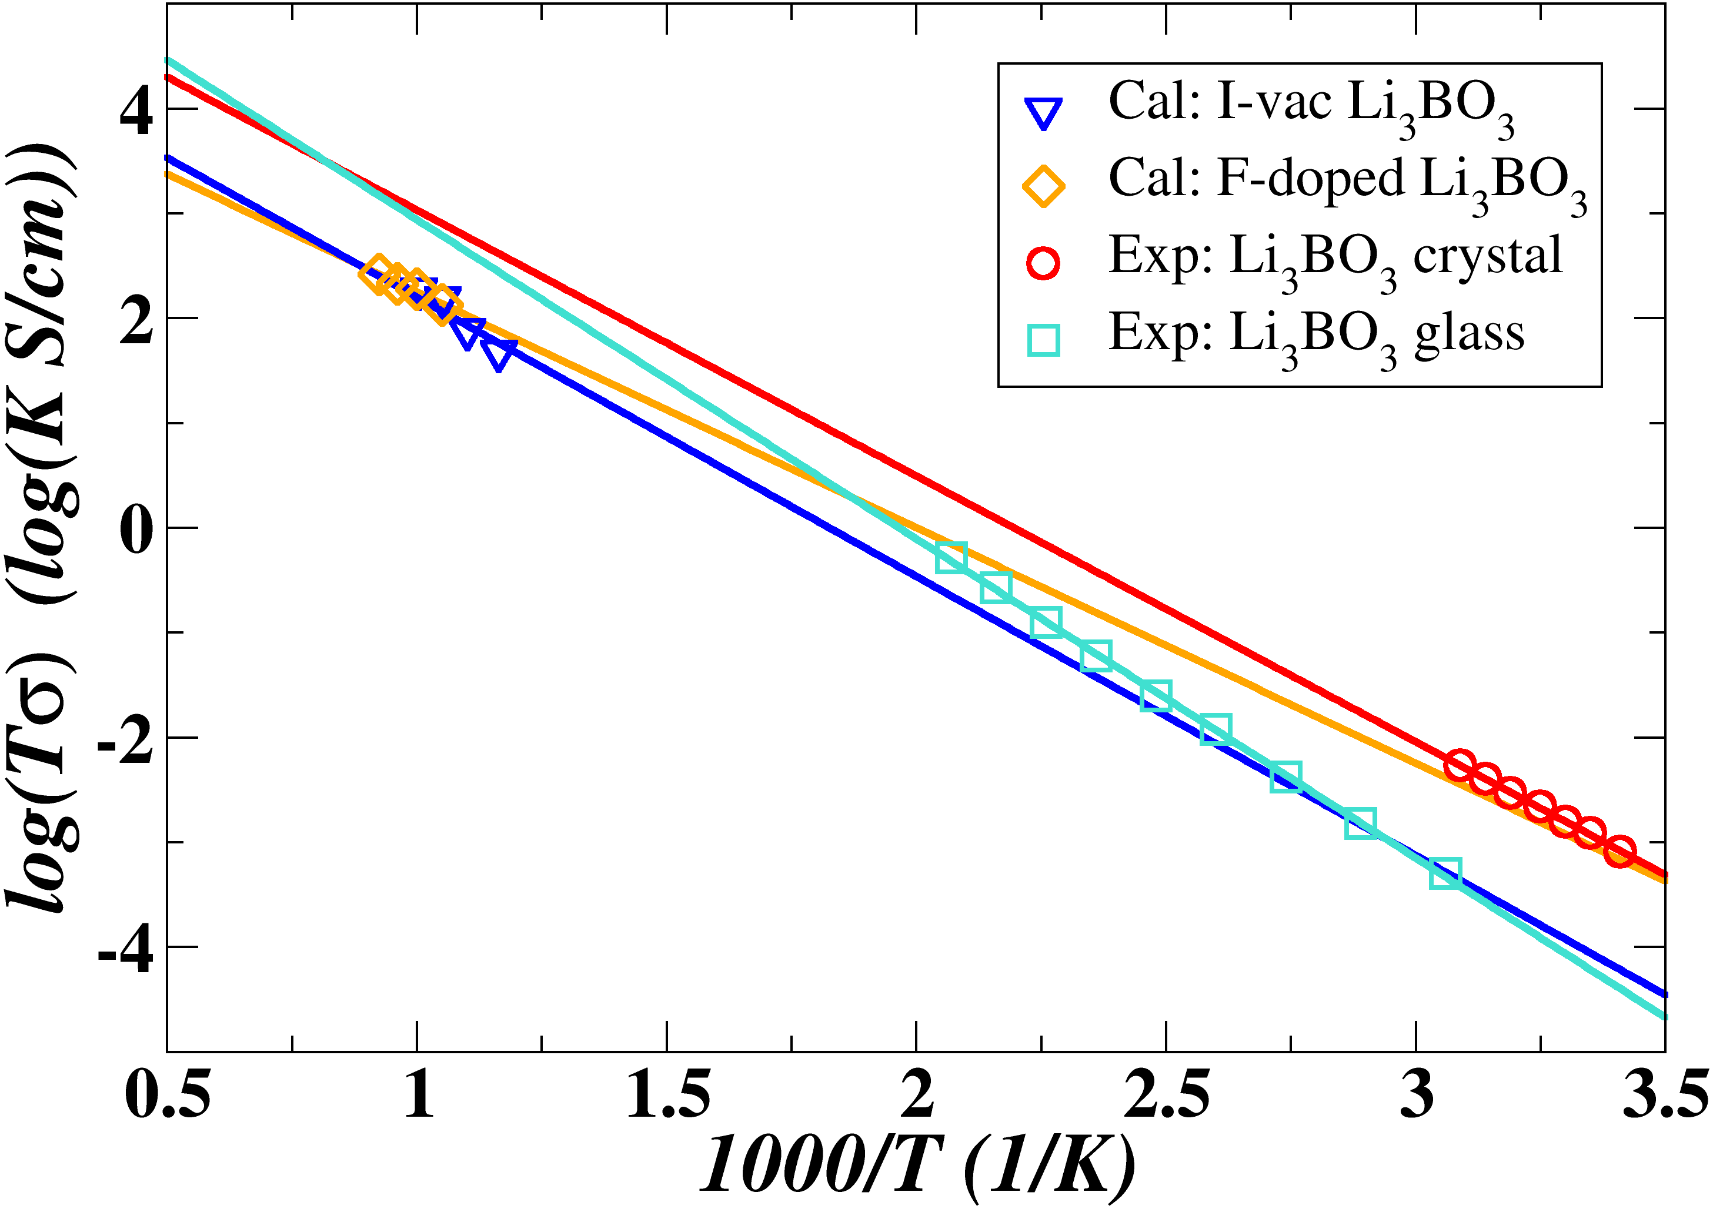
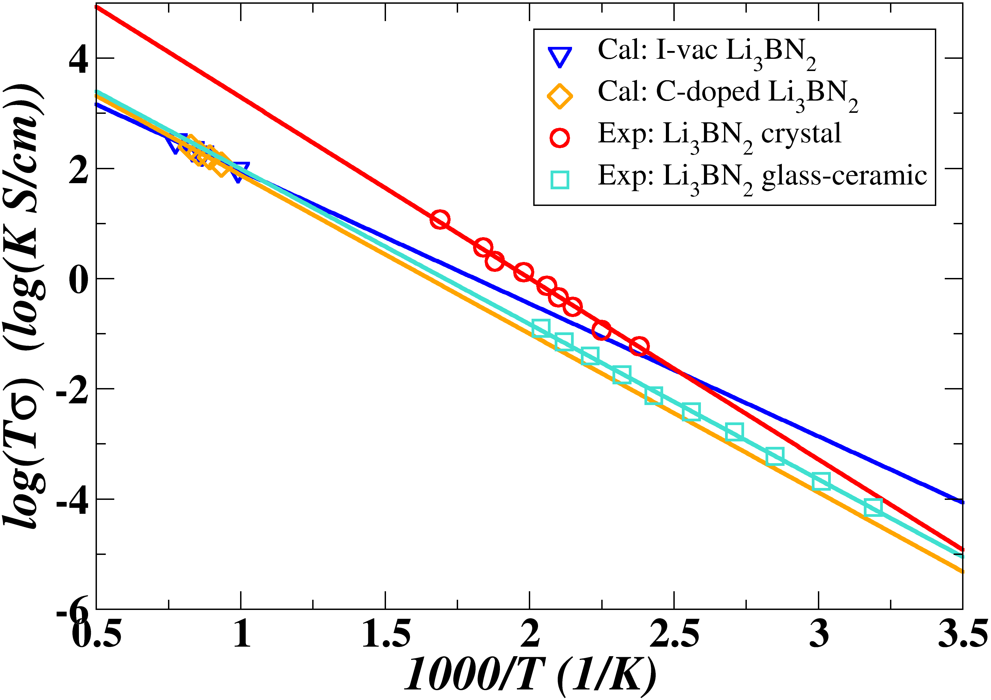
Ionic conductivities
Li₃BO₃
Li₃BN₂
Materials | Analysis | E_{a} | σ (T = 300 K)
I-vac Li₃BO₃ | MD | 0.53 | 3.2 x 10⁻⁷
 | NEB | 0.38 | --
F-doped Li₃BO₃ | MD | 0.45 | 3.4 x 10⁻⁶
 | NEB | 0.72 | --
Polycrystalline Li₃BO₃ | Exp¹ | 0.51 | $$\text{2.}\text{0} \text{x}\text{ 10−6}$$
Glassy Li₃BO₃ | Exp² | 0.60 | $$\text{3.4 }\text{x}\text{ 10−7}$$
Materials | Analysis | E_{a} | σ (T = 300 K)
I-vac Li₃BN₂ | MD | 0.48 | 7.2 x 10⁻⁷
 | NEB | 0.30 (a)/0.81 (bc) | --
C-doped Li₃BN₂ | MD | 0.57 | 4.8 x 10⁻⁸
 | NEB | 0.40 (a)/1.02 (bc) | --
Polycrystalline Li₃BN₂ | Exp² | 0.66 | $$\text{1}\text{.}\text{4} \text{x}\text{ 10−7}$$
Glassy-ceramic Li₃BN₂ | Exp³ | 0.56 | $$\text{1}\text{.}\text{1} \text{x}\text{ 10−7}$$
Exp¹: Ohta et al., J. of Power Sources 238, 53 (2013)
Exp²: Yamane et al., J. Solid State Chem. 71, 1 (1987)
Exp³: Shigeno et al., Solid State Ion. 339, 114985 (2019)
with

Slide 10
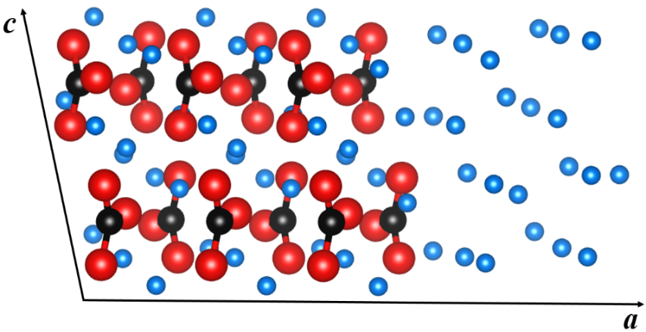
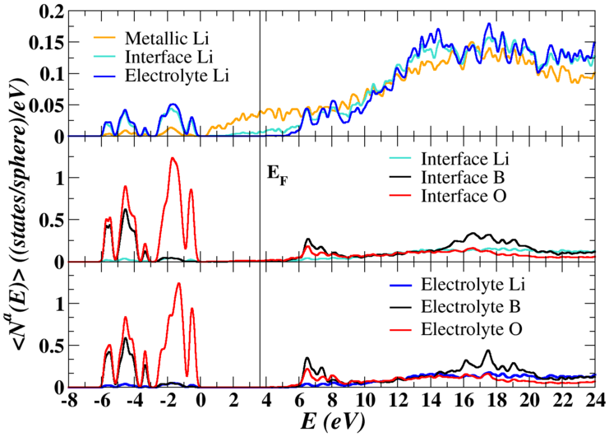
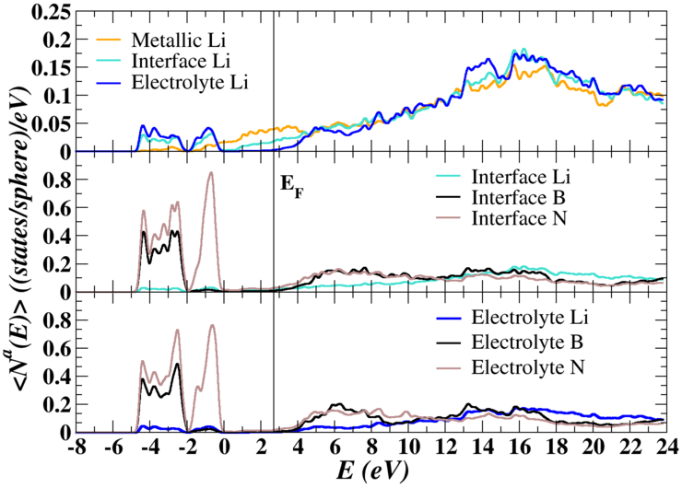
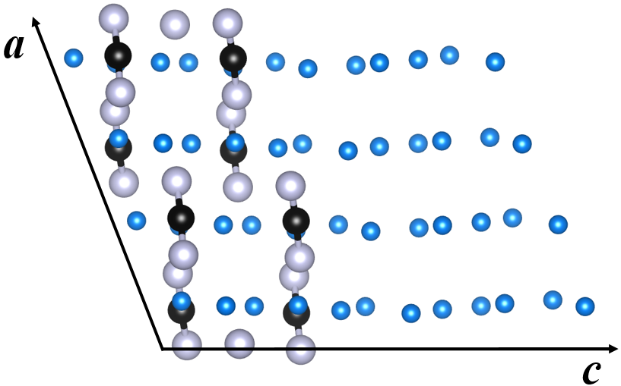
Interfaces with Li metal anode
Li
B
O
N
Predicted reactions:
Reaction: R → P | ∆U_{SL} | ∆F_{vib} | ∆F
 | 0.19 | 0.07 | 0.26
 | 0.64 | 0.08 | 0.72
 | 1.91 | 0.06 | 1.97
 | 1.38 | 0.07 | 1.45
Interface
Electrolyte
3x1x1 supercell of Li₃BO₃ and 24 metallic Li ions in [100] direction.
The interface energy:
Interface
Where σ denotes the strain factor.
a -- electrolytes; b -- Li
Electrolyte
σ(Li₃BO₃/Li) = 19 meV/Å²/Li
σ(Li₃BN₂/Li) = 0.11 meV/Å²/Li -- good compatibility
2x1x1 supercell of Li₃BN₂ and 24 metallic Li ions in [001] direction.

Slide 11
Summary
The imaginary phonon modes near the M point of the Brillouin zone suggested the structural instability of the reported tetragonal phase of α-Li₃BN₂.
The real α phase has an orthorhombic structure formed with twice as many formula units and very small adjustments of the fractional coordinates compared with the original analysis. Quasi-harmonic corrections further improve the comparisons with experiment.
Both NEB and MD simulations indicate that the Li ion migration in monoclinic crystals of Li₃BO₃ and β-Li₃BN₂ most likely proceeds via vacancy mechanisms.
To enhance the ionic conductivity, the practical methods include: 1) Varying the structural perfection to intentionally form poor-crystallinity material containing vacancy-interstitial defect pairs; 2) Substituting F for O in Li₃BO₃ and C for B in β-Li₃BN₂.
The plausible Li₃BO₃ /Li and β-Li₃BN₂/Li interfaces are found to be physically and chemically stable.

Slide 12
Acknowledgements
Prof. Natalie A. W. Holzwarth
(Wake Forest University)
Dr. Zachary D. Hood
(Argonne National Laboratory)
**Computations were performed on the Wake Forest University DEAC cluster, a centrally managed resource
with support provided in part by the University.
DE-AC02-06CH11357
DMR-1940324

