Slide 1
Li₁₄(PON₃)₂: Computational study of a possible
new electrolyte for Li ion batteries
Ahmad N.Al-Qawasmeh and N. A. W. Holzwarth*
Wake Forest University, Winston-Salem, NC, USA
*Research was supported by NSF DMR 1507942. Computations were performed on WFU’s DEAC cluster.

Slide 2
• Density functional theory with LDA approximation
• PAW formalism using datasets generated with ATOMPAW code (Holzwarth et al. CPC 135, 329 (2001))http://pwpaw.wfu.edu
• Electronic structure calculations performed using QUANTUM ESPRESSO . (Giannozzi et al. JPCM 21, 394402 (2009);http://www.quantum-espresso.org
• Plane wave expansion for wave functions with |k+G|² ≤ 64 Ry

Slide 3
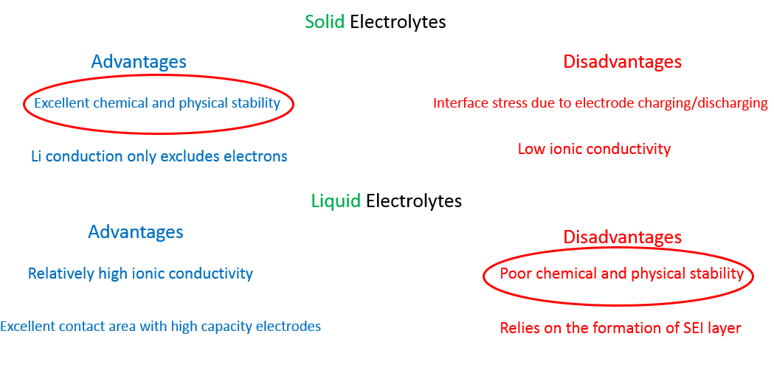
Solid Electrolyte materials

Slide 4
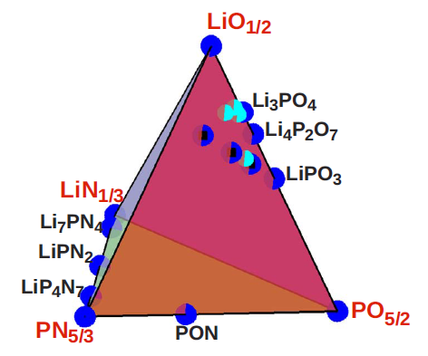
Li_{x}PO_{y}N_{z}
(x=2y+3z-5)
(Du,PHYSICAL REVIEW B 81, 184106,2010)

Slide 5
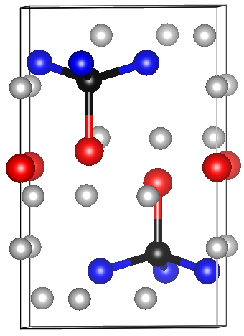
Li₁₄ (PON₃ )₂O: Computational study of a possible new electrolyte for Li ion batteries
trigonal, P3 (no. 147)
N
PON₃
P
The First LiPON material with PON₃
Tetrahedra .
O
Li
Li₂O
(Schnick,Eur. J. Inorg. Chem. 2015, 617-621 )

Slide 6
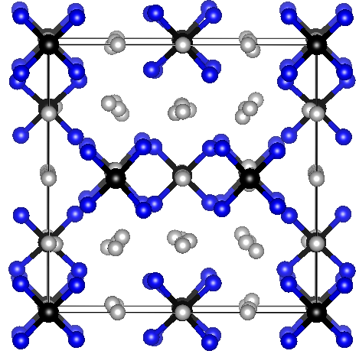
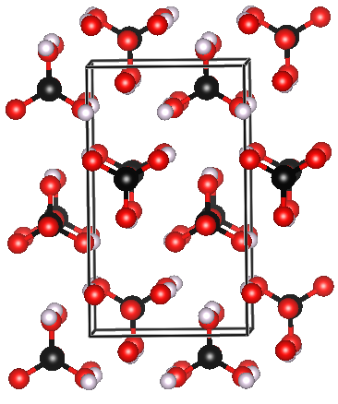
Comparison of different LiPON materials
trigonal, P3 (no. 147)
Li7PN4, cubic P43n (no. 218)
γ – Li₃PO₄ ,orthorhombic Pnma
N
P
O
Li
(Schnick,Eur. J. Inorg. Chem. 2015, 617-621 )
(Schnick ,J of solid state chemistry. 1990, 37,101 )
(Du,Phys Rev B 76, 174302)

Slide 7
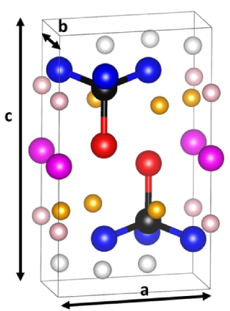
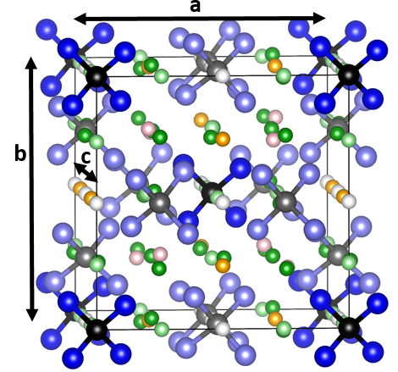
Structure analysis

Slide 8
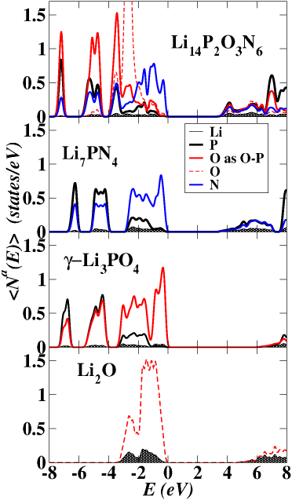
Electronic structure calculation
The valence band states are characterized by the 2p states of O and
N together with bonding combination of P 3s and 3p states, while the
N 2p dominates the top of the valence bands of the Li₁₄(PON₃)₂ .
The conduction band are characterized by the corresponding antibonding
states

Slide 9
Heat of decomposition calculation
Li₁₄P₂O₃N₆
3Li₂O + 2Li₃N+2LiPN₂
Products
∆H_{D} = - 2.93eV
Energy
Li₇PN₄
LiPN₂+2Li₃N
Compound
∆H_{D} = - 2.88 eV

Slide 10
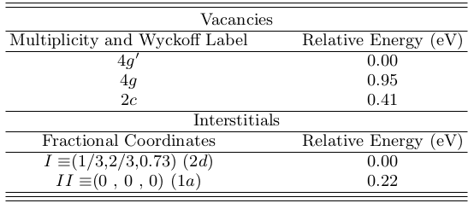
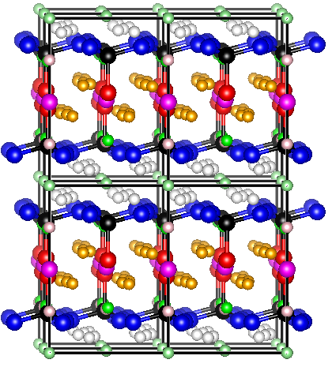
Li₁₄(PON₃)₂ : Li ion migration analysis
2d
1a
I
II
Formation Energy of 0.32 eV which involves
the pair ( g’-I ) .

Slide 11
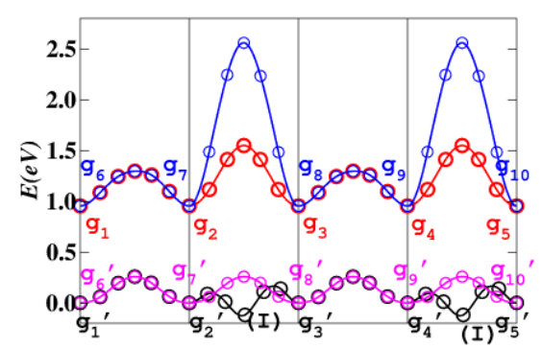
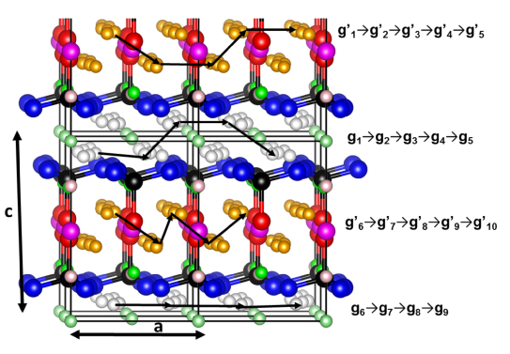
Li₁₄(PON₃)₂ : Li ion migration analysis
Vacancy mechanism

Slide 12
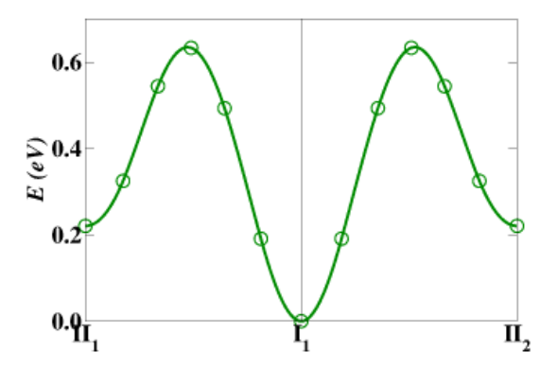
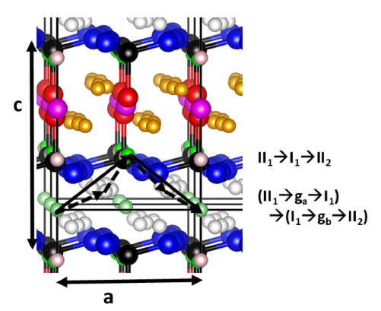
Li₁₄(PON₃)₂ : Li ion migration analysis
Interstitial mechanism

Slide 13
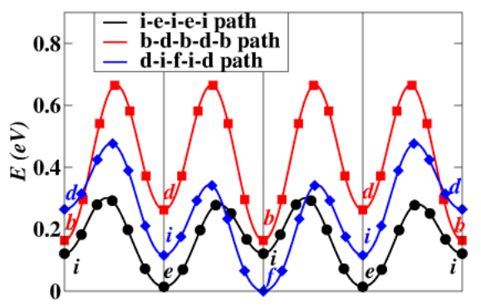
Li₇PN₄ : Li ion migration analysis

Slide 14
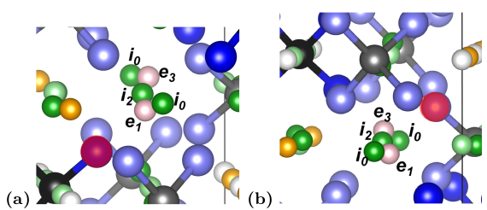
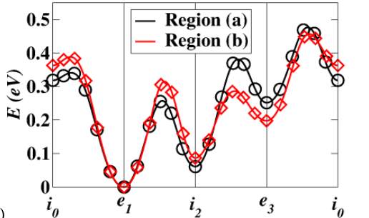
Li₇PN₄ : Li ion migration analysis

Slide 15
Li ion migration summary
Simulation
Experimental
Material | Mechanism | E_{f} (eV) | E_{m} (eV) | E_{m} +1/2 E_{f} (ev) | E_{A} (eV)
Li₁₄(PON₃)₂ | Vacancy | 0.3 | 0.3 | 0.4
Li₁₄(PON₃)₂ | Kick-out | 0.3 | 0.6 | 0.7
Li₇PN₄ | Vacancy | 1.9 | 0.3 | 1.3 | 0.48
Li₇PN₄ with O | Vacancy |  | 0.5 |  | 0.48
ϒ-Li₃PO₄ | Kick-out | 1.7 | 0.3 | 1.2 | 1.1 – 1.2
β-Li₃PO₄ | Kick-out | 2.1 | 0.4 | 1.5

Slide 16
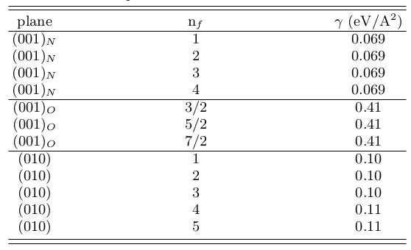
Li₁₄(PON₃)₂ : Interface with Vacuum
(001)_{N}
(001)_{O}
(001)_{N}

Slide 17
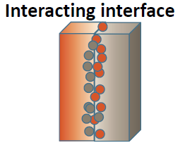
Li₁₄(PON₃)₂ : Interface with Li

Slide 18
Li₁₄(PON₃)₂ : Interface with Li
(Lepley, PHYSICAL REVIEW B 92, 214201 (2015))

Slide 19
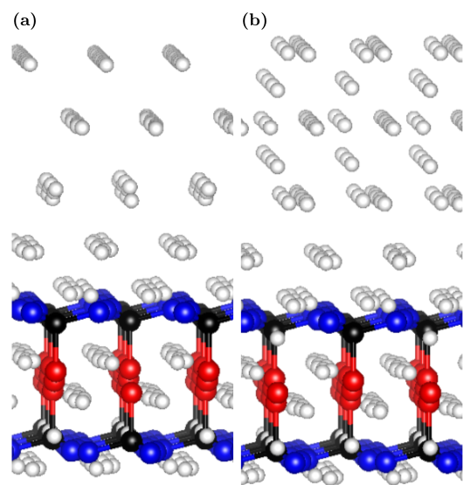
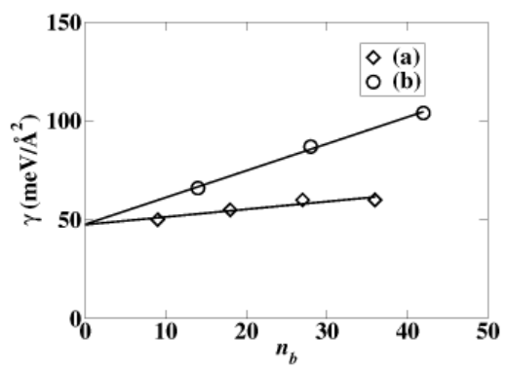
Li₁₄(PON₃)₂ : Interface with Li

Slide 20
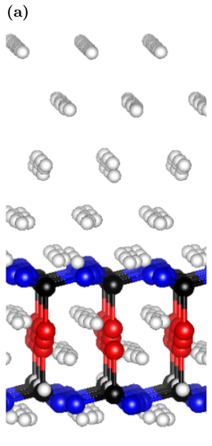
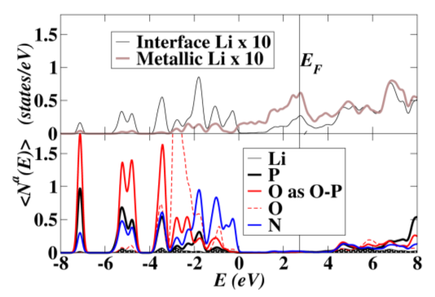
Li₁₄(PON₃)₂ : Interface with Li

Slide 21
Summary and Conclusions
This work report a computational study of the structural and electrolyte properties
of the Li₁₄(PON₃)₂ and Li₇PN₄ solid electrolyte materials .
The conduction process for these LiPON materials was dominated by the vacancy
mechanism in comparison to the kick-out mechanism in the Li₃PO₄ .
The calculated range of the activation energies for the Li₁₄(PON₃)₂ was found to be lower
than Li₇PN₄ and Li₃PO₄ indicating relatively good conduction properties .
Both Li₁₄(PON₃)₂ and Li₇PN₄ have a stable interface with metallic Li .

