Slide 1
First Principles Simulations to Understand the Structural and Electrolyte Properties of Idealized Li_{7.5}B₁₀S₁₈X_{1.5} (X = Cl, Br, I)
-- Li Superionic Conductors Recently Identified
in the Experimental Literature
Yan Li and N. A. W. Holzwarth, Wake Forest University, Winston-Salem, NC, USA
Acknowledgments: NSF DMR-1940324, WFU DEAC cluster
Motivation and background information
Structural model in comparison with experimental results
Stability considerations
Molecular dynamics simulation results on Li and X conductivity
Outlook
Notes:
This presentation follows #A3-0255 in computationally investigating promising solid-state Li ion electrolytes reported in the recent literature. This work is part of the Ph. D. thesis of Yan Li (graduating in Dec. 2021 from Wake Forest University, Department of Physics).

Slide 2
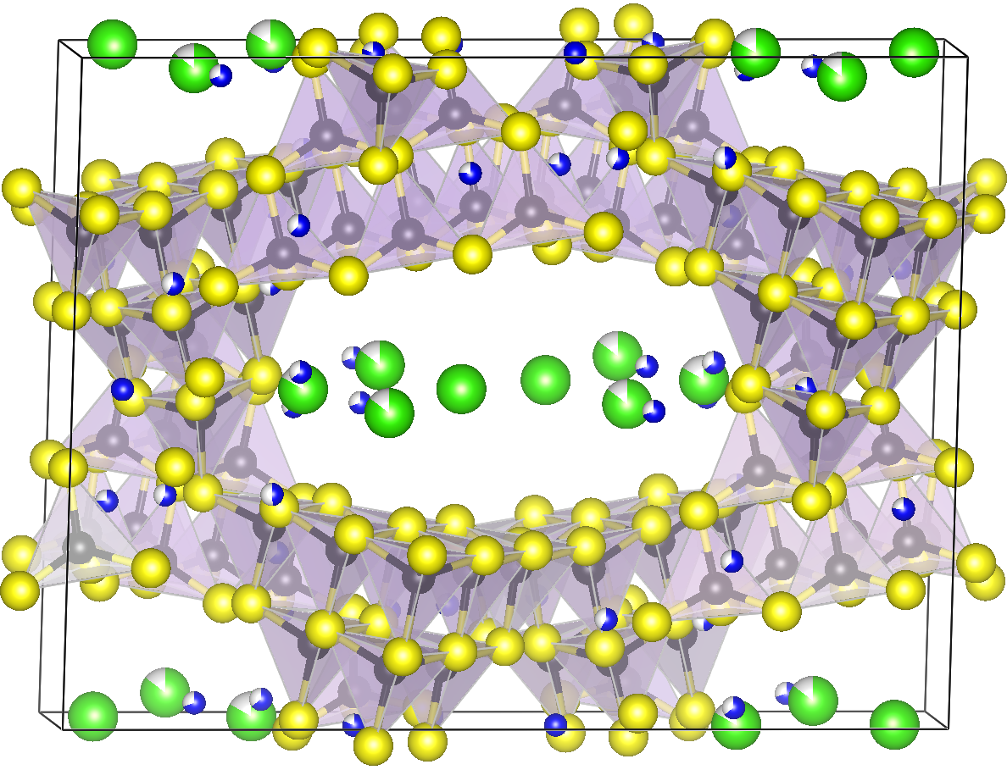
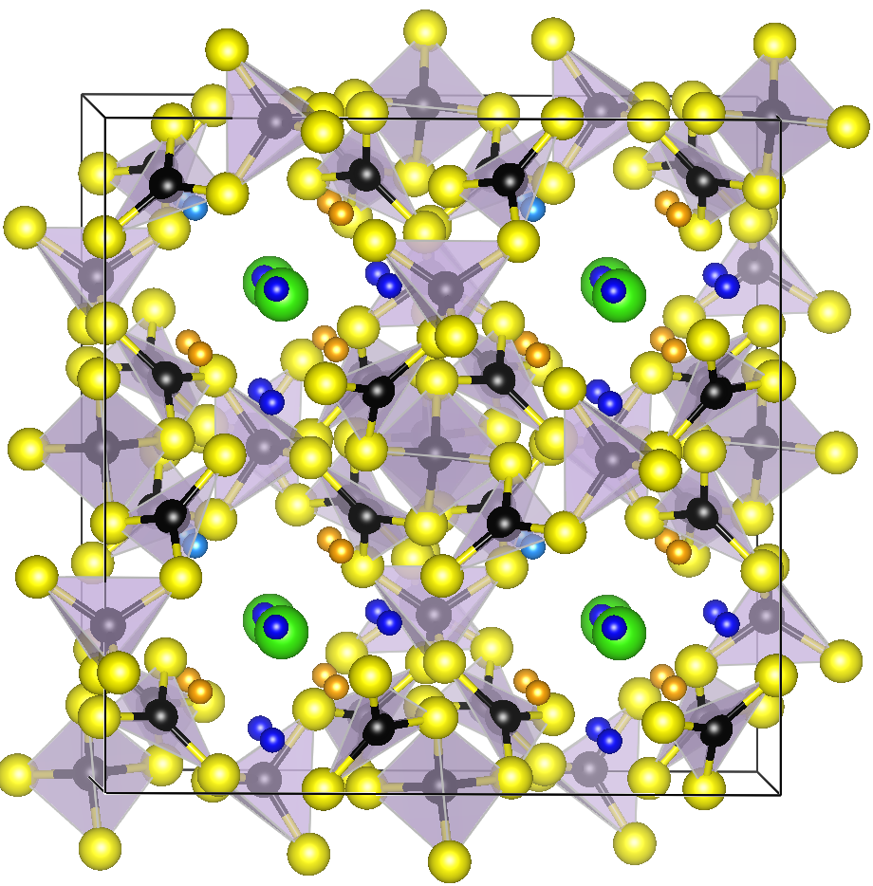
New fast Li ion electrolytes -- Li_{7.5}B₁₀S₁₈Cl_{1.5}
developed in 2020 by Kaup, Assoud, Liu, & Nazar, U. Waterloo and ORNL
Angew. Chem. Int. Ed. 2021, 60, 6975–6980
Modified Li₄B₇S₁₂Cl boracite
(discussed in talk A3-0255)
b=21.2 Å>a>c
a=b=c=14.9 Å
Notes:
Kavish Kaup, Abdeljalil Assoud, Jue Liu, and Linda F. Nazar from the University of Waterloo, ON, Canada and Oak Ridge National Laboratory, TN, USA, reported their findings in late 2020 on “Fast Li-Ion Conductivity in Superadamantanoid Lithium Thioborate Halides”, finding high ionic conductivities of up to 1.4 mS/cm at room temperature. The so-called supertetrahedral lithium thioborate halide materials have some common features with other materials that we have been studying related to lithium boracites and we were intrigued.

Slide 3
Comparison of the two projects
Similarities –
Same elemental constituents
BS_{x} framework + large voids for Li and Cl
Favorable Li ion conductivity
Li_{7.5}B₁₀S₁₈Cl_{1.5}
Li₄B₇S₁₂Cl
Supertetrahedral lithium thioborate halide
Lithium thioboracite
Differences:
Experimentally realized; chemically stable
Framework based on BS₄ tetrahedra
Low symmetry structure (monoclinic)
Large voids without obvious structure
148 ions in MD simulation cell (primitive C2/c lattice)
Not (yet) experimentally realized; chemical reactivity
Framework based on BS₄ + BS₃ units
Based on ordered rhombohedral structure
Structured voids
196 ions in MD simulation cell (similar to conventional fcc lattice)
Notes:
Here we list some similarities and differences of the two projects, from the viewpoint of computational materials physics simulations.

Slide 4
Computational methods
Detailed in talk A3-0255 -- based on density functional theory (DFT), using the Quantum Espresso code
Scalar relativistic effects were included in the PAW datasets for iodine ions
All simulations were performed using 148 ion primitive cell of the C2/c lattice. Results are reported in the conventional cell setting (296 ions/cell)
Determination of the idealized structures of Li_{7.5}B₁₀S₁₈X_{1.5} (X=Cl, Br, I)
For various reasons (including synthesis details and high ionic conductivity at room temperature), the structural analysis by Kaup et al. (Angew. Chem. Int. Ed. 2021, 60, 6975–6980) finds disorder on the Li and X sites. From the reported structural data, and systematic search methods, we found optimized ordered structural models consistent with the C2/c, space group #15 symmetry. The optimization was carried out for Cl first; optimizations for Br and I were based on the idealized Cl structure.
Notes:
The computational methods used in this work are the same as reported in A3-0255. While the search for the optimized ground state structure was not exhaustive, it was systematic and reasonably comprehensive, based on the assumption of an ordered structure with C2/c symmetry. Starting from the analysis of Kaup et al. (2021) for Li7.5B10S18Cl1.5, the fractional occupancies were adjusted. In this case, it was necessary to find 4 additional optimized Li sites, so that a systematic search for sites of 4f or 2e symmetry within the primitive cell were investigated. The computed optimized structure had an energy of at least 0.06 eV/primitive cell lower than the energies of the other candidate structures.

Slide 5
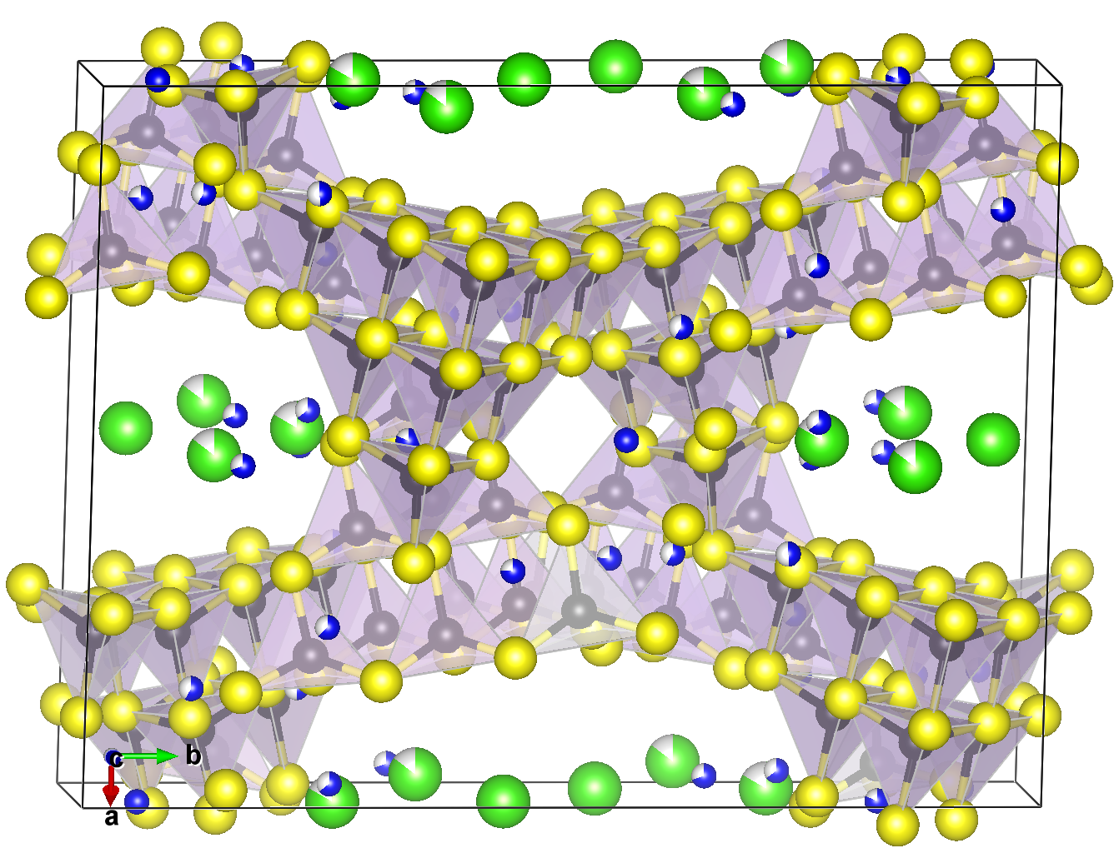
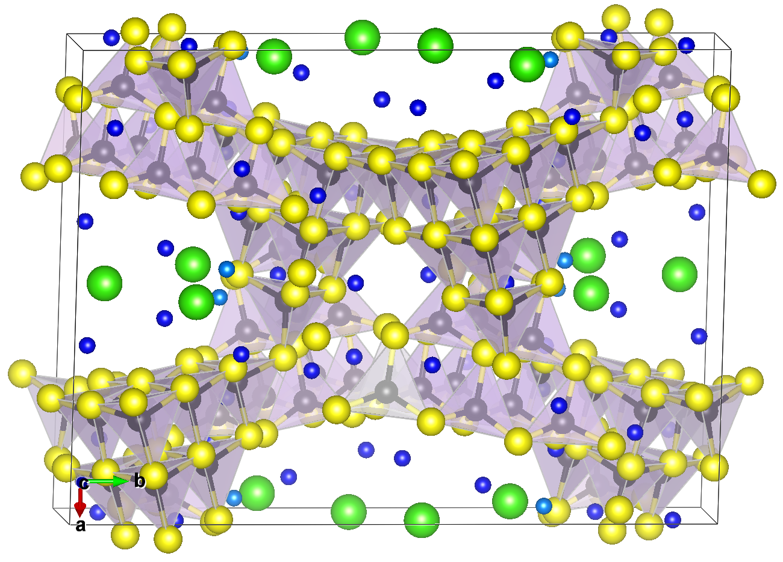
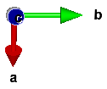
Structure of Li_{7.5}B₁₀S₁₈Cl_{1.5}
From experiment
From computation
Li_{7.5}B₁₀S₁₈Cl_{1.5} from Kaup et al. (2021)
Li_{7.5}B₁₀S₁₈Cl_{1.5} from DFT optimization
Notes:
This is a visualization of the structure deduced from diffraction data (left) compared with the optimized structure of Li7.5B10S18Cl1.5 (right).

Slide 6
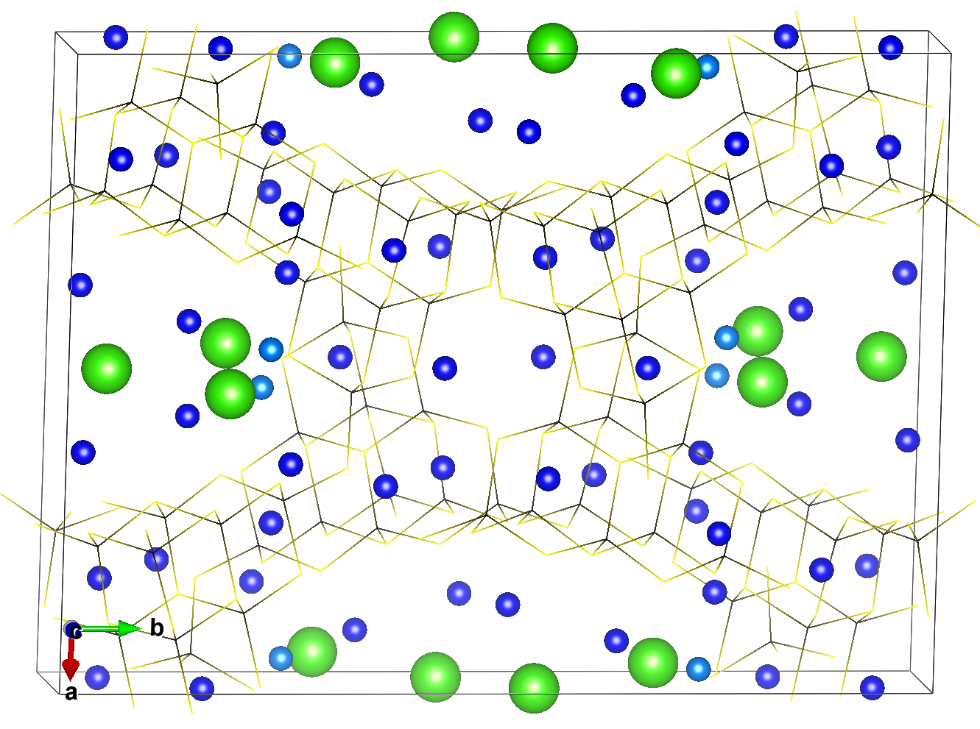
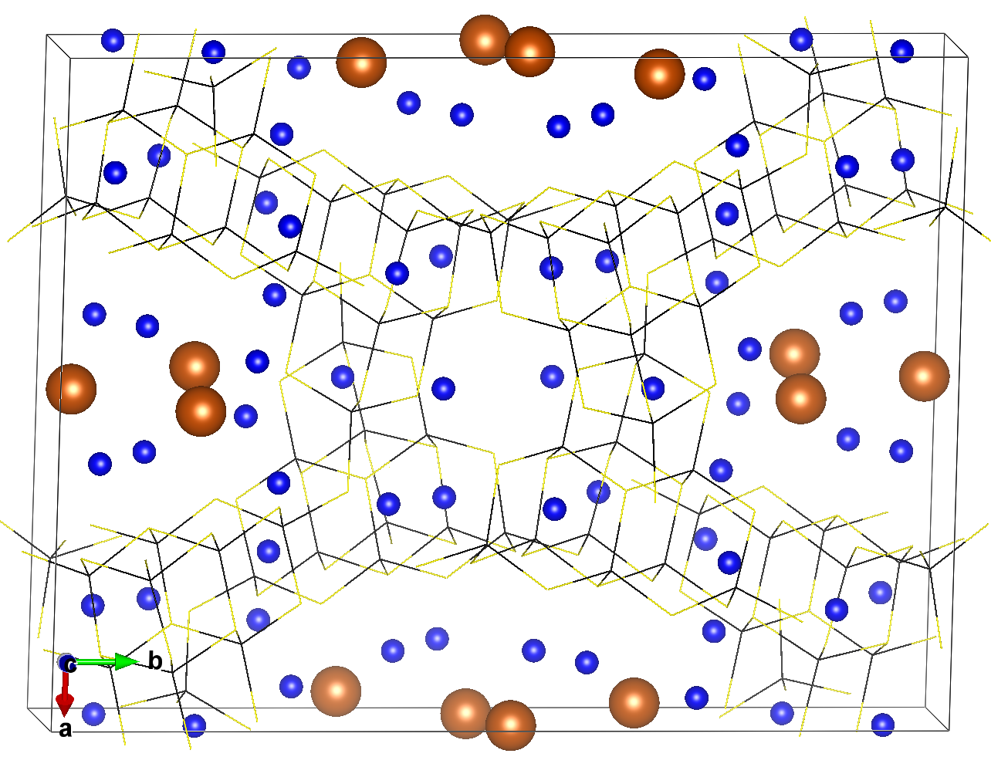
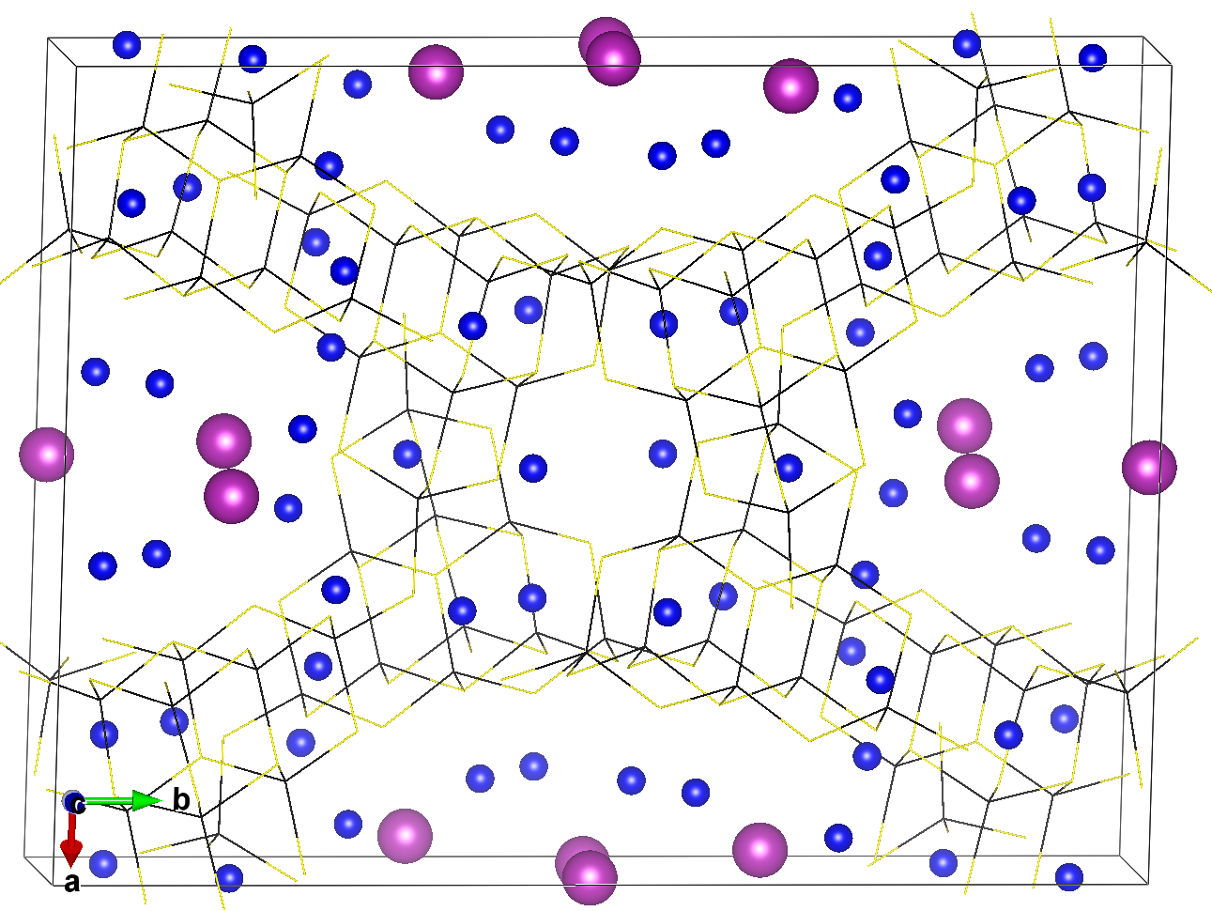
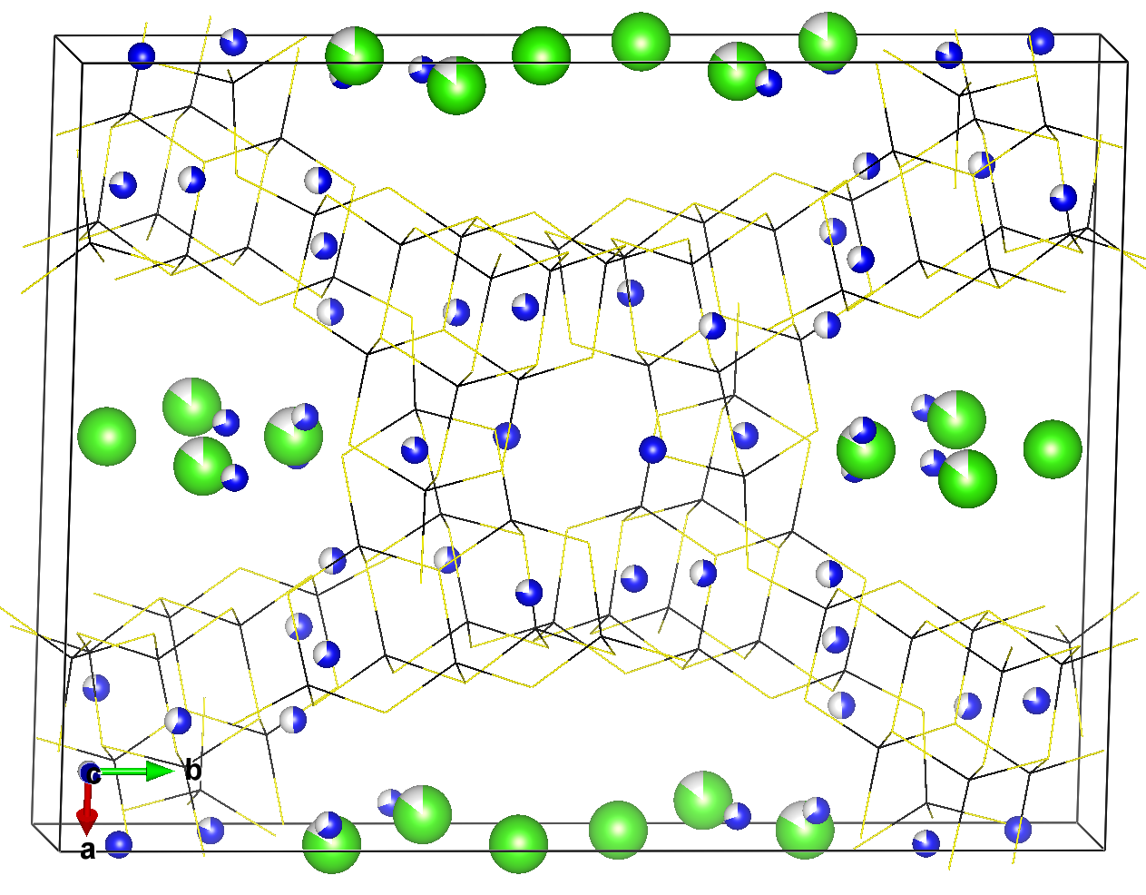
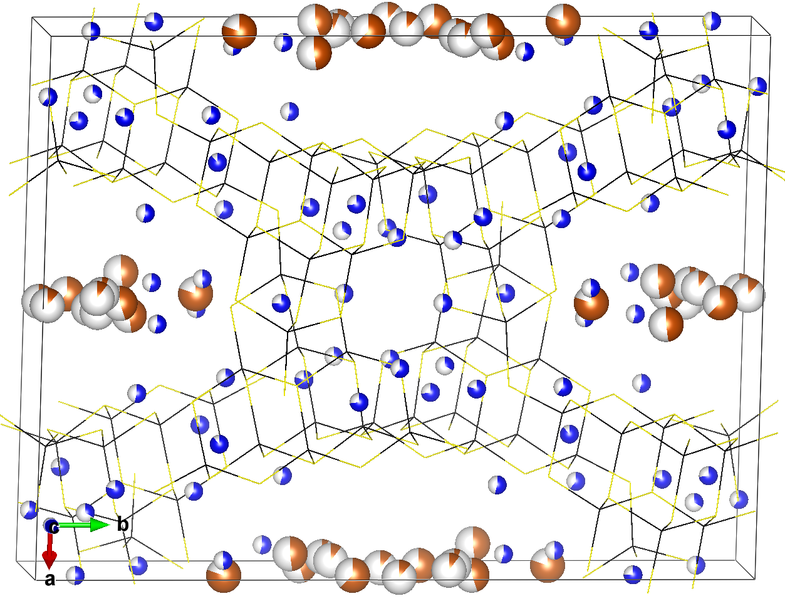
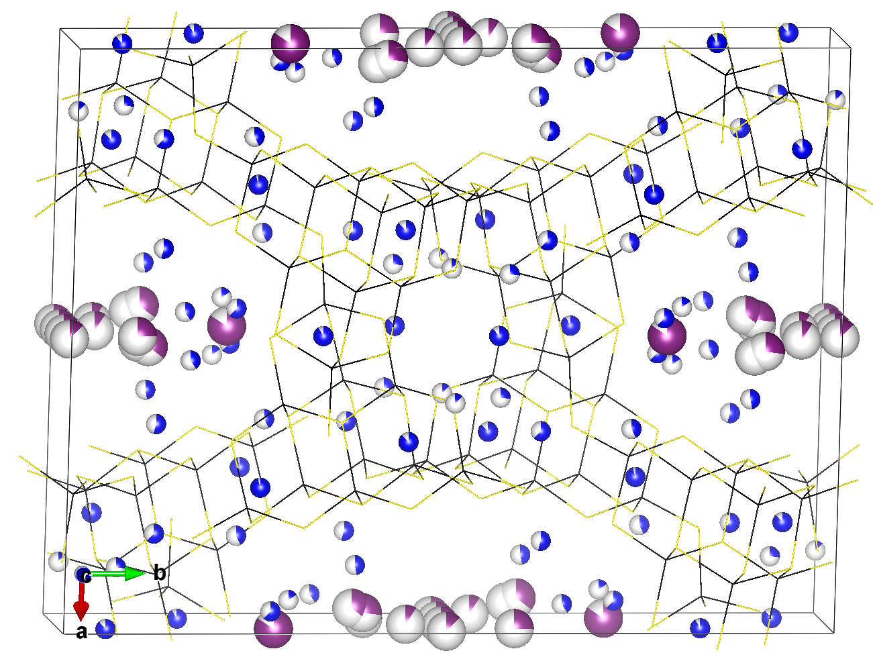
Structures of Li_{7.5}B₁₀S₁₈X_{1.5} (X=Cl, Br, I)
Li_{7.5}B₁₀S₁₈Cl_{1.5}
Li_{7.5}B₁₀S₁₈Br_{1.5}
Li_{7.5}B₁₀S₁₈I_{1.5}
From calc ➔
DFT opt
(at 0 K)
From
exp ➔
(at 300K)
Notes:
Summary of results for the three different halides, comparing computationally optimized structures (top row) with the structures deduced by Kaup et al. (2021) (lower row). In these figures, the Li and halide positions are indicated with colored balls while the thioborate structure is indicated with wireframes.

Slide 7
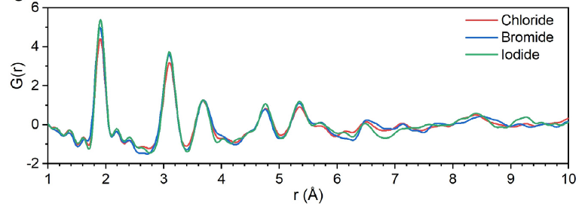
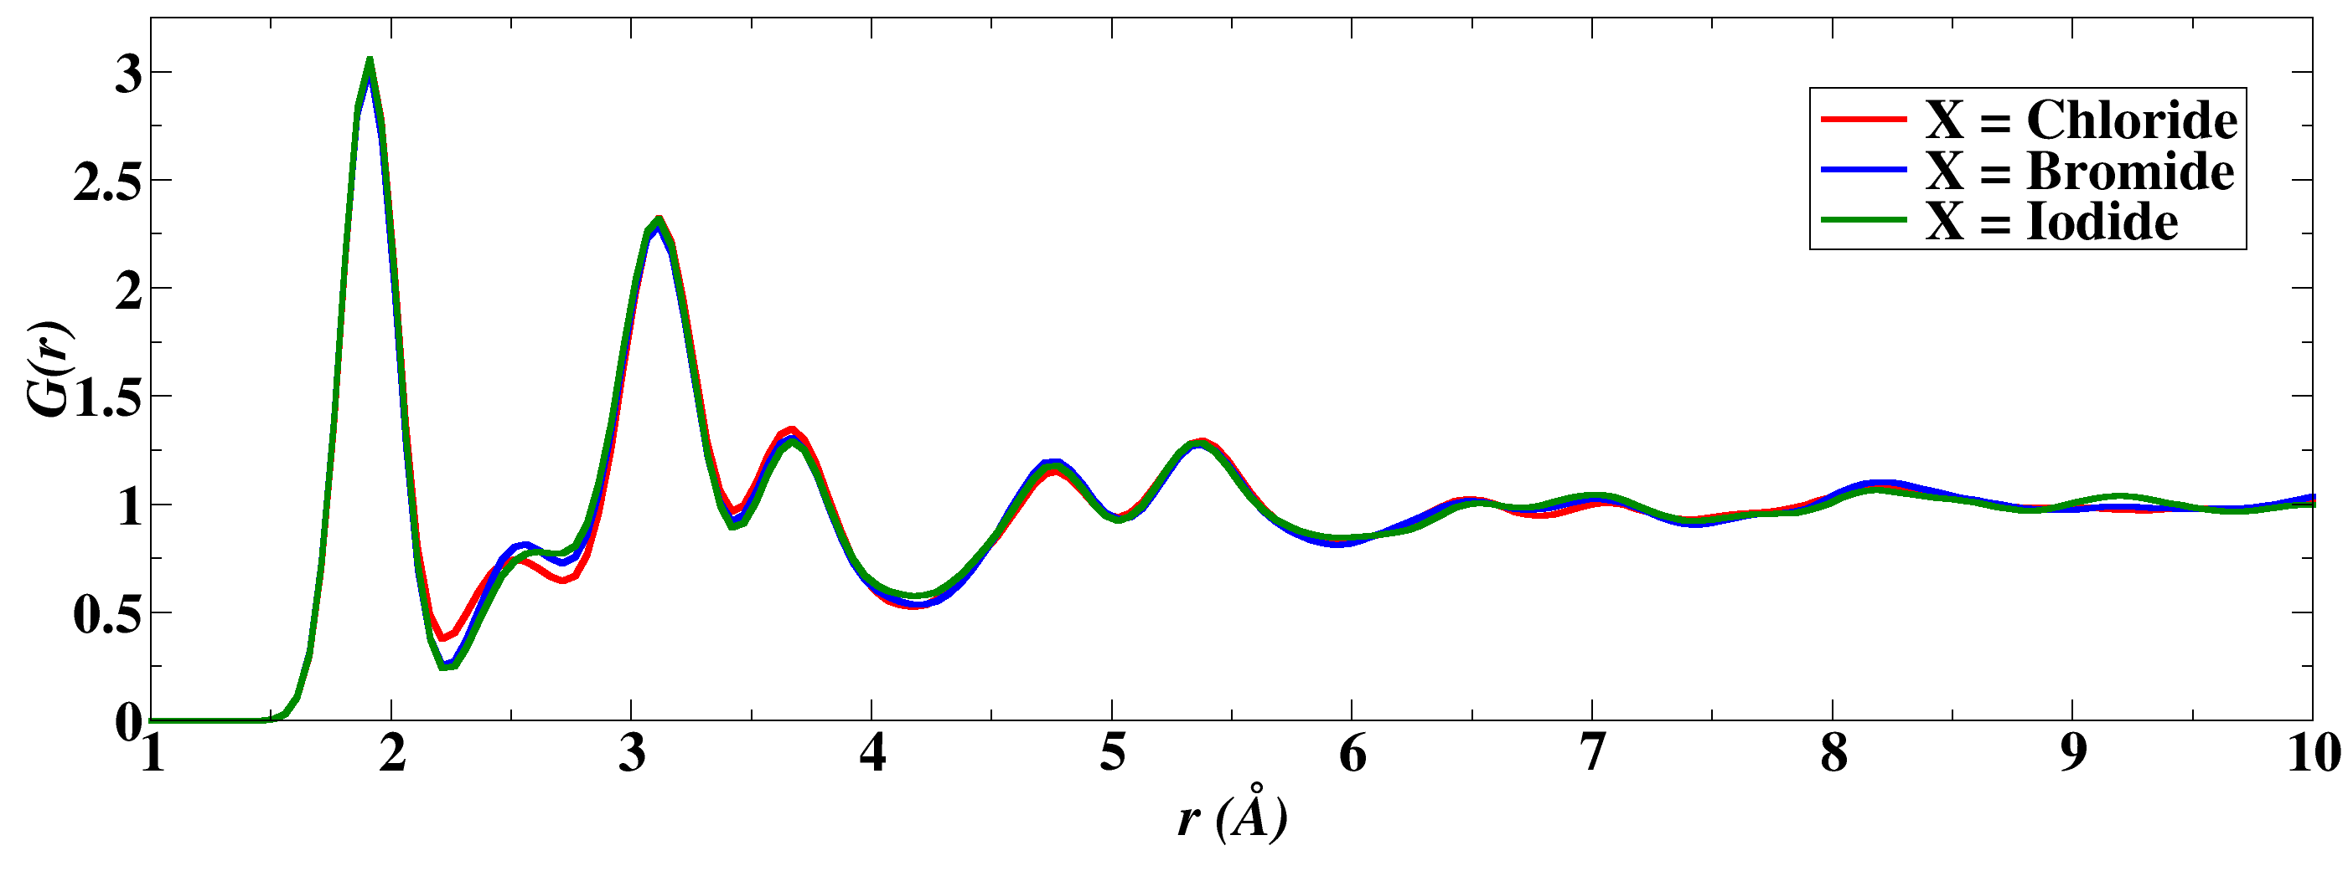
Numerical comparison of conventional lattice parameters of optimized (“cal”) and experimental* Li_{7.5}B₁₀S₁₈X_{1.5} (X=Cl, Br, I)
*Kaup et al. (2021)
Pair distribution analysis:
From neutron scattering
(Kaup et al.)
From molecular dynamics
simulations
(this work)
Notes:
Comparison of simulated and experimental lattice parameters. Also shown are the pair distribution functions for these materials, comparing results deduced from the experimental neutron diffraction by Kaup et al. with results calculated from molecular dynamics simulations at <T>=400 K, averaged over 30 pico seconds of simulation time. Interestingly, results for the three halides are very similar in both experiment and simulation., perhaps because the dominating effects are coming from the thioborate framework The simulation results are shown to capture the main features of the experimental results.

Slide 8
Computational estimate of chemical stability –
Based on DFT static lattice calculations, several decomposition pathways indicate endothermic reactions at equilibrium and suggest chemical stability of Li_{7.5}B₁₀S₁₈X_{1.5} for example --
Li_{7.5}B₁₀S₁₈Cl_{1.5} → 1.5LiCl + 5B₂S₃ + 3Li₂S - 0.8 eV
Li_{7.5}B₁₀S₁₈Cl_{1.5} → 1.5LiCl + 4B₂S₃ + 2Li₃BS₃ - 1.0 eV
Li_{7.5}B₁₀S₁₈Br_{1.5} → 1.5LiBr + 5B₂S₃ + 3Li₂S - 0.9 eV
Li_{7.5}B₁₀S₁₈Br_{1.5} → 1.5LiBr + 4B₂S₃ + 2Li₃BS₃ - 1.1 eV
Li_{7.5}B₁₀S₁₈I_{1.5} → 1.5LiI + 5B₂S₃ + 3Li₂S - 1.0 eV
Li_{7.5}B₁₀S₁₈I_{1.5} → 1.5LiI + 4B₂S₃ + 2Li₃BS₃ - 1.2 eV
Notes:
In order to address the likely stability of the lithium thioborate halide materials, we considered various decomposition reactions, estimating the reaction energies from the electronic total energies of the optimized ground state structures for each of the materials. The negative energy values of the results indicate that the lithium thioborate halide is energetically more stable than the sum of the given decomposition productions for these cases. While this is not an exhaustive study, together with the fact that the lithium thioborate halide materials have been realized experimentally is encouraging.

Slide 9
Assessing ion mobility in Li_{7.5}B₁₀S₁₈X_{1.5}
Å
*He, Zhu, & Mo, Nat. Comm. 8, 15893 (2017)
Notes:
In order to assess the ion mobility for the lithium thioborate halides, the molecular dynamics simulation results can be analyzed, Here we adapted the ideas of He, Zhu, and Mo to determine a probability density within each position r of the conventional unit cell based on the time fraction an ion of type “u” visits that position.

Slide 10
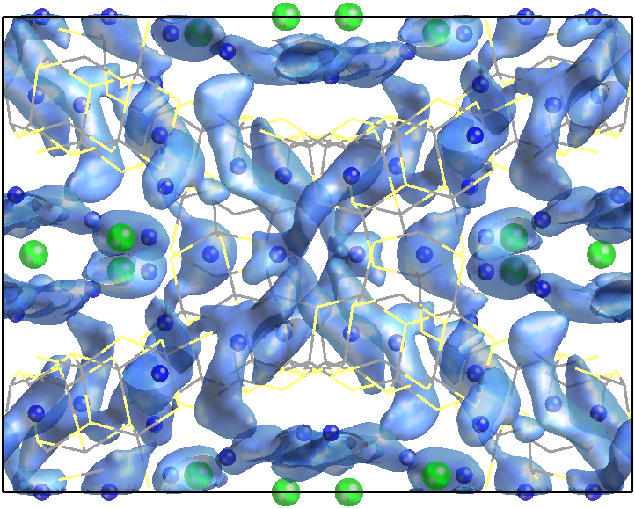
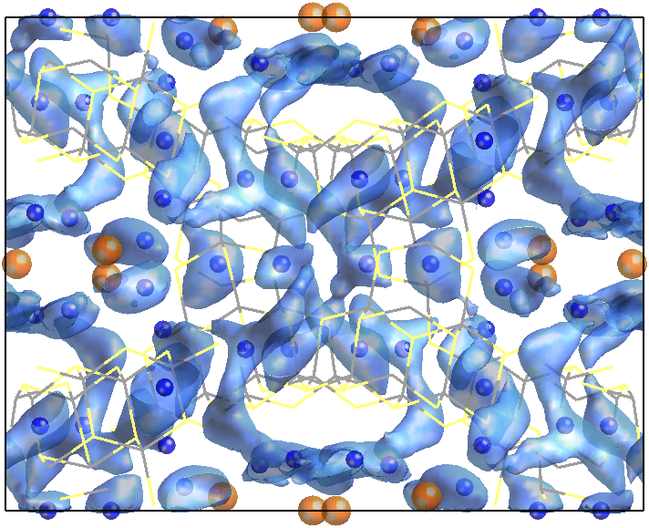
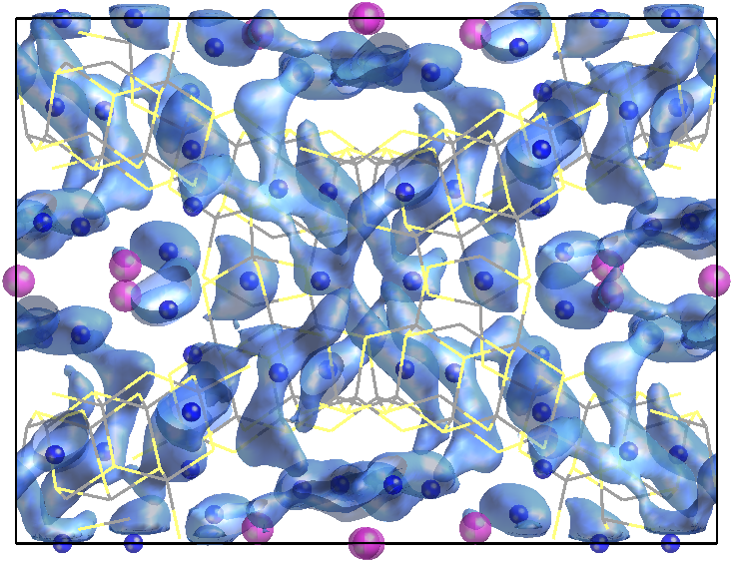
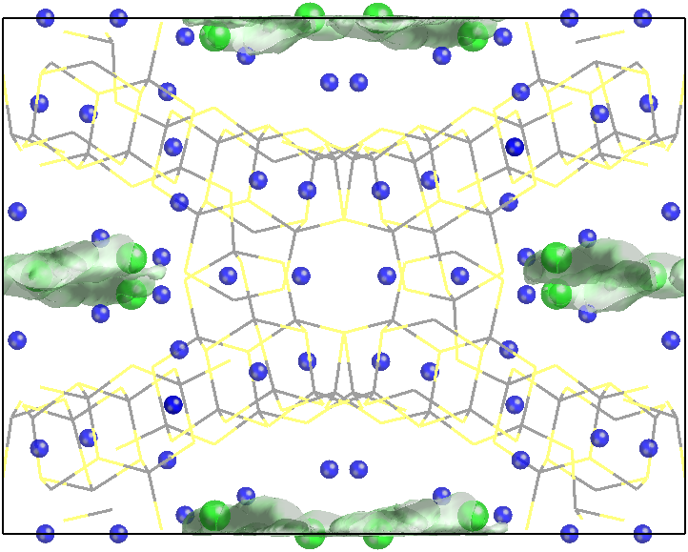
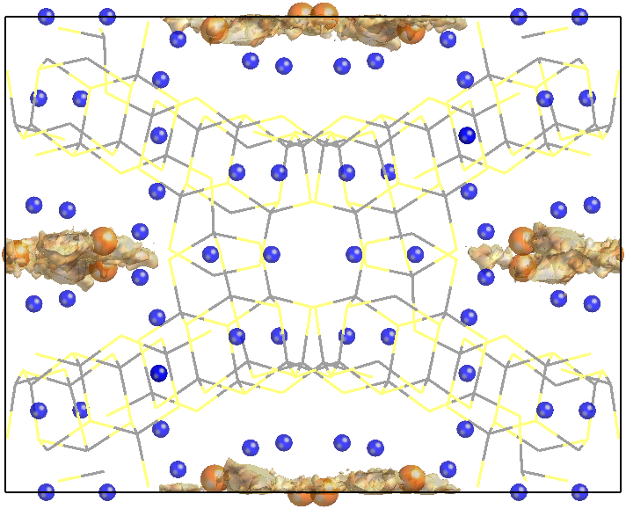
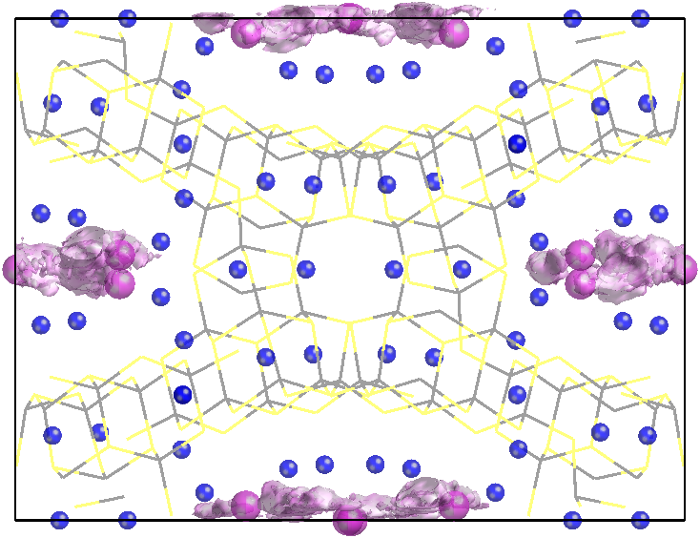
Isosurface plots of P^{u}(r)=0.04 Å⁻³ for Li_{7.5}B₁₀S₁₈X_{1.5} (X=Cl, Br, I)
visualized along the c-axis from MD simulations at ~800 K
Li_{7.5}B₁₀S₁₈Cl_{1.5}
Li_{7.5}B₁₀S₁₈Br_{1.5}
Li_{7.5}B₁₀S₁₈I_{1.5}
u=Li
u=X
Notes:
The results of the probability analysis are shown here in terms of the colored isosurfaces of constant probability values superposed on the optimized structural diagrams. The top row figures show the probability densities for Li, indicating very similar patterns for the three halides. The results suggest that all of the Li ions contribute to ionic current and move in all three dimensions throughout the crystals. The probability densities for the halides are shown in the bottom row, indicating limited motions confined within the void channels.

Slide 11
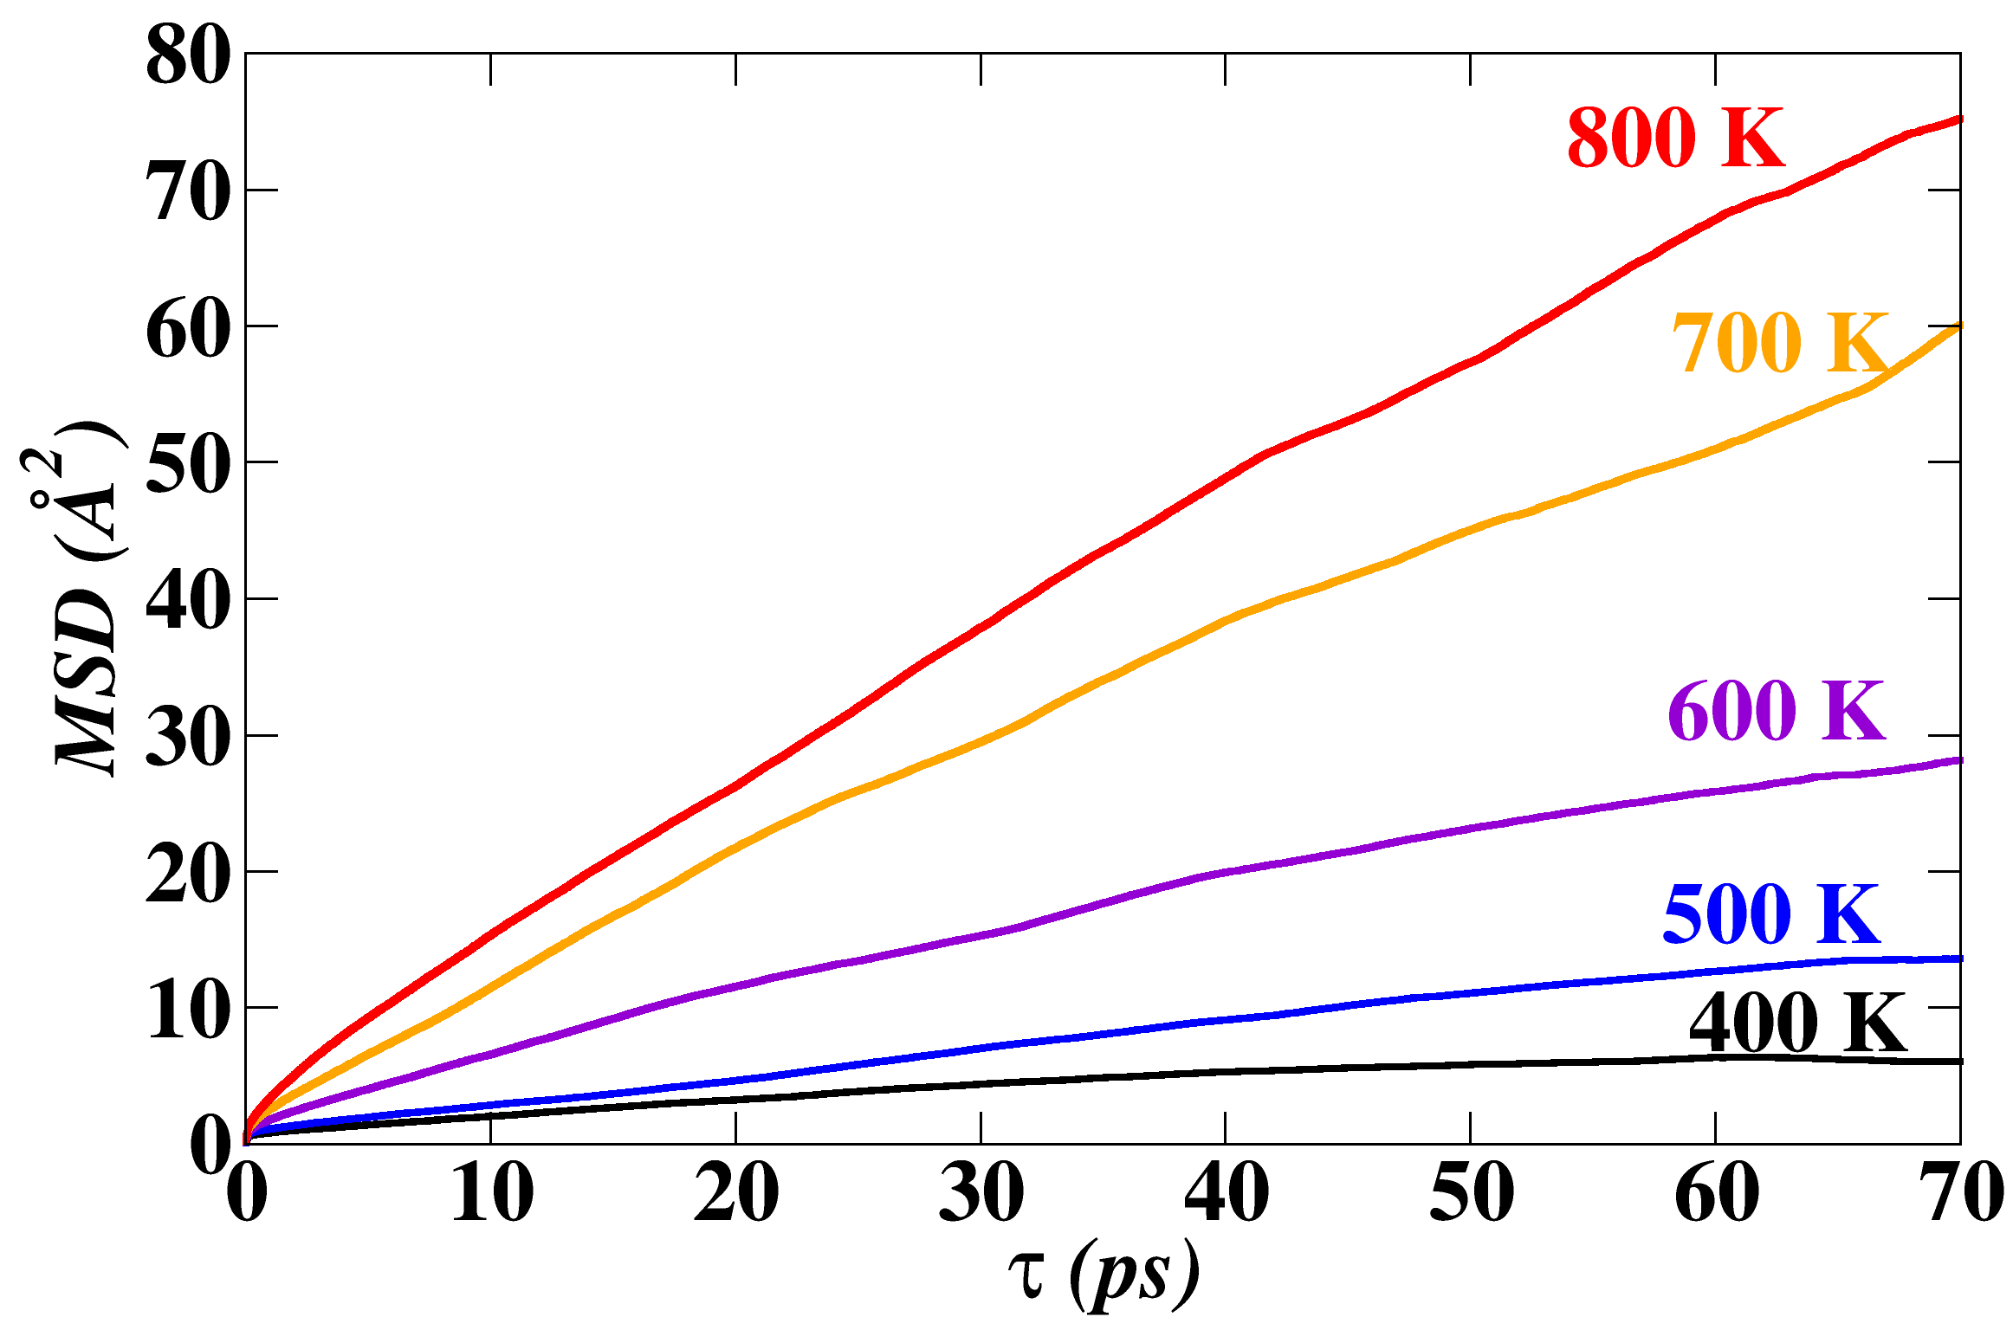
Mean squared displacements of Li ions from MD simulations
Li_{7.5}B₁₀S₁₈Cl_{1.5}
Notes:
It is possible to make a rough estimate of the ionic conductivity for Li by calculating the mean squared displacements within long molecular dynamics simulations. Here we show MSD results for simulations of Li7.5B10S18Cl1.5 averaged over time intervals of up to 70 pico seconds for five different average temperatures from 400K to 800K.

Slide 12
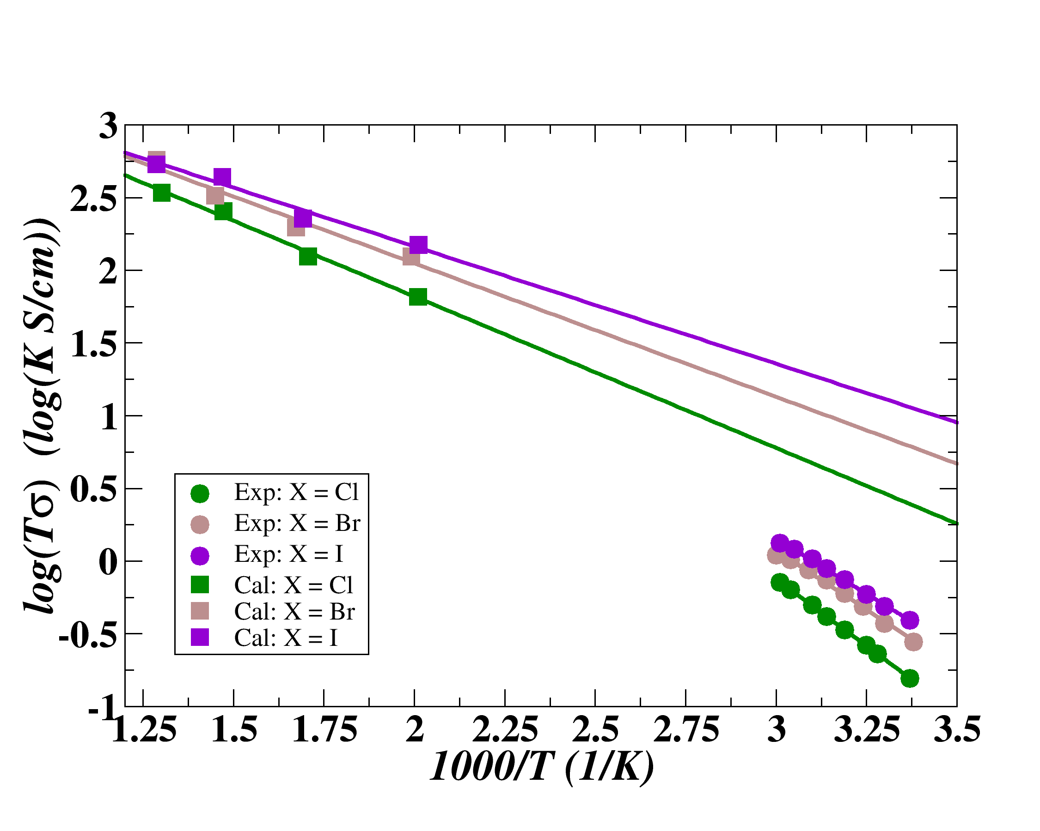
Preliminary results for Li ion conductivity from MD simulations in comparison with experimental conductivity measurements
From MD simulations --
MD simulations
Li_{7.5}B₁₀S₁₈I_{1.5}
Li_{7.5}B₁₀S₁₈Br_{1.5}
Li_{7.5}B₁₀S₁₈Cl_{1.5}
Activation energies E_{a}
halide | Cal (eV) | Exp (eV)
Cl | 0.21 | 0.36
Br | 0.18 | 0.33
I | 0.16 | 0.30
Exp.
(Kaup et al. 2021)
Notes:
Here we compare the Li ion conductivities estimated from the molecular dynamics results with the experimental results reported by Kaup et al. While the general trend of the computational results, including the higher conductivity for the iodine material are consistent with experiment, the quantitative comparison shows a large discrepancy. For example, measured room temperature conductivies are found to be 1 mS/cm while the simulated results are >10 times larger. More generally, the simulation results calculated with a Haven ratio of 1, over estimate the conductivities by more than a factor of 10. One possible reason for this discrepancy is that the Li ion motions are not independent as implied by the mean squared displacement estimate of the ionic diffusion.

Slide 13
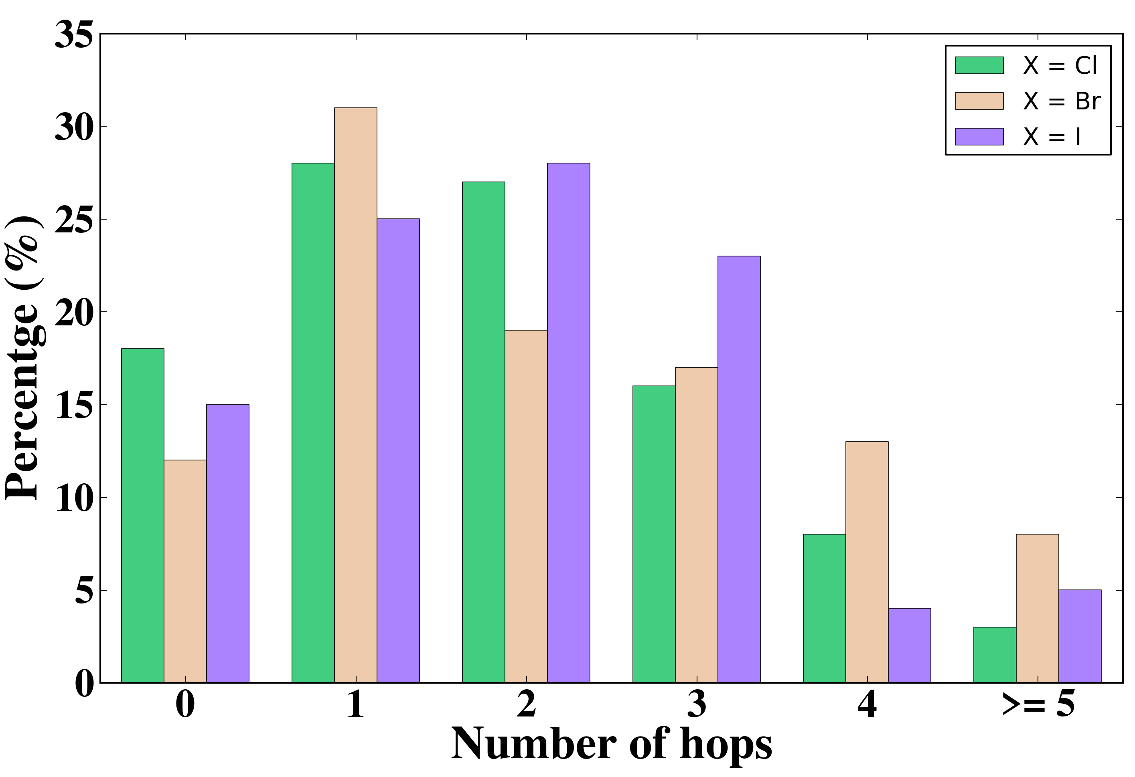
Assessment of Li ion correlations
from MD simulation trajectories at 800 K
100 time intervals of 0.5 ps each were analyzed in terms of the number of hopping events that occurred. Each hopping event was assessed on the basis of the equilibrium sites of the optimized lattice. A hopping event was tabulated at each arrival time of an ion at a new site.
Here we see that the percentage of time intervals experiencing 0 or 1 hops is less than the intervals experiencing 2 or more hops. This suggests concerted motion within a 0.5 ps time frame.
Histogram of numbers of Li ion hops within 0.5 ps time intervals
Notes:
Given that the Li ions travel throughout the crystal, there are many ways to analyze motion. One convenient method is to use the equilibrium positions found for the optimized structures as a basis for the analysis as described. In order to make the analysis more quantitative, the arrival time was indicated when the Li ion reached the shortest distance from its equilibrium site within a sphere of 1 Angstrom about that site. Li ions were only assigned a site label whenever they were within one of the equilibrium spheres.

Slide 14
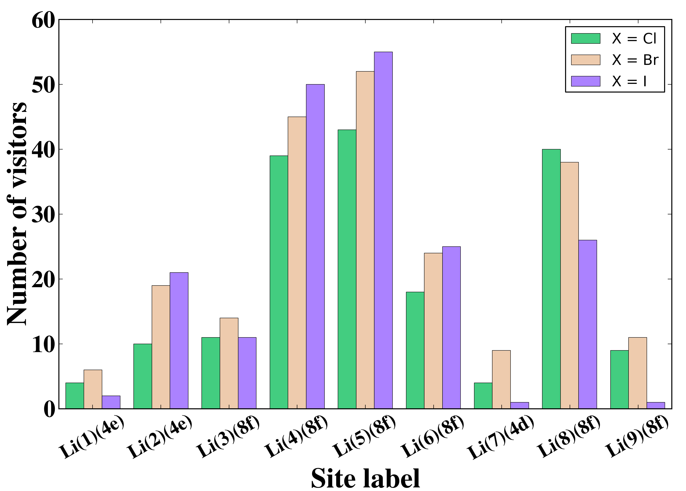
Further assessment of Li ion correlations from MD simulation trajectories at 800 K -- finding the most active sites --
Li #4
Li #5
Li #4
Li #5
Visualization of active Li sites for Li_{7.5}B₁₀S₁₈Cl_{1.5}
Notes:
From the hopping analysis, it could be determined which of the 9 symmetry inequivalent Li sites within the optimized structure experience the most hopping events. Here we find that sites #4 and #5 which are located within the large void channels seem to be the most active according to the simulation results at the 800 K simulation temperature.

Slide 15
Conclusions
Computationally determined plausible idealized structures for the Li_{7.5}B₁₀S₁₈X_{1.5} (X = Cl, Br, I) materials developed by Kaup et al. (2021), consistent with published X-ray and neutron diffraction analyses
Computed equilibrium total energies suggest chemical stability against decomposition
MD simulations show remarkable 3-dimensional Li ion mobility within the B₁₀S₁₈ framework at temperatures close to 400 K and higher.
Preliminary analysis of detailed MD trajectories suggests concerted mechanisms for the Li ion motions primarily within the void cavities.
Notes:
Simulation results based on idealized optimized structures of the lithium thioborate halide materials developed by Kaup et al. provide very encouraging evidence for high Li ion conductivity with promising prospects for use as solid state electrolytes in battery technology. The work completed so far encourages further simulation studies to better understand the details of their ionic conductivity.

