Slide 1
Progress on self-consistent
meta-gga PAW datasets from ATOMPAW
Natalie Holzwarth, Physics Dept., Wake Forest U.
Winston-Salem, NC, USA
Collaborators: Marc Torrent, CEA
also Michel Côté and Surya Timilsina, U. Montreal
Acknowledgements: NSF DMR-1940324, WFU DEAC cluster
Outline
Motivation and brief history
Numerical issues associated with SCAN functional
Self-consistent atomic solver and results for r2SCAN
Pseudopotential construction methods for meta-GGA and results for r2SCAN
Summary and outlook

Slide 2
To do list
Develop a self-consistent all electron atomic solver for the generalized Kohn-Sham equations needed to evaluate exchange-correlation functionals having the meta-GGA form.
Adapt pseudization schemes for basis and projector functions for use in the generalized Kohn-Sham formalism.
Test and evaluate.

Slide 3
Motivation and brief history –
As density functional theory develops, new exchange correlation functionals are frequently proposed and, thanks to Libxc (Marques et al. Comp. Phys. Comm. 183, 2272 (2012), Lehtola et al. Software X 7, 1 (2018)), they can be incorporated into various codes.
The meta-GGA functional form adds the kinetic energy density into the functional; considerable improvements in DFT prediction of materials properties has been reported within the context of “generalized” DFT (Yang et al. PRB 93, 205205 (2016))
“SCAN” form of meta-GGA -- “Strongly Constrained and Appropriately Normed Semilocal Density Functional” (Sun et al. PRL 115, 036402 (2015)) demonstrates improved materials prediction for a variety of systems; >950 citations as of 5/2021.

Slide 4
Motivation and brief history – continued --
However, most of the SCAN results were obtained using codes with localized basis sets or VASP which appears to use a special form of SCAN functional.
Several authors reported numerical difficulties in using plane wave codes with the SCAN functional (Yao et al. JCP 146, 224105 (2017), Bartók et al. JCP 150, 161101 (2019) & rSCAN)
We found that the effective potentials for the SCAN form analytically diverges in regions of space where the radial wavefunction decreases exponentially.
A revised functional was introduced by the Tulane and Temple groups (“Accurate and Numerically Efficient r2SCAN Meta-Generalized Gradient Approximation”, Furness et al., J. Phys. Chem. Lett 11, 8208 (2020)).

Slide 5
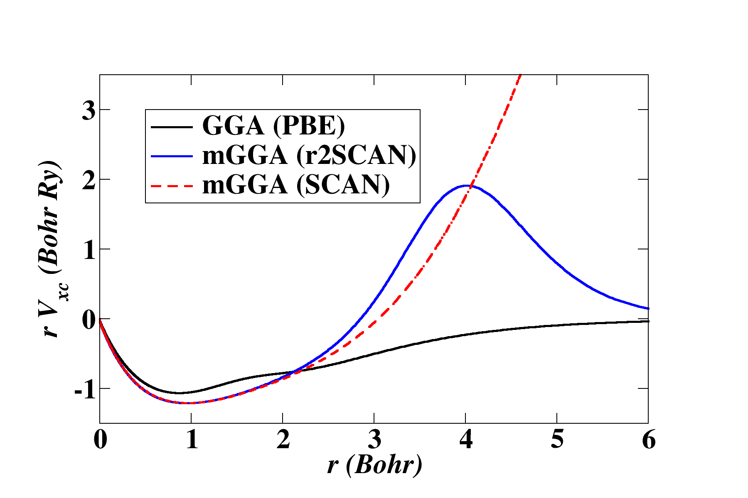
Functional form of V_{xc}(r) for textbook model of He atom
thanks to L. Schiff,
Quantum Mechanics
(1955)
Unphysical behavior of V_{xc}(r) for SCAN
discouraged further development.
Better behavior of V_{xc}(r) for r2SCAN allowed for resumption of project.

Slide 6
With the introduction of the r2SCAN functional,
work on developing a self-consistent atomic solver for meta-GGA formalism resumed.
dimensionless
“kinetic potential”

Slide 7
Some details for spherical atom
occupancy for state n_{i}l_{i}

Slide 8
Differential equations to solve numerically
in ATOMPAW

Slide 9
Some further details –
In developing the self-consistent atomic solver, we found some further numerical issues with r2SCAN which could be ameliorated by making one further small change in the formulation.

Slide 10
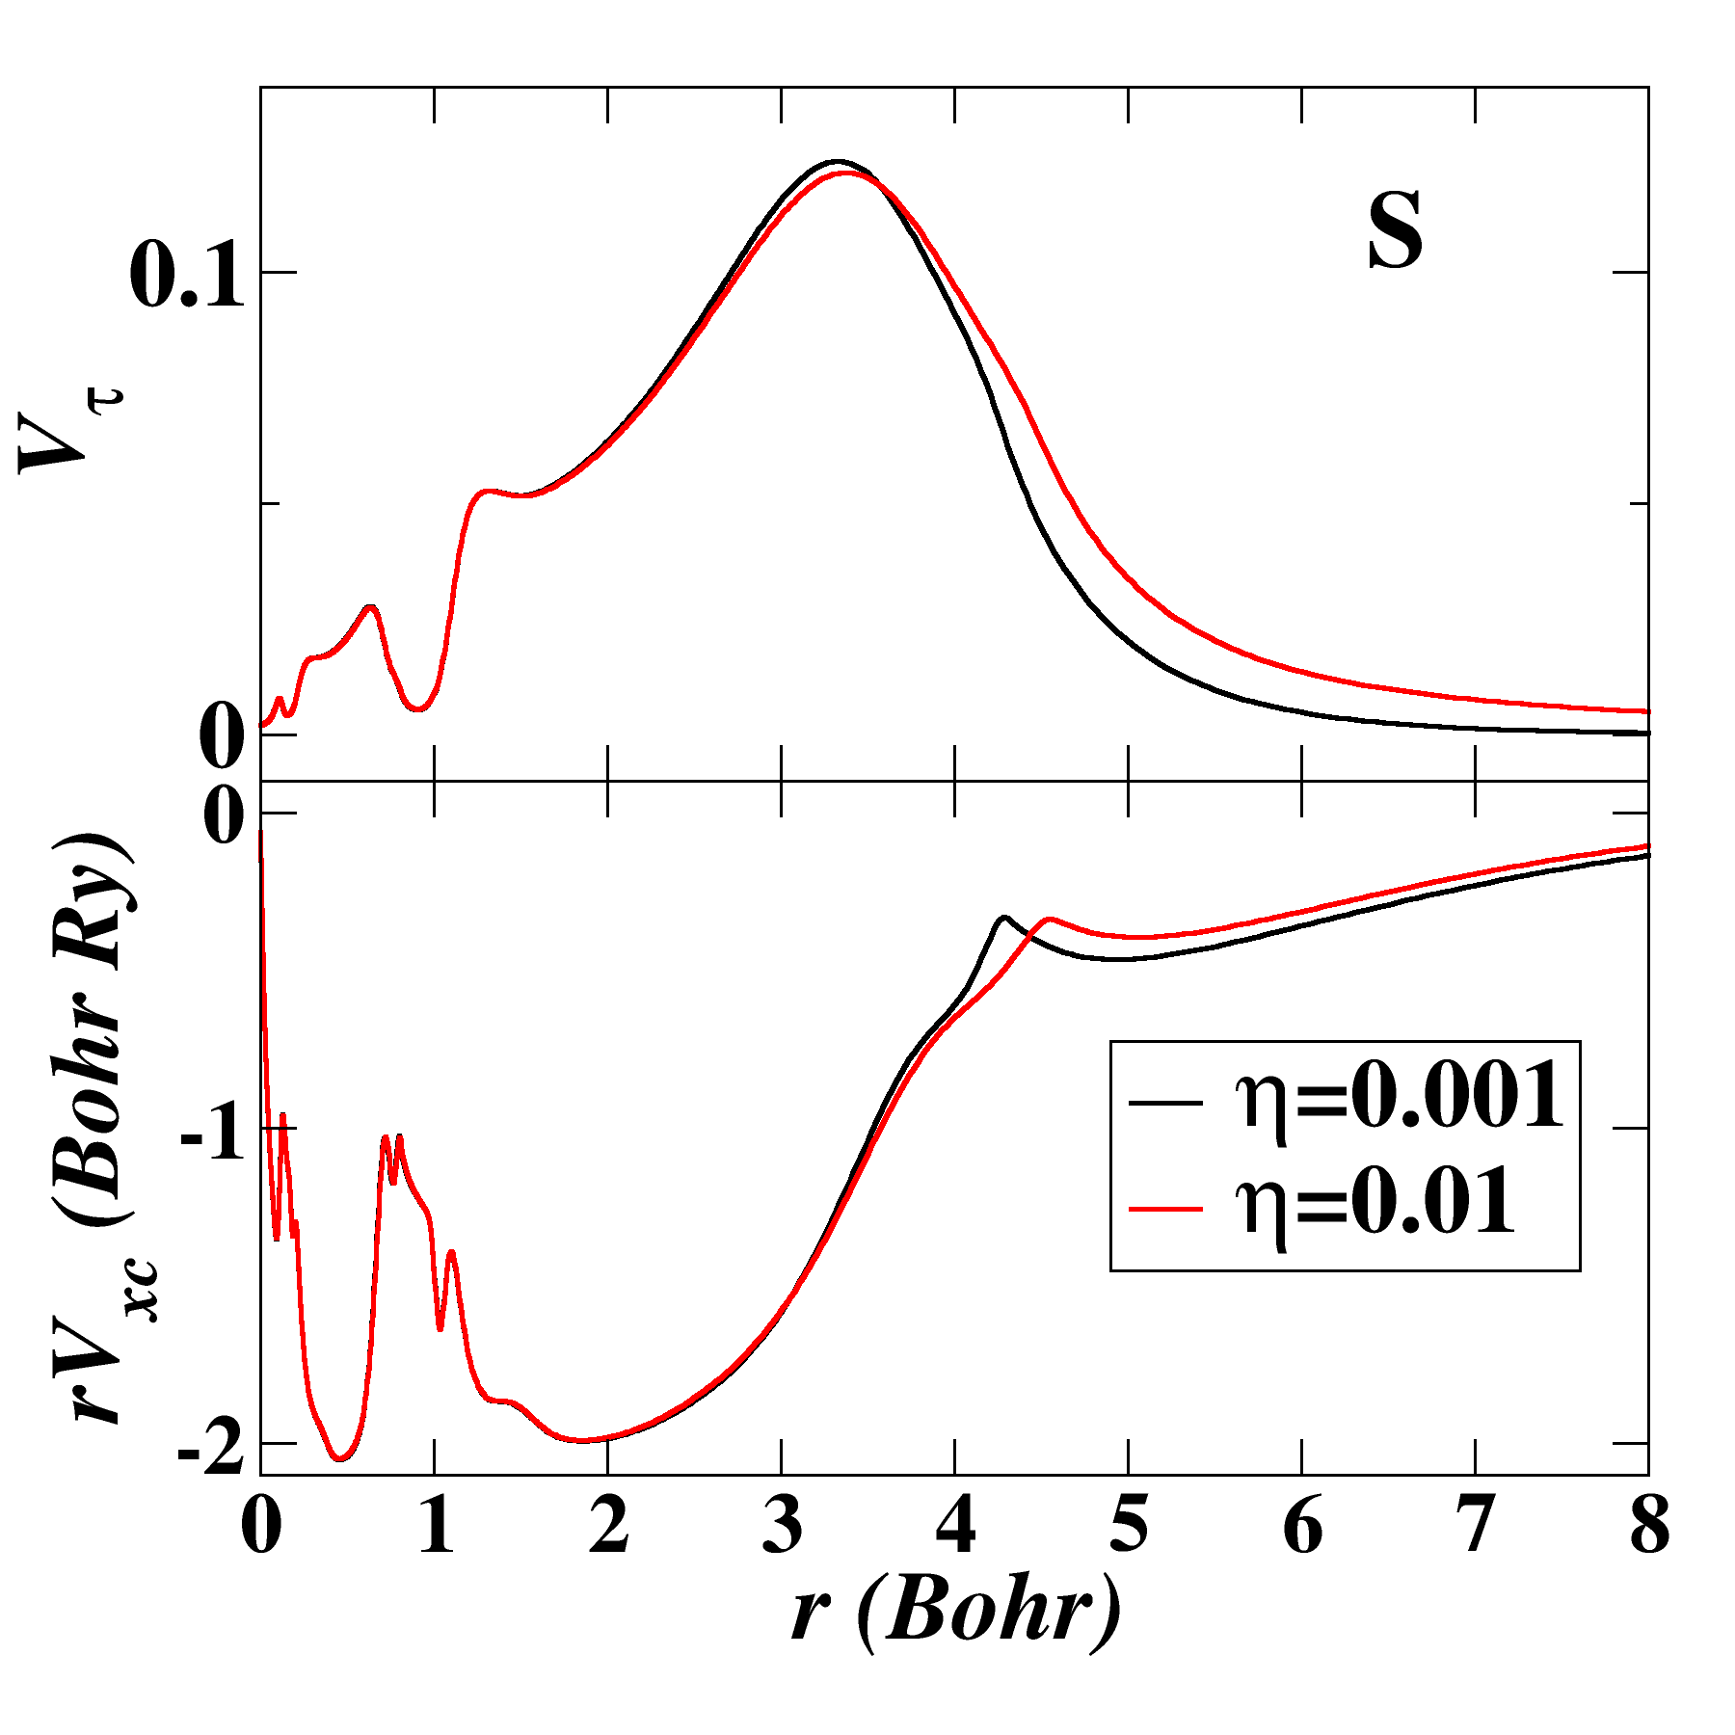
Comparison of self-consistent r2SCAN potentials
for atomic S with η=0.01 and η=0.001.

Slide 11
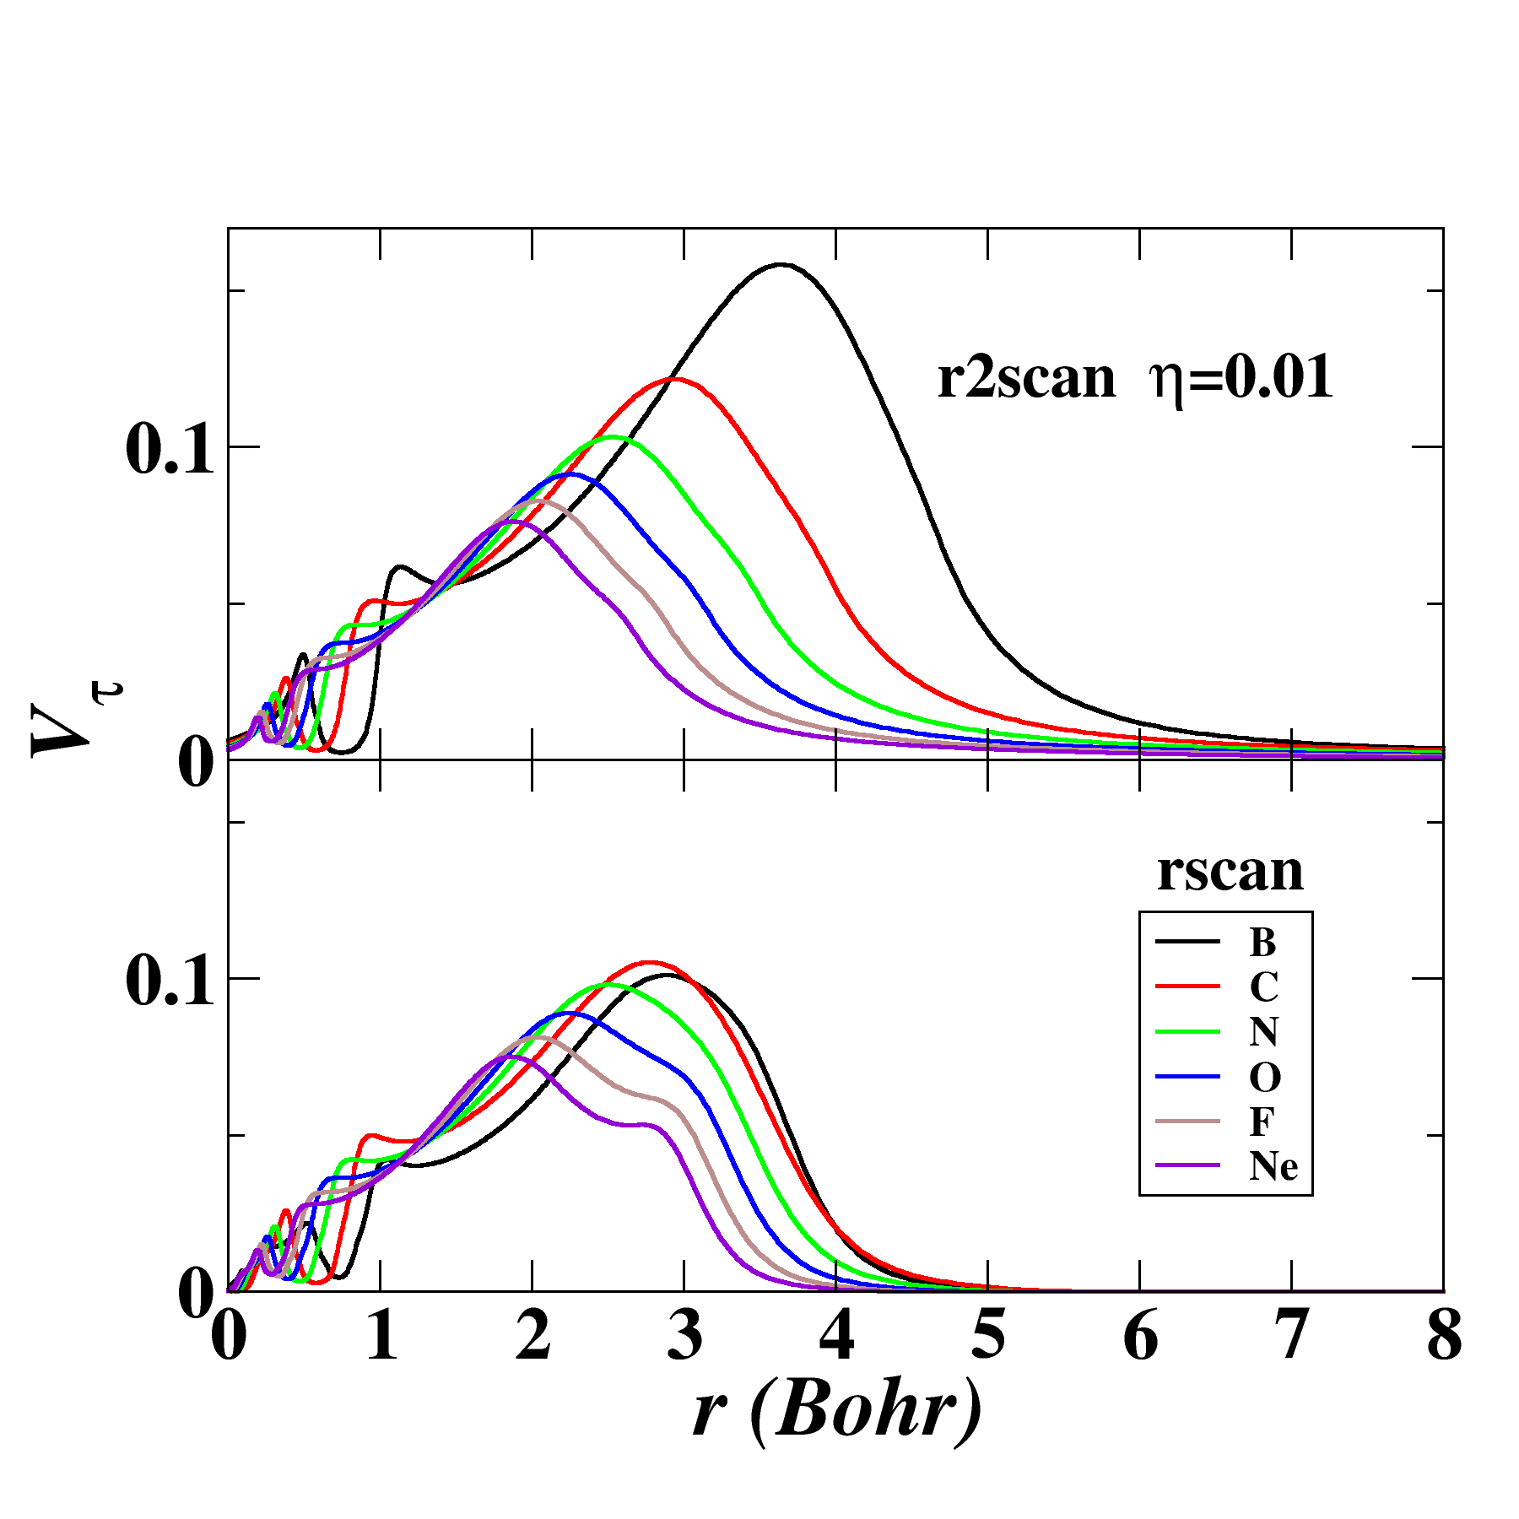
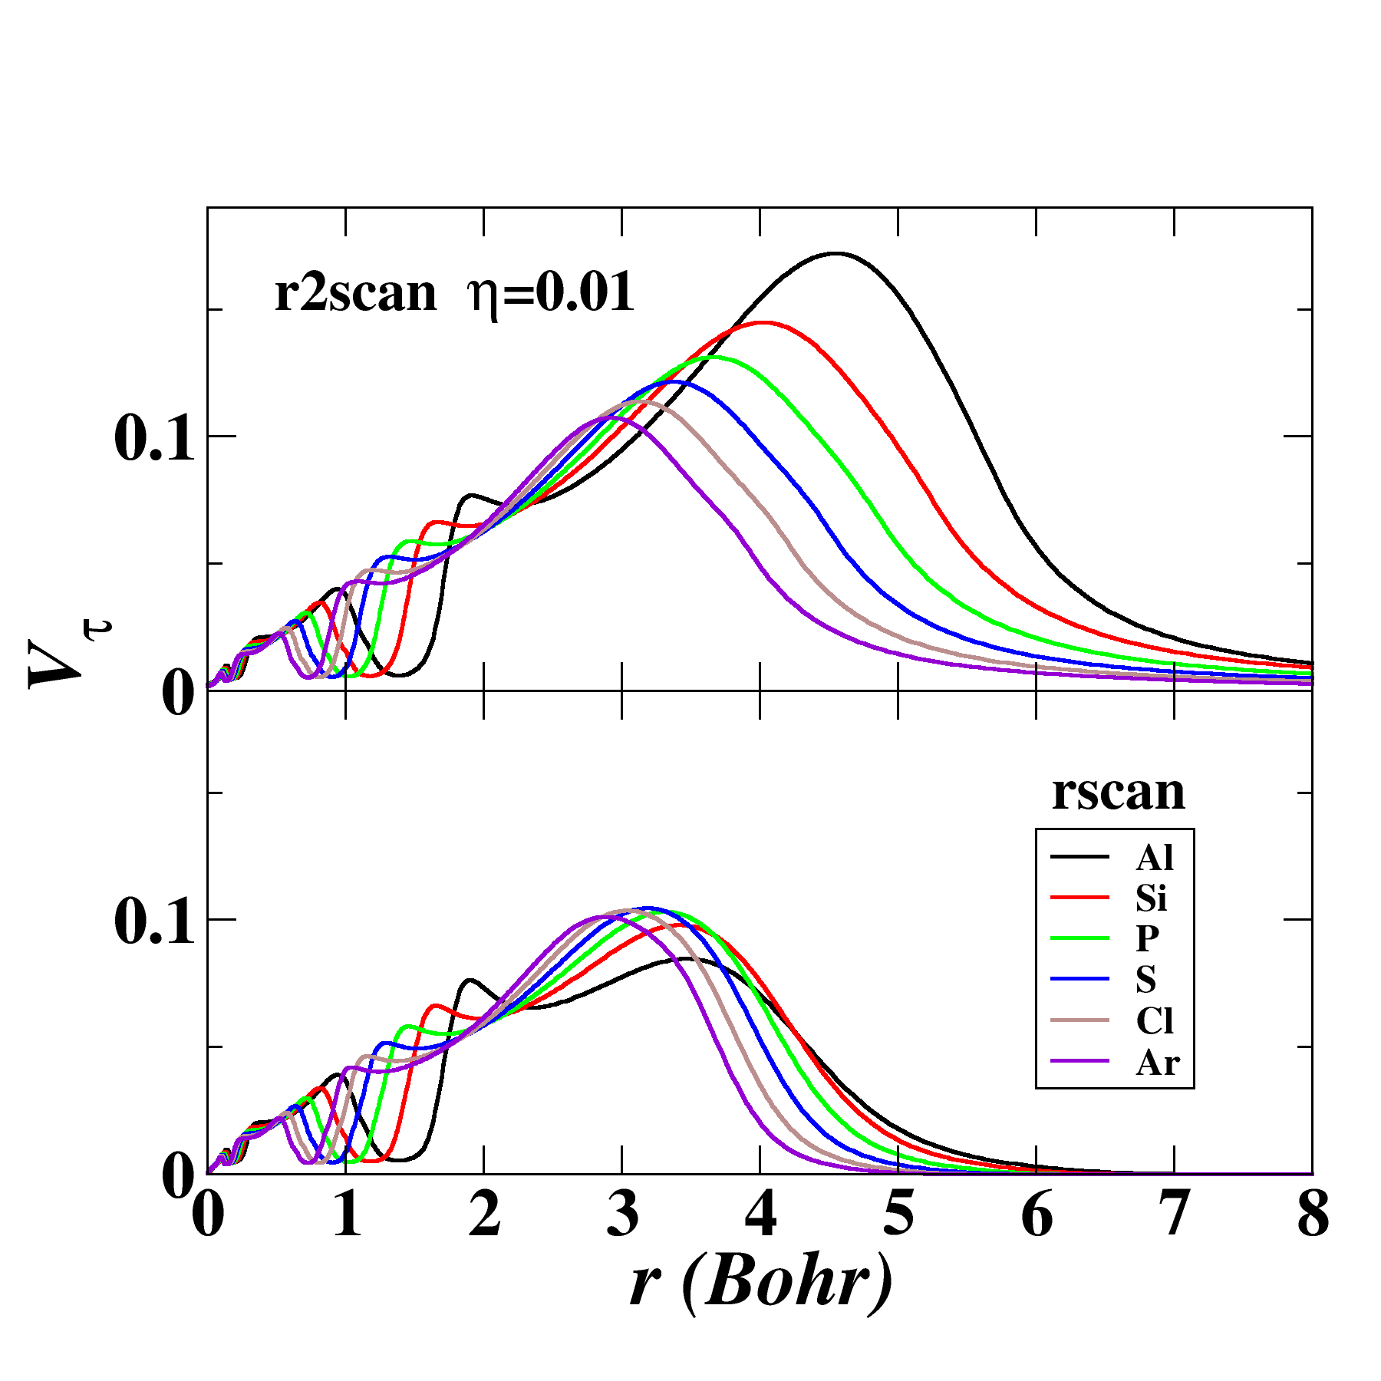
Some results for V_{τ}(r)
comparing r2SCAN η=0.01 (Furness, 2020)
with rSCAN (Bartók, 2019)
Al
B
Ne
Ar

Slide 12
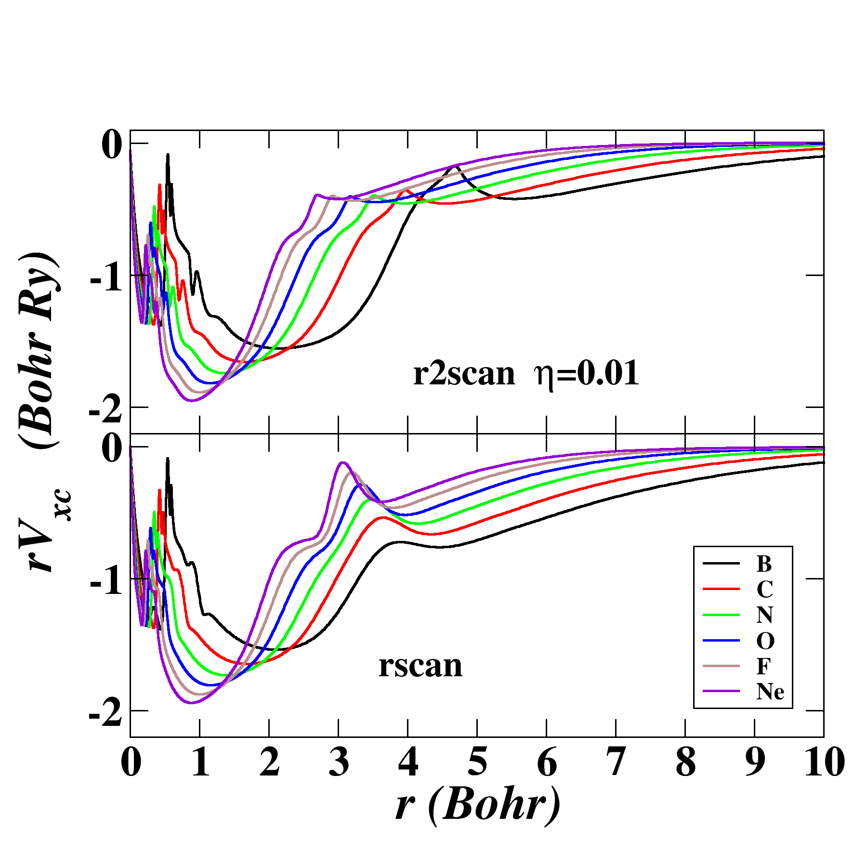
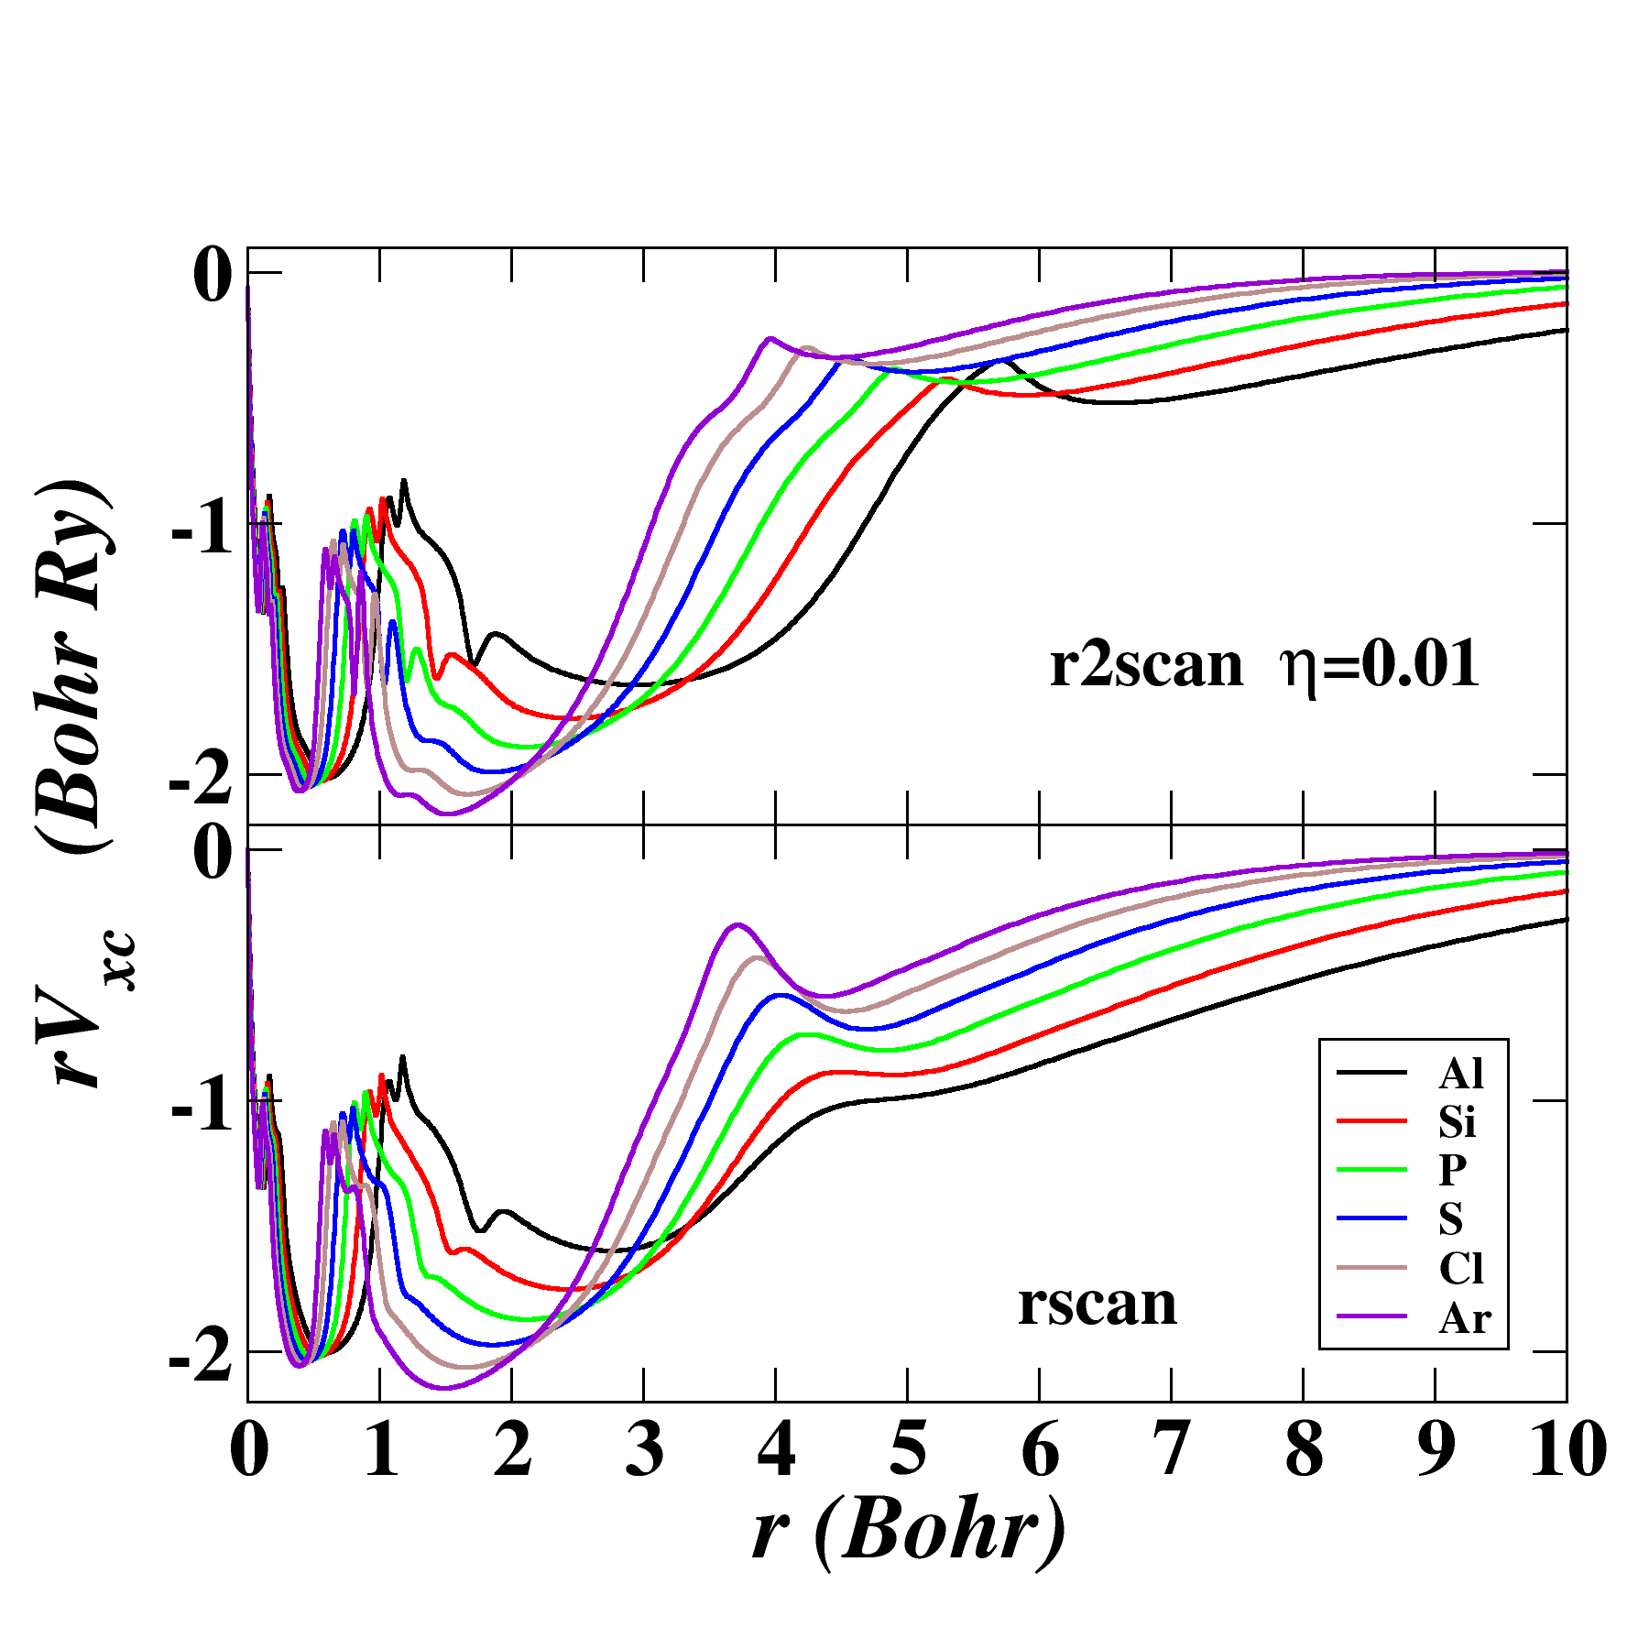
Some results for V_{xc}(r)
comparing r2SCAN η=0.01 (Furness, 2020)
with rSCAN (Bartók, 2019)
Ne
Ar
B
Al

Slide 13
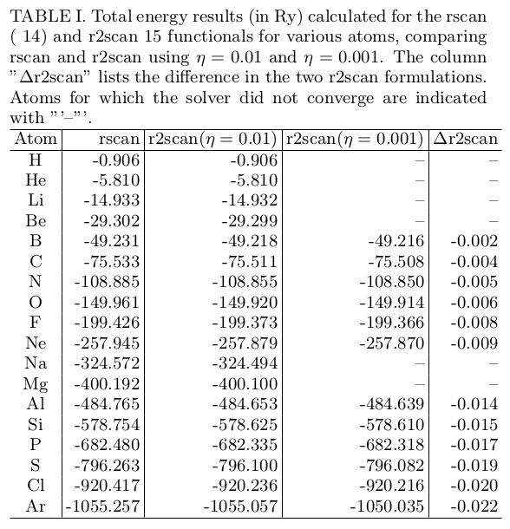
Self-consistent total energy results
Find that self-consistency is hard to achieve for some atoms with the η=0.001 version of r2SCAN.

Slide 14
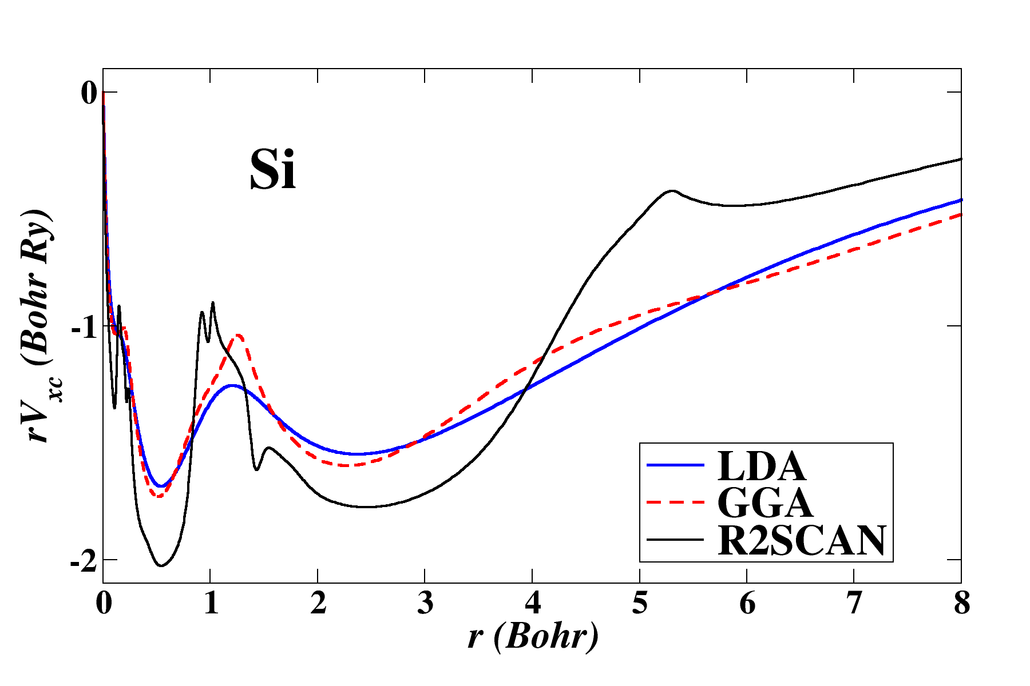
How does the r2scan V_{xc}(r) compare with other functionals?

Slide 15
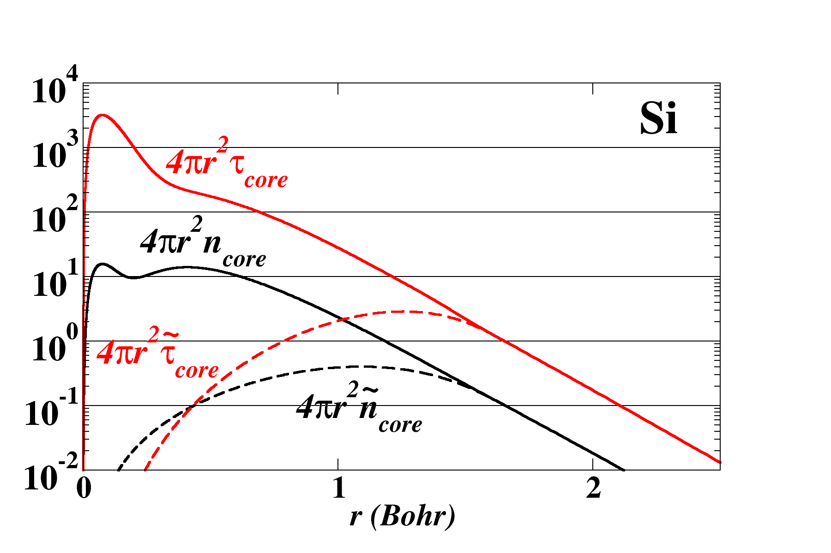
Construction of PAW datasets
Core functions for Si atom --
r_{c}

Slide 16
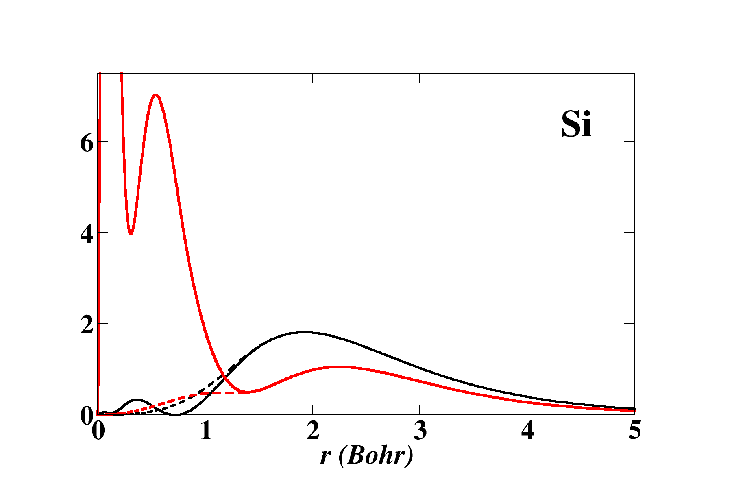
Construction of PAW datasets -- continued
The datasets are focused on the valence electrons and there are many formulations which can be adopted for use with the generalized Kohn-Sham PAW equations (although some schemes may be more difficult).
Valence functions for Si atom
r_{c}

Slide 17
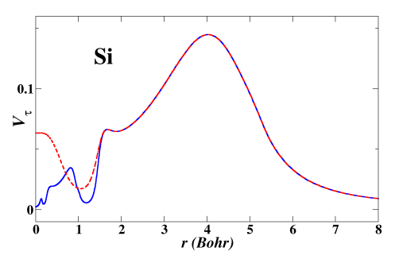
Construction of PAW datasets -- continued
Dimensionless kinetic potential and kinetic pseudopotential for Si for r2SCAN η=0.01

Slide 18
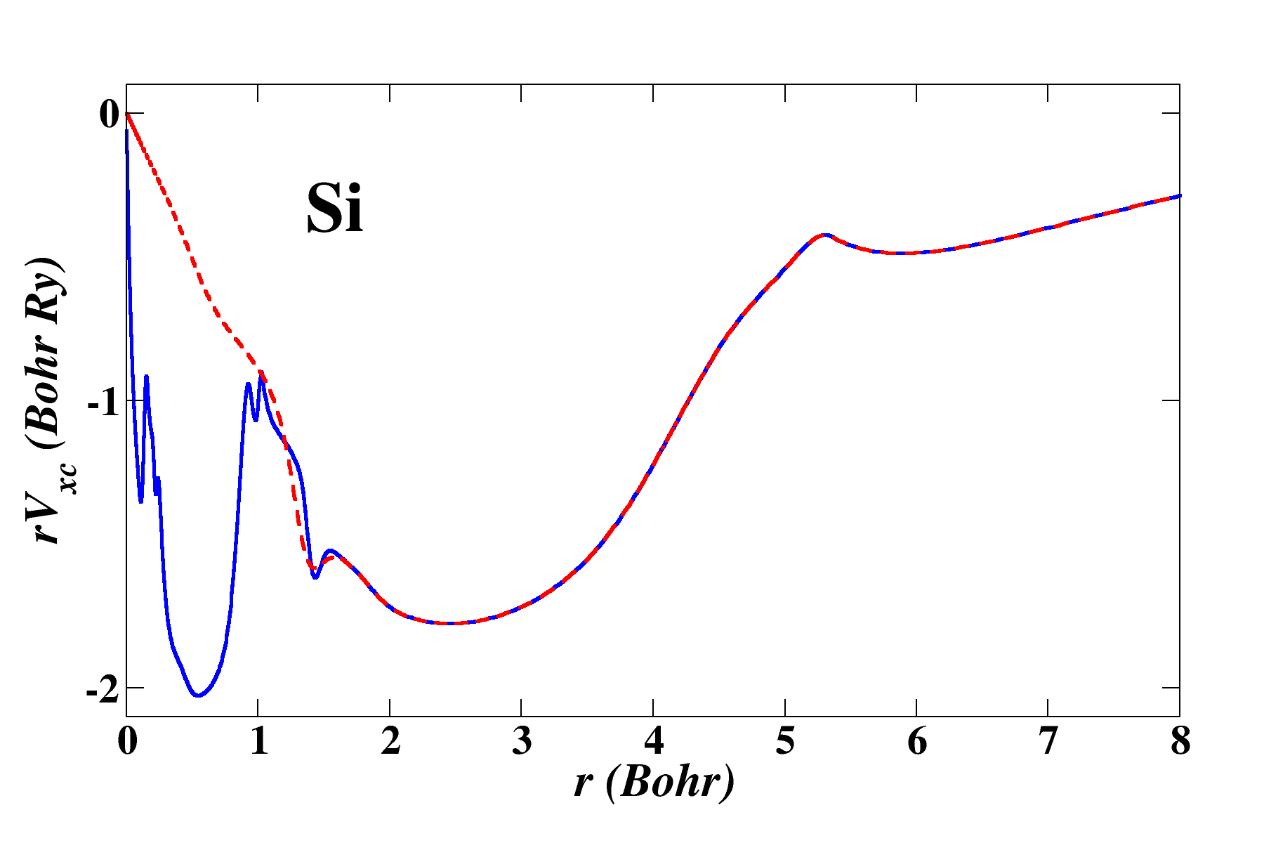
Construction of PAW datasets -- continued
Exchange-correlation potential and pseudopotential for Si for r2SCAN η=0.01

Slide 19
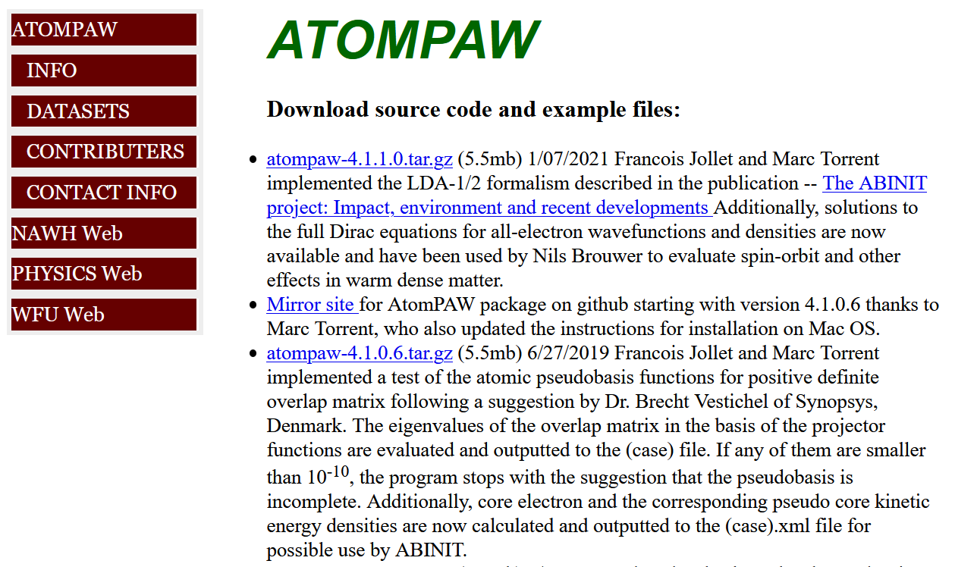
Construction of PAW datasets -- continued
Various schemes to constructed screened pseudopotential –
http://pwpaw.wfu.edu

Slide 20
Construction of PAW datasets -- continued
Various schemes to constructed screened pseudopotential – V^{PS}(r)
http://pwpaw.wfu.edu specifically from Marc Torrent’s usersguide
For now, added VPSMATCHNC/VPSMATCHNNC similar to “ultrasoft” with or without norm conservation.

Slide 21
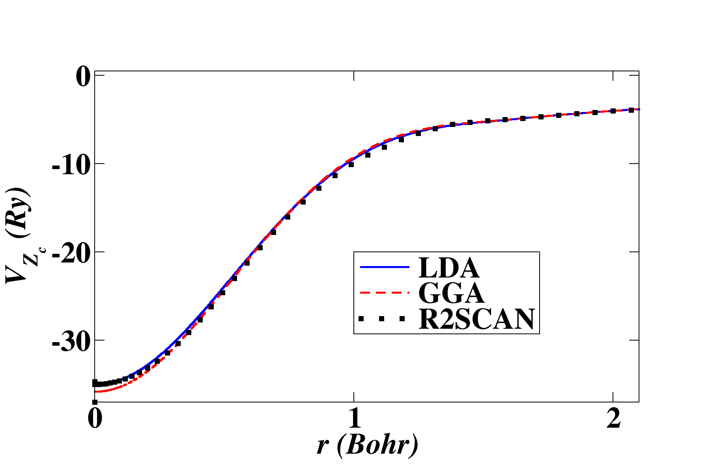
Construction of PAW datasets -- continued
Determine ionic pseudopotential by unscreening V^{PS}(r)
Ionic pseudopotential for Si for r2SCAN η=0.01
in comparison with LDA and GGA
Si
VPSMATCHNC option

Slide 22
To do list
Develop a self-consistent all electron atomic solver for the generalized Kohn-Sham equations needed to evaluate exchange-correlation functionals having the meta-GGA form.
Adapt pseudization schemes for basis and projector functions for use in the generalized Kohn-Sham formalism.
Test and evaluate.
3
4
Still to do

Slide 23
Additional considerations
How sensitive are the results to the dataset?
Given apparently reasonable results for r2SCAN η=0.01, should we stick with that form or work harder on the solver? (Perhaps should also consult with Tulane/Temple developers.)
Not all pseudization schemes are easily converted for use in generalized density functional formulation due to the dimensionless kinetic energy potential term. Which ones should we try to preserve?
Further considerations?

