Slide 1
Structure and interface properties of the electrolyte material Li₄P₂S₆*
Zachary D. Hood,ª Cameron M. Kates,^{b,c} and
N. A. W. Holzwarth^{b}
ªCenter for Nanophase Materials Sciences,
Oak Ridge National Laboratory, Oak Ridge, TN 37831,
^{b}Department of Physics, Wake Forest University, Winston-Salem, NC, USA, 27109,
^{c}Currently attending the Pratt School of Engineering at Duke University
*Supported by NSF Grant DMR-1105485. Computations were performed on WFU’s DEAC cluster. ZDH was supported by the HERE program at ORNL. Helpful discussion with Chengdu Liang, Gayatri Sahu, Hui Wang, Melanie Kirkham, Jong Keum, and E. Andrew Payzant at ORNL and William C. Kerr, Keerthi Senevirathne, Cynthia Day, and Abdessadek Lachgar at WFU are gratefully acknowledged.

Slide 2
Li₄P₂S₆
Why--
What--
Part of search for ideal solid electrolyte materials for all-solid state Li ion batteries
Reported in by Mercier et. al. , J. Solid State Chemistry 43, 151-164 (1982); hexagonal structure with disorder on the P sites
Frequently identified as unintended constituent of solid electrolyte preparations; relatively stability in air
Combined experimental and computation study including:
Structural analysis
Thermal stability
Transport properties

Slide 3
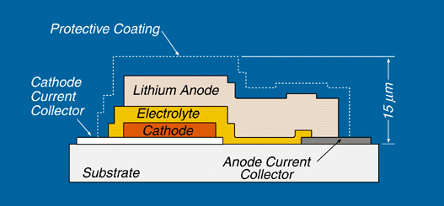
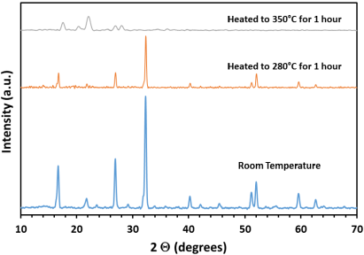
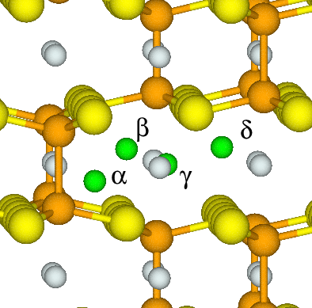
Outline
Motivation
Structural analysis
Thermal stability
Ionic conductivity
Summary and conclusions

Slide 4
Motivation for studying Li₄P₂S₆:
Part of the search for the ideal solid electrolyte material for all-solid state Li ion batteries
Li₄P₂S₆ frequently identified as unintended stable component of solid electrolyte preparations
Interesting structural properties, including disorder
Transport and stability properties
Previous work:

Slide 5
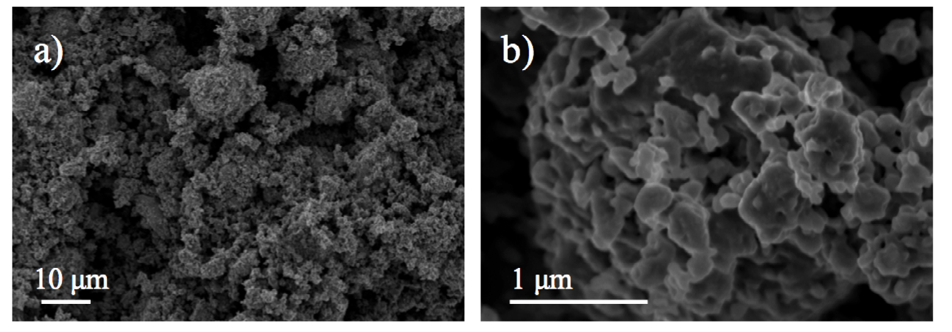
Synthesis:
Sulfur removed by treatment with solvent; sample prepared for electrochemical applications using ball milling.
Scanning Electron Micrograph of prepared sample:

Slide 6
Computational methods
Density functional theory with LDA
PAW formalism using datasets generated with ATOMPAW code
Electronic structure calculations performed using QUANTUM ESPRESSO and ABINIT codes
Plane wave expansion for wave functions with
Brillouin zone integration mesh of 0.003 bohr⁻³
Visualization software: Xcrysden and VESTA; X-ray powder diffract simulated using Mercury

Slide 7
Crystal structure: Space Group P6₃/mcm (#193)
Projection on to hexagonal plane:
Li
P
S
a
a

Slide 8
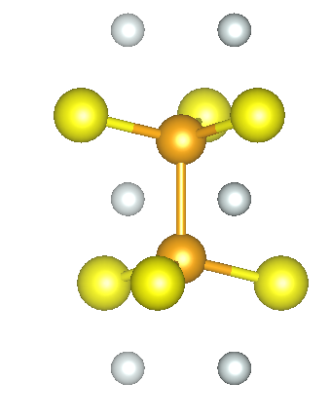
Crystal structure: Space Group P6₃/mcm (#193)
Li₄P₂S₆ units:
Li
P
S
c
2.3 Å
2.1 Å

Slide 9
Crystal structure: Space Group P6₃/mcm (#193)
Disorder in P-P placements:
+(1/2-z)
+z
c
Li
-z
P
-(1/2-z)
S
­
Site label z­
Site label z­ ­­­­­­

Slide 10
Structural variation can be mapped on to a two-dimensional hexagonal lattice with each P configuration taking z or z settings; Li and S configurations fixed
Li
P
S

Slide 11
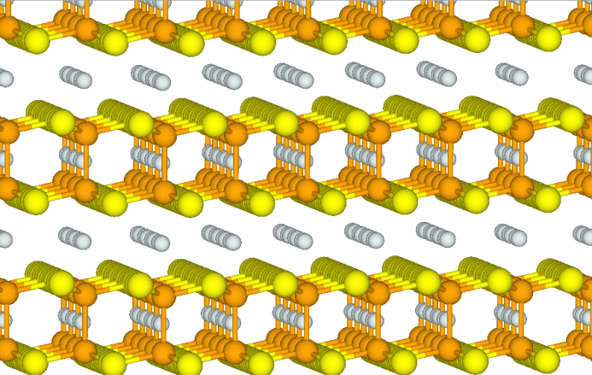
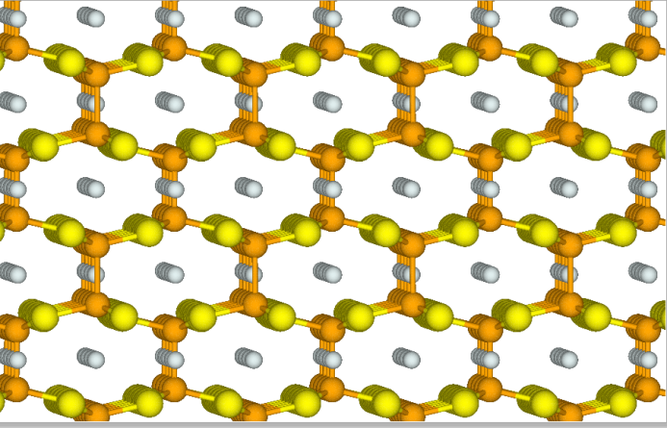
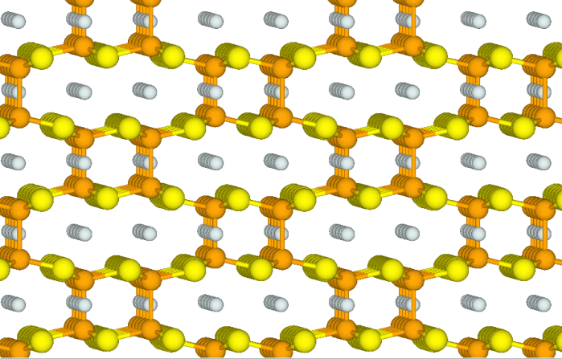
Examples:
Structure “b”
ΔE = 0.03 eV
100% z­ ­­­­­­
ΔE = 0
Structure “c”
50% z
50% z­ ­­­­­­
Li
Structure “d”
ΔE = 0
P
50% z
50% z­ ­­­­­­
S

Slide 12
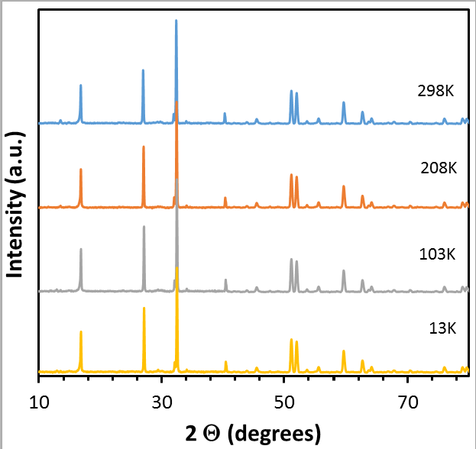
in
^
Temperature dependence of X-ray powder diffraction

Slide 13
Diffraction analysis
 | a (Å) | c (Å) | z_{P} | z_{S}
Exp. 298K (X-ray) | 6.0709 | 6.5903 | 0.1715 | 0.3237
Exp. 13K (X-ray) | 6.0747 | 6.5966 | 0.1715 | 0.3237
Exp. 13K (neutron) | 6.0761 | 6.5961 | 0.1698 | 0.3284

Slide 14
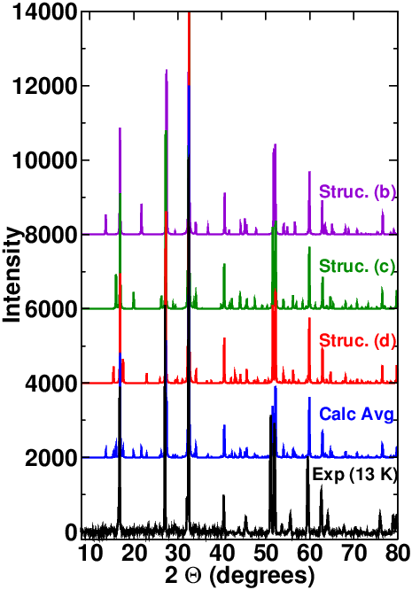

Slide 15
Comparison of 13 K
X-ray data with simulations
Extra peaks
Note: simulations scaled by 102% to compensate for systematic LDA error.
Simulations consistent with incoherent average over all P z and z
configurations

Slide 16
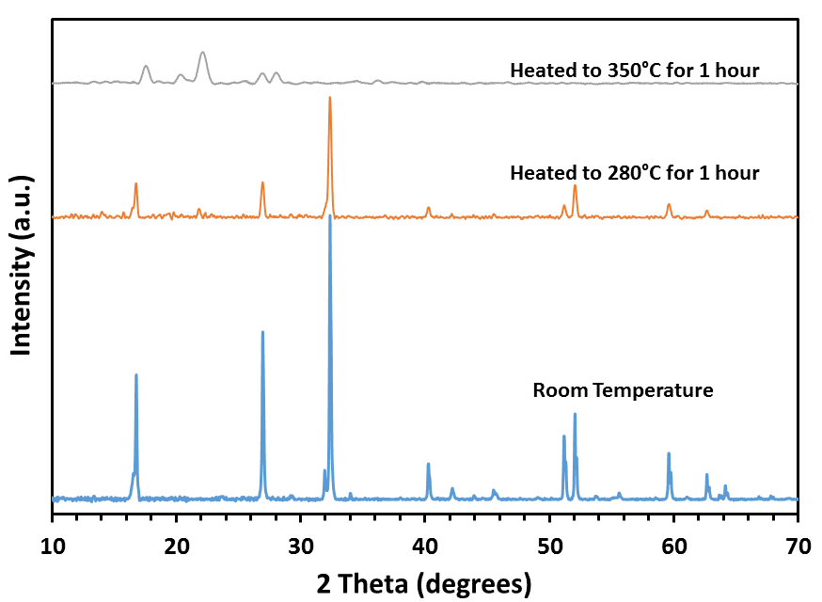
Stability: Li₄P₂S₆ is much less reactive than other lithium thio-phosphates, but it decomposes in air, especially at higher temperature
Decomposition products:
P₂O₅
Li₄P₂O₇
Li₂SO₄

Slide 17
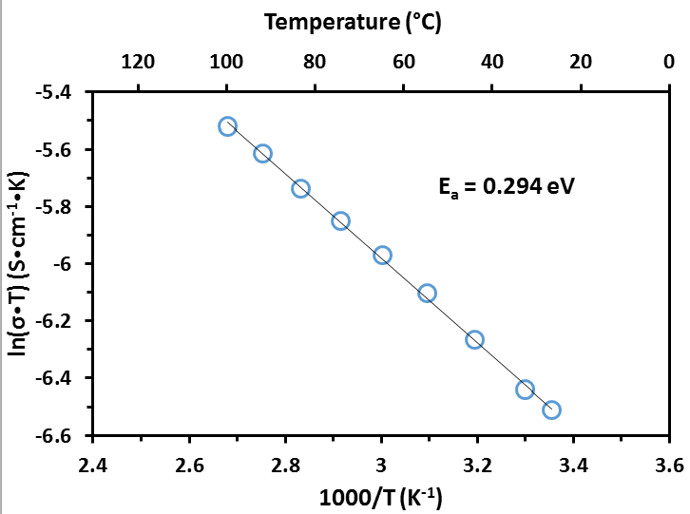
Ionic conductivity and Activation Energy
2.38 x 10⁻⁷ S/cm at 25˚C and 2.33 x 10⁻⁶ S/cm at 100˚C
Li₄P₂S₆ pressed pellets with blocking (Al/C) electrodes

Slide 18
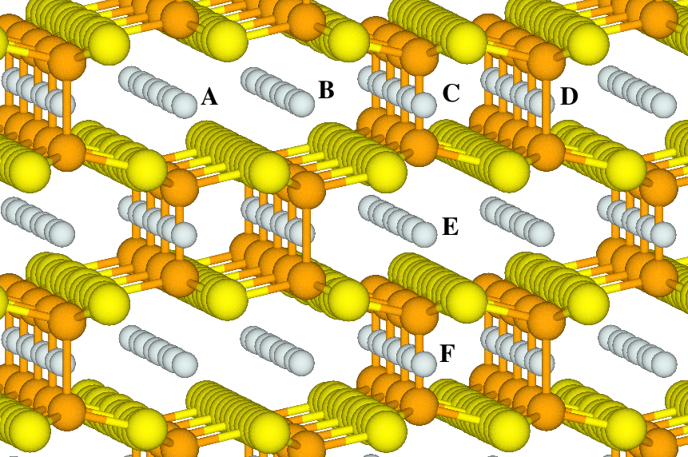
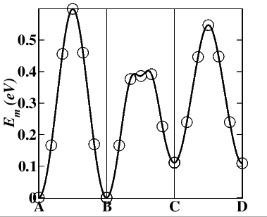
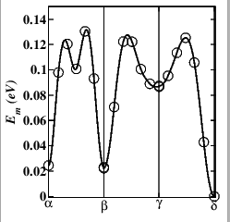
Simulations of ion mobility using Nudged Elastic Band Model
Vacancy mechanism:
ΔE>0.6 eV
Li
P
S
Interstitial mechanism:
ΔE>0.1 eV
Possible interstitial sites

Slide 19
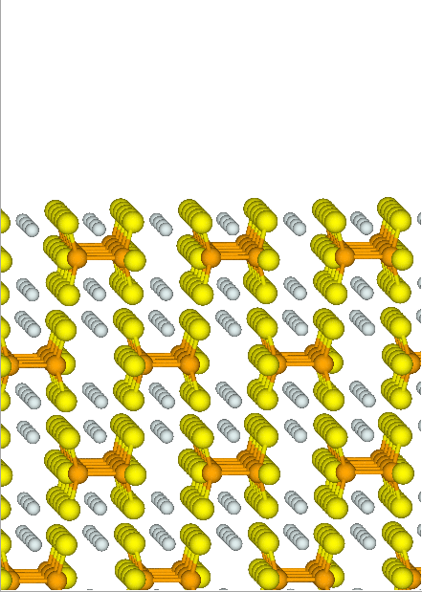
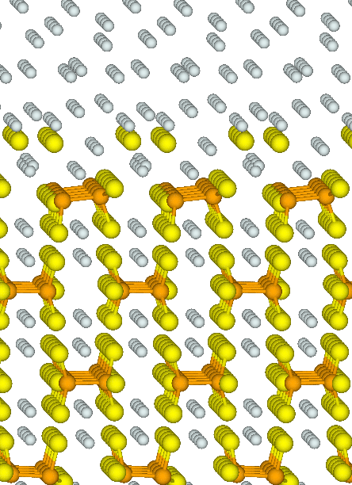
Models of Li₄P₂S₆/Li interfaces -- Surface parallel to P-P bonds:
Surface with vacuum
Surface with lithium
Li
P
S

Slide 20
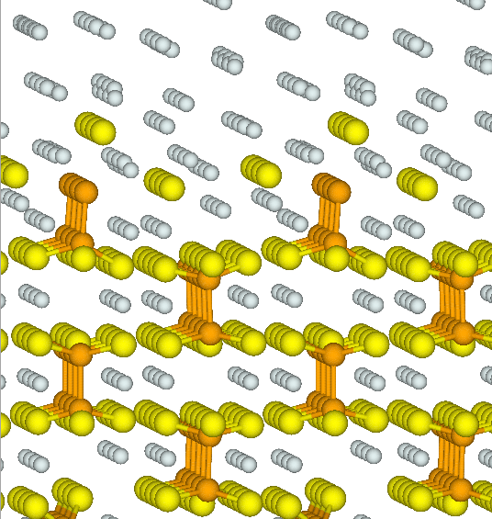
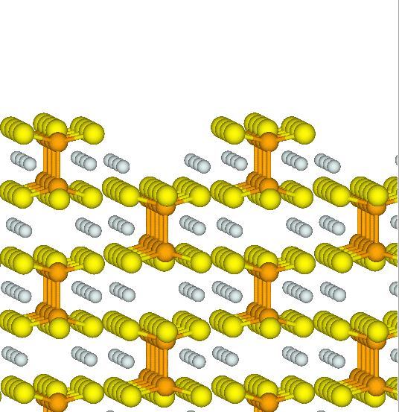
Models of Li₄P₂S₆/Li interfaces -- Surface perpendicular to P-P bonds:
Surface with vacuum
Surface with lithium
Li
P
S

Slide 21
Conclusions:
Diffraction results are consistent with Mercier’s 1982 analysis with disorder on P sites due to small energy differences of alignment of P₂S₆ fragments; remarkably temperature independent
Small activation energy (E_{a} = 0.3 eV) for ion conductivity consistent with interstitial mechanism
Thermal stability relative to other thio-phosphates
Simulations of Li₄P₂S₆/Li interfaces suggest that meta-stable buffer layers may be formed
Further processing of materials needed to improve conductivity and stabilize Li/Li₄P₂S₆/Li cells

