Slide 1
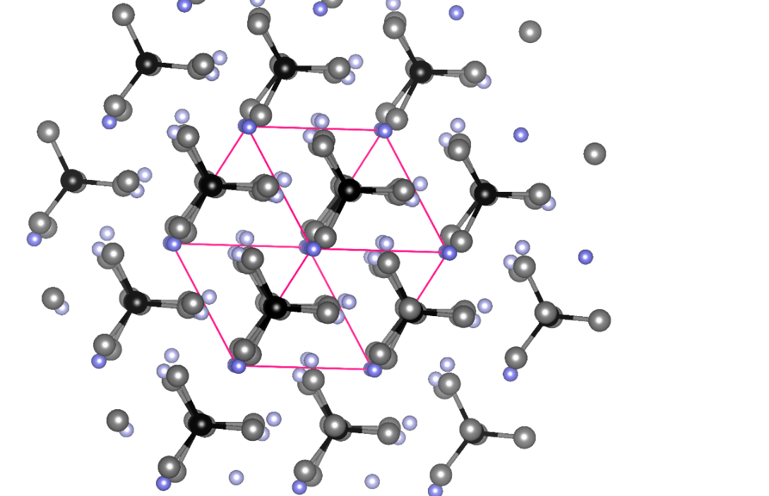
Computational Study of Ideal Electrolyte/Anode Interface for Na₃SbS₄/Na
Larry E. Rush Jr., N.A.W. Holzwarth
Department of Physics, Wake Forest University, Winston-Salem, NC 27109
*Thanks to Zach Hood from Georgia Tech and ORNL for introducing us to this system $$
NSF grant DMR-1507942

Slide 2
Outline
Na-ion electrolytes for all-solid-state Na-ion batteries
Motivation behind studying Na₃SbS₄
Computational Methods
Results
Conclusions

Slide 3
Na-ion Electrolytes
Abundant (geopolitically-neutral & cheap)
↑ size of Na ions = ↑ intercalation w.r.t. Li ions (higher reversibility)*
Cost-effective large-scale grid storage (option for Morocco’s energy initiative?)
High energy density
* https://ceder.berkeley.edu/research-areas/na-ion-battery-materials-design-and-discovery//

Slide 4
Why Na₃SbS₄?
Similar to Na₃PSe₄¹
Air-stable & high ionic conductivity^{2,3,4}
$E_{a} =0.20 eV$at 25⁰C⁴
1. Ceder et al., Chem. Mater., 28, pp. 252-258 ⁽²⁰¹⁶⁾
2. Wang et al., Angew. Chem., 55, pp. 8551-8555 (2016)
3. Zhang et al., Adv. Sci., 3, pg. 1600089 (2016)$$$$$$
4. Banerjee et al., Angew. Chem., 55, ^{pp.} ⁹⁶³⁴⁻⁹⁶³⁸ ⁽²⁰¹⁶⁾

Slide 5
Methodology
Density functional theory with local-density approximation (LDA)
Projector Augmented Wave (PAW) formalism
PAW basis and projector functions generated by ATOMPAW¹
Quantum Espresso software package²
Density of States calculations
Nudged Elastic Band (NEB) calculations³
1. Holzwarth et al., Computer Physics Communications, ^{135,} ^{pg. 329 (2001)}
^{2. Giannozzi et al.,} ^{J.} ^{Phys.:} ^{Cond.} ^{Mat.,} ^{21,} ^{pg.} ^{395592 (2009) $$$$$$$$$$}
^{3. Henkleman et} ^{al.,} J. Chem. Phys., 113, pp. 9901-9904 (2001)$$$$$$$$$$$$

Slide 6
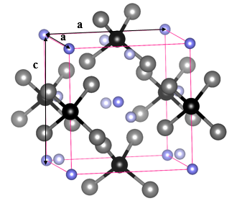
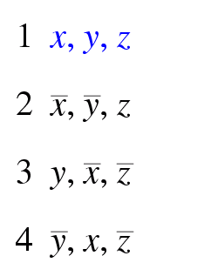
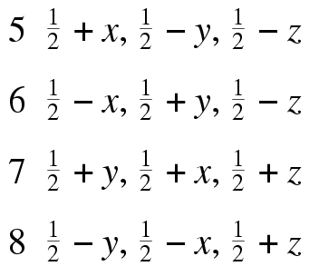
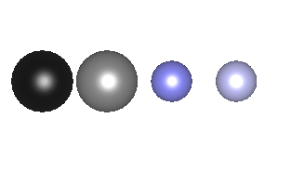
Results
Low temperature phase Na₃SbS₄ (space group P $\overline{4}$ 2₁ c)
2b 8e 2a 4d
Wyckoff labels
Sb S Na Na
Atoms

Slide 7
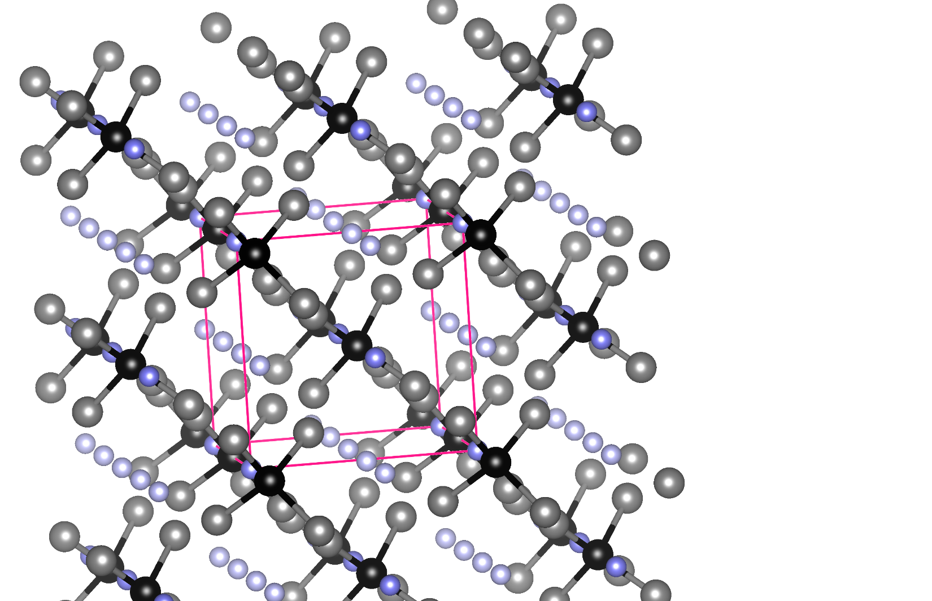
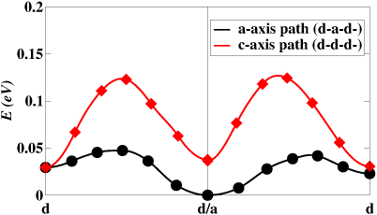
Results
Ball-and-stick model for Na₃SbS₄
NEB calculations
σ = $\frac{C}{T }{ e }^{−\frac{Ea}{kT}}$
$$E_{a}≈ E_{m}$$
$$E_{m}≈0.1 eV$$
a-axis
a-axis
c-axis
$$E_{m}≈0.05 eV$$
2b 8e 2a 4d
Wyckoff labels
Sb S Na Na
Atoms

Slide 8
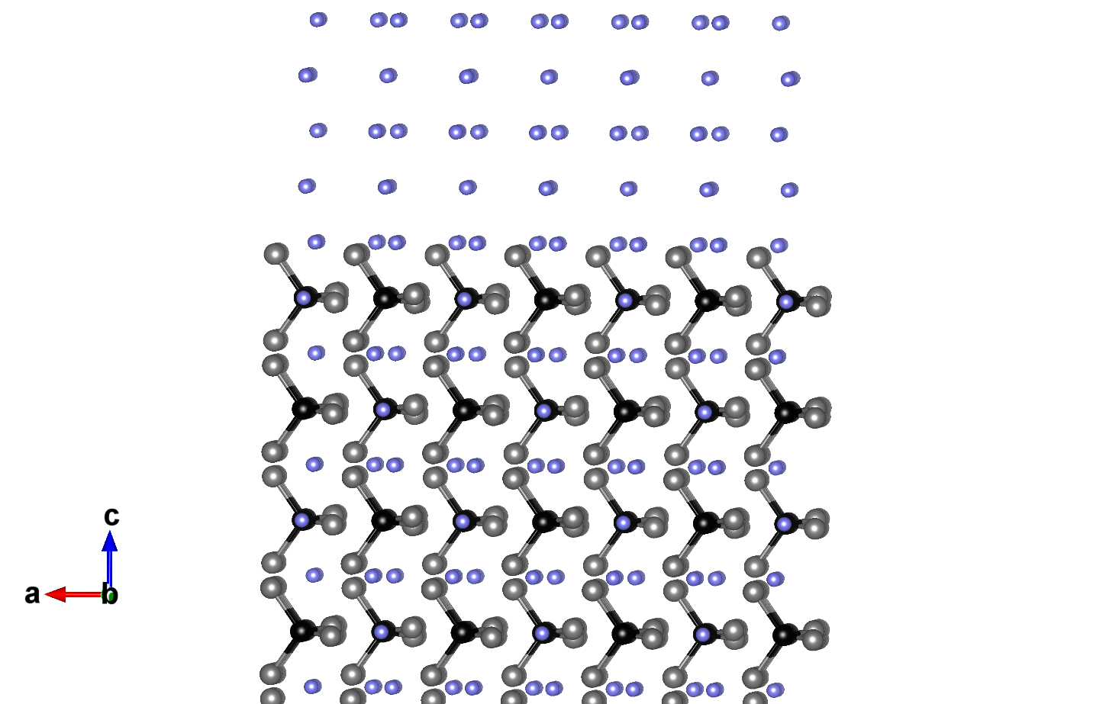
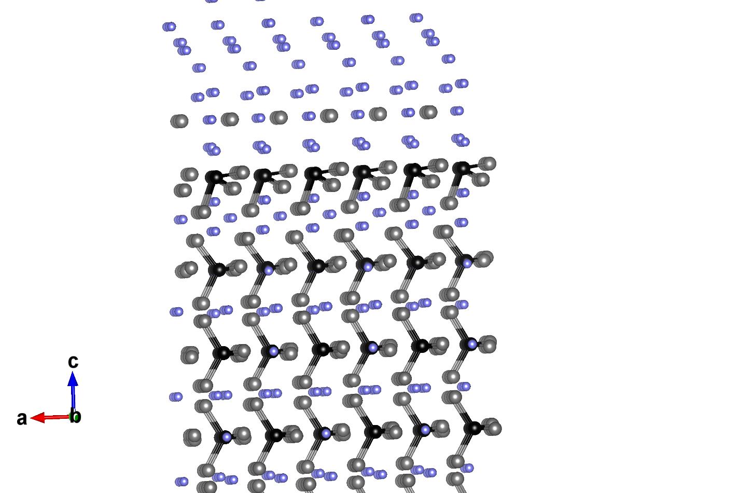
Results
Interface Properties
Initial Na₃SbS₄/Na interface
Final Na₃SbS₄/Na interface
Na
Na
Na₂S?
Na₃SbS₃?
Sb S Na
(110) Na₃SbS₄
(110) Na₃SbS₄

Slide 9
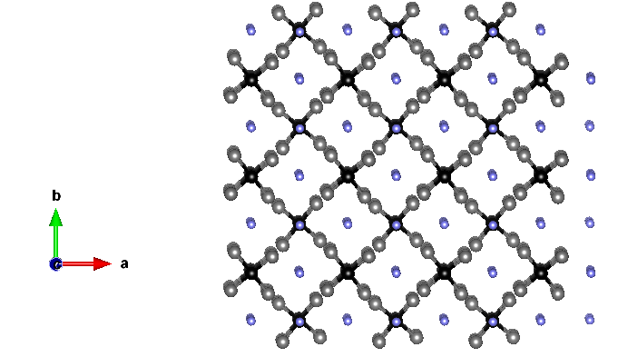
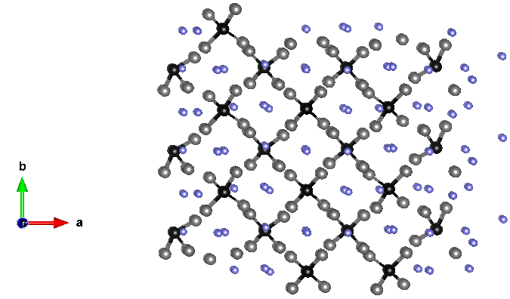
Results
Initial Na₃SbS₄/Na interface
Final Na₃SbS₄/Na interface
(100) Na₃SbS₄
Na
(100) Na₃SbS₄
Na
Sb S Na
Na₃SbS₃?
Na₂S?

Slide 10
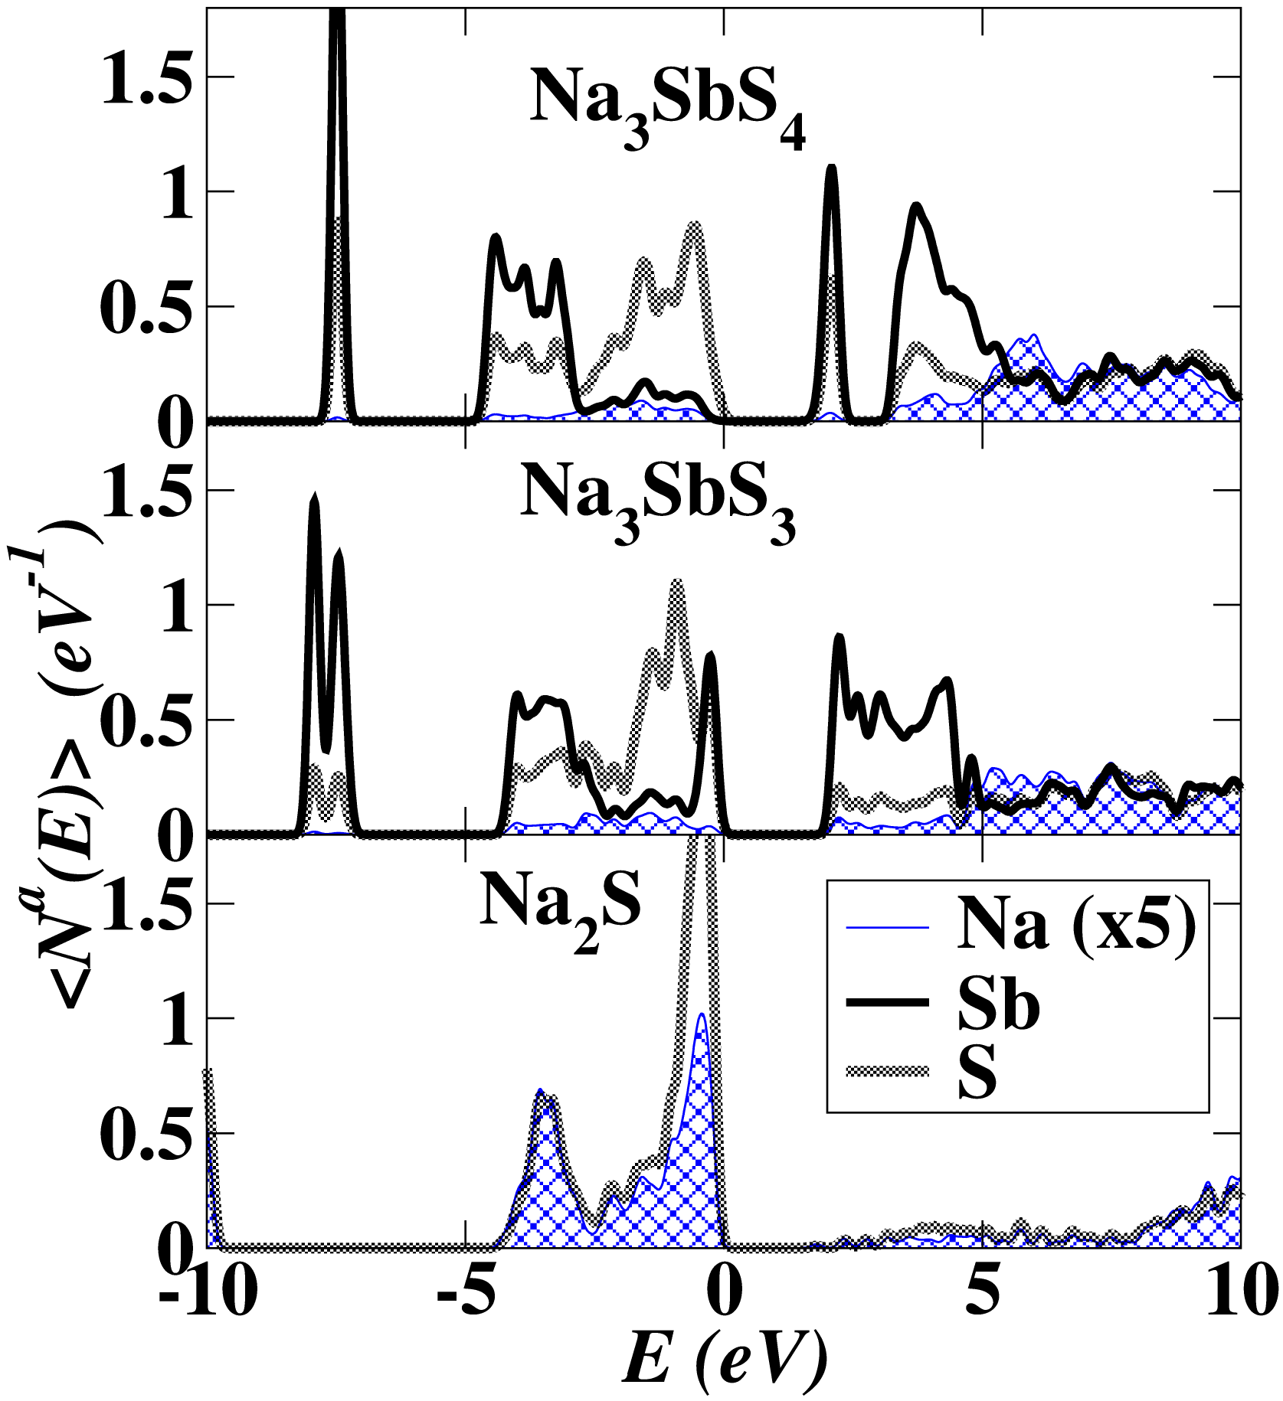
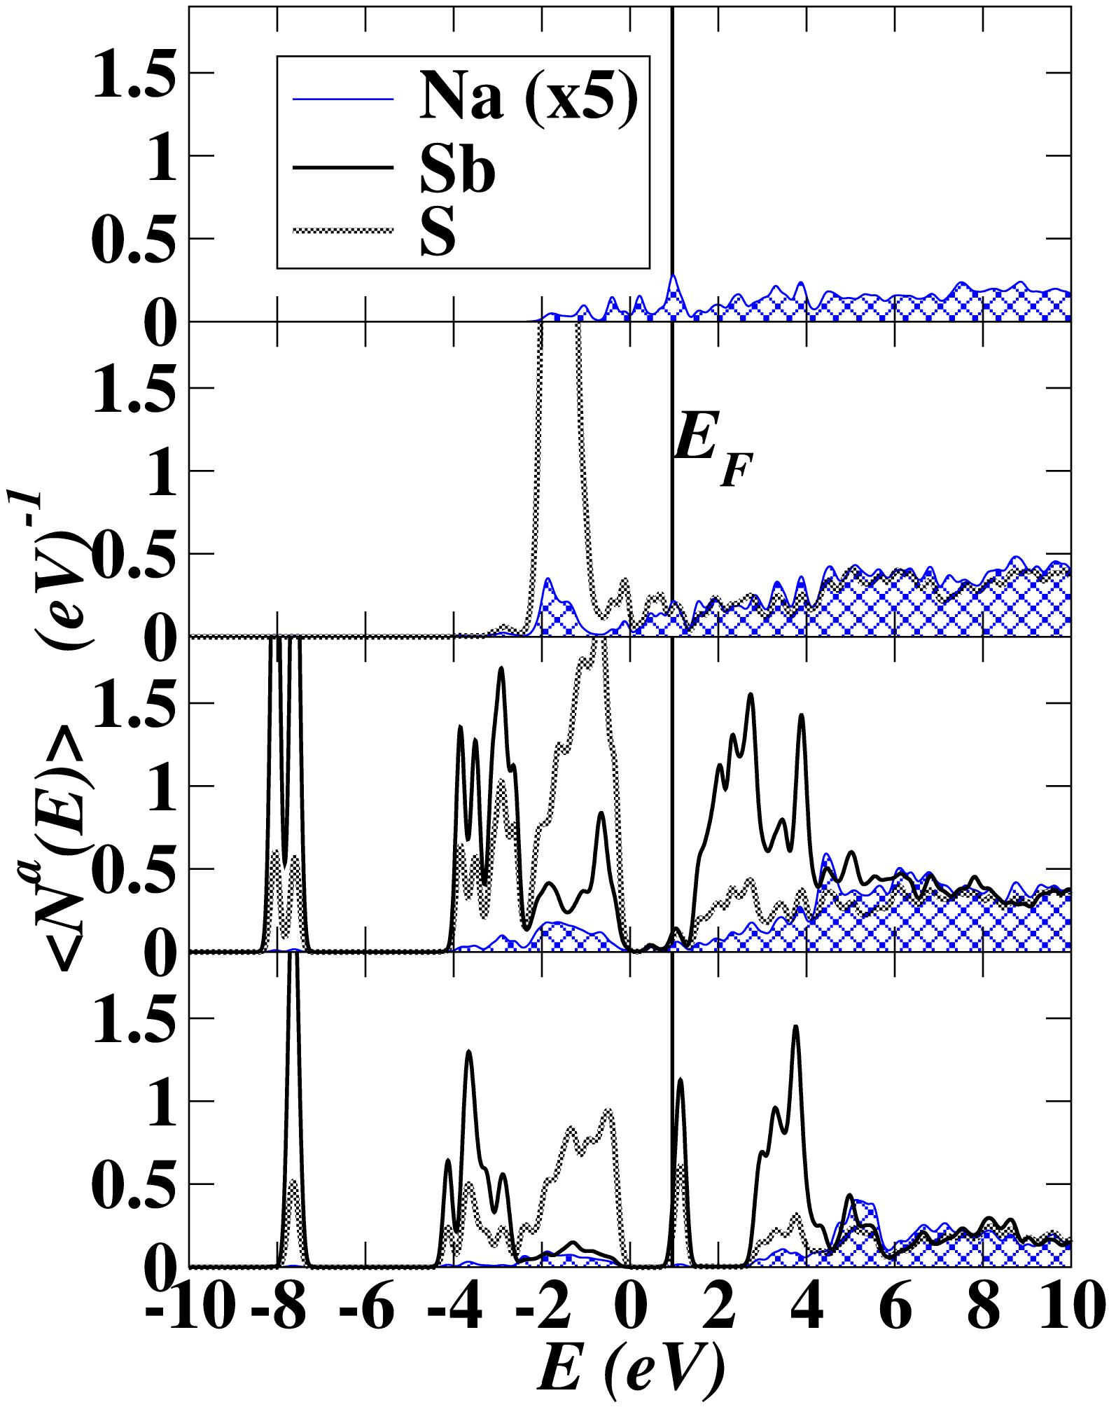
Results
Density of States (DOS)
Bulk materials DOS
(110) Na₃SbS₄/Na interface
(110) Na₃SbS₄/Na interface DOS
Na
Na₂S?
Sb S Na
Na₃SbS₃?
Na₃SbS₄

Slide 11
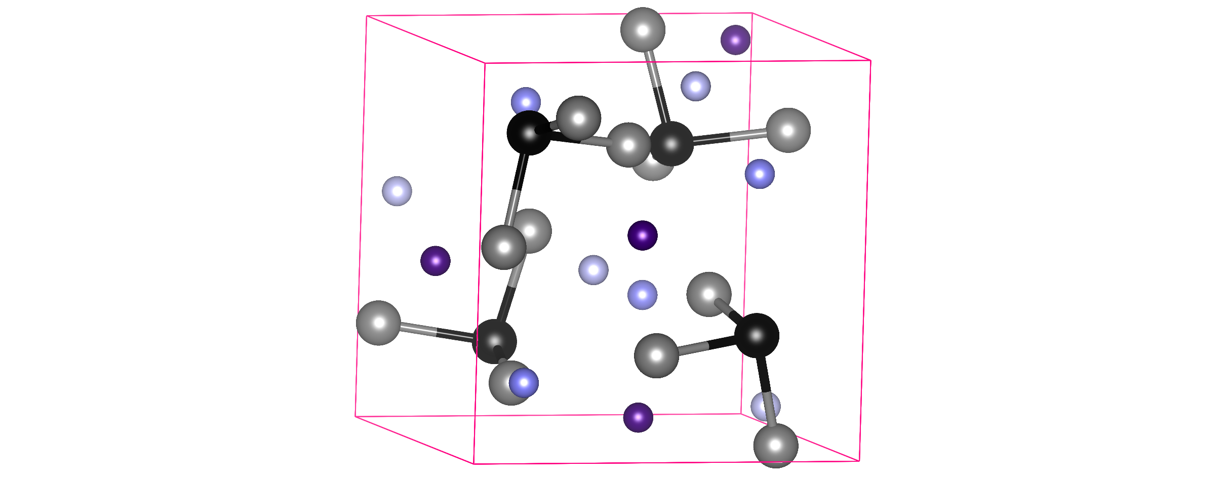
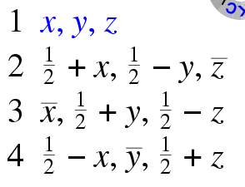
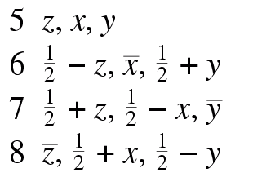
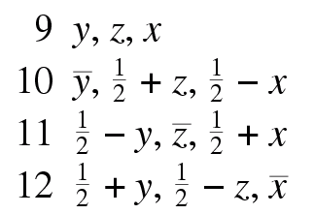
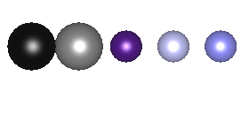
Results
Bulk Na₃SbS₃ (space group P 2₁ 3)
a
a
a
4a 12b 4a 4a 4a
Wyckoff labels
Sb S Na Na Na
Atoms

Slide 12
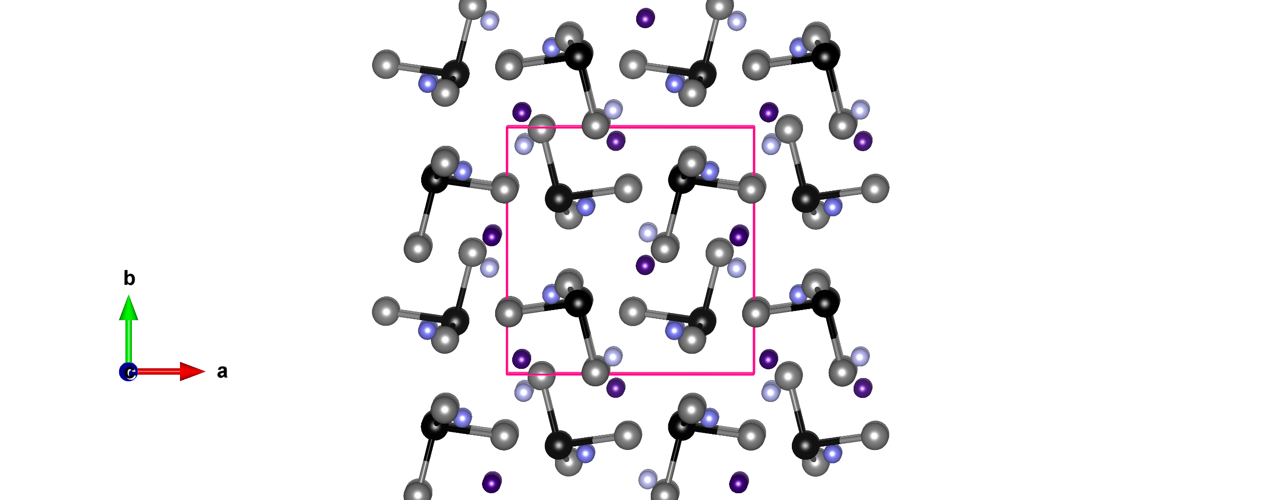
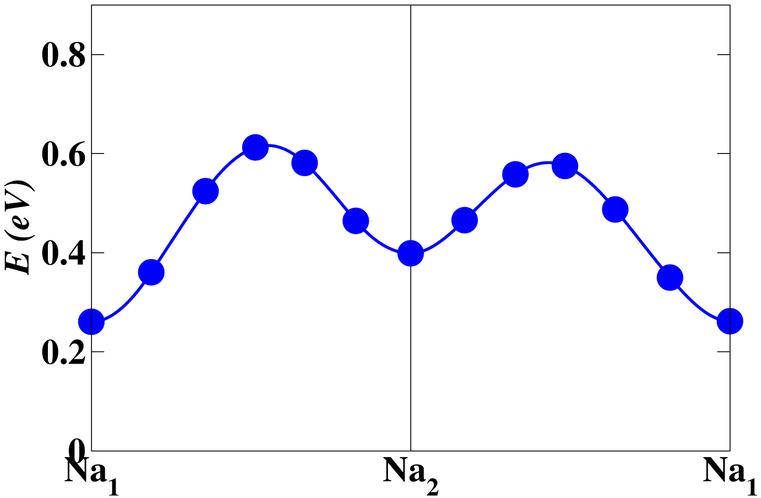
Results
Ball-and-stick model for Na₃SbS₃
NEB calculations
1
2
1
2
$$E_{m}≈0.4 eV$$
1
Wyckoff labels
4a 12b 4a 4a 4a
1
2
3
Atoms
Sb S Na Na Na

Slide 13
Conclusions
Na₃SbS₄ has E_{m} ≈ 0.05 eV for a-axis migration
Na₃SbS₄ is reactive to Na
Na₃SbS₃ & Na₂S form at the Na₃SbS₄/Na interface (based on DOS)
Pure Na₃SbS₃ has E_{m} ≈ 0.4 eV

Slide 14
Acknowledgements
This work was supported by NSF grant DMR-1507942. Computations were performed on the Wake Forest University HPC DEAC Cluster.
Special thanks to Prof. Natalie Holzwarth
Thank you for your attention!

