Slide 1
Continuity of Phonon Dispersion Curves of
Anisotropic Ionic Materials
Yan Li, W. C. Kerr, and N. A. W. Holzwarth
Department of Physics, Wake Forest University
Supported by NSF Grant DMR-1507942 and by
WFU contributions to the DEAC Computer Cluster
Outline
Motivation
Formalism
Example – boron nitride
Ref. Li, Kerr, & Holzwarth, J. Phys.: Condens. Matter 32, 055402 (2020)
Notes:
This talk discusses an old topic with some new perspectives – focusing on the coupling of long wavelength electromagnetic waves with lattice vibrations in ionic crystals.

Slide 2
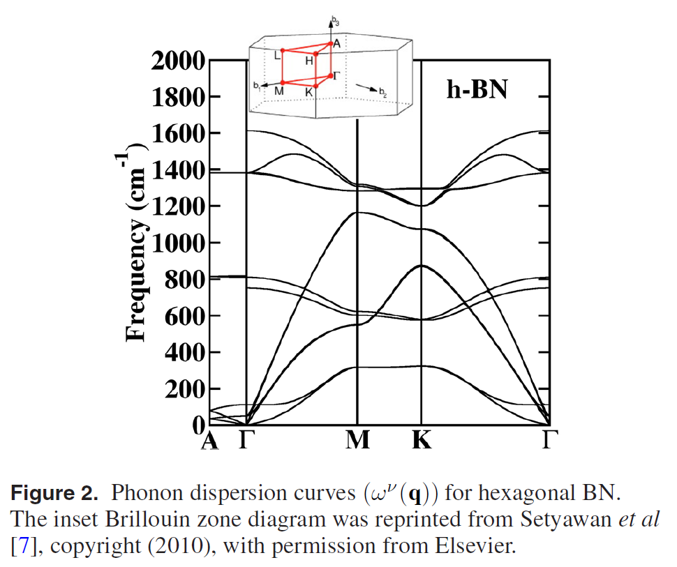
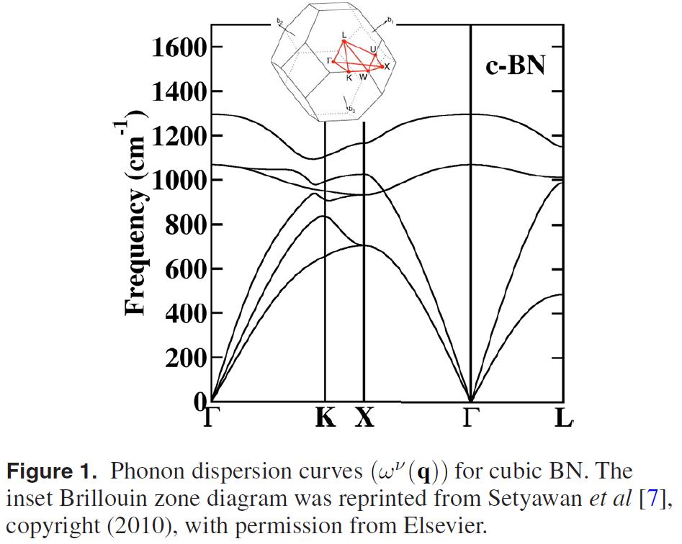
Phonon dispersion curves for boron nitride
Cubic structure
Hexagonal structure
Notes:
This slide shows two examples of phonon dispersion curves for boron nitride which is an ionic material. Figure 1 shows the phonon dispersion curves for boron nitride in the zincblende structure which has a cubic unit cell. Figure 2 shows the phonon dispersion for boron nitride in the hexagonal structure. In both cases, the k-point values of the plots correspond to the lines and points illustrated in the inserted Brillouin zone diagrams. These results were generated using the ABINIT code. Identical results were generated using the QUANTUM ESPRESSO code.

Slide 3
Details of phonon dispersion for hexagonal boron nitride
Continuous mode dispersion for complete phonon-photon system.
Notes:
The red circles on this slide indicate the “discontinuities” at the Gamma point of the phonon dispersion curves for hexagon boron nitride. We will show that these are not really discontinuities; the complete dispersion curves for the coupled phonon-photon system are continuous.

Slide 4
Basic physics --
➔K. Huang worked out the basic features of phonon-photon coupling in ionic lattices in 1951.¹
New wrinkles –
➔The parameters needed to analyze the phonon-photon coupling can be calculated from first principles using density functional theory (DFT) and density functional perturbation theory (DFPT), available in ABINIT and QUANTUM ESPRESSO, for example.
➔Apparent ‘discontinuities’ or mode ‘disappearances’ in the phonon dispersion curves of ionic materials for q→0 in hexagonal and other anisotropic materials are caused by the directional dependence of the Born effective charge tensor.
➔The full dispersion curves of the phonon–photon system, including both longitudinal and transverse modes, are continuous functions of wavevector.
K. Huang, Proc. Roy. Soc. A208 352-365 (1951)
Notes:
This is also well explained in the textbook: M. Born and K. Huang, Dynamical Theory of Crystal Lattices, Oxford University Press (1954).

Slide 5
Ingredients of analysis evaluated by DFT and DFPT
Notes:
These ideas were developed in a number of papers such as P. Giannozzi, S. De Gironcoli, P. Pavone, and S. Baroni, Phys. Rev. B 43, 7231 (1991) and X. Gonze, Phys. Rev. B 55, 10337 (1997). Density functional theory is generally used to determine the equilibrium energy of the system U_{SL} within the Born-Oppenheimer approximation. Density functional perturbation theory is used to determine the derivatives with respect to lattice displacements and electric fields.

Slide 6
Coupled equations for ion displacements near q→0 and long wavelength electromagnetic fields
Notes:
Within the Born-Oppenheimer approximation and using a classical treatment of the ionic motion, the first equation describes the coupling of the lattice displacements to an electric field in the long wavelength range. The second two equations describe the relevant Maxwell’s equations for the electric and displacements fields. The last equation represents the relationship of the displacement field to the electric field including both the electronic (“high frequency”) response and the dipolar contributions due to the ionic displacements.

Slide 7
Solution of coupled equations for ion displacements near q→0 and long wavelength electromagnetic fields
Notes:
Here we use linear combinations of the eigenstate displacements of the q=0 phonon modes to solve the coupled equations. Only a few of the modes have non-trivial coupling to the electromagnetic waves.

Slide 8
Longitudinal solutions to the phonon-photon equations
Note that only the modes which have non-trivial values of and are included so that typically, the dimension of eigenvalue problem is a small fraction of the dimension of the corresponding dynamical matrix.
Notes:
The coupled longitudinal modes can be determined from these eigenvalue equations.

Slide 9
Transverse solutions to the phonon-photon equations
Note that this is not a normal eigenvalue problem, but iterative methods can be used for solution. Note that only the modes which have non-trivial values of and are included so that typically, the number of coupled equations is relatively small.
Notes:
The equations for the transverse modes are more complicated. They can be written as an eigenvalue problem which can be solved iteratively.

Slide 10
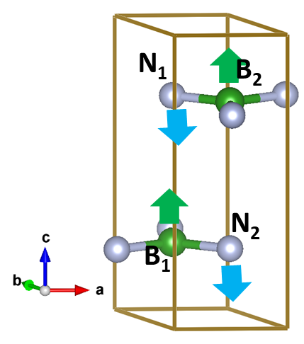
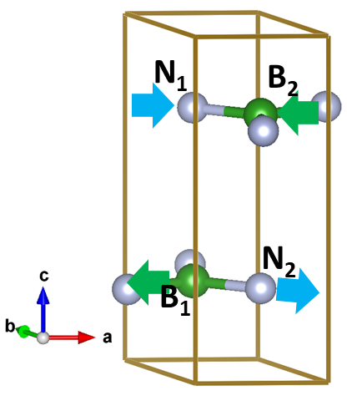
Example of hexagonal boron nitride
Of the 12 normal modes near q=0, only 3 couple with EM waves:
Mode 7 involves displacements along z (c) axis
Modes 11 & 12 involve displacements along x,y (a,b) axes
Notes:
These diagrams represent ball and stick models of the hexagonal boron nitride unit cell with arrows indicating the directions of the ion motions for the coupled modes.

Slide 11
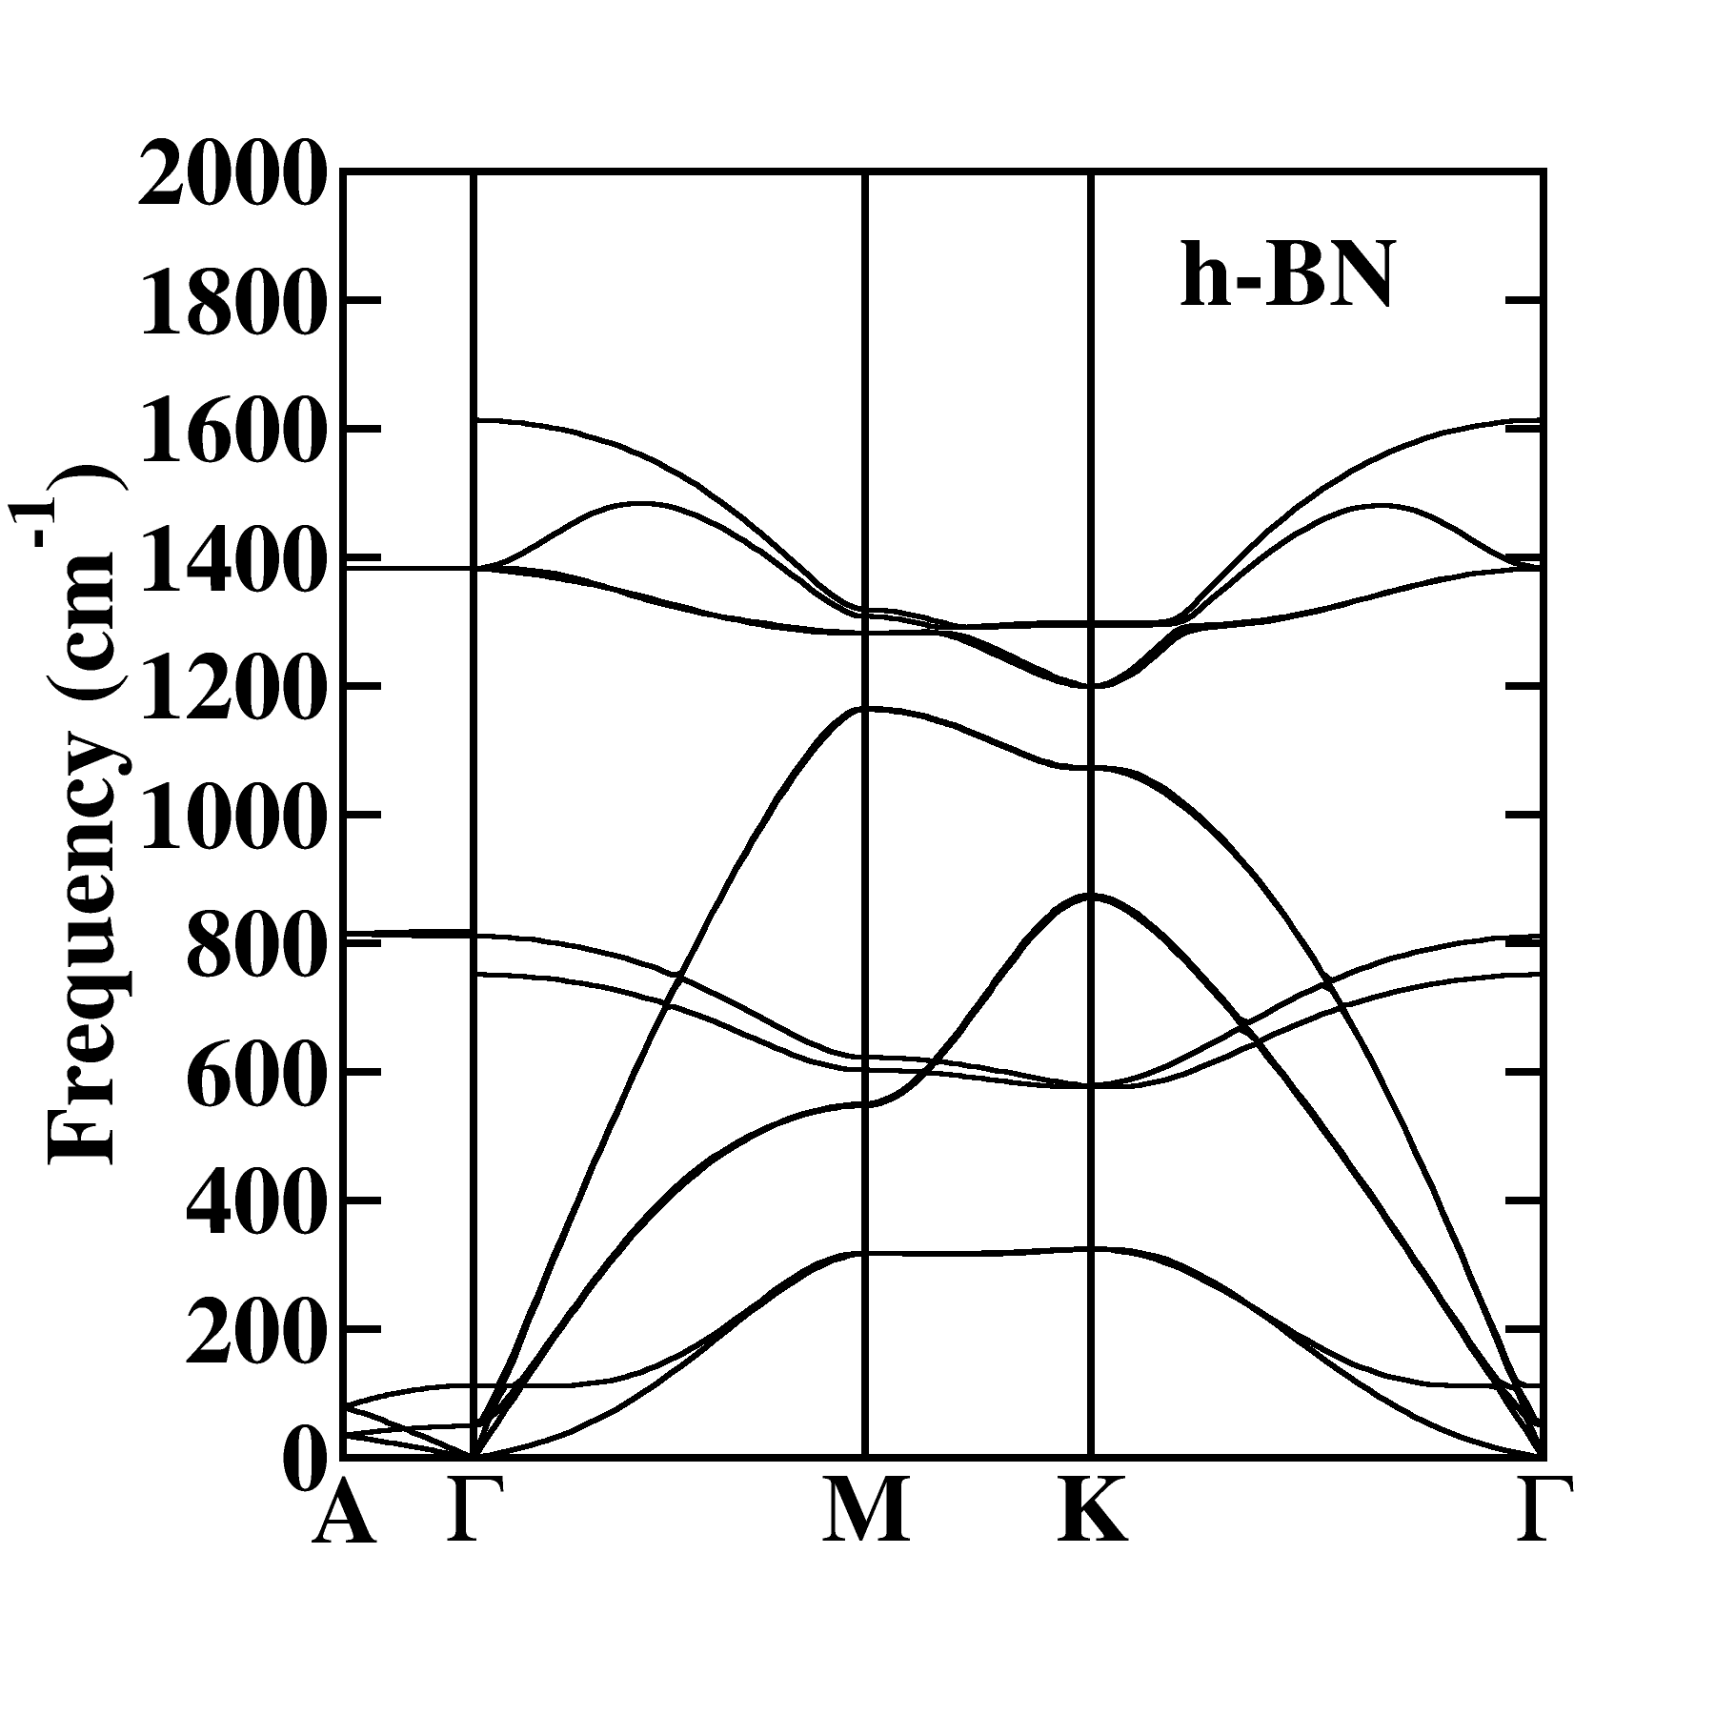
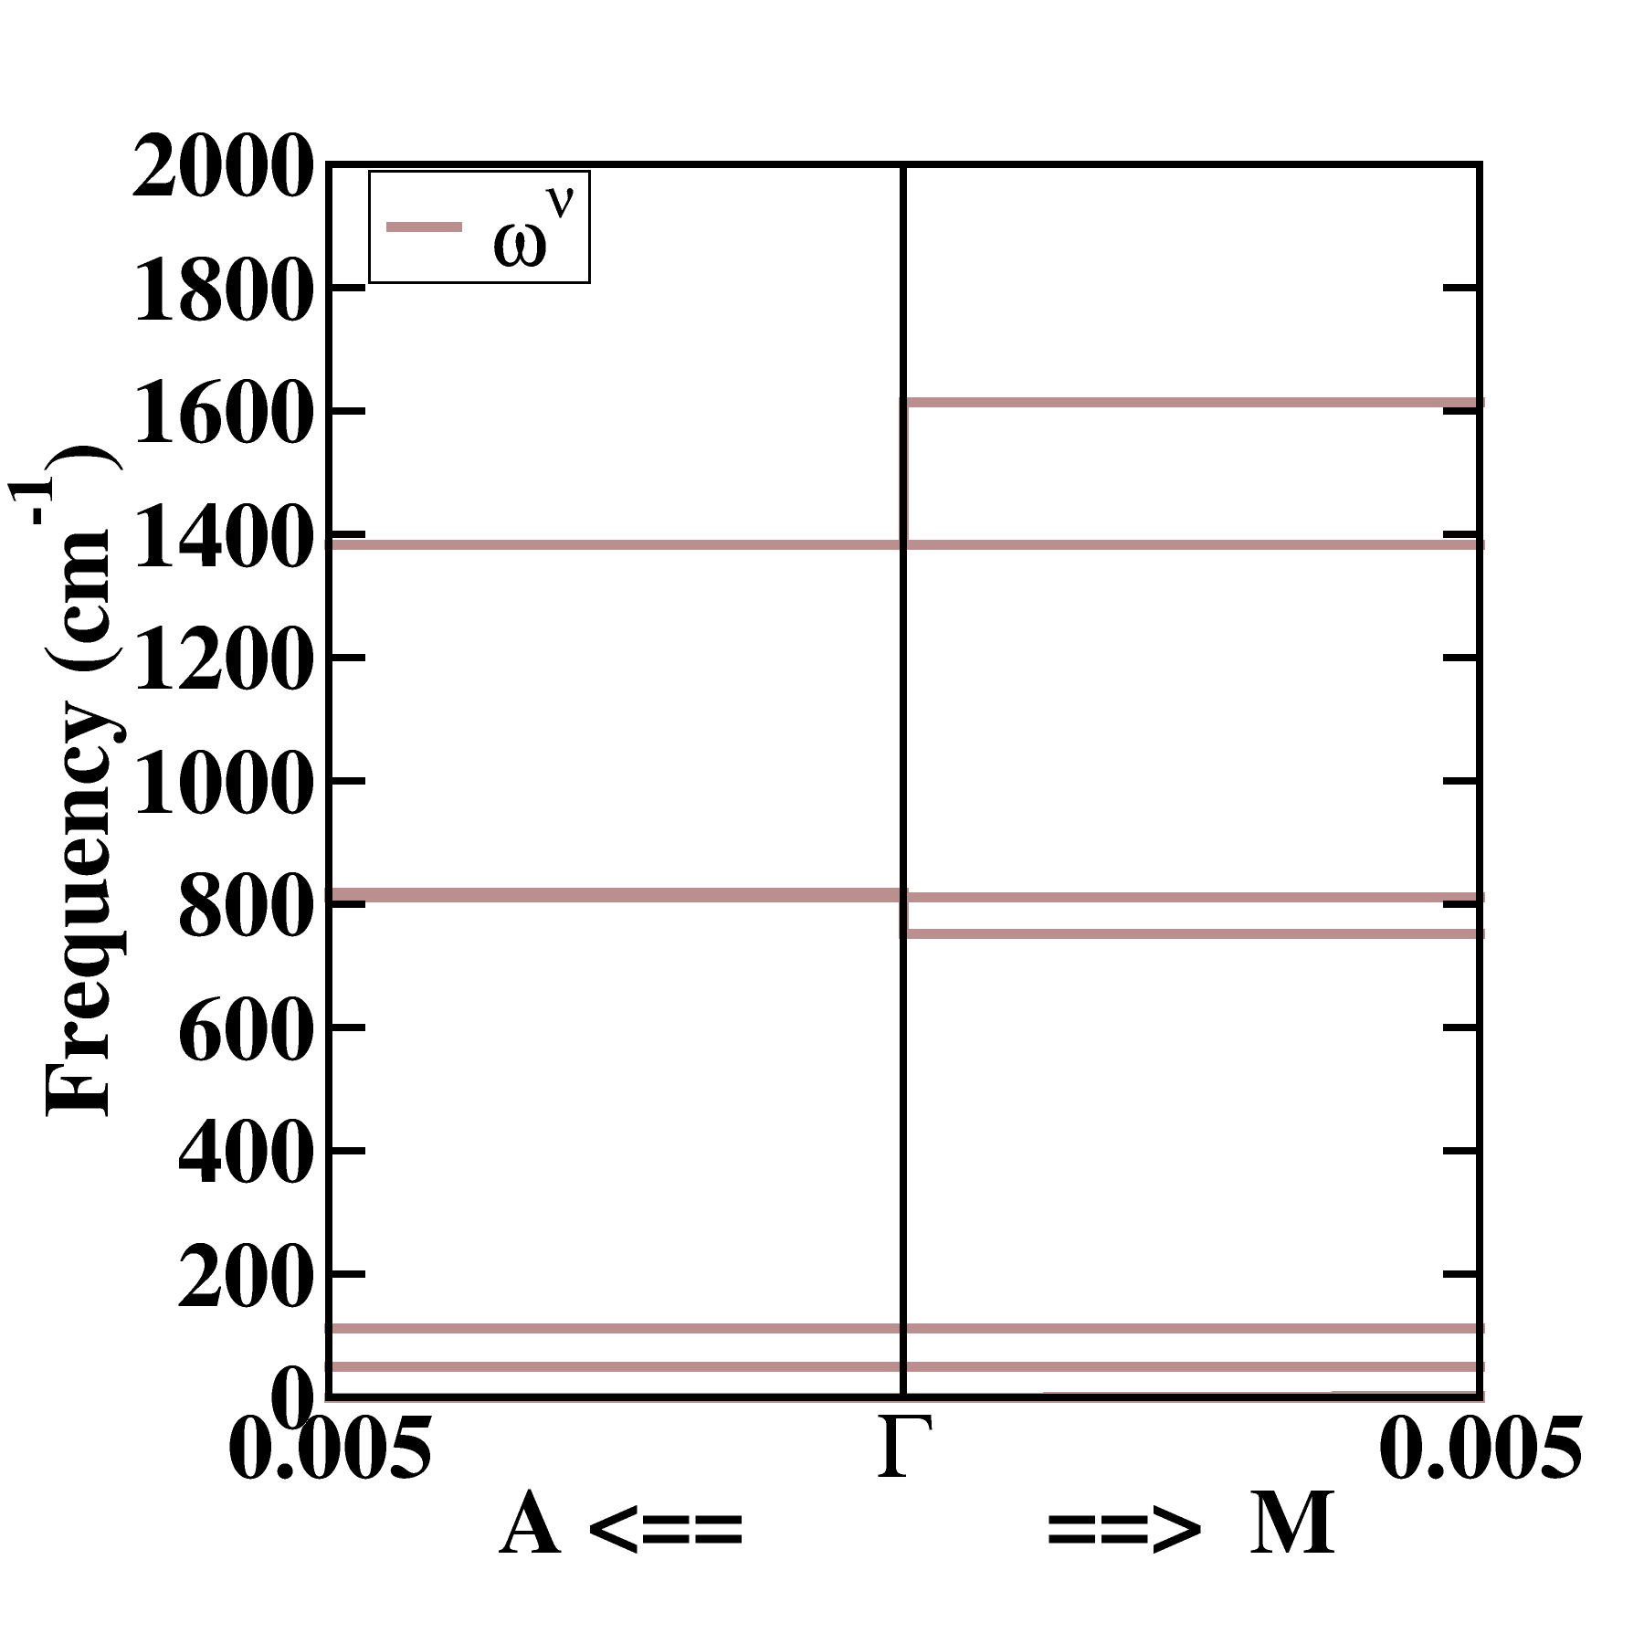
Notes:
This diagram shows the relationship of the phonon modes in a typical Brillouin zone plot to the expanded detail near q=0.

Slide 12
Notes:
Reference plot of uncoupled phonons. (In fact, the optical mode frequencies at exactly at q=0 were corrected for their LO-TO splitting according to the method of P. Giannozzi, S. De Gironcoli, P. Pavone, and S. Baroni, Phys. Rev. B 43, 7231 (1991).)

Slide 13
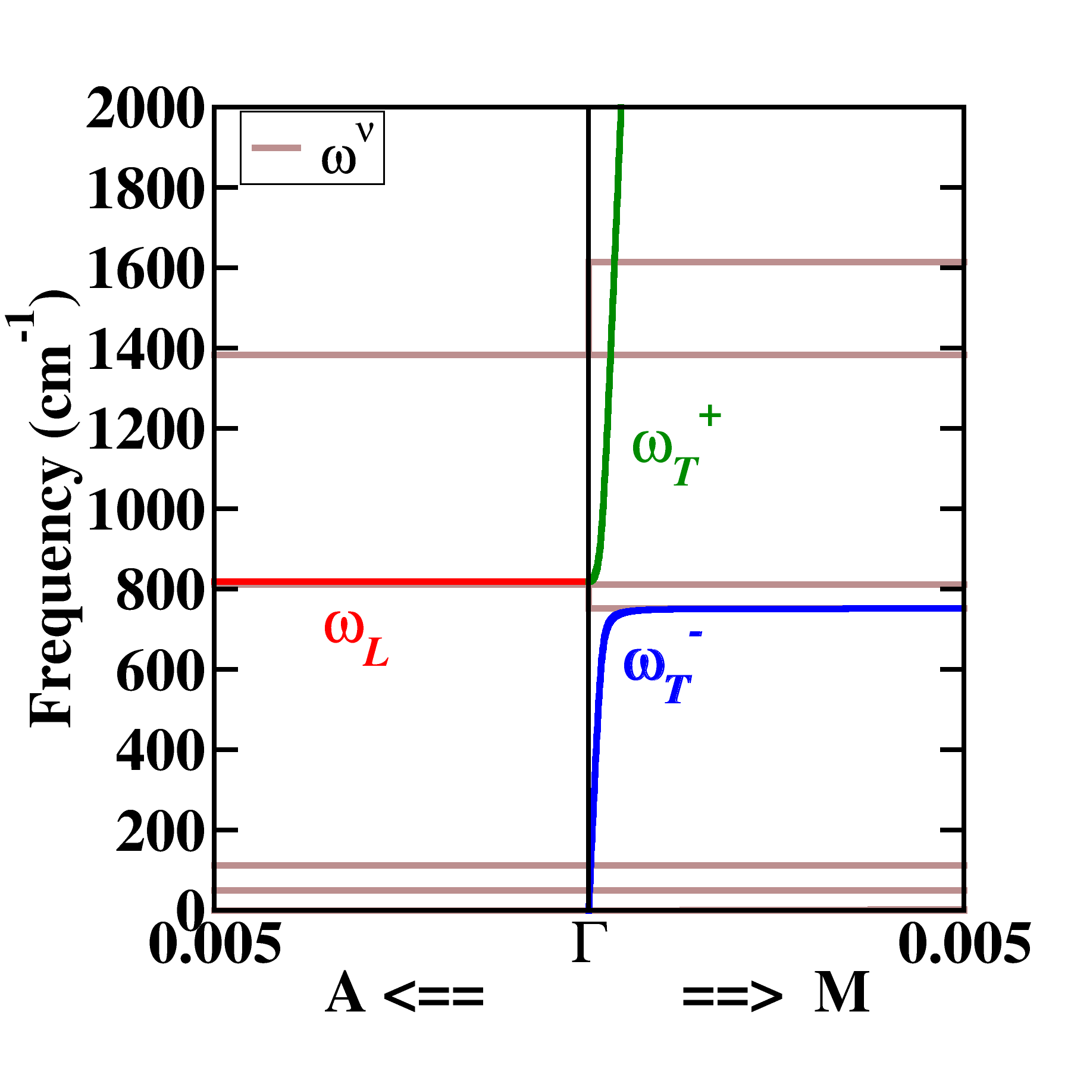
Phonon-photon coupling to mode #7
Mode 7 involves
displacements along z (c) axis
Notes:
For coupling mode #7, the displacements are along the z-direction. This affects the longitudinal dispersion for q along z as plotted along Gamma→A. In this limit, there is no q dependence in the dispersion. This also affects the transverse dispersion along x as plotted along Gamma→M. These results in two transverse modes as indicated with “+” and “-” curves with the analytic q dependencies as shown.

Slide 14
Notes:
Reference plot of uncoupled phonons. (In fact the optical mode frequencies at exactly at q=0 were corrected for the LO-TO splitting according to the method of P. Giannozzi, S. De Gironcoli, P. Pavone, and S. Baroni, Phys. Rev. B 43, 7231 (1991).)

Slide 15
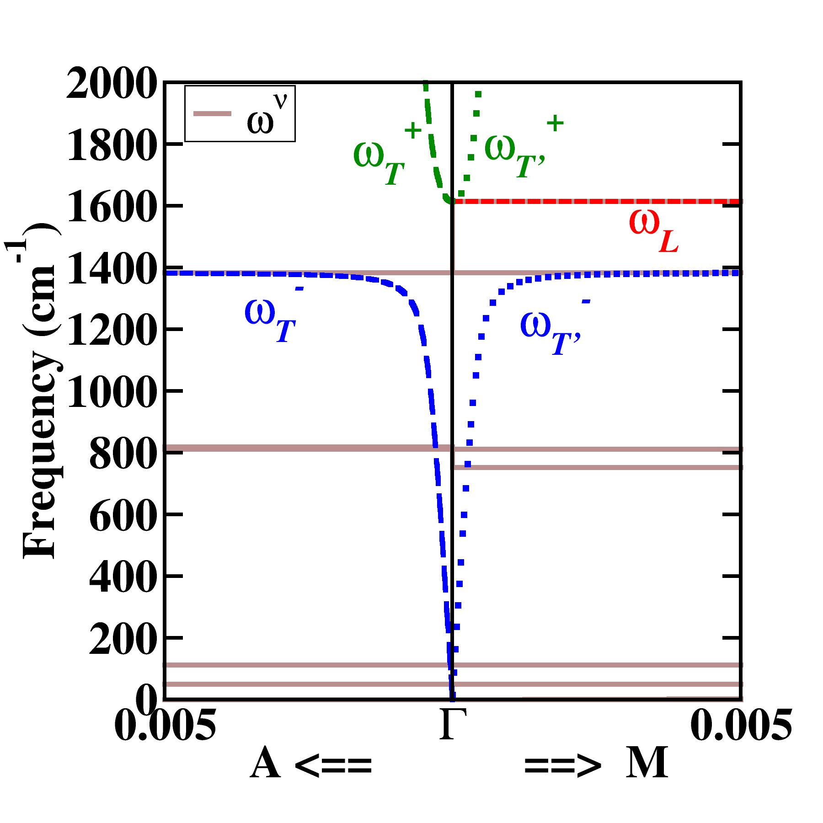
Phonon-photon coupling to modes #11 & 12
Modes 11 & 12 involve displacements along x,y (a,b) axes
Note that … (ω_{T} ) curves represent coupling to mode 12 with transverse contributions associated with longitudinal mode along Γ→K
Notes:
For coupling mode #11, the displacements are along the x-direction. This affects the longitudinal dispersion for q along x as plotted along Gamma→M. In this limit, there is no q dependence in the dispersion. This also affects the transverse dispersion along z as plotted along Gamma→A. These results in two transverse modes as indicated with “+” and “-” curves with the analytic q dependencies as shown. Mode #12 is degenerate with #11 and can be represented with displacements along the y axis. The corresponding longitudinal dispersion is not shown in this plot. The corresponding transverse dispersions along Gamma→M which are included in this plot.

Slide 16
Summary and conclusions –
➔The parameters needed to analyze the phonon-photon coupling can be calculated from first principles using density functional theory (DFT) and density functional perturbation theory (DFPT), available in ABINIT and QUANTUM ESPRESSO, for example. Particularly, the phonon eigenstates evaluated at q=0, the Born effective charge tensors, and the electronic contributions the dielectric permittivity tensor.
➔Apparent ‘discontinuities’ or mode ‘disappearances’ in the phonon dispersion curves of ionic materials for q→0 in hexagonal and other anisotropic materials are caused by the directional dependence of the Born effective charge tensor.
➔The full dispersion curves of the phonon–photon system, including both longitudinal and transverse modes, are continuous functions of wavevector, modifying both the longitudinal and transverse dispersions. This was illustrated for hexagonal boron nitride.

Slide 17
Summary and conclusions –
LO-TO splitting for mode #7
LO-TO splitting for mode #11 & 12
Notes:
The LO-TO splitting of the modes are shown in these diagrams are identical to those discussed by P. Giannozzi, S. De Gironcoli, P. Pavone, and S. Baroni, Phys. Rev. B 43, 7231 (1991).

Slide 18
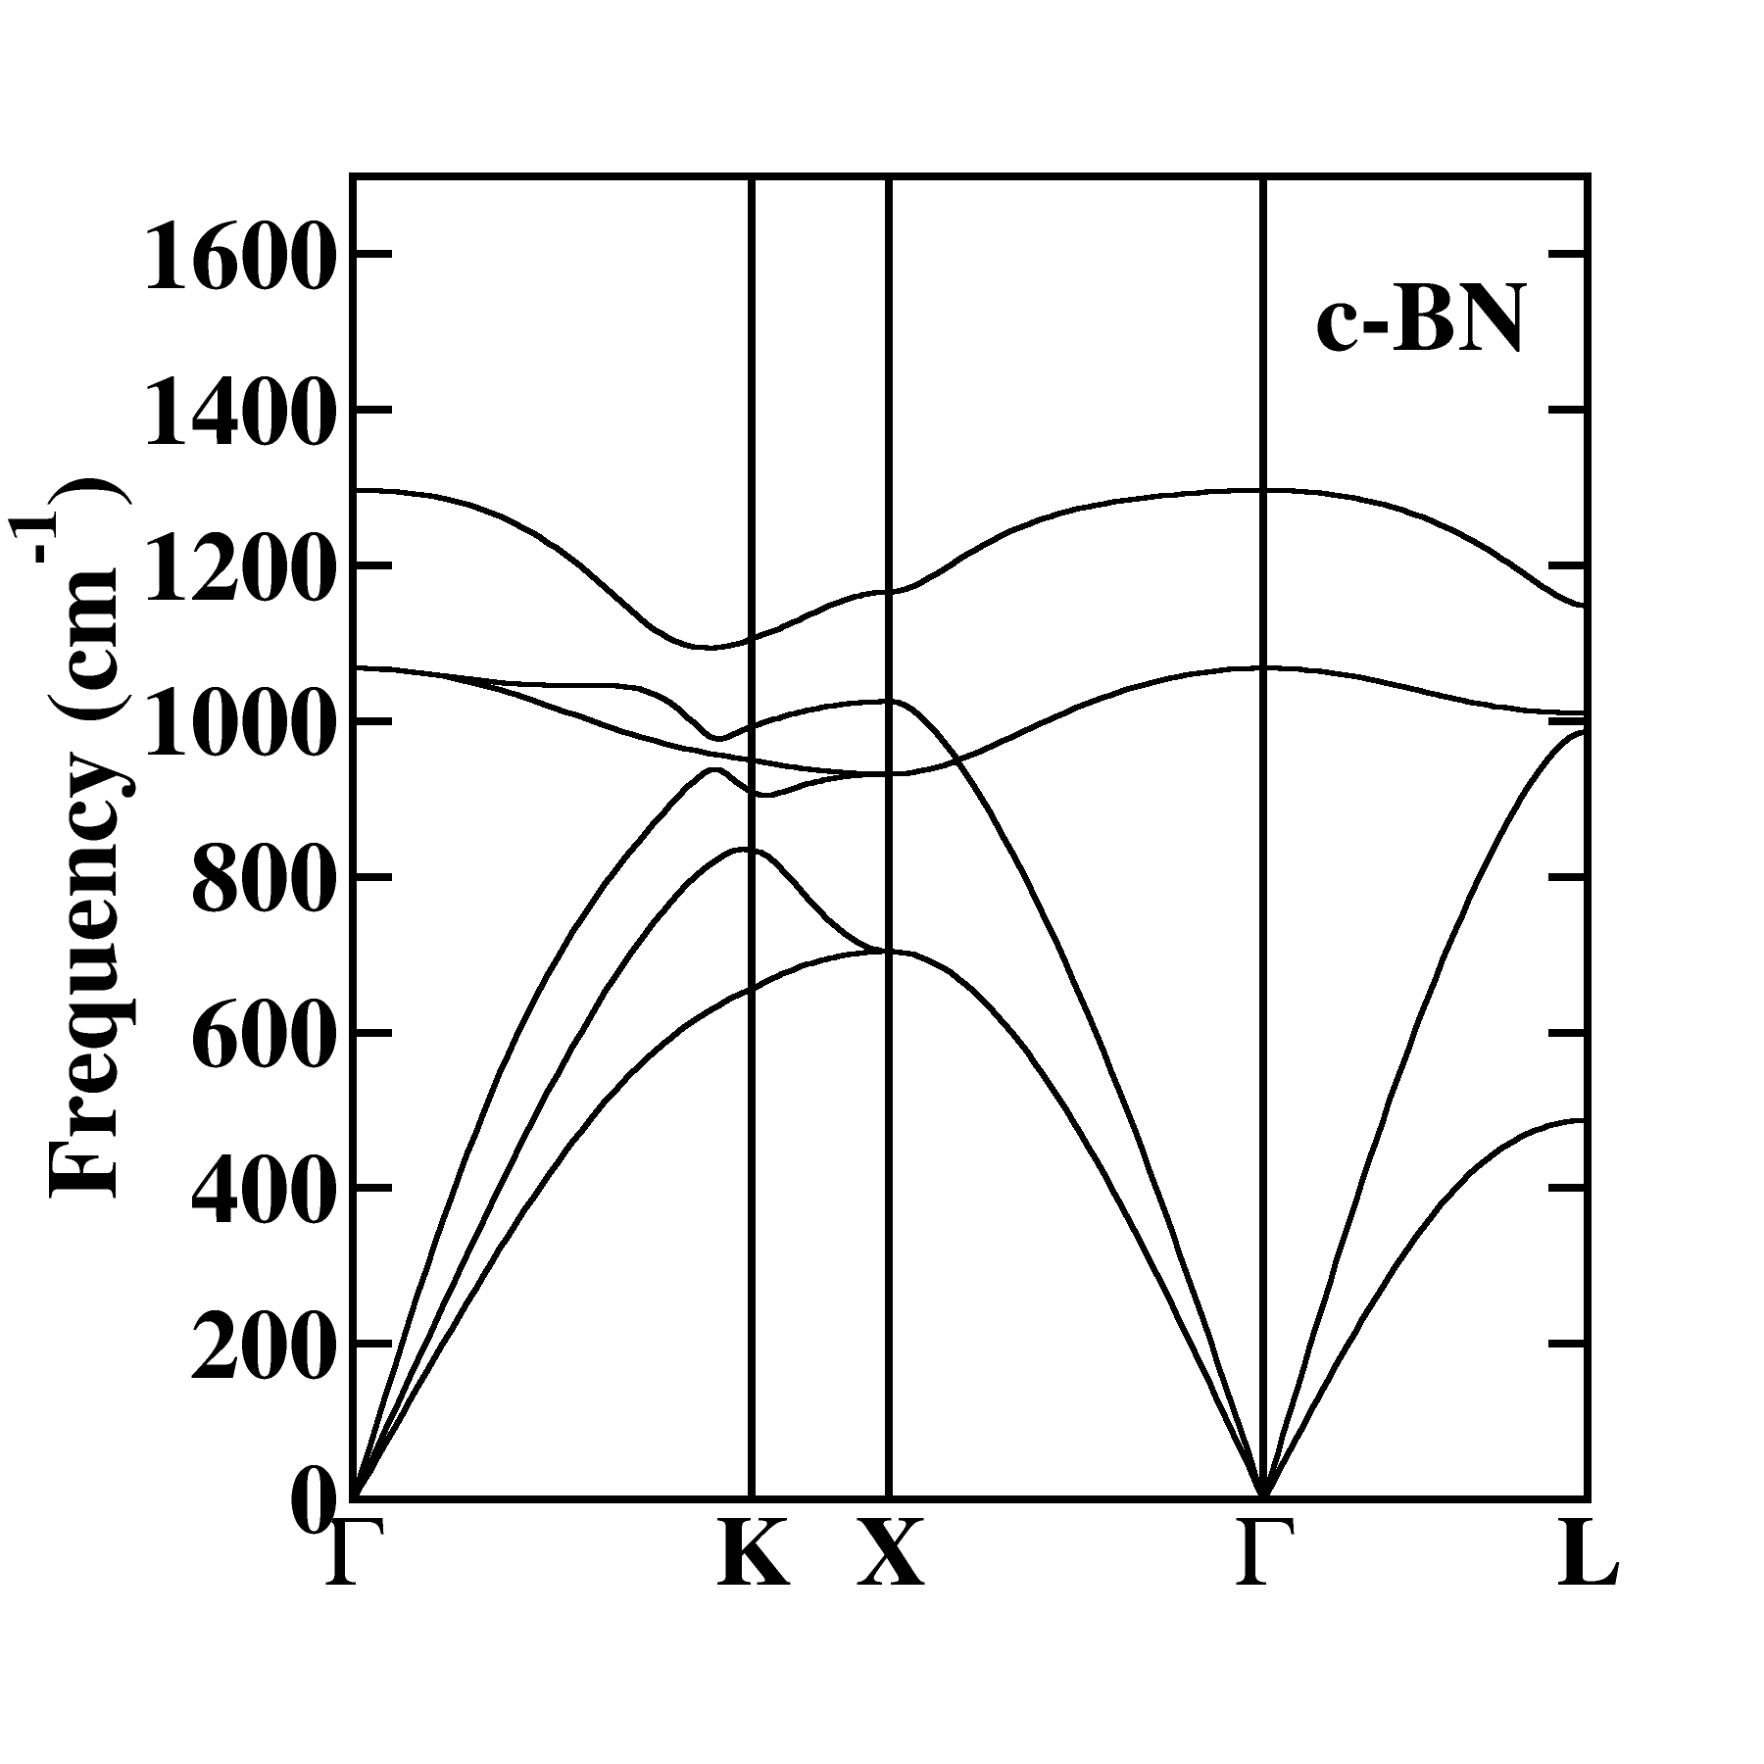
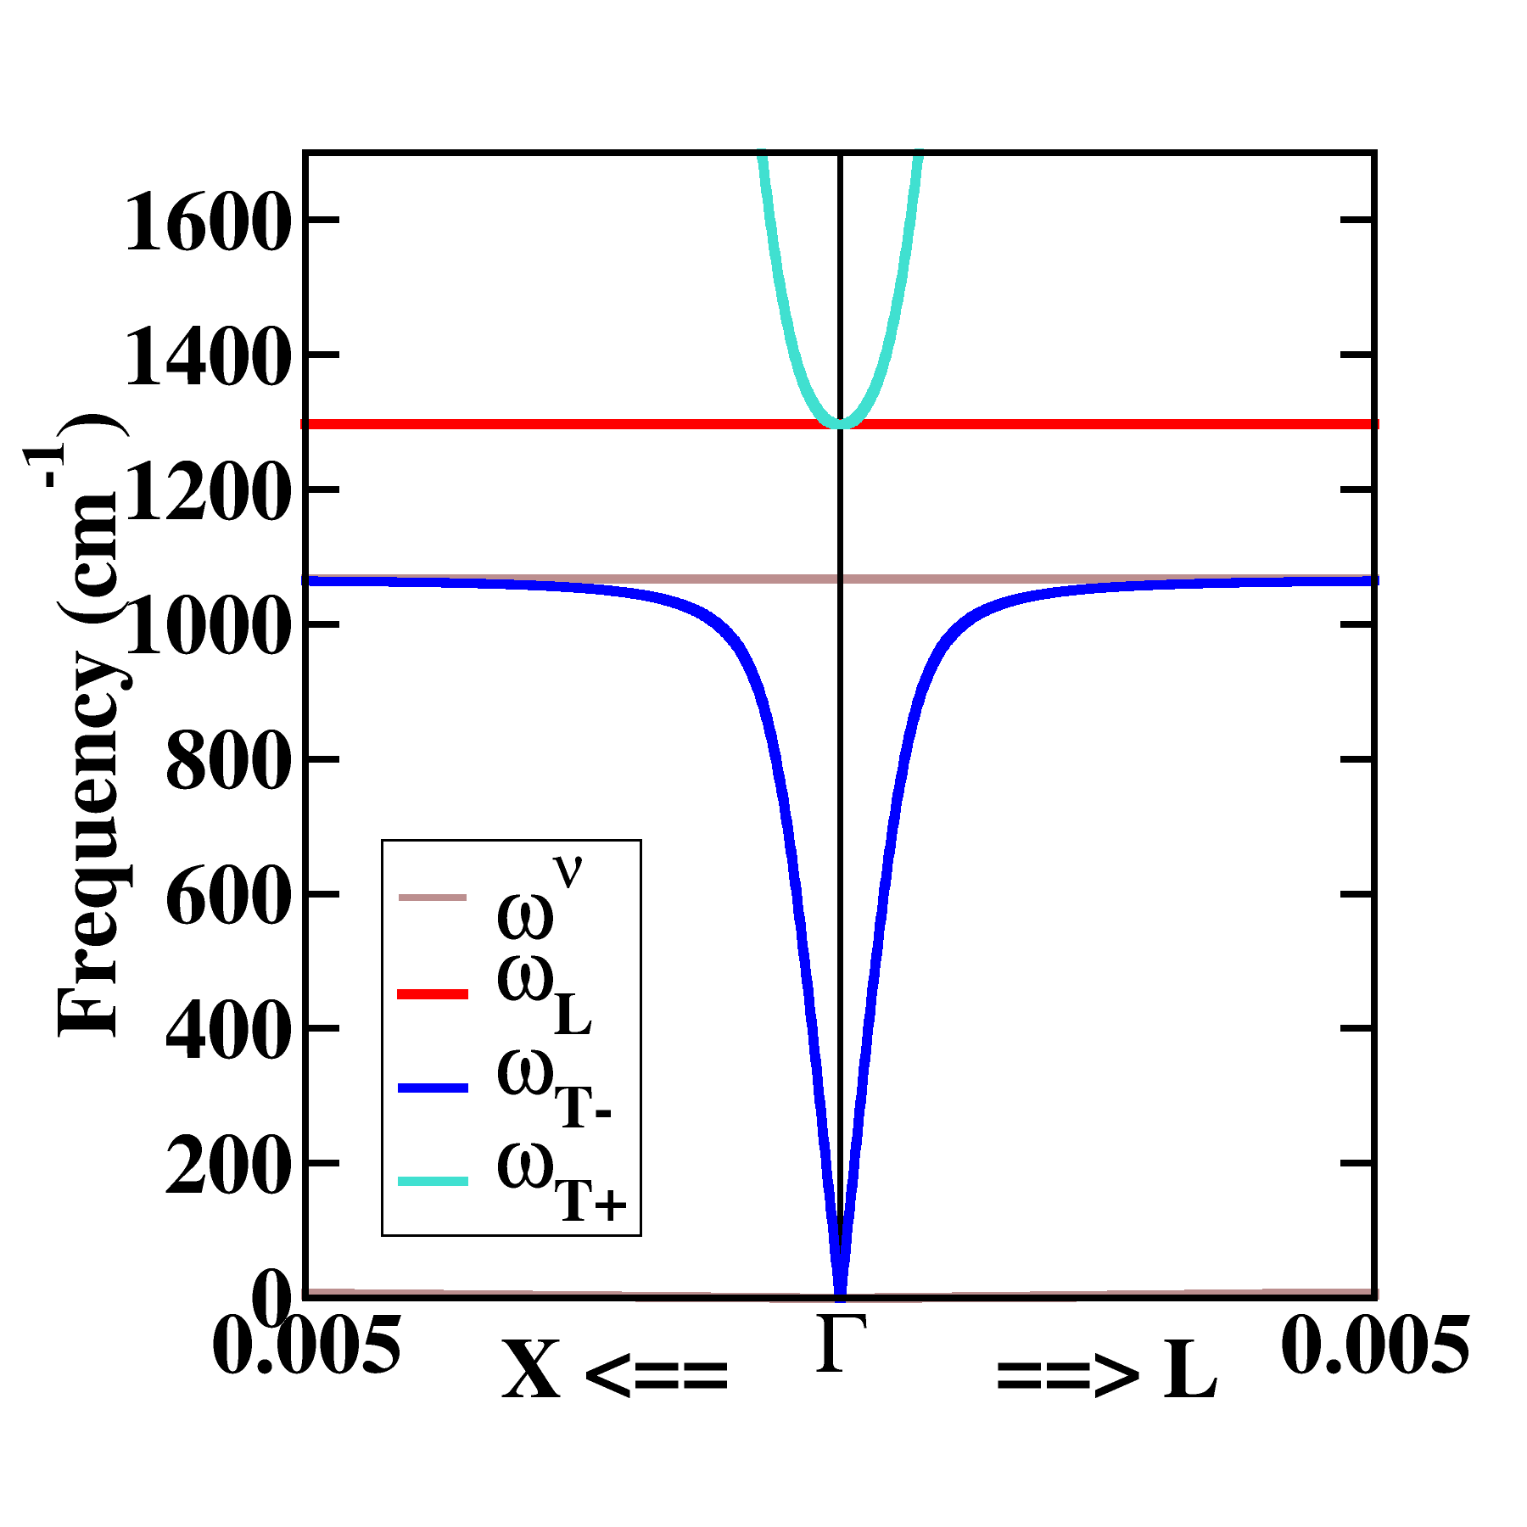
Final comment –
Of course, phonon-photon coupling also occurs for cubic crystals as well
For example, boron nitride in the zincblende structure is illustrated below.
Notes:
While ionic crystals having a cubic structure do not typically show discontinuities in the phonon dispersion plots, the coupling of the ions to long wavelength electromagnetic waves still exists. The corresponding analysis of the coupled phonon-photon dispersion curves for cubic boron nitride are shown in the right diagram.

