Slide 1


First principles simulations of electrolyte materials with a view toward all solid-state battery technology --
Li₄P₂S₆, Na₄P₂S₆, and possible alloys
Yan Li¹, Zachary Hood², and Natalie Holzwarth¹
¹Department of Physics, Wake Forest University
²Electrochemical Materials Laboratory, MIT; now at
Argonne National Labs
WFU effort supported by Deac Cluster and
NSF Grants DMR-1507942 and 1940324.
Contributions from previous students including Larry Rush and Cameron Kates are also gratefully acknowledged.
Ref: PRM 4, 045406 (2020)
Zach, Natalie, and Yan posing at 256th Meeting of the Electrochemical Society in Atlanta, GA Oct. 12-17, 2019

Slide 2
Outline
Motivation
Experimental story
Computational story
Outlook

Slide 3
Motivation
  Research on battery materials
  The case for all solid state batteries
  Challenges for realistic (idealistic??) computer modeling

Slide 4
Motivation
  Research on battery materials
Materials components of a Li or Na ion battery
Role of the electrolyte is to allow for the transport of Li+ or Na+ ions, excluding electrons from the battery and forcing them through the external circuit.
Li+ or
Na+
+
-
Illustrating discharge mode

Slide 5
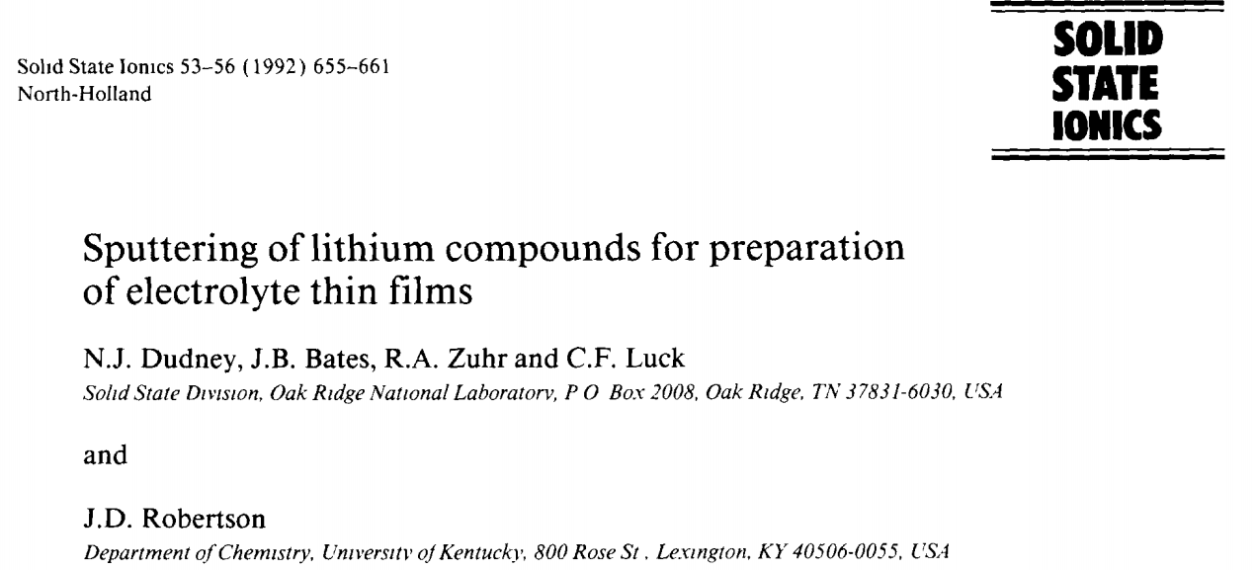
Motivation
  The case for all solid state batteries
Development of LiPON electrolyte films at Oak Ridge National Laboratory

Slide 6

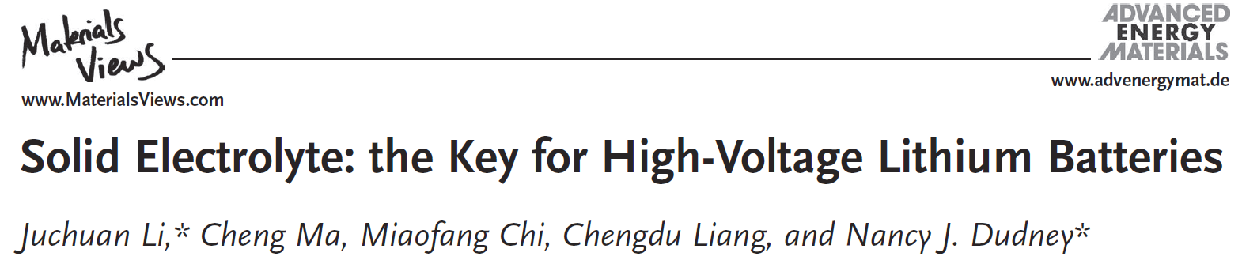

Motivation -- The case for all solid state batteries
ORNL
  Advantages
Compatible and stable with high voltage cathodes
Compatible and stable with Li metal anodes
Can be effective in thin formats
  Disadvantages
Relatively low ionic conductivity
Lower total capacity compared with liquid electrolytes
Possible physical and chemical interface issues
Demonstrated for LiNi_{0.5}Mn_{1.5}O₄/LiPON/Li
  10⁻⁶ m LiPON electrolyte layer achieved adequate conductivity
  10,000 cycles* with 90% capacity retention
*1 cycle per day for 27 years

Slide 7
Motivation
  Challenges for realistic (idealistic??) computer modeling
    Technological challenges –
      Improving the ionic conductivity
      Stabilizing the electrolyte material in battery conditions
      Stabilizing the cathode/electrolyte and anode/electrolyte interfaces
    Checking accuracy of computational models in terms of physical and numerical approximations, comparing with real materials

Slide 8
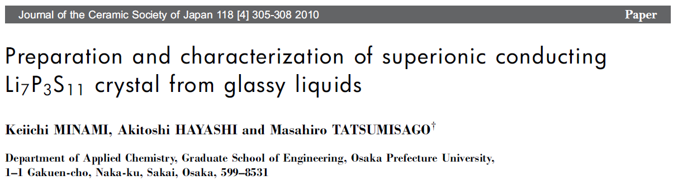
Experimental story – Li₄P₂S₆ and Na₄P₂S₆ as examples of interesting electrolyte systems
Li₄P₂S₆ has been identified as a low conductivity decomposition product in the formation of lithium thiophosphate electrolytes.

Slide 9
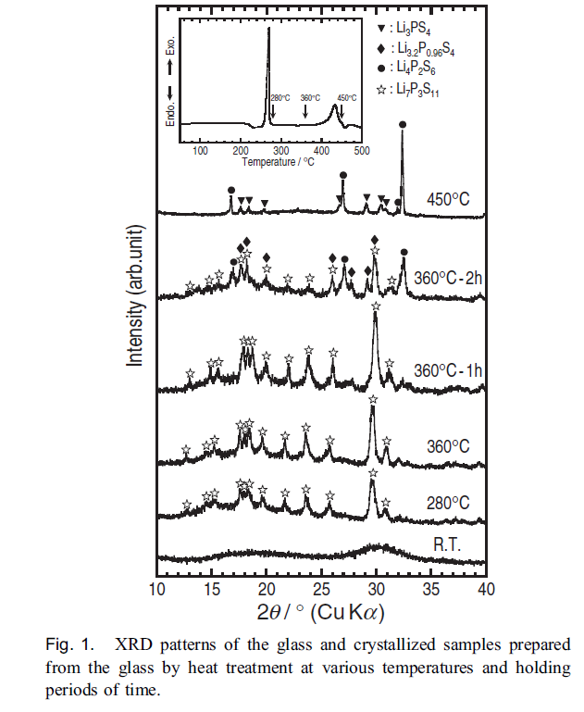
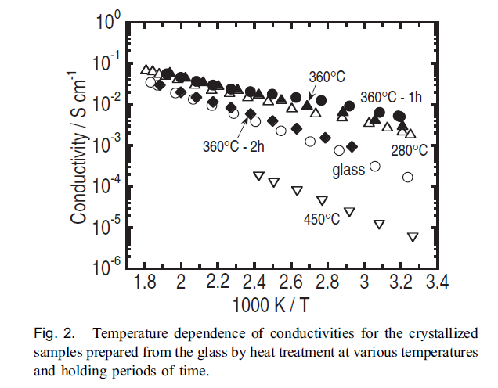
Minami et al. 2010, continued
Li₇P₃S₁₁
Li₄P₂S₆
Li₄P₂S₆
Li₇P₃S₁₁

Slide 10
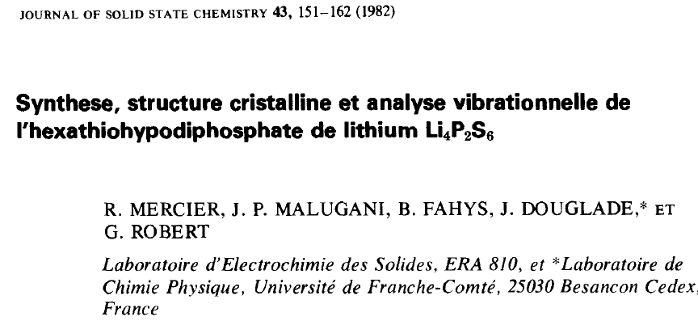
Experimental story – Li₄P₂S₆ continued --
Structure analyzed as a disordered hexagonal structure with space group P6₃/mcm (#193)

Slide 11
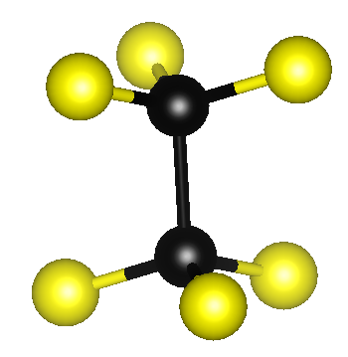
Experimental story – Li₄P₂S₆ continued --
P₂S₆⁴⁻ building blocks:
Mercier’s disordered structure ascribed to placement of the building blocks and the corresponding arrangement of Li ions.
hexathiohypodiphosphate
S
P

Slide 12
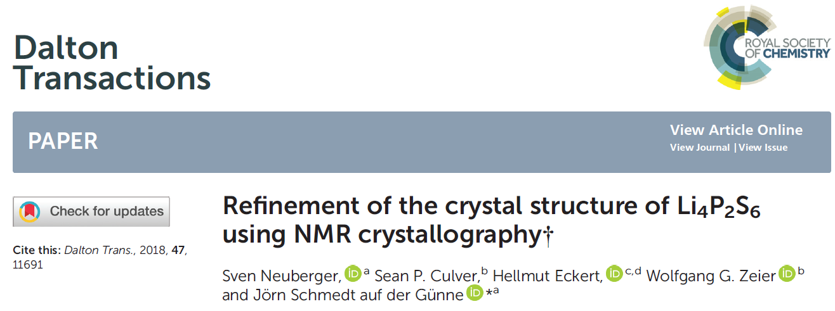
Experimental story – Li₄P₂S₆ continued --
Prepared more highly crystalline samples; combined NMR and X-ray analysis to show that there are two inequivalent P sites

Slide 13
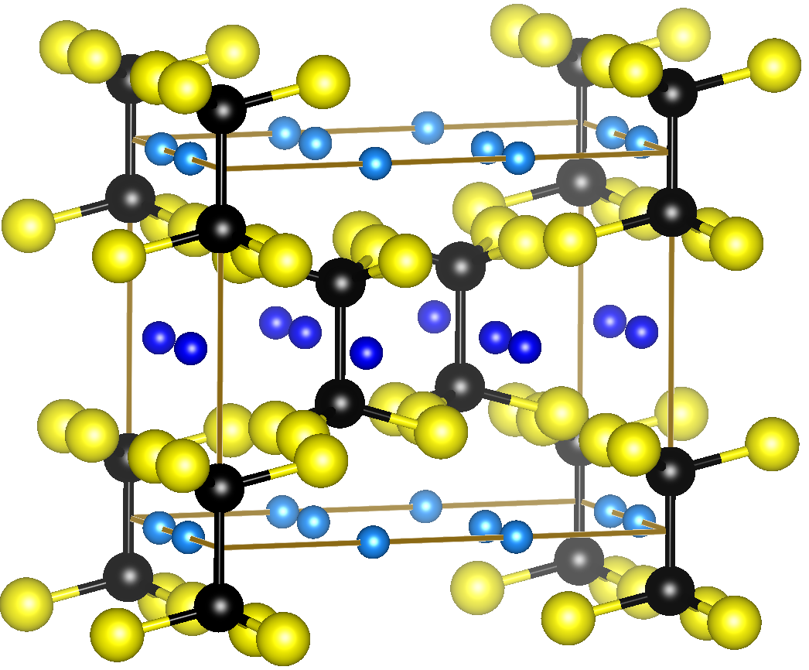
Experimental story – Li₄P₂S₆ continued --
Neuberger structure
➔ordered structure
reported as P321
Space group
P321 → P3m1
_
our simulations
Li
S
P

Slide 14
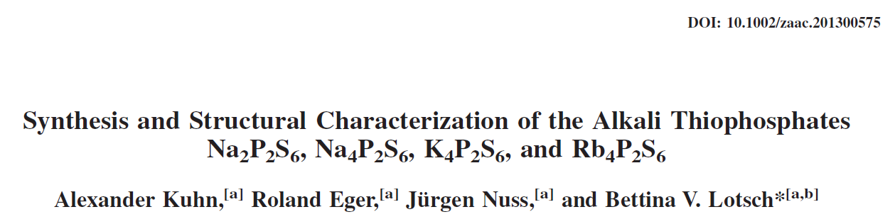
Experimental story – Na₄P₂S₆ continued --
Na₄P₂S₆ found to crystallize in a base centered monoclinic structure with space group C2/m (#12); result verified by Zachary Hood and colleagues who also found the material to have appreciable Na ion conductivity.

Slide 15
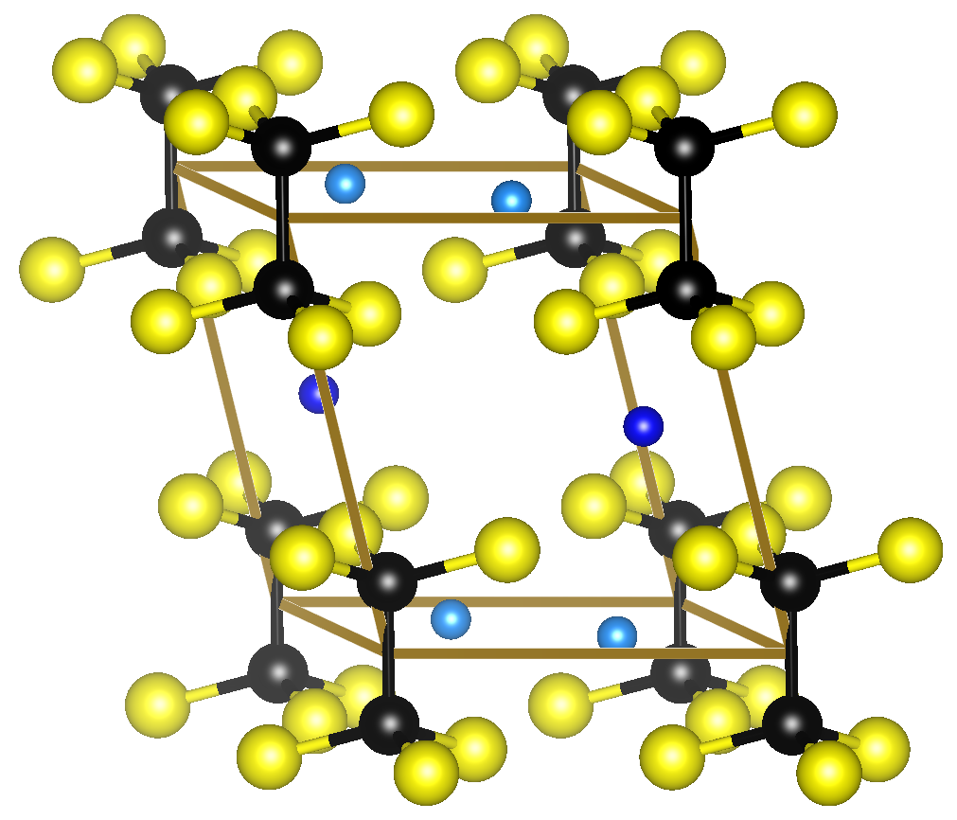
Experimental story – Na₄P₂S₆ continued --
Primitive cell of the Kuhn structure
Space group C2/m
Na
S
P

Slide 16
Computational challenges –
  Can computer modeling explain the structural stability patterns found by experiment?
  What about possible new related materials?
  What does computer modeling say about the mechanisms of ionic conductivity?

Slide 17
  Simulation of structural stability patterns
Computational details –
  Formalism: Born-Oppenheimer approximation + Density functional theory (Hohenberg and Kohn, Phys. Rev. 136 B864 (1964); Kohn and Sham, Phys. Rev. 140 A1133 (1965))
  Method: Projector Augmented Wave (P. Blöchl, Phys. Rev. B 50 17953 (1994))
  Exchange correlation function: PBEsol (Perdew et al., PRL 100 136406 (2008))
Codes used for calculations
Function | Code | Website
Generate atomic datasets | ATOMPAW | http://pwpaw.wfu.edu
DFT; optimize structure; vibrational analysis | PWscf abinit | http://www.quantum-espresso.org http://www.abinit.org
Structural visualization | XCrySDen VESTA | http://www.xcrysden.org http://jp-minerals.org/vesta/en/

Slide 18
Simulation of structural stability patterns -- continued
Static lattice
approx
Harmonic phonon approx
Internal energy from DFT
phonon DOS

Slide 19
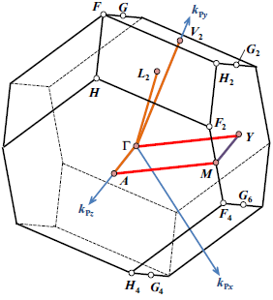
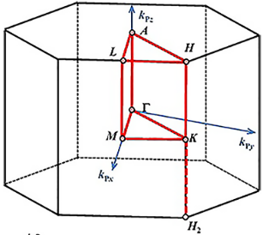
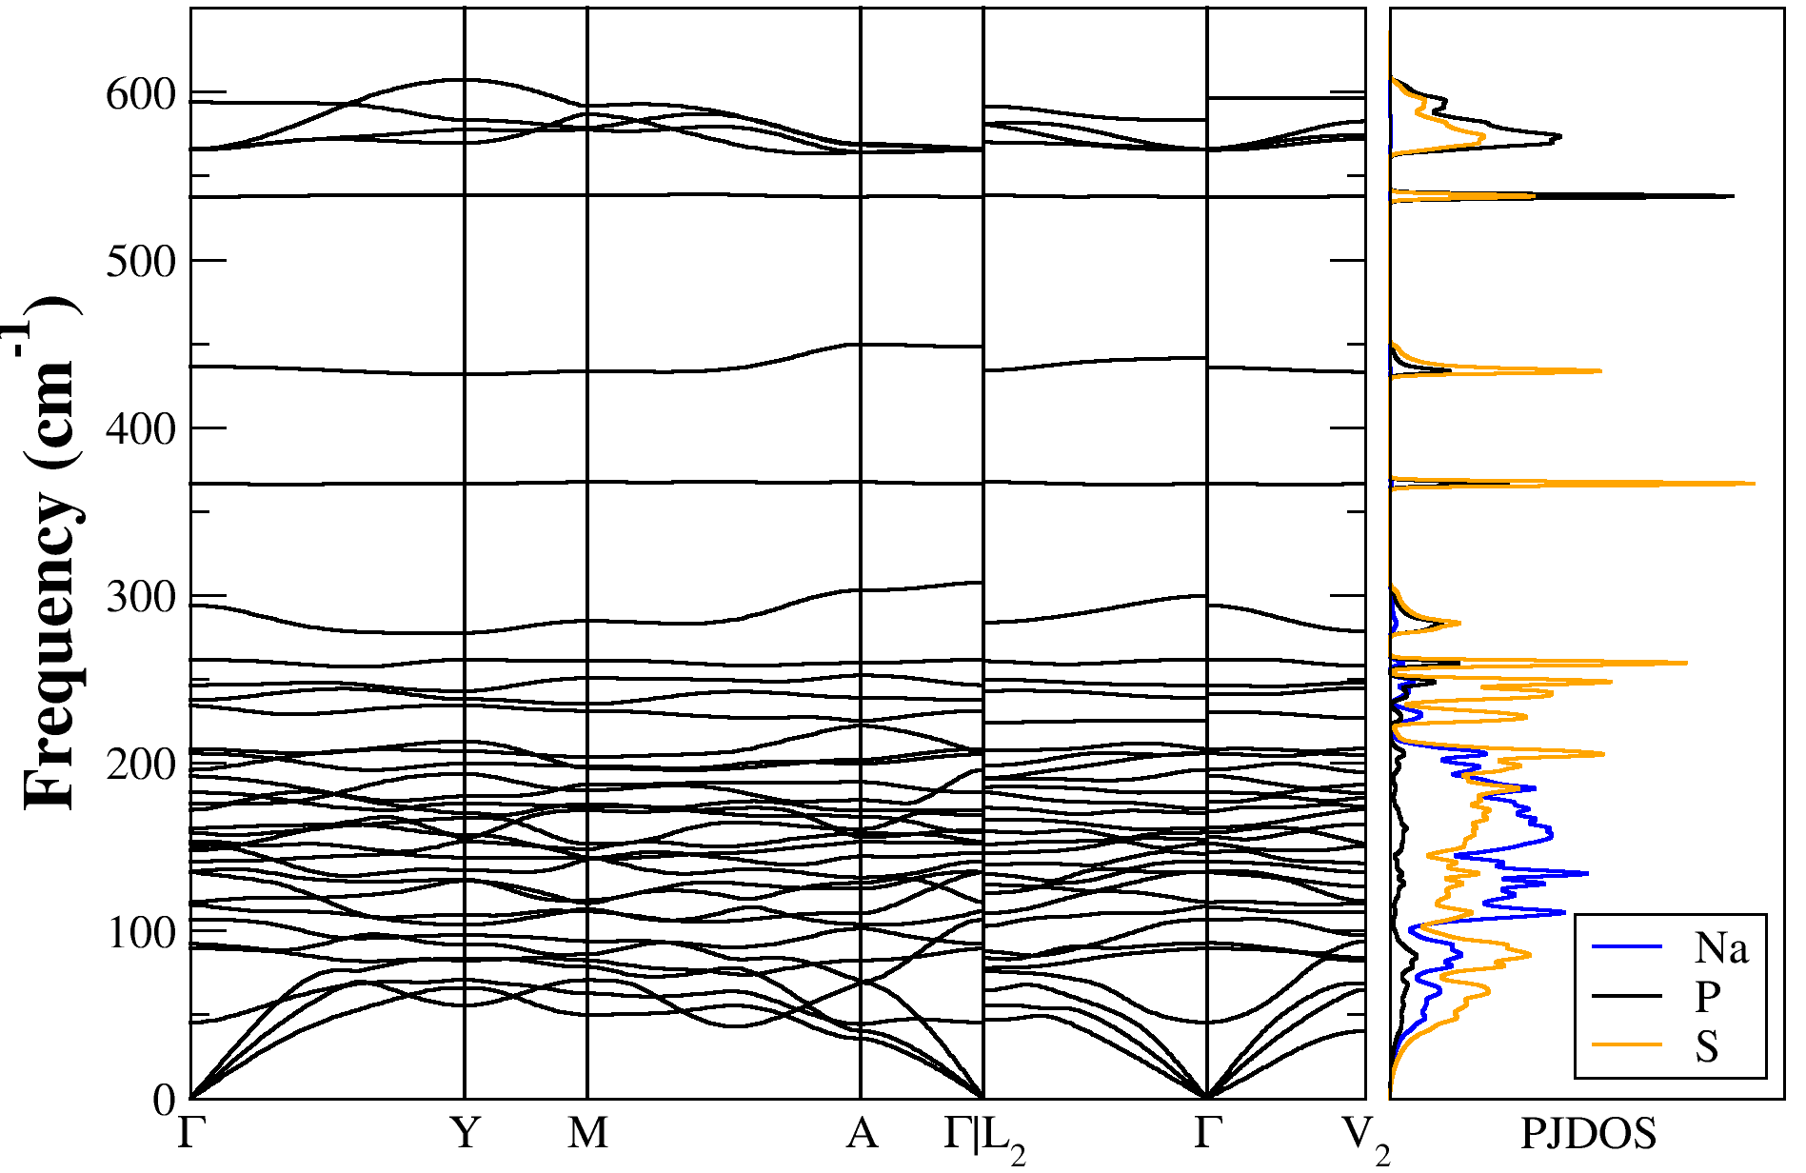
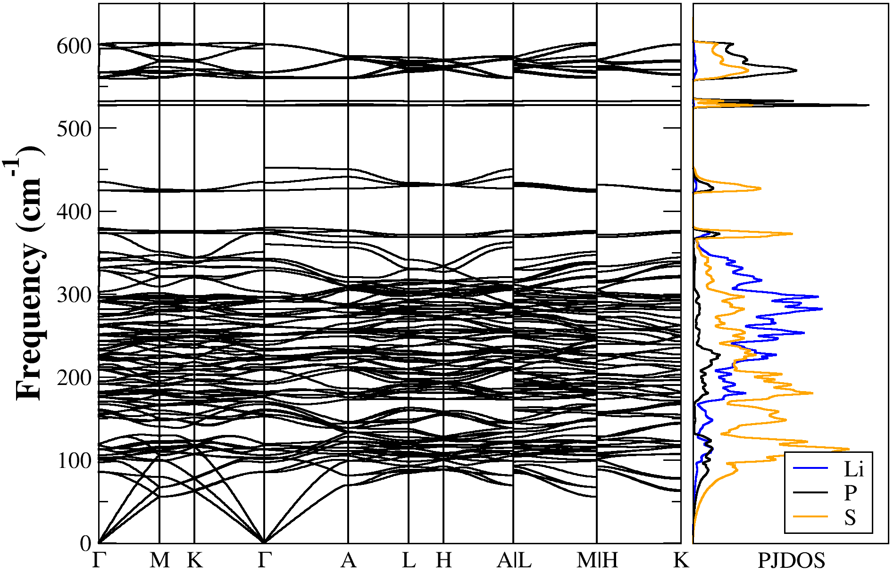
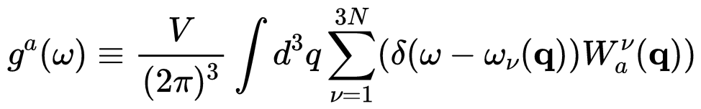



Simulation of structural stability patterns -- continued
Na₄P₂S₆ in the C2/m Structure (36 modes)
Li₄P₂S₆ in the P$\overline{3}$m1 Structure (108 modes)
$${\text{ω}}^{32}\left(q\right)$$
$${\text{ω}}^{30}\left(q\right)$$
Li⁺ 0~370 cm⁻¹
Na⁺ 0~300 cm⁻¹
(P₂S₆)⁴⁻ 370~600 cm⁻¹
(P₂S₆)⁴⁻ 300~600 cm⁻¹
¹Suggested path: Hinuma et al., Comp. Mat. Sci. 128, 140-184 (2017)
²Li et al., J. Phys. Condens. Matter, 32, 055402 (2020)
PJDOS:
Discontinuous branches at Г: coupling between photon and photon²

Slide 20
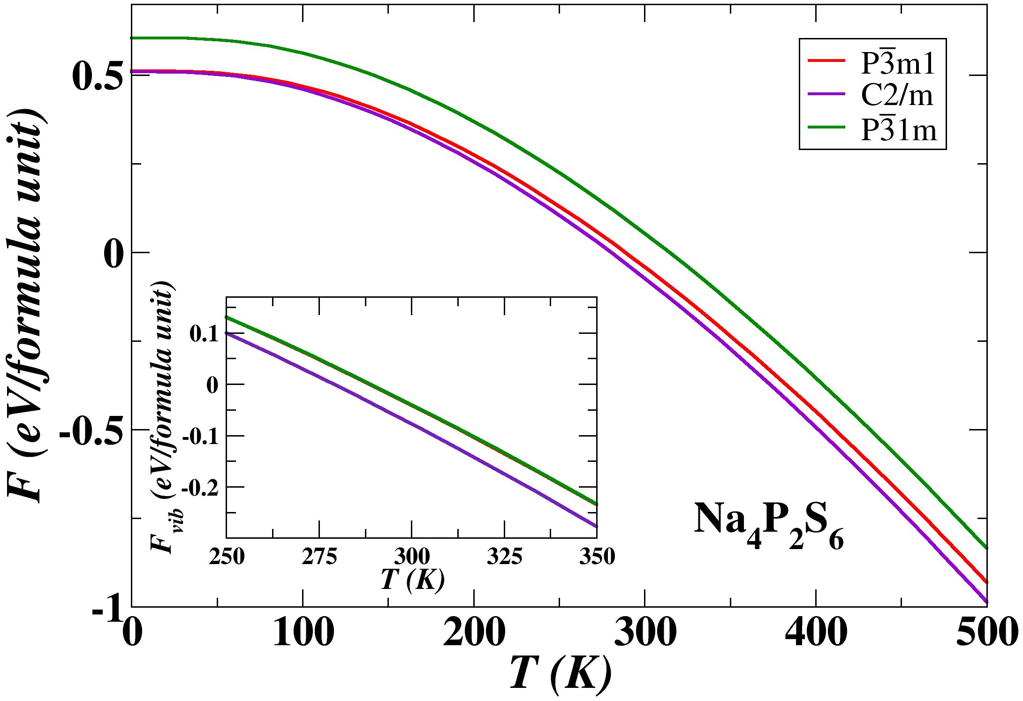
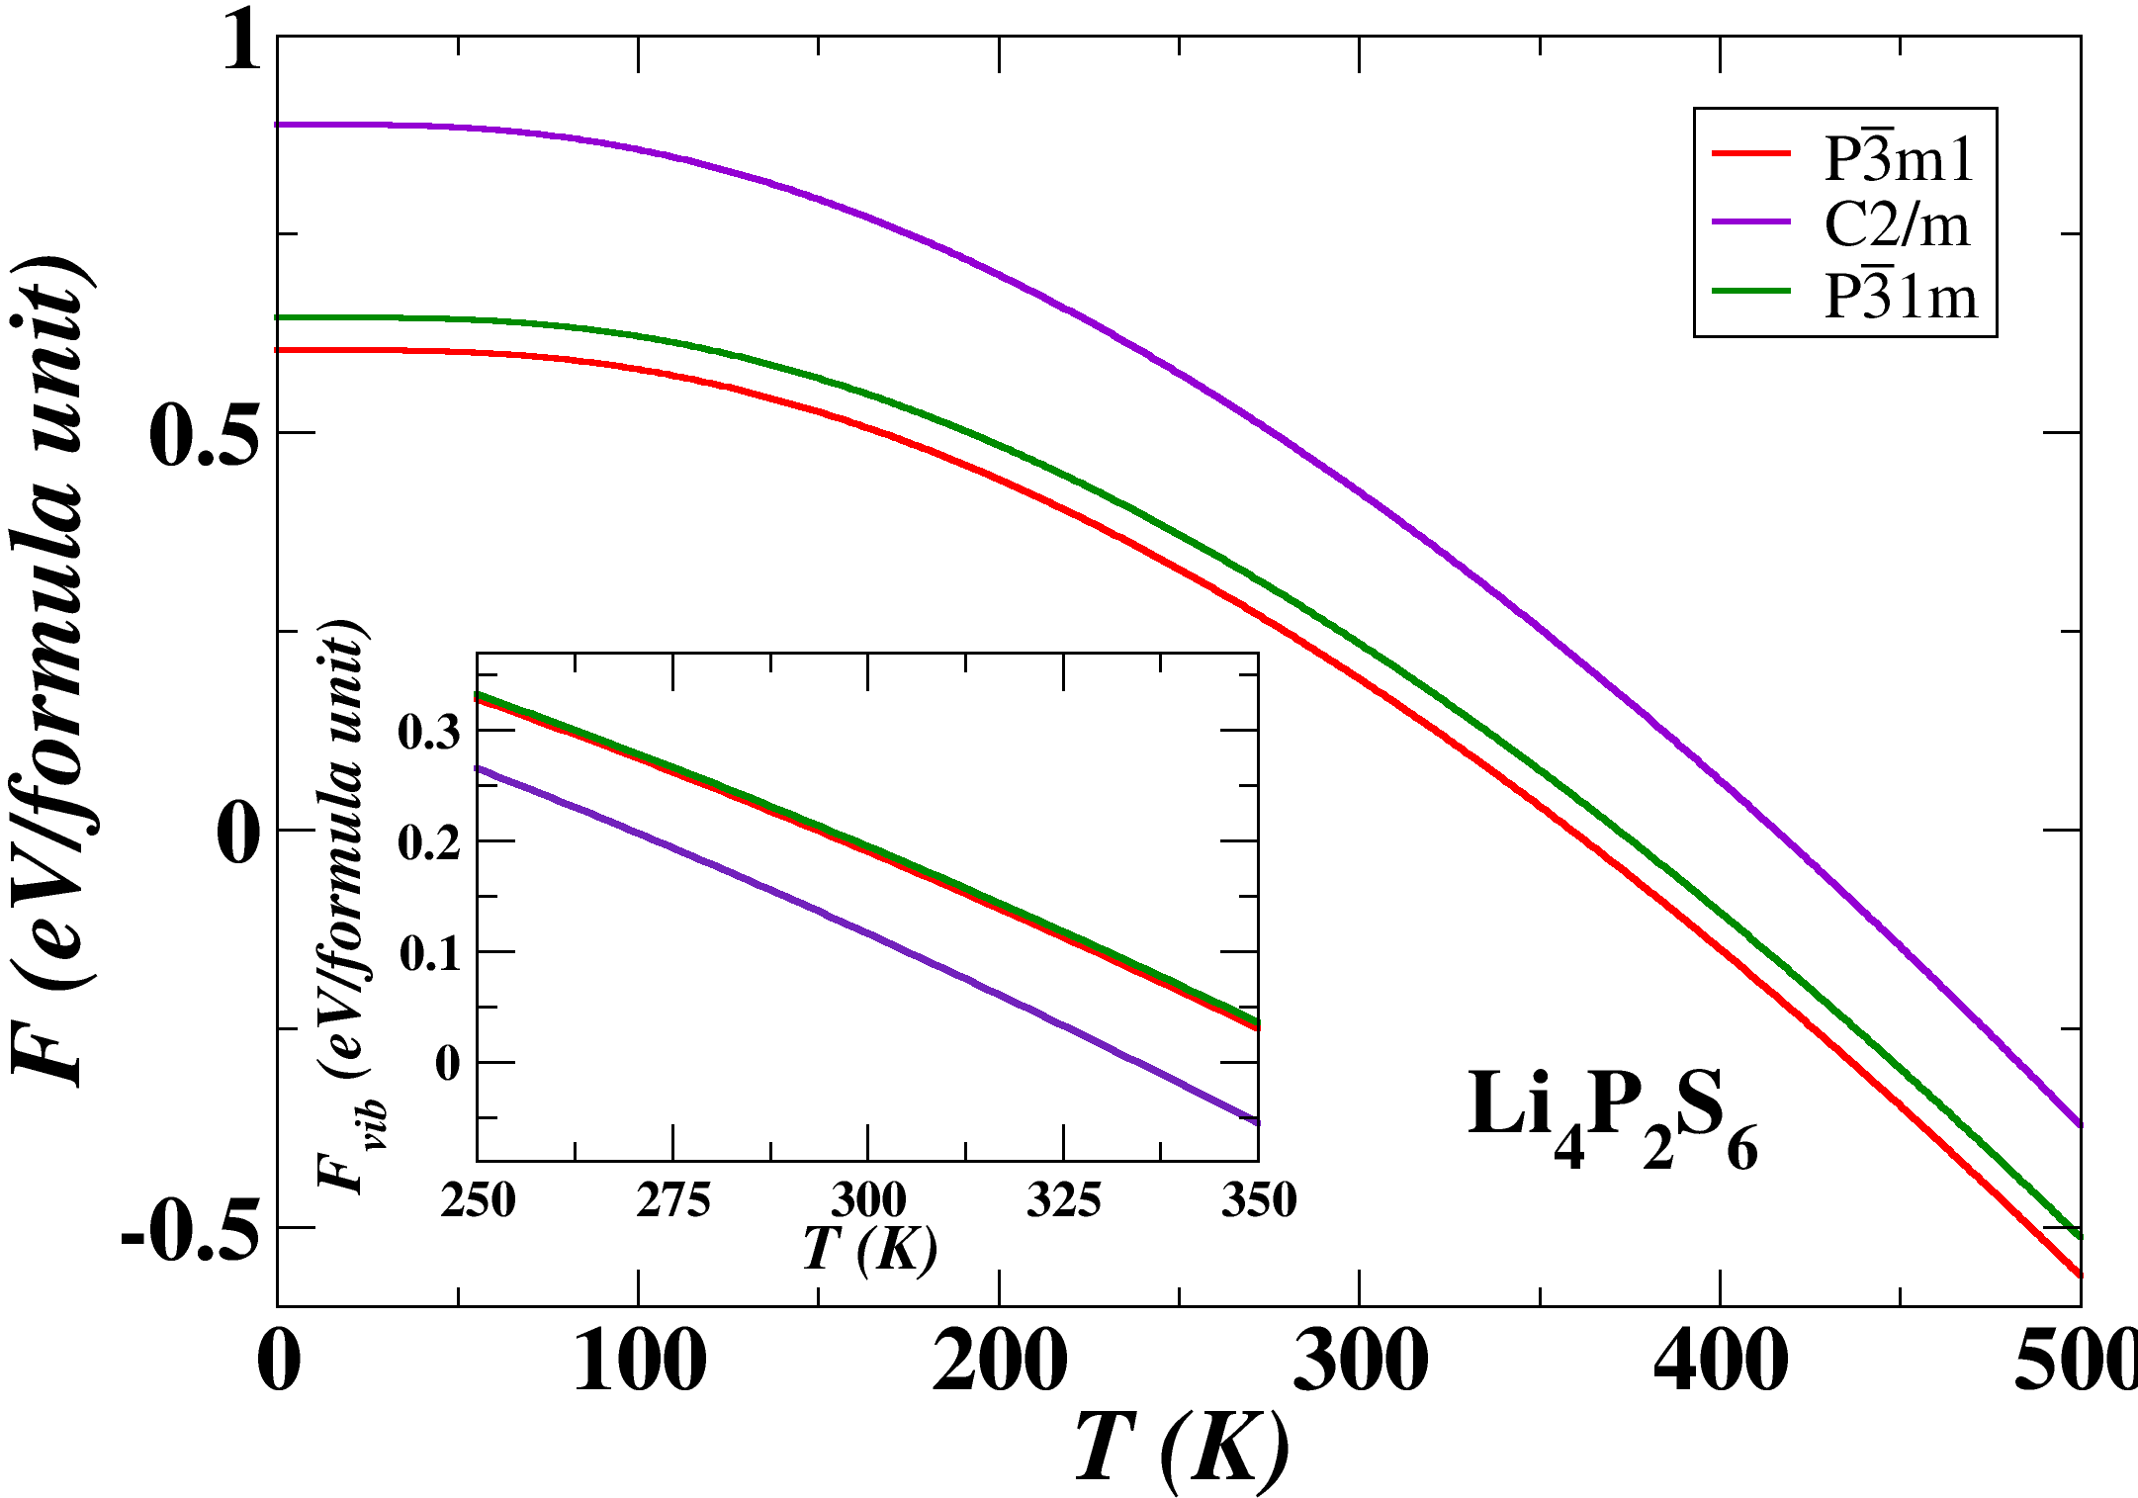





Simulation of structural stability patterns -- continued
Helmholtz free energy:
F = U_{SL} + F_{vib}
U_{SL}: P$\overline{3}$m1 = C2/m < P$\overline{3}$1m
U_{SL}: P$\overline{3}$m1 < P$\overline{3}$1m < C2/m
F_{vib}: C2/m < P$\overline{3}$m1 = P$\overline{3}$1m
F_{vib}: C2/m < P$\overline{3}$m1 = P$\overline{3}$1m
F_{lowest}: C2/m (expt.^{1,2})
F_{lowest}: P$\overline{3}$m1 (expt.³)
¹Kuhn et al., Z. Anorg. Allg. Chem. 640, 689-692 (2014)
²Hood et al., J. Solid State Ionics 284, 61 (2016)
³Neuberger et al., Dalton Trans. 47, 11691-11695 (2018)

Slide 21
Simulation of structural stability patterns -- continued
Summary of simulation energies
Na₄P₂S₆ | ΔU_{SL}(eV) | F_{vib}(300K)(eV) | F(300K)(eV)
Neuberger structure (P3m1) | 0.00 | -0.04 | -0.04
Kuhn structure (C2/m) | 0.00 | -0.08 | -0.08
Simple hex structure (P31m) | 0.09 | -0.04 | 0.05
Li₄P₂S₆ | ΔU_{SL}(eV) | F_{vib}(300K)(eV) | F(300K)(eV)
Neuberger structure (P3m1) | 0.00 | 0.19 | 0.19
Kuhn structure (C2/m) | 0.31 | 0.12 | 0.43
Simple hex structure (P31m) | 0.04 | 0.20 | 0.24
_
_
_
_
Energies given in units of eV/formula unit with zero set at the static lattice energy for the Neuberger structure.

Slide 22
Some details of the vibrational stabilization

Slide 23
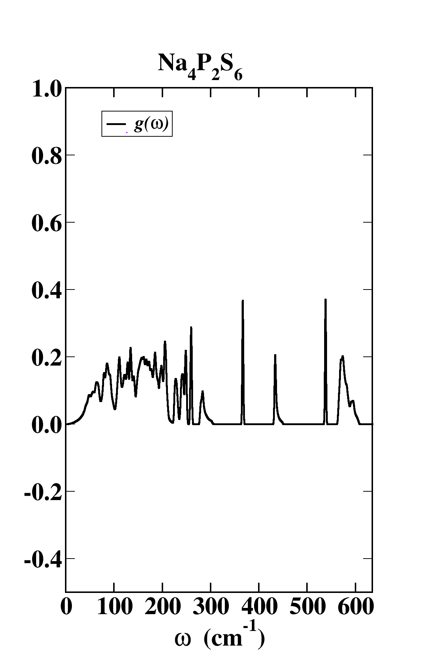
Some details of the vibrational stabilization

Slide 24
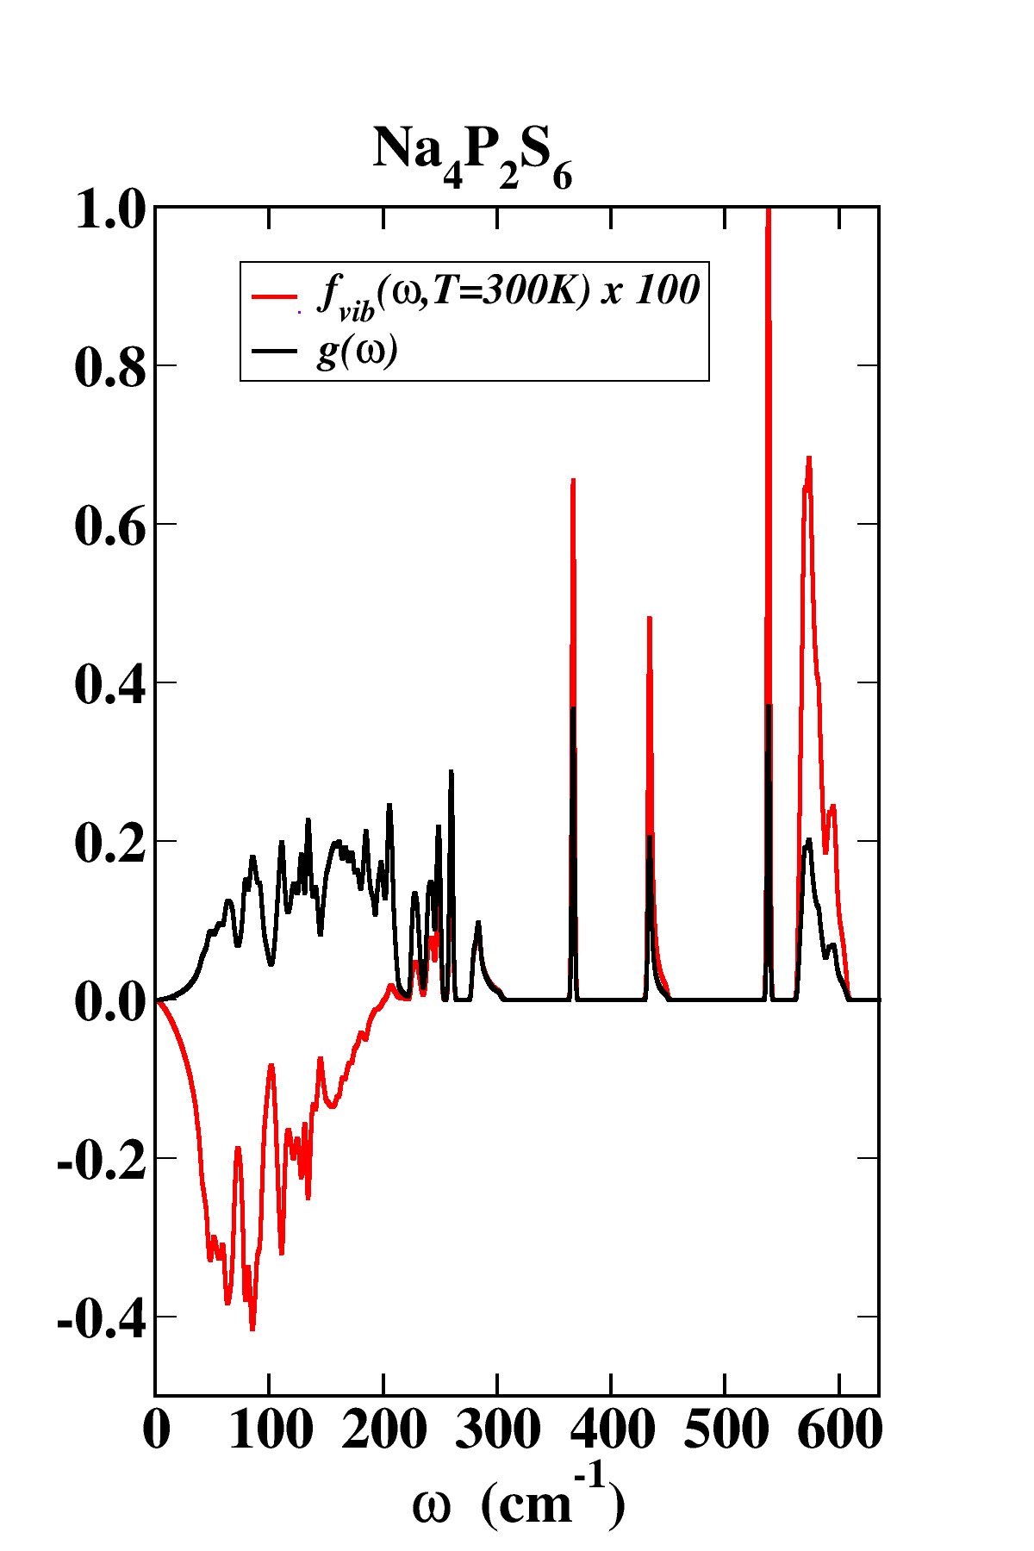
Some details of the vibrational stabilization

Slide 25
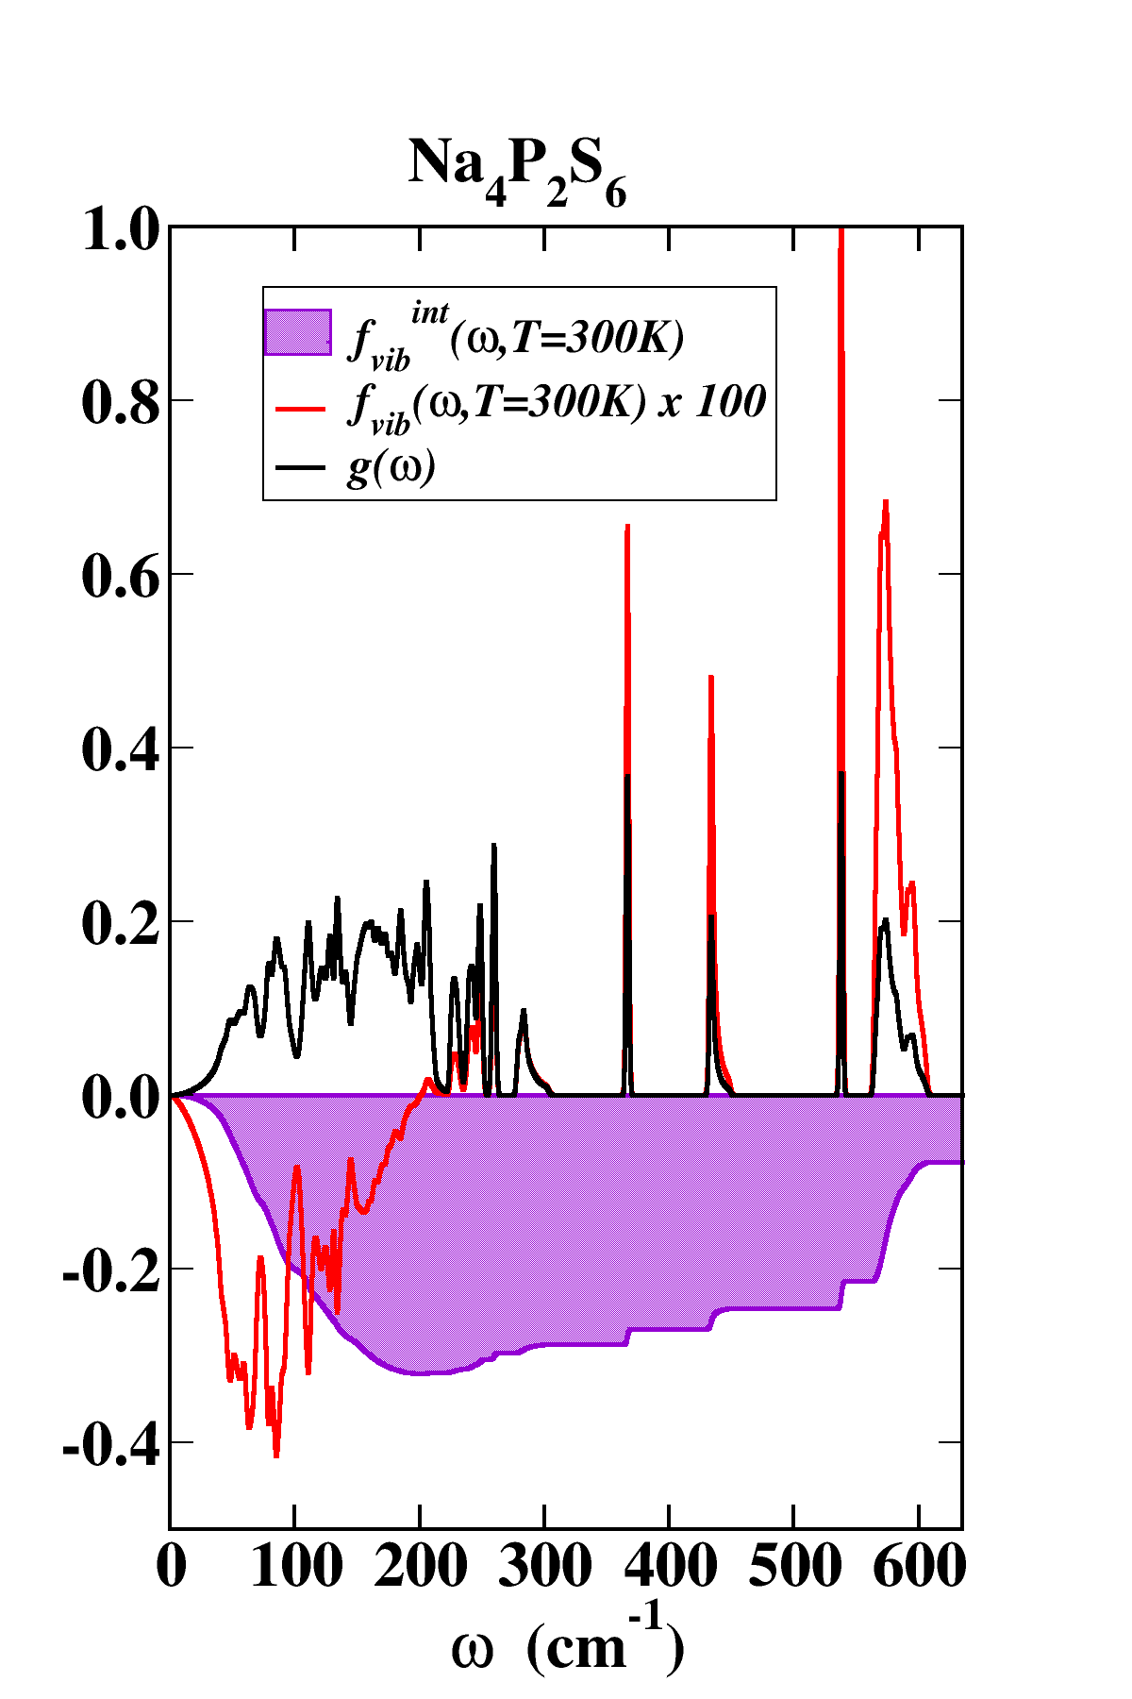
Some details of the vibrational stabilization

Slide 26
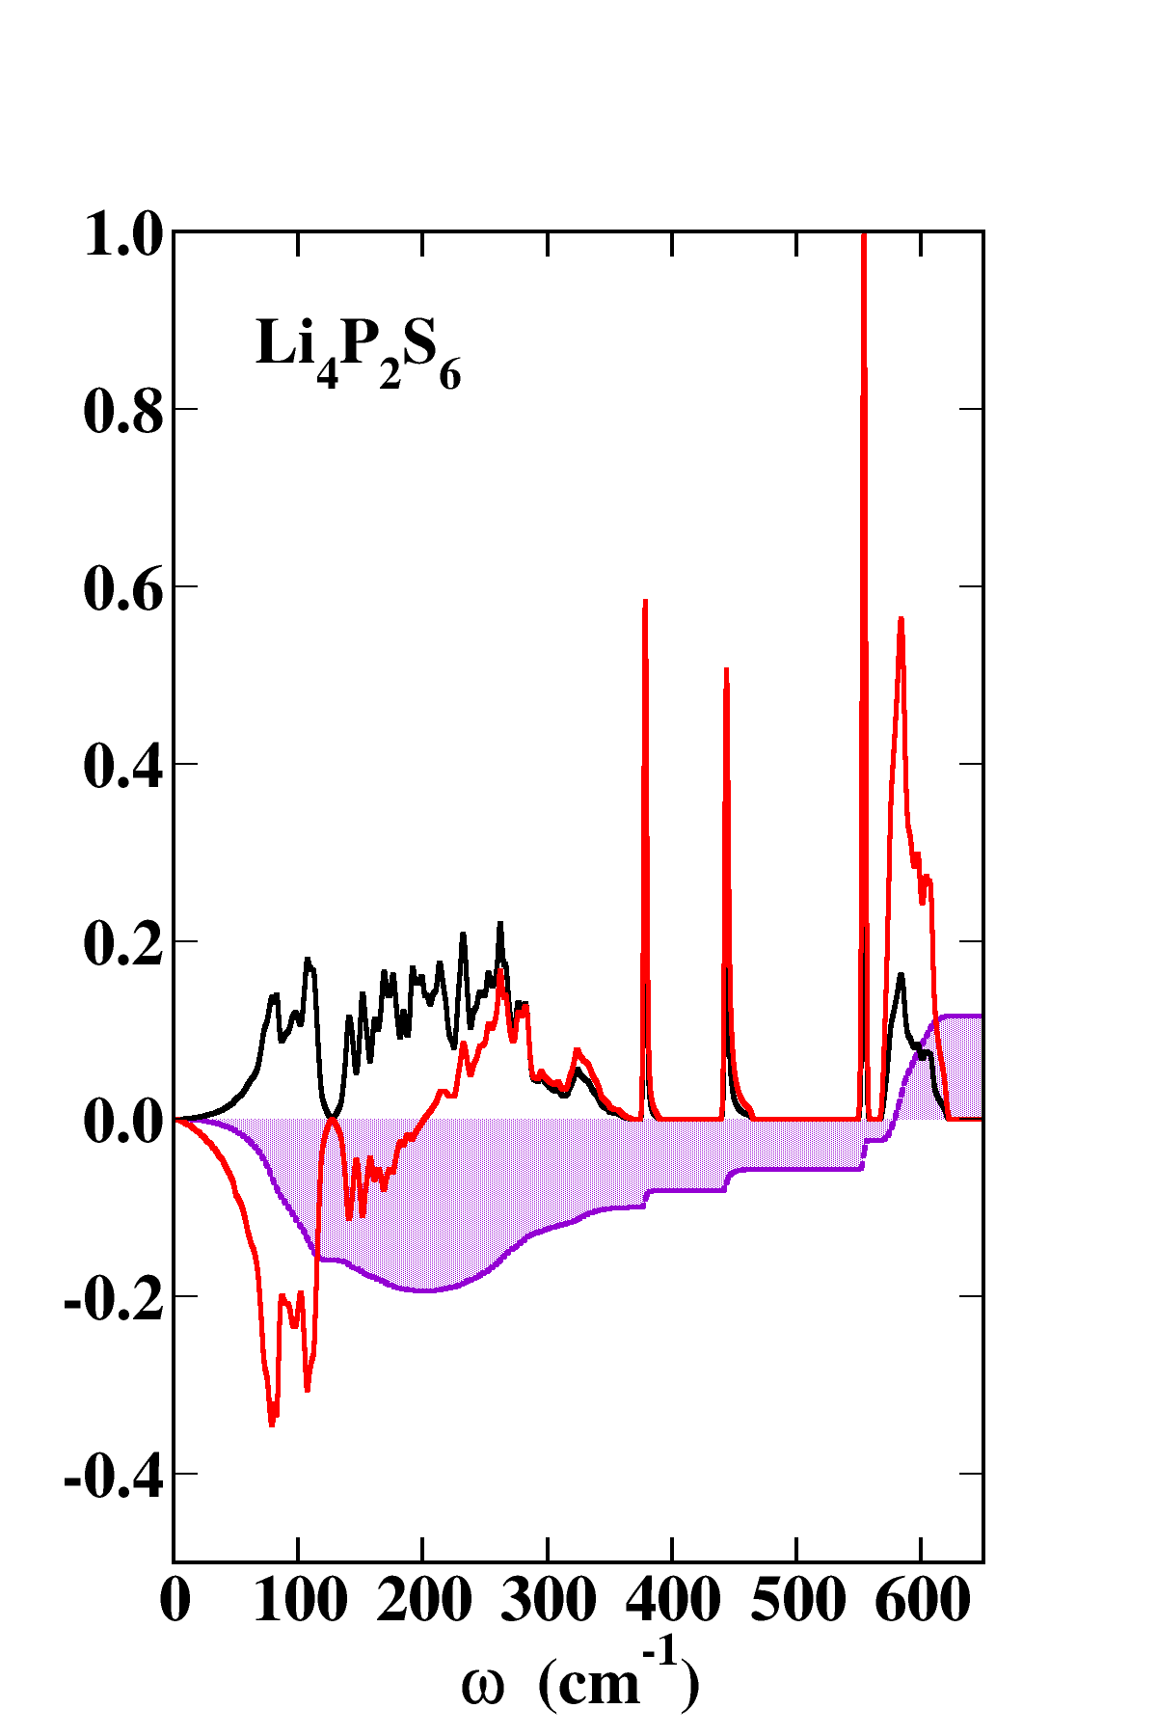
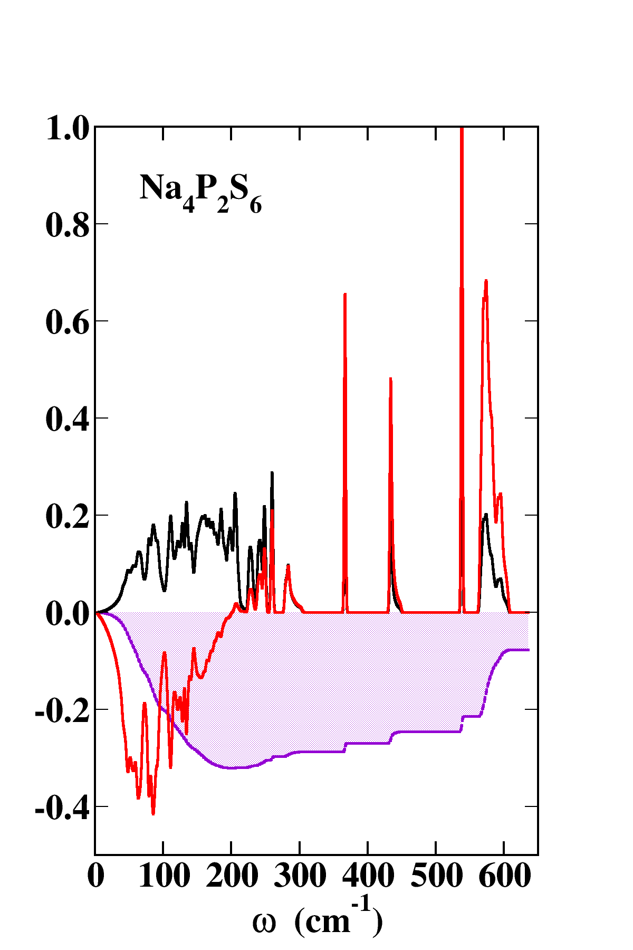
Some details of the vibrational stabilization at T=300K for Li₄P₂S₆ and Na₄P₂S₆ in C2/m structure
F_{vib}(300K)=0.12 eV
F_{vib}(300K)=-0.08 eV
~
~

Slide 27
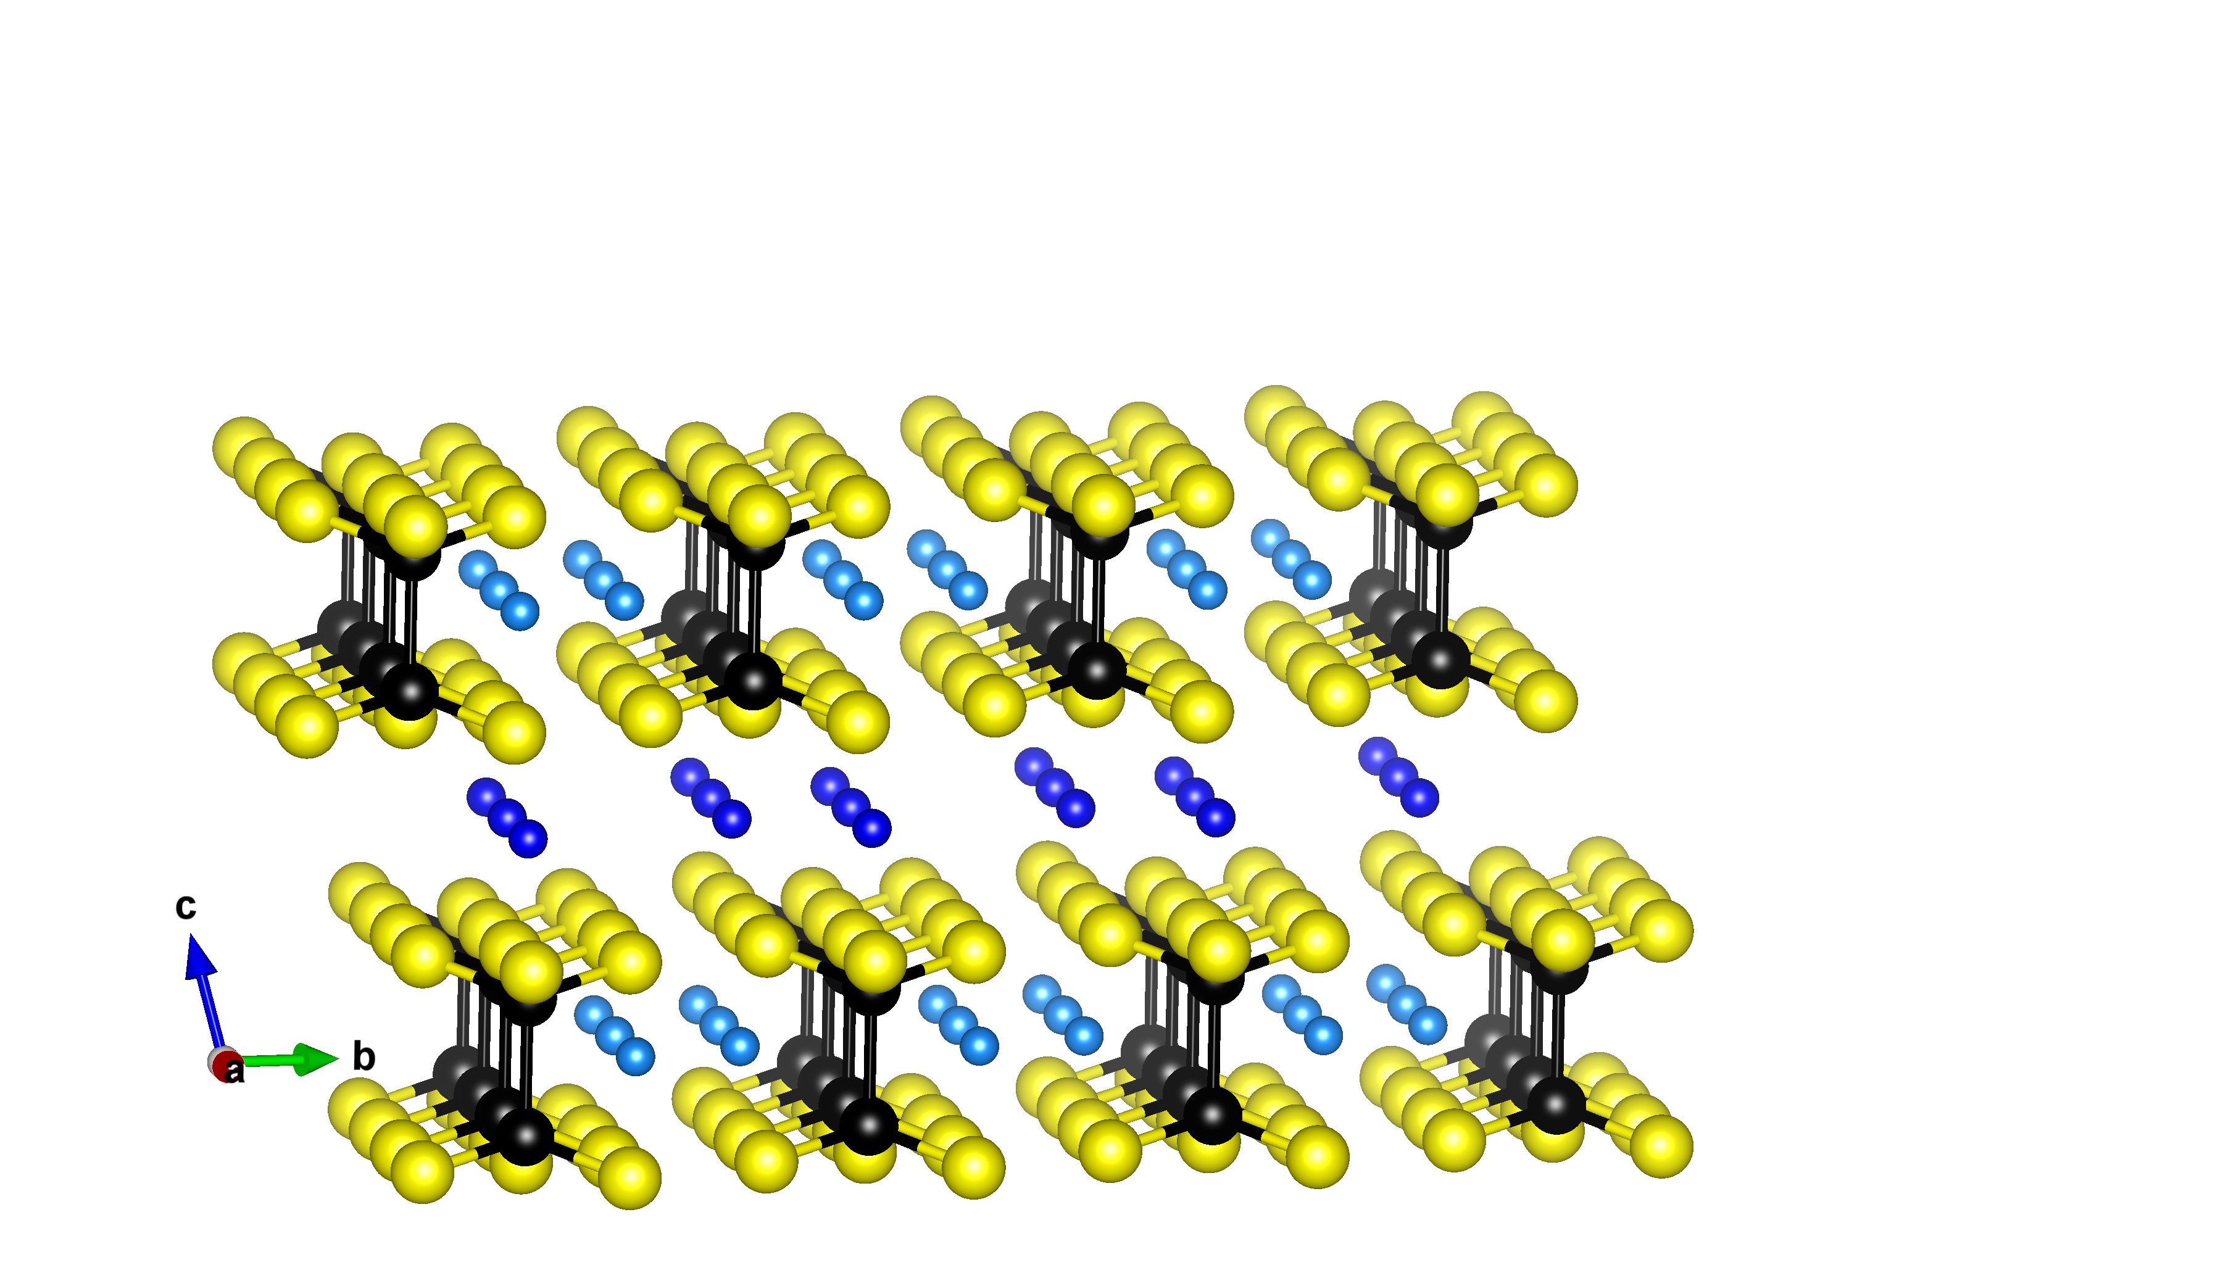
Na ion conductivity of Na₄P₂S₆ and Li₂Na₂P₂S₆ in the C2/m structure
Conducting plane for Na ions
Predicted Li₂Na₂P₂S₆ has Li ions at these g sites.

Slide 28
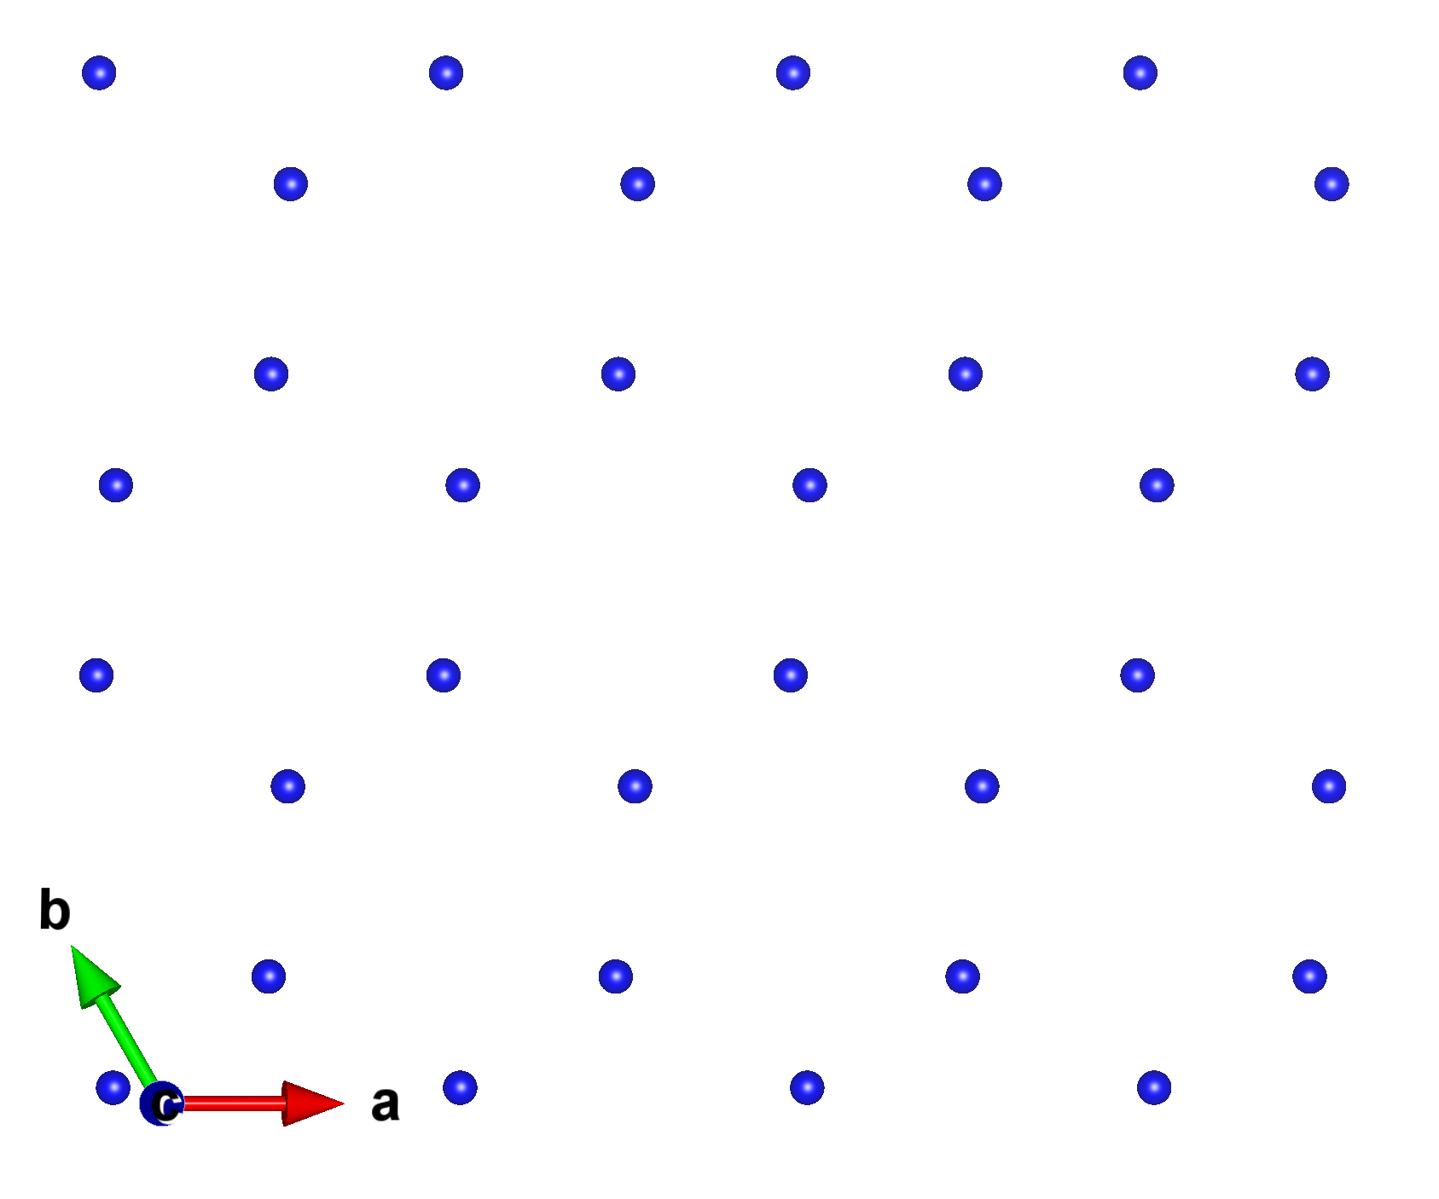
Na ion conductivity of Na₄P₂S₆ and Li₂Na₂P₂S₆ in the C2/m structure
View of mobile Na ion plane (h plane)
host Na site
interstitial Na site

Slide 29
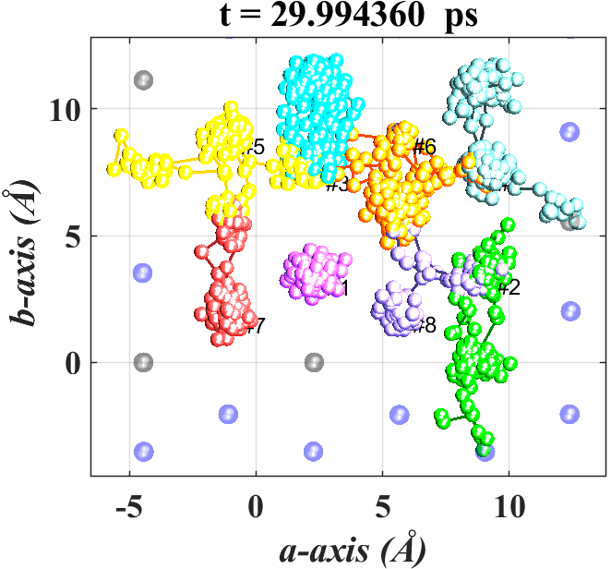
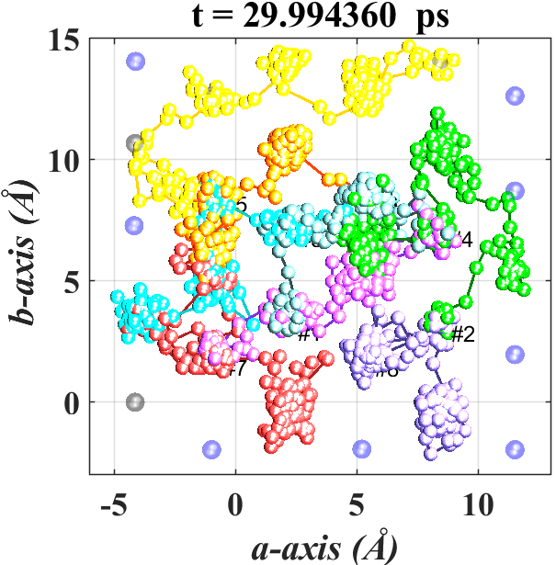

Computer modeling of mechanisms of ionic conductivity; comparing Na₄P₂S₆ and Li₂Na₂P₂S₆ --
MD simulations at <T>=1000K; Na ion motion in h planes --
Na₄P₂S₆
Li₂Na₂P₂S₆

Slide 30
  Ionic conductivity

Slide 31
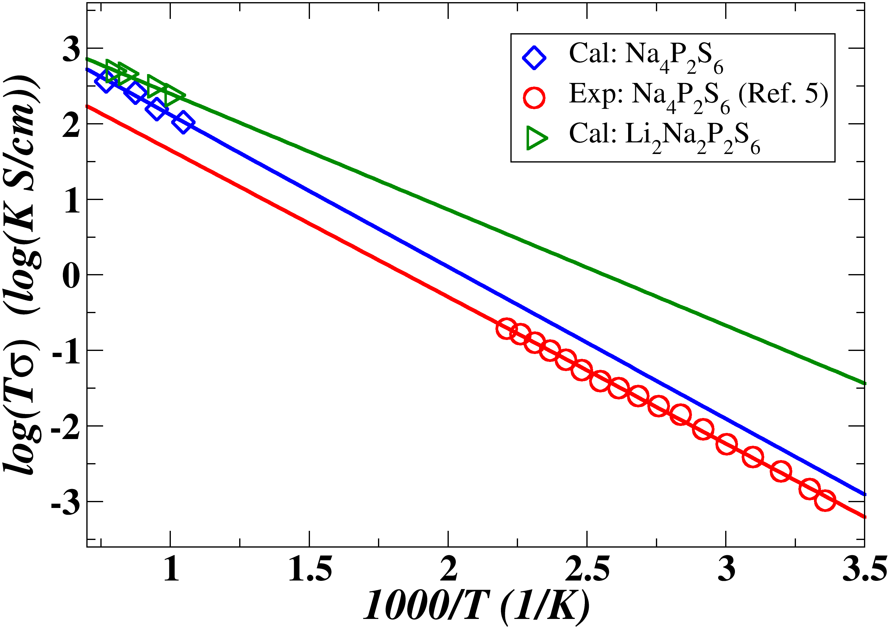
  Ionic conductivity

Slide 32
  Summary
Li₄P₂S₆
Na₄P₂S₆
Poor ionic conductor
Structure stabilized by static lattice energy
Good ionic conductor within plane
Structure stabilized by vibrational energy

Slide 33
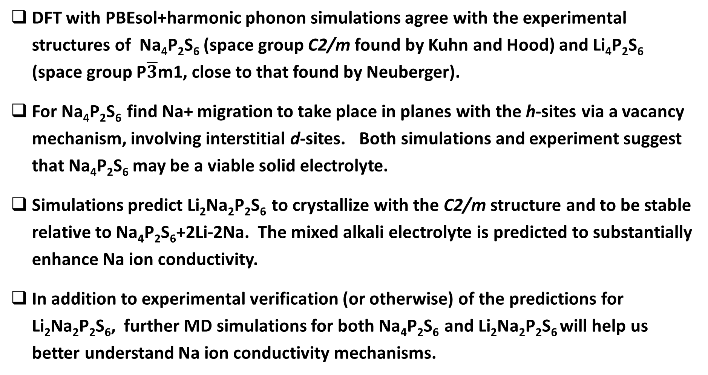
  More thoughts
DFT with PBEsol+harmonic phonon simulations agree with the experimental structures of Na₄P₂S₆ (space group C2/m found by Kuhn and Hood) and Li₄P₂S₆ (space group P$\overline{3}$m1, close to that found by Neuberger).
For Na₄P₂S₆ find Na+ migration to take place in planes with the h-sites via a vacancy mechanism, involving interstitial d-sites. Both simulations and experiment suggest that Na₄P₂S₆ may be a viable solid electrolyte.
Simulations predict Li₂Na₂P₂S₆ to crystallize with the C2/m structure and to be stable relative to Na₄P₂S₆+2Li-2Na. The mixed alkali electrolyte is predicted to substantially enhance Na ion conductivity.
In addition to experimental verification (or otherwise) of the predictions for Li₂Na₂P₂S₆, further MD simulations for both Na₄P₂S₆ and Li₂Na₂P₂S₆ will help us better understand Na ion conductivity mechanisms.

