Slide 1
Prediction and analysis of a sodium ion electrolyte: Li₂Na₂P₂S₆
Yan Li¹, Zachary D. Hood² and Natalie A. W. Holzwarth¹
¹Department of Physics, Wake Forest University, Winston-Salem, NC 27109, USA
²Electrochemical Materials Laboratory, MIT, Cambridge, MA 02139, USA
Acknowledgements: This work is supported by NSF grant DMR-1507942. Computations were performed on the Wake Forest University DEAC cluster, a centrally managed resource with support provided in part by the University.

Slide 2
Outline
Three focuses of submitted work “Computational and experimental (re)investigation of the structural and electrolyte properties of Li₄P₂S₆, Na₄P₂S₆, and Li₂Na₂P₂S₆” by Yan Li, Zachary D. Hood, and N. A. W. Holzwarth,
Crystal structure stabilities of Li₄P₂S₆ and Na₄P₂S₆
This talk:
Structure and stability of predicted mixed ion electrolyte Li₂Na₂P₂S₆
Performance of Li₂Na₂P₂S₆ in comparison with Na₄P₂S₆ as solid electrolytes
The Helmholtz free energy:
$$F\left(T\right)=F_{SL}\left(T\right)+F_{vib}\left(T\right)={U_{SL}+F}_{vib}\left(T\right)$$
$${F_{vib}\left(T\right)= k}_{B}T\int_{0}^{∞}{dω ln⁡\left(2 sinh\left(\frac{ℏω}{2k_{B}T}\right)\right)g\left(ω\right)}$$
Ground state structure:
Na₄P₂S₆ : Monoclinic C2/m (#12)
Li₄P₂S₆: Hexagonal P$\overline{3}$m1 (#164)
consistent with those experiment results¹⁻³
See more at http://users.wfu.edu/natalie/presentations/
¹Neuberger et al., Dalton Trans. 47, 11691-11695 (2018)
²Kuhn et al., Z. Anorg. Allg. Chem. 640, 689-692 (2014)
³Hood et al., Manuscript in preparation.
Notes:
My talk is based on our recently submitted work “Computational and experimental (re)investigation of the structural and electrolyte properties of Li₄P₂S₆, Na₄P₂S₆, and Li₂Na₂P₂S₆” which has three main focuses. In the first part of the work, we showed that the enhanced computational methods with consideration of phonon contributions can explain the experimentally observed structures of Na₄P₂S₆ and its Li₄P₂S₆ analog.
Studies on these two materials also prompt an investigation of their alloys, one of them has composition Li₂Na₂P₂S₆. The following slides will show the predicted structures of this mixed ion material and the stability analysis in terms of reaction energies of proposed reaction pathways. Also the electrolyte properties of Li₂Na₂P₂S₆ will be discussed in comparison with those of Na₄P₂S₆.

Slide 3
Summary of computational methods
Density Functional Theory (DFT) and Density Functional Perturbation Theory (DFPT) with the modified Perdew-Burke-Ernzerhof generalized gradient approximation¹ (PBEsol GGA)
The projector augmented wave (PAW) formalism using ABINIT (https://www.abinit.org) & QUANTUM ESPRESSO (http://www.quantum-espresso.org)
Datasets generated by ATOMPAW code available at http://pwpaw.wfu.edu
Visualization software: XCrySDen, VESTA
Space-group analysis: FINDSYM
X-ray powder diffraction: Mercury
¹Perdew et al., Phys. Rev. L. 100, 136406 (2008)
Notes:
The computational methods are based on Density Functional Theory (DFT) and Density Functional Perturbation Theory (DFPT) using the Projector Augmented Wave (PAW) formalism. The PAW basis and projector functions were generated by the ATOMPAW code and used in both the ABINIT and QUANTUM ESPRESSO packages. In the present work, the PBEsol GGA was used to treat the exchange and correlation effects.

Slide 4
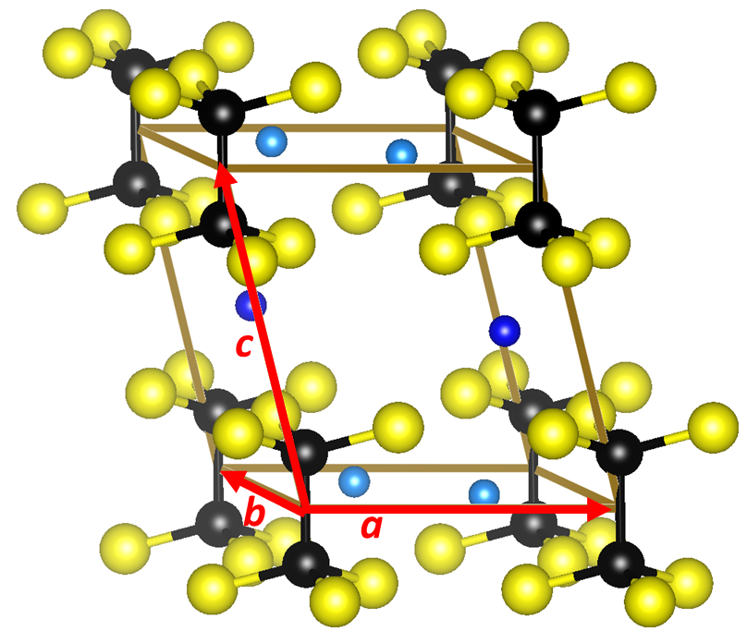
The prototypic structure
Na₄P₂S₆ crystallizes in a base-centered monoclinic structure with space group C2/m (#12)^{1,2} and this material was also found to have appreciable Na ion conductivity (3x10⁻⁶ S/cm) at room temperature².
intralayer plane
interlayer plane
g-type Na
h-type Na
(P₂S₆)⁴⁻ units
with D_{3d} symmetry
Primitive cell with 12 atoms/formula unit
¹Kuhn et al., Z. Anorg. Allg. Chem. 640, 689-692 (2014)
²Hood et al., Manuscript in preparation.
Notes:
This diagram shows the ball and stick model of the C2/m structure in primitive cell setting, in which the P₂S₆ building blocks aligned orderly and uniformly throughout the space. Such structural framework may benefit the diffusions of Na ions in the material.
As what we see this structure has two crystallographically distinct Na sites with Wyckoff labels g and h, respectively. Each g-type Na ion is located in an intralayer plane which contains the P₂S₆ units, while each h site Na ion is located in an interlayer plane between the P₂S₆ units. Staring with the monoclinic structure of the pure Na material, we predicted the possible structures of the mixed ion material Li₂Na₂P₂S₆ based on the idea of ionic substitution.

Slide 5
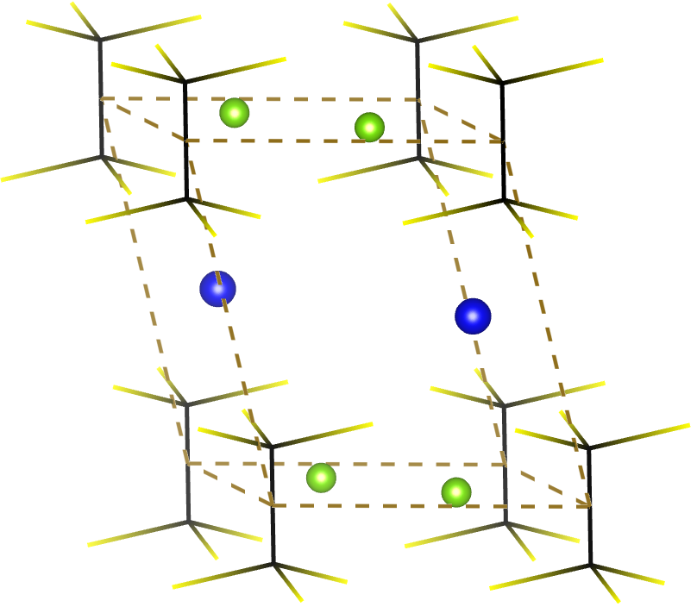
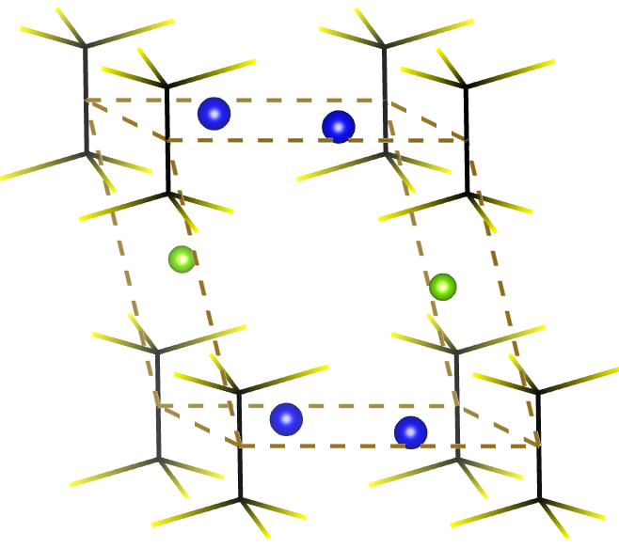
Structures of the predicted material: Li₂Na₂P₂S₆
Replace the (a) g-type or (b) h-type Na ions in the monoclinic Na₄P₂S₆ with Li ions
TABLE: Comparison of the optimized lattice parameters for Li₂Na₂P₂S₆ in the $R_{g}^{Li}$ and $R_{h}^{Li}$ structures. Also listed is the static lattice energy differences U_{SL} referenced to the energy of the $R_{h}^{Li}$structure in units of eV/formula unit.
g sites
in intralayer
 |  | $$R_{g}^{Li}$$ | $$R_{h}^{Li}$$
Primitive cell: | a = b (Å) | 6.18 | 6.46
 | c (Å) | 7.50 | 7.01
 | α = β (deg) | 97.77 | 97.88
 | γ (deg) | 119.21 | 118.43
Conventional | a_{c} (Å) | 6.26 | 6.61
cell: | b_{c} (Å) | 10.67 | 11.10
 | c_{c} (Å) | 7.50 | 7.01
 | β_{c} (deg) | 105.50 | 105.54
 | ∆U_{SL} (eV/FU) | -0.16 | 0.00
h sites
in interlayer
Na
Li
Notes:
The left diagram illustrates one likely geometry $R_{g}^{Li}$ of atomic arrangements, generated by replacing all equivalent Na ions at g sites with Li ions. And by substituting the Li ions for all h-type Na ions in interlayer planes, we obtain another possible atomic configuration $R_{h}^{Li}$.
After optimization, we found both proposed structures retain their space group symmetry C2/m. For the reason that $R_{g}^{Li}$ results in a lower static energy structure relative to $R_{h}^{Li}$, the configuration $R_{g}^{Li}$ is determined to be the ground state structure of Li₂Na₂P₂S₆ and will be used in subsequent analysis and simulations.

Slide 6
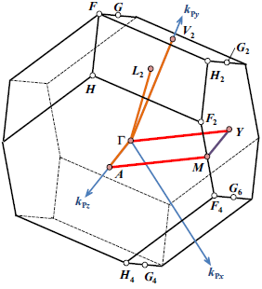
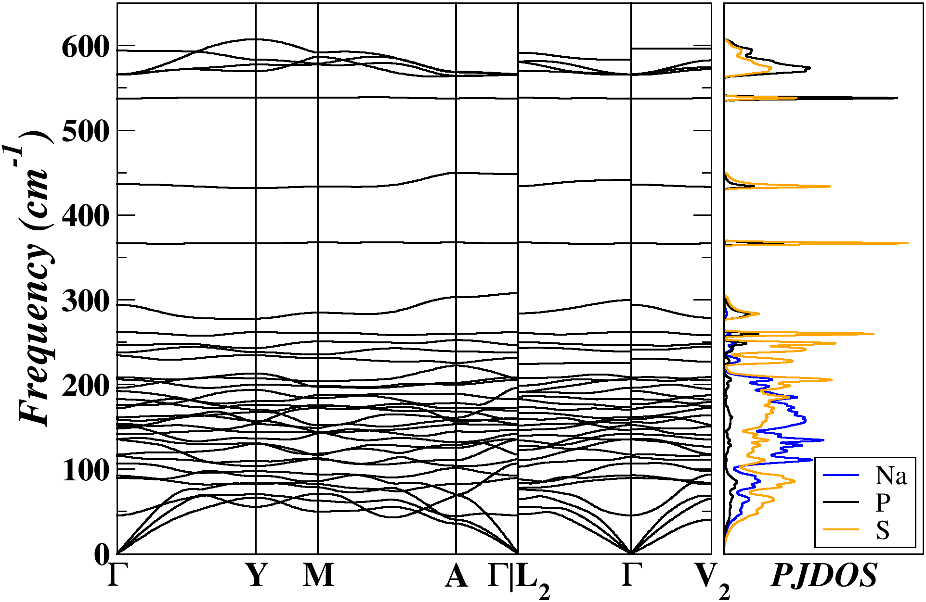
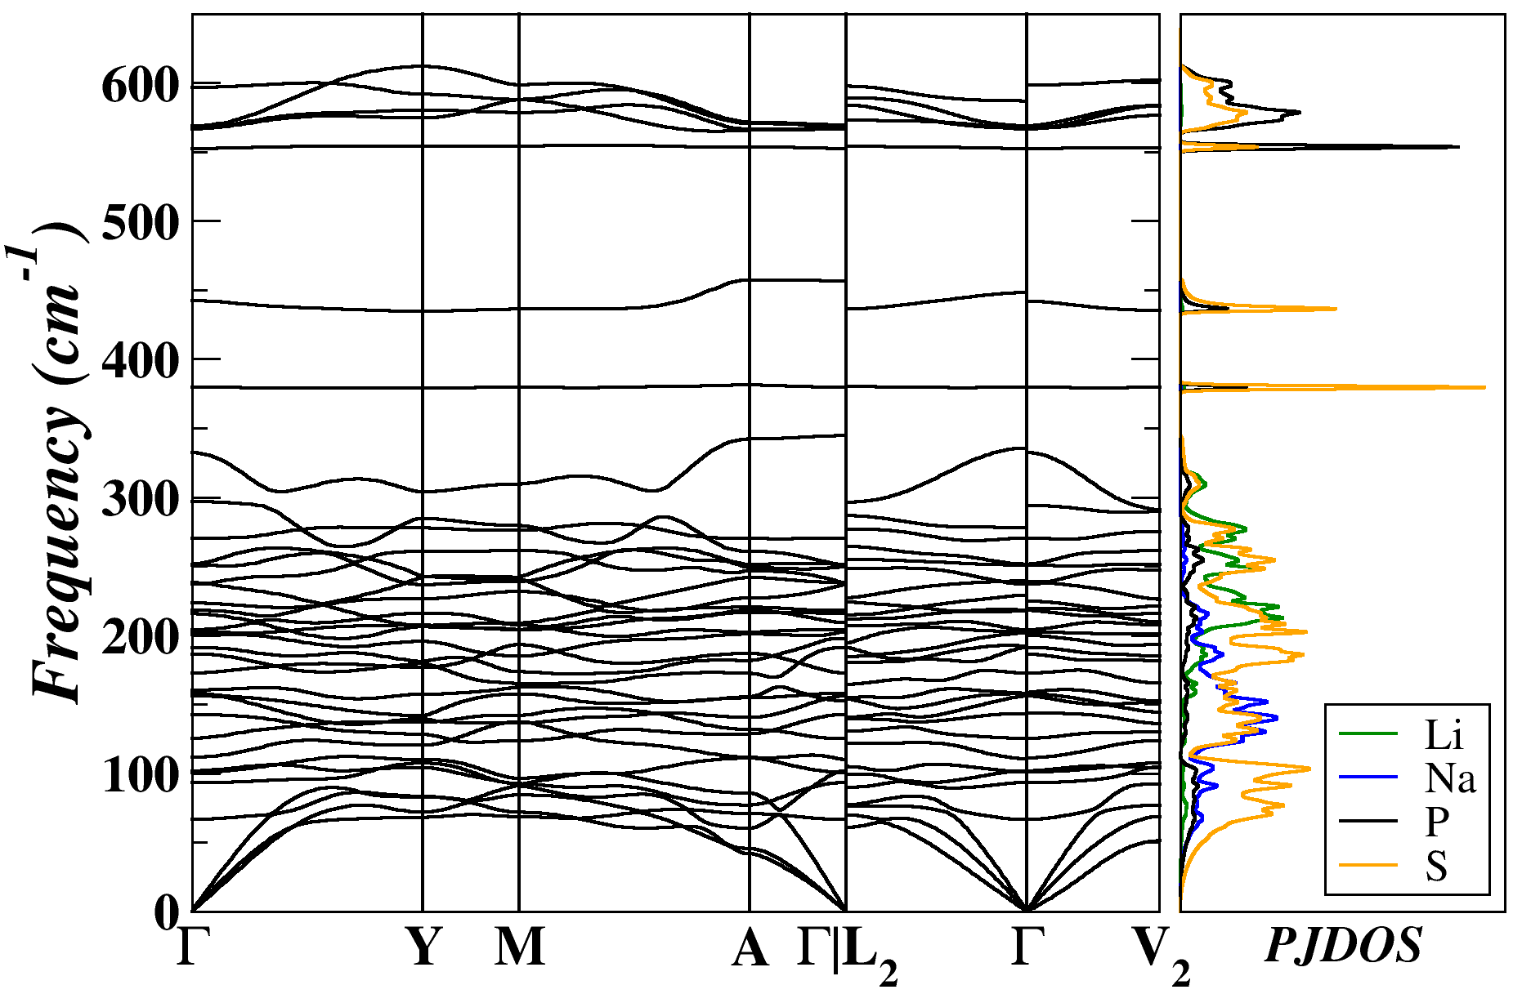
Comparison of phonon spectra
Na₄P₂S₆ in the C2/m Structure (36 modes)
Li₂Na₂P₂S₆ in the C2/m Structure (36 modes)
Na⁺ 0~300 cm⁻¹
Li⁺ 0~320 cm⁻¹
evidence of dynamical stability
(P₂S₆)⁴⁻ 300~600 cm⁻¹
¹Suggested path: Hinuma et al., Comp. Mat. Sci. 128, 140-184 (2017)
²Li et al., J. Phys. Condens. Matter, 32, 055402 (2019)
PJDOS:
Discontinuous branches at Г: coupling between photon and photon²
Notes:
Here we see that phonon dispersion curves of the two materials are very similar with the same number of modes covering an almost identical range of frequencies. For the case of Li₂Na₂P₂S₆ , the fact of having all real phonon frequencies implies that its possible ground state structure is dynamically stable.
As highlighted by short red arrows, there are several branches that are not continuous functions of q near gamma point. The physical reason for this kind of discontinuity is explained in terms of the coupling between the optical phonon modes and the electromagnetic field. For some of you who interest in such coupling effects, detailed discussions can be found in our published paper “Li et al., J. Phys. Condens. Matter, 32, 055402 (2019)”.

Slide 7
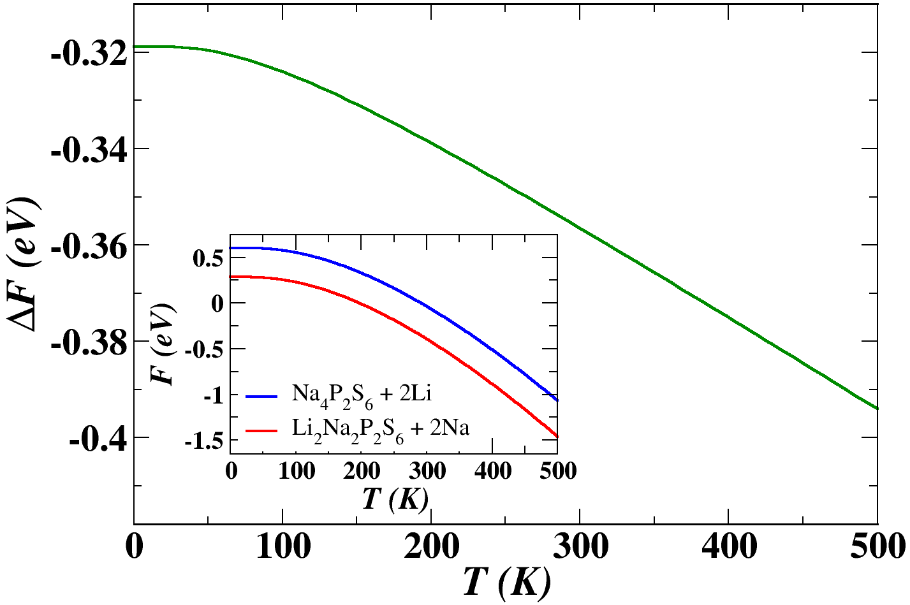
Stability of the predicted material: Li₂Na₂P₂S₆
The possible reaction pathway:
trivial contribution
(10⁻³ eV)
Energy changes at T = 300 K in eV:
Negative energies (net released energies) implies that the products Li₂Na₂P₂S₆ + 2 Na is stable with respect to the reactants Na₄P₂S₆ + 2 Li.
Notes:
To further evaluate the stability of this predicted alloyed material Li₂Na₂P₂S₆, we proposed this possible reaction pathway and calculated the reaction energy which is determined from the energy difference between the right side products and the left-side reactants. For each component, the energy of it is obtained from the sum of static and vibrational contributions. In particular for Li and Na in their metallic form, we also considered the energy due to the temperature-dependent excitations, but it turns out this contribution is very small compared to others and can be neglected.
It shows that at room temperature, the reaction energy is -0.35 eV. The figure on the right demonstrates that the reaction energy is gradually decreasing along with the increasing temperature, suggesting that it is energetically favorable for Li to replace Na according to this reaction over a significant temperature range.

Slide 8
More possible reaction pathways
TABLE: Computed energy differences for indicated reactions in eV units, evaluated
at T = 300 K and neglecting electronic excitation contributions.
ª Black phosphorous with Space Group Cmce (#64); from Brown et al. Acta Cryst. 19, 684 (1965).
^{b} Orthorhombic (α-S8) with Space Group Fddd (#70); from S. J. Rettig and J. Trotter, Acta Cryst. C 43, 2260 (1987).
^{c} γ-Li3PS4 with Space Group Pmn2₁ (#31); from Homma et al., Solid State Ionics 182, 53 (2011).
^{d} α-P4S4 with Space Group C2/c (#15); from Minshall et al., Acta Cryst. B 34, 1326 (1978)..
^{e} α-Na3PS4 with Space Group P42₁c (#114); from Jansen et al., J. Solid State Chem. 99, 110 (1992).
^{f} P₄S₁₀ with Space Group P$\overline{1}$ (#2); from Vos et al., Acta Cryst. 19, 864 (1965).
Notes:
Besides the possible synthesis route given in the previous slide, there are a number of other possible reactions we can imagine to produce the mixed ion electrolyte Li₂Na₂P₂S₆. In this table, we summarized the room-temperature reaction energies for some of those pathways. Here we see that the only reaction that has a positive reaction energy ∆F is reaction No. 3, which means the mixed material is unstable relative to these two left-side reactants. But we also learn from the experiment that the pure Li material Li₄P₂S₆ forms at very high temperatures, which implies that it is still possible to produce Li₂Na₂P₂S₆ via a low-temperature synthesis process with the metal-stable phase of Li₄P₂S₆ as one of the reactants.

Slide 9
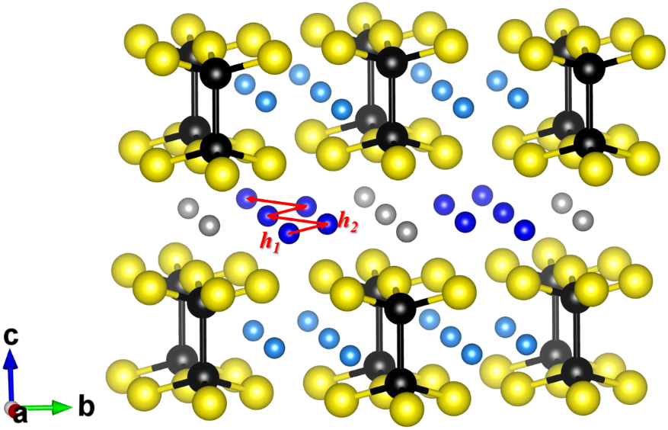
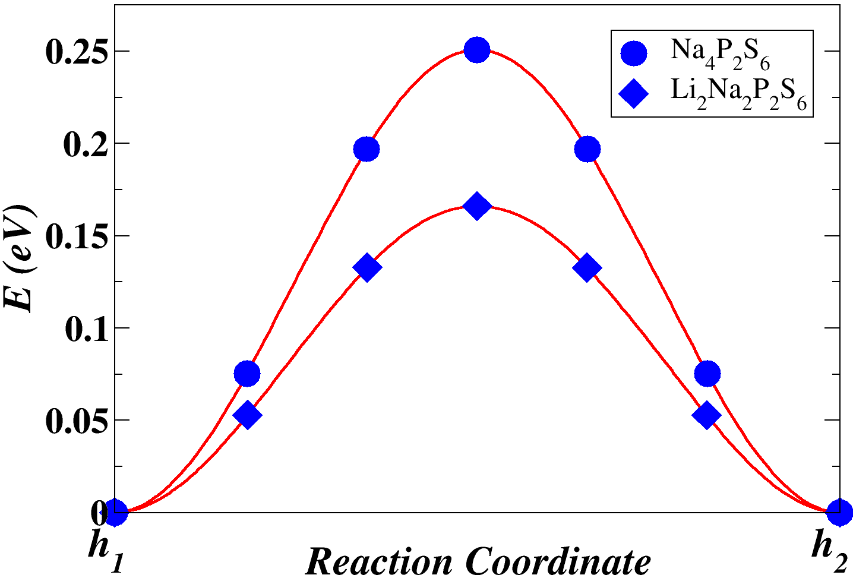
Ion migration of vacancy mechanisms
Interstitial d site
Na/Li (g)
Na (h)
P
S
interlayer plane
Activation energy: $E_{a}=E_{m}^{NEB}+\frac{1}{2}E_{f}$
Configuration energy diagram results of NEB calculation of Na ion vacancy migration along one step of the indicated pathway.
$$E_{m}^{NEB}$$
Nudged Elastic Band¹ algorithm
$$E_{defect}(Nah−Nad)−E_{perfect}$$
$E_{f}$
¹Henkelman et al., J. Chem. Phys. 113, 9901-9904 (2000)
Notes:
To understand the conductivity properties of the mixed ion material Li₂Na₂P₂S₆ in comparison with the pure Na material Na₄P₂S₆, we investigated the diffusion mechanisms and estimated the related activation energy E_{a} for Na ions hopping for both materials. And among many possible migrating paths, we identified that the most favorable path for Na ion vacancy migration appears to be between h sites. When viewing down the c axis, we would see the hops from one host h site to the adjacent vacancy construct a continuous zig-zag path from one side of the crystal structure to another. The resulted NEB diagram between such two local minimum energy configurations shows that the energy barrier of the mixed material is lower by about 0.1 eV than of the pure Na material.
Within this methodology, the activation energy E_{a} of the perfect crystal includes both migration energy E_{m} and also the formation energy E_{f} which is associated with the creation of a vacancy-interstitial pair (defect). In this diagram, the extra gray balls represent the interstitial d sites from which the defect formation energy E_{f} is determined.

Slide 10
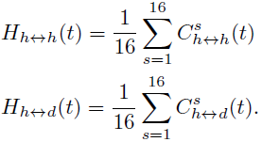
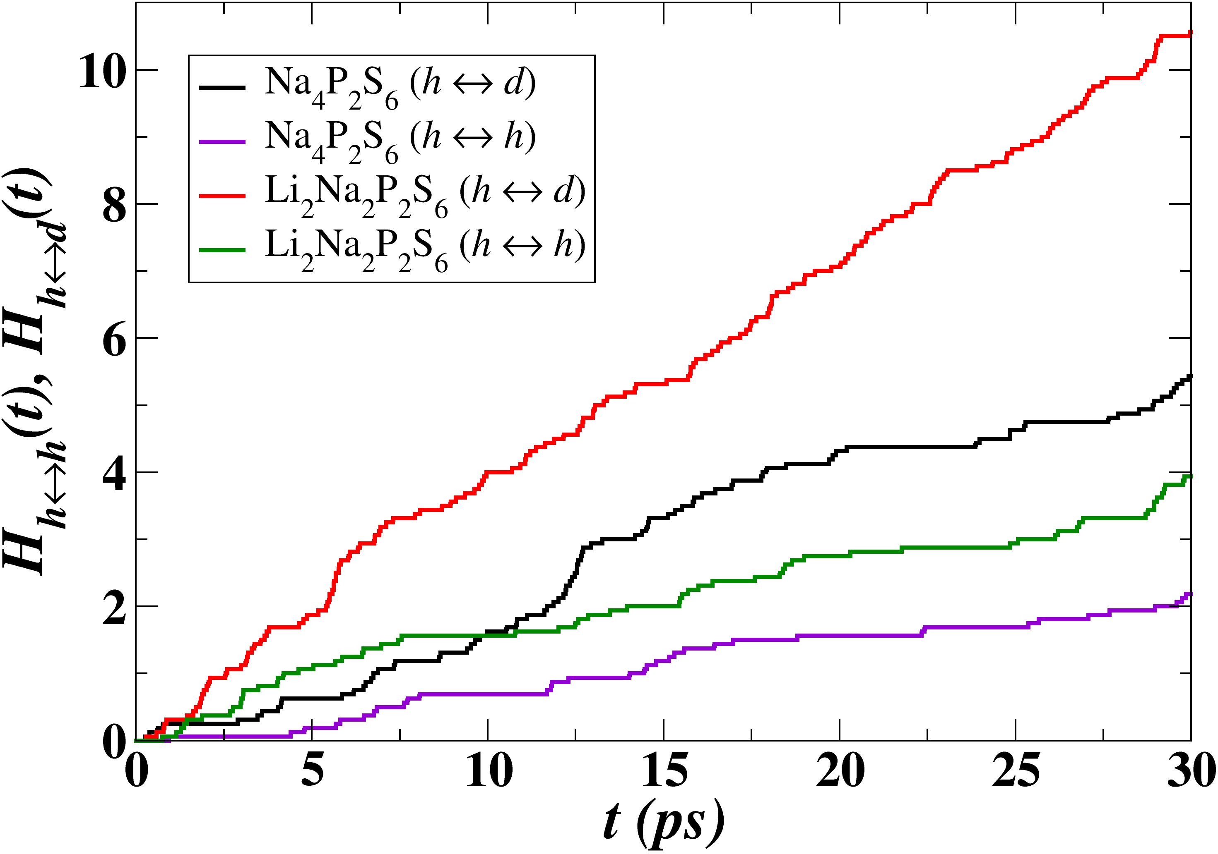
Migration study using molecular dynamics simulations
interlayer plane
at T = 1000 K
Na₄P₂S₆
Li₂Na₂P₂S₆
Host h site
Extra interstitial d site
No $g →h$ and $g →g$ hopping
All migrations occur within interlayer plane containing h-type Na ions
Direct $h→h$ vacancy migration is consistent with NEB analysis
Indirect $h →d$ $→h$ vacancy migration is prevalent
No interstitial $d$ $→d$migration
Both Na ion vacancy sites and indirect participation of interstitial sites contribute to the conductivity throughout the interlayer plane
*AIMD simulations were carried out using supercells composed of 2x1x2 conventional units (96 atoms)
Notes:
By directly observing the trajectories of atoms produced by molecular dynamics simulations, we found that for both materials all migration events only occur within the interlayer plane containing all h sites. Here we have movies for visualizing the trajectories of h-type Na ions at T = 1000K. At the beginning of the calculation, there are 8 Na ions resided at each interlayer plane in the simulation cell. More balls were placed to display that the Na ion may migrate to the neighboring cells.
Note in this document, the animations were represented by the superposed snapshots of the ion positions at t =~10 ps, ~15 ps and ~30 ps as presented in the next 3 slides.

Slide 11
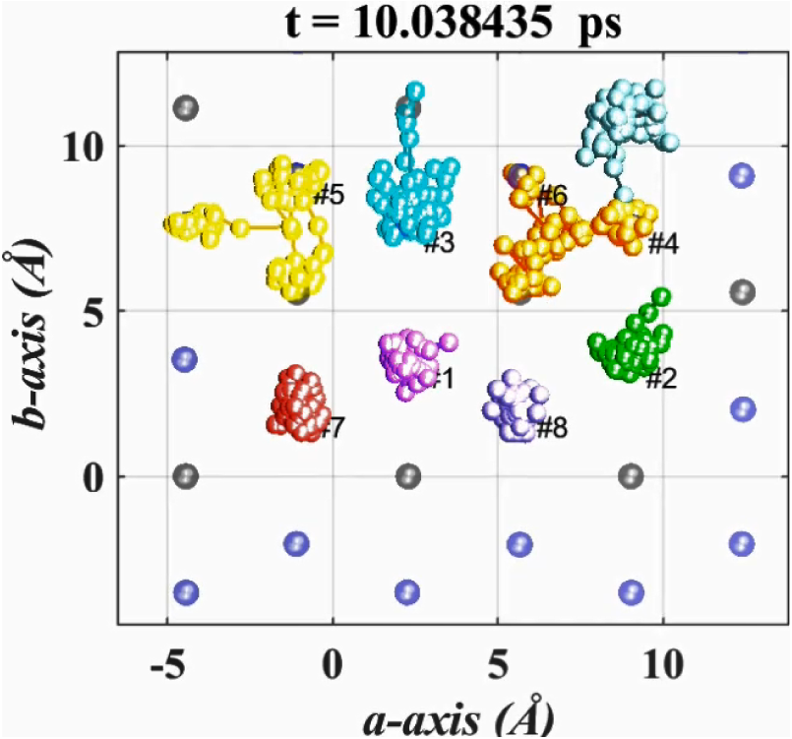
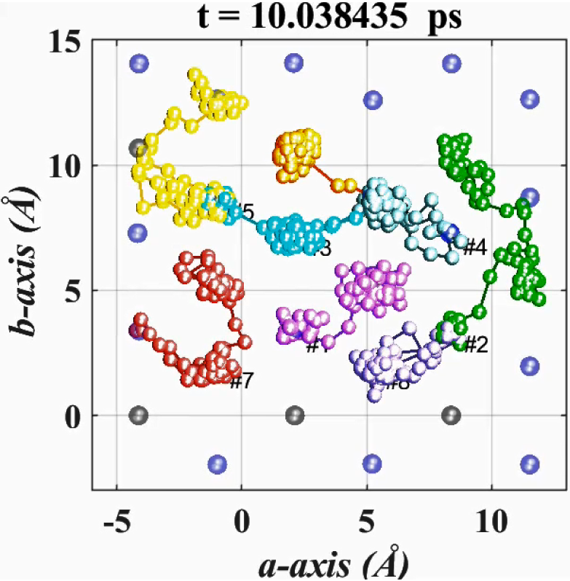
Migration study using molecular dynamics simulations
interlayer plane
at T = 1000 K
Na₄P₂S₆
Li₂Na₂P₂S₆
Host h site
Extra interstitial d site
No $g →h$ and $g →g$ hopping
All migrations occur within interlayer plane containing h-type Na ions
Direct $h→h$ vacancy migration is consistent with NEB analysis
Indirect $h →d$ $→h$ vacancy migration is prevalent
No interstitial $d$ $→d$migration
Both Na ion vacancy sites and indirect participation of interstitial sites contribute to the conductivity throughout the interlayer plane
*AIMD simulations were carried out using supercells composed of 2x1x2 conventional units (96 atoms)
Notes:
Qualitatively speaking, compared to the case for Na₄P₂S₆ the Na ions migrate more frequently in the mixed material Li₂Na₂P₂S₆, presenting a more extensive network of diffusional channels. To quantify these effects, we analyzed the nearest-neighbor hopping events, that is, the average number of hops between nearest neighboring sites, as a function of time. The story we can tell from the plots of H vs t is that for each material, the Na ion diffusion is either via direct vacancy mechanism between h to h, or via indirect vacancy mechanism between h to d or d to h. The h to d hops are more prevalent than the h to h hops, suggesting the interstitial d sites play an important role as intermediates in the Na ion migration processes throughout the interlayer plane.

Slide 12
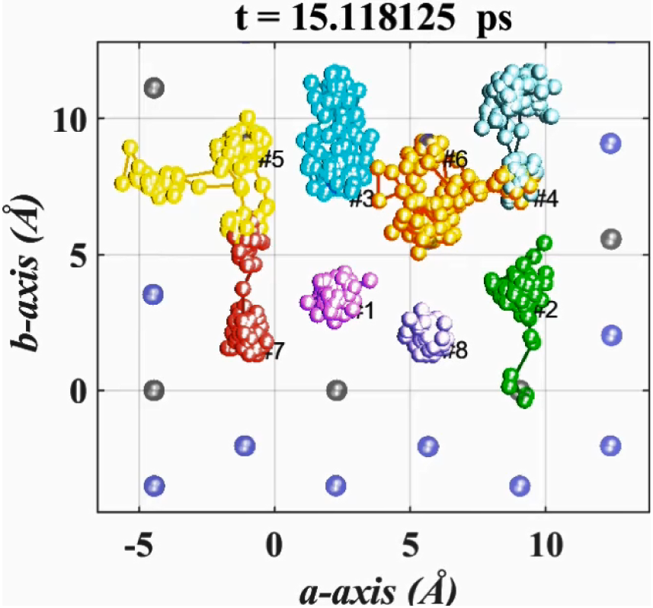
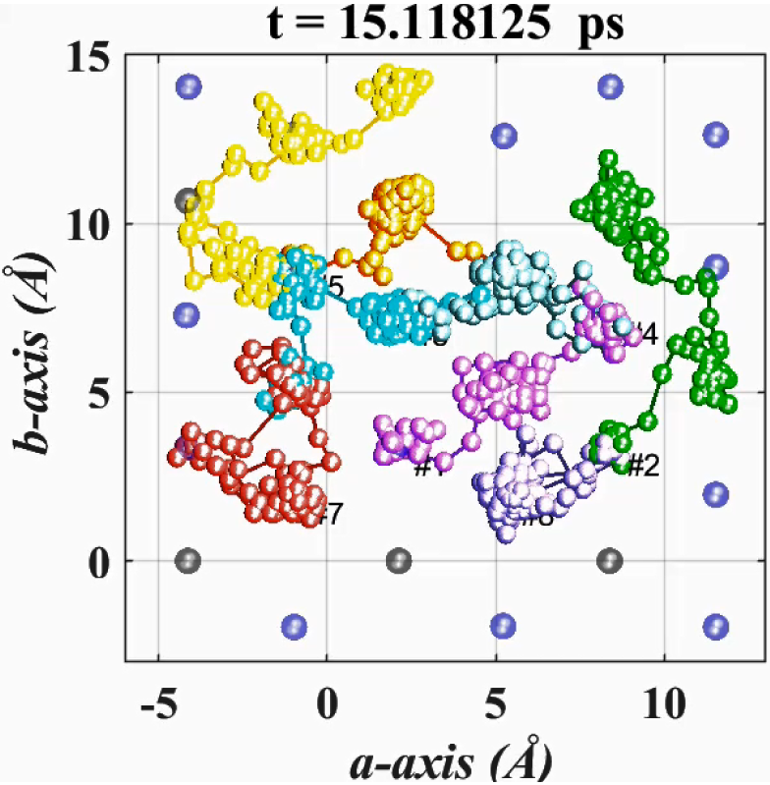
Migration study using molecular dynamics simulations
interlayer plane
at T = 1000 K
Na₄P₂S₆
Li₂Na₂P₂S₆
Host h site
Extra interstitial d site
No $g →h$ and $g →g$ hopping
All migrations occur within interlayer plane containing h-type Na ions
Direct $h→h$ vacancy migration is consistent with NEB analysis
Indirect $h →d$ $→h$ vacancy migration is prevalent
No interstitial $d$ $→d$migration
Both Na ion vacancy sites and indirect participation of interstitial sites contribute to the conductivity throughout the interlayer plane
*AIMD simulations were carried out using supercells composed of 2x1x2 conventional units (96 atoms)

Slide 13
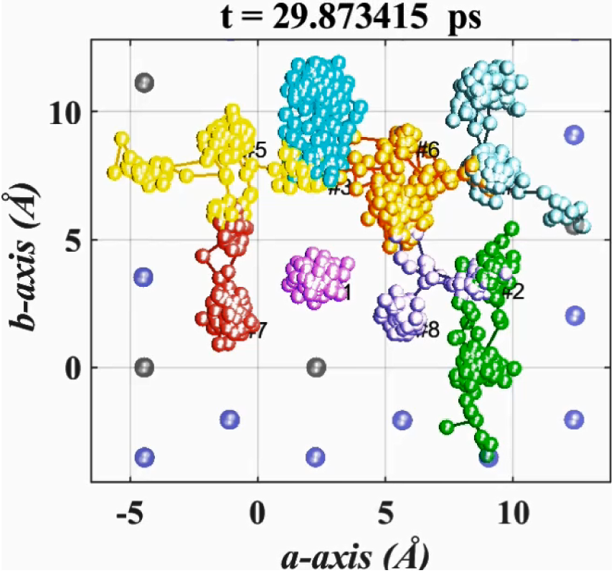
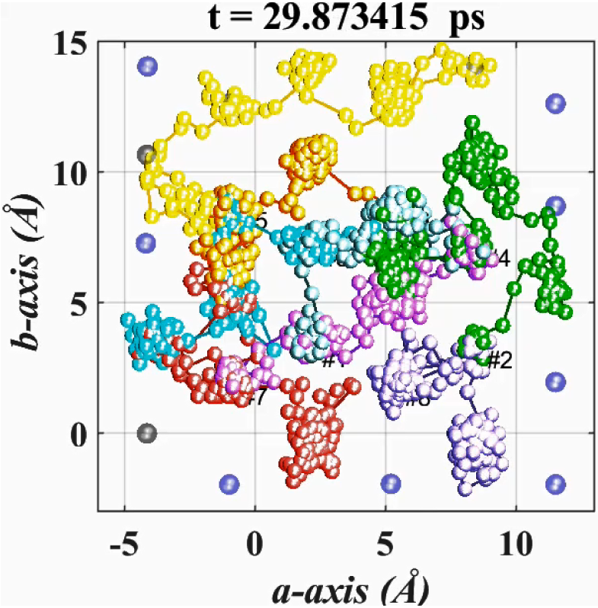
Migration study using molecular dynamics simulations
interlayer plane
at T = 1000 K
Na₄P₂S₆
Li₂Na₂P₂S₆
Host h site
Extra interstitial d site
No $g →h$ and $g →g$ hopping
All migrations occur within interlayer plane containing h-type Na ions
Direct $h→h$ vacancy migration is consistent with NEB analysis
Indirect $h →d$ $→h$ vacancy migration is prevalent
No interstitial $d$ $→d$migration
Both Na ion vacancy sites and indirect participation of interstitial sites contribute to the conductivity throughout the interlayer plane
*AIMD simulations were carried out using supercells composed of 2x1x2 conventional units (96 atoms)

Slide 14
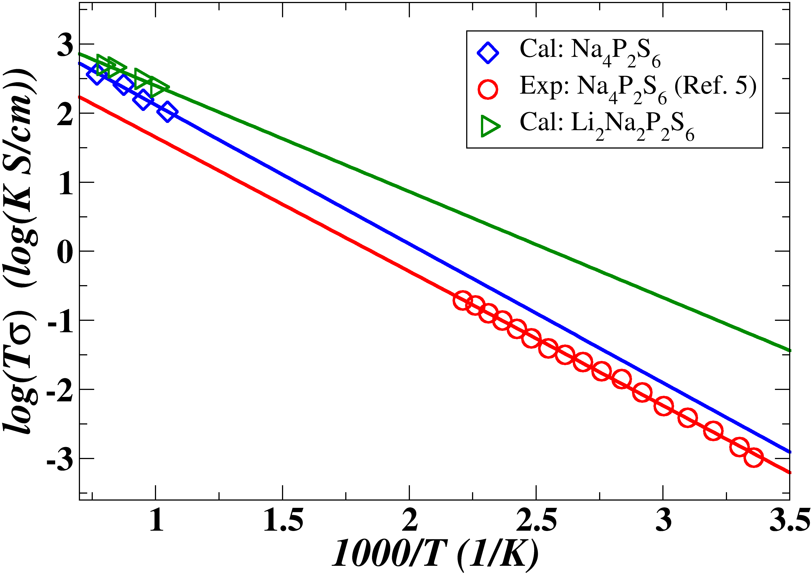
Ionic conductivity (continued)
TABLE: NEB and MD results calculated with the PBEsol exchange-correlation functional, in comparison to those of previous work obtained using the LDA exchange-correlation functional and available experimental data. All energies are given in eV units.
Materials | Analysis | E_{m} | E_{f} | E_{a}
Na₄P₂S₆ | LDA + NEB¹ | 0.30 | 0.24 | 0.42
 | PBEsol + NEB | 0.25 | 0.18 | 0.34
 | PBEsol + MD | -- | -- | 0.41
 | Experiment² | -- | -- | 0.39
Li₂Na₂P₂S₆ | PBEsol + NEB | 0.16 | 0.13 | 0.23
 | PBEsol + MD | -- | -- | 0.30
Molecular dynamics analysis of the ionic conductivity. The activation energy is obtained from the slope of the corresponding fit line.
Li₂Na₂P₂S₆ presents better Na ion conductivity than Na₄P₂S₆
¹Rush et al., Solid State Phys. 286, 45-50 (2016)
²Hood et al., Manuscript in preparation.
Notes:
Both NEB and molecular dynamics analyses suggest that the mixed ion material Li₂Na₂P₂S₆ has lower activation barriers and larger conductivity compared with Na₄P₂S₆. The present computational results on Na₄P₂S₆ are in reasonable agreement with the available calculated results using LDA in Ref. 1 and the experimental measurement in Ref. 2.
We also noticed that for these systems, $E_{a}^{NEB}$≠ $E_{a}^{MD}$ because of their different treatments of the effects of interstitial d sites. The NEB analysis presented here only considered direct hops between nearest neighbor vacancy sites, including the interstitial sites only in the estimation of the population of vacancies via the Boltzmann factor due to the formation energy E_{f} of the interstitial-vacancy pair. The molecular dynamics results indicate significant contributions of hops between vacancy and interstitial sites, presenting a plausibly more physical picture of the Na ion migration processes.

Slide 15
Summary
Using first-principle computational tools, we predicted the structure of a possible mixed ion material Li₂Na₂P₂S₆ and analyzed its stability in terms of Helmholtz free energies of proposed reaction pathways.
Conductivity studies on both Na₄P₂S₆ and Li₂Na₂P₂S₆ indicates that Na ions move primarily within the interlayer region between the (P₂S₆)⁴⁻ layers, efficiently proceeding via direct or indirect hops between vacancy sites, with indirect processes involving intermediate interstitial sites.
Li₂Na₂P₂S₆ has larger conductivity and lower activation barriers compared with Na₄P₂S₆, suggesting that the predicted material to be more promising Na ion electrolytes.

