Slide 1
PHY 114 A General Physics II
11 AM-12:15 PM TR Olin 101
Plan for Lecture 1:
Welcome & overview
Class structure & announcements
Electrical charges and forces

Slide 2
PHY 114 A General Physics II
11 AM-12:15 PM TR Olin 101
Instructor: Natalie Holzwarth (Olin 300)
Course Webpage: http://www.wfu.edu/~natalie/s12phy114
Webpage for Webassign system:
http://www.webassign.net/
You will also need an
i-clicker device for each class

Slide 3
Where to find information about the course on the web:

Slide 4
Course organization:

Slide 6
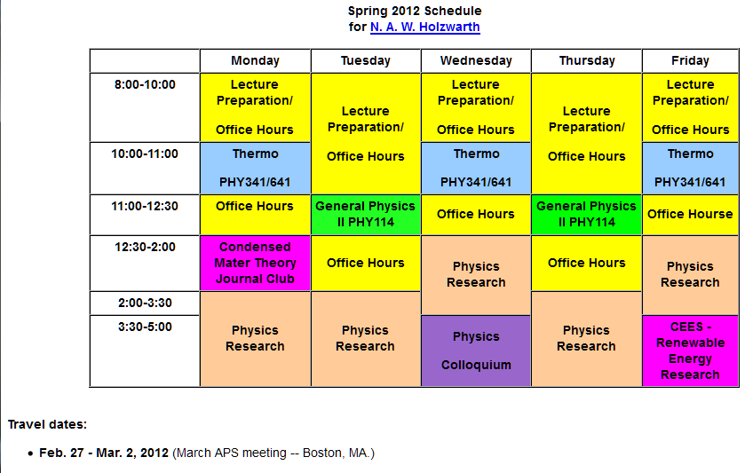
Tentative schedule – subject to change (after vote)

Slide 7
i-clicker exercise:
When would you prefer to have scheduled office hours? (Note additional meetings with your instructor can always be arranged.)
Before class (9-10:30 AM TR)
After class (12:15-1:30 PM TR)
Evenings 6-7 PM TR
Evenings 6-7 PM MWF
Other

Slide 8
➔ PHY 114 Labs will start Monday Jan. 23rd and run through the week of April 16th.
➔ PHY 114 Tutorial sessions will also start next week.

Slide 9
General advice on how to learn physics:
Physics is built on basic principles (“laws”) from which all results can be derived (deduced)
Focus your attention on understanding the basic principles
Practice using the basic principles to solve problems
Take care to formulate your questions and make sure they are answered
Note: In general, the best way to develop your problem solving skills is to practice solving problems. There is less (no ??) need to memorize.
As you are working problems, you may wish to construct a sheet of paper containing the basic equations you need to consult in order to solve the problems. You can take this same basic equation sheet to use during the in-class exams.

Slide 10
Overview --
Important concepts from General Physics I
F = m a (force ⬅➔ acceleration)
K_{f} + U_{f} = K_{i} + U_{i} + W_{(other)} (energy relationships)
Important concepts in General Physics II
General Physics I is still true
Electricity & Magnetism
Light
“Modern” Physics

Slide 11
Charging ahead.... (Chap. 23 of S & J)
Most matter is made up of charged particles
labeled + (proton: q_{p}= 1.60217733 x 10⁻¹⁹ C)
labeled - (electron: q_{e}= − 1.60217733 x 10⁻¹⁹ C)
Coulomb’s law describes the electrical force between two charged particles:
1
r₁
2
r₂

Slide 12
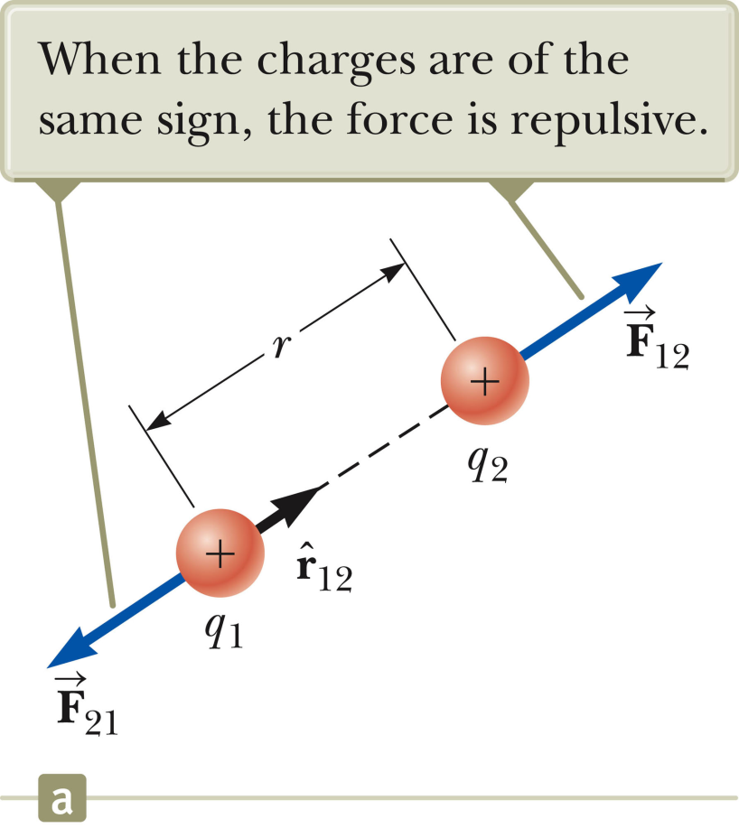
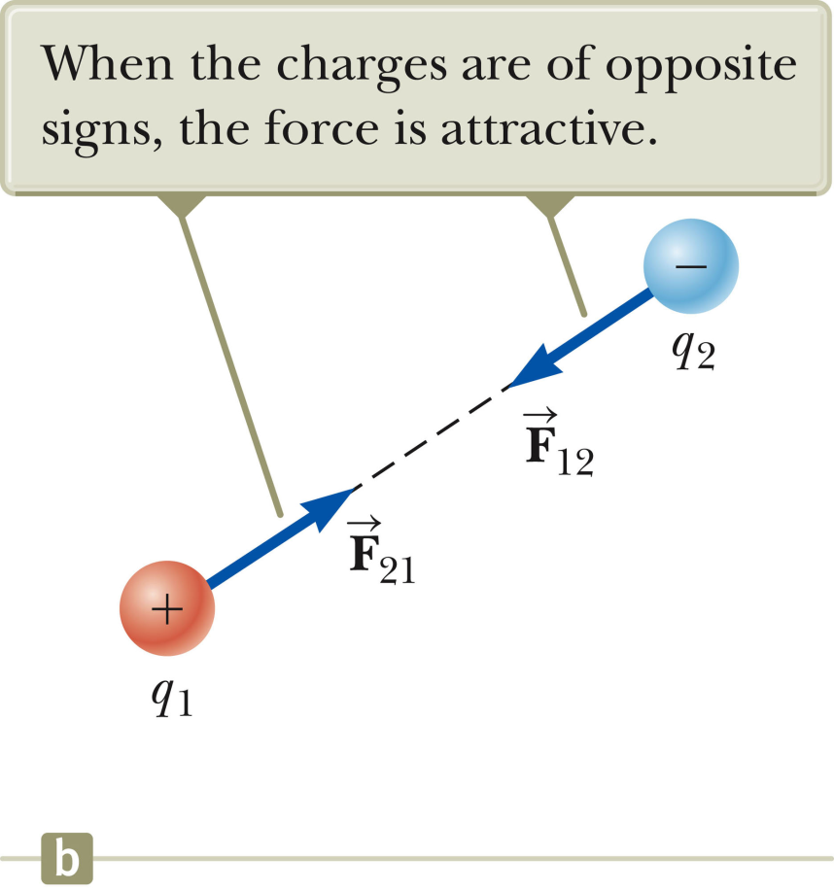
Coulomb’s law (continued)

Slide 13
Coulomb’s law (continued)

Slide 14
i-clicker exercise:
Consider a proton (m_{p}=1.67x10⁻²⁷ kg; q_{p}=+1.60x10⁻¹⁹ C) and an electron (m_{e}=9.11x10⁻³¹ kg; q_{e}=-1.60x10⁻¹⁹ C) separated by 5.29x10⁻¹¹ m. The particles are attracted to each other by both the force of gravity and by Coulomb’s law force. Which of these has the larger magnitude?
Gravitational force
B. Coulomb’s law force
➔We will mostly ignore gravitational effects when we consider electrostatics.

Slide 15
Problem solving steps
Visualize problem – labeling variables
Determine which basic physical principle(s) apply
Write down the appropriate equations using the variables defined in step 1.
Check whether you have the correct amount of information to solve the problem (same number of knowns and unknowns).
Solve the equations.
Check whether your answer makes sense (units, order of magnitude, etc.).

Slide 16
Problem example from Webassign:

Slide 18
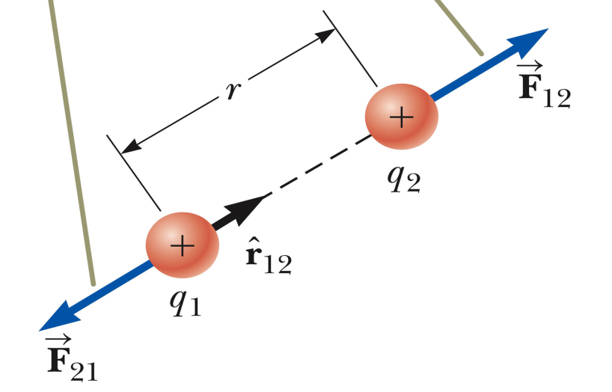
9.21e-4
Problem solving steps
Visualize problem – labeling variables
Determine which basic physical principle(s) apply
Write down the appropriate equations using the variables defined in step 1.
Check whether you have the correct amount of information to solve the problem (same number of knowns and unknowns).
Solve the equations.
Check whether your answer makes sense (units, order of magnitude, etc.).

Slide 19
Where do the charges q_{i} come from?
All matter is composed of nuclei (q_{N} = Ze) and electrons (q_{e} = -e) and generally there are an equal number of positive and negative charges.
Insulating material
Metallic material
Cu⁺
Cl⁻
Na⁺
e⁻

Slide 20
Note: Coulomb’s law applies both at the atomic level and at the macroscopic scale
Example on the macroscopic scale:

Slide 21
T
mg

Slide 22
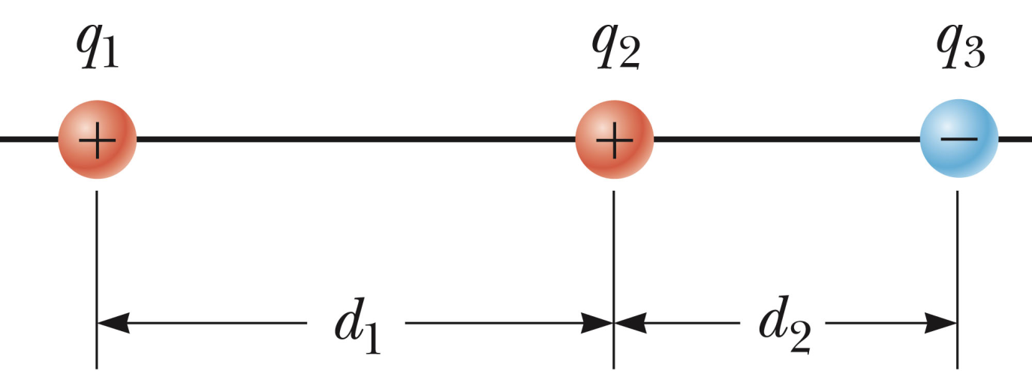
Coulomb’s law for multiple charges
F₁₂
F₁₃

Slide 23
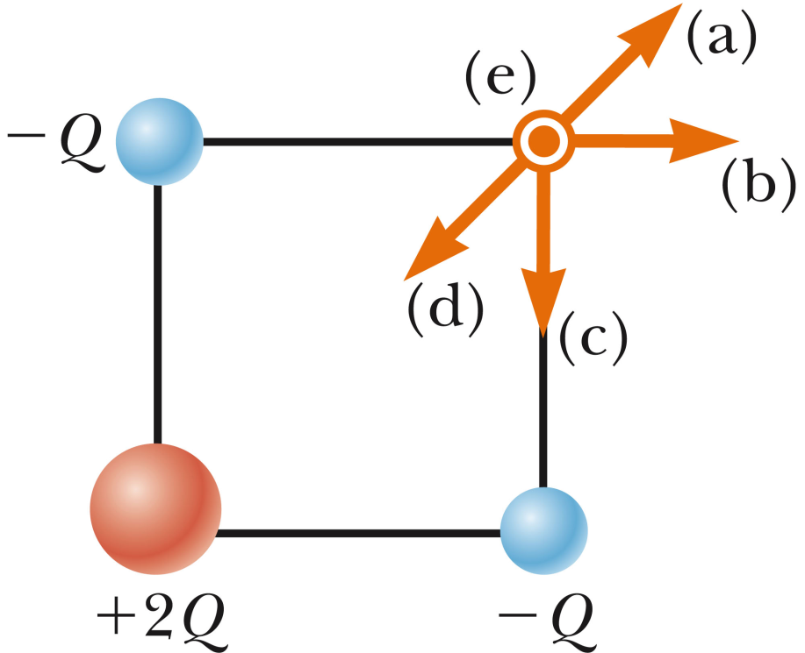
i-clicker exercise
Consider the configuration of 4 charges at the 4 corners of a square shown in the diagram. Which vector a,b,c,d, or e (pointing into the screen) indicates the direction of net force on the charge?
+Q

