Slide 1
PHY 114 A General Physics II
11 AM-12:15 PM TR Olin 101
Plan for Lecture 10 (Review Chapters 26-28):
Capacitance
Resistance
Voltage

Slide 2
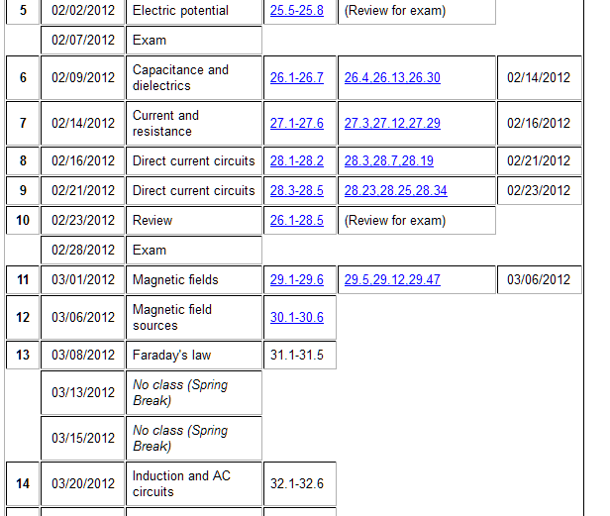
Remember to send in your chapter reading questions…

Slide 3
Professor George Holzwarth (gholz@wfu.edu)
  will administer the exam on 2/28/2012 and will lecture on magnetic fields, electric motors, etc. on 3/1/2012.

Slide 4
Reminder:
Second exam – Tuesday, February 28, 2012 – covering Chapters 26-28.
  ~5 problems – show your work and reasoning for possible partial credit.
  Should bring 1 8½” x 11” sheet of paper to the exam (to be turned in with your exam papers).
  Should bring calculator for numerical work. Must not use cell phones or computers during the exam.
  There will be assigned seating in Olin 101 for the exam.

Slide 5
Problem solving skills
Math skills
Equation Sheet
Advice:
Keep basic concepts and equations at the top of your head.
Practice problem solving and math skills
Develop an equation sheet that you can consult.

Slide 6
Problem solving steps
  Visualize problem – labeling variables
  Determine which basic physical principle(s) apply
  Write down the appropriate equations using the variables defined in step 1.
  Check whether you have the correct amount of information to solve the problem (same number of knowns and unknowns).
  Solve the equations.
  Check whether your answer makes sense (units, order of magnitude, etc.).

Slide 7
How many times did you use your equation sheet during the last exam?
  0
  1
  2
  >2

Slide 8
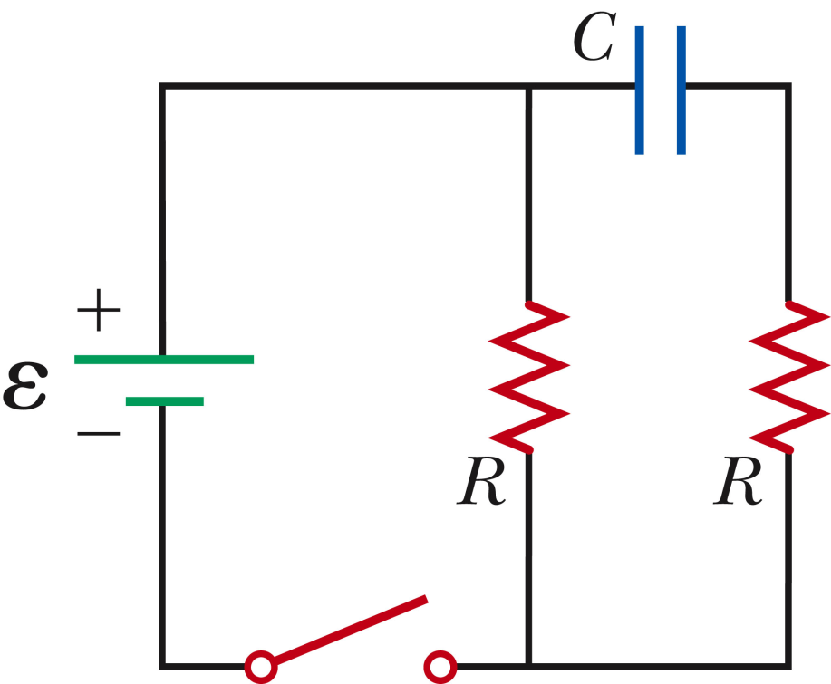
What is the current I flowing through the battery just when the switch is closed?
0
E/2R
E/R
2E/R
Example 28.5 :
Assume the capacitor is initially uncharged.
I
What is the current I flowing through the battery after the switch has been closed for a long time?
0
E/2R
E/R
2E/R

Slide 9
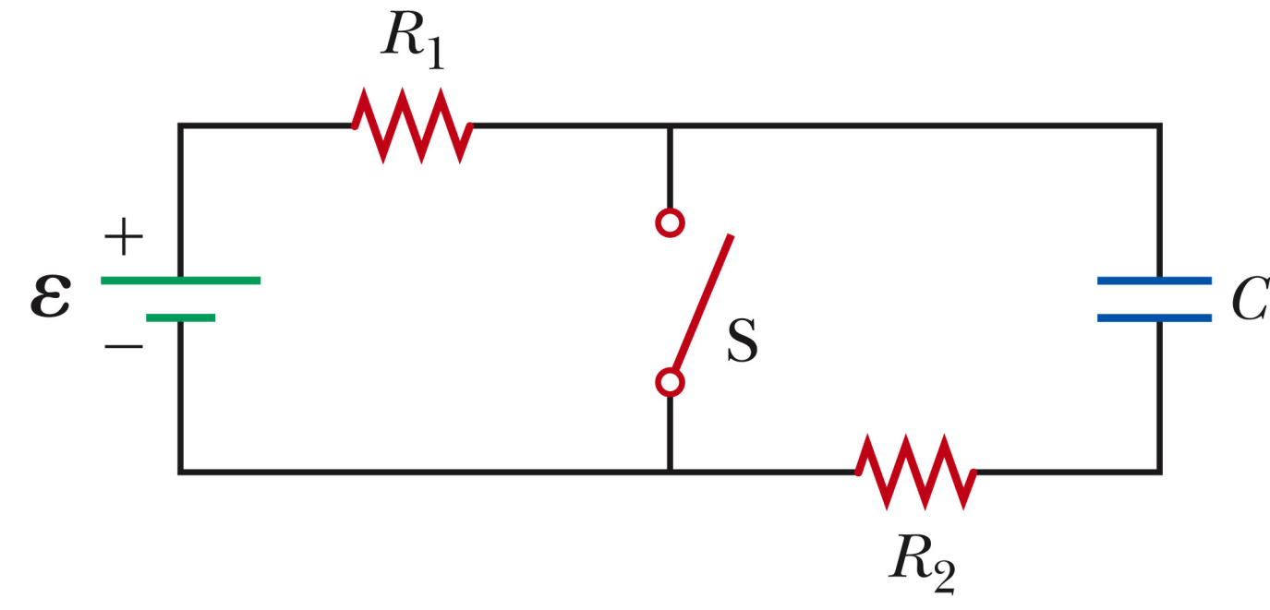
When switch is open:
+Q
I
I
-Q

Slide 10
When switch is closed (reset t=0):
+Q
I₁
I_{S}
I₂
-Q

Slide 11
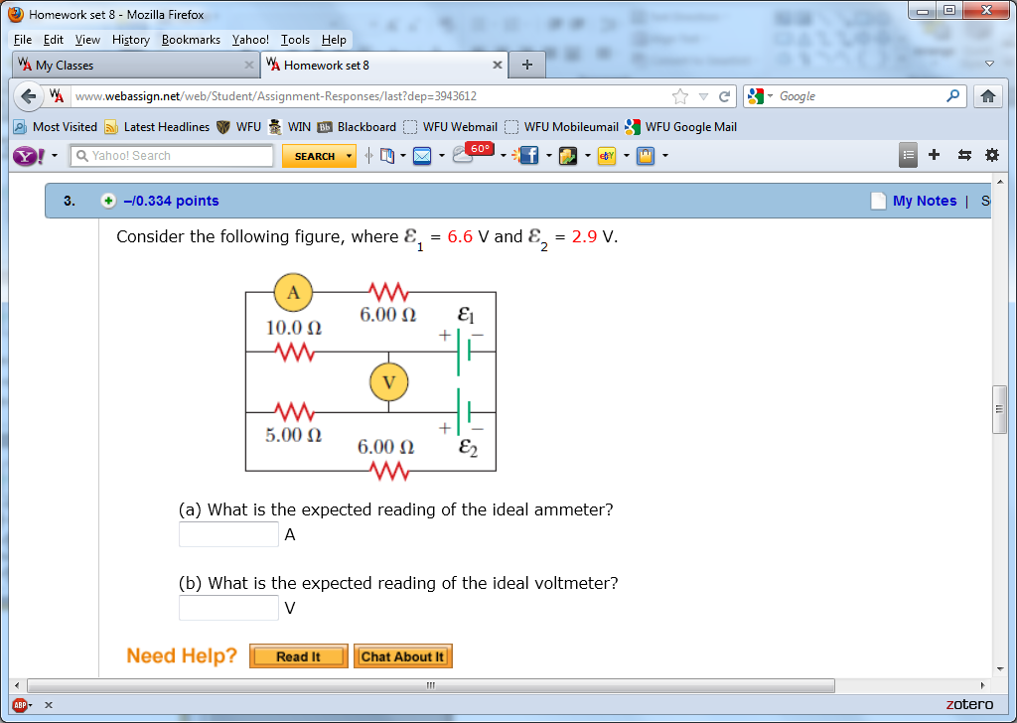
From webassign:
I₁
I₂
I₅
I₃
I₄

Slide 13
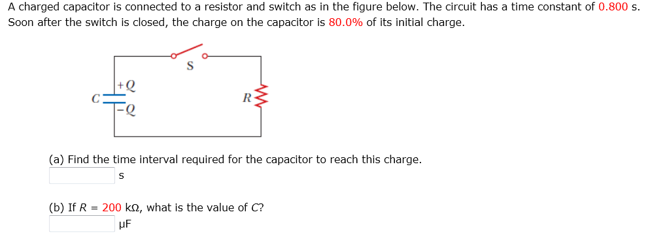

Slide 14
Review of Chapters 26-28

Slide 15
General formulation of capacitance
Ignoring sign:
Units:
Voltage drop across capacitor terminals
Charge on + and – terminals of capacitor
Depends on geometry and material composition of capacitor

Slide 16
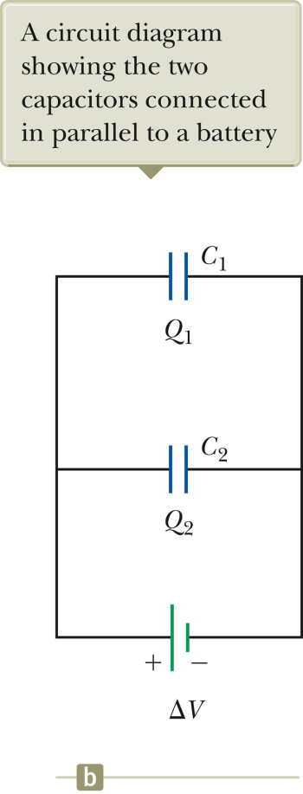
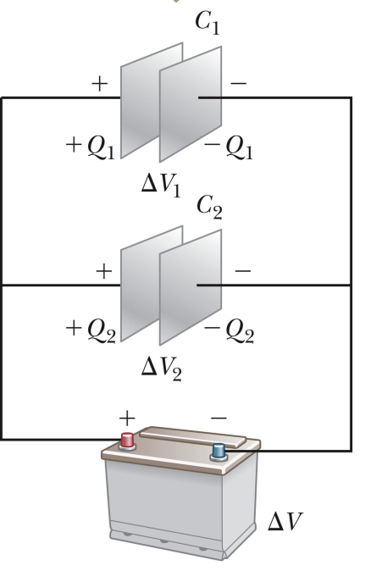
More complicated circuits –
Capacitors connected in parallel

Slide 17
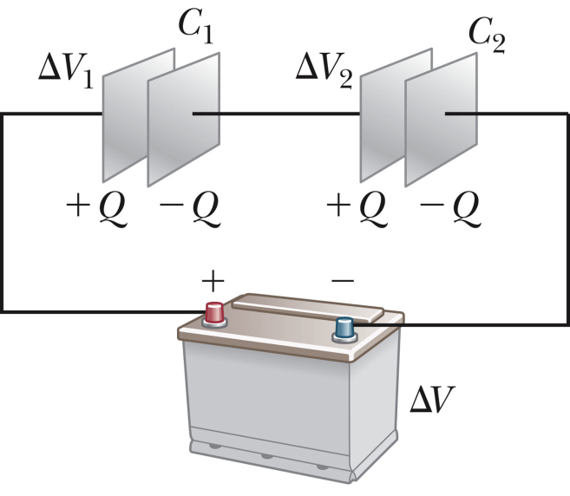
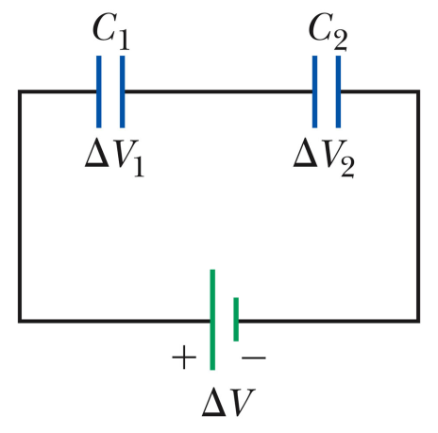
More complicated circuits –
Capacitors connected in series

Slide 18
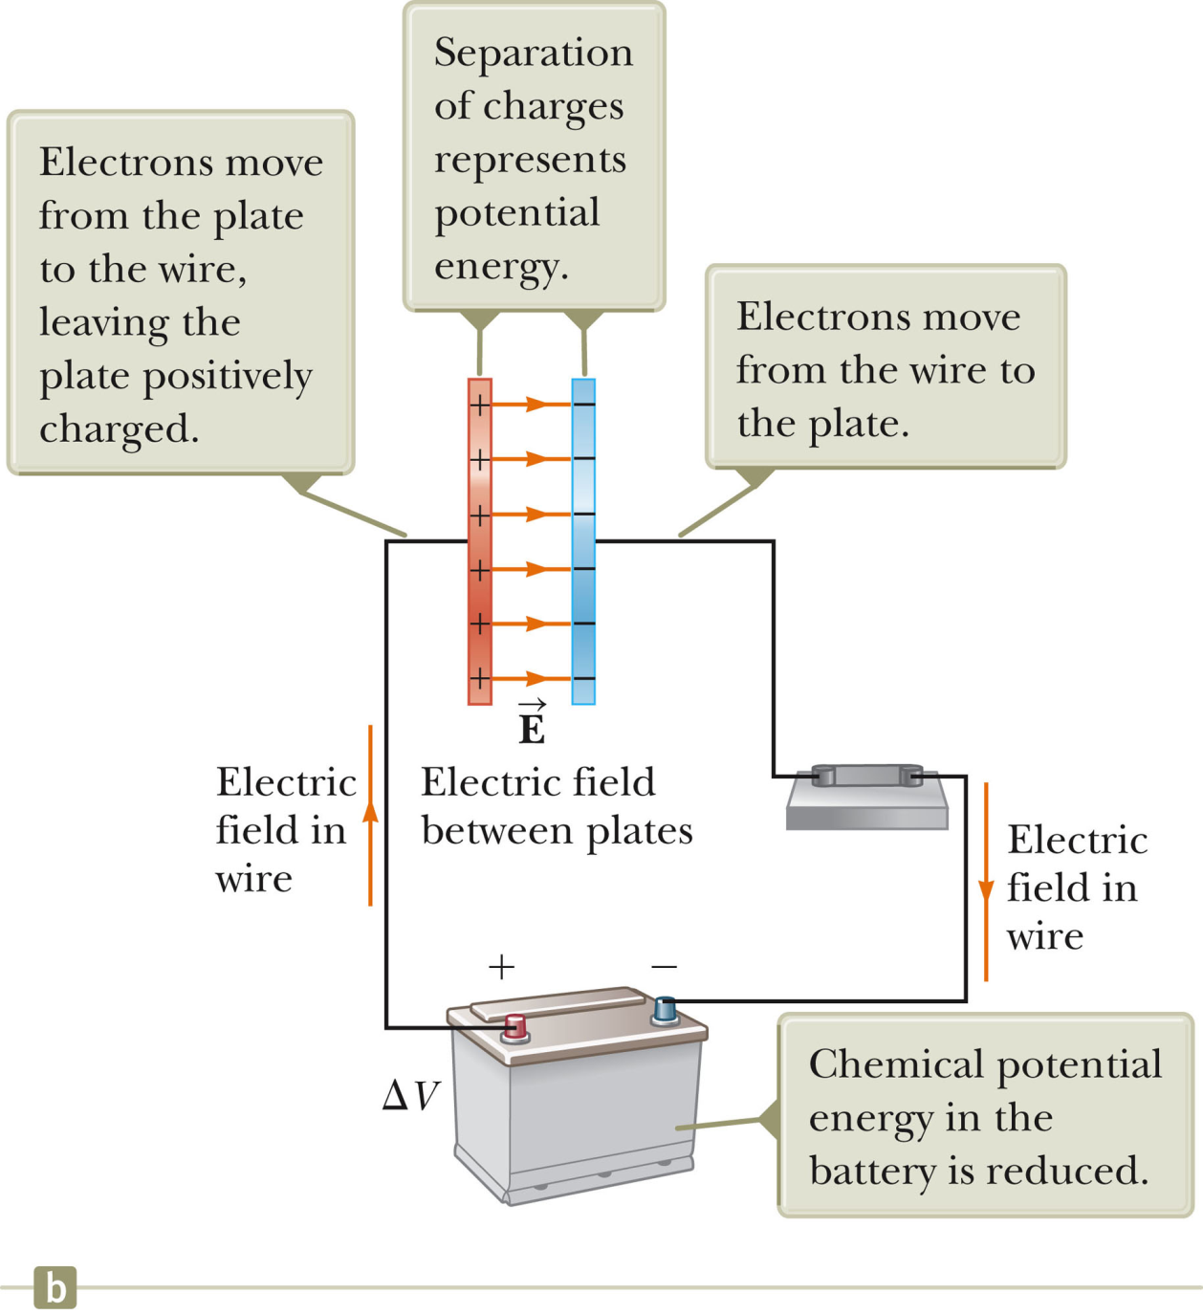
Energy storage within a capacitor

Slide 19
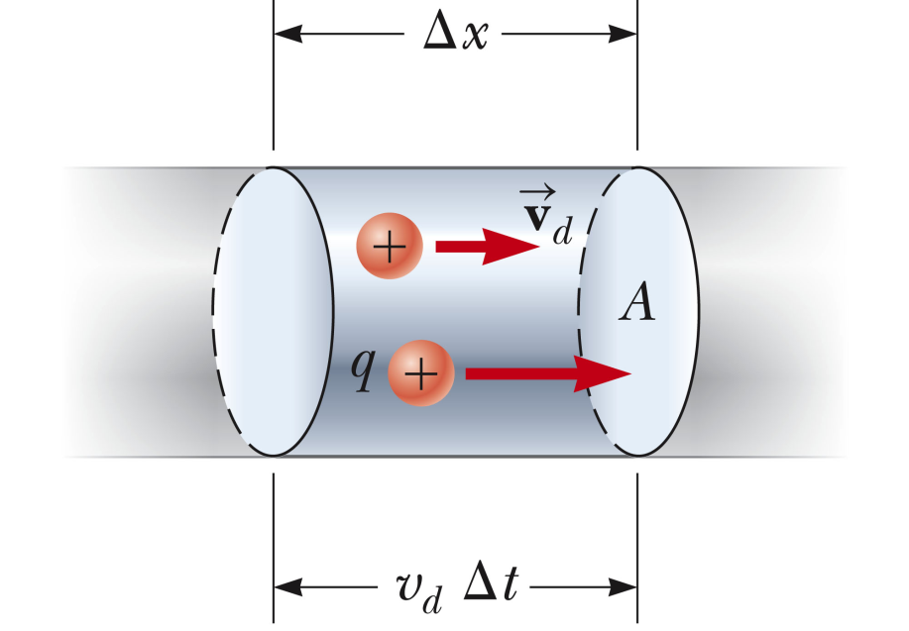
Up to now, we have been considering equilibrium configurations of charges -- electrostatics. Now we will consider steady-state motions of charges.
Electrical current
➔By convention +I denotes the direction of positive charge flow (or the opposite direction of negative charge flow).
drift velocity
# charges/volume

Slide 20
Model to describe drift velocity
term representing collisions on a time scale of τ

Slide 21
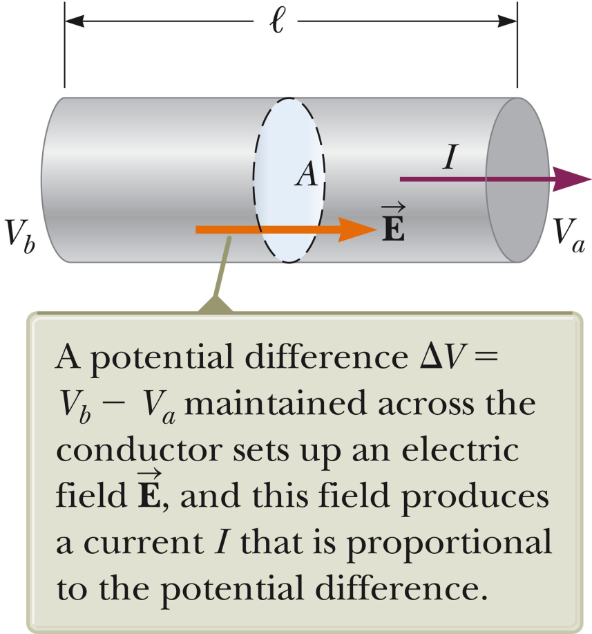
ΔV=E l

Slide 22
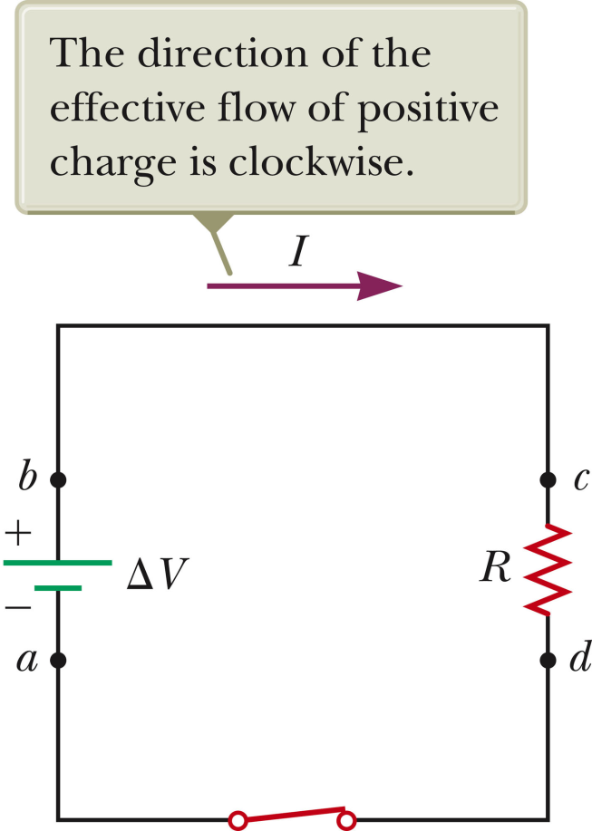
Switch open, no current flowing, battery storing energy
Switch closed, current flowing, battery discharging
I

Slide 23
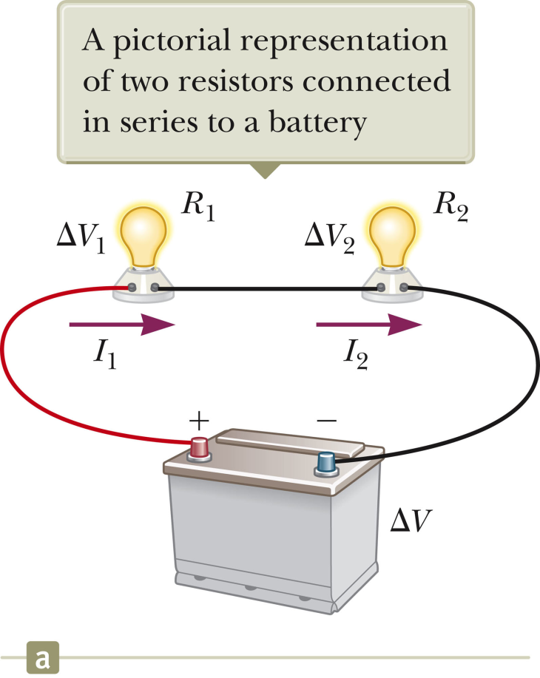
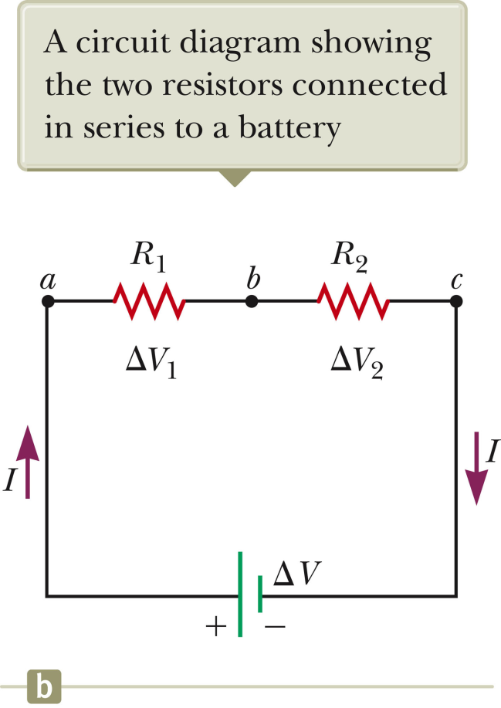
Resistors in series:

Slide 24
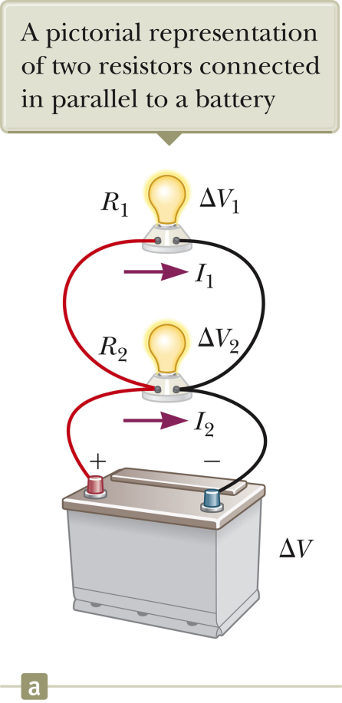
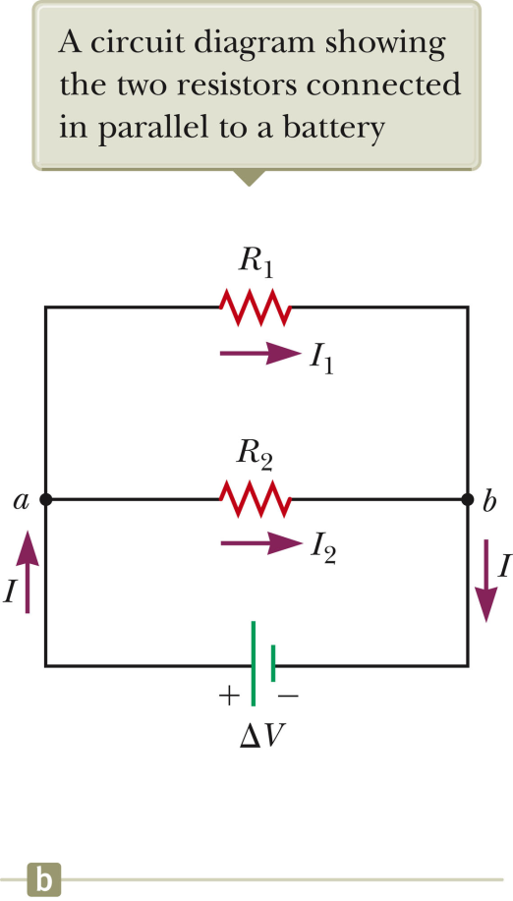
Resistors in parallel

Slide 25
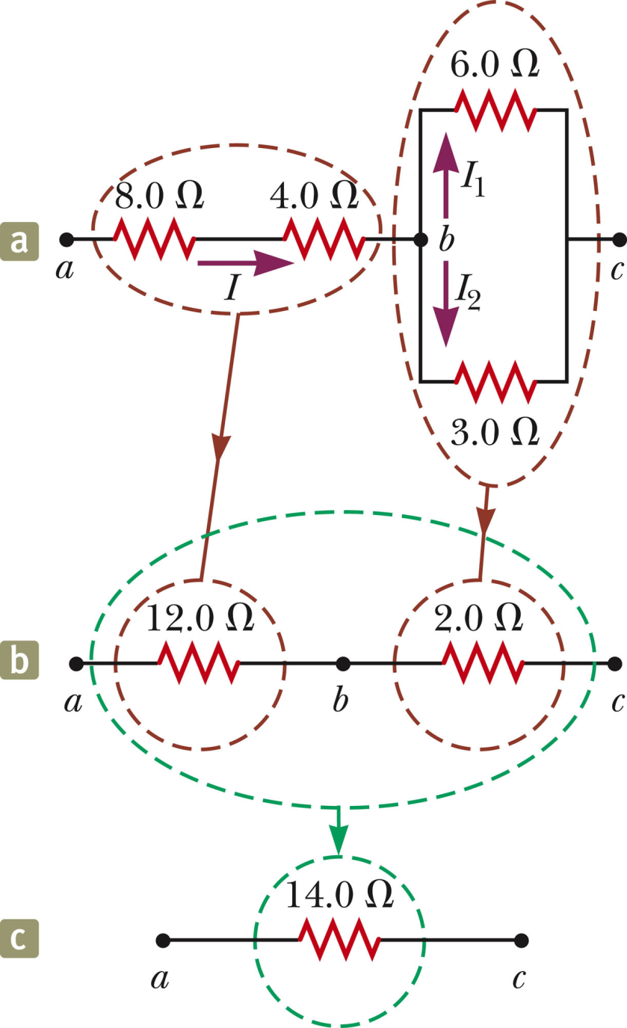
Step-by-step reduction of resistor circuit to its equivalent

Slide 26
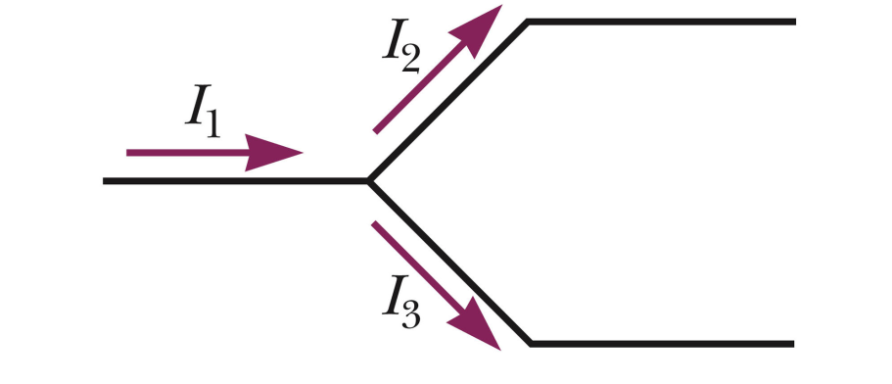
Circuit analysis – Kirchhoff’s rules
Conservation of charge (current) at a junction:

Slide 27
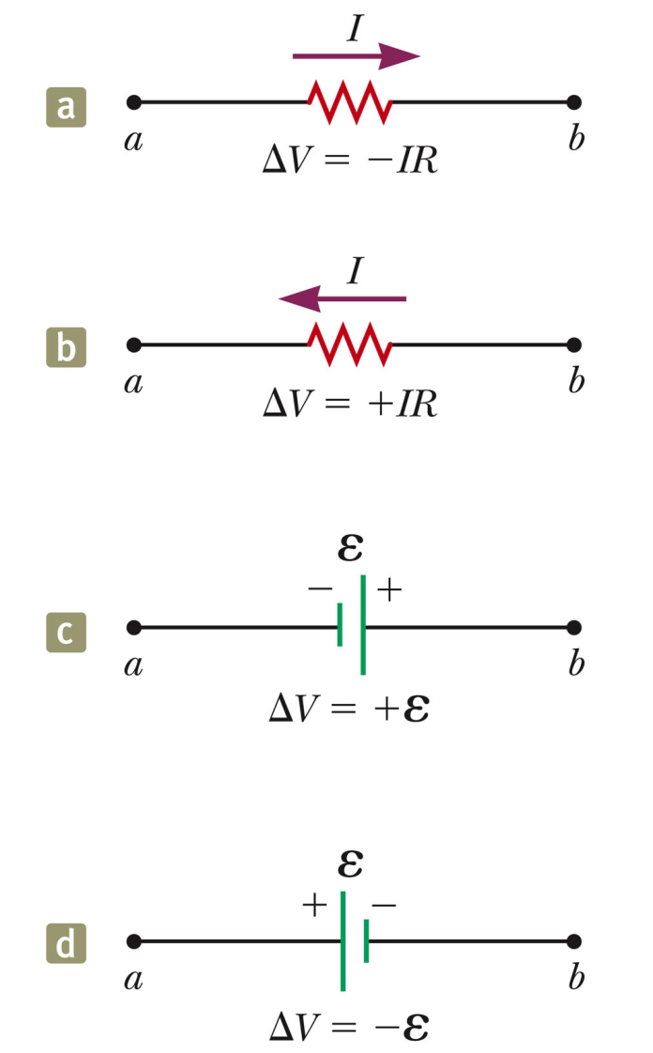
Circuit analysis – Kirchhoff’s rules
Conservation of potential around a closed circuit:
Sign conventions:ΔV=V_{b}-V_{a}
ΔV₁
ΔV₂
ΔV₃

Slide 28
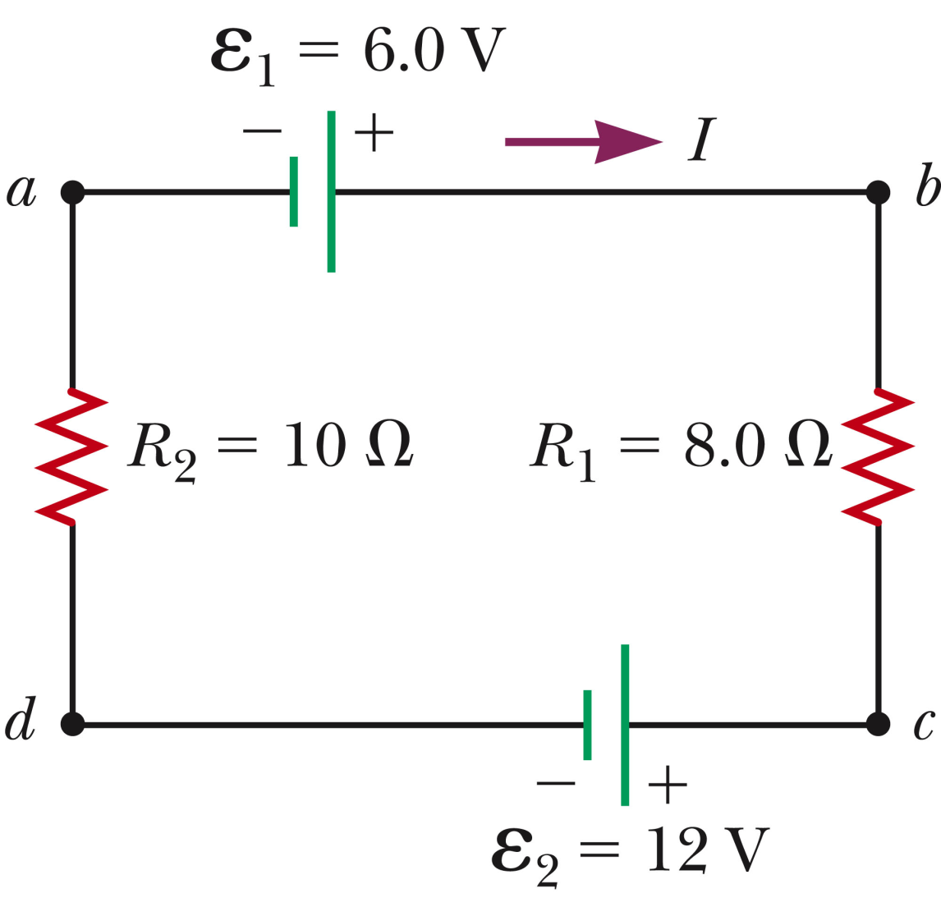
Example:
I<0 means:
The circuit is wrong (cannot exist or will blow up).
The current flows opposite the arrow.

Slide 29
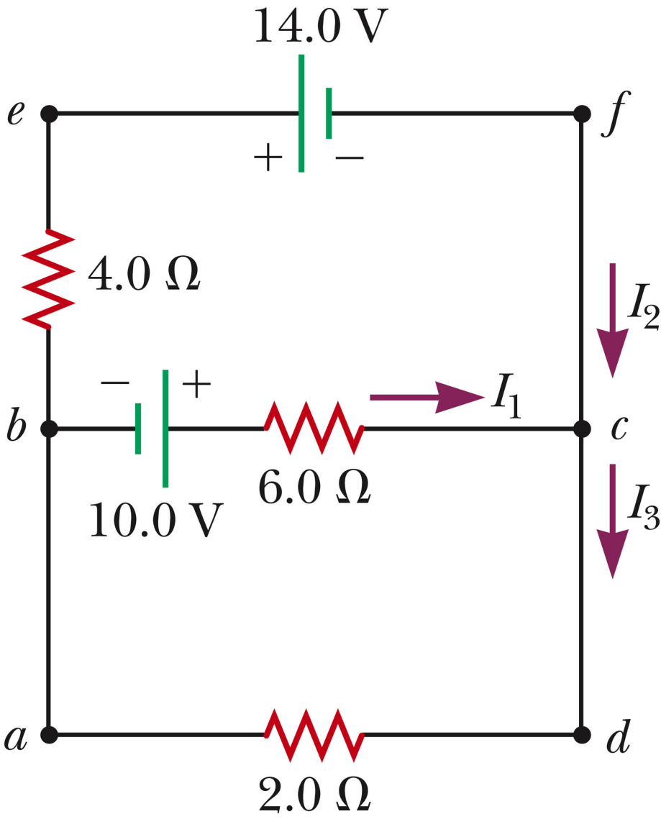
Example:
I₂
I₃

