Slide 1
PHY 114 A General Physics II
11 AM-12:15 PM Olin 101
George Holzwarth
gholz@wfu.edu
Main topics today (Chapt 29):
Magnetic field
history:
applications:
Lorentz force law for charged particles moving in electric and magnetic fields
Magnetic force on a current-carrying wire
Torque on a current loop
Hall effect to measure B electrically

Slide 2
Remember to send in your chapter reading questions…

Slide 3
Brief history of Magnetism
1300 BC compass used to help travellers find directions in China.
800 BC Greeks observe that pieces of magnetite (Fe₃O₄) attract pieces of iron (Fe).
AD Using a compass to point along field lines outside a spherical magnet,
de Maricourt (France) observes 1 source and 1 sink ( poles)
1269-1820 AD Everybody busy with wars and plagues for 550 years. No time for magnetism.
1820 AD Oersted (Denmark) observes that electric current in a wire deflects a nearby compass. Faraday(England), Henry(US), Maxwell (England) work on the physics of magnetism.
Late 1800’s: motors, generators, power grids, electric lighting, electric refrigeration invented. GE, Siemens, Westinghouse, etc make these products widely available.
Heaviside derives a key equation relating magnetic field B to force F on a moving charge or current.
1899 H. A. Lorentz derives the same equation, now known as the Lorentz Equation.
1900: EE programs developed at MIT, Stanford.
Introduction

Slide 4
Applications of magnetic forces
“electric” motor, “electric” car, “electric” generator,
“electric” drill, solenoid actuator.
tape recorder, magnetic hard drive, CRT for oscilloscopes and TV
magnetic levitation for trains
science (Nmr, mass spectrometer)
medicine (MRI; magnetic navigation systems for catheter)

Slide 5
Recall what we did for
Electric field has magnitude and direction
Source of E is charged particles (e⁻ , Na⁺,….)
Potential energy
Voltage difference
Force
electric charge₁ electric charge₂
Math for F is easy

Slide 6
“Electric” cars are propelled by magnetic force
Motor in the Tesla electric car:
3-phase, 4-pole induction motor,
248 hp (185 kW).
Maximum torque: 270 N·m between
0 and 6,000 rpm

Slide 7
Magnetic Field
B has both magnitude and direction (vector)
direction is given by the direction toward ` which the north pole of a compass needle points
field lines can be traced out by a compass or by metal filings
Section 29.1

Slide 8
Magnetic Field Lines around a bar magnet
A compass shows the direction of the field lines.
The field lines outside a bar magnet point from its North pole to the its South pole. Think of the N pole as the source of the field lines.
compass points toward the south pole of the magnet.
Compass doesn’t measure field strength
Section 29.1

Slide 9
demos with magneprobe, iron filings

Slide 10
Magnetic Field Lines, Bar Magnet
Iron filings align along the magnetic field lines.
The direction of the field is given by the direction in which the north pole of a compass points.
Section 29.1

Slide 11
Magnetic Field Lines, Opposite Poles
Iron filings are used to show the pattern of the electric field lines.
The direction of the field is the direction a north pole would point.
Compare to the electric field produced by an electric dipole
Section 29.1

Slide 12
Magnetic Field Lines, Like Poles
Iron filings show the alignment of the magnetic field lines.
The direction of B is the direction a north pole would point.
Compare to the electric field produced by like charges
Section 29.1

Slide 13
Earth’s Geographic & Magnetic Poles
Earth’s magnetic field behaves like there’s a gigantic bar magnet inside Earth.
The magnet’s S pole is near Earth’s geographical N pole. (Careful ! Confusing!)
On surface of Earth, the magnetic field lines begin near the S geographic pole and end near Earth’s N geographic pole.
A compass needle points in the direction of B, so it points toward the N geographic pole.
Section 29.1

Slide 14
Earth’s Magnetic Field
Section 29.1

Slide 15
Force on a Charge Moving in a Magnetic Field
is the magnetic force
is the charge
is the velocity of the charge
is the magnetic field
This equation defines B, just as defines .
Section 29.1

Slide 16
Direction of F_{B}: tricky because of cross product
Section 29.1

Slide 17
Direction of F_{B}: Right-Hand Rule #1
Your thumb is in the direction of the force if q is positive.
The force is in the opposite direction if q is negative.
Section 29.1

Slide 18
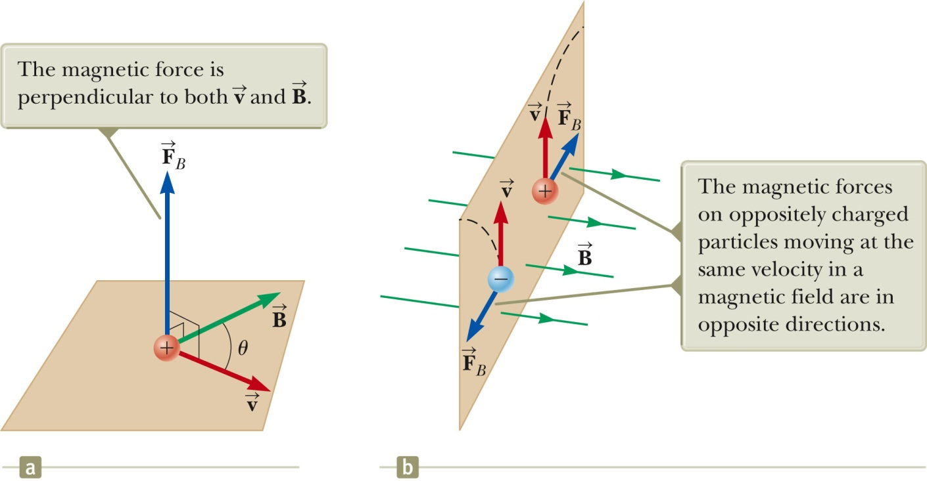
Magnitude of F_{B}.
xxxxxxxxxxxxxxxxxxxxxxxxxxxxxxxxxxxxxxxxxxxxxxxxxxxxxxxxxxxxxxxxxxxxxxxxxxxxxxxxxxxxxxxxxxxxxxxxxxxxxxxxxxxxxxxxxxxxxxxxxxxxxxxxxxxxxxxxxxxxxxxxxxxxxxxxxxxxxxxxx
The magnitude of F_{B} = |q| v B sin θ.
θ is the smaller angle between and
F_{B} is zero when and are parallel or antiparallel
θ = 0 or 180º
F_{B} is a maximum when and are perpendicular
θ = 90º
Section 29.1

Slide 19
The SI unit of Magnetic Field is the Tesla
Recall
The SI unit of magnetic field is the tesla (T).
Wb is a weber
The gauss (G) is also a commonly used unit:
1 T = 10⁴ G
Section 29.1

Slide 20
Typical values of T
Best superconducting lab magnet 30 T
Medical MRI magnet (supercon) 5
electric motor 2
Small bar magnet 0.01
At surface of earth 0.5x10⁻⁴
Inside human brain 10⁻¹³
_____________________________________________________
Surface of a magnetar (1992) 10¹⁰

Slide 21
Demo deflection of cathode ray

Slide 22
Differences Between Electric and Magnetic Fields
Direction of force
The electric force acts along the direction of E.
The magnetic force acts perpendicular to B.
Motion
The electric force acts on a charged particle regardless of whether the particle is moving.
The magnetic force acts on a charged particle only when the particle is in motion.
Work
The electric force does work in displacing a charged particle.
The magnetic force associated with a steady magnetic field does no work when a particle is displaced.
This is because the force is perpendicular to the displacement of its point of application.
Section 29.1

Slide 23
Work in constant B, cont.
The kinetic energy of a charged particle moving through a constant B cannot be altered by B alone.
When a charged particle moves with a given v through a constant magnetic field, the field can alter the direction of the v, but not the speed or the kinetic energy.
Section 29.1

Slide 24
Depiction of a uniform magnetic field.
When vectors are perpendicular to the page, dots and crosses are used.
dots represent the points of arrows coming out of the page.
crosses represent the tail feathers on the arrows going into the page.
The same notation applies to other vectors.
Section 29.2

Slide 25
Moving charged particles in a uniform B field travel in circles or helices.
Simplest case:
always points toward the center of a circular path.
causes a centripetal acceleration of the particle
direction of v changes, but not its magnitude
magnitude of F = qvB
Section 29.2

Slide 26
Find the radius of the circle
uniform circular motion requires a mechanical force:
Equating the magnetic and centripetal forces:
Solve for r:
r is proportional to the linear momentum of the particle and inversely proportional to the magnetic field and the charge.
Section 29.2

Slide 27
Bending of an Electron Beam in a uniform B-field
A beam of electrons with velocity v is generated by an “electron gun”
electrons then enter a uniform magnetic field that is perpendicular to v.
The electrons trace out in a curved path but their speed is unchanged.
Conservation of energy gives v
Class question: direction of B?
Section 29.2

Slide 28
More About Motion of the Particle in uniform B (makes a circle)
The angular speed of the particle is
The angular speed, ω, is also referred to as the cyclotron frequency.
The period of the motion is
Section 29.2

Slide 29
Motion of a charged particle if v is not perpendicular to B
Assume B points along x
If v of the charged particle is not B , break up v into two parts.
1) a part parallel to B; F_{B} =0.
2) a part to B. This gives non-zero F_{B.} Particles moves in a circle in the yz plane.
The overall motion is a helix.
radius of helix is same as previous equation for r, but with v replaced by
Section 29.2

Slide 30
Van Allen Radiation Belts
The Van Allen radiation belts consist of charged particles surrounding the Earth in doughnut-shaped regions.
The particles are trapped by the Earth’s nonuniform magnetic field.
The particles spiral from pole to pole.
May result in auroras
Section 29.2

Slide 31
Particle in a magnetic bottle (B is non-uniform in magnitude AND direction)
the particles oscillate back and forth between the two ends of the bottle while spiralling around the axis of the bottle.
Section 29.2

Slide 32
Charged Particles Moving in Electric and Magnetic Fields
In many applications, charged particles will move in the presence of both electric and magnetic fields.
The total force is called the Lorentz force
(O. Heaviside, 1889; H. A. Lorentz, 1899).
Section 29.3

Slide 33
Velocity Selector
A device to transmit in a straight line only particles with the a specified velocity. Particles going faster or slower are deflected to left or right. How does it work?
E points to the right
B points into the board
When , the particle is undeflected
qE = qvB so v = E / B
Suppose a particle is deflected right of the centerline. Is v >E/B or < E/B?
Section 29.3

Slide 34
Mass Spectrometer
A mass spectrometer separates ions according to their mass-to-charge ratio.
In one design, a beam of ions passes through a velocity selector and enters a second magnetic field.
After entering the second magnetic field, the ions move in a semicircle of radius r before striking a detector at P.
If the ions are positively charged, they deflect to the left.
If the ions are negatively charged, they deflect to the right.
Section 29.3

Slide 35
Mass Spectrometer, cont.
The mass-to-charge ratio (m/q) can be determined by measuring the radius of curvature r. But
so
In practice, you can measure the masses of various isotopes of a given atom, with all the ions carrying the same charge.
The mass ratios can be determined even if the charge is unknown.
Section 29.3

Slide 36
Thomson’s e/m Experiment (J.J. Thomson, “Cathode Rays”, Philosophical Magazine, 44, 293-305 (1897))
“Cathode Rays” (electrons) are generated with a heated cathode and nearby anode with a hole (electron gun).
They are deflected by
electric and magnetic fields.
The beam of electrons strikes a fluorescent screen.
e/m is determined from known values of v, E, and B
Section 29.3

Slide 37
Cyclotron (E. O. Lawrence and M. S. Livingston, 1934)
A cyclotron is a device that can accelerate charged particles to very high speeds.
The energetic particles produced are used to bombard atomic nuclei and thereby produce reactions.
Key idea: give charged particles an electrical kick of energy
Use a transverse B to make them go in a circle.
The radius of the circle increases with velocity of particle, but the period of circular motion is independent of v
Section 29.3

Slide 38
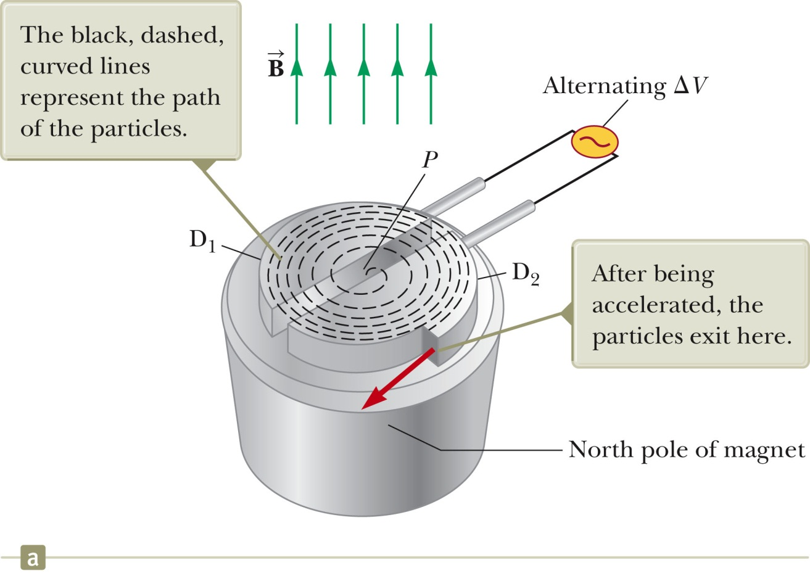
Cyclotron, cont’d
D₁ and D₂ are called dees because of their shape.
A high frequency alternating voltage is applied to the dees.
A uniform magnetic field is perpendicular to them.
A positive ion is released near the center and moves in a semicircular path.

Slide 39
Cyclotron, final
The frequency of the electrical voltage is adjusted to be the same as the frequency of circular travel:
The cyclotron’s operation is based on the fact that this frequency is independent of the speed and radius of the particle. Clever observation (Nobel prize).
However, the energy of the particle depends on R:
When the energy of the ions in a cyclotron exceeds about 20 MeV, relativistic effects come into play.
Most accelerators currently used in research are synchrotrons.
Section 29.3

Slide 40
Magnetic Force on a Current Carrying Conductor (think “electric” motor)
When a current-carrying wire is placed in a magnetic field, it experiences a force
The direction of the force is given by the right-hand rule.
Section 29.4

Slide 41
Force on a Wire, equation
The magnetic force exerted on one moving charge in the wire is
Current I is given by (eq. 27.4)
The total force is the product of the force on one charge and the number of charges in a length L of wire:
Substituting I for nqv_{d}A gives
Section 29.4

Slide 42
Force on a straight wire, Equation cont.
is a vector that points in the direction of the current.
Its magnitude is the length L of the segment.
is the magnetic field.
Section 29.4

Slide 43
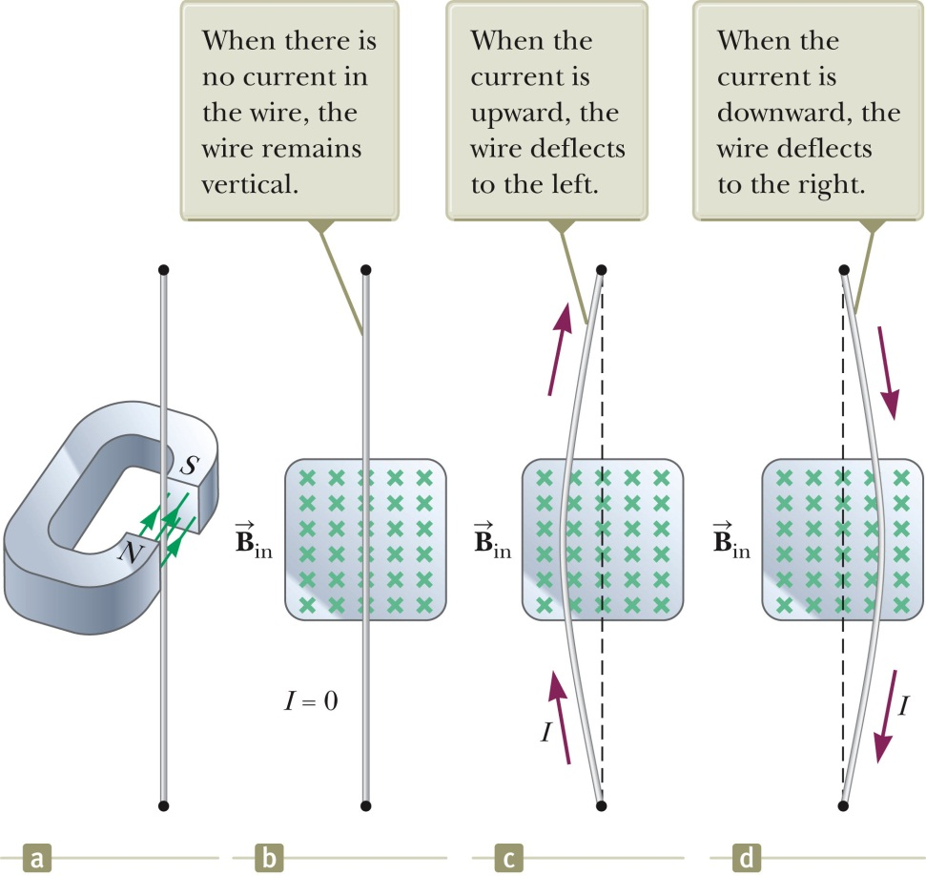
Demo: Force on a Wire
The magnetic field is into the page
The current is up the page
The force is to the left
The wire deflects to the left
DO DEMO
Section 29.4

Slide 44
Force on a Wire of Arbitrary Shape
Consider a small segment of the wire,
The force exerted on this segment is
The total force is
Next: build a motor. Motor needs torque, not force.
Section 29.4

Slide 45
Torque on a rectangular current loop
The loop carries a current I in a uniform magnetic field.
sides 1 & 3: the wires are parallel to the field so
F = 0 on sides 1 & 3
torque = 0
Now look at sides 2 and 4.
Section 29.5

Slide 46
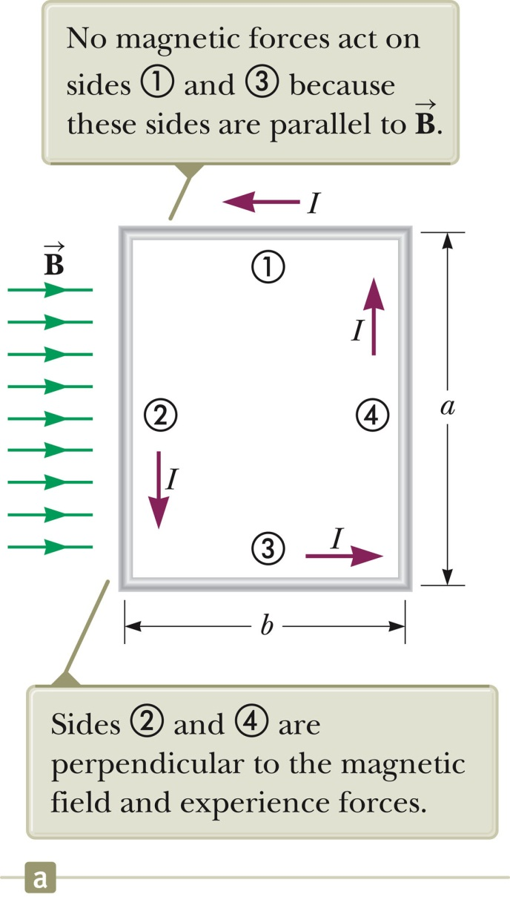
Torque on sides 2 and 4 of the current loop,
The magnitude of the magnetic force on side 2 and side 4 is :
F₂ = F₄ = I a B
The direction of F₂ is out of the page.
The direction of F₄ is into the page.
Thus, net force = 0
BUT net torque is NOT zero.
Section 29.5

Slide 47
Torque on a Current Loop, 3
The forces are equal in magnitude but in opposite directions
They produce a torque around an axis through O .
Section 29.5

Slide 48
Torque on a Current Loop, equation
Recall the equation for torque (Eq 11.1):
The magnitude of the torque is:
(ab=area A of loop)
This orientation of the loop gives the maximum torque. Plane of the loop is parallel to the magnetic field. If A is a vector normal to the loop, A is perpendicular to B.
Section 29.5

Slide 49
Torque on a Loop, General orientation
If B makes an angle of θ < 90º with a line perpendicular to the plane of the loop, the lever arm for the torques is reduced to (b/2)sin θ so
Section 29.5

Slide 50
Torque on a Current Loop, Summary
The torque has a maximum value when the field is perpendicular to the normal to the plane of the loop.
The torque is zero when the field is parallel to the normal to the plane of the loop.
is perpendicular to the plane of the loop and has a magnitude equal to the area of the loop.
Section 29.5

Slide 51
Direction of A, the normal to a current loop
The right-hand rule is used to determine the direction of
Curl your fingers in the direction of the current in the loop.
Your thumb points in the direction of .
Section 29.5

Slide 52
Magnetic Dipole Moment
The product I is defined as the magnetic dipole moment, , of the loop.
Often called the magnetic moment
SI units: A · m²
Torque in terms of magnetic moment:
Analogous to for electric dipole
Valid for any orientation of the field and the loop
Valid for a loop of any shape
Section 29.5

Slide 53
Potential Energy of magnetic dipole
The potential energy of a magnetic dipole in a magnetic field depends on the orientation of the dipole in the magnetic field given by
U_{min} = -μB and occurs when the dipole moment is in the same direction as the field (compass needle).
U_{max} = +μB and occurs when the dipole moment is in the direction opposite the field.
What is the force on the magnetic dipole?
Section 29.5

Slide 54
Hall Effect: a way to measure B electrically (Edwin Hall, 1879)
When a current carrying conductor is placed in a magnetic field, a potential difference is generated in a direction perpendicular to both the current and the magnetic field.
charge carriers are deflected to one side of the conductor as a result of the magnetic forces they experience.
Section 29.6

Slide 55
Hall Voltage
This shows an arrangement for observing the Hall effect.
The Hall voltage is measured between points a and c.
Section 29.6

Slide 56
Hall Voltage, cont.
When the charge carriers are electrons, they experience an upward magnetic force which deflects them upward, so an excess of positive charge is left at the lower edge.
This accumulation of charge establishes an electric field in the conductor.
It increases until the electric force balances the magnetic force.
If the charge carriers are positive, an excess of negative charges accumulates on the lower edge.
Section 29.6

Slide 57
Hall Voltage: cont’d
ΔV_{H} = E_{H}d = v_{d} B d
d is the width of the conductor
v_{d} is the drift velocity
If v_{d} and d are known, we can measure B
If B and d are known, we can determine the number and type of charge carriers in a test sample.
Section 29.6

Slide 58
Next:
Chapt 30: Sources of B
Chapt 31: Faraday’s Law: Using motion to generate current
Chapt 32: Solenoids, Transformers

