Slide 1
PHY 114 A General Physics II
11 AM-12:15 PM TR Olin 101
Plan for Lecture 12 (Chapters 30):
Sources of Magnetic fields
“Permanent” magnets
Biot-Savart Law; magnetic fields from a current-carrying wire
Ampere’ Law
Magnetic fields in a solenoid

Slide 2
Remember to send in your chapter reading questions…

Slide 3
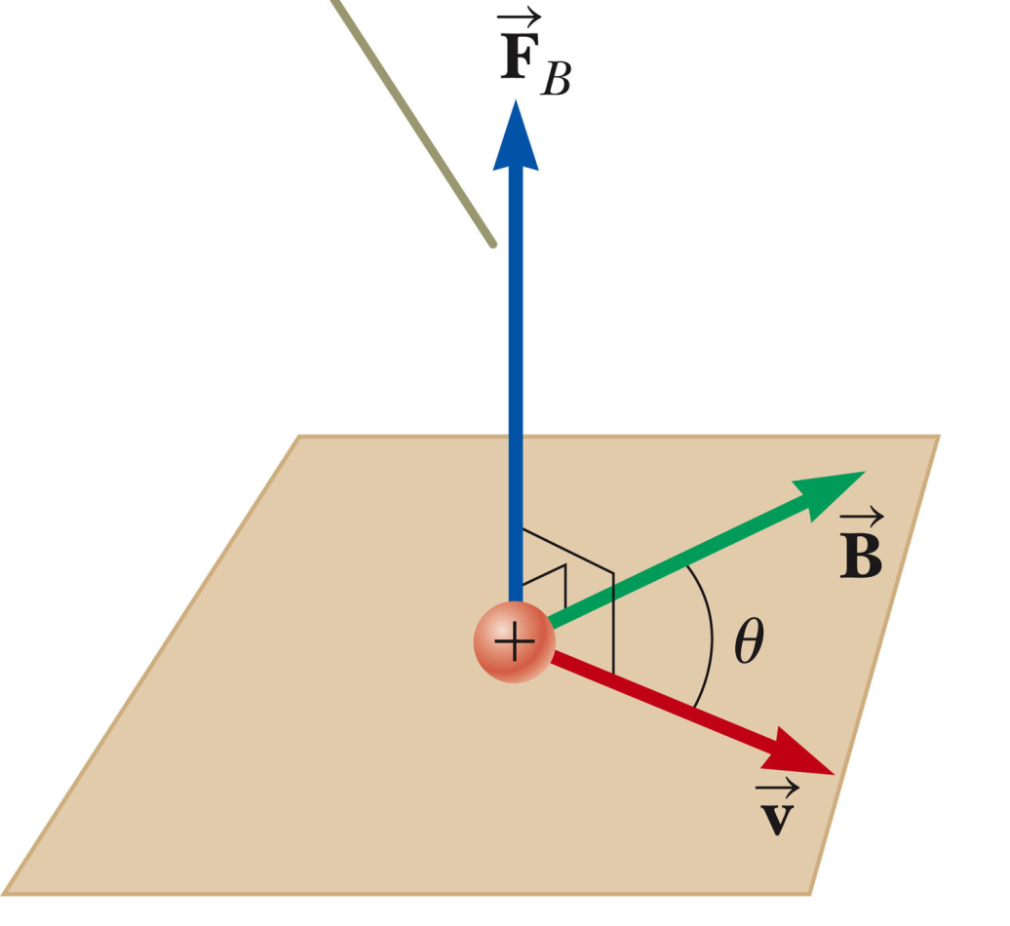
Review of magnetic forces:
Right hand rule
http://www.fotosearch.com/CSP760/k7601927/
, I ds

Slide 4
Vector cross product

Slide 5
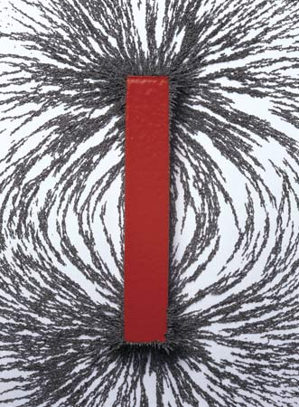
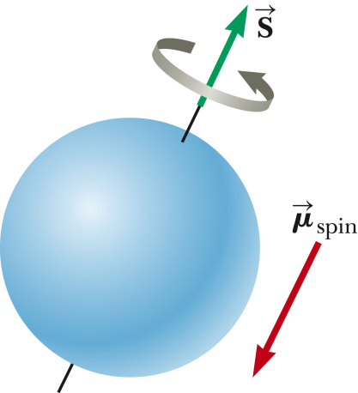
Sources of magnetic fields B
Permanent magnet materials – Fe, Fe₂O₃ , Co, Ni, alloys
Visualization of intrinsic spin magnetic moment of electron.
http://littlegreenfootballs.com/weblog/img/bobibutu/2011/10/04/magnet.jpg

Slide 6
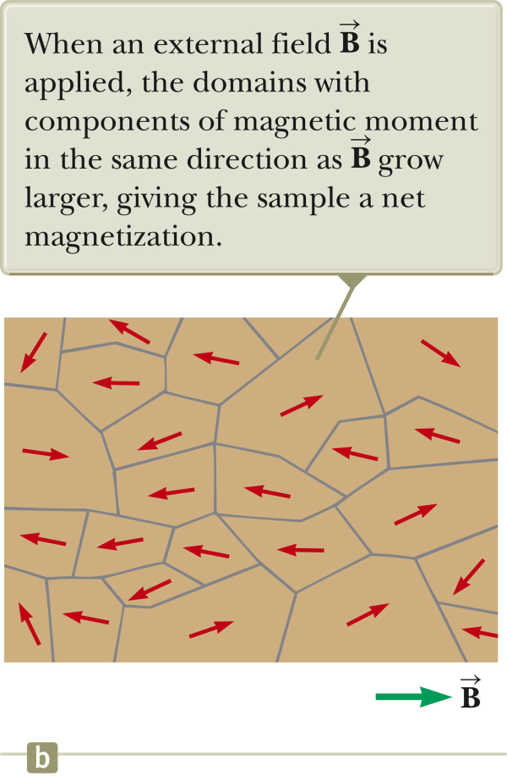
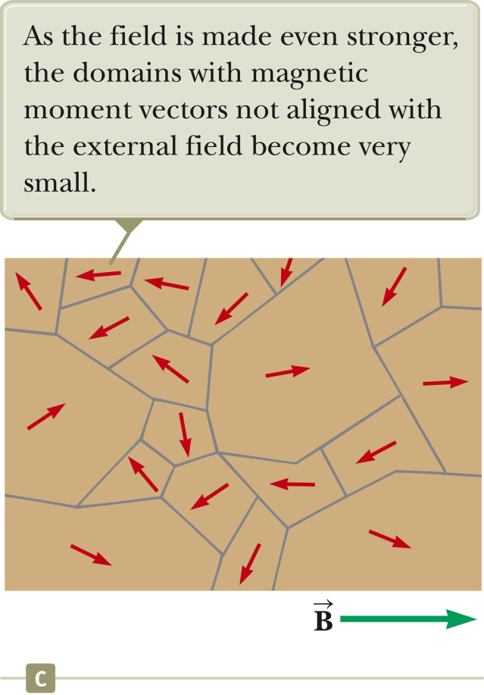
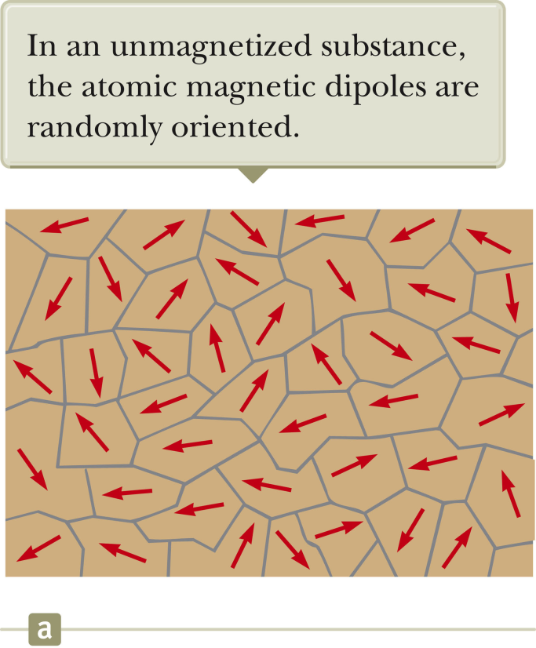
“Permanent” magnets controlled by temperature and external magnetic fields.

Slide 7
Magnetic fields generated by moving charge:

Slide 8
Biot-Savart Law:
Units: B ➔ T (Tesla)
J = I/area ➔ A/m²
Constant: μ₀ “permeability” of free space
4π 10⁻⁷ Tm/A

Slide 9
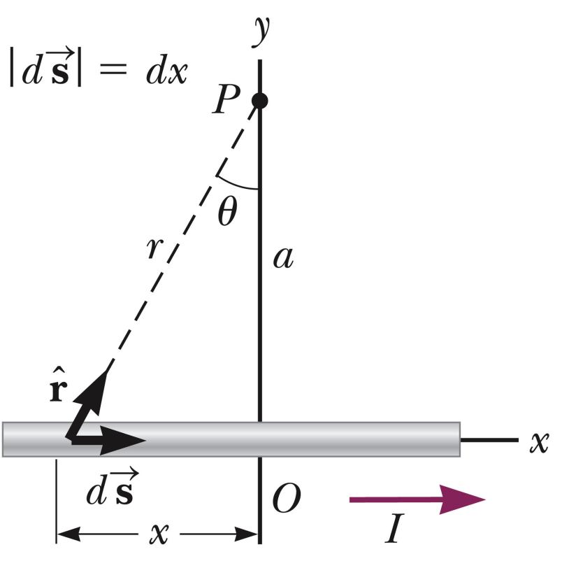
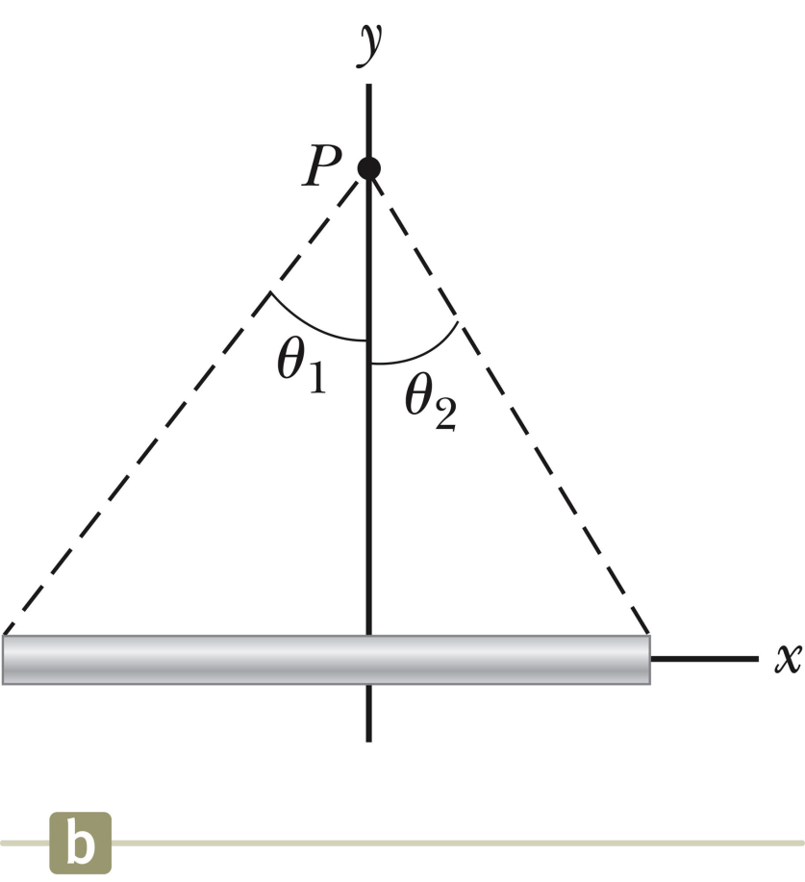
Magnetic field produced by straight wire:
B (out of screen)
a
x_{min}
x_{max}

Slide 10
B (out of screen)
a
I
x_{min}
x_{max}

Slide 11
Consider 2 (infinitely long) wires. Vote for the least incorrect answer:
The two wires cancel each other completely
The two wires generate exactly twice the magnet field compared to a single wire
The two wires attract each other.
The two wires repel each other.
I₁
I₂

Slide 12
Consider 2 (infinitely long) wires. Vote for the least incorrect answer:
The two wires cancel each other completely
The two wires generate exactly twice the magnet field compared to a single wire
The two wires attract each other.
The two wires repel each other.
I₁
I₂

Slide 13
B
I₁
F
I₂
➔wires repel each other

Slide 14
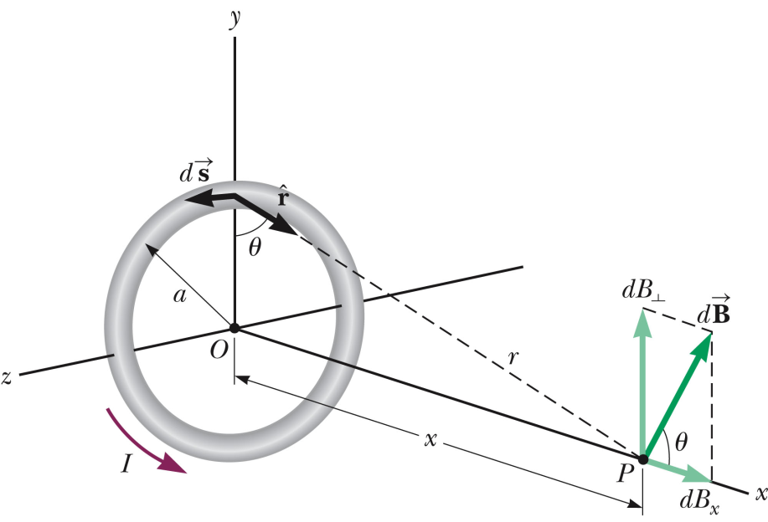
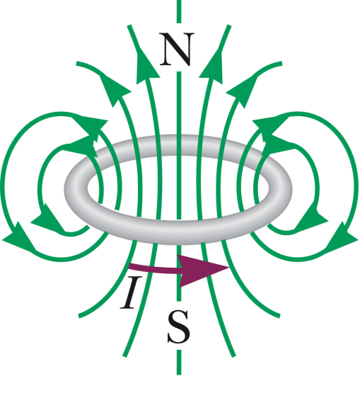
Magnetic field produced by wire loop:

Slide 15
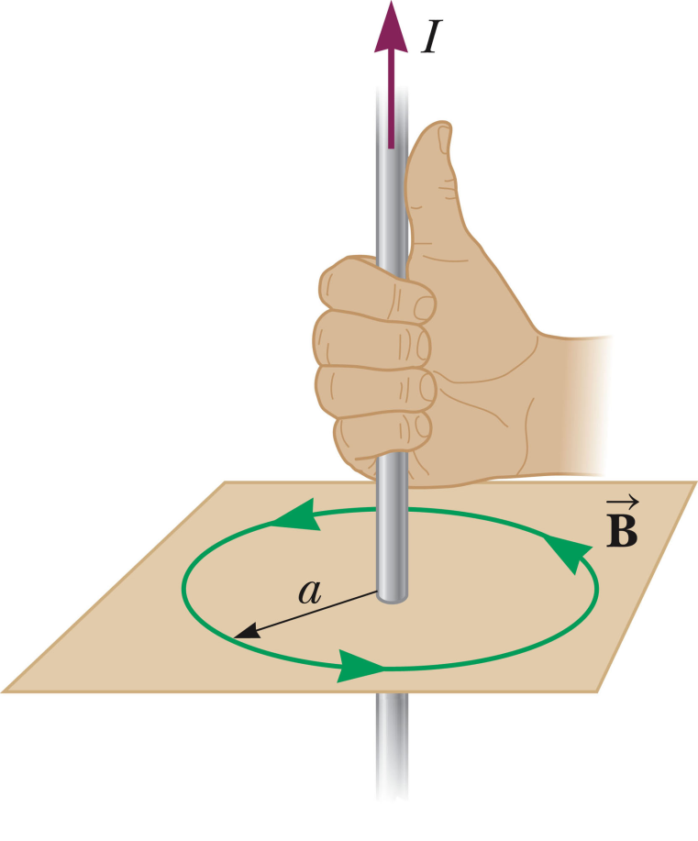
Easier way for situations with high symmetry
– Ampere’s Law

Slide 16
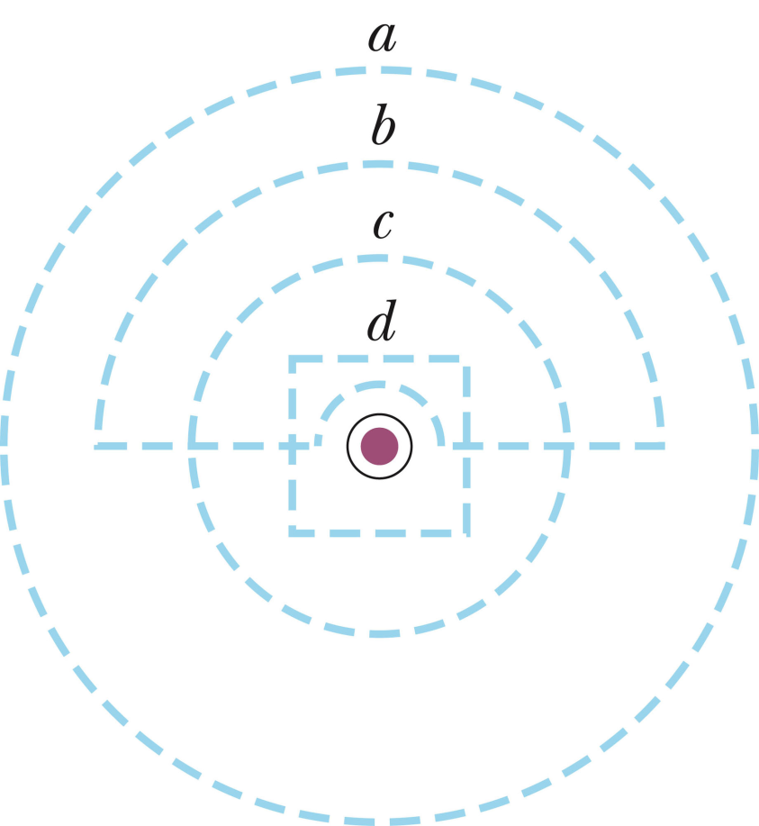
Example of Ampere’s law:
The figure below shows a wire coming out of the screen. Which of the paths for has the smallest magnitude?
a
b
c
d

Slide 17
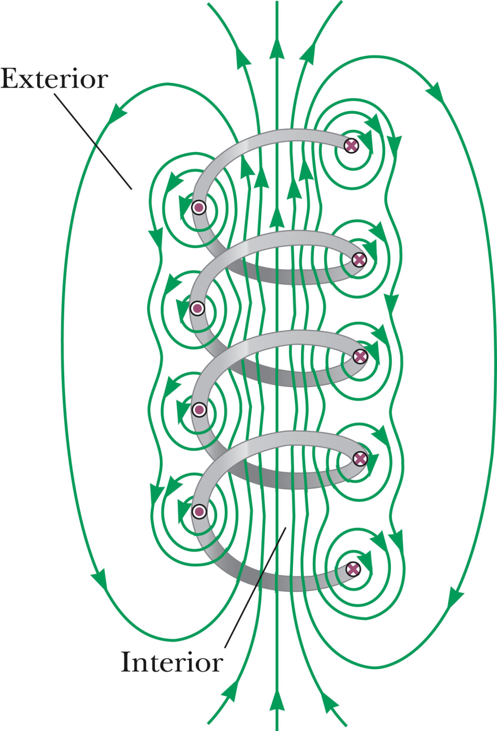
Magnetic field in a solenoid
Ideal solenoid

Slide 18
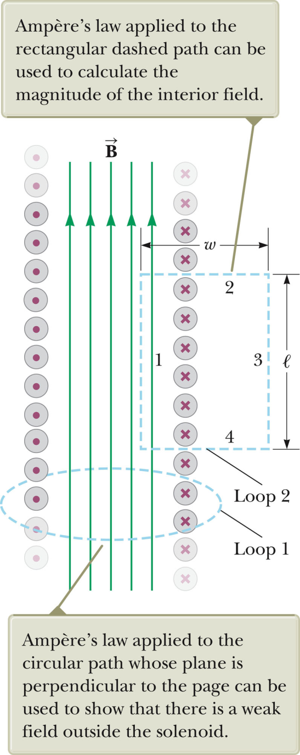
Magnetic field inside ideal solenoid:

Slide 19
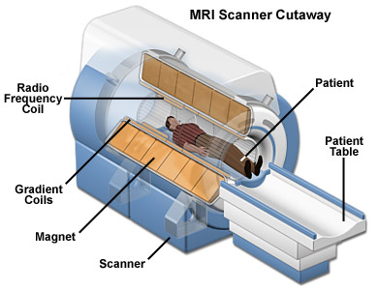
B ≈ 21 T
(experimental MRI at FSU)
http://www.magnet.fsu.edu/education/tutorials/magnetacademy/mri/images/mri-scanner.jpg

Slide 20
MRI signal – detects H nuclei using the magnetic moment of H – μ_{H}.

Slide 21
Summary:

