Slide 1
PHY 114 A General Physics II
11 AM-12:15 PM TR Olin 101
Plan for Lecture 13 (Chapter 31):
Faraday’s Law
Time varying magnetic flux ➔ induced EMF
Electric generators and motors
Eddy currents

Slide 2
Remember to send in your chapter reading questions…

Slide 3
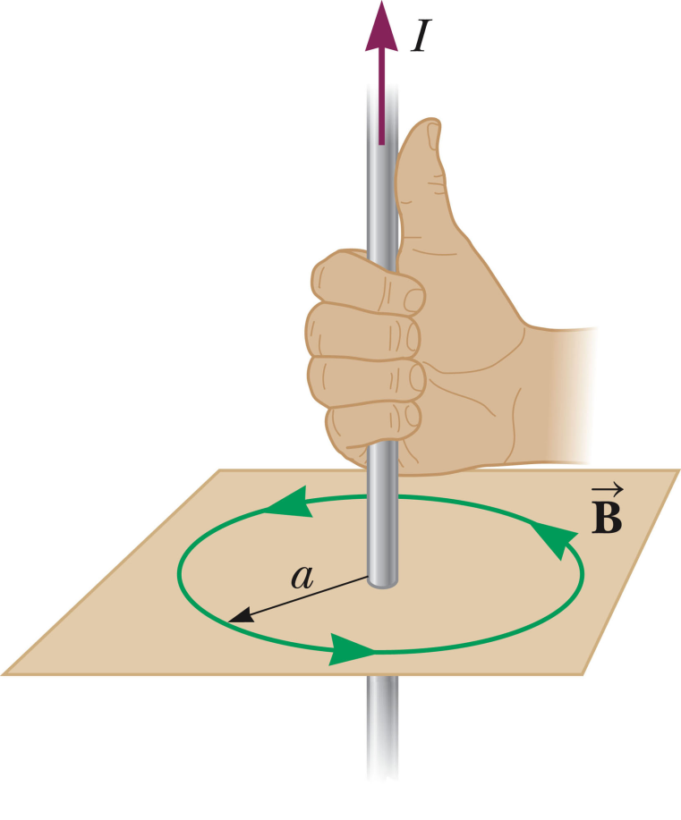
Comment on magnetic field directions:
Right-hand “thumb” rule for current-carrying wires
From HW:

Slide 4
Comment on magnetic field directions:
Right-hand “thumb” rule for current-carrying wires
From HW:

Slide 5
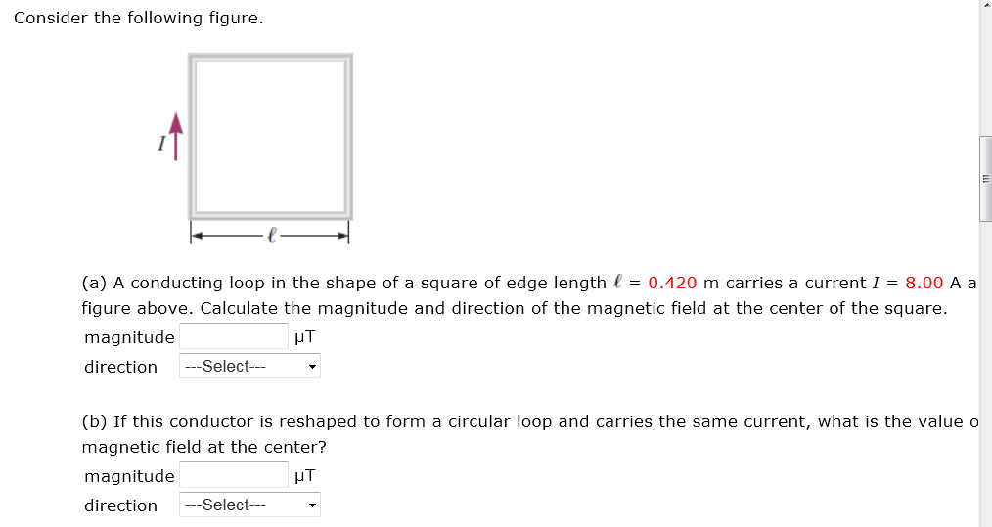
More webassign hints:
a

Slide 6
Summary:

Slide 7
Faraday’s law
Effects of time-changing currents and fields
v
B
A
v
E

Slide 8
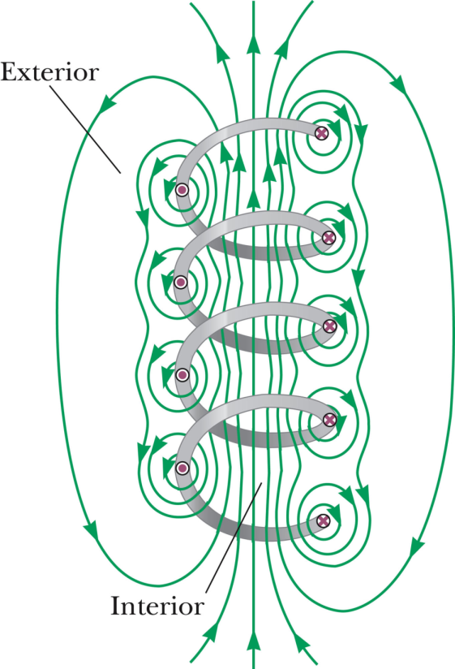
Faraday’s law

Slide 9
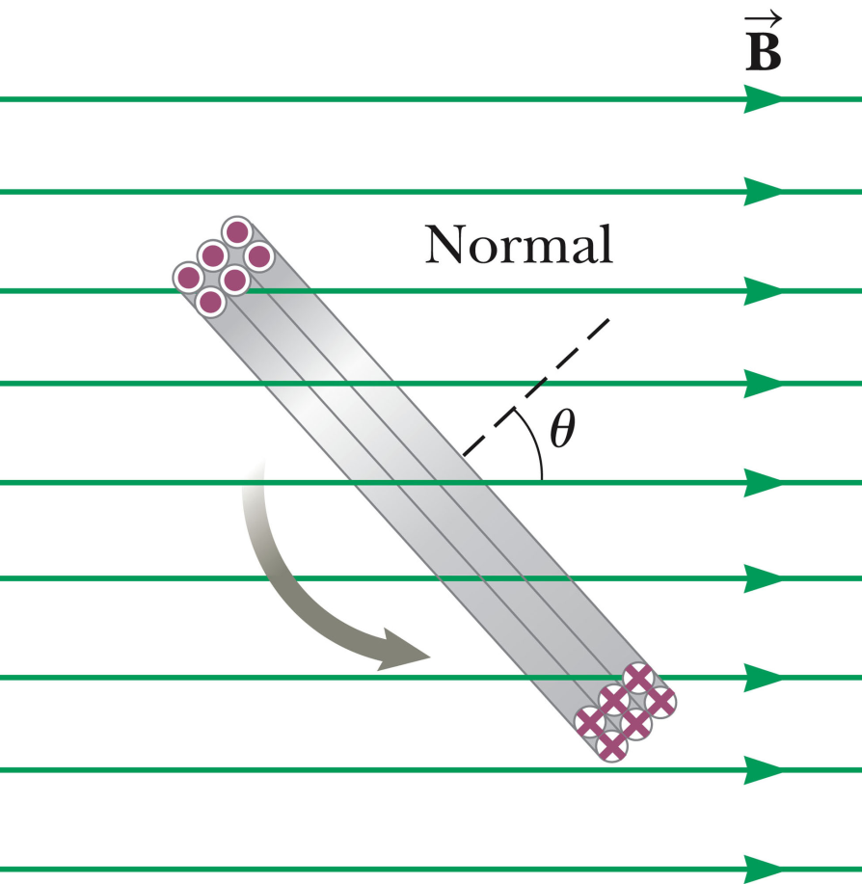
Faraday’s law

Slide 10
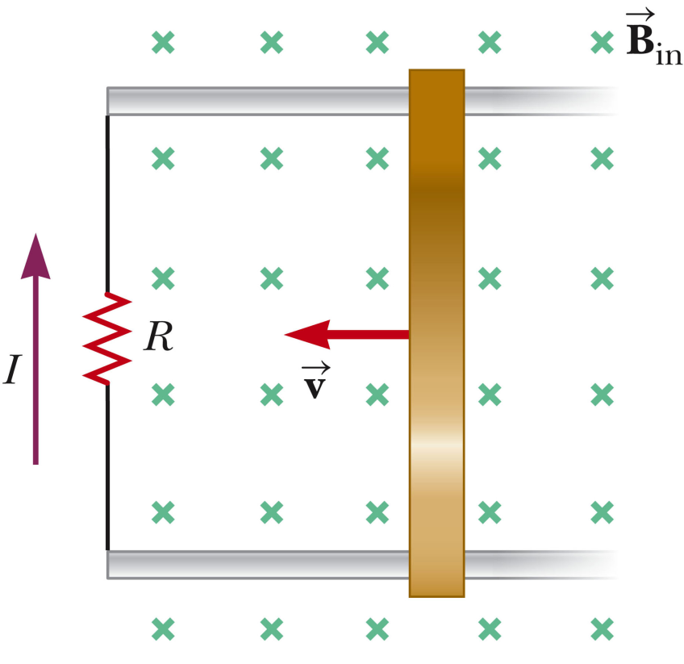
Faraday’s law
Example

Slide 11
Consider the setup shown in the figure. What can cause the bar to move with velocity v:
Evil physics professor
Applied force on bar pulling to right
Applied force on bar pulling to left
Magnetic forces

Slide 12
Consider the setup shown in the figure where current I is flowing through the mobile bar. What is the effect of the magnetic force acting on the bar?
It is too small to have an effect.
It has an effect in the same direction as the applied force.
It has an effect in the opposite direction as the applied force.
I

Slide 13
I
F_{mag}

Slide 14
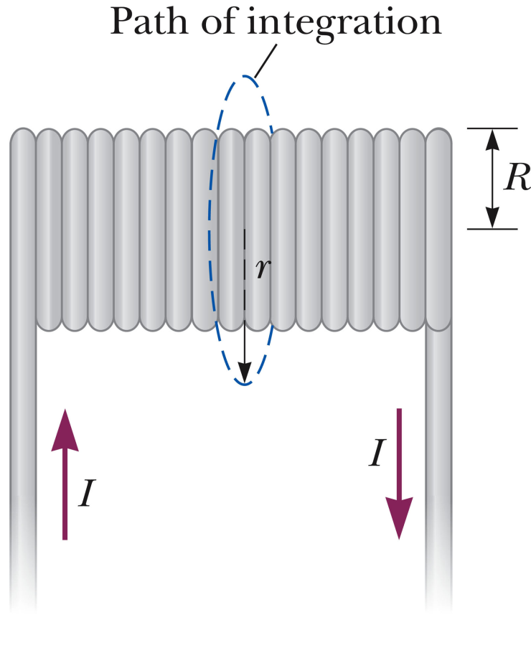

Slide 15
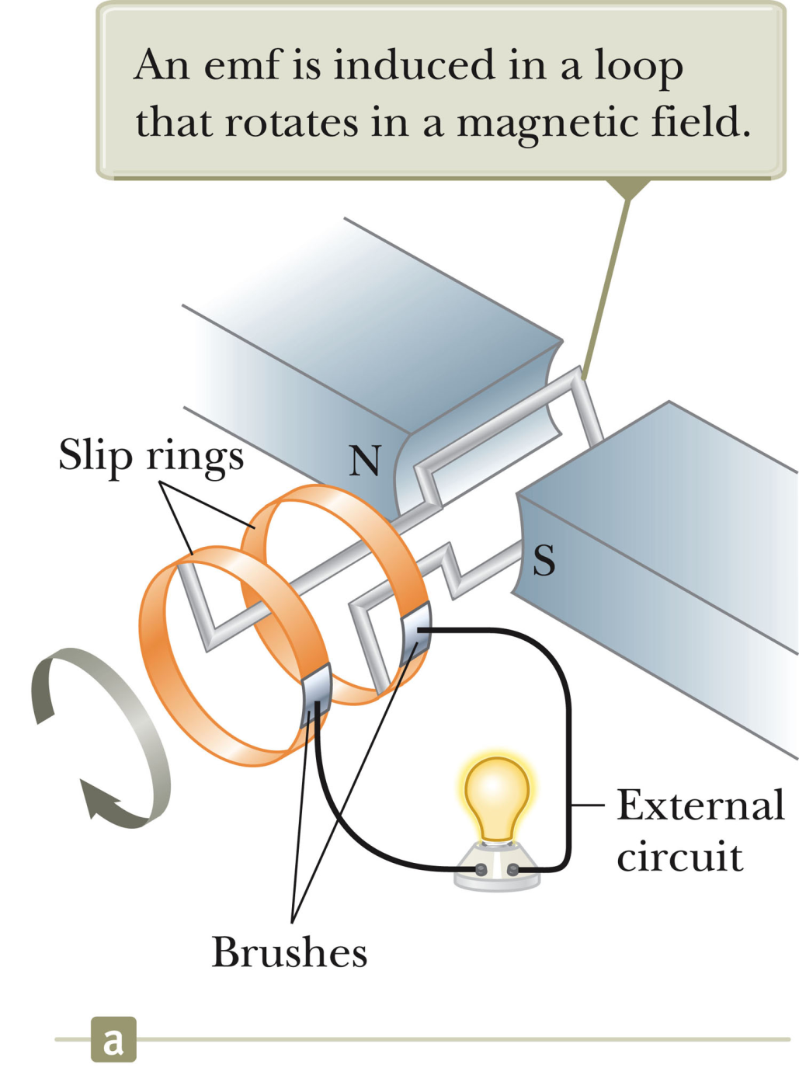
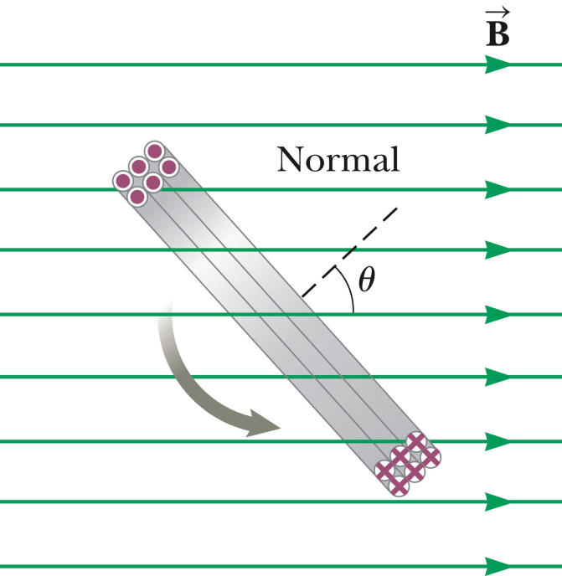
Electric generator:
θ = ωt

Slide 16
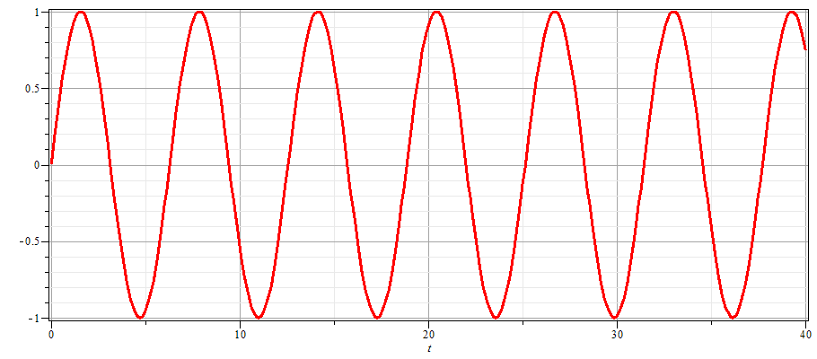
Electric generator:
I
t

Slide 17
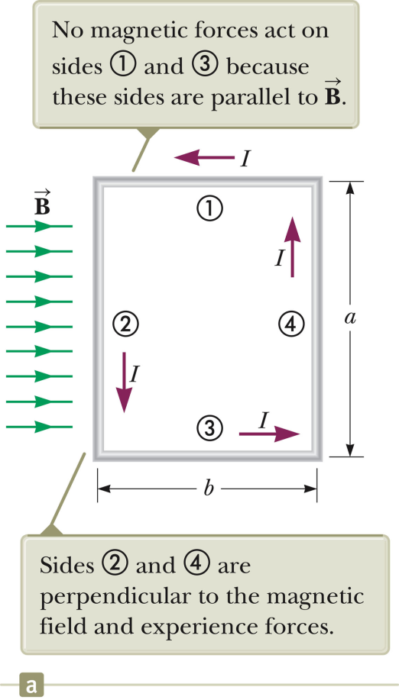
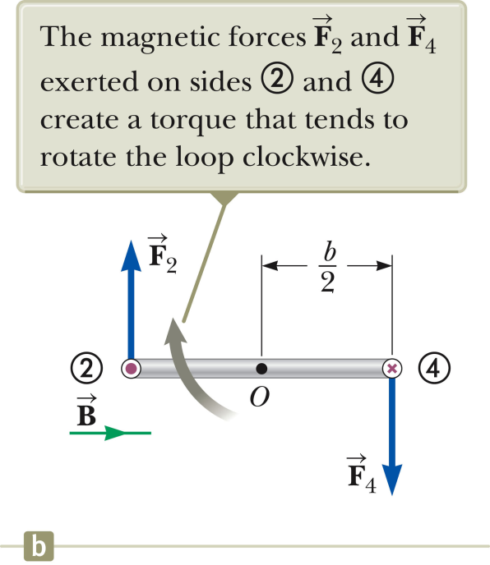
Torque on a current-carrying wire in a magnetic field
Recall that a generator has a current-carrying coil in a magnetic field.
No problem – that was in Chap. 29 and no longer relevant.
Generator coil will experience a torque which makes the coil spin faster.
Generator coil will experience a torque which makes the coil spin slower.

Slide 18
Electric generators and motors
Hybrid vehicles are designed so that their electric motors are equipped with circuits to take advantage of “regenerative” braking, effectively converting the motor to a generator to recharge the batteries when the breaks are activated.
Other uses for inductors
Rechargeable electric toothbrush
Induction heating cooking

Slide 19
Uses of Faraday’s law continued:
http://theinductionsite.com/how-induction-works.shtml

