Slide 1
PHY 114 A General Physics II
11 AM-12:15 PM TR Olin 101
Plan for Lecture 14 (Chapter 32):
Inductance
Inductors as a circuit element
RL, LC, and RLC circuits
Energy stored in an inductor

Slide 2
Remember to send in your chapter reading questions…

Slide 3
Web assign question -- hint
1000 turns/m

Slide 4
Web assign question -- hint
A
θ = ωt

Slide 5
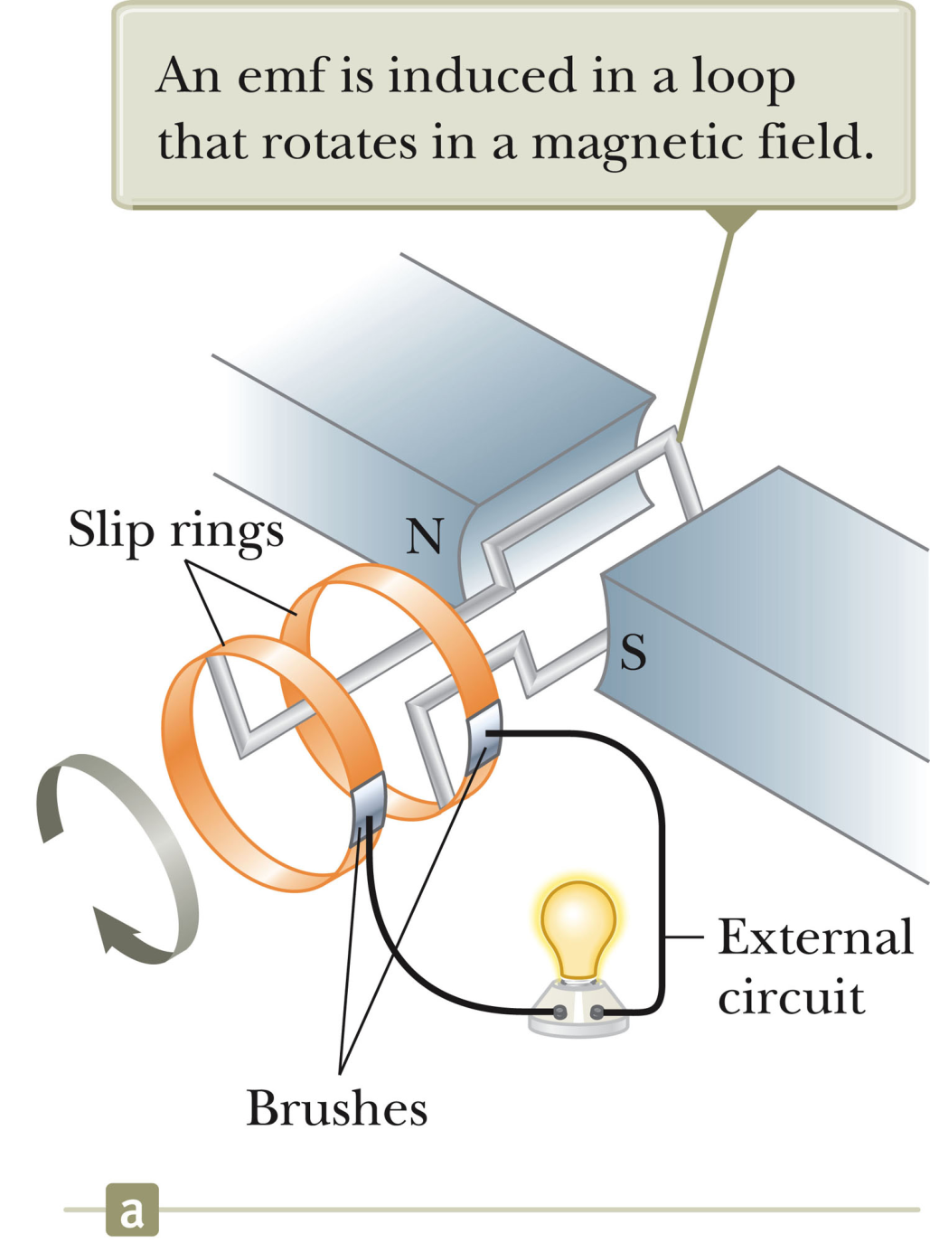
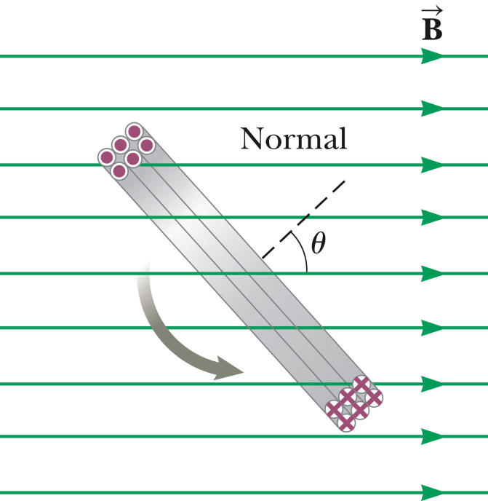
Electric generator:
θ = ωt

Slide 6
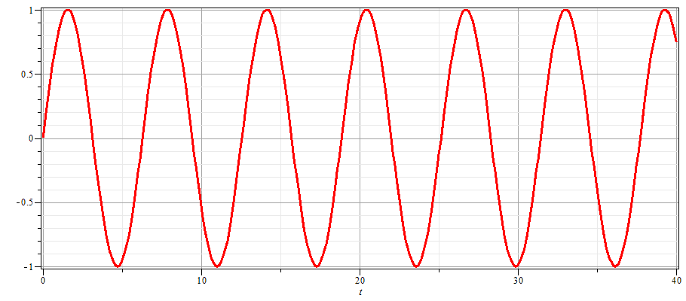
Electric generator:
I
t

Slide 7
Summary:

Slide 8
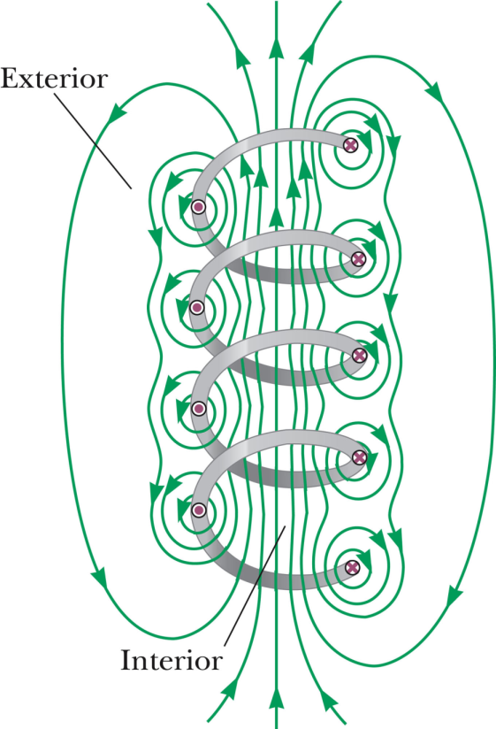
Faraday’s law for EMF induced in a current loop:

Slide 9
“Mutual” inductance
=N_{c}
A

Slide 10
“Self” inductance
L inductance

Slide 11
Inductors in a circuit Example: LR circuit

Slide 12
Example: LR circuit

Slide 13
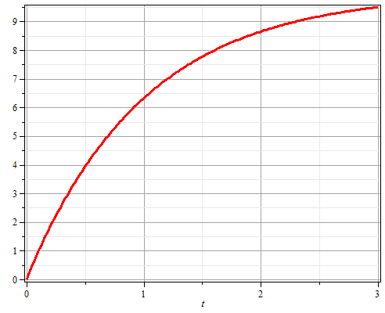
Example: LR circuit
I
t

Slide 14
The LR circuit reminds us of:
Why physics class is so beautiful.
Why physics class is so terrible.
RC circuit.
Money in the bank.

Slide 15
Energy storage in inductor:

Slide 16
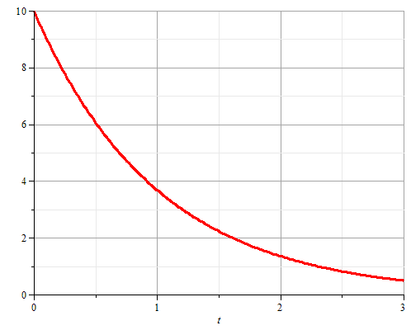
Example: LR circuit continued
I
t

Slide 17
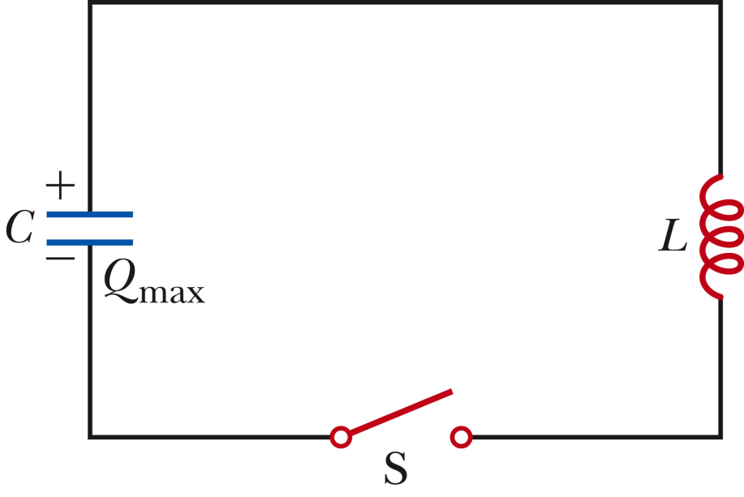
LC circuit
This circuit has the following time dependence after the switch is closed:
Charge decays with time
Charge increases with time
Charge remains constant with time
Charge increases and decreases with time

Slide 18
LC circuit

Slide 19
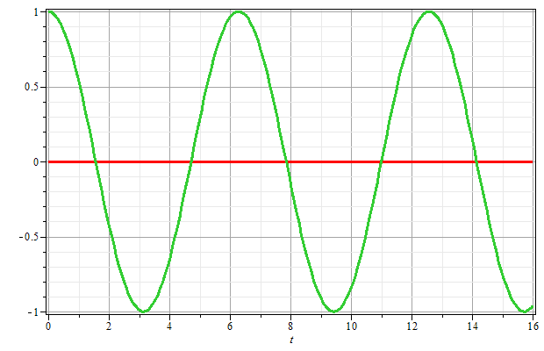
LC circuit
For L=1 H, C=1 F; ω=1 rad/s
Q/Q_{max}
ω=2πf
t

Slide 20
The LC circuit is mathematically analogous to:
Nothing seen previously seen in class
An elastic bouncing ball
A swinging pendulum
A mass attached to a spring
All above, except A
The LC circuit is useful:
Because of its mathematical analogies
Physicists like simple formulae like cos(ωt)
It could be useful in science experiments
It could be useful for toys
It could be useful for everyday appliances

Slide 21
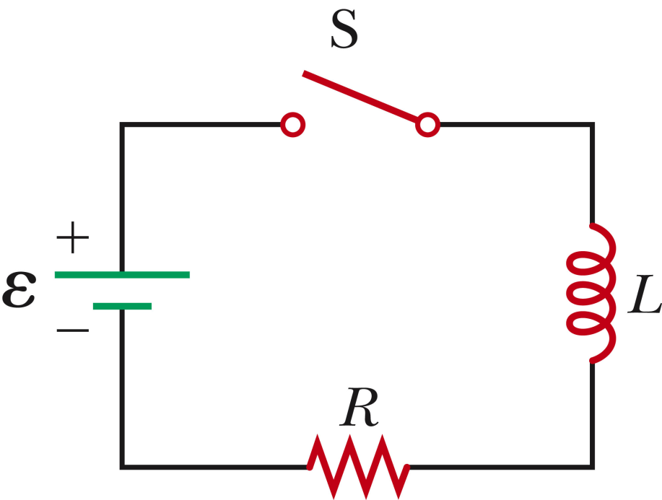
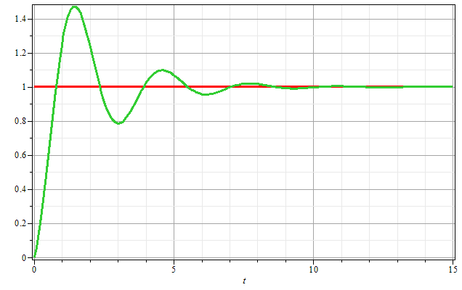
LRC circuit:
Q/CE
t

