Slide 1
PHY 114 A General Physics II
11 AM-12:15 PM TR Olin 101
Plan for Lecture 15 (Chapter 33):
Alternating current circuits
AC EMF
R, C, L behaviors in AC circuit
RLC circuits

Slide 2
Remember to send in your chapter reading questions…
3rd exam will be scheduled for evenings during the week of 4/2/2012

Slide 3
Homework hint:
“The switch S is closed for a long time, and no voltage is measured across the capacitor.” Which of the following statements is false?
The voltage across the inductor and the capacitor must always be the same.
After a long time the current through the inductor is E/R.
After a long time the current through the resistor is E/R.
After a long time, the current through the inductor is 0.

Slide 4
Homework hint:
After the switch S is opened (t=0) which of the following statements are true?
The circuit is now an LC circuit with the initial condition that Q(t=0)=CE.
The circuit is now an LC circuit with the initial condition that I(t=0)=E/R.
The current will oscillate forever with an angular frequency of

Slide 5
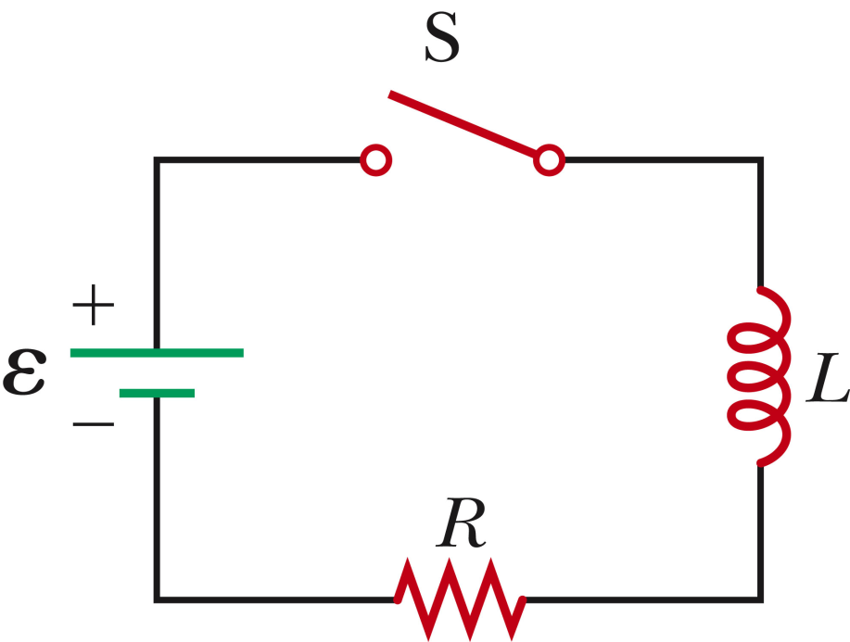
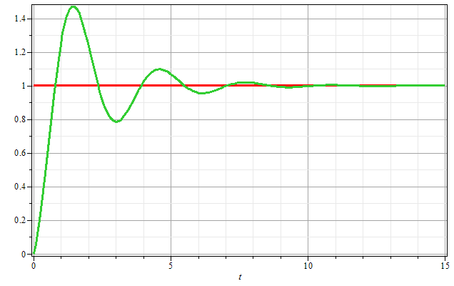
DC - LRC circuit:
C
Q/CE
t

Slide 6
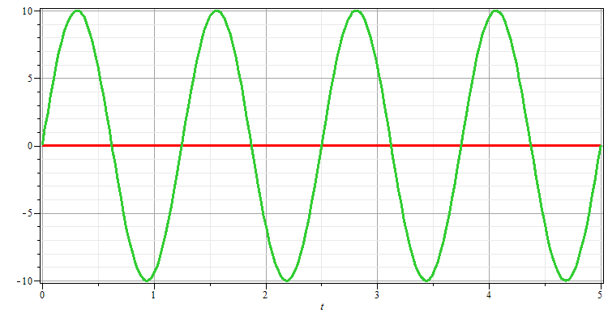
AC EMF source
ΔV_{max}
Δv
1/2πf
t

Slide 7
AC EMF source
Δv
t

Slide 8
In US the standard wall voltage is ΔV_{rms} =120 V with f =60 Hz
In Europe the standard wall voltage is ΔV_{rms} =220 V with f =50 Hz
Voltage standards throughout the world:
http://users.telenet.be/worldstandards/electricity.htm#voltage

Slide 9
DC - LRC circuit:
AC - LRC circuit:

Slide 10
Which of the following statements most accurately reflect the relationships between the behaviors of LRC circuits with a DC versus an AC EMF source.
The differential equations are different and the solutions are different.
The differential equations are the same – but the solutions are different.
The differential equations are the same – so the solutions have to be the same.
In fact: The DC solutions to the differential equations are generally valid representations of transient behaviors. Often we are interested in the “steady state” solutions in the presence of AC voltage sources.

Slide 11
AC EMF with resistor:

Slide 12
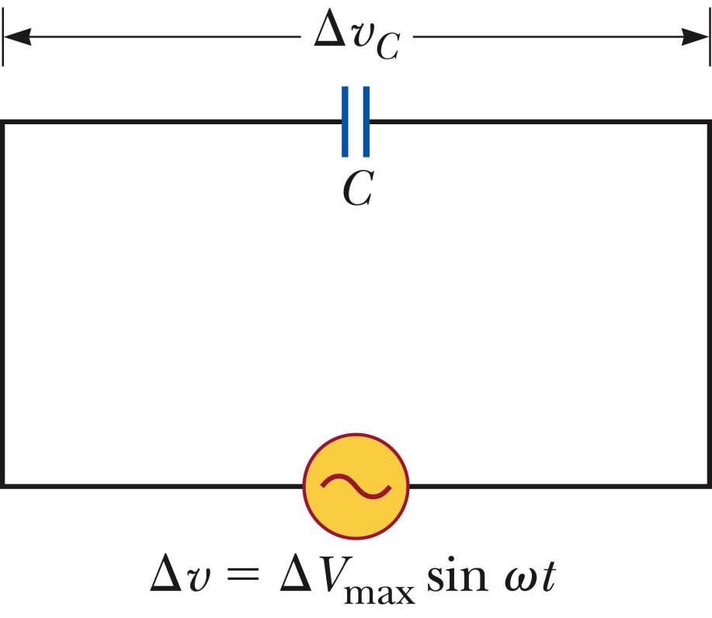
AC EMF with capacitor:

Slide 13
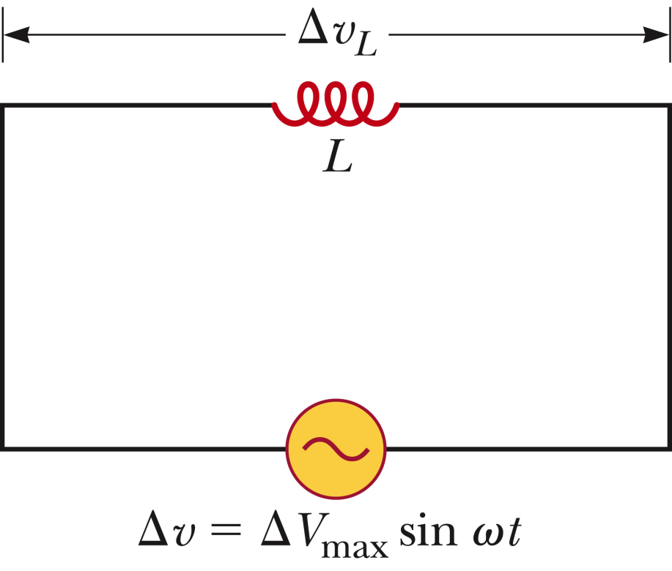
AC EMF with inductor:

Slide 14
Summary of results for each circuit element:

Slide 15
Comment about phase factor φ:
Plots of sin(2πt+φ)
φ=0
φ=0.5
φ=1.57

Slide 16
Series AC LRC circuit
C

Slide 17
Series AC LRC circuit
C
➔ Must be true at all t; special values of I_{max} and φ

Slide 18
Series AC LRC circuit
C

Slide 20
Series AC LRC circuit
C

Slide 21
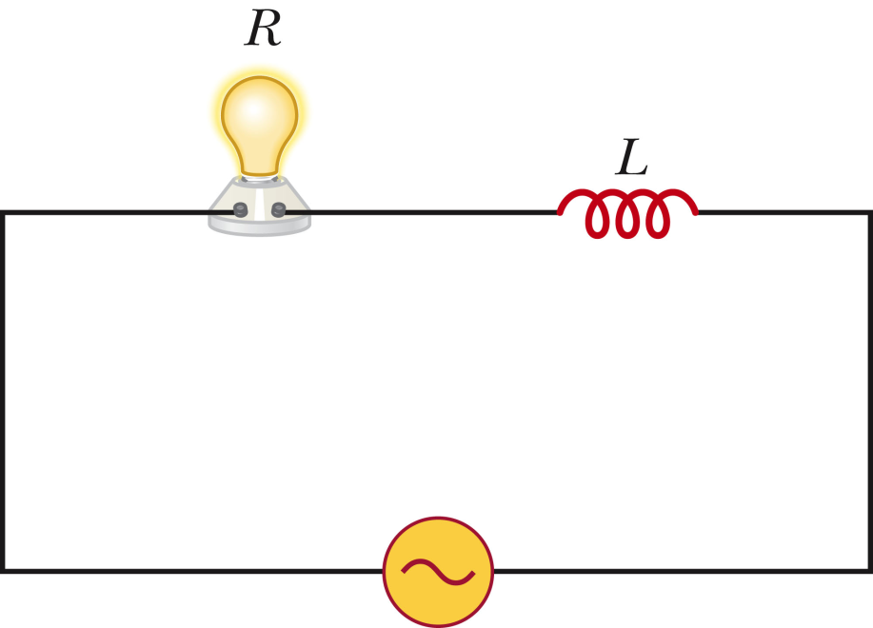
Example AC LRC circuit:
Consider the series resistor R and inductor L connected to an AC EMF. The voltage amplitude V_{max} is held fixed while the frequency ω is varied. The bulb is brightest when
ω is highest
ω is lowest
Bulb brightness is independent of ω

Slide 22
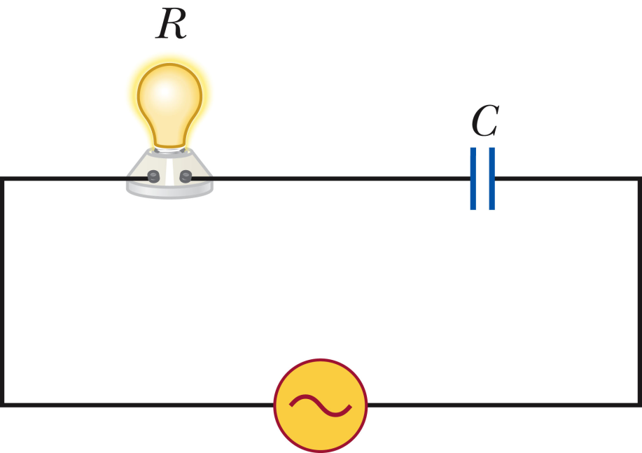
Example AC LRC circuit:
Consider the series resistor R and capacitor C connected to an AC EMF. The voltage amplitude V_{max} is held fixed while the frequency ω is varied. The bulb is brightest when
ω is highest
ω is lowest
Bulb brightness is independent of ω

Slide 23
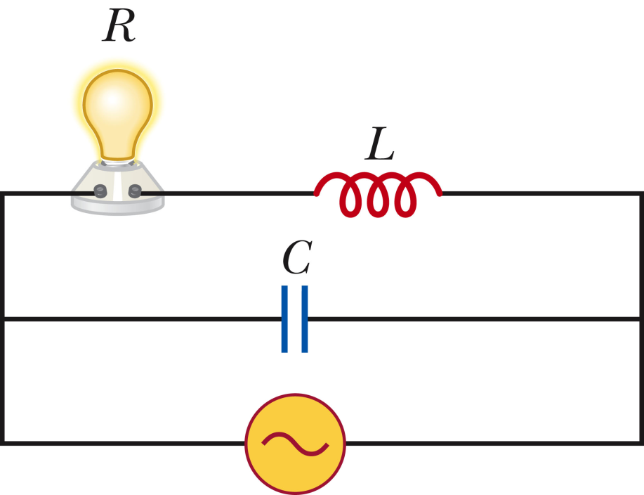
Example AC LRC circuit:
Consider the series resistor R and capacitor C connected to an AC EMF. The voltage amplitude V_{max} is held fixed while the frequency ω is varied. The bulb is brightest when
ω is highest
ω is lowest
Bulb brightness is independent of ω

Slide 24
Power in an AC circuit

Slide 25
Power in an AC circuit -- continued

Slide 26
Frequency dependence of impedance in AC circuit

Slide 27
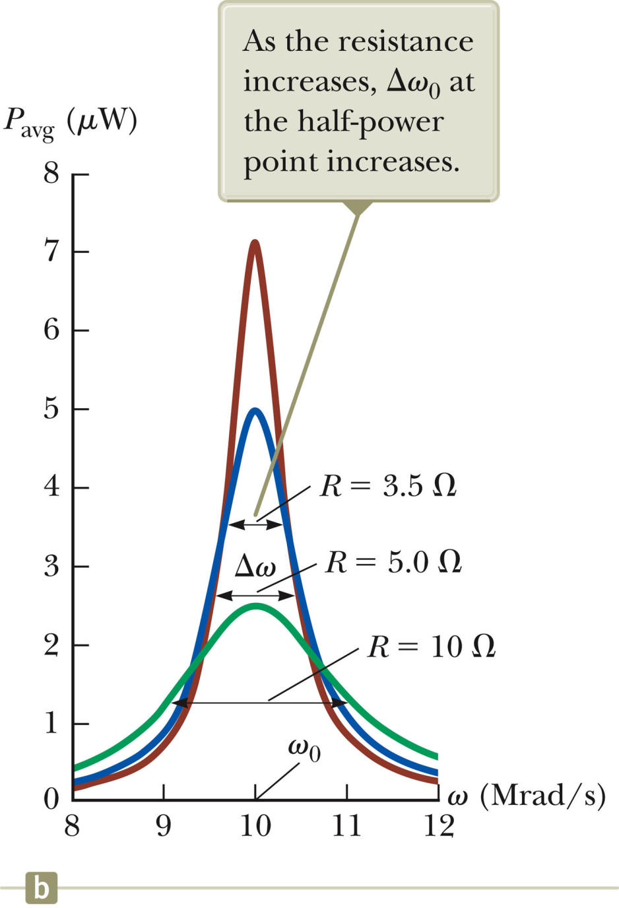

Slide 28
DC - LRC circuit:
AC - LRC circuit:

Slide 29
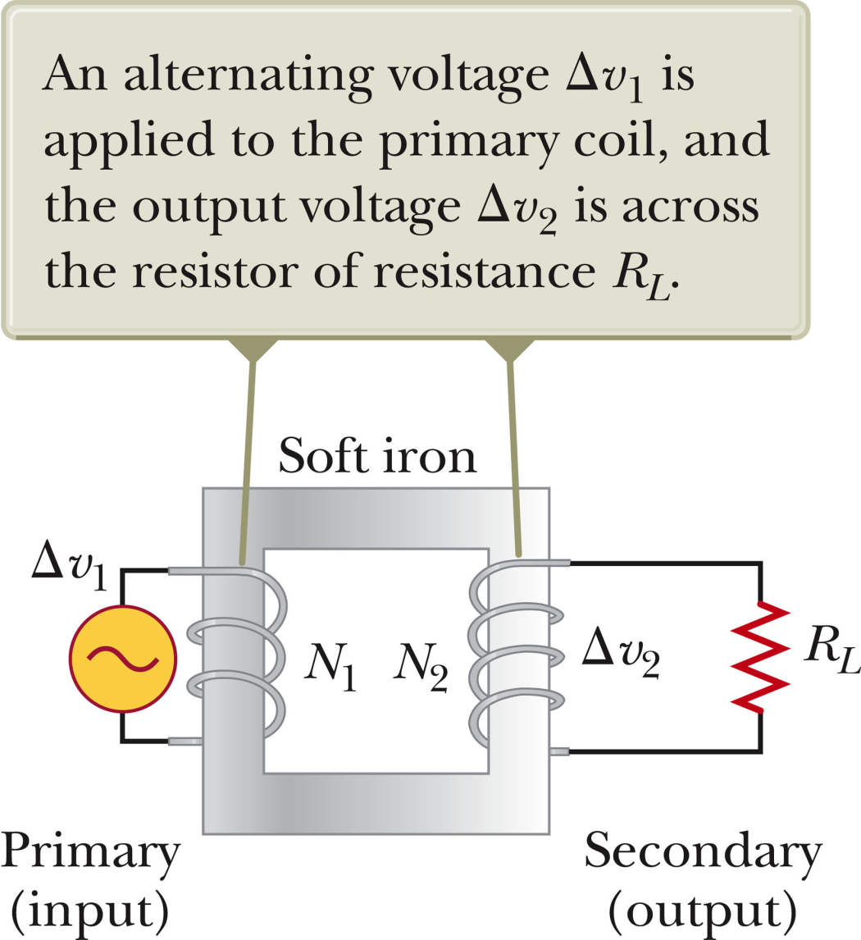
AC transformer devices:

Slide 30
AC transformer example:
If Δv₁ were a DC voltage source:
The transformer would work in the same way.
The transformer would not work at all.

