Slide 1
PHY 114 A General Physics II
11 AM-12:15 PM TR Olin 101
Plan for Lecture 16 (Chapter 33):
Electromagnetic Waves
Maxwell’s equations (with help from Coulomb, Ampere, Faraday, Gauss …)
Solutions to Maxwell’s equations and their significance.

Slide 2
Remember to send in your chapter reading questions…
3rd exam will be scheduled for evenings during the week of 4/2/2012

Slide 3
Possible exam dates
Preferred times:
5-7 PM
6-8 PM
7-9 PM
8-10 PM
Preferred evenings:
Monday 4/2
Tuesday 4/3
Wednesday 4/4
Thursday 4/5

Slide 4
Comment on AC circuits:
I₁
I₂
I₃
Solution method:
Transform differential equation in to algebraic equation using trig or complex functions
“Solve” algebra problem
Analyze for physical solution

Slide 5
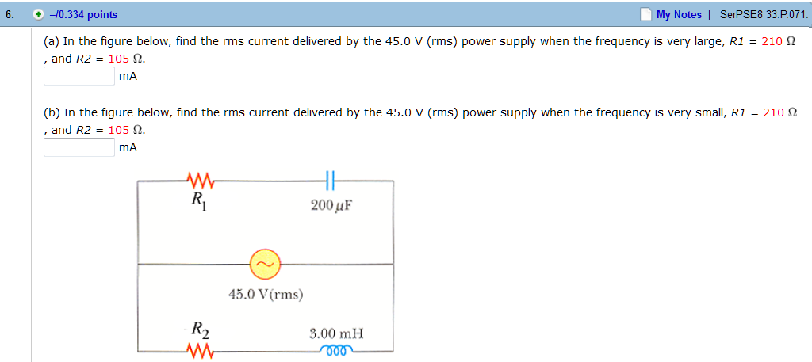
Homework hint:
Which components have the largest Z at high frequency?
A. R₁ and C B. R₂ and L
Which components have the largest Z at low frequency?
A. R₁ and C B. R₂ and L

Slide 6
Summary of electric and magnetic equations known before ~1860:
Couples E and B fields

Slide 7
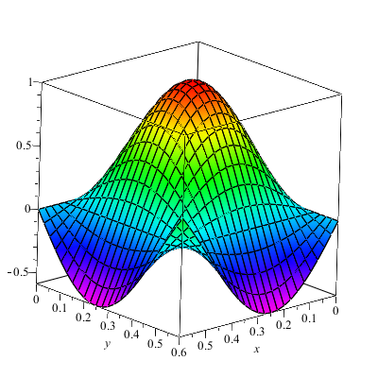
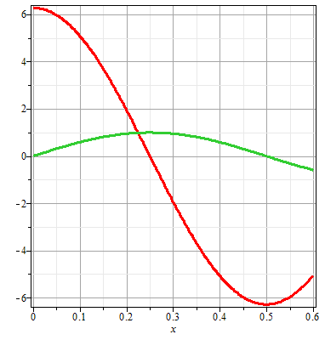
Comments on vector fields, partial derivatives, gradient, curl …
Function of several variables and their derivatives
Vector functions
Derivatives of vector functions
f(x,y)

Slide 8
Comments on vector fields, partial derivatives, gradient, curl …
Function of several variables and their derivatives
Vector functions
Derivatives of vector functions

Slide 9
Comments on vector fields, partial derivatives, gradient, curl …
Function of several variables and their derivatives
Vector functions
Derivatives of vector functions

Slide 10
Comments on vector fields, partial derivatives, gradient, curl …
Function of several variables and their derivatives
Vector functions
Derivatives of vector functions

Slide 11
Comments on vector fields, partial derivatives, gradient, curl …
Function of several variables and their derivatives
Vector functions
Derivatives of vector functions

Slide 12
Additional comments
Integral ⬅➔ differential form of Gauss’s law
x
x + dx

Slide 13
Incomplete set of equations:
A changing magnetic flux produces an electric field – can a changing electric flux produce a magnetic field?
What happens to fields between capacitor plates with time varying charge?

Slide 14
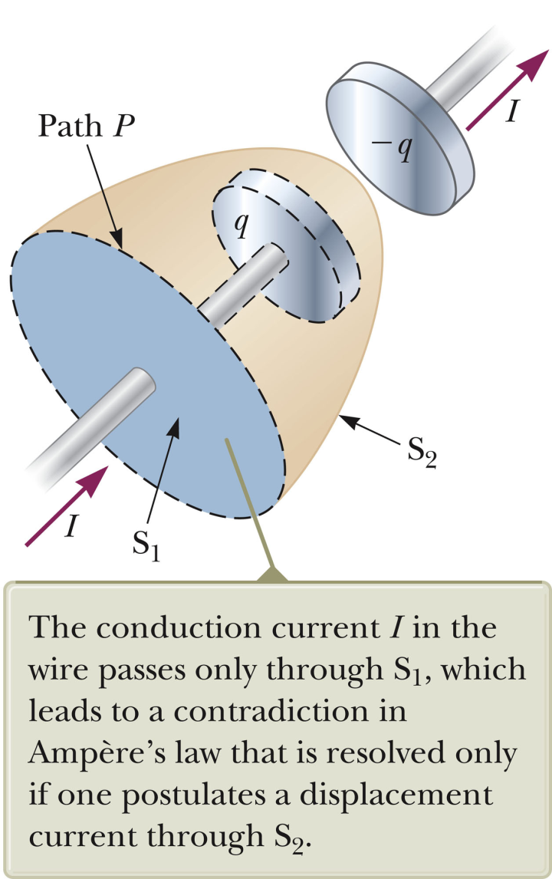
Slight problem with Ampere’s law applied in the vicinity of a capacitor:

Slide 15
Slight problem with Ampere’s law applied in the vicinity of a capacitor:

Slide 16
More details about Ampere-Maxwell equation:
I
I
r
r
r
B
B
B

Slide 17
Full Maxwell’s equations

Slide 18
Why are Maxwell’s equations important?
They are not really – physicist are weird
They are used to torture PHY 114 students
They summarize all of electricity and magnetism presently known.
They explain the nature of light

Slide 19
Full Maxwell’s equations
Some conclusions:
Without sources, there are no E or B fields
E and B can exist far from the sources

Slide 20
Maxwell’s equations without sources
Far from the charge and current sources the E and B fields
Always get smaller with increasing distance
Always get smaller at long times
Can maintain a steady amplitude at all times and distances

Slide 21
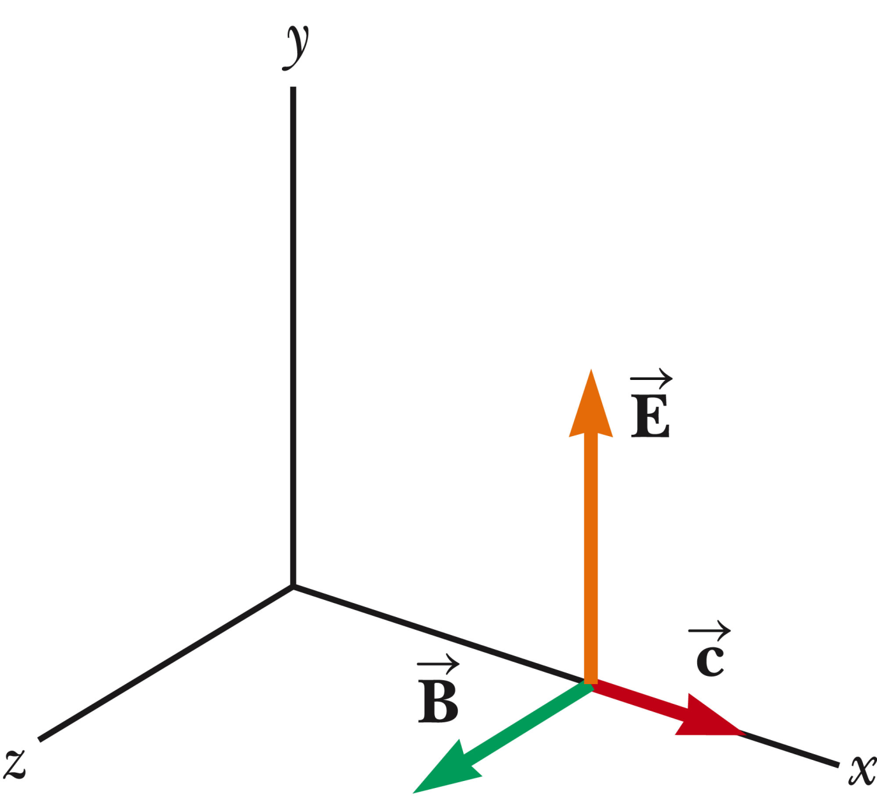
Possible solution:

Slide 24
The wave equation

Slide 25
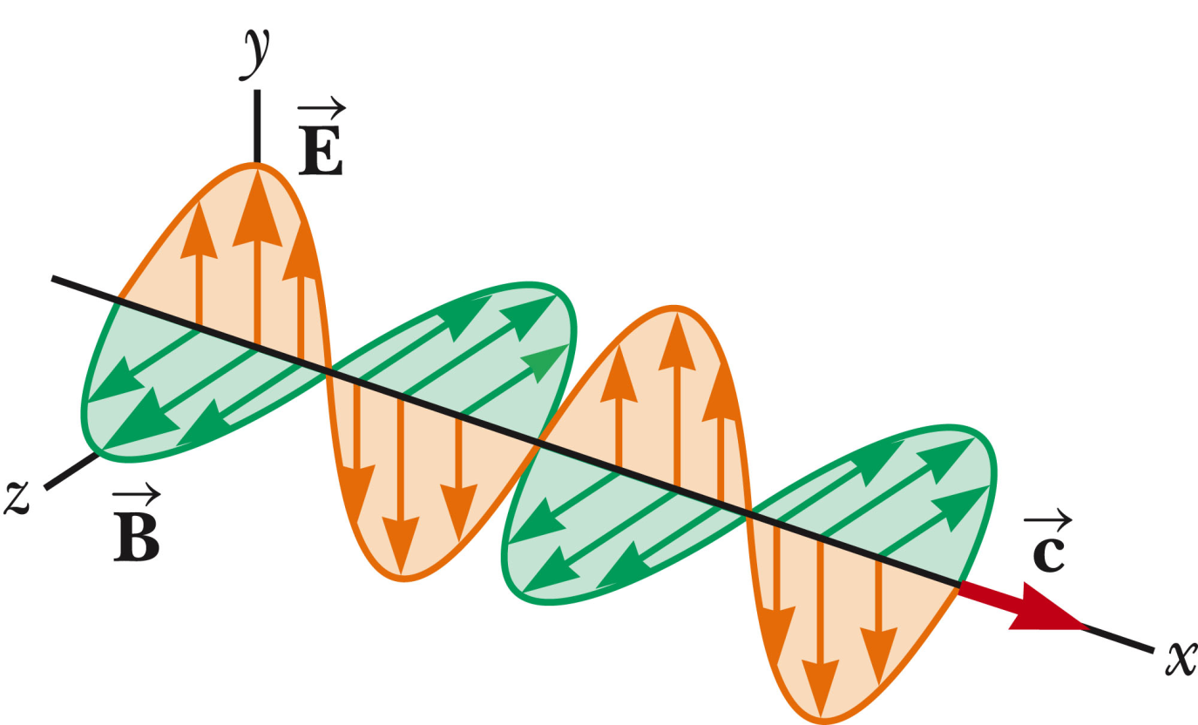

Slide 26
What good are electromagnetic plane waves?
They are good for nothing.
They are idealizations that physics students never see.
They come from outer space.
An example is in this room.
Which of the following states comparing sound waves to electromagnetic waves are false?
They both satisfy the wave equation
For both, the wave speed c is related to frequency and wavelength according to c=λf.
They both travel through a medium.
The Doppler effect for sound waves is different in electromagnetic waves and in sound waves.

Slide 27
Astronomers think that they have detected radiation from a star 15x10⁹ light years away.

