Slide 1
PHY 114 A General Physics II
11 AM-12:15 PM TR Olin 101
Plan for Lecture 17 (Chapter 34):
Electromagnetic Waves
  Maxwell’s equations & their solutions
  Electromagnetic energy and their spectral distribution
  Review of Chapters 29-34

Slide 2
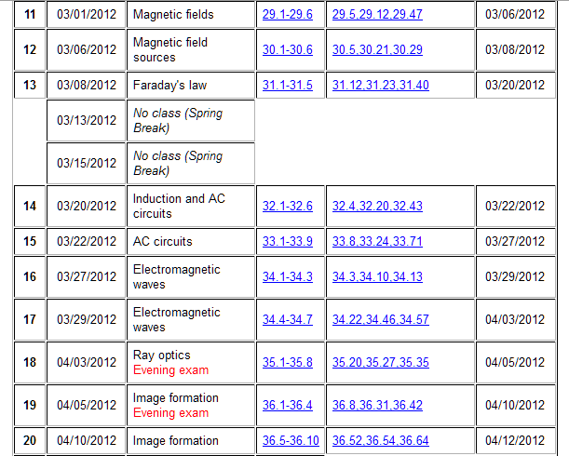
Remember to send in your chapter reading questions…
3rd exam (covering Chapters 29-34) is scheduled for evenings during the week of 4/2/2012.

Slide 3
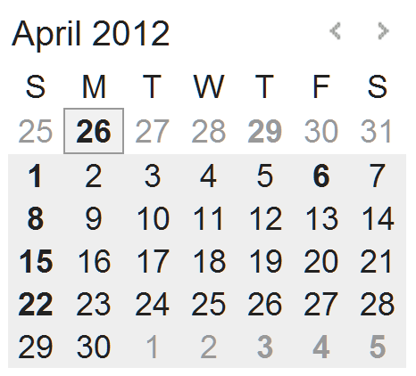
3rd exam dates
You will be scheduled for one of these (based on email info) – probably in Olin 107 between 6-10 PM:
  Monday 4/2
  Tuesday 4/3
  Wednesday 4/4
  Thursday 4/5
Several people still need to email their preferred exam times.

Slide 4
Full Maxwell’s equations

Slide 5
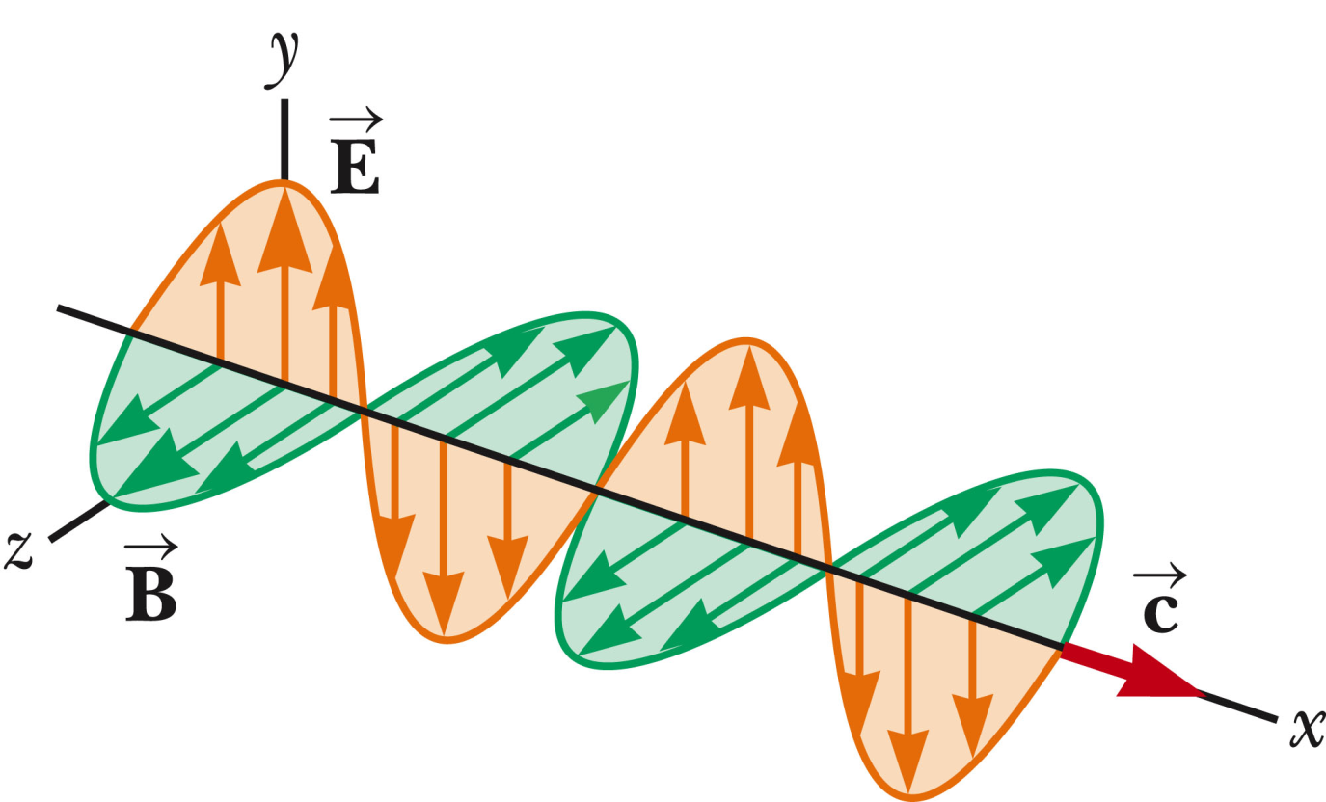
Plane wave solution to Maxwell’s equations, far from sources:

Slide 6

Plane wave solution to Maxwell’s equations, far from sources:
Which of the following changes in the above solution would no longer represent E-M waves:
  cos ⬅➔sin
  Change value of E_{max}
  Change value of k
  Change value of c
  All of the above

Slide 7
Plane wave solution to Maxwell’s equations, far from sources:
Additional comments:
  For this solution, the y direction is called the polarization direction (the E field orientation)
  This is a periodic wave, where k=2π/λ and λ represents the wavelength and the frequency of the wave is kc=ω=2πf.

Slide 8
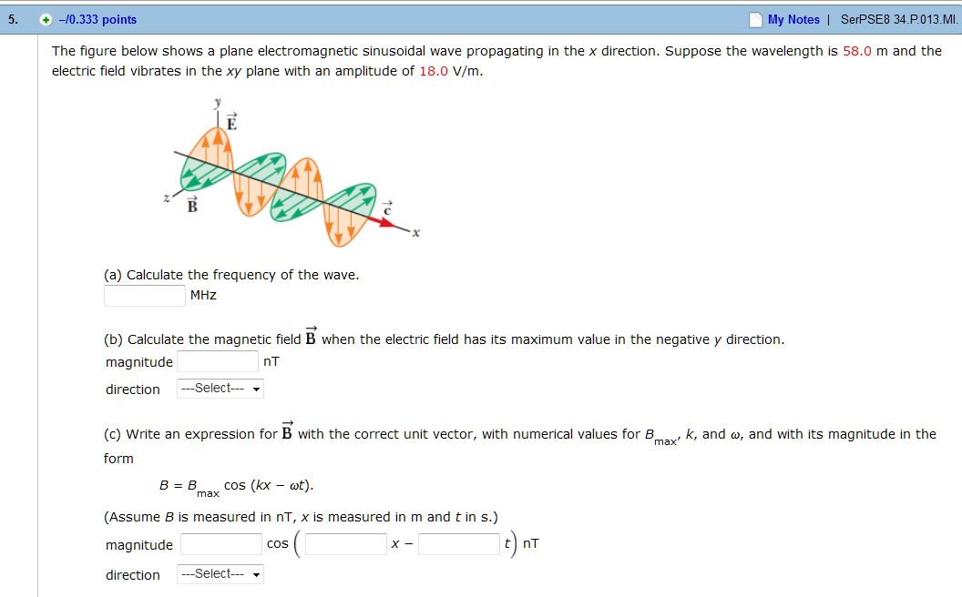
Homework hint:

Slide 9
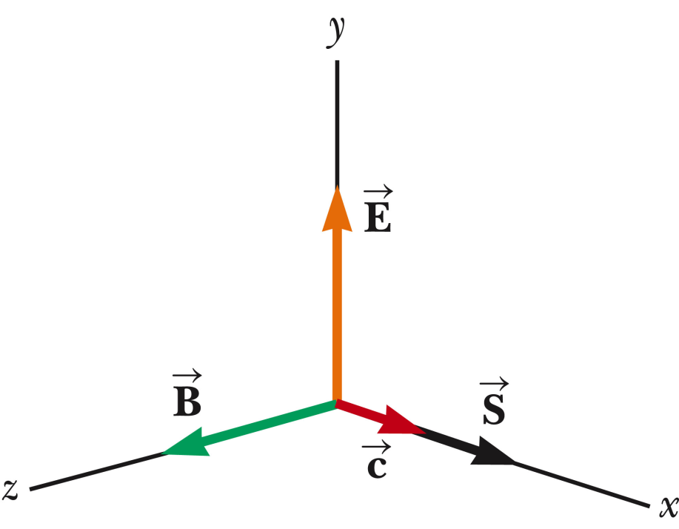
Energy carried by electromagnetic waves:

Slide 10
Energy carried by electromagnetic waves – continued :
A
S

Slide 12
Energy density within electromagnetic wave:

Slide 13
Sources of electromagnetic radiation
➔Need accelerating charges to produce E-M radiation

Slide 14
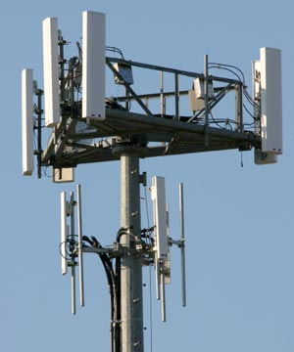
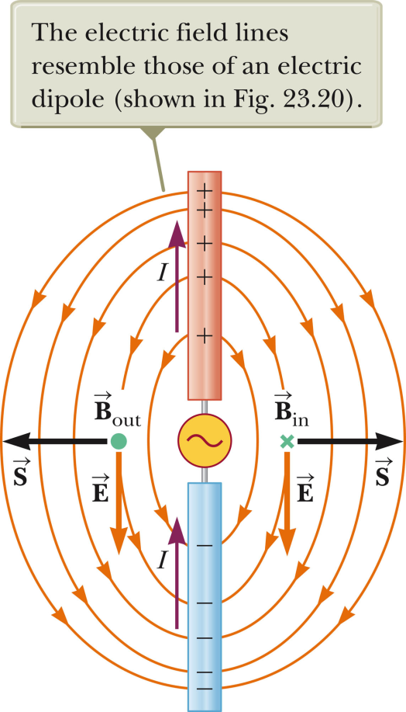
Radiation from antenna’s

Slide 15
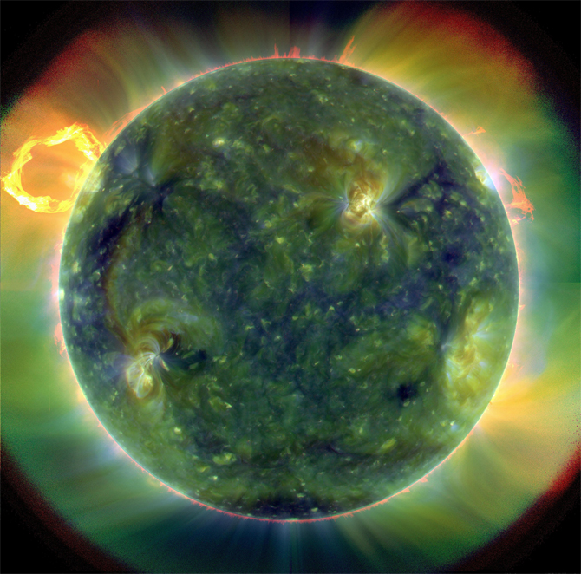
Electromagnetic radiation from the sun
http://www.nasa.gov/mission_pages/sdo/news/first-light.html
A full-disk multiwavelength extreme ultraviolet image of the sun taken by SDO on March 30, 2010. False colors trace different gas temperatures. Reds are relatively cool (about 60,000 Kelvin, or 107,540 F); blues and greens are hotter (greater than 1 million Kelvin, or 1,799,540 F). Credit: NASA/Goddard/SDO AIA Team
Launched on Feb. 11, 2010, SDO is the most advanced spacecraft ever designed to study the sun. During its five-year mission, it will examine the sun's magnetic field and also provide a better understanding of the role the sun plays in Earth's atmospheric chemistry and climate. Since launch, engineers have been conducting testing and verification of the spacecraft’s components. Now fully operational, SDO will provide images with clarity 10 times better than high-definition television and will return more comprehensive science data faster than any other solar observing spacecraft.

Slide 16
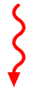
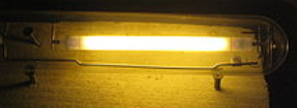
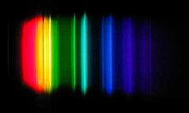
Electromagnetic radiation from quantum mechanics:
Atoms, molecules, solids
Ground state
Excited state
Radiation
Sodium vapor lamp
Spectrum

Slide 17
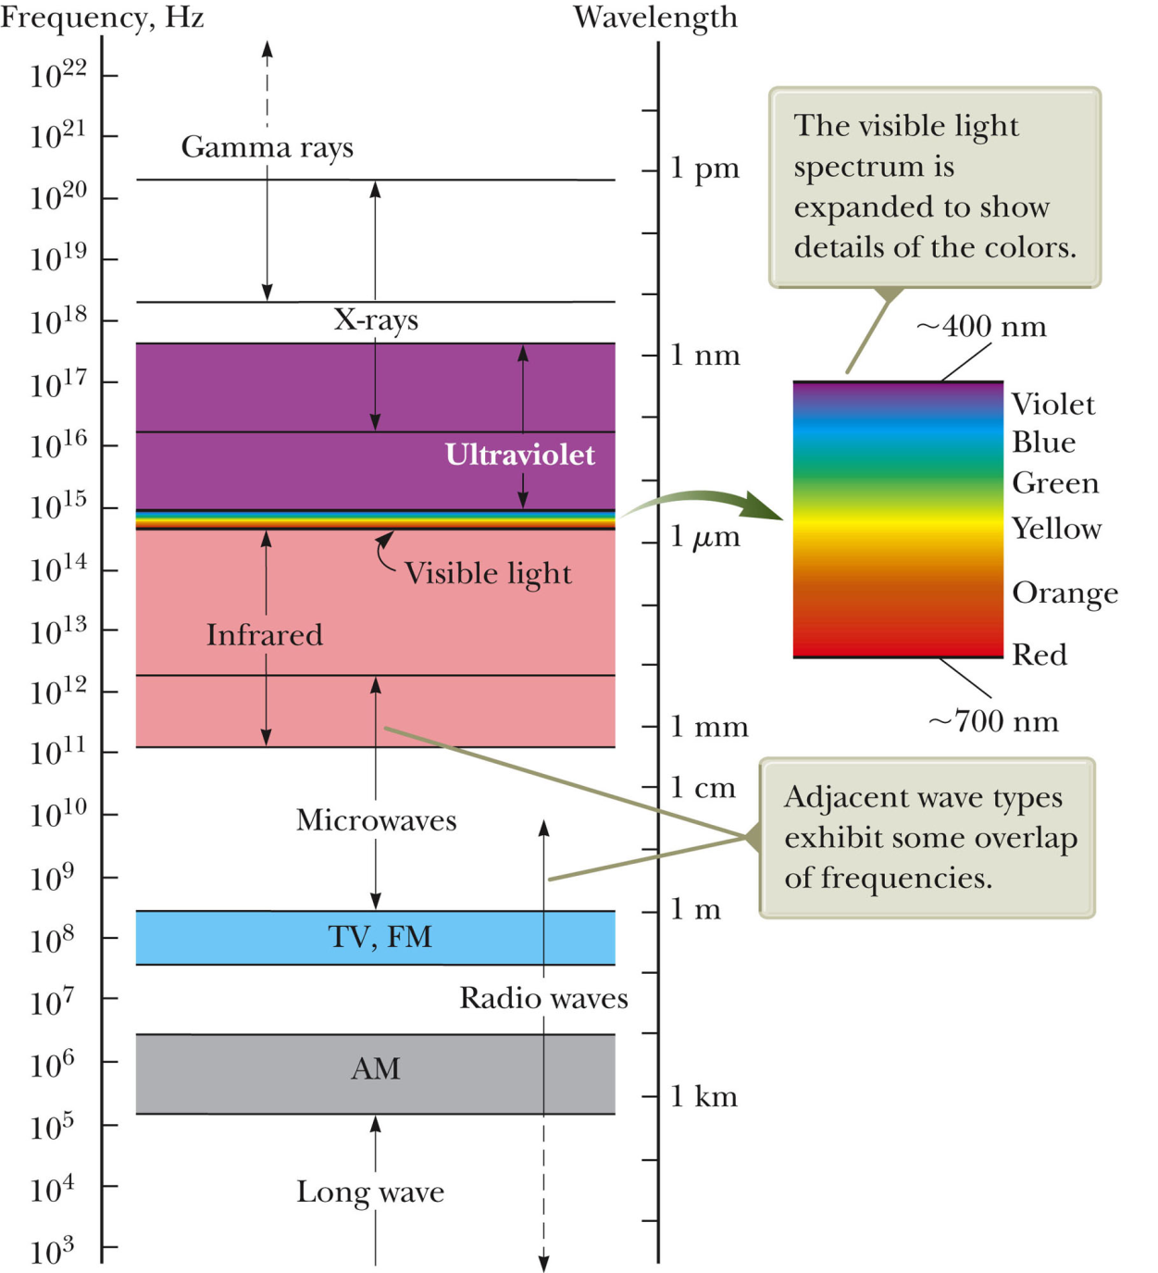
Electromagnetic spectrum

Slide 18
Comment about solar energy
  Technology to capture and use electromagnetic radiation from the sun and use it as a heat source or as a generator of voltage in special semiconductor devices
  (see web page from Prof. Wesley Henderson from NCSU:
  http://www.che.ncsu.edu/ILEET/CHE596web_Fall2011/
  21_CHE596-015_2011-11-15_Renewables.pdf

Slide 19
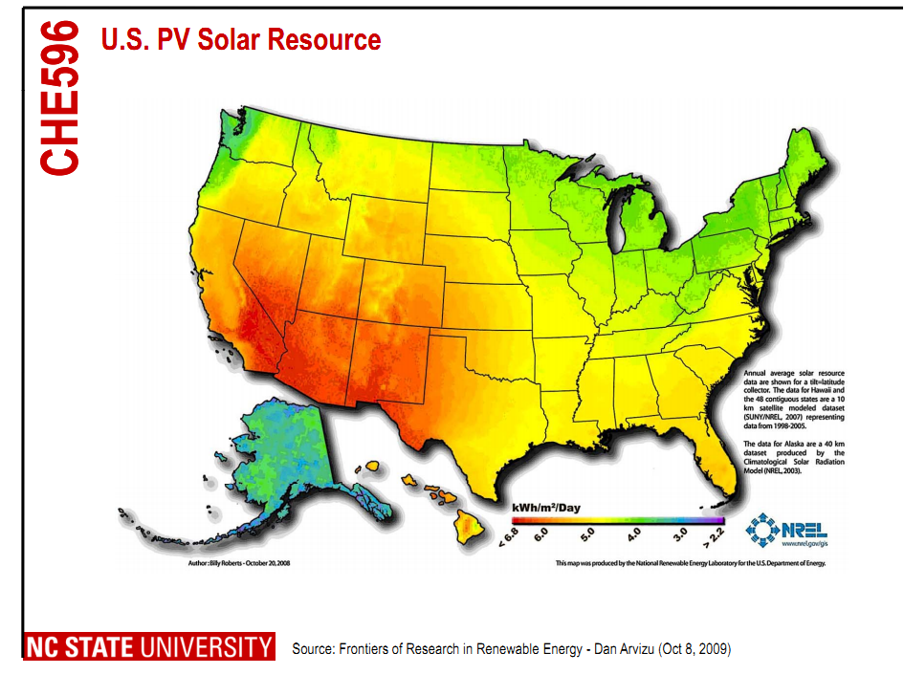
From Prof. Wesley Henderson

Slide 20
Reminder:
Third exam – evenings of Mon-Thurs (4/2-4/5) – covering Chapters 29-34
  ~5 problems – show your work and reasoning for possible partial credit.
  Should bring 1 8½” x 11” sheet of paper to the exam (to be turned in with your exam papers).
  Should bring calculator for numerical work. Must not use cell phones or computers during the exam.
  Exams will be in Olin 107 Mon-Wed and Olin 101 Thurs
  6-10 PM (must schedule by email before 3/30/2012)

Slide 21
Problem solving skills
Math skills
Equation Sheet
Advice:
Keep basic concepts and equations at the top of your head.
Practice problem solving and math skills
Develop an equation sheet that you can consult.

Slide 22
Problem solving steps
  Visualize problem – labeling variables
  Determine which basic physical principle(s) apply
  Write down the appropriate equations using the variables defined in step 1.
  Check whether you have the correct amount of information to solve the problem (same number of knowns and unknowns).
  Solve the equations.
  Check whether your answer makes sense (units, order of magnitude, etc.).

Slide 23
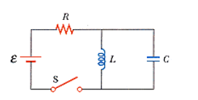
Comment on AC circuits:
I₁
I₂
I₃
Solution method:
Transform differential equation in to algebraic equation using trig or complex functions
“Solve” algebra problem
Analyze for physical solution

Slide 24
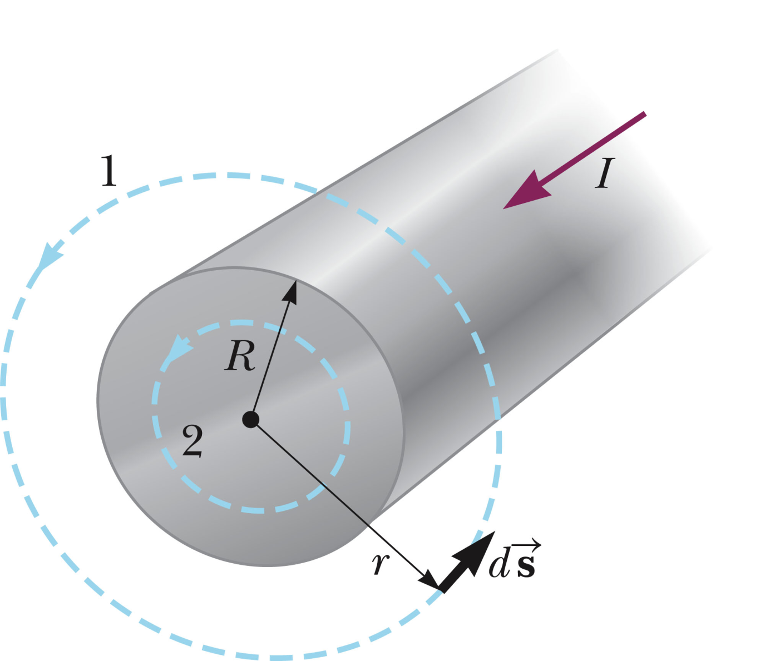
Example using Ampere’s law and Ampere-Maxwell law:
First consider Ampere’s law and a wire with uniform current I

Slide 25
Example using Ampere’s law and Ampere-Maxwell law:
Now consider Ampere-Maxwell’s law and a uniform electric field with a constant rate of change:
E(t)

Slide 26
Example using Ampere’s law and Ampere-Maxwell law:
  Now consider Ampere-Maxwell’s law and a uniform electric field with a constant rate of change -- connection to capacitance circuit where R denotes radius of plates
I
I

Slide 27
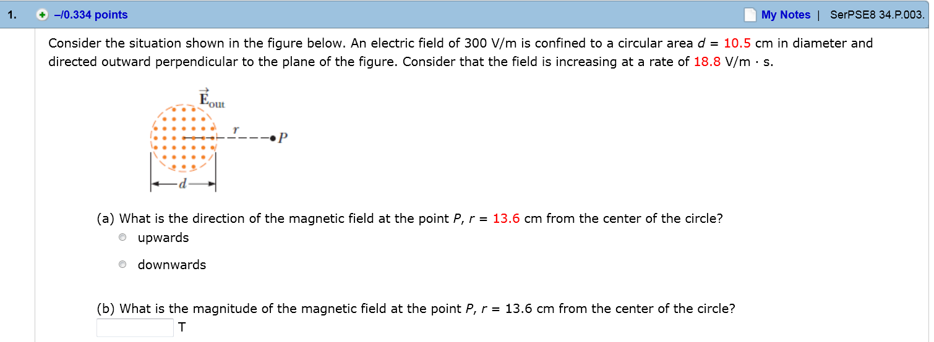
Homework hint:

Slide 28
Full Maxwell’s equations
Lorentz force law:

