Slide 1
PHY 114 A General Physics II
11 AM-12:15 PM TR Olin 101
Plan for Lecture 18 (Chapter 35):
Optical properties of light
  Speed of light in vacuum and in materials
  Refraction and reflection of light
  Spectrum of light and dispersion

Slide 2
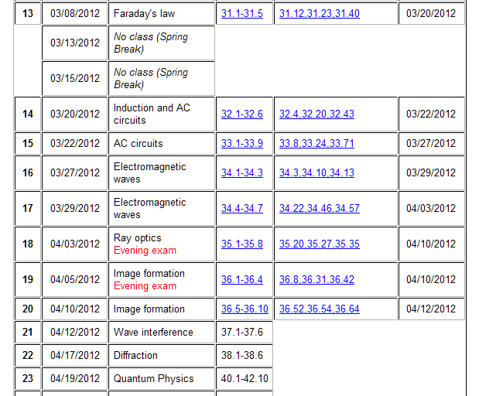

Slide 3
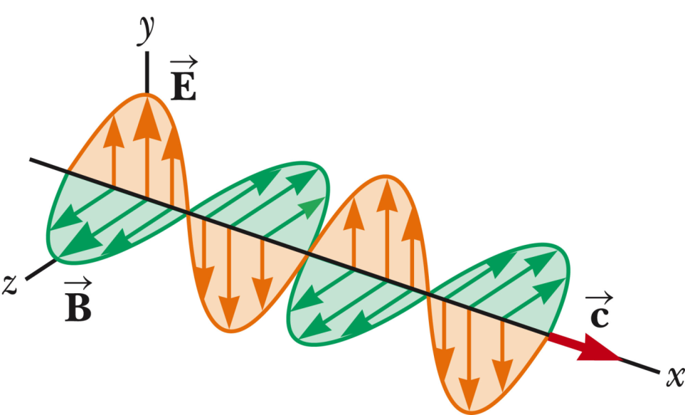
Plane wave solution to Maxwell’s equations in vacuum:
Additional comments:
  For this solution, the y direction is called the polarization direction (the E field orientation)
  This is a periodic wave, where k=2π/λ and λ represents the wavelength and the frequency of the wave is kc=ω=2πf.

Slide 4
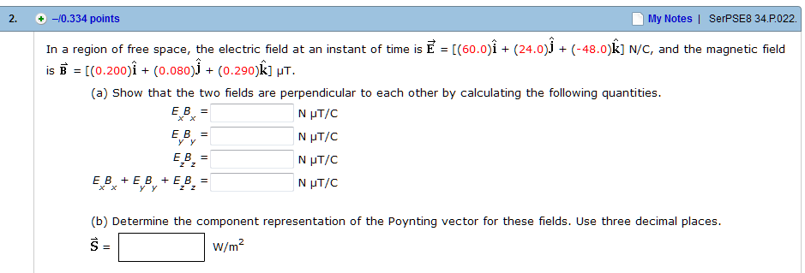
Webassign hint:

Slide 5
Index of refraction n:
What happens to an electromagnetic wave traveling when it encounters a different medium?
  It usually passes through the medium without any change
  It usually passes through the medium but the velocity is changed
  It usually passes through the medium with a different velocity; the E and B fields are also changed
  It usually cannot pass through the different medium

Slide 6
C
B
A
What happens to the propagation of an electromagnetic wave traveling when it encounters a different medium?
  The propagation vector continues the medium without change
  The propagation vector is reflected before passing second medium
  The propagation vector changes when it passes through the medium
  More than one possibility

Slide 7


θ₁
n₁
θ₂
n₂
n₁
θ₁
n₂
θ₂

Slide 8
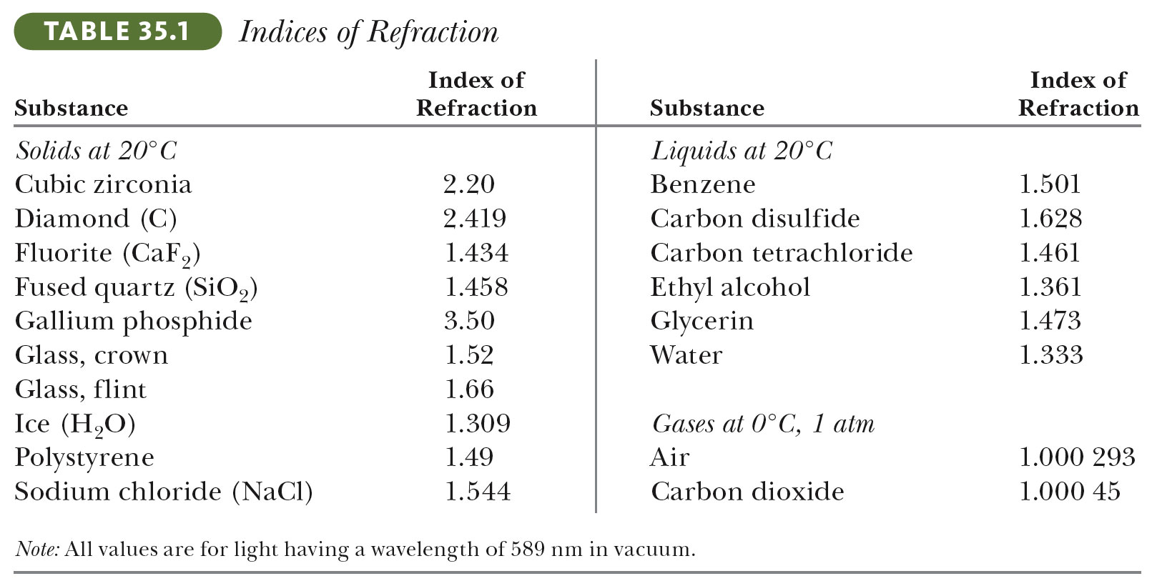
Indices of refraction for various media:

Slide 9
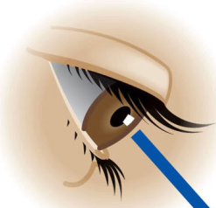
Suppose that you observe , at an angle of θ₁= 45º, a fish in a pond with refractive index n₂ = 1.333. How does the fish appear to you relative to its actual location
  Further to the right?
  Further to the left?
  At the same location.
n₁
θ₁
θ₂
n₂

Slide 10
Suppose that you observe , at an angle of θ₁= 45º, a fish in a pond with refractive index n₂ = 1.333. How does the fish appear to you relative to its actual location
  Further to the right?
  Further to the left?
  At the same location.
n₁
θ_{1S}
θ₂
n₂

Slide 11
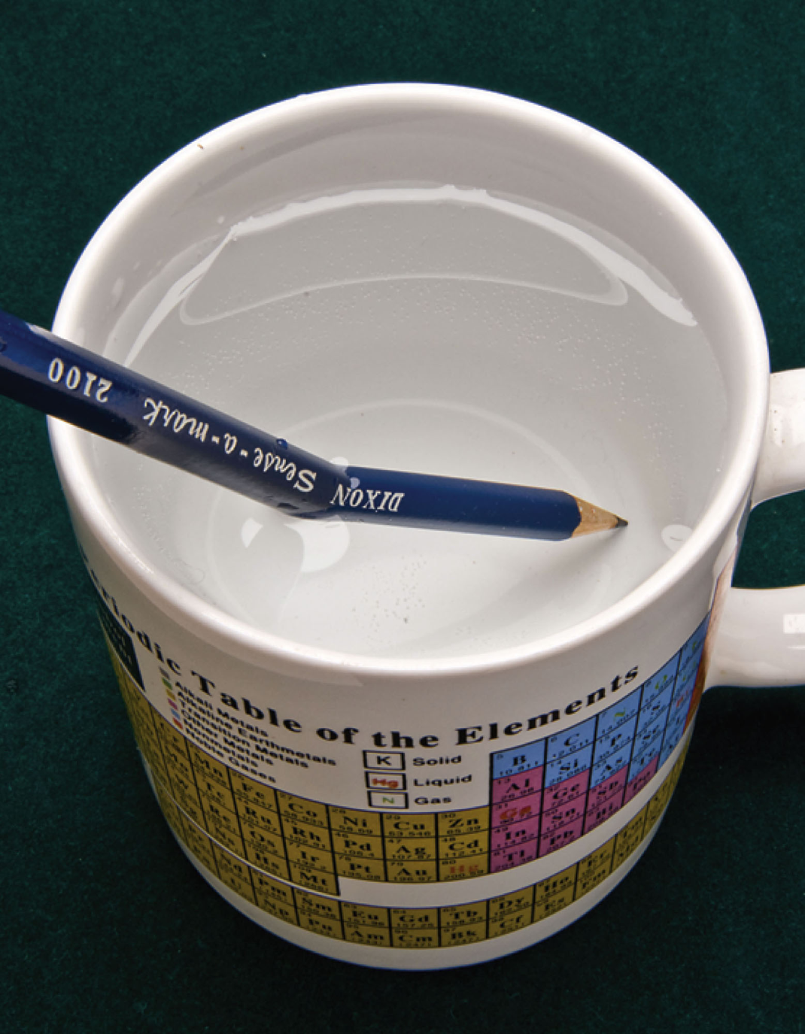
The picture to the left
  Is consistent with Snell’s law
  Shows that Snell’s law is false
  Shows that water bends pencils

Slide 12
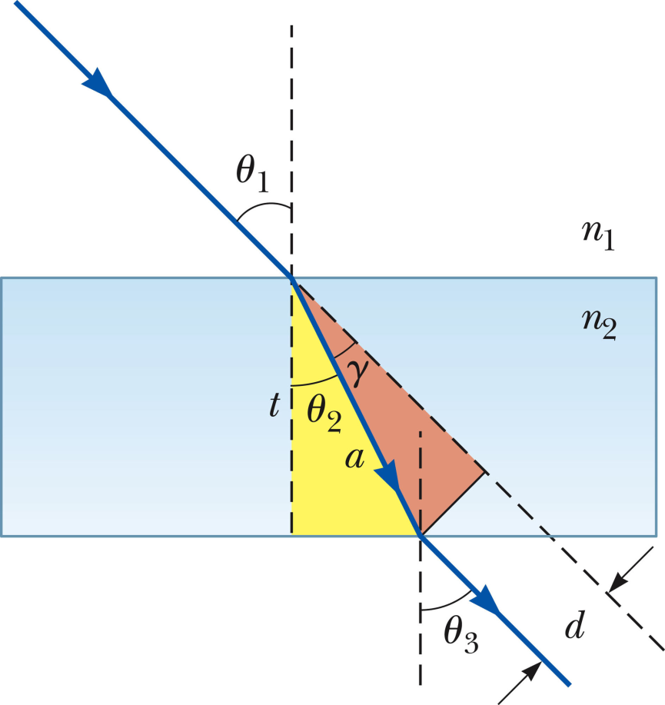
Light through a slab
n
What is the value of θ₃?
  θ₁
  θ₂
  θ₁+ θ₂

Slide 13
More geometrical optics
60º
n
30º
θ

Slide 14
More geometrical optics
60º
30º
30º
n
30º
30º
θ

Slide 15
Which of the following statements is true:
  0 < θ₂ < 90º
  0 < θ₂ < θ_{c}
  θ₂ > θ₁
n₁
θ₁
n₂
θ₂

Slide 16
Total internal reflection for θ₂ > θ_{c}
n₁
n₂
θ₂
θ₂

Slide 17
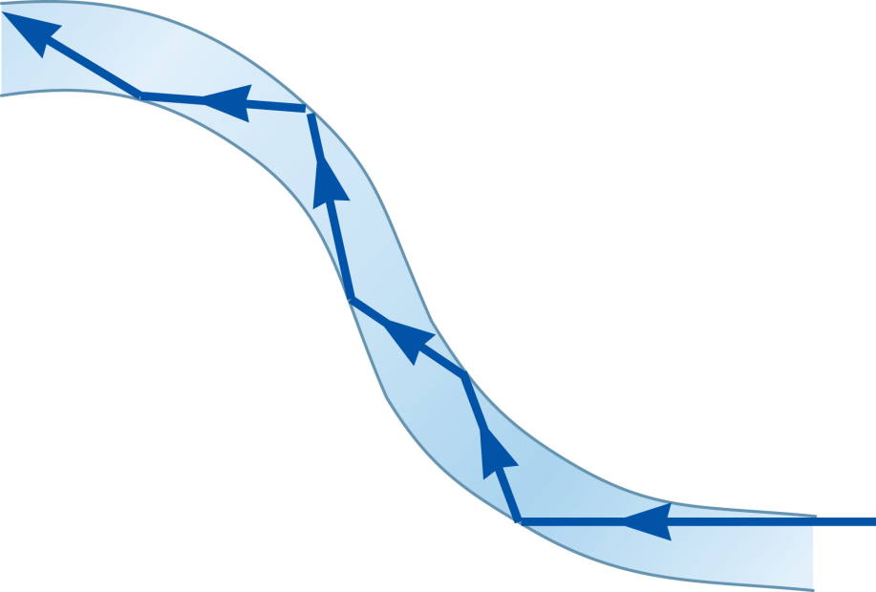
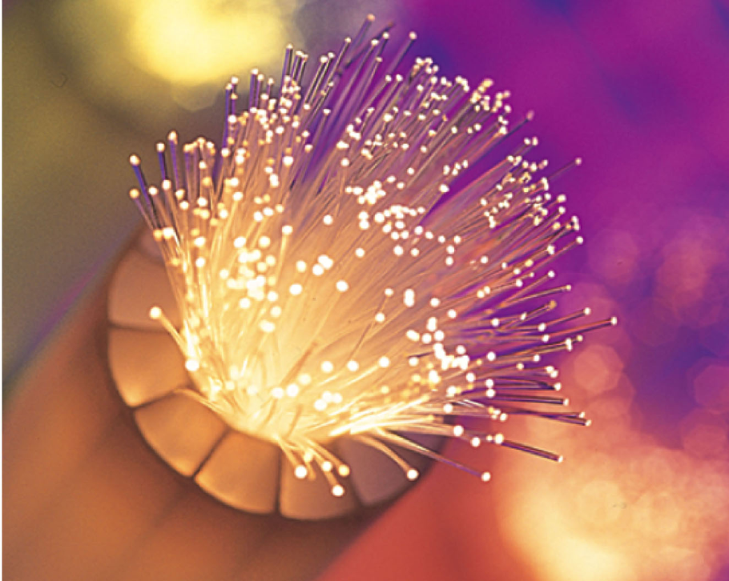
Uses for total internal reflection – fiber optic cables

Slide 18
General case – reflection and refraction
n₁
θ₁
θ₁
n₂
θ₂

Slide 19
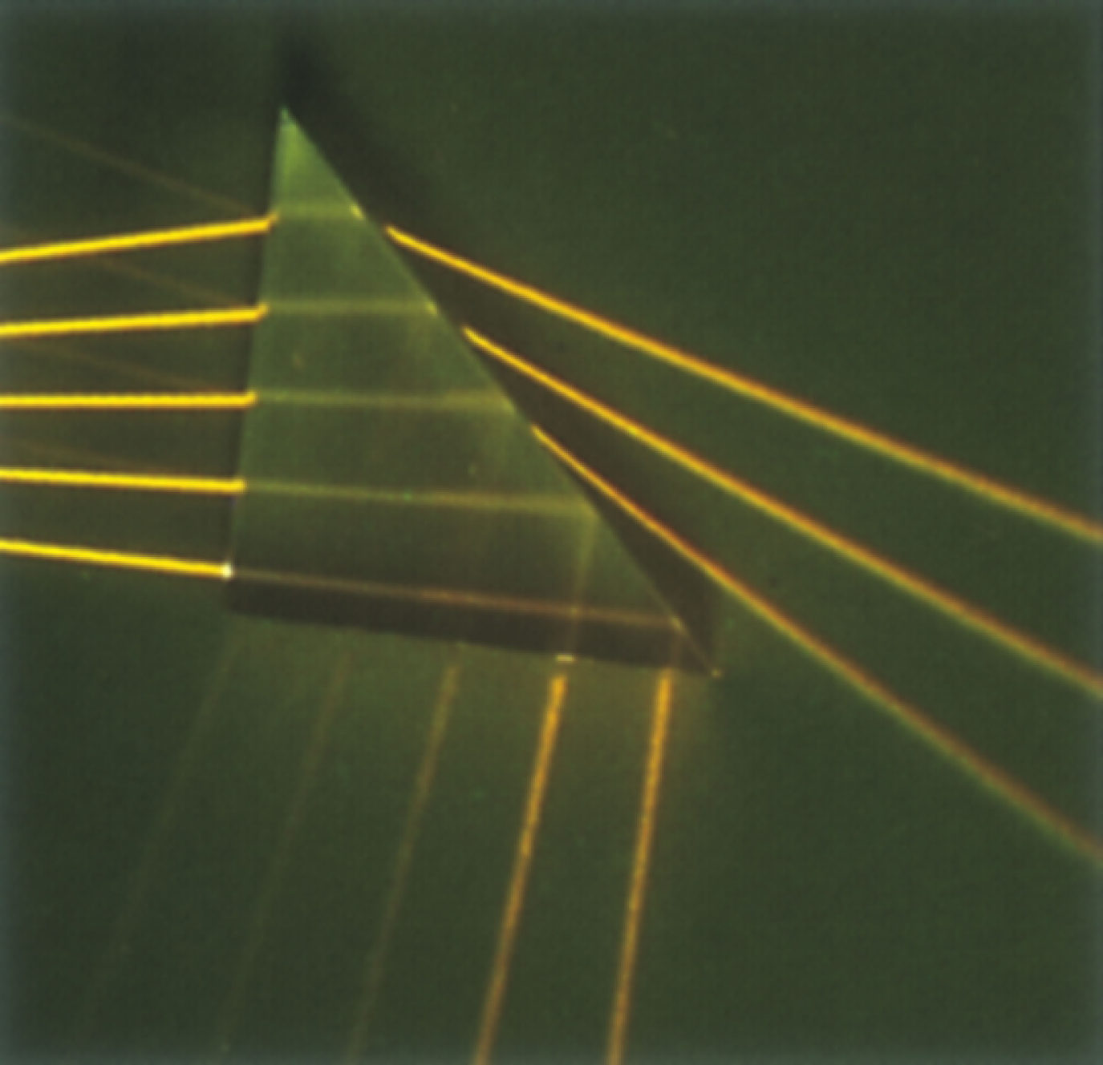
General case – reflection and refraction and multiple surfaces

Slide 20
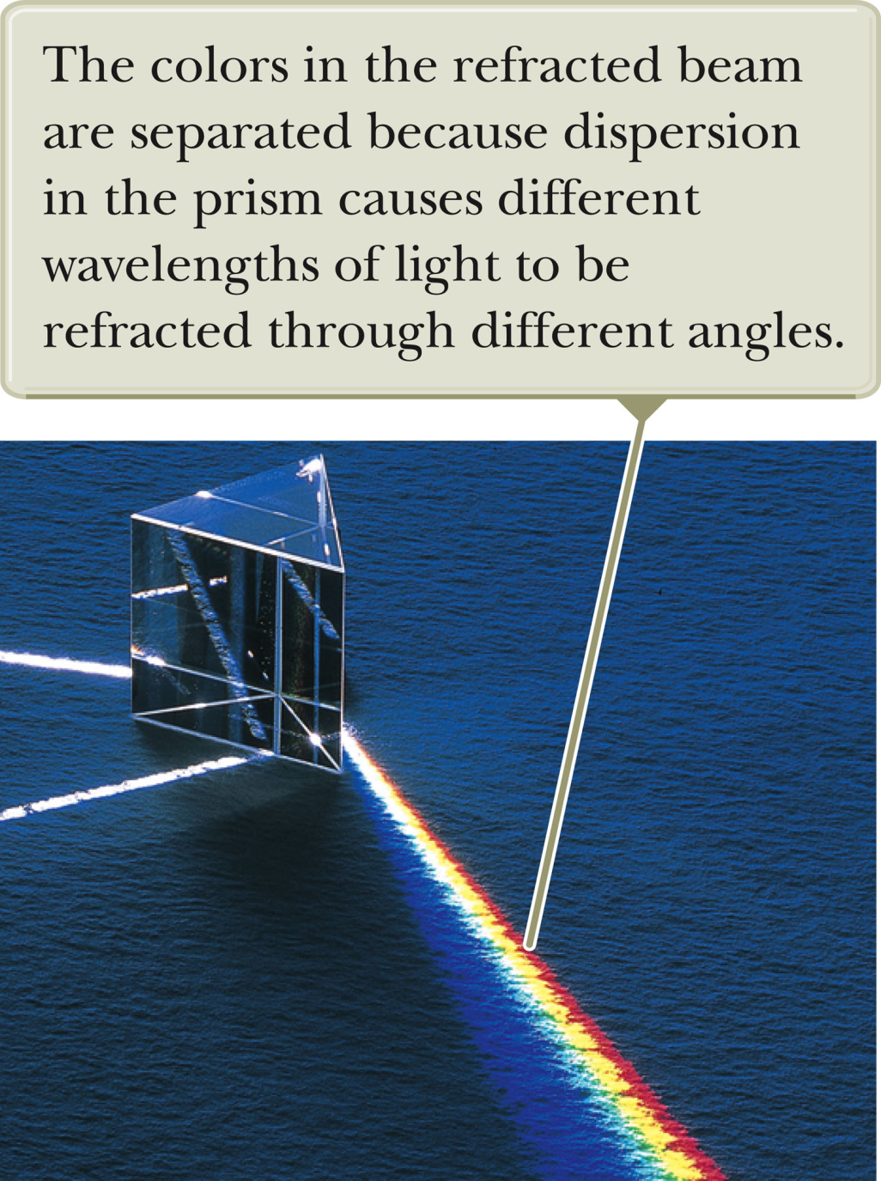
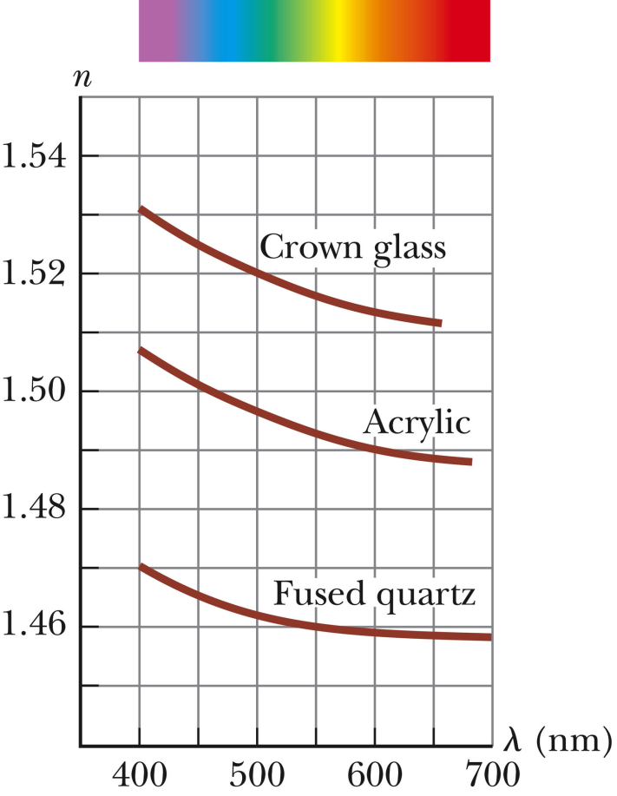
Dispersion
n=n(λ)

Slide 21
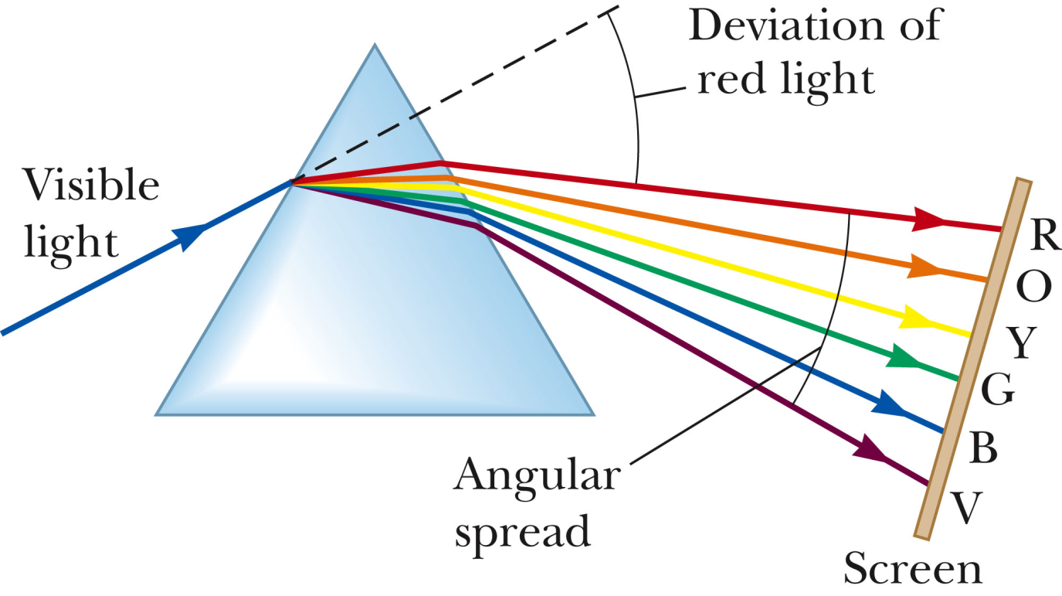
Dispersion from prism

Slide 22
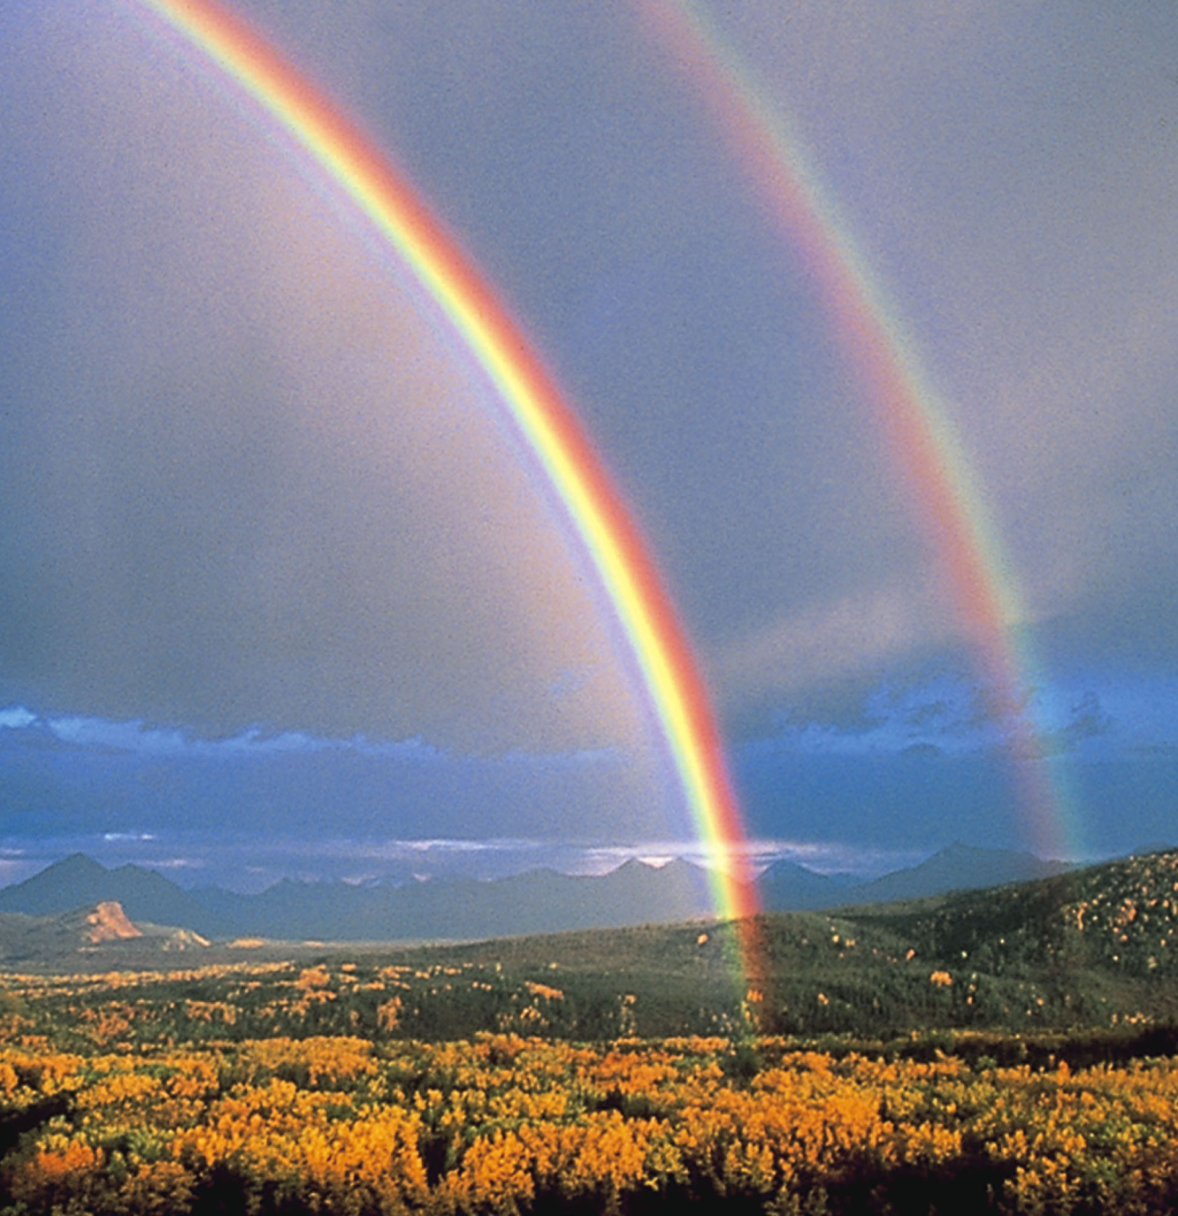
Where is the pot of gold?
  Primary rainbow
  Secondary rainbow
  Both

Slide 23
Imagine you are viewing this scene. Where is the sun?
  To your right
  To your left
  Behind you
  In front of you

