Slide 1
PHY 114 A General Physics II
11 AM-12:15 PM TR Olin 101
Plan for Lecture 19 (Chapter 36):
Optical properties of light
Mirror reflections
Images in flat and spherical mirrors

Slide 3
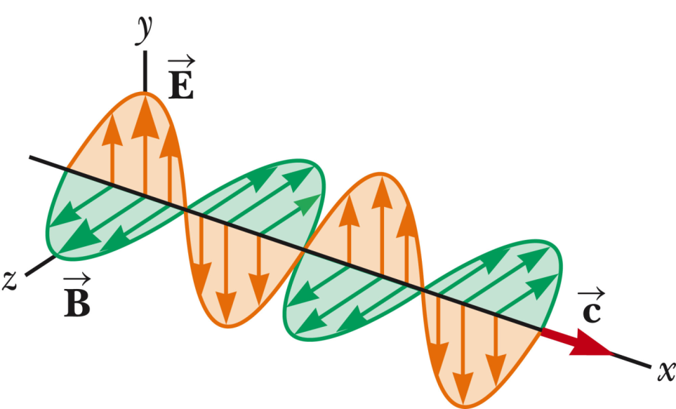
Plane wave solution to Maxwell’s equations in dielectric medium with v=c/n:
Additional comments:
For this solution, the y direction is called the polarization direction (the E field orientation)
This is a periodic wave, where k=2π/λ and λ represents the wavelength and the frequency of the wave is kc/n=ω=2πf.

Slide 4
Index of refraction n:

Slide 5
θ₁
n₁
θ₂
n₂
n₁
θ₁
n₂
θ₂

Slide 6
General case – reflection and refraction
n₁
θ₁
θ₁
n₂
θ₂

Slide 7
Notation for image position:
i ←→ q
Images formed from reflected light:
i
θ₁
object
virtual image
θ₁
ideal surface

Slide 8
Analysis of mirror image
Mirror symmetry:
i
Using geometry:
i = p h=h'

Slide 9
Terminology:
Virtual image -- perceived image but no light can be detected at the location of the virtual image
Real image - - light can detected at the location of the real image

Slide 10
virtual image
object

Slide 11
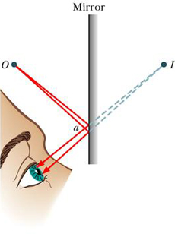
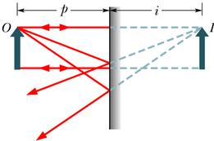
Summary of geometric optics of plane mirror
“virtual” image
General equation describing object and image positions:

Slide 12
Analysis of image from plane mirror
i
Some details:
By convention,
i < 0 for virtual image
(virtual)
Geometrical relationships
|i| = p h=h’
Magnification

Slide 13
Spherical mirrors -- concave
Reflection of parallel light rays:
Detail
θ
θ
R
f = ½ R
f

Slide 14
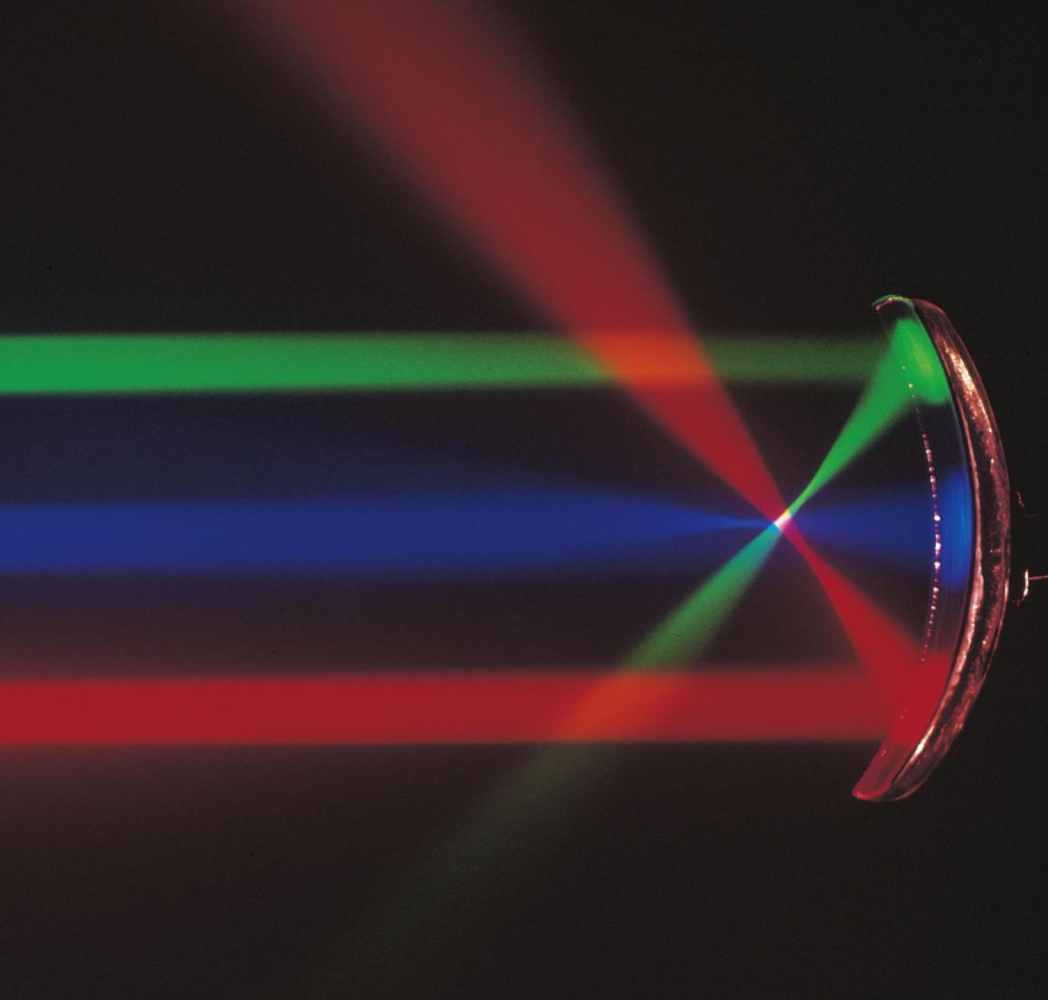

Slide 15
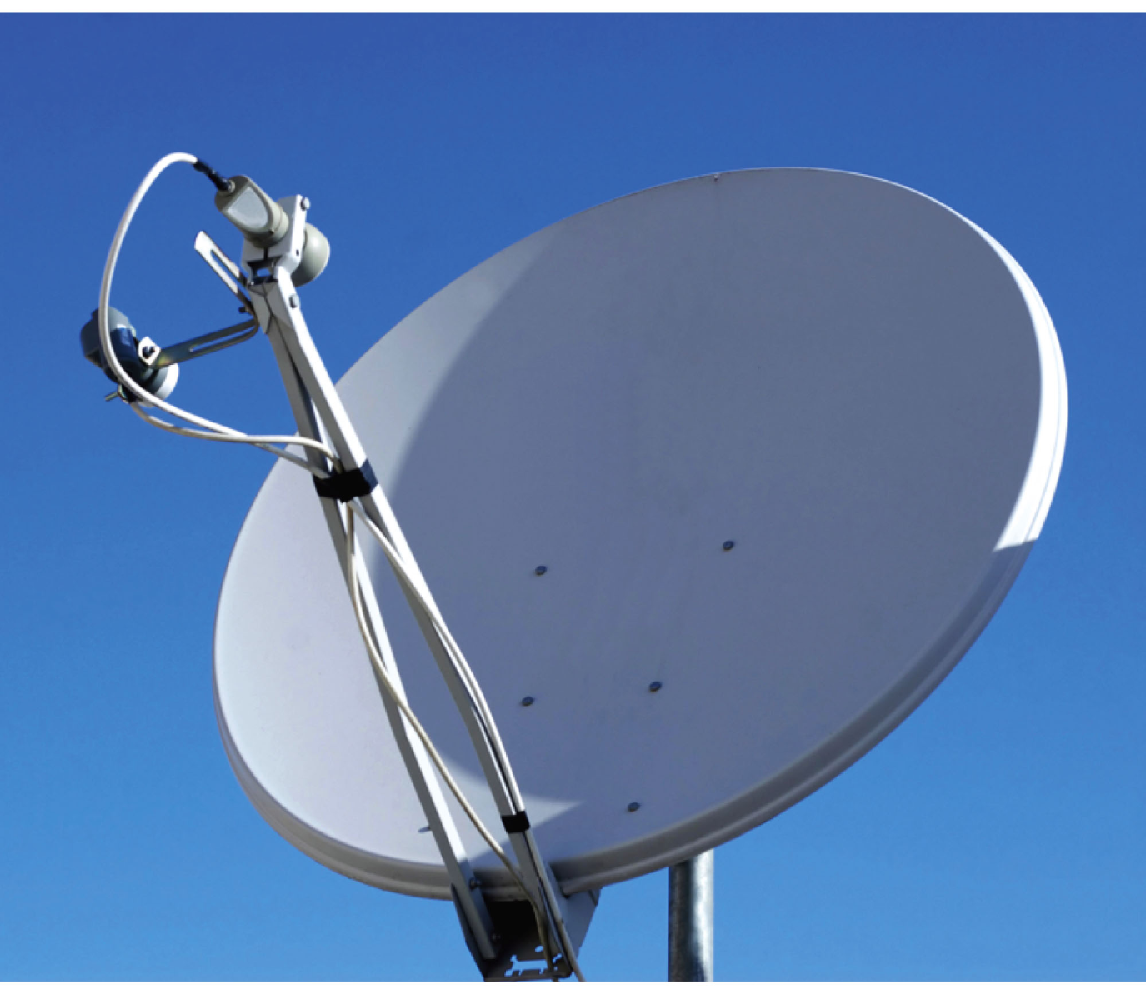
Why does this satellite-dish look like a concave mirror?
Because it is.
It doesn’t – not shiny enough.
Where is the receive placed relative to the radius of curvature R?
Placed at R.
Placed at R/2.

Slide 16
Image formed in concave mirror:
Plane mirror:
−
i
p
f
-q
Example: f = 4 cm
p = 1 cm
i = -1.33 cm

Slide 17
“Proof” of mirror equation:
p
h’
h
f
-i
Similar triangles:
Similar triangles:

Slide 18
Image formed by concave mirror:
p
f
-i
General result for virtual image formed by concave mirror
p < f
image is upright and increased in size

Slide 19
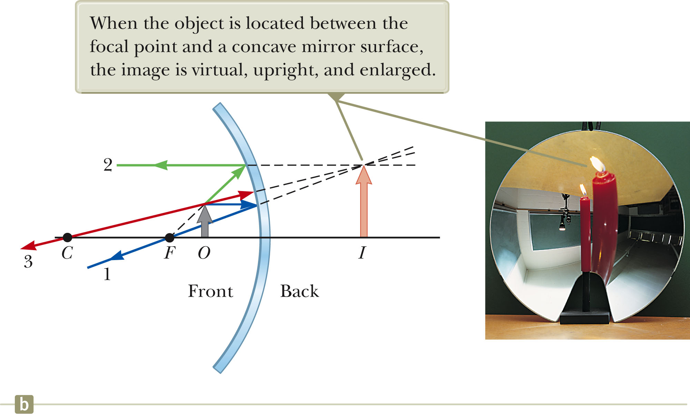

Slide 20
Image formed by concave mirror:
Example: f = 4 cm
p = 10 cm
i = 6.67 cm
p
f
i

Slide 22
Image formed by concave mirror:
p
f
i
General result for real image formed by concave mirror
p > f
image is upside down
Is image always reduced in size?
(A) yes (B) no

Slide 23
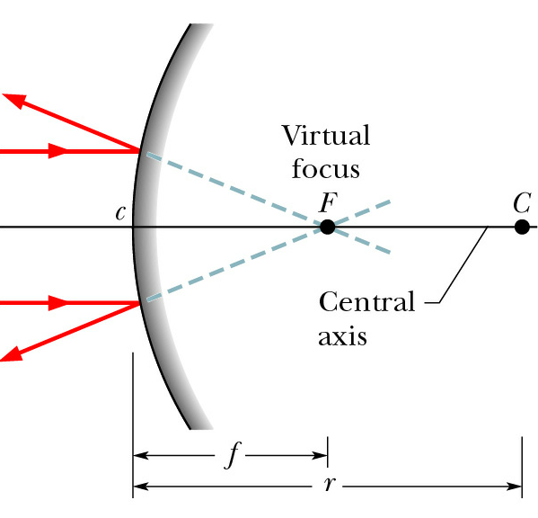
Convex mirror
f

Slide 24
Image formed by convex mirror:
Example: f = -4 cm
p = 16 cm
i = -3.2 cm
-i
p
-f
General result for virtual image formed by convex mirror:
image is upright and decreased in size

Slide 25
Can the image formed by a convex mirror ever be increased in size (|M|>1)?
(A) yes (B) no
Is it possible to form a real image with a convex mirror?
(A) yes (B) no

Slide 26
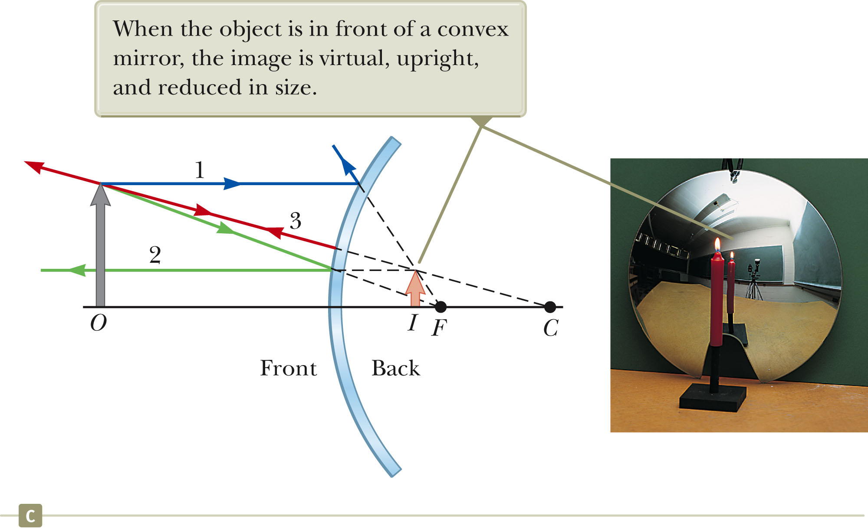

Slide 27
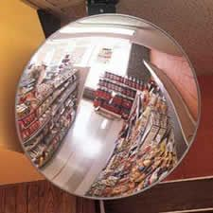
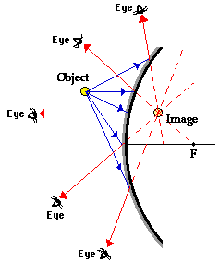
Convex mirror used for surveillance:
http://www.physicsclassroom.com/class/refln/u13l4a.cfm

Slide 28
Suppose that you were behind the steering wheel and saw this image in your rear-view mirror. Which of these is likely to be true?
The truck is closer to you than it appears.
The truck is further from you than it appears.
Don’t change lanes just in case.

