Slide 1
PHY 114 A General Physics II
11 AM-12:15 PM TR Olin 101
Plan for Lecture 2:
Review of Coulomb’s law
Introduction to the notion of Electric Fields
Electric Fields for various charge configurations

Slide 2
➔ PHY 114 Labs started Monday Jan. 23rd and run through the week of April 16th.
PHY 114 Tutorial sessions in Olin 103
Sunday 5:30-7:30 PM Jie Liu
Monday 5:30-7:30 PM Jie Liu
Tuesday 6:00-8:00 PM Loah Stevens
Wednesday 5:30-7:30 PM Jie Liu
Thursday 5:30-7:30 PM Loah Stevens

Slide 3
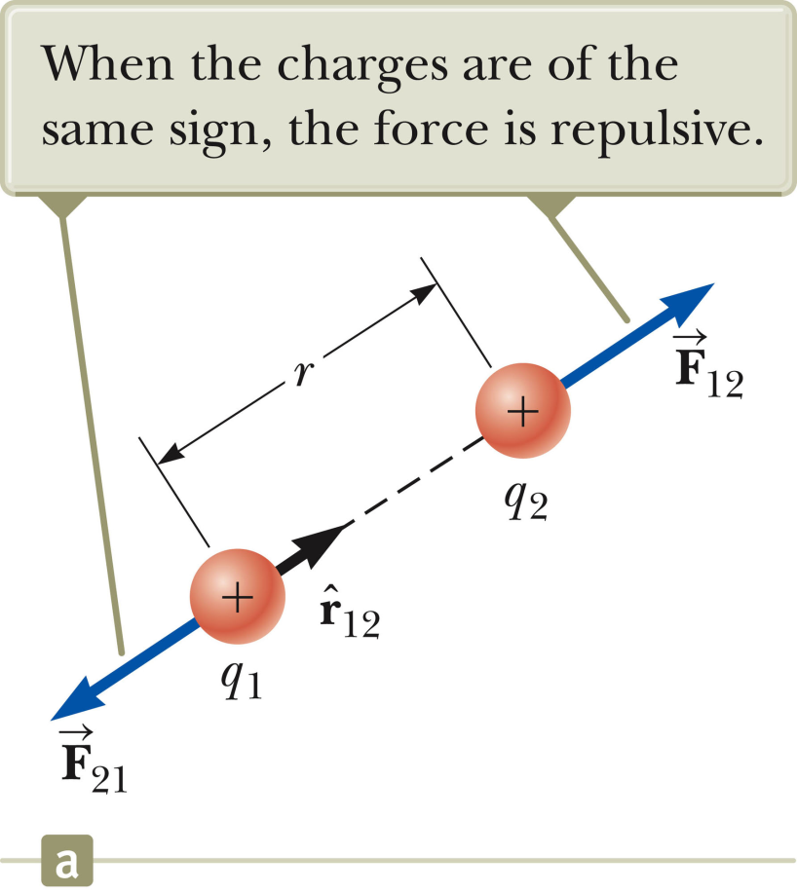
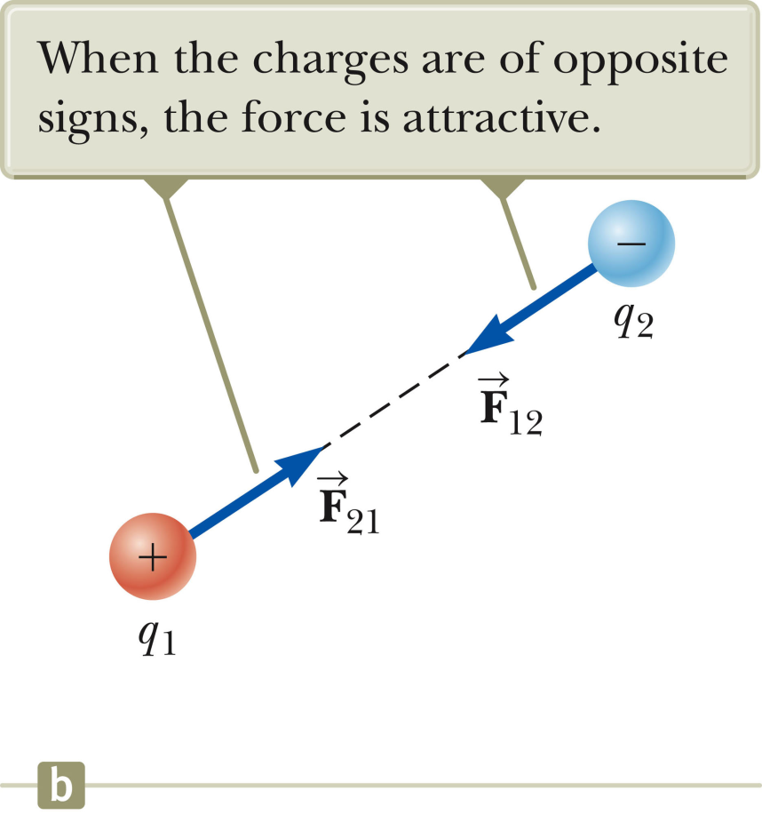
Recap -- Coulomb’s Law

Slide 4
Example from last lecture:
Consider the configuration of 4 charges at the 4 corners of a square shown in the diagram. What is the direction of the force on the charge +Q in the right corner?
F₃₁
F₂₁
2
1
+Q
-Q
F₄₁
F₁
d
3
4
+2Q
-Q

Slide 5
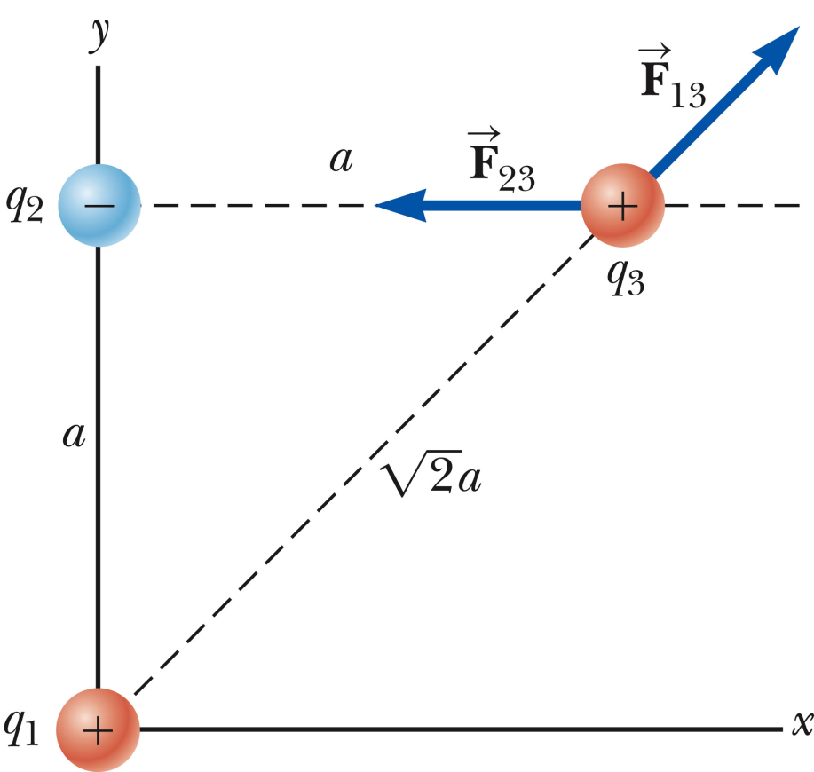
Another example:

Slide 6
Electric field:
An electric field E(r) is the Coulomb’s law force at the position r on a positive charge of q=1 Coulomb due to all other sources.
The electric force on a point charge q at the position r is

Slide 7
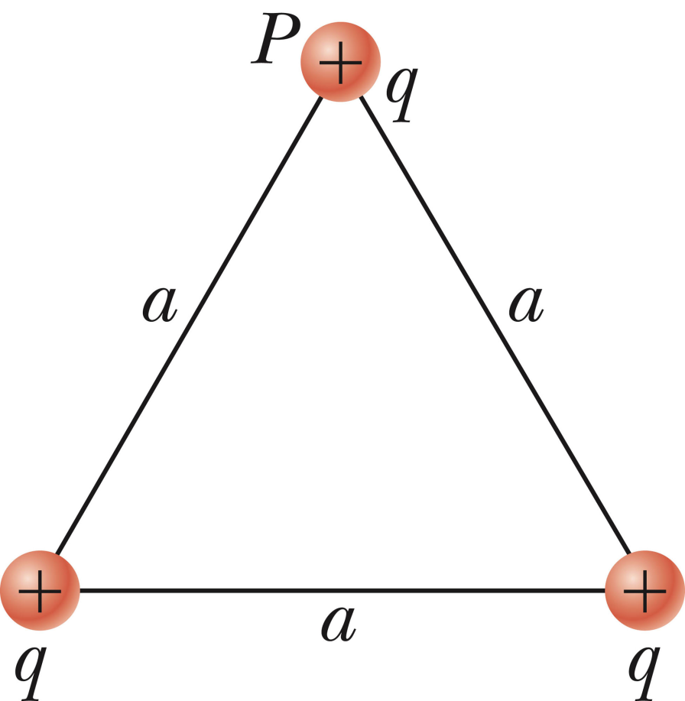
i-clicker exercise
The diagram below shows 3 equal positive charges arranged on an equilateral triangle. Choose the point A, B, C, D, E which has the largest total electric field strength.
A
B
C
E
D

Slide 8
i-clicker exercise
The diagram below shows 3 equal positive charges arranged on an equilateral triangle. Choose the point A, B, C, D, E which has the smallest total electric field strength.
A
B
C
E
D

Slide 9
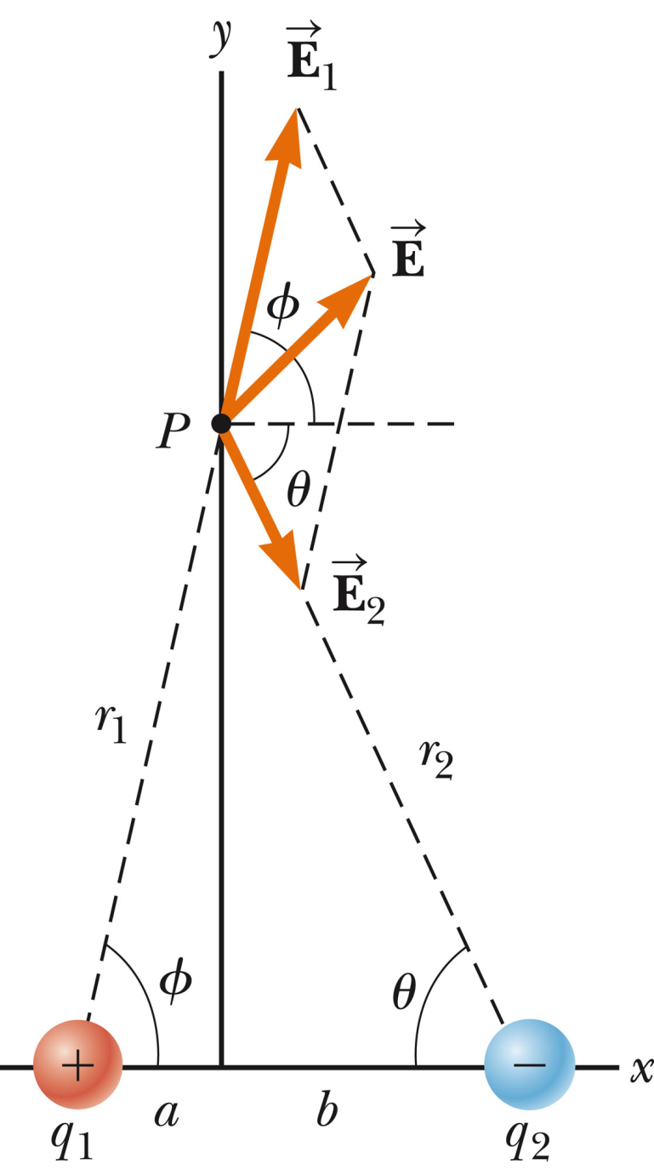
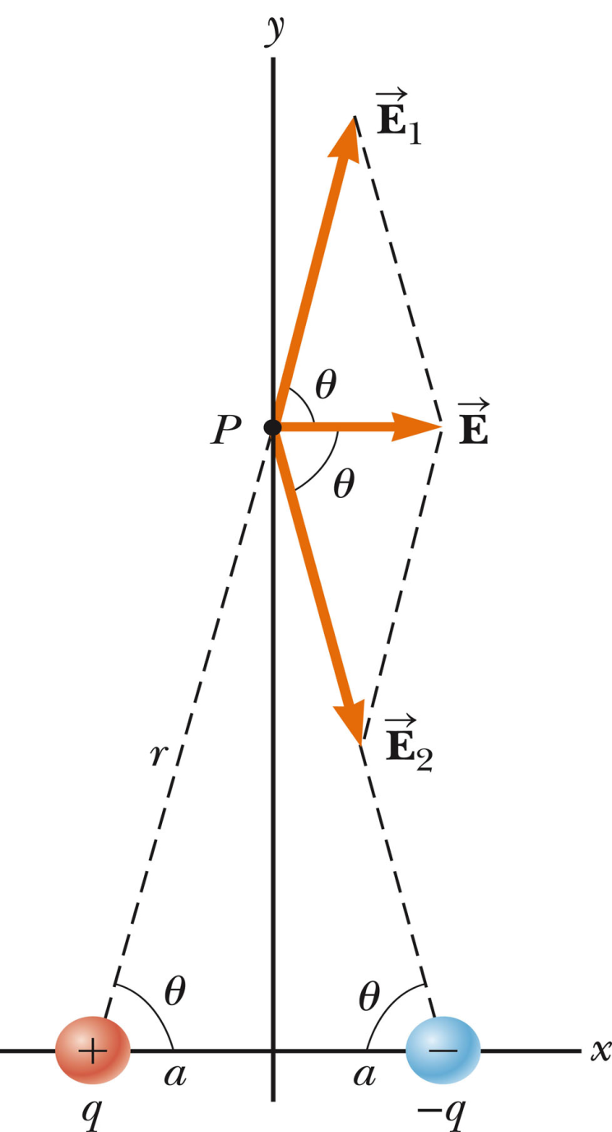
Electric field due to 2 point charges:

Slide 10
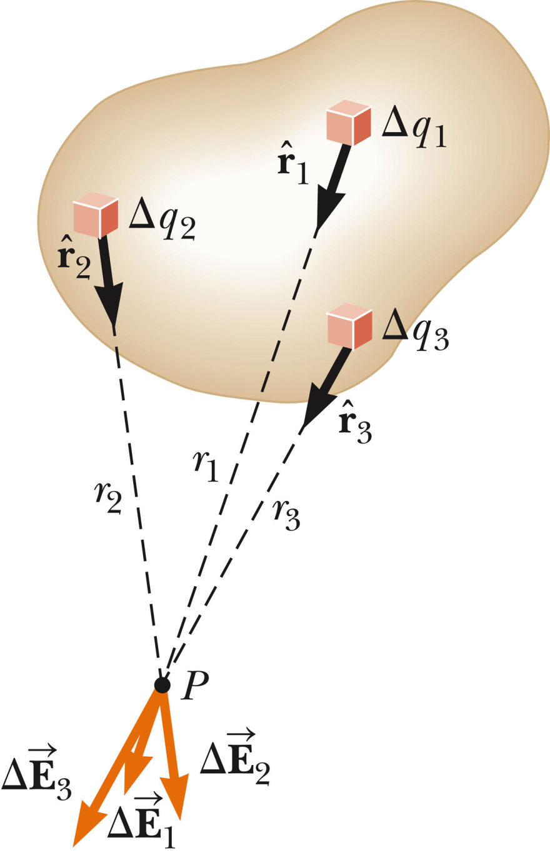
Electric field due to many charges
➔In general this integral is very difficult; Gauss’s law makes it easier to evaluate.

Slide 11
Example – consider a long thin uniformly charged rod:
E
E_{R}
E_{L}
P
y
-L
x
Q
L

Slide 12
i-clicker exercise
Consider a large flat plate of area A made of a material which has a uniformly distributed positive charge q=σA. Which vector A,B,C, or D represents the direction of the electric field a small distance above the center of the plate?
A
C
B
D

Slide 13
i-clicker exercise
Consider a large flat plate of area A made of a material which has a uniformly distributed positive charge q=σA. This question concerns the electric field strength E measured at a distance x from the center of the plate (x<<radius of plate).
x

Slide 14
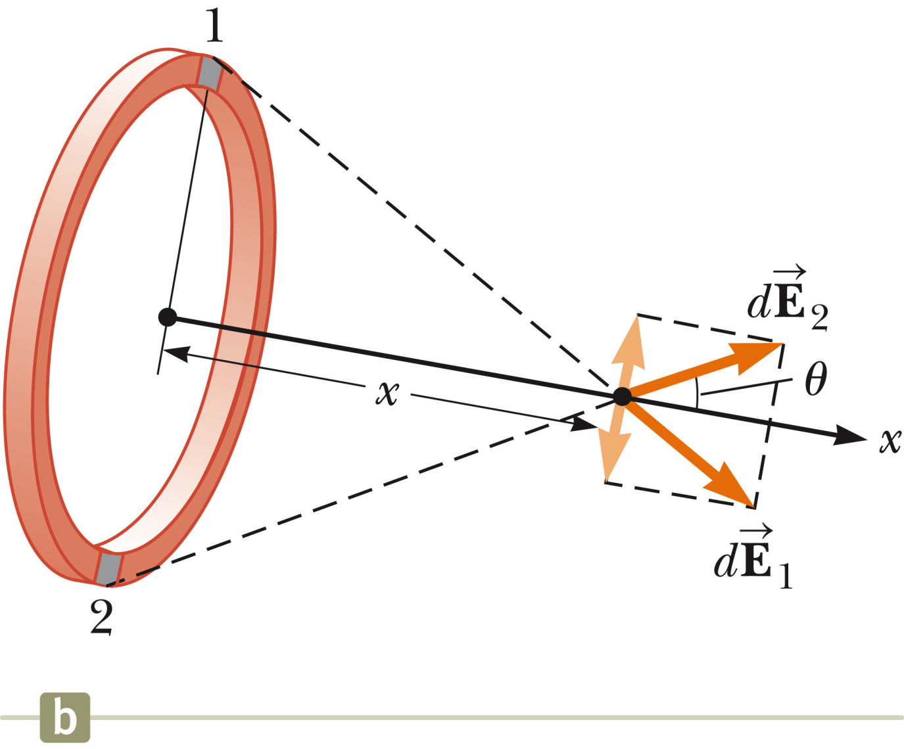
Electric field generated by a ring of charge

Slide 15
Electric field generated by a ring of charge

Slide 16
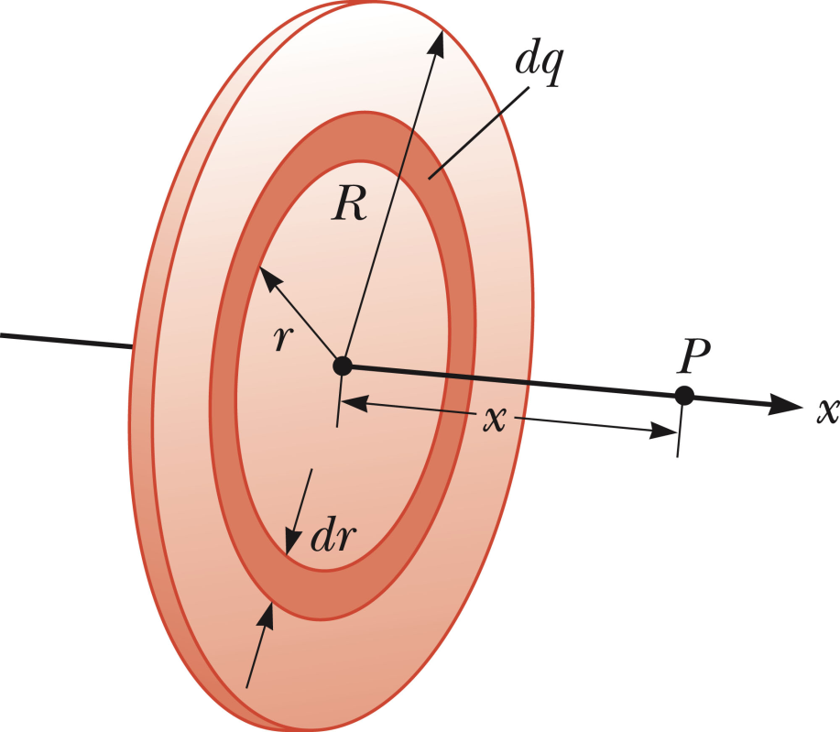
Electric field generated by a plate of charge

Slide 17
i-clicker question
What is the magnitude and direction (+→up, -→down) of the electric field between oppositely charged plates?
-σ
E
+σ

Slide 18
Summary

Slide 20
F₁
q₁
F₂
q₂

Slide 21
Some of your questions:
How to understand and handle continuous charge distributions
At the a microscopic (classical) viewpoint elementary charges are discrete; at a macroscopic viewpoint it is often convenient to consider a distribution of charges.

Slide 22
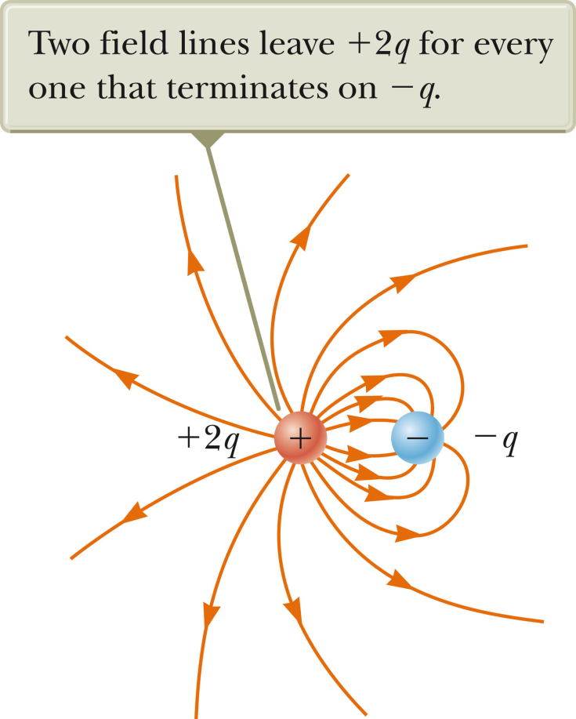
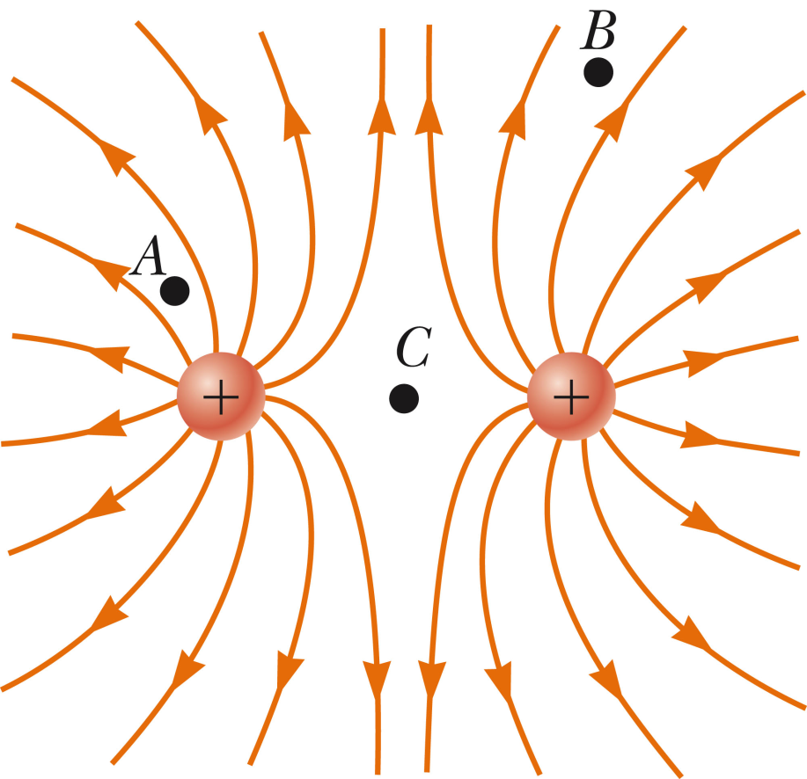
Some of your questions:
Some questions about field lines

Slide 23
Questions about usefulness of electric fields outside of physics class.
Example: ipad touch screen (from HowThingsWork web page)

