Slide 1
PHY 114 A General Physics II
11 AM-12:15 PM TR Olin 101
Plan for Lecture 20 (Chapter 36):
Optical properties of light
  Images formed by thin lenses
  Optical devices
    Eyeglasses
    Cameras, microscopes, telescopes

Slide 2
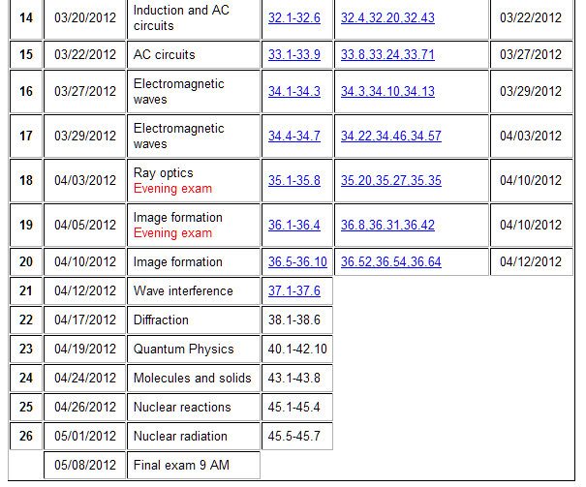
Note: HW 17 slightly altered

Slide 3
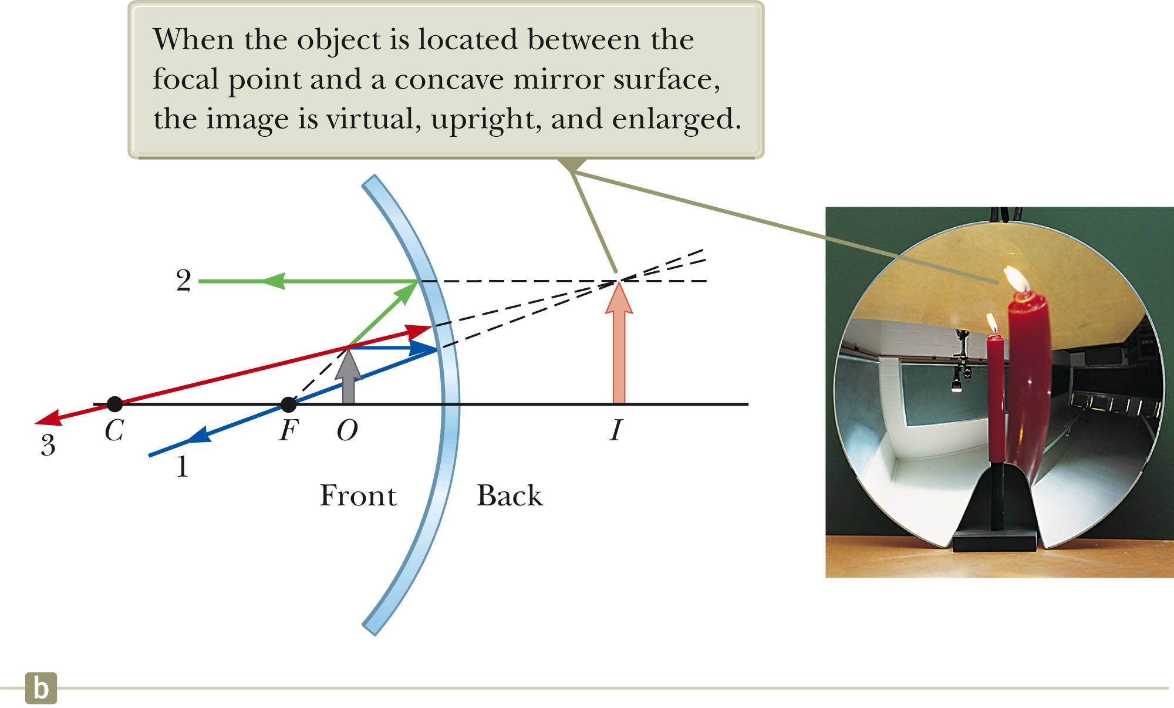
Virtual image ➔ not really there

Slide 4
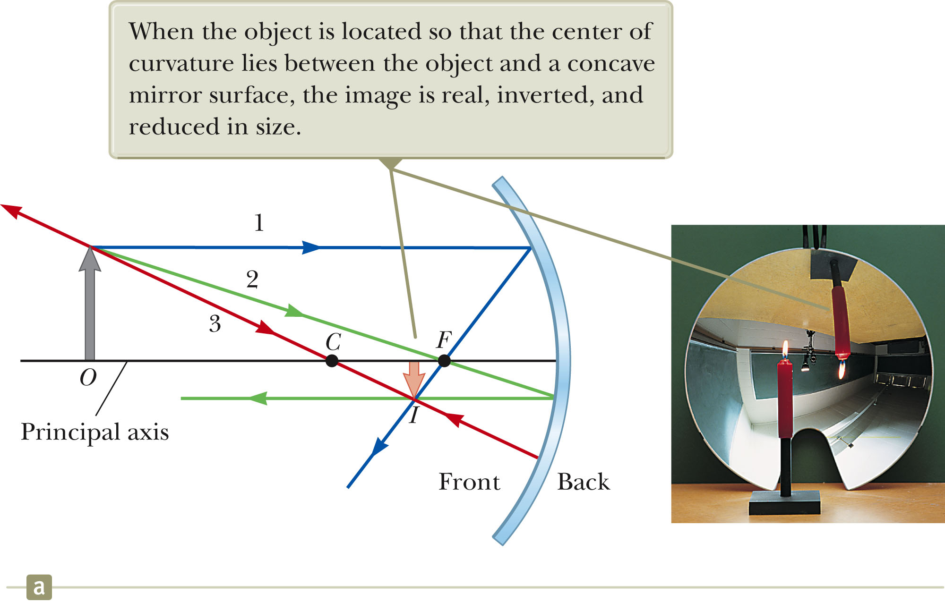
Real image ➔ really there

Slide 5
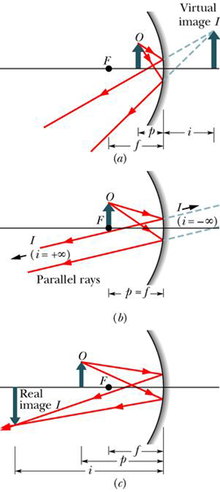
Summary of results for mirrors:
The mirror equation:
h
h'
+ signs for: p, f (concave mirror),i (real image),m (upright image)
− signs for: f (convex mirror),i (virtual image),m (inverted image)

Slide 6
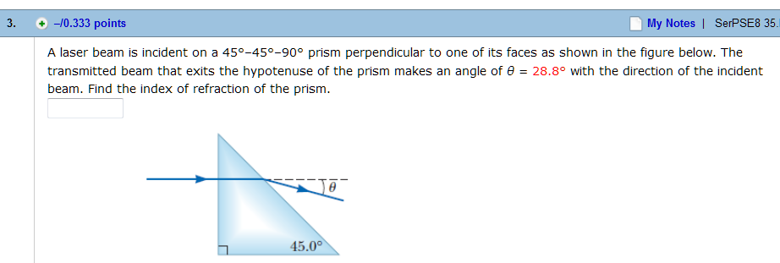
Homework hint: (HW 16)
θ₂
θ₁
n₁
n₂

Slide 7
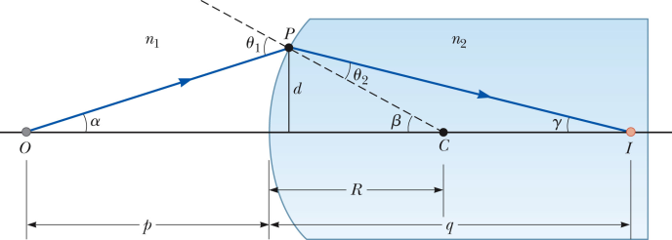
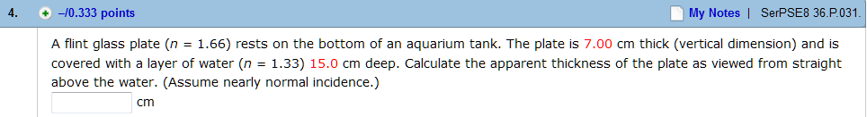

Homework hint: (HW 17; note this problem is now optional)
n₀=1
n₁=1.33
n₂=1.66

Slide 8
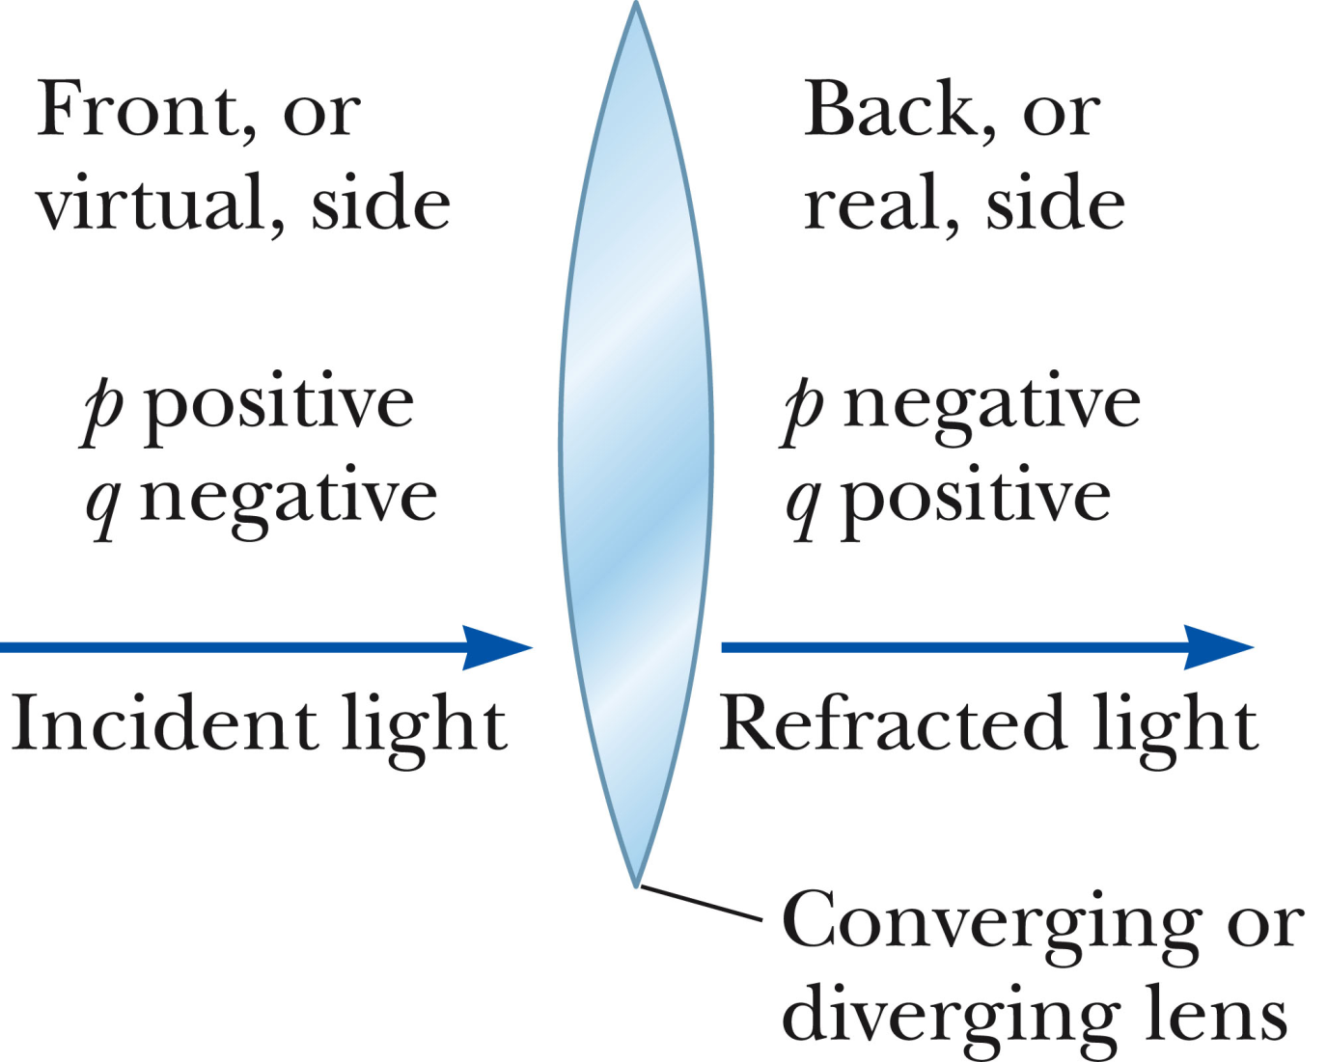
Image formation by refraction -- lenses
Thin lens equation

Slide 9
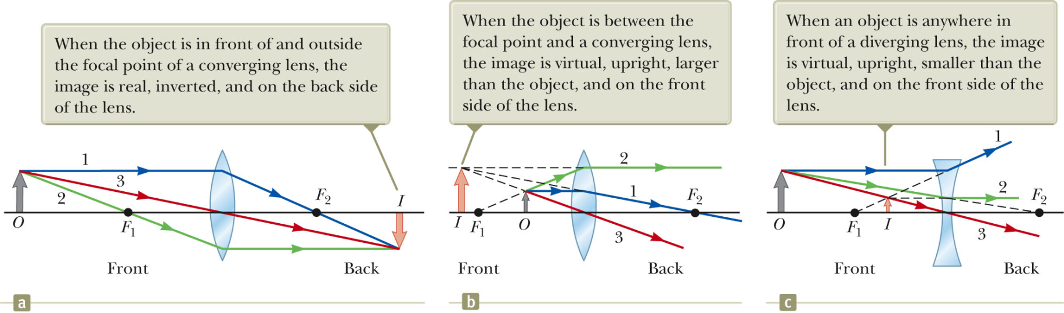
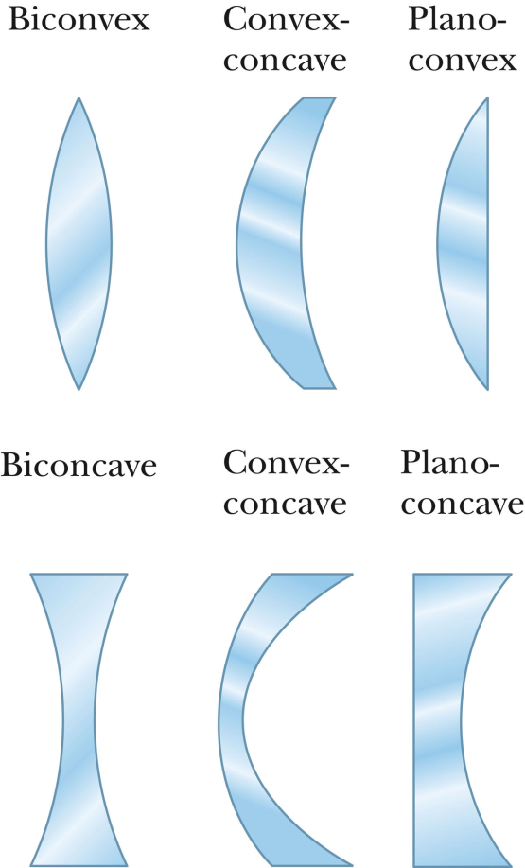
Summary of thin lens configurations
Lens makers’ equation

Slide 10
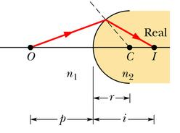
Basic physics of lenses:
Snell’s law: n₁ sin θ₁ = n₂ sin θ₂
θ₁
θ₂
Refraction at a spherical surface:
θ₁
θ₂
Notation note:
q ⬅➔ i

Slide 11
Refraction at a spherical surface
n₂
n₁
θ₁
θ₂
α
d
β
γ
C
a
R
b

Slide 12
Refraction at a spherical surface – continued
➔ In the small angle approximation, result is independent of angle.
Application to 2 surfaces in thin lens geometry
➔ “lens makers’ equation”
R₂
R₁
Sign convention:
R_{i} is positive if it is convex relative to object and negative if it is concave relative to object.
C₂
n
C₁
object side

Slide 13
Lens makers’ equation – continued:
R₂
R₁
Sign convention:
R_{i} is positive if it is convex relative to object and negative if it is concave relative to object.
C₂
n
C₁
object side
R₁ > 0, R₂ < 0 ➔ f > 0 ➔ converging lens
R₁
R₂
C₁
C₂
object side
n
R₁ < 0, R₂ > 0 ➔ f < 0 ➔ diverging lens

Slide 14
Lens makers’ equation:
R₂
R₁
Sign convention:
R_{i} is positive if it is convex relative to object and negative if it is concave relative to object.
C₂
n
C₁
Lens makers’ equation can be proven using
  Snell’s law: n₁ sin θ₁ = n₂ sin θ₂
  small angle approximation: sin θ₁ ≈ tan θ₁ ≈ θ₁
  thin lens approximation: thickness << f,p,i
➔ Lens equation:

Slide 15
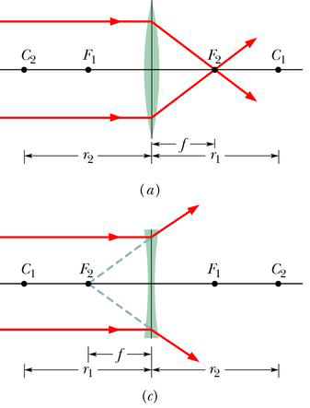
Example of thin lenses:
Converging lens: f > 0
Diverging lens: f > 0

Slide 16
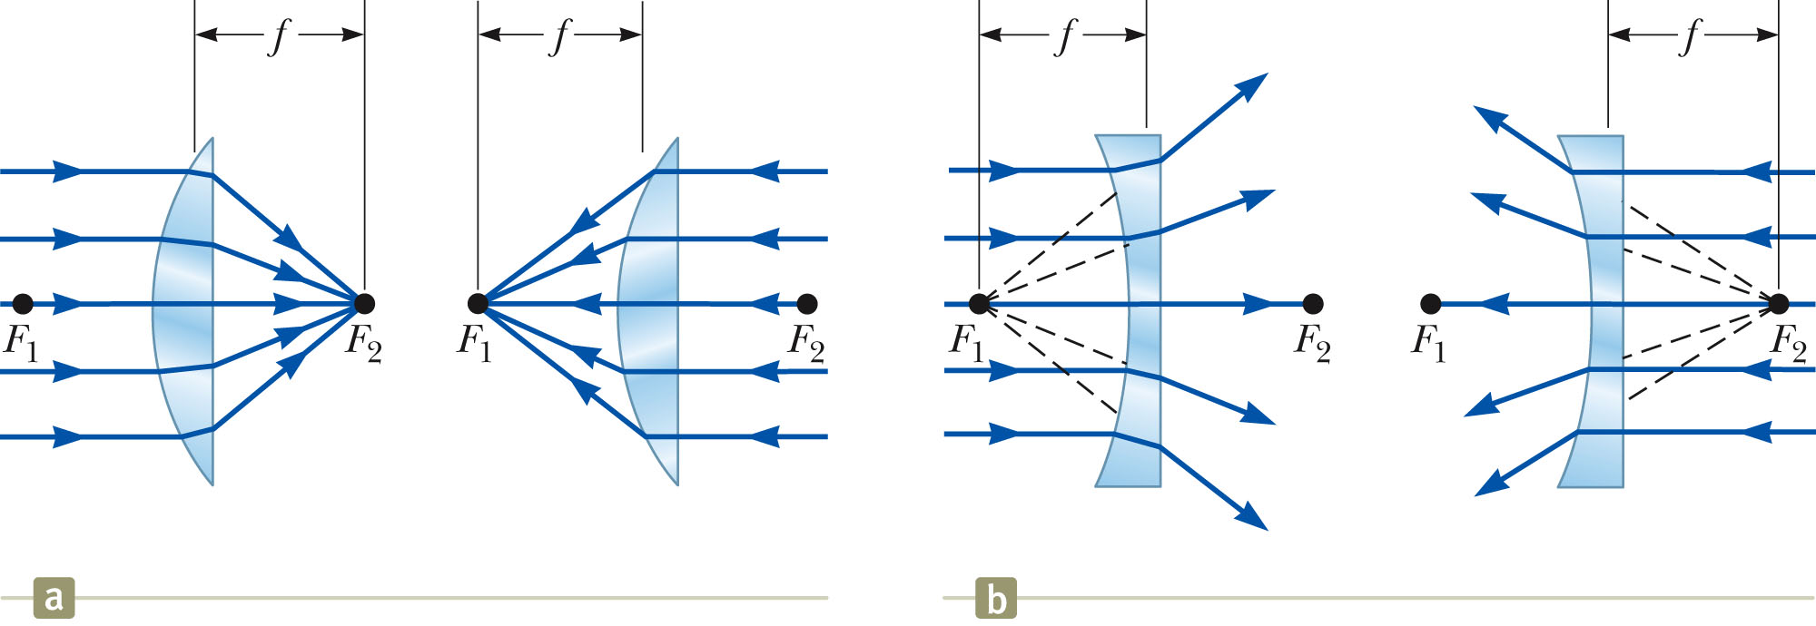

Slide 17
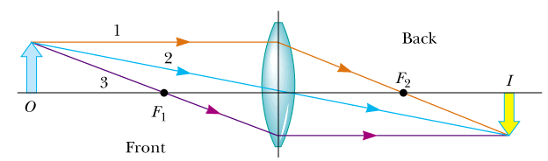
Example:
Forming a real image using a converging lens
f
p
i
This could represent, for example the lens system of a camera.
Example:
f = 2 cm, p = 5 cm
➔ i = 3.33 cm
(real image)

Slide 18
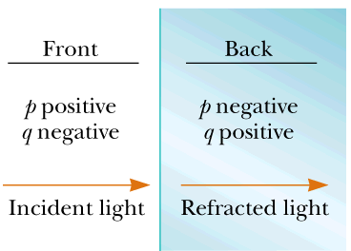
Thin lens equation: assuming sign convention:
f
Example:
f = 2 cm, p = 5 cm
➔ i = 3.33 cm
(real image)
p
i

Slide 19
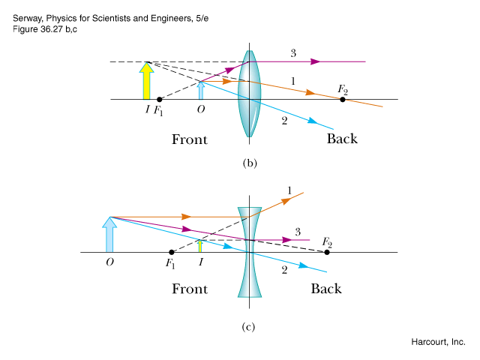
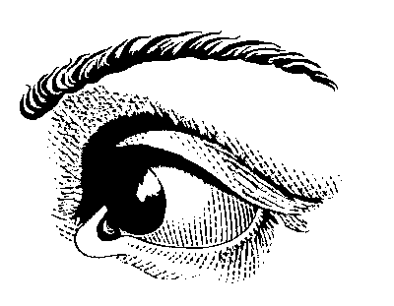
Thin lens refraction -- continued
−i
f
p
Example:
f = 2 cm, p = 1.2 cm
➔ i = -3 cm
(virtual image)

Slide 20
Thin lens refraction -- continued
−q
p
−f
Example:
f = -2 cm, p = 4 cm
➔ i = -1.333 cm
(virtual image)

Slide 21
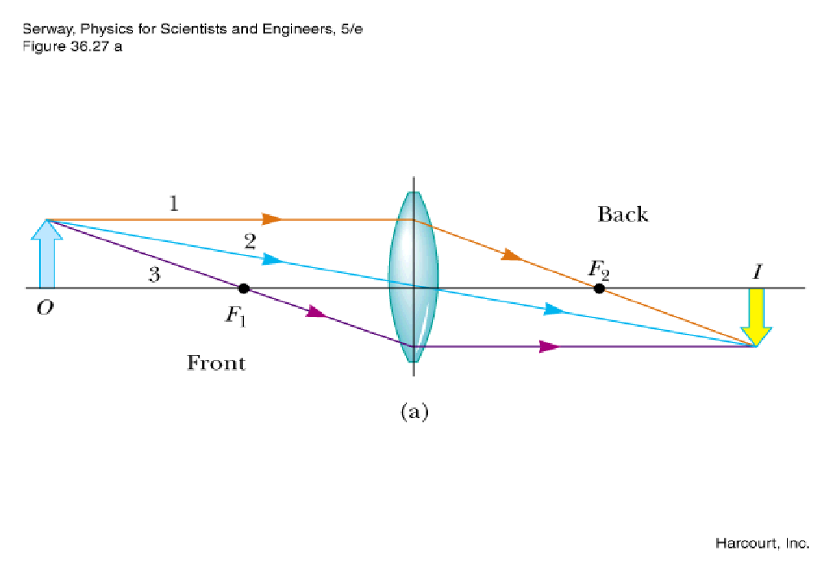
Sherlock Holmes is apparently examining some evidence.
Which ray diagram most closely describes this situation:
(B)
(A)
(C)

Slide 22
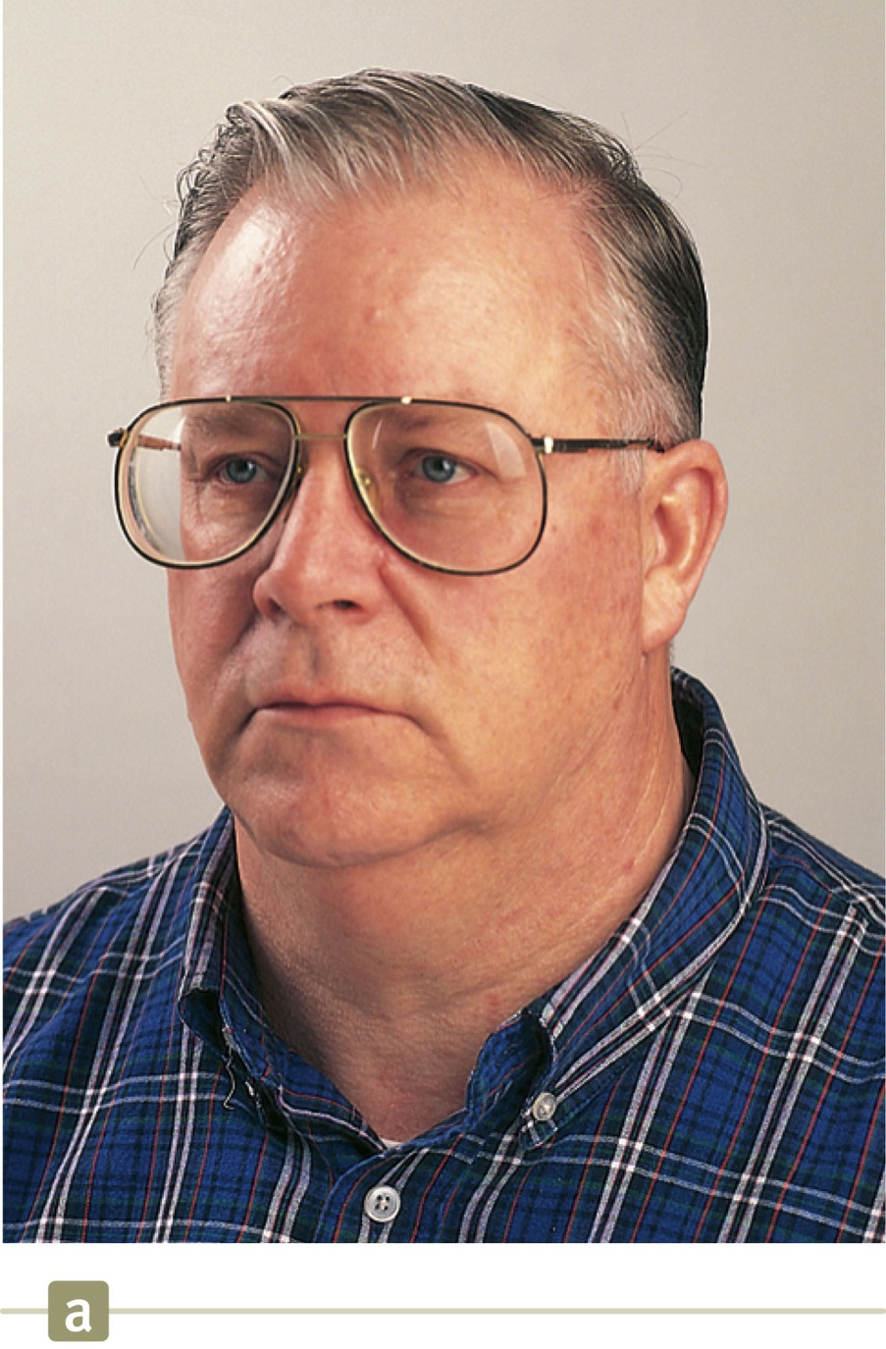
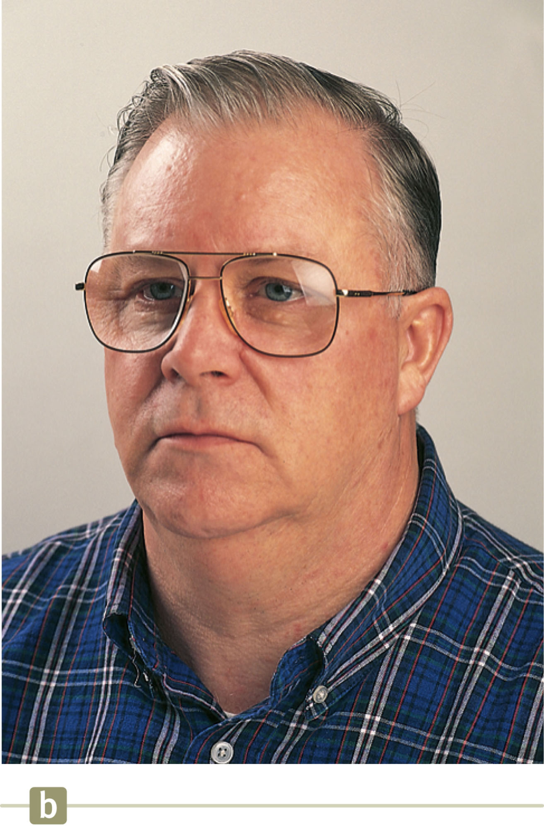
Which picture shows diverging corrective lenses? (A or B)

Slide 23
Which corrective lens is appropriate for nearsighted person? (A or B)

Slide 24
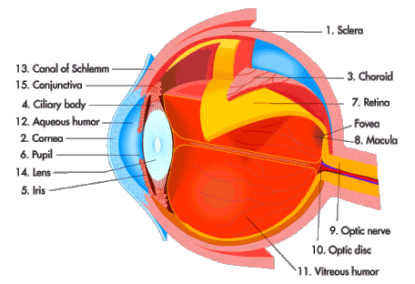
View of the eye from
http://science.howstuffworks.com/eye1.htm
image on retina
object

Slide 25
Vision problems and corrective lenses
Ideal vision:
object
Near sighted vision – problem with “Far point”
image in front of retina ➔ need diverging corrective lens
object
Far sighted vision – problem with “Near point”
object
image in back of retina ➔ need converging corrective lens

Slide 26
More details about eye:
object
image on retina
variable lens
“near point” ≡ closest point that the eye can focus
25 cm standard value
7-200 cm depending on person

Slide 27
Refraction from two or more lenses
→ Successive use of lens equation
−i₁
i₂
p₁
d
p₂

Slide 28
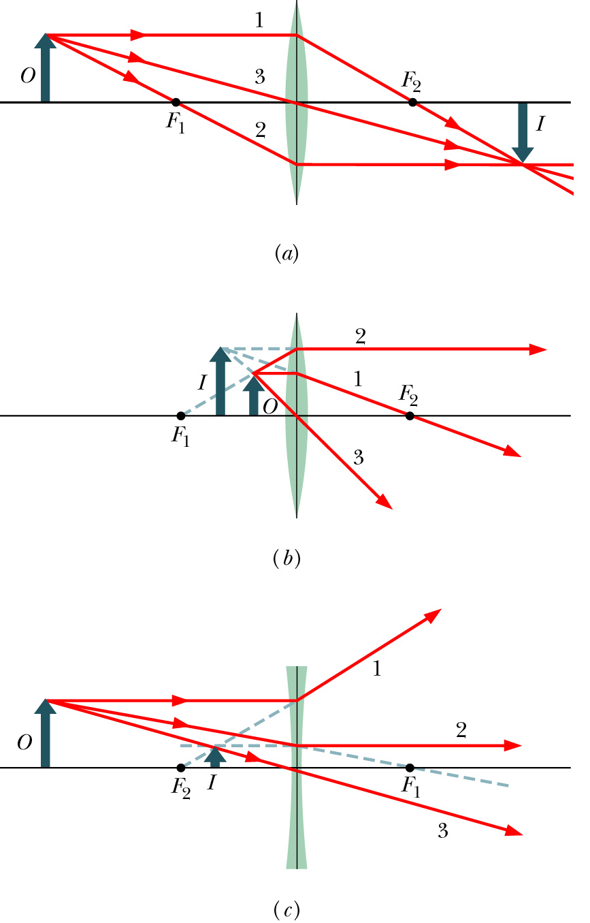
Thin lens equation:

Slide 29
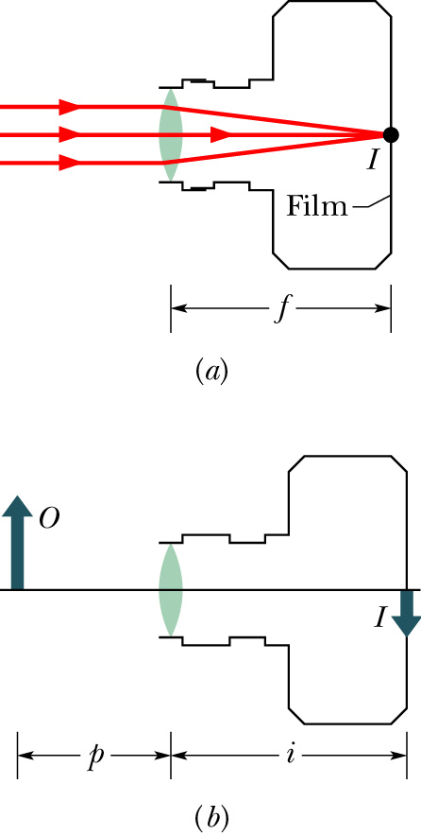
Physics of the camera
aperture
shutter
real image on detector
Example: f=50mm ➔i=50mm for p=∞
➔i=51.3mm for p=2m

Slide 30
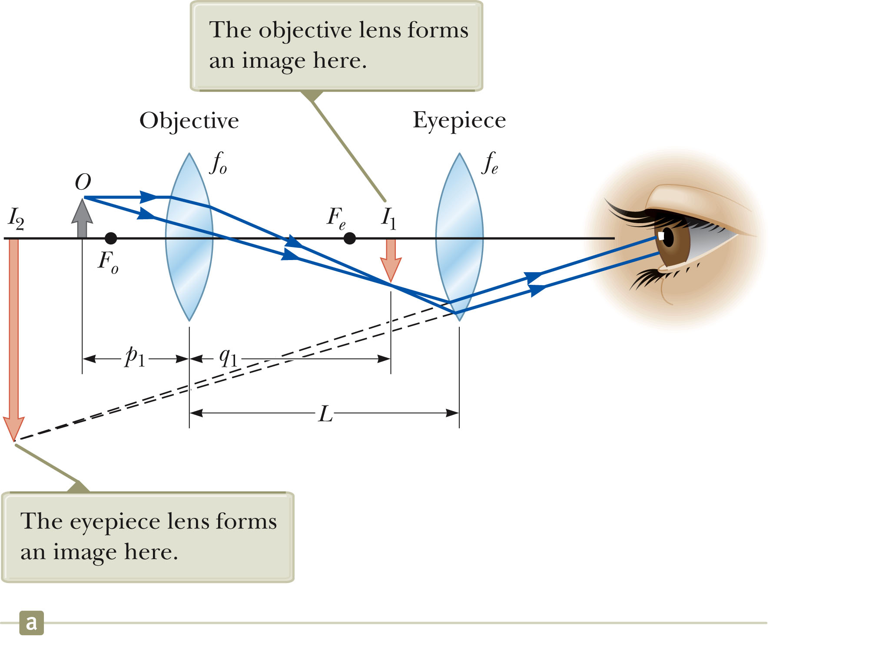
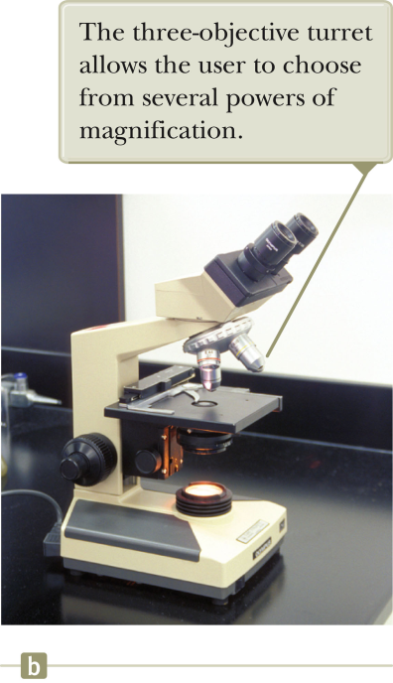
Compound microscope

Slide 31
Suppose you want to record an microscope image. Where would you place the camera?
  Where eye is
  Not at eye position

Slide 32
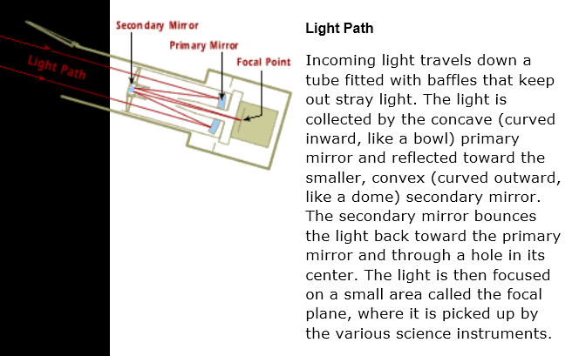
Optics in the Hubble Space Telescope – two convex mirrors
http://hubblesite.org/the_telescope/nuts_.and._bolts/optics/index.php
Mirror surfaces are coated with 5 x 10⁻⁸ m Al and 3 x 10⁻⁸ m MgF₂
(early version had 10⁻⁶ curvature error which was subsequently corrected)

Slide 33
