Slide 1
PHY 114 A General Physics II
11 AM-12:15 PM TR Olin 101
Plan for Lecture 21 (Chapter 37):
Wave properties of light
Interference of two electromagnetic waves
Interference of electromagnetic waves in thin films

Slide 2
4th exam will be offered during the week of April 23rd.

Slide 3
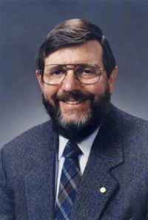
Upcoming event:
Society of Physics Students Keynote address
Friday April 20, 2012 8 PM in Brendle recital Hall
Professor William Phillips from NIST and UMD
“Time, Einstein, and the Coolest Stuff in the Universe”
Dr. Phillips was awarded the 1997 Nobel Prize in Physics :
“for development of methods to cool and trap atoms with
laser light” The 1997 prize was shared with Steven Chu of Stanford University and Claude Cohen-Tannoudji of the Ecole Normale Superieure, Paris.

Slide 4
3rd exam solutions
Solutions posted on web
Exam review session??
Would you like to attend an exam review session?
(A) yes (B) no
If you would like a review session, can you meet
(A) Today at 2 PM (here)
(B) Tomorrow at 1 PM Olin 107
(C) Tomorrow at 2 PM Olin 107
(D) Other?
Similar problems may appear on final exam

Slide 5
Comment about functions and derivatives:

Slide 6
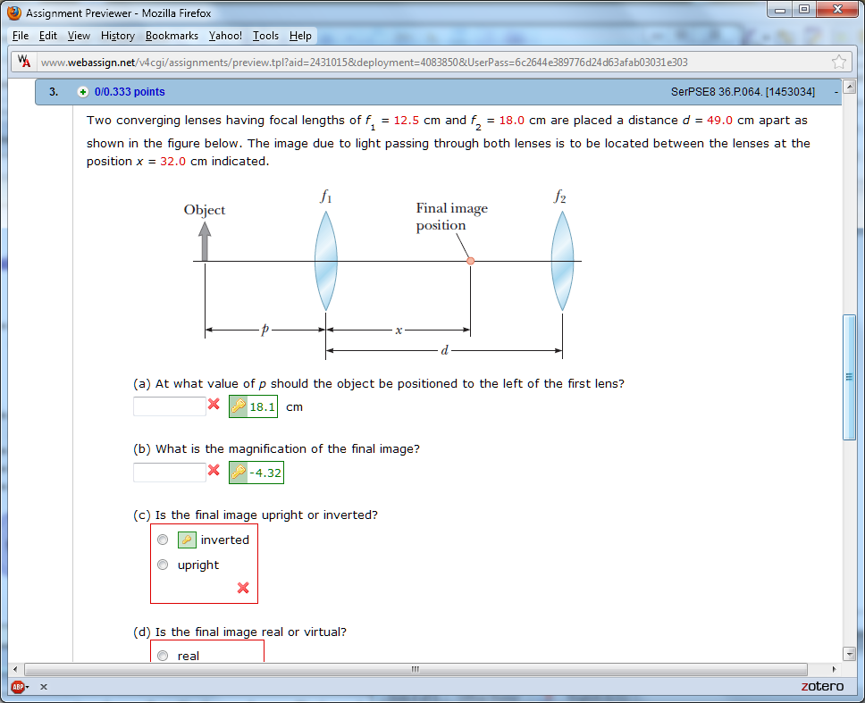
Webassign hint:

Slide 7
q₂
q₁
p₂

Slide 8
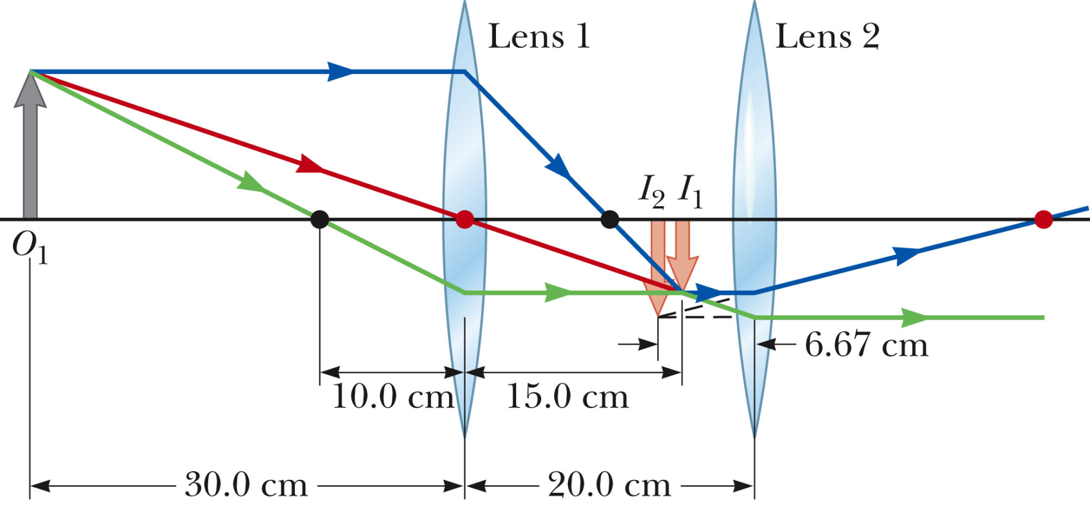
Another example (#36.10 in your text):

Slide 9
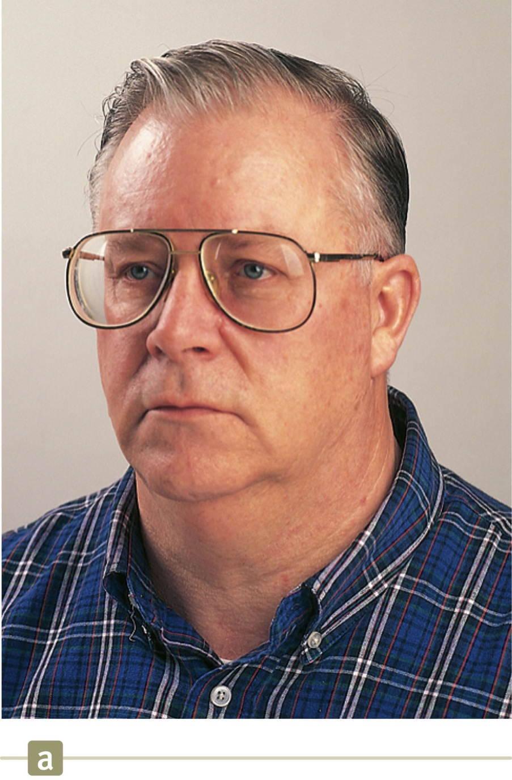
From previous lecture:
Diverging lens: Converging lens:
virtual image of face smaller virtual image of face larger

Slide 10
Wave phenomena associated with light
Plane polarized
electromagnetic wave
at an instant of time:
k

Slide 11
Constant in time
Time average = 1/2

Slide 12
Example: ϕ=0.5 rad -- plotting snapshot of EM wave
Example: ϕ=3 rad – plotting snapshot of EM wave
Intensity as a function of ϕ:
ϕ/(2π)

Slide 13
Summary of interference phenomena due to two or more electromagnetic waves which combine at a give point P with path lengths r₁ and r₂ and fixed frequency f.
−2π
−π
0
π
2π
−2π
−π
0
π
2π

Slide 14
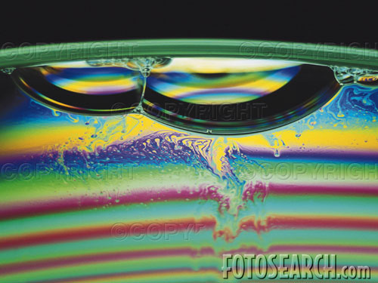
Two examples of superposed radiation:
Interference from refraction and reflection of thin films
Young’s double slit

Slide 15
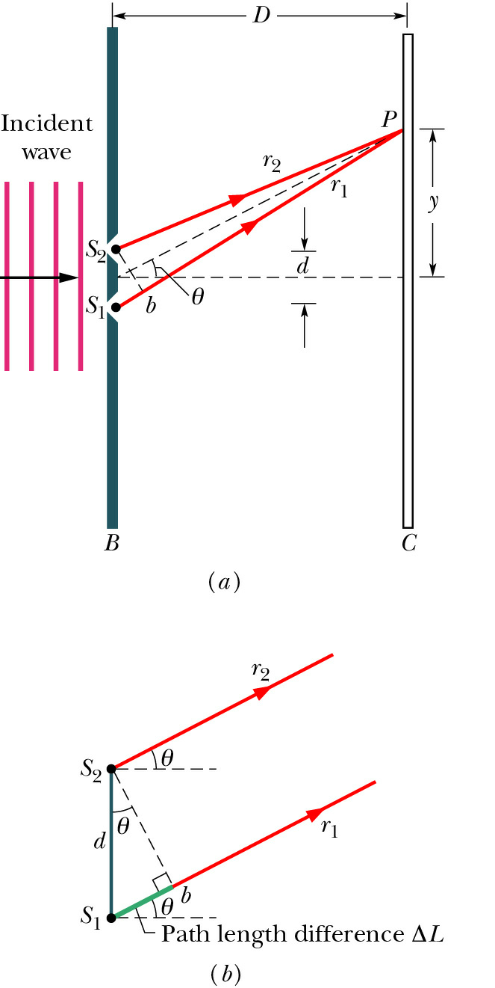
Young’s double slit geometry:
Mathematical analysis of bright fringes:
δ
➔ intensity maxima occur for

Slide 16
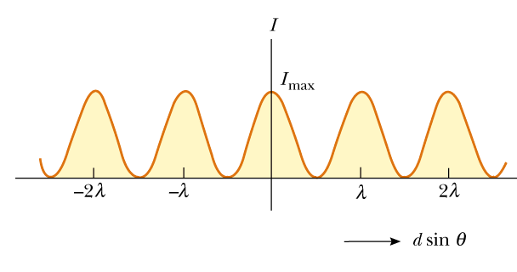
Intensity pattern at screen for double slit:
I_{max}

Slide 17
Diffraction pattern from a plane wave incident on a double slit:
δ
➔ intensity maxima occur for

Slide 18
Summary of results:

Slide 19
Interference in thin films
Interfering reflected light
Interfering transmitted light

Slide 20
Interference between reflected waves:
Recall -- the behavior of a plane-polarized electromagnetic wave near the surface of two materials:
Periodic waves:
E₁
E’₁
k₁´
B₁
k₁
E₂
k₂

Slide 21
Matching electric and magnetic fields at boundary:
E₁
E’₁
k₁´
B₁
k₁
n₁
n₂
E₂
k₂
or

Slide 22
Plane waves reflected and refracted at surface:
Matching electric and magnetic fields at boundary:
For reflected waves:
E₁
E’₁
k₁´
B₁
k₁
n₁
n₂
E₂
for E in plane of incidence
or
for E out of plane of incidence:
k₂

Slide 23
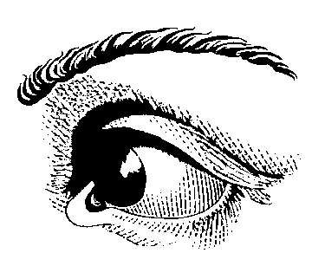
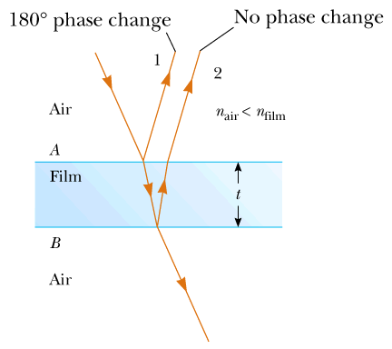
Multiple refractions and reflections in a thin film
P

Slide 24
Example of interference with “+”
n₁< n₂< n₃
For each surface with n₁< n₂
E₂ = -E₁ for reflected beam
n₁
n₂
peaks at
n₃

Slide 25
Example of interference with “−”
n₁> n₂
n₁
peaks at
n₂
n₁
Example of interference with “+”
peaks at

Slide 26
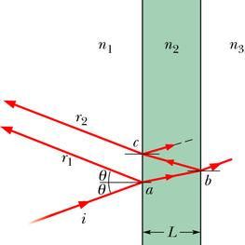
Summary

Slide 27
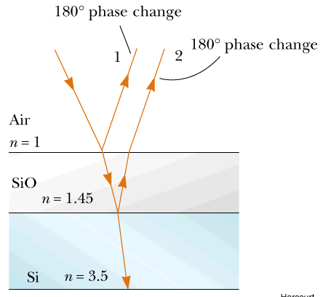
Example:
Suppose you want to prepare a surface so that it has minimal reflection such as in a solar cell where it is desirable to optimize refraction and minimize reflection at λ=550nm.

Slide 28
Example:
Suppose you see a rainbow pattern for oil on a pavement. What is the the approximate thickness of the oil in the red (λ=700nm) region. Assume that n_{oil}=1.4.

