Slide 1
PHY 114 A General Physics II
11 AM-12:15 PM TR Olin 101
Plan for Lecture 22 (Chapter 38):
Diffraction of light
Diffraction gratings
X-ray diffraction
Other properties of light

Slide 3
Part of SPS zone 5 conference
April 20-21, 2012
Offer 1 point extra credit for attendance*
*After the lecture, email me that you attended. In the following email exchange you will be asked to answer one question about the lecture.
www.wfu.edu/physics/sps/spszone52012conf/welcome.html

Slide 4
3rd exam solutions
Solutions posted on web
Exam review session??
Would you like to attend an exam review session?
(A) yes (B) no
If you would like a review session, can you meet
(A) Today Tuesday at 2 PM (here)
(B) Today Tuesday at 5 PM Olin 107
(C) Tomorrow Wed. at 1 PM Olin 107
(D) Tomorrow Wed. at 2 PM Olin 107
(E) Other?
Similar problems may appear on final exam

Slide 5
Fourth exam – scheduled during the week of April 23 (evenings 6-10 PM) Note: Content mostly on material in Chapters 35-38, optics, diffraction, plus possibly some ideas of Quantum Mechanics and possibly some topics from Exam 3
Which of these times are you likely to prefer:
Monday 4/23
Tuesday 4/24
Wednesday 4/25
Thursday 4/26
Friday 4/27

Slide 6
Wave phenomena associated with light
Plane polarized electromagnetic wave
at an instant of time:
k

Slide 7
Constant in time
Rapidly changing in time

Slide 8
Example: ϕ=0.5 rad -- plotting snapshot of EM wave
Example: ϕ=3 rad – plotting snapshot of EM wave
Intensity as a function of ϕ:
ϕ/(2π)

Slide 9
What is the significance of this result?
No significance – only an evil physics professor could love such a result.
Shows that any two electromagnetic waves can interfere
Shows that two electromagnetic wave with the same amplitude, wavelength, and velocity can interfere if they have different phases φ

Slide 10
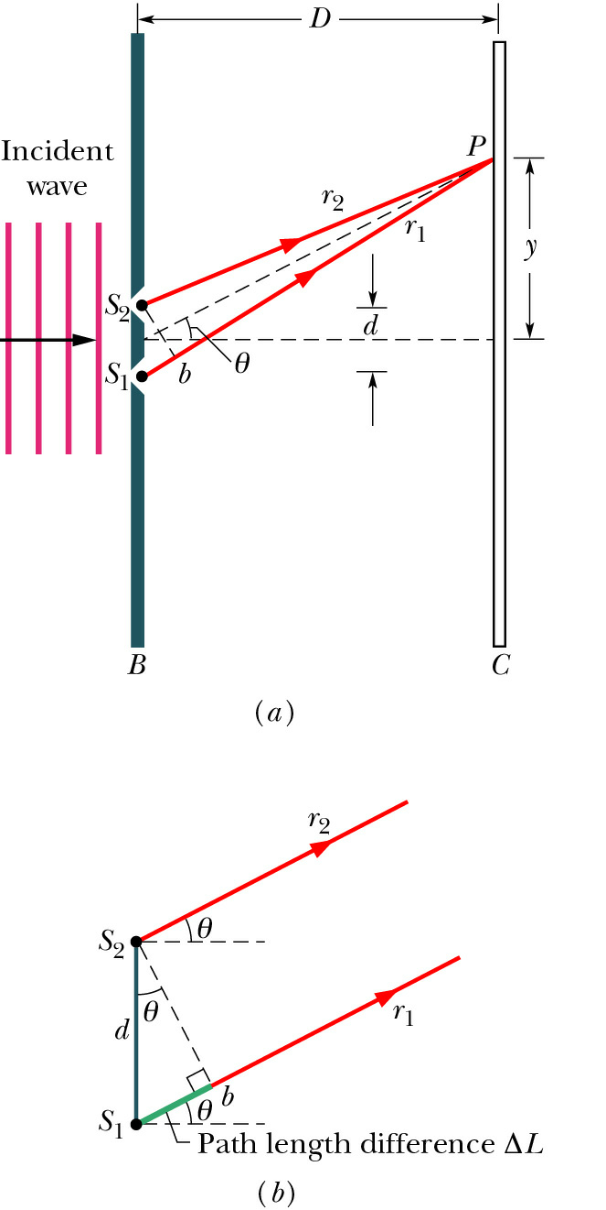
Young’s double slit geometry:
Mathematical analysis of bright fringes:
δ
➔ intensity maxima occur for

Slide 11
Diffraction pattern from a plane wave incident on a double slit:
δ
➔ intensity maxima occur for

Slide 12
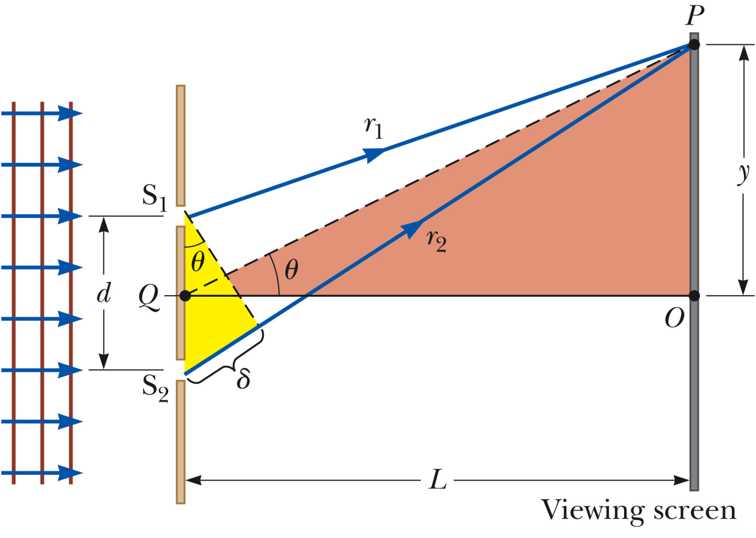

Slide 13
Webassign hints:

Slide 15
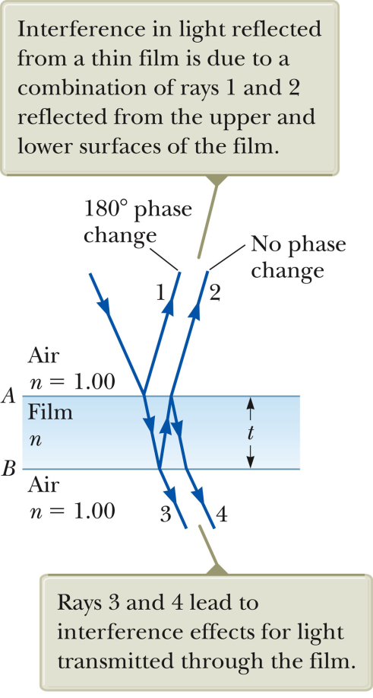
Webassign hint:

Slide 16
Light intensity patterns seen on screen for very thin double slit
λ₁
λ₂
Assuming that d and L are the same which plot corresponds the the greater wavelength?
λ₁> λ₂
λ₂> λ₁

Slide 17
Ideal infinitely thin 2-slit pattern
Finite thickness 2-slit pattern

Slide 18
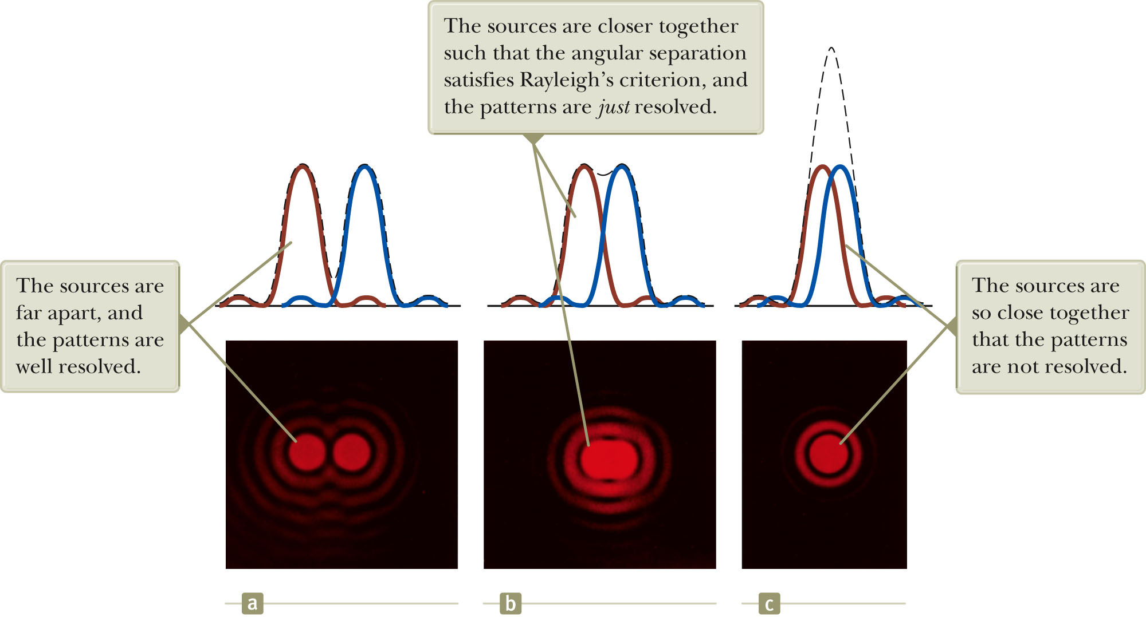
Effects of diffraction when you may not want it – images of small objects near the “diffraction” limit

Slide 19
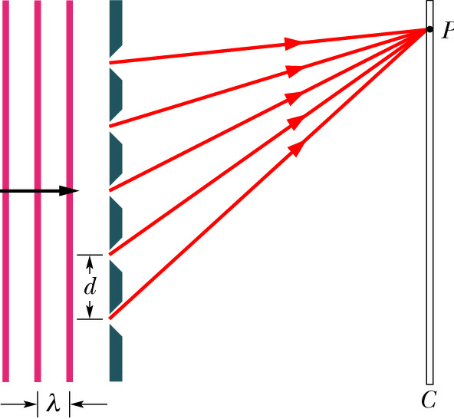
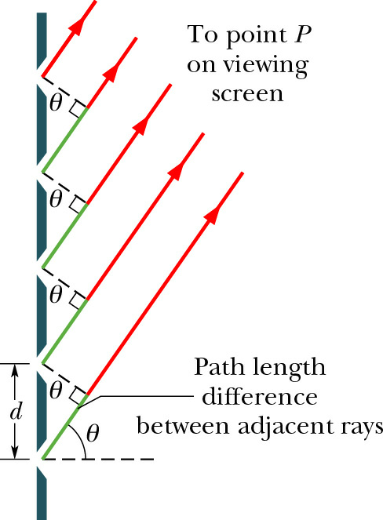
Enhancement of diffraction – diffraction gratings

Slide 20
Diffraction pattern for N slits – diffraction grating

Slide 21
Intensity pattern from multiple slit grating:
N=2
N=5
N=10

Slide 22
Sanity check:
If the intensity pattern for N slits is given by
what happened to the formula two-slit intensity pattern?
NEVER trust your physics professor
More evidence that physics does not make sense
The formula look different, but are equivalent for N=2

Slide 24
thin multiple slits
fat single slit
fat double slits
thin double slits

Slide 25
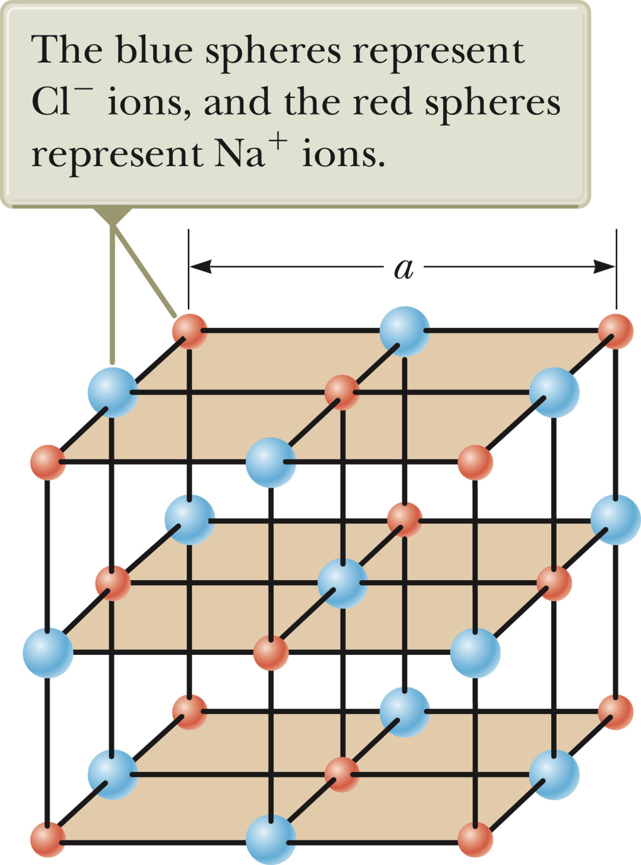
Diffraction gratings in nature -- crystals
Model of NaCl
Typical atomic distances
a =0.1-1.0 nm

Slide 26
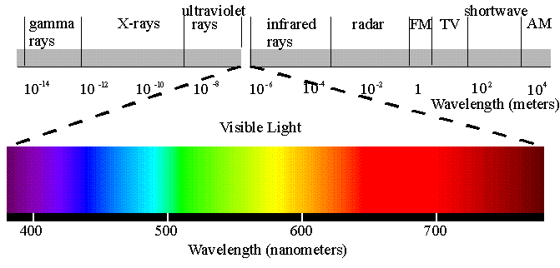

Slide 27
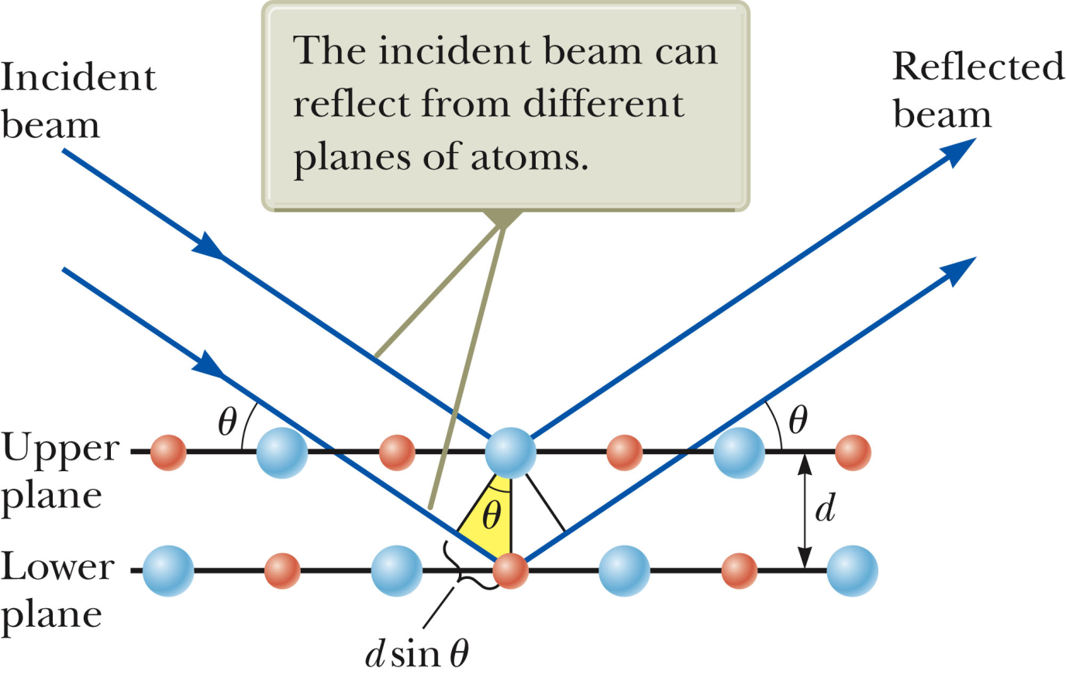
X-ray diffraction geometry:

Slide 28
Example of X-ray scattering for NaCl
Note that in this case d=a/2

Slide 29
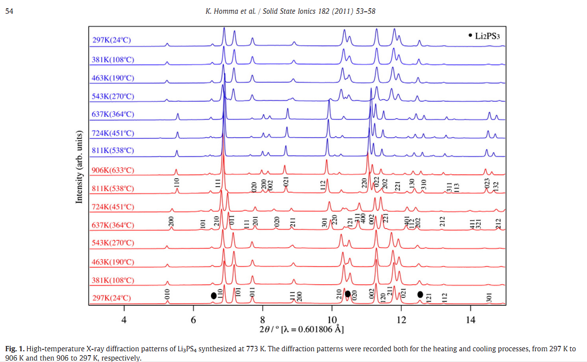
Example of X-ray diffraction data at different temperatures

Slide 30
Constituents of Li₁₀GeP₂S₁₂:
S
Li
P
Ge
*K. Homma et al, Solid State Ionics 182, 53-58 (2011)
**M. Murayama et al, Solid State Ionics 154-155, 789-794 (2002)

Slide 31
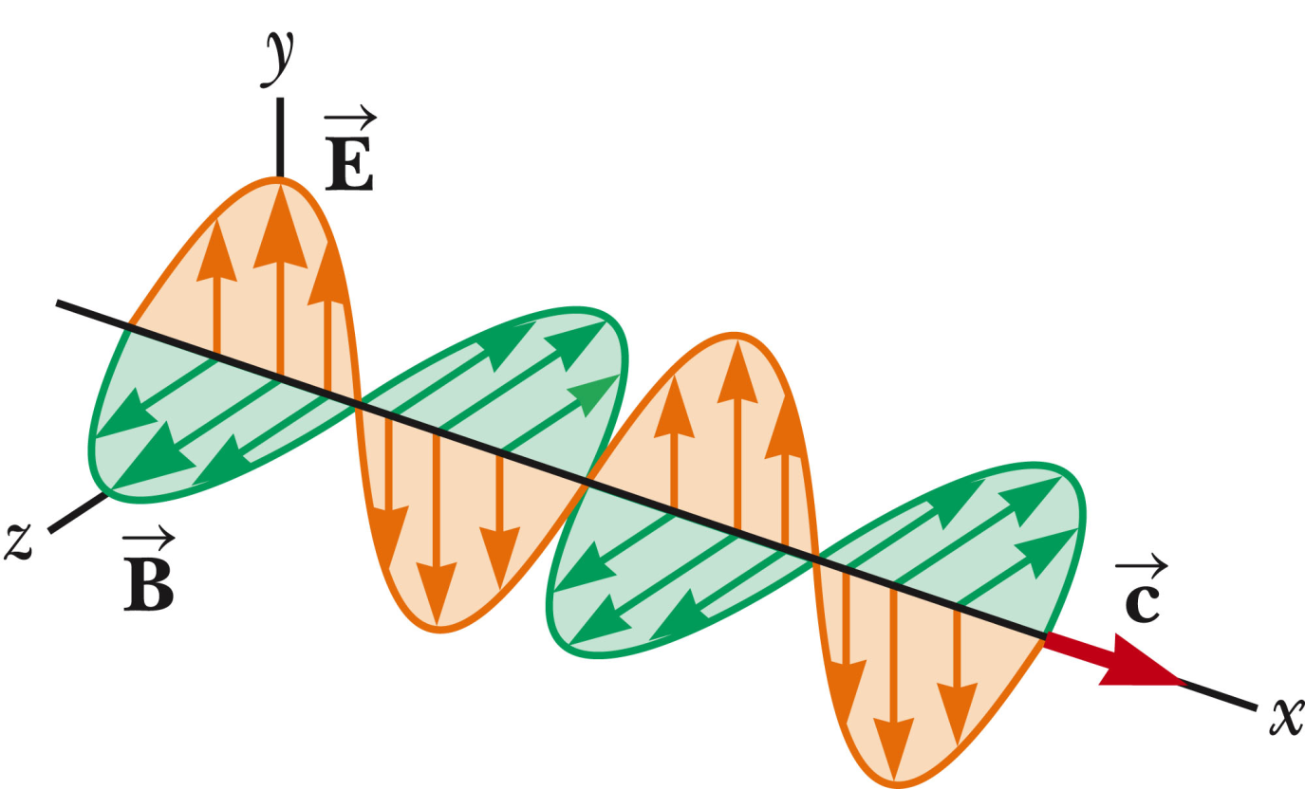
Polarization of light
In this case, E is polarized in y direction.

Slide 32
General case – reflection and refraction
n₁
θ₁
θ₁
n₂
θ₂

Slide 33
General case – reflection and refraction
n₁
θ₁
θ₁
n₂
θ₂

Slide 34
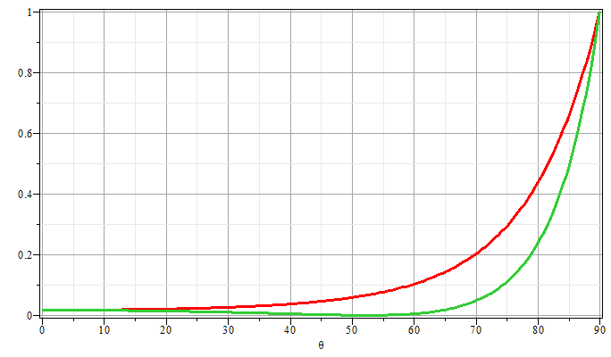
Plot of reflectivity R versus θ
E perpendicular to scattering plane
E parallel to scattering plane
Brewster’s angle

