Slide 1
PHY 114 A General Physics II
11 AM-12:15 PM TR Olin 101
Plan for Lecture 23 (Chapter 40-42):
Some topics in Quantum Theory
Particle behaviors of electromagnetic waves
Wave behaviors of particles
Quantized energies

Slide 3
Part of SPS zone 5 conference
April 20-21, 2012
Offer 1 point extra credit for attendance*
*After the lecture, email me that you attended. In the following email exchange you will be asked to answer one question about the lecture.
www.wfu.edu/physics/sps/spszone52012conf/welcome.html

Slide 4
Webassign hint:

Slide 5
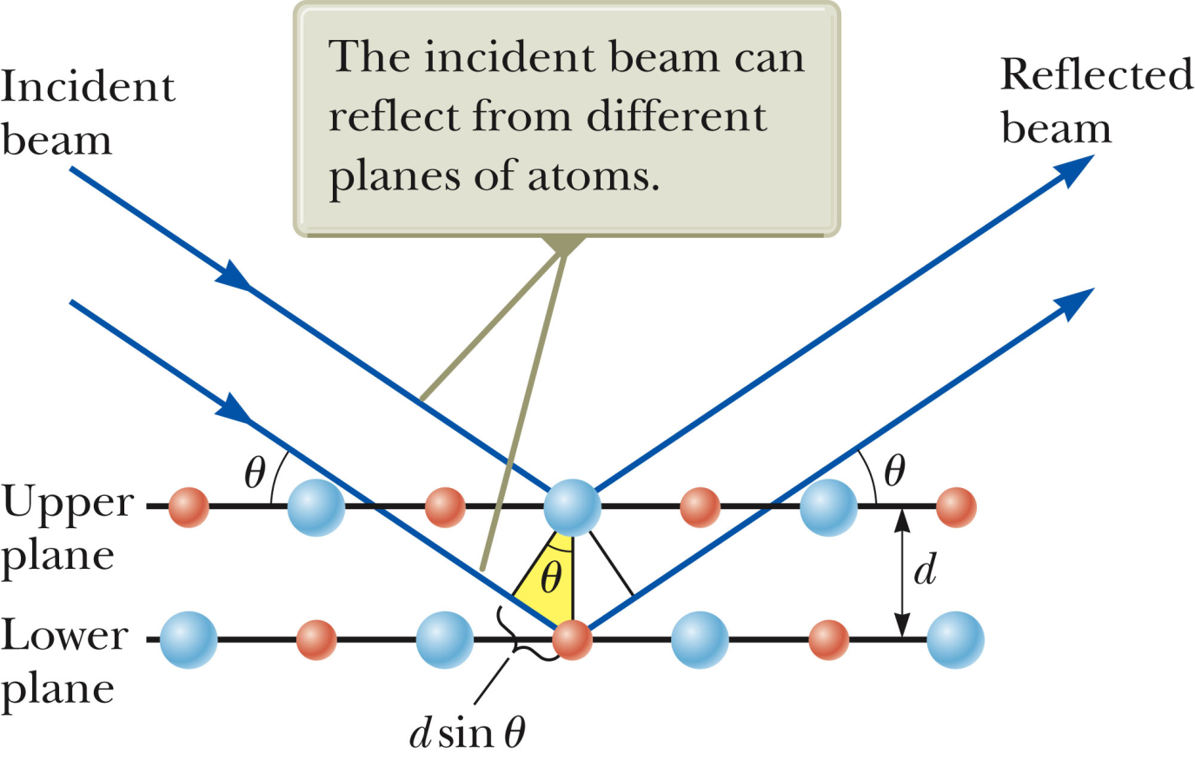
Webassign hint:

Slide 6
If you have not already done so – please reply to my email concerning your intentions regarding Exam 4.
The material you have learned up to now in PHY 113 & 114 was known in 1900 and is basically still true. Some details (such as at high energy, short times, etc. ) have been modified with Einstein’s theory of relativity, and with the development of quantum theory.

Slide 7
Which of the following technologies do not need quantum mechanics.
X-ray diffraction
Neutron diffraction
Electron microscope
MRI (Magnetic Resonance Imaging)
Lasers
Which of the following technologies do not need quantum mechanics.
Scanning tunneling microscopy
Atomic force microscopy
Data storage devices
Microwave ovens
LED lighting

Slide 8
Image of Si atoms on a nearly perfect surface at T=7 K.
Image made using atomic force microscopy.
From Physical Review Letters March 20, 2000 -- Volume 84, Issue 12, pp. 2642-2645

Slide 9
Quantum physics –
Electromagnetic waves sometimes behave like particles
one “photon” has a quantum of energy E=hf
momentum p=h/λ=hf/c
Particles sometimes behave like waves
“wavelength” of particle related to momentum:
λ=h/p
➔ quantum particles can “tunnel” to places classically “forbidden”
➔ Stationary quantum states have quantized energies

Slide 10
Classical physics
Wave equation for electric field in Maxwell’s equations (plane wave boundary conditions):
Equation for particle trajectory r(t) in conservative potential U(r) and total energy E

Slide 11
Particle ←→wave properties in classical physics
Particle properties | Wave properties
Position as a function of time is known -- r(t) Particle is spatially confined when E≤U(r). Particles are independent. | Phonomenon is spread out over many positions at an instant of time. Notion of spatial confinement non-trivial. Interference effects.

Slide 12
Mathematical representation of particle and wave behaviors.
Consider a superposition of periodic waves at t=0:
superposed wave (many values of k)
single wave (one value of k)

Slide 13
Δx Δk ≈ 2π
Δk = 1
Δx
Δk = 10
Δx
Δx smaller ➔ more particle like
Δk smaller ➔ more wave like

Slide 14
Δx Δk ≈ 2π ➔ Heisenberg’s uncertainty principle
De Broglie’s particle moment – wavelength relation:
Heisenberg’s hypotheses:
h = 6.6×10⁻³⁴ Js = 4.14×10⁻¹⁵ eVs

Slide 15
Wave equations
Electromagnetic waves:
Matter waves: (Schrödinger equation)

Slide 16
Comparison of different wave equations
Electromagnetic waves | Matter waves
Vector – E or B fields Second order t dependence Examples: | Scalar – probability amplitude First order t dependence Examples:

Slide 17
What is the meaning of the matter wave function Ψ(x,t)?
Ψ(x,t) is not directly measurable
|Ψ(x,t)|² is measurable – represents the density of particles at position x at time t.
For a single particle system – represents the probability of measuring particle at position x at time t.
For many systems of interest, the wave function can be written in the form Ψ(x,t) = ψ(x)e^{-iEt/} |Ψ(x,t)|² = | ψ(x)|²

Slide 18
Wave-like properties of particles
Louis de Broglie suggested that a wavelength could be associated with a particle’s momentum
“Wave” equation for particles – Schrödinger equation

Slide 19
Example: Suppose we want to create a beam of electrons (m=9.1x10⁻³¹kg) for diffraction with λ=1x10⁻¹⁰m. What is the energy E of the beam?

Slide 20
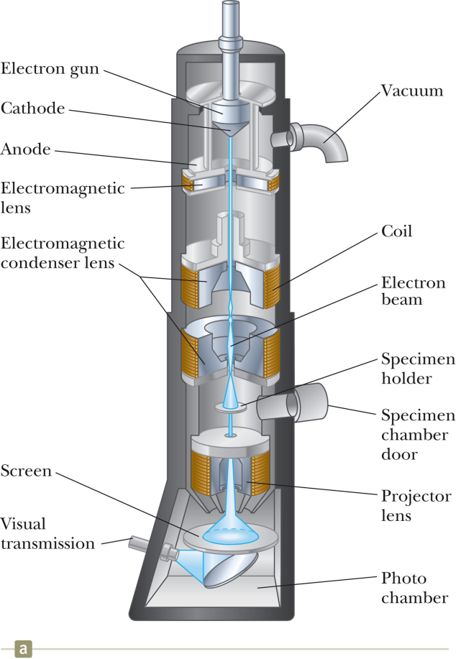
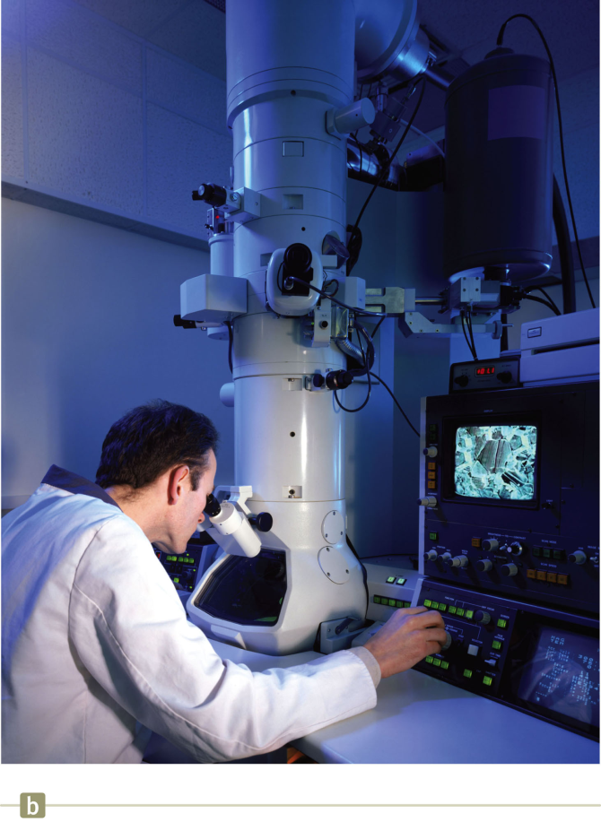
Electron microscope
Typically E=120,000-200,000 eV for high resolution EM
From Microscopy Today article May 2009

Slide 21
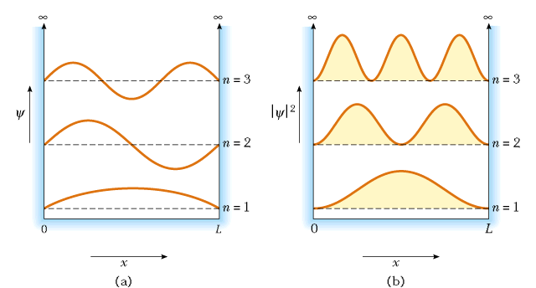
Electrons in an infinite box:

Slide 22
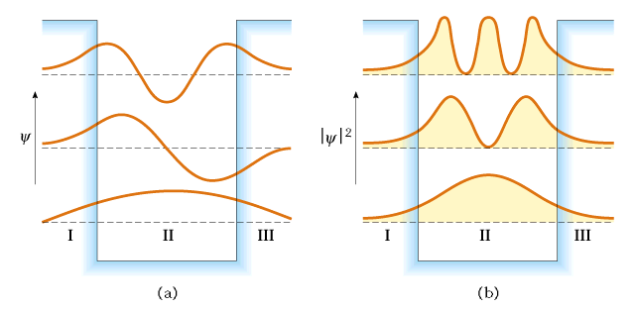
Electrons in a finite box:
finite probability of electron existing outside of classical region

Slide 23
Why would it be interesting to study electrons in a finite box?
It isn’t
It is the mathematically most simple example of quantum system
Quantum well systems can be manufactured to design new devices

Slide 24
Tunneling of electrons through a barrier
surface region
tip
vacuum

Slide 25
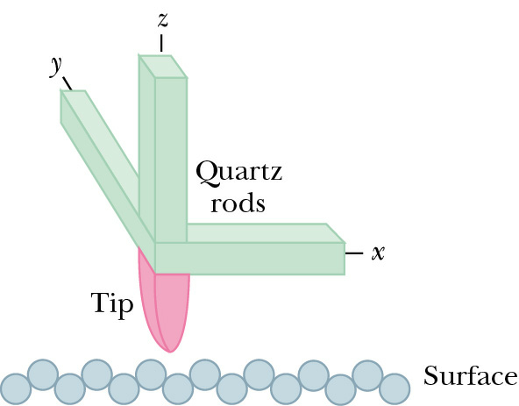
How a scanning tunneling microscope works:
Developed at IBM Zurich by Gerd Binnig and Heinrick Rohrer who received Nobel prize in 1986.

Slide 26
Visualization of | ψ(x)|²
A surface if a nearly perfect Si crystal
Physical Review Letters -- March 20, 2000 -- Volume 84, Issue 12, pp. 2642-2645

Slide 27
The physics of atoms –
Features are described by solutions to the matter wave equation – Schrödinger equation:
“reduced” mass of electron and proton

Slide 28
Form of probability density for ground state (n = 1)

Slide 29
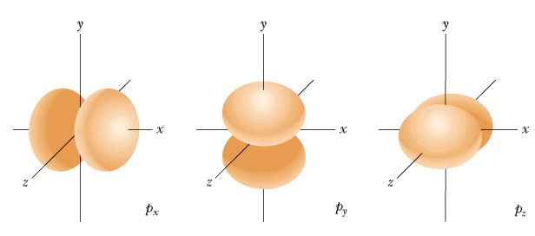
Angular degrees of freedom
-- since the force between the electron and nucleus depends only on distance and not on angle, angular momentum L ≡ r x p is conserved. Quantum numbers associated with angular momentum:
Notation:
p
s

Slide 30
Summary of results for H-atom:
n = 4
Balmer series
spectra
n = 3
n = 2
degeneracy associated with each n: 2n²
n = 1

Slide 31
Atomic states of atoms throughout periodic table:
effective potential for an electron in atom

Slide 32
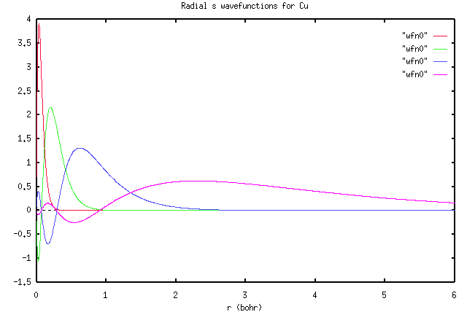
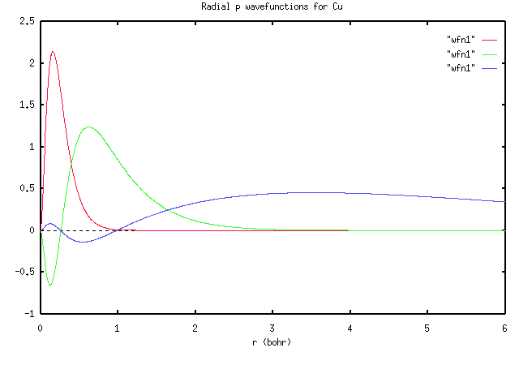
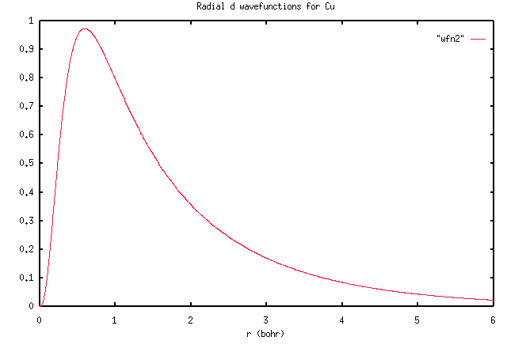
Example: Cu (Z=29) 1s²2s²2p⁶3s²3p⁶3d¹⁰4s¹
s
p
d

Slide 33
