Slide 1
PHY 114 A General Physics II
11 AM-12:15 PM TR Olin 101
Plan for Lecture 24 (Chapter 43):
Some topics in the physics of molecules and solids
Physics of atoms
Physics of molecules
Physics of solids

Slide 3
Webassign hint:

Slide 4
Webassign hint -- continued:
Interfering
electron beams
θ
φ
Bragg condition: 2d sin θ = λ

Slide 5
Webassign hint -- continued:
Interfering
electron beams
Bragg condition: 2d sin θ = λ
θ
φ
δ₁
δ₂
d= δ₁ sin θ
δ₁+ δ₂=2d sin θ = m λ

Slide 6
Some ideas of quantum theory discussed last time:
Matter wave equation – Schrödinger equation:

Slide 7
Example: Suppose we want to create a beam of electrons (m=9.1x10⁻³¹kg) for diffraction with λ=1x10⁻¹⁰m. What is the energy E of the beam?

Slide 8
Recall de Broglie’s relation between wavelength and momentum:
Which has the larger de Broglie wavelength:
An electron with a velocity of 100 m/s (mass = 9.1x10⁻³¹ kg)
A baseball with a velocity of 100 m/s (mass = 1 kg)

Slide 9
Another example -- electron bound to a proton:
(H atom)

Slide 10
Quantum theory for electromagnetic radiation
The transition between bound quantum states can correspond to the emission (production) or absorption (consumption) of electromagnetic quanta:
|ΔE|

Slide 11
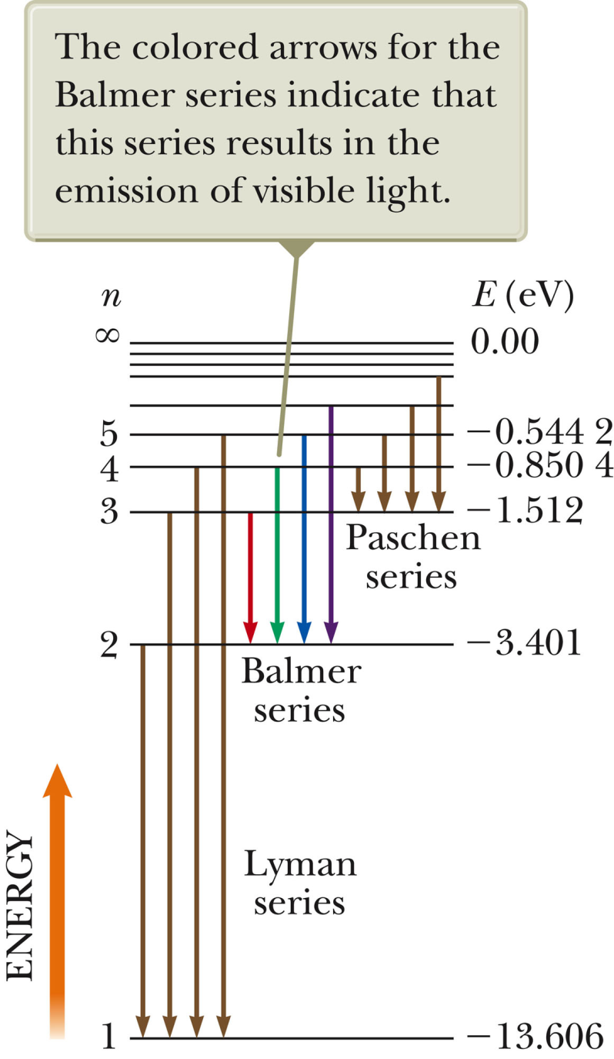
Energy level diagram for H atom

Slide 12
Physics of molecules – H₂
Recall for H atom:

Slide 13
Physics of molecules – H₂ -- continued

Slide 14
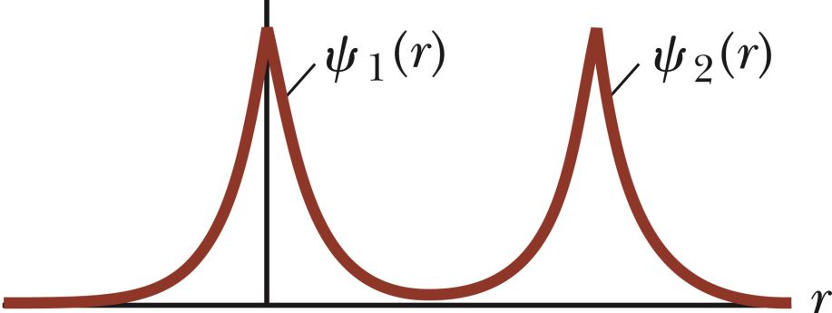
Physics of molecules – H₂ -- continued
R
http://farside.ph.utexas.edu/teaching/qmech/lectures/node129.html
R
R

Slide 15
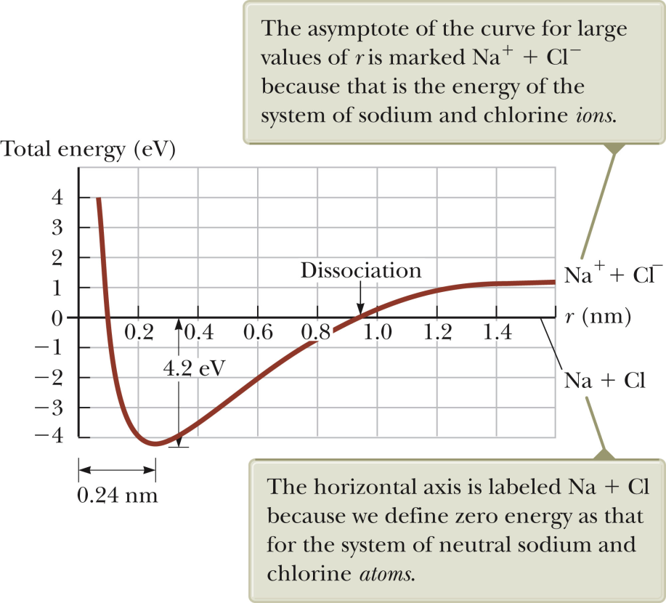
Physics of molecules – continued
Energy diagram for NaCl molecule as a function of ion separation
Stable equilibrium

Slide 16
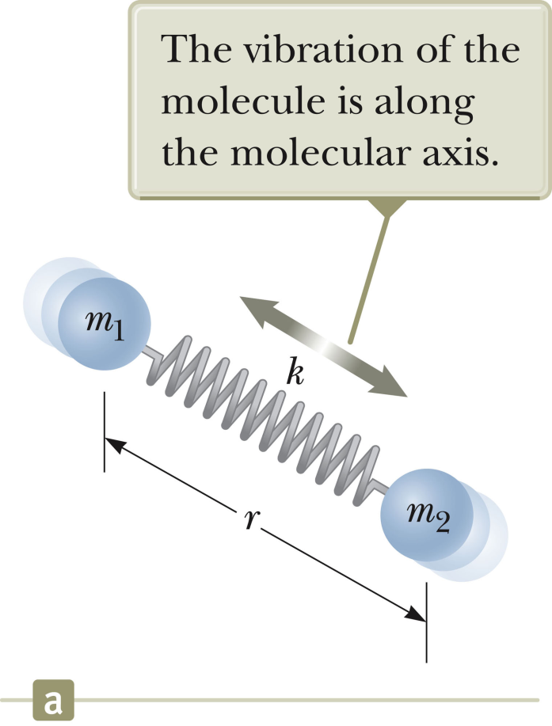
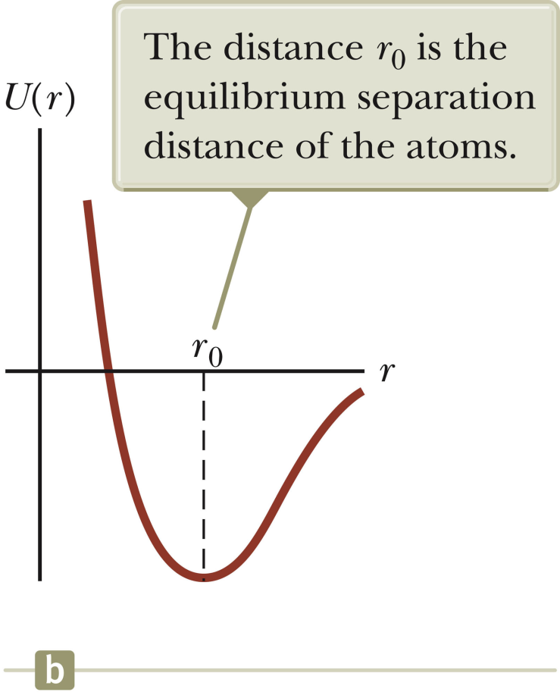
Physics of molecules – continued
Vibration about equilibrium point

Slide 17
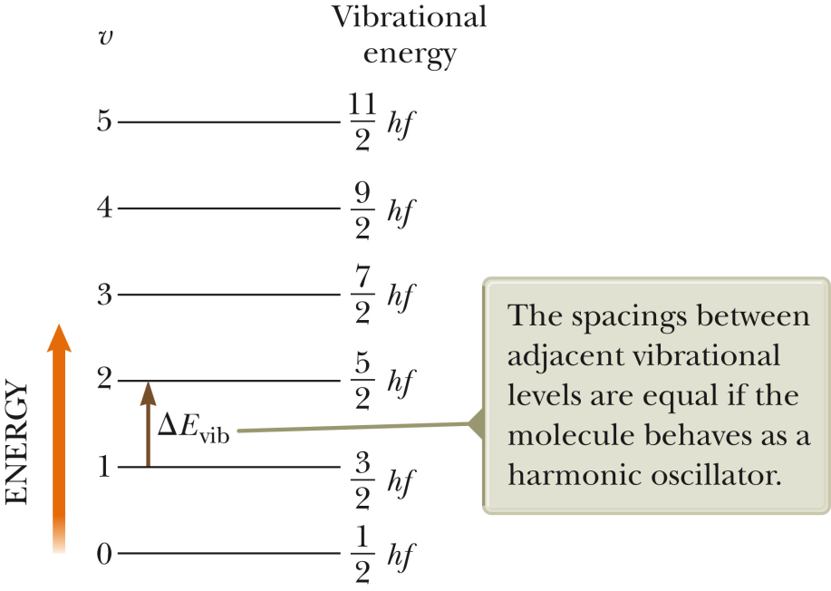
Physics of molecules – continued
Vibration about equilibrium point
Given that f₀=6x10¹³ cycle/s for a vibrating CO molecule, if this vibration were to couple to EM radiation, what would be the wavelength of light?
A. 5x10⁻⁶m B. 2x10⁵m C. 1x10⁻⁴⁷m

Slide 18
Physics of molecules and solids
effective potential for electron in molecule or solid
Example: electron density associated with
H₂ molecule: CH₄
molecule:

Slide 19
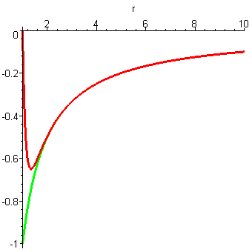
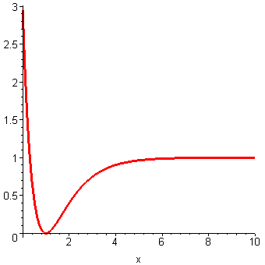
Molecular binding of nuclei due to electron “glue”:
R
1/R
V(R)
V(R)
ionic interaction
Dissociation energy
R

Slide 20
effective potential for electron in molecule or solid
Physics of solids
Energy spectrum of atom or molecule :
highest filled state for metal
highest filled state for insulator

Slide 21
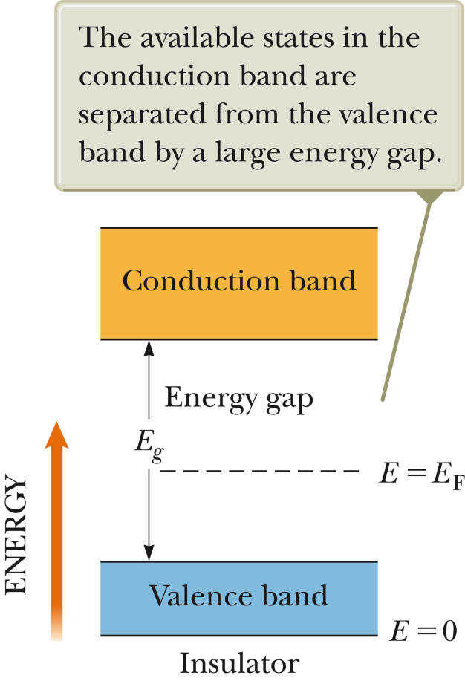
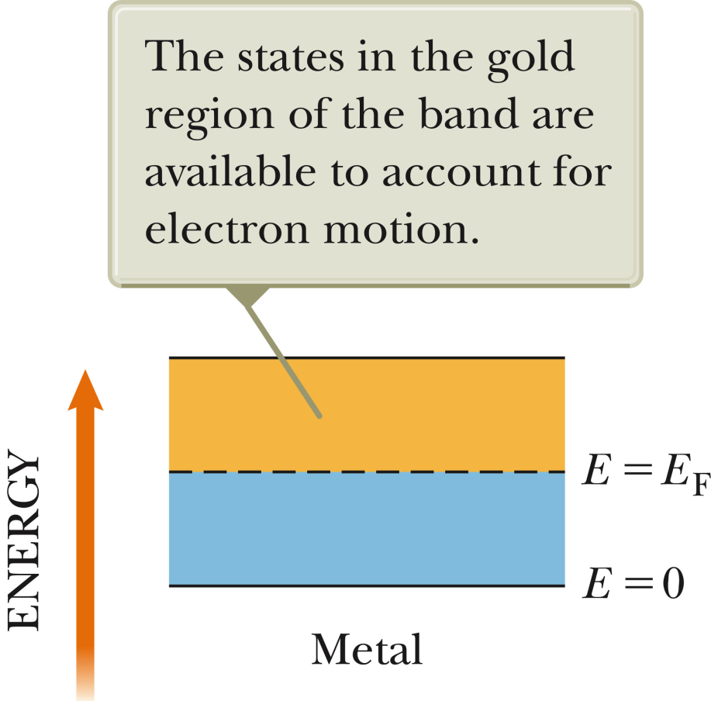
Insulator
Metal

Slide 22
Example: 2 materials made of pure carbon:
graphite (semi-metal)
diamond (insulator)
E_{g}=5.5 eV
E_{g}=0.0 eV

Slide 23
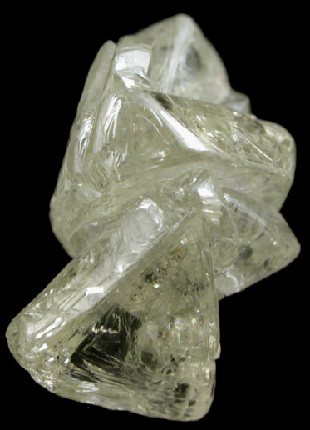
Which photo is diamond?
A. left B. right

Slide 24
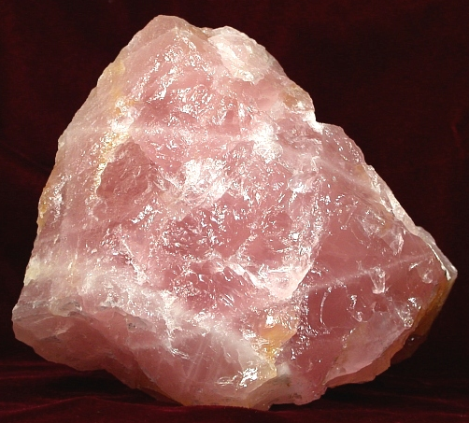
Some energy band gaps:
C (diamond) 5.5 eV
SiO₂ (quartz) 8.9
NaCl (rock salt) 8.5
Two images of quartz:

Slide 25
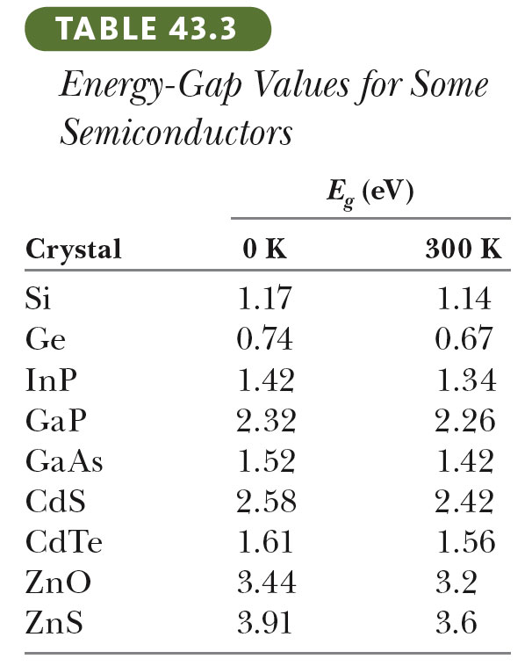
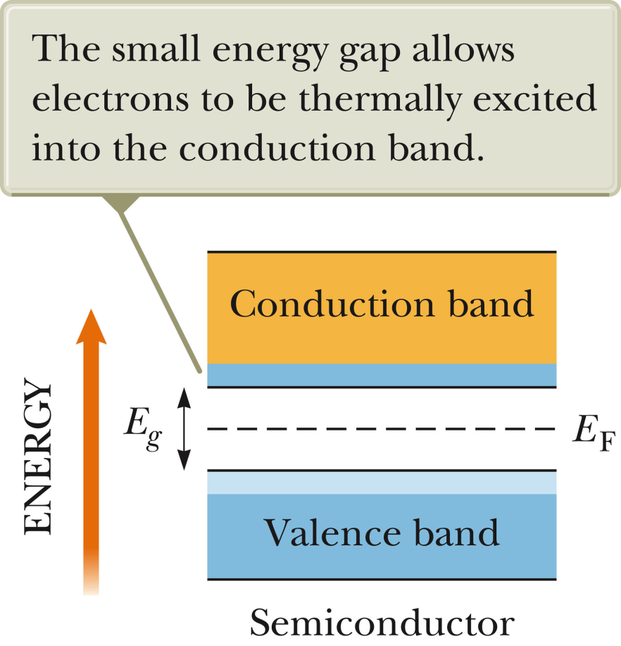
Semi-conductor materials; E_{g} < 5 eV or so

Slide 26
Electron conductivity in metals and semiconductors:
In a perfect semiconductor at T=0K n=0. To control conduction, impurities are introduced.

Slide 27
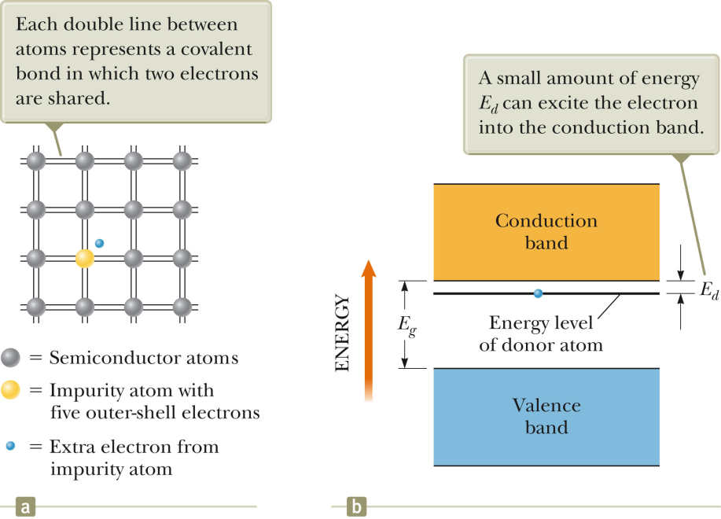
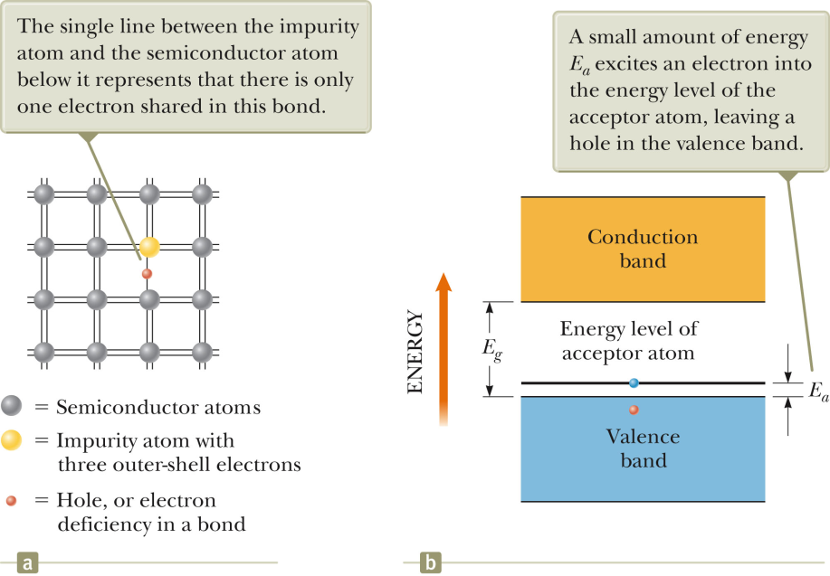
Electron doping
“Hole” doping

Slide 28
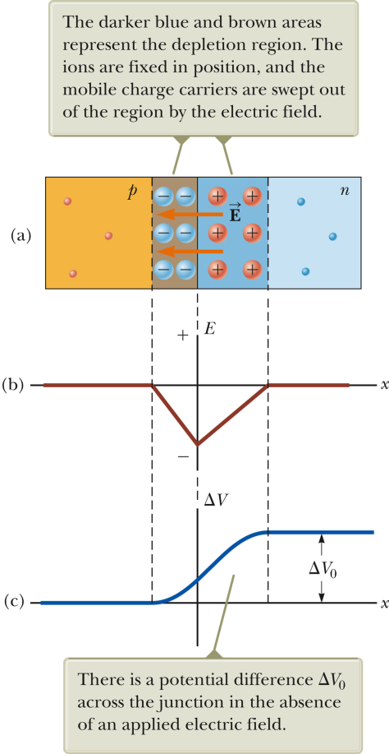
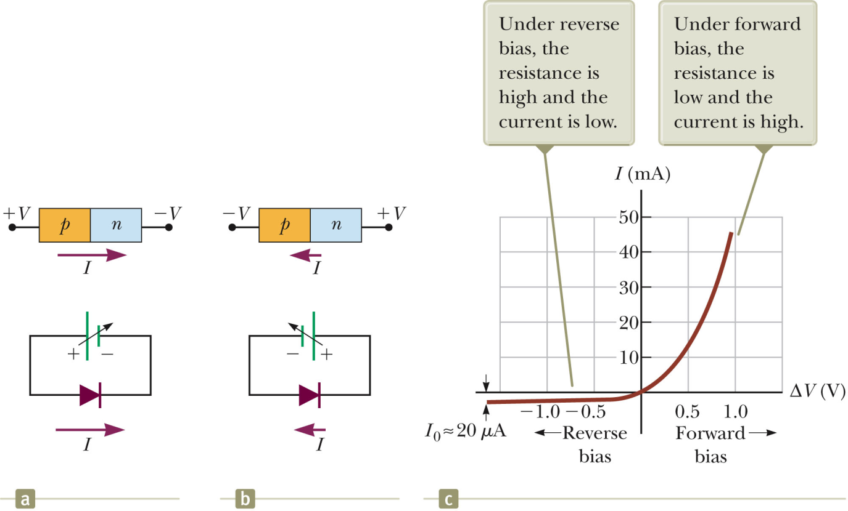
Semiconductor devices; combining electron doped and hole doped materials to control the flow of mobile charriers

Slide 29
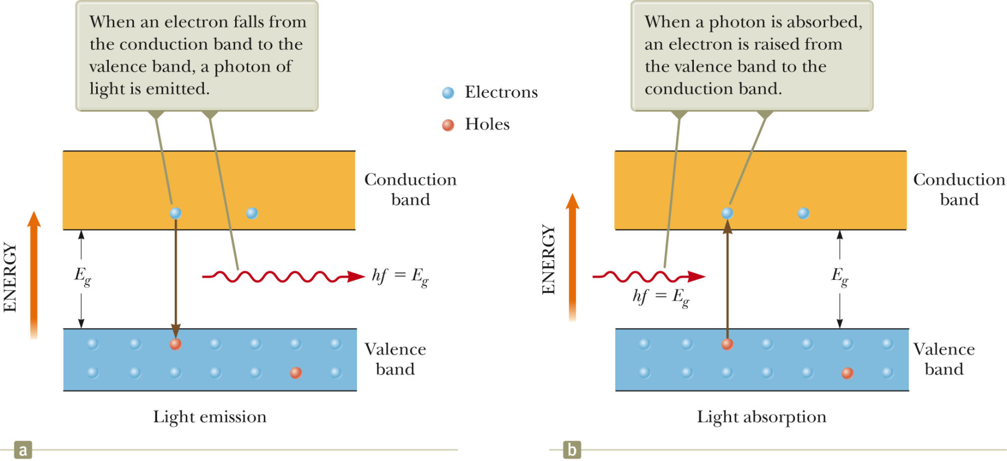
Photovoltaic devices

Slide 30
Laser technology:
System with ground and excited state at desired λ (E_{ex}-E_{g}=hc/λ).
Standing EM wave
Mechanism for “population inversion”

Slide 31
E₂
E₂
E₁
E₁
Normal population
“Inverted” population

