Slide 1
PHY 114 A General Physics II
11 AM-12:15 PM TR Olin 101
Plan for Lecture 25 (Chapters 44-45):
Some topics in nuclear physics
Nuclear binding energies
Radioactivity
Nuclear reactions

Slide 3
What do you think of when you hear the phrase nuclear reaction?
Clean energy source
Radiation danger
Nuclear weapons
No opinion

Slide 4
http://www.nei.org

Slide 5
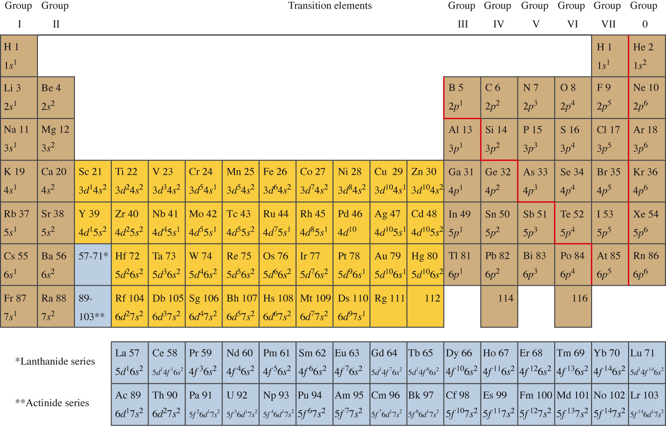
Properties of Nuclei
Z Atomic number (number of protons) N Neutron number
A = Z+N (number of nucleons)
Periodic Table
Z

Slide 6
Constituents of the nucleus

Slide 7
Nuclear notation:
Z Atomic number (number of protons)A = A Nucleon number
Natural abundance
91.754%
99.275%
Natural abundance
98.93%
1.07%
Some examples:
Some isotopes of C:

Slide 8
A
Z
%
Ref: http://www.physics.nist.gov/PhysRefData/Compositions/index.html

Slide 9
mass of neutral atom ➔ includes Z electrons
Z A
Mass of nucleus:
M_{sum} = Zm_{p} + (A-Z)m_{n} + Zm_{e} = 59.474281 u
ΔM = 0.5410806 u
What should we do with this mass deficit?
Chalk it up to inaccuracy of my calculator.
Figure that NIST made a mistake.
Give up on physics as a quantitative science.
Find some meaning associated with ΔM.

Slide 10
mass of neutral atom ➔ includes Z electrons
Z A
Mass of nucleus:
M_{sum} = Zm_{p} + (A-Z)m_{n} + Zm_{e} = 59.474281 u
ΔM = 0.5410806 u = 504.0135 MeV /c²
ΔM/A = 8.5426 MeV /c² /nucleon ➔ energy associated with nuclear “binding”
Another example:
ΔM/A(⁴₂He) = 7.1 MeV/c²/nucleon
ΔM/A(³₂He) = 2.6 MeV/c²/nucleon

Slide 11
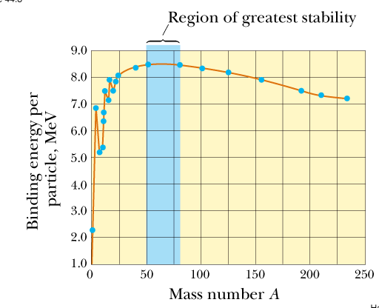

Slide 12
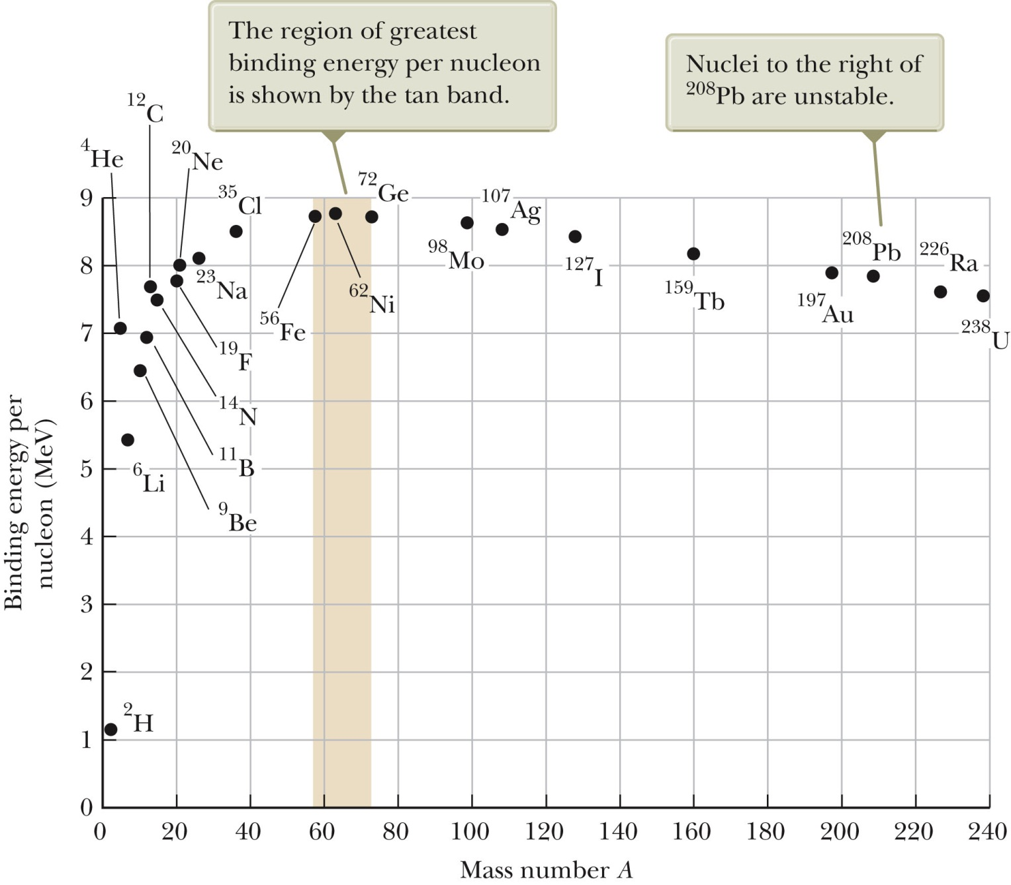
Nuclear binding energies per nucleon

Slide 13
Neutral atom with Z electrons and Z protons
Neutral H atom
Neutrons
Nuclear forces are so strong that within the nucleus, mass can be converted to energy and visa versa: E = mc² .

Slide 15
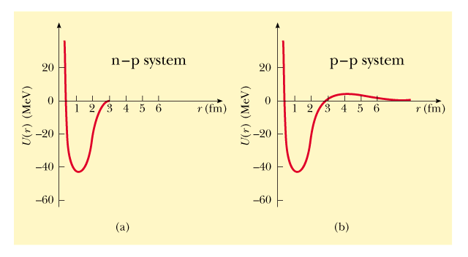
➔There must be a strong attraction between nuclear particles
1 fm = 10⁻¹⁵m

Slide 16
Not all nuclei are stable:
Some types of nuclear decay
α≡⁴₂He⁺⁺ Ex: ²³⁸₉₂U →²³⁴₉₀Th + α
β≡e⁻ or e⁺ Ex: ¹⁴₆C → ¹⁴₇N + e⁻
γ≡ (photon) Ex: ¹²₅B → ¹²₆C* + e⁻ +
Measure of radioactive decays:

Slide 17
Half-life:
When N(t) = ½ N₀:
Some units of nuclear decay:
1 Ci (Curie) ≡ 3.7 x 10¹⁰ decays/s
1 Bq (Becquerel) ≡ 1 decay/s

Slide 18
Example:
Suppose that you have a sample of 10²³ ¹⁴₆C nuclei
each of which has a half-life of 5730 years. How many Curies of radiation is this?

Slide 20
Effects of radiation in matter
Release of energetic particles –
α, n, p → move atoms in materials
e⁻, e⁺, γ → remove or excite electrons
→ cause chemical reactions
Quantitative measures of radiation dose
rad (“radiation absorbed dose”): amount of radiation that increases the energy of 1kg of absorbed materials by 0.01 J.
gray (Gy): 1 Gy = 100 rad
RBE (“relative biological effectiveness” factor): ratio of biological damage of radiation type to that of γ rays
rem (“radiation equivalent in man”): rad x RBE
sievert (Sv): 1 Sv = 100 rem

Slide 21
Some RBE factors
Radiation type | RBE
γ rays | 1
β particles | 1-1.7
n (slow) | 4-5
n & p (fast) | 10
α particles | 10-20
heavy ions | 20

Slide 22
Some typical values of dose
Source | Dose
Background radiation | 0.13 rem/year
Recommended limit | 0.5 rem/year
Diagnostic chest X-ray | 0.01 rem
Mammogram | 0.1 rem
Fatal dose | 400-500 rem

Slide 23
Summary of radiation units:
Radiation dose: Amount of radiation absorbed/unit mass
1 Gy = 1 J/kg of absorbed radiation = 100 rad
1 Sv = RBE x (dose in Gy units) = 100 rem
relative biological effectiveness
248x10⁻⁶ x 0.85 x 45 = 9.5x10⁻³J

Slide 24
Example:
A sealed capsule containing the radiopharmaceutical ³²₁₅P with an initial radioactivity of 5.22x10⁶ Bq, is implanted into a 0.1 kg tumor. Each decay produces e⁻ particles at an energy of 7x10⁵ eV. Determine the absorbed dose in a 10 day period. T_{1/2} =14.26 days. Assume all emitted particles are absorbed.
0.1 kg
dose = RBE x (number of decays) x (energy released)/mass
7x10⁵ x 1.6x10⁻¹⁹J
1
dose = 4 J/kg = 400 rem = 4 Sv

Slide 25
Other facts about nuclei
Nuclei are confined to a very small region of space – typical nuclear radii are 10⁻¹⁵m = fm (compare with atomic radius of 10⁻¹⁰m)
For some nuclei, there are stable forms with the same Z, but different A (isotopes)
Some nuclei are meta-stable; they transform (decay) into other forms

Slide 27
Summary of some ideas about nuclear physics
The basic forces that describe nuclei are stronger, shorter range, and more complicated than electromagnetic forces. Nuclear binding energies are typically 8 MeV/nucleon.
Most nuclear decay processes are described by a simple rate equation
For example: ²³⁸U→ ²³⁴Th + ⁴He T_{1/2}=4.5×10⁹ yr.
Radiation effects on humans and other sensitive forms of life and devices are due to the light decay products – α,β,γ particles Radiation dose: Amount of radiation absorbed/unit mass
1 Gy = 1 J/kg of absorbed radiation = 100 rad
1 Sv = RBE x (dose in Gy units) = 100 rem
relative biological effectiveness

Slide 28
Guide to nuclear reactions
General rules
Total A (number of nucleons (Z+N)) is conserved
Total charge is conserved
protons and neutrons can convert to each other
antineutrino
neutrino
positron
Neutrinos were first detected in 1956 by Fred Reines and George Cowan, who showed that a nucleus undergoing beta decay emits a neutrino with the electron. Neutrinos are VERY weakly interacting and recent evidence suggests they have a mass of < 0.1 eV.

Slide 29
Examples of nuclear reactions
Used for carbon dating
Nucleus captures an electron
Positron emission
Beta decay followed by gamma decay

Slide 30
More nuclear reactions
Energy accounting :
for a general reaction of the type a+X→Y+b
energy released as kinetic energy of the products can be calculated:
Q=(M_{a}+M_{X}−M_{Y}−Μ_{β})c²
In this case, Q=(1.007825+7.016003−2*4.002602) c²
=17.348 MeV

Slide 31
Fission: Some history –
1932 James Chadwick (England) discovered neutron
Enrico Fermi (Italy) discovered that neutrons could be absorbed by nuclei to form new elements
Lise Meitner, Otto Hahn, Fritz Strassmann, Otto Frisch (Germany) discovered fission of U
Example:
Q≈200 MeV

Slide 32
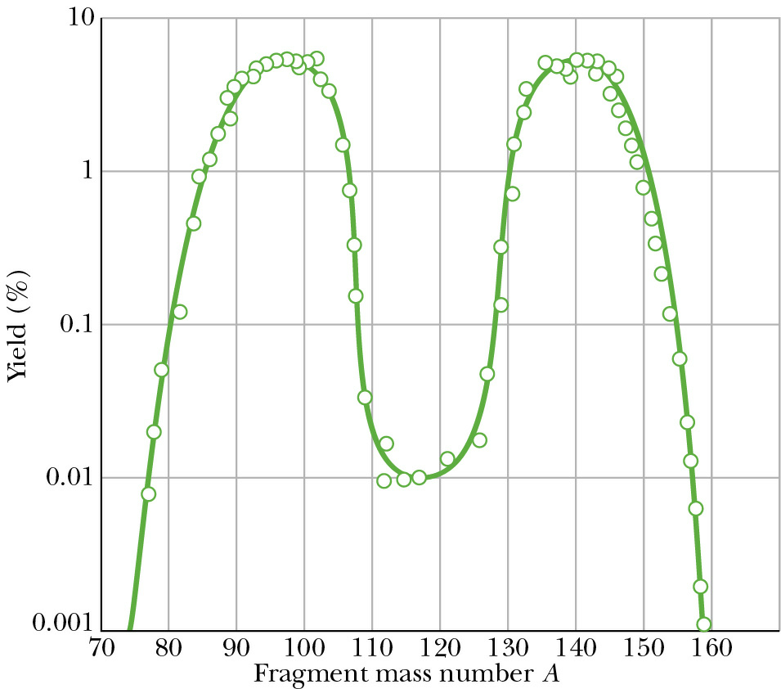
Other decay products for

