Slide 1
PHY 114 A General Physics II
11 AM-12:15 PM TR Olin 101
Plan for Lecture 26 (Chapter 45):
Some topics in nuclear physics
Nuclear reactions
Fusion reactors
Fission reactors
Link to NCSU Professor Wesley Henderson's course materials on "Engineering Challenges at the Energy Frontier“ (includes fission reactors) http://www.che.ncsu.edu/ILEET/CHE596web_Fall2011/index.html

Slide 3
General comments on final exam:
It will be comprehensive
May bring up to 4 equation sheets (turned in with exam papers)
Need calculator; must not use cell phone, computer, etc.
May pick up final exams from my office after they are graded
A PHY 114 review session has tentatively been scheduled for Thursday 5/3/2012 at 11 AM in Olin 107
I plan to come
I do not plan to come
Other suggestions?

Slide 4
Other exams
PHY114 A
NOTE: Students should have no more than two exams in a 24-hour period. They should be allowed to reschedule exams in excess of two in a 24-hour period.

Slide 5
How many of you need to reschedule the final exam time:
Happy to take the exam as scheduled (May 8)
Entitled to reschedule according to WFU policy
Not entitled, but would prefer to reschedule
For those of you who need/would like to reschedule – which time is likely to be preferable
Prefer rescheduled time earlier than May 8
Prefer rescheduled time later than May 8

Slide 6
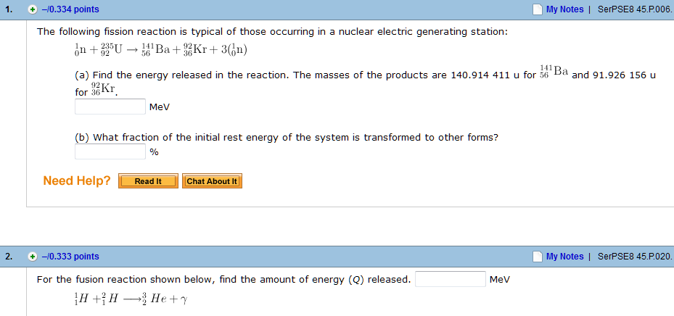
Webassign comments:

Slide 7
Assume that any available mass can be converted to energy according to E=mc².
Need table of atomic mass numbers:
http://www.nist.gov/pml/data/comp.cfm

Slide 8
Neutron 1.008655 u

Slide 9
Example:
In principle, nuclear energy is available in both fission and fusion reactions.

Slide 10
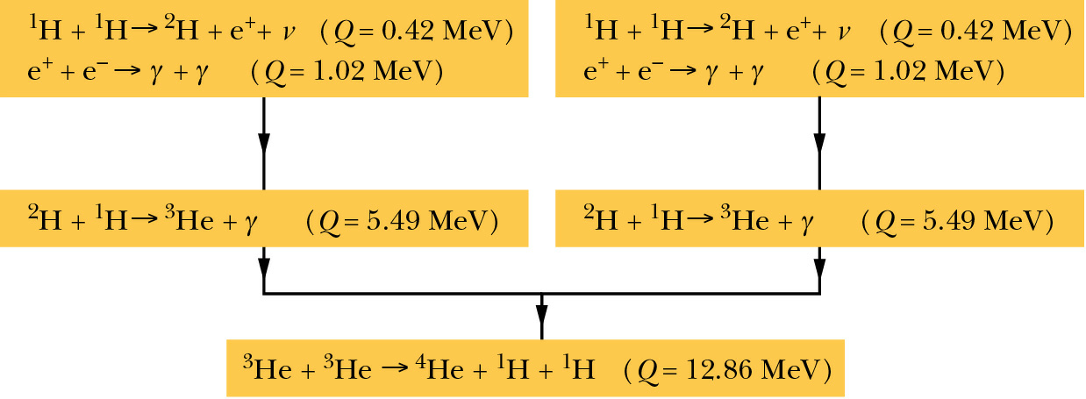
Fusion reactions
Summary of reactions in the sun:
Total energy release for each event: 26.7 MeV
This process has been occurring for ≈ 5 x 10⁹ years and is expected to last for 10⁹ more years

Slide 11
Fusion reactions which might be possible on earth:
²₁H + ²₁H → ³₂He + n (Q=3.27 MeV)
²₁H + ²₁H → ³₂He + ¹₁H (Q=4.03 MeV)
²₁H + ³₁H → ⁴₂He + n (Q=17.59 MeV)
n + ⁶₃Li → ⁴₂He + ³₁H (Q=4.78 MeV)
Technological challenge: How to control the energetic reactants to effect net energy gain???
Magnetic confinement – “tokamak” design
Laser confinement – high powered lasers focused on fuel put into solid form

Slide 12
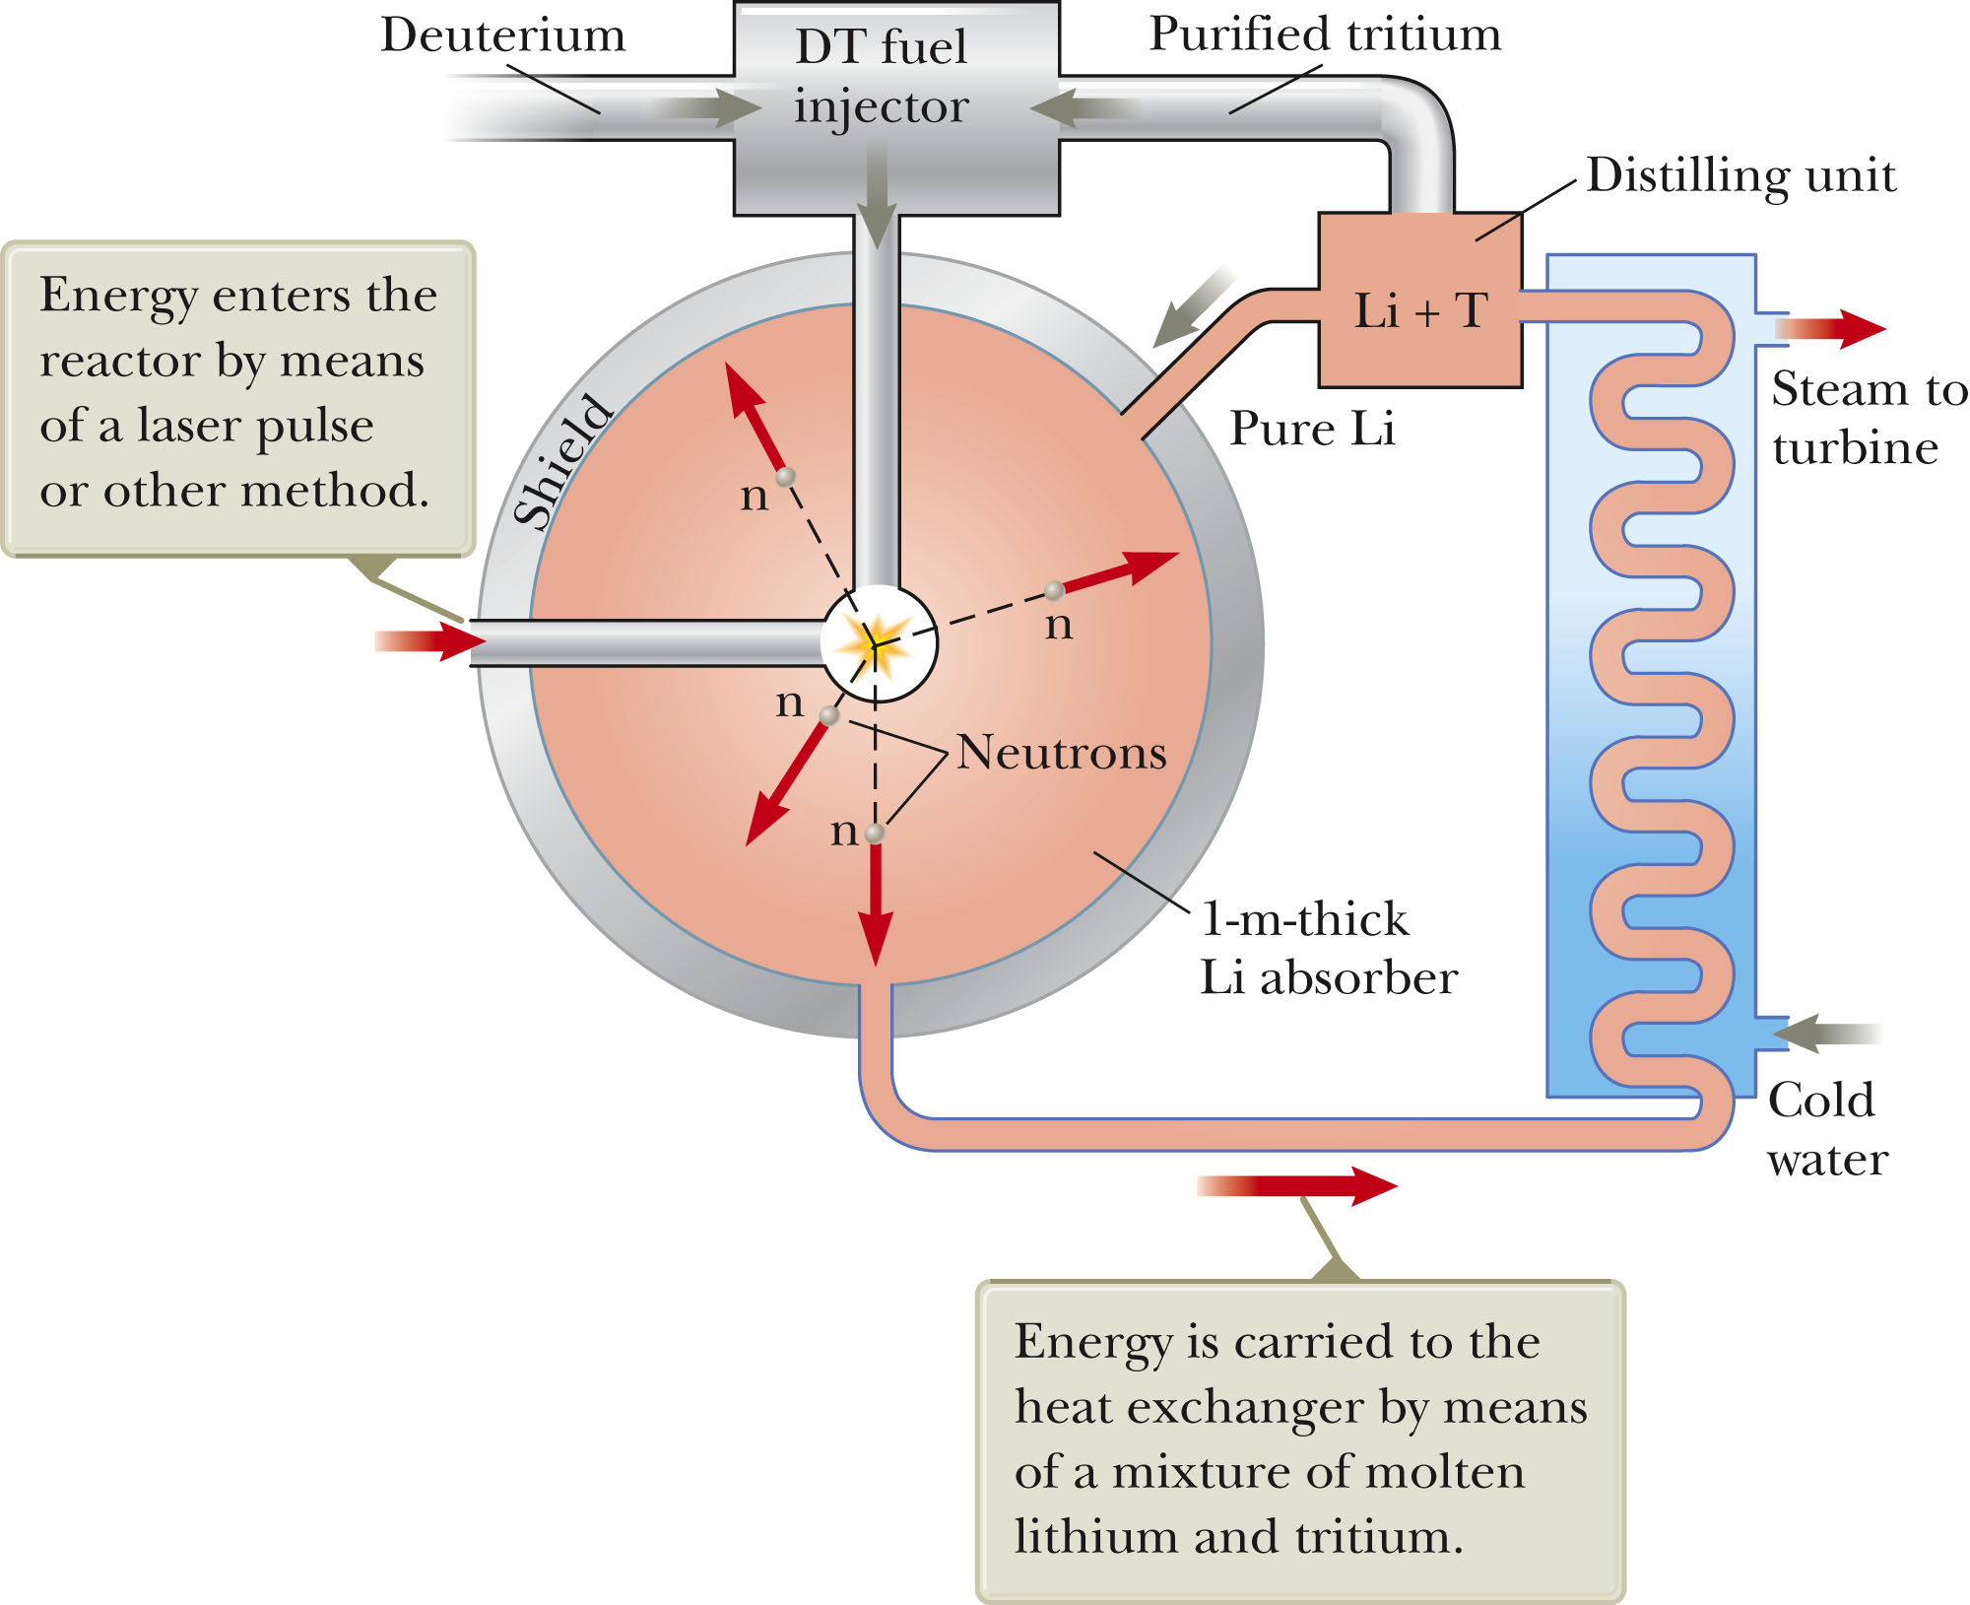

Slide 13
 | Advantages | Disadvantages
Fission | Technology has been demonstrated | Nuclear waste
Fusion | Less dangerous nuclear waste | Technology has not yet been demonstrated

Slide 14
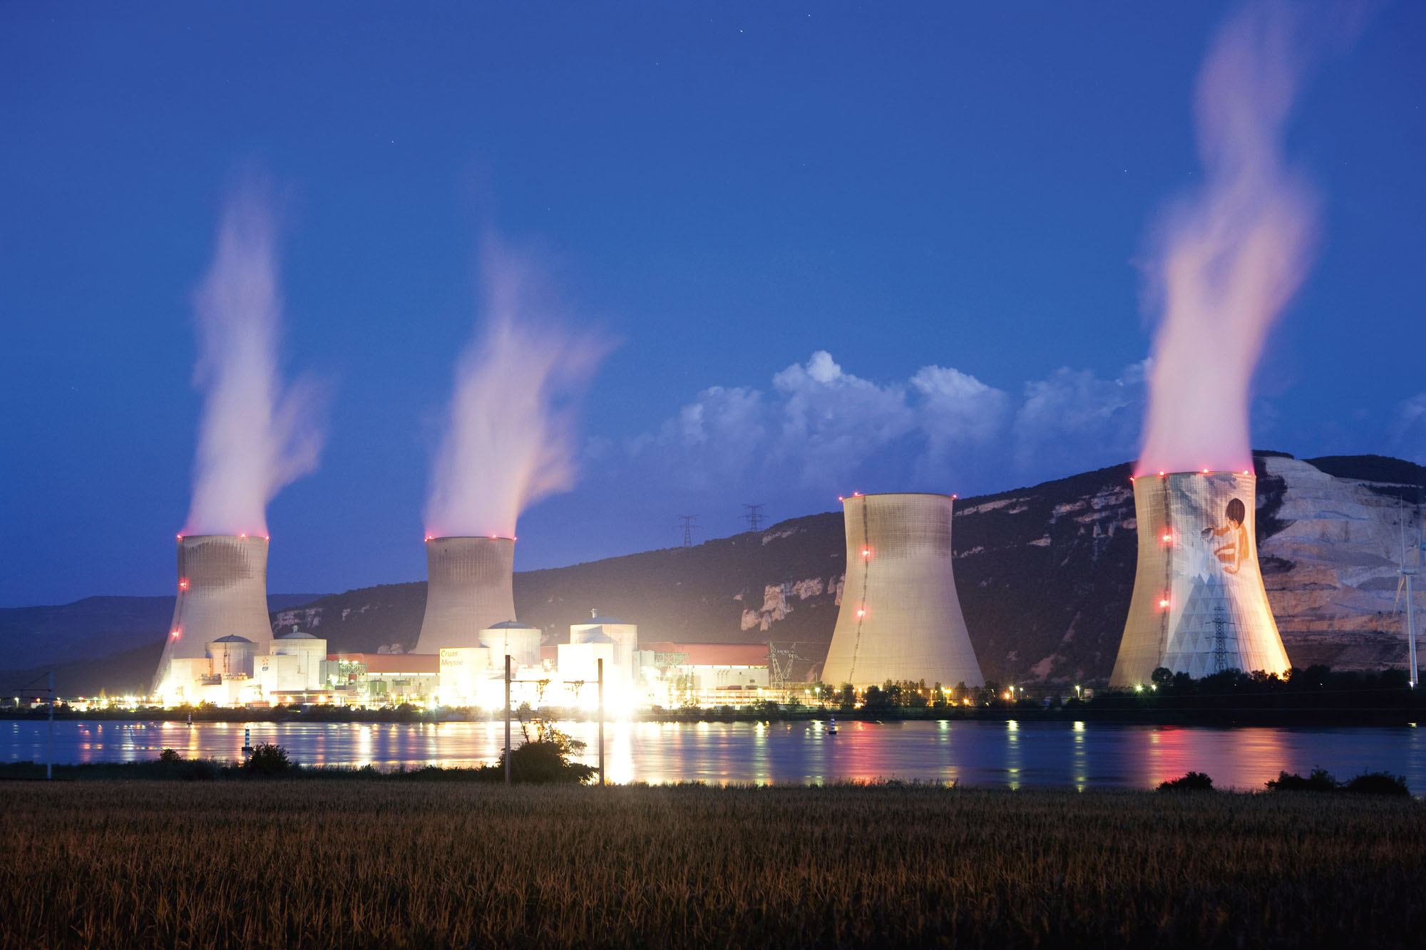
Nuclear power plant in France (photo from textbook)

Slide 15
Fission: Some history –
1932 James Chadwick (England) discovered neutron
Enrico Fermi (Italy) discovered that neutrons could be absorbed by nuclei to form new elements
Lise Meitner, Otto Hahn, Fritz Strassmann, Otto Frisch (Germany) discovered fission of U
Example:
Q≈200 MeV

Slide 16
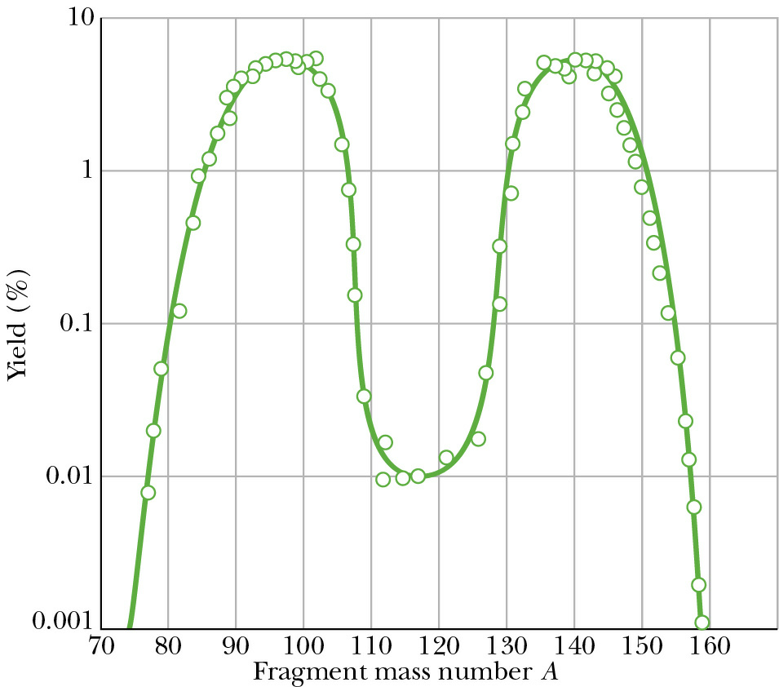
Other decay products for

Slide 17
Mechanism for power plant
Heat → mechanical energy → generator → electricity
Heat sources:
Chemical burning: oxygen + coal, oil, etc.
Nuclear burning: n + ²³⁵₉₂U
neutrons generated in the reaction are also used to fuel the reaction

Slide 18
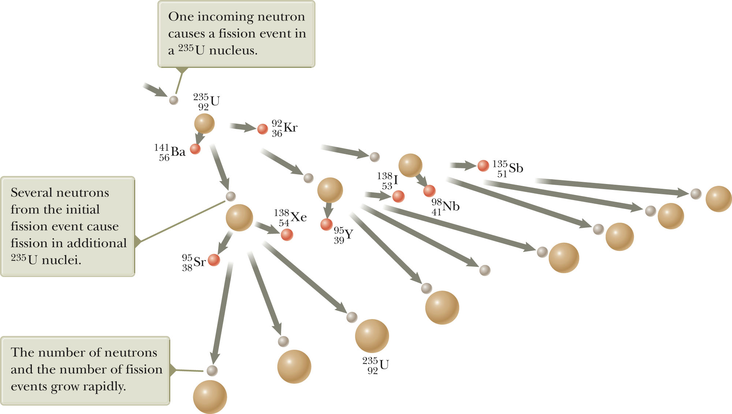

Slide 19
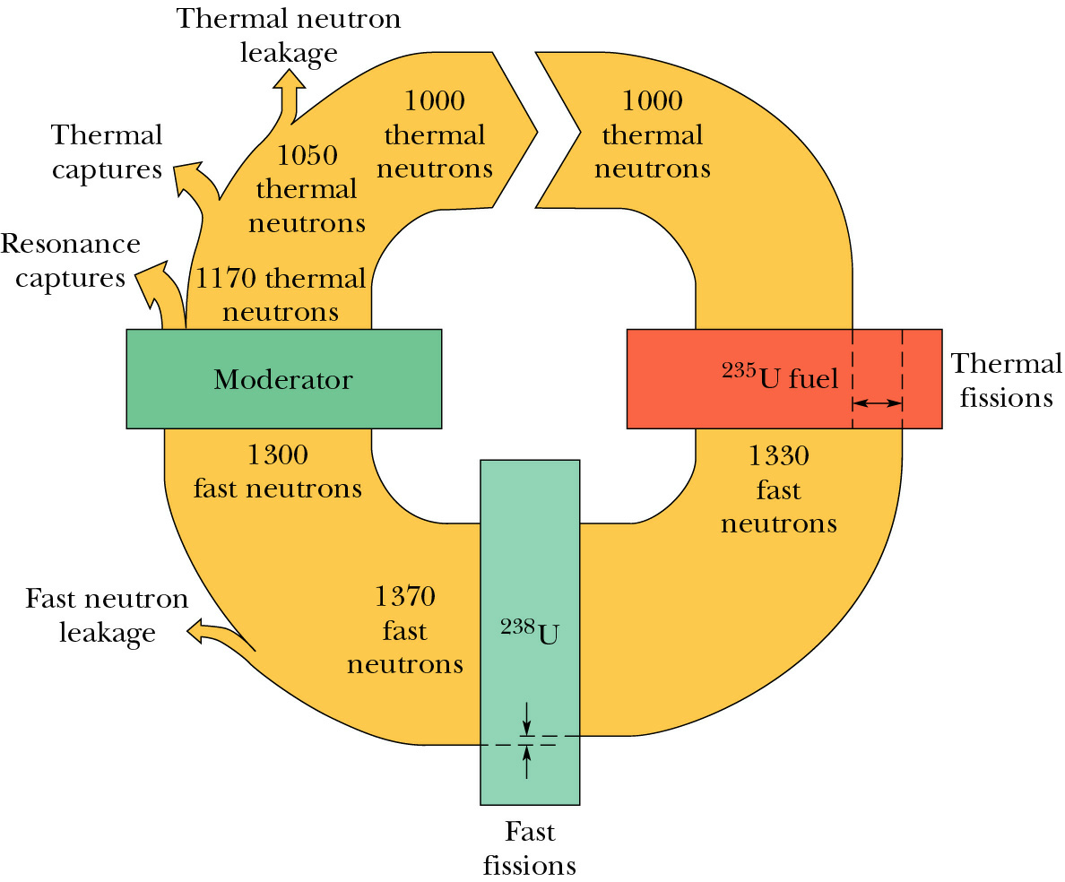
Model for nuclear reactor – accounting for 1000 neutrons
(water)

Slide 20
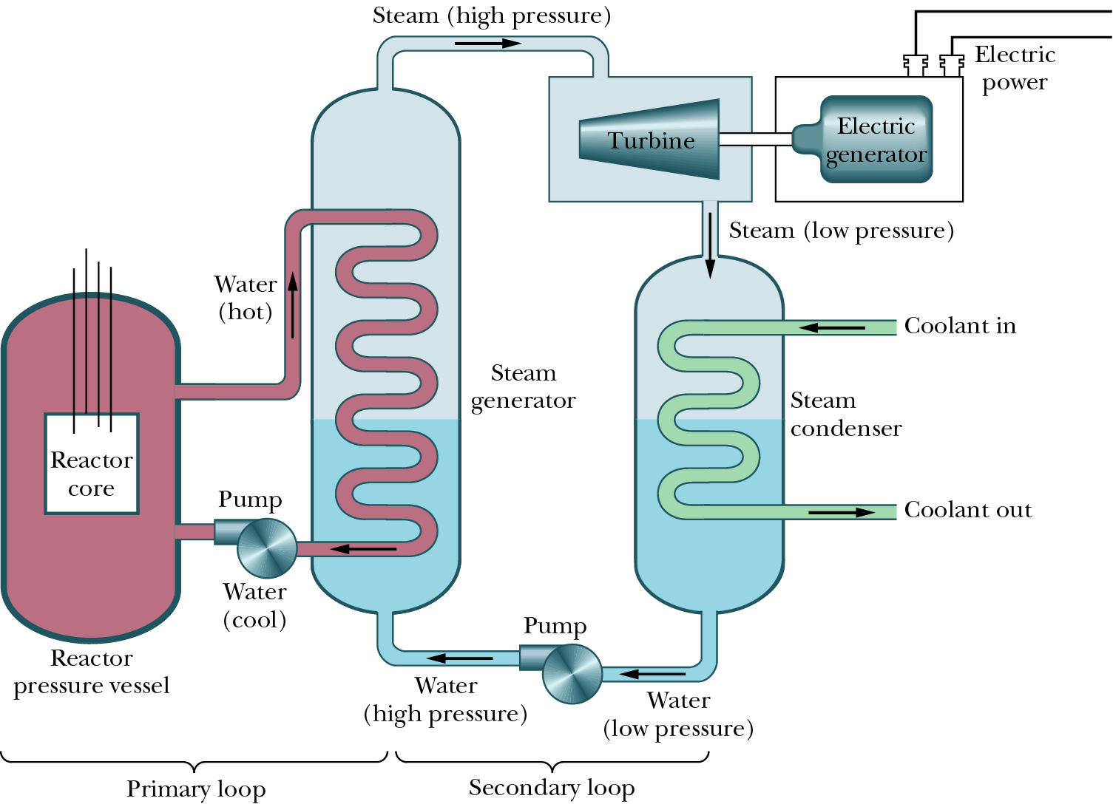
Simplified model of nuclear power plant

Slide 21
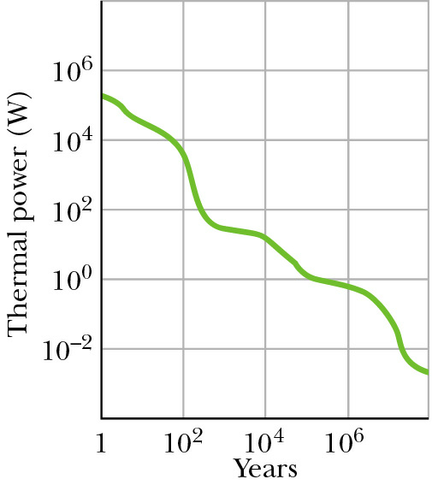
Thermal power release by radioactive wastes from one year’s operation of a typical large nuclear power plant

Slide 22
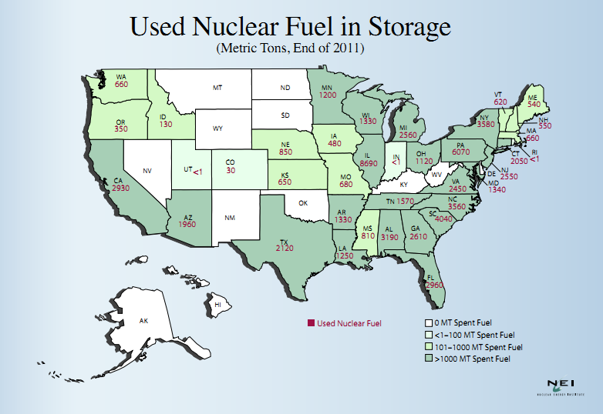
http://www.nei.org

Slide 23
http://www.gen-4.org

Slide 26
Other uses of nuclear radiation
Food irradiation:
http://www.epa.gov/rpdweb00/sources/food_irrad.html
Food irradiation is a technology for controlling spoilage and eliminating food-borne pathogens, such as salmonella. The result is similar to conventional pasteurization and is often called "cold pasteurization" or "irradiation pasteurization." Like pasteurization, irradiation kills bacteria and other pathogens, that could otherwise result in spoilage or food poisoning. The fundamental difference between the two methods is the source of the energy they rely on to destroy the microbes. While conventional pasteurization relies on heat, irradiation relies on the energy of ionizing radiation. The FDA emphasizes that no preservation method is a substitute for safe food handling procedures.

Slide 27
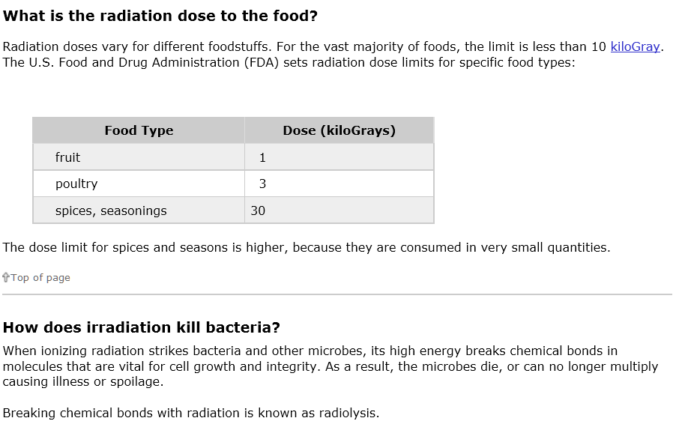
http://www.epa.gov/rpdweb00/sources/food_irrad.html

Slide 28
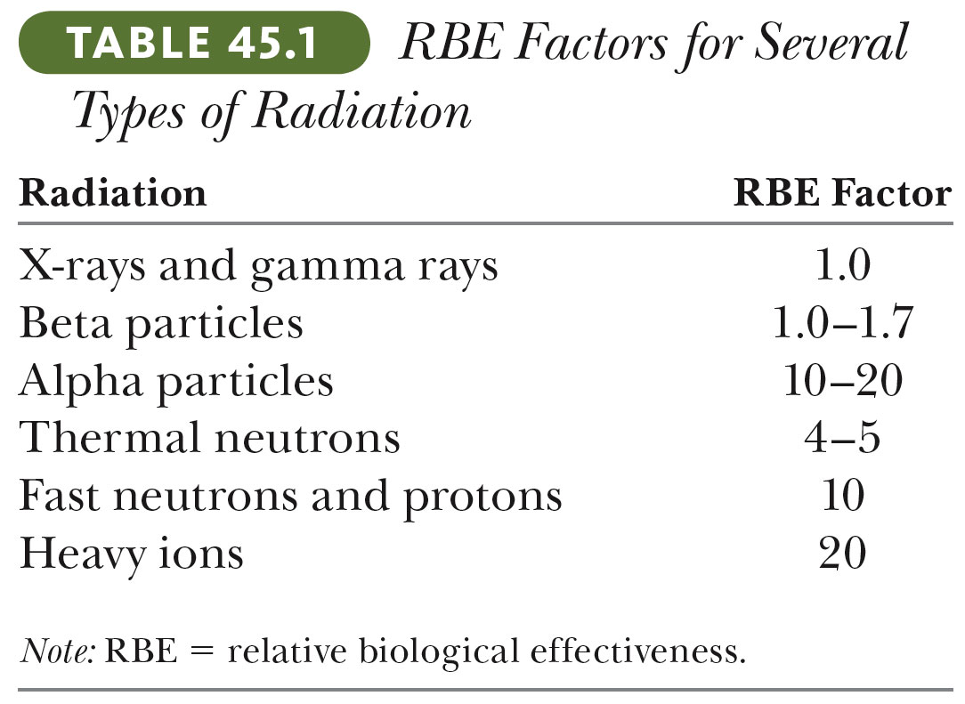
Measures of radiation:

Slide 29
Fundamental processes of radiation
Nuclear reactions
Move nuclei of atoms in materials (Ex: neutrons can cause crystal defects)
Produce many electronic excitations ➔ excited and/or charged species undergo uncontrolled chemical reactions (Ex. Electrons and γ-rays are examples of effective “ionizing” radiation); the greater the energy the greater the potential radiation damage
The least massive reaction products carry the most energy and are responsible for the most radiation effects

Slide 30
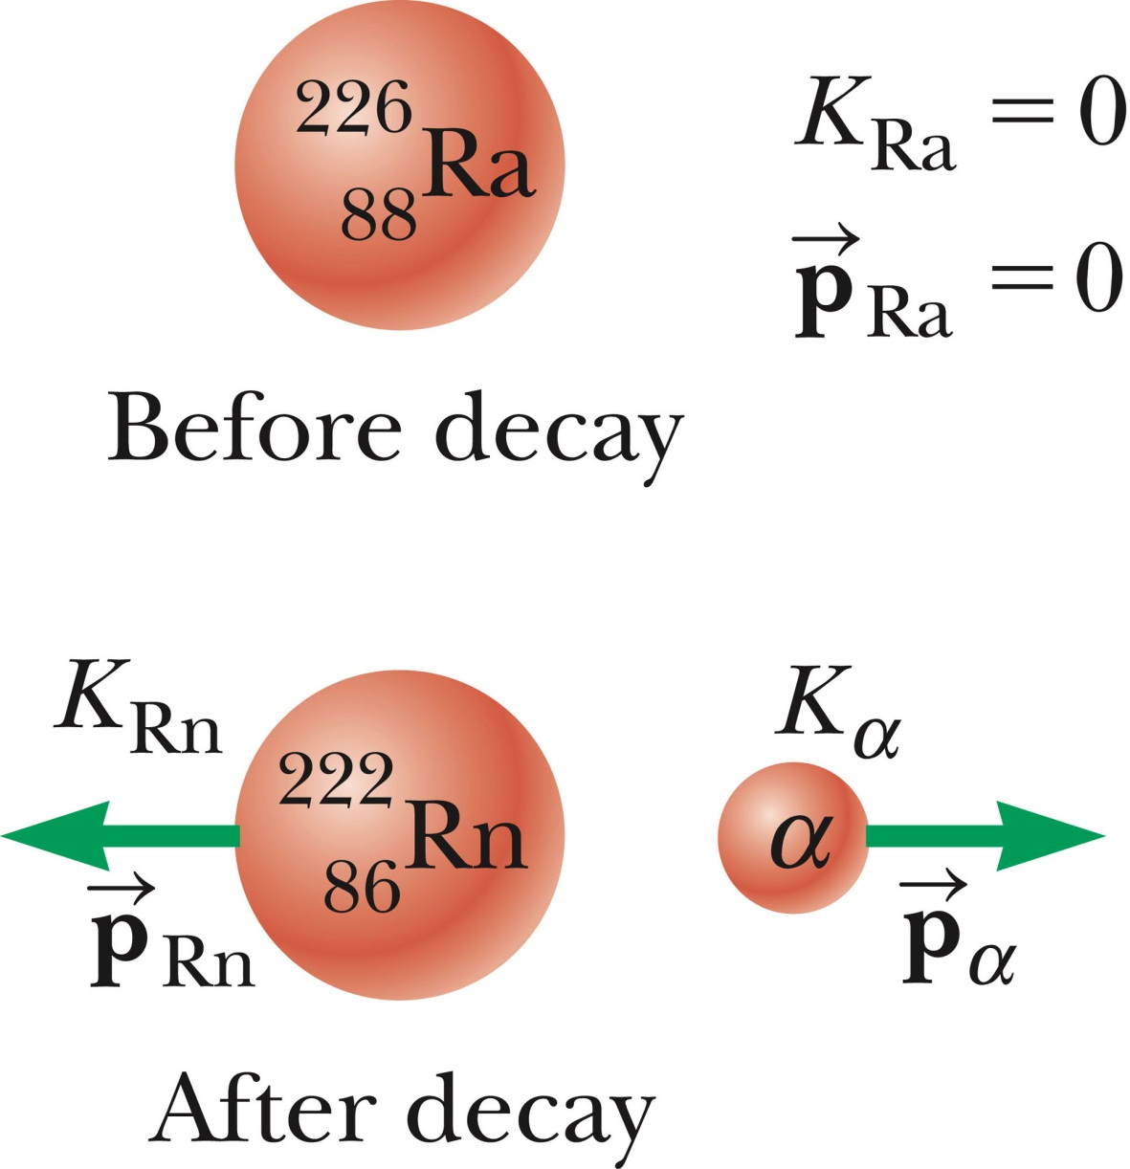
Energy analysis of a simple reaction :
Q=4.87 MeV

Slide 31
Energy analysis of a simple reaction :
Q=4.87 MeV

Slide 32
Other uses of nuclear radiation
Carbon dating
Living organisms have a ratio of ¹⁴C / ¹²C of 1.3x10⁻¹² reflecting normal atmospheric processes. When an organism dies, the ratio is reduced due to the 5730 yr half-life of ¹⁴C.
Example from your textbook: A piece of charcoal containing 25 g of carbon is found to have an activity of 4.167 decays/s. How long ago did the tree live that produced this charcoal?

Slide 33
Other uses of nuclear radiation
Carbon dating -- continued

