Slide 1
PHY 114 A General Physics II
11 AM-12:15 PM TR Olin 101
Plan for Lecture 3:
Introduction to Gauss’s law
Relationship between Coulomb’s law and Gauss’s law

Slide 2
Announcements:

Slide 3
i-clicker registration problems:
Campbell, Thane
Chung, Jae
Dearmon, Jake
Desaly Gonzalez
Klebous, Sandy
Samsel, David
Tulowiecki, Alex
Valderrey, Melina

Slide 4
Comment about finding the electric field at an arbitrary point.
P
r-r_{q}
q
r
r_{q}

Slide 6
V
V
Surface integral enclosing volume V
Volume integral of charge within volume V

Slide 7
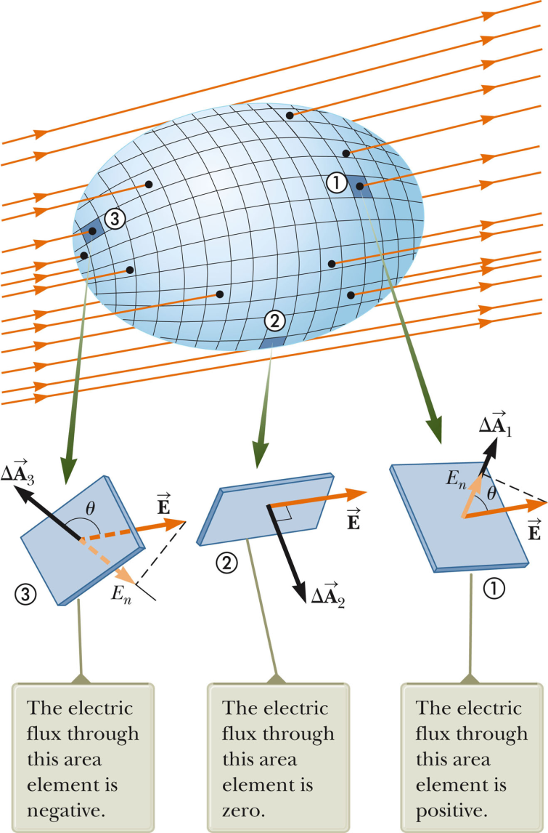
How to evaluate Gauss’s law:

Slide 8
i-clicker questions
Consider the cube with each face having an area A in the presence of a uniform electric field E along the z-axis. Possible answers are
EA B. –EA C. 2EA
D. – 2EA E. 0
What is the flux through the front surface in the x-y plane?
What is the flux through the back surface in the x-y plane?
What is the flux through the side surface in left y-z plane?
What is the total flux through complete surface of the cube?

Slide 9
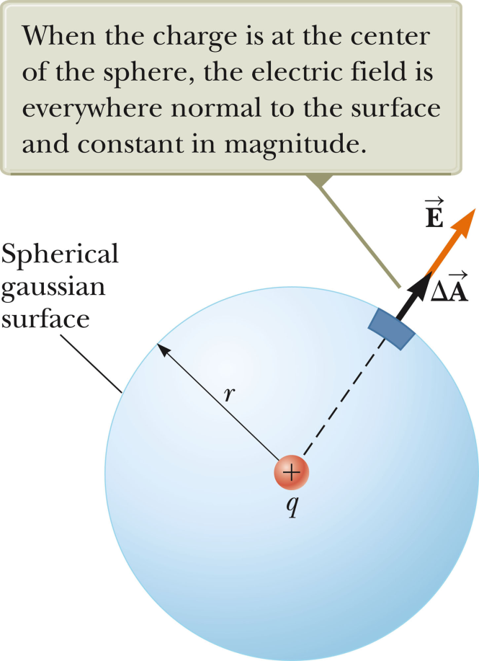
Example of Gauss’s Law for familiar case:

Slide 10
r
r
q
q

Slide 11
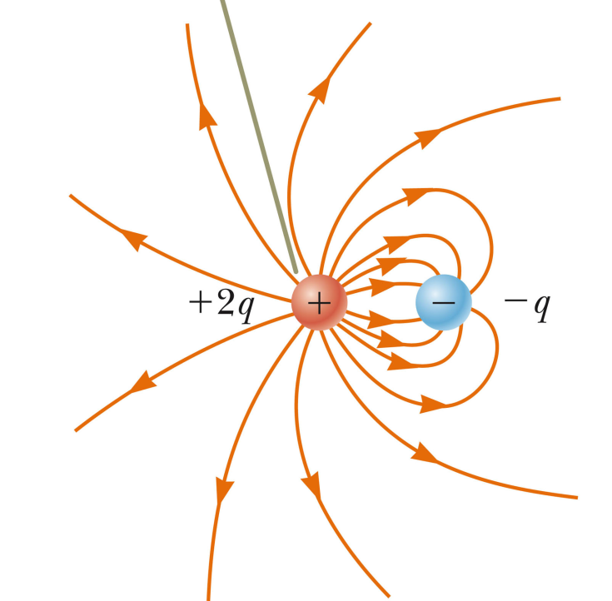
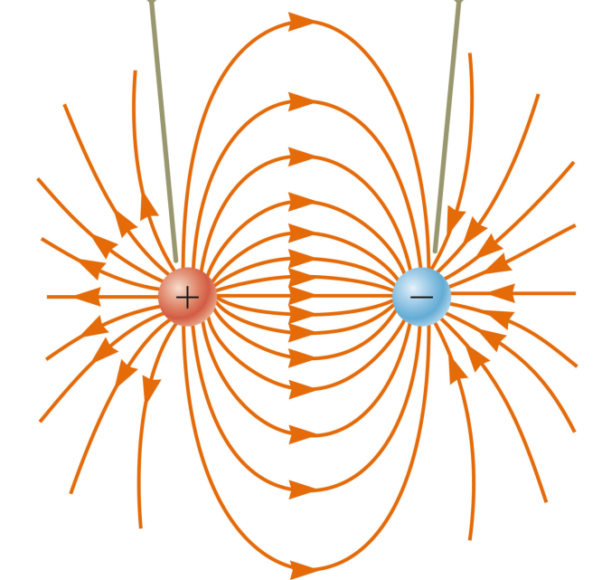
dipole
dipole plus monopole

Slide 12
i-clicker question
Consider the following statements
Only 1 is true
1 and 2 are true
1 and 3 are true
Gauss’s law cannot be applied to gravitational fields

Slide 13
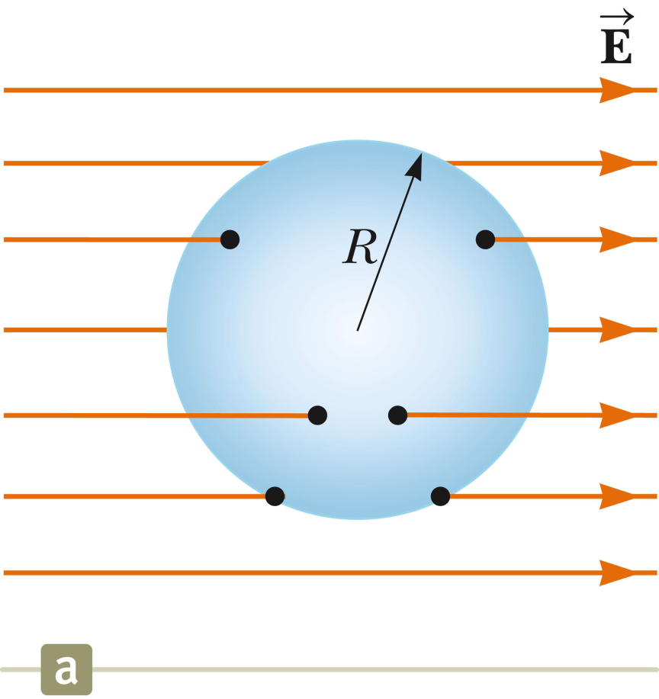
i-clicker question
Consider the following diagram showing a Gaussian sphere in a region of a uniform electric field. What can you conclude about the total charge Q within the sphere?
Q > 0
Q < 0
Q = 0
Not enough information

Slide 14
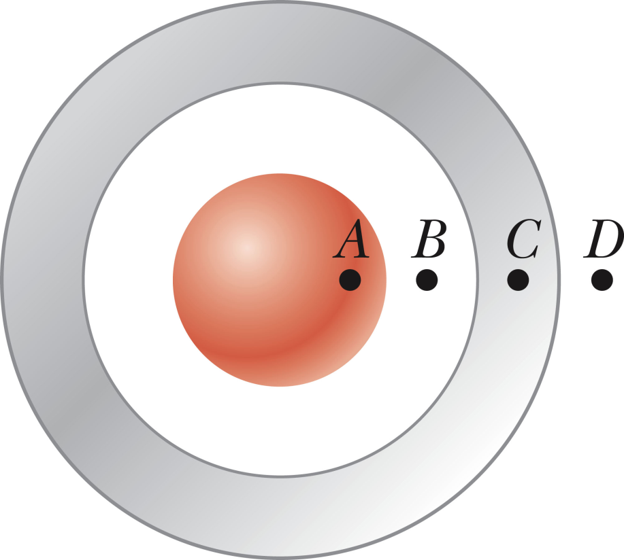
i-clicker question
The grey shell represents a metal having a uniform surface charge (indicated in red).
R
Q=4πR²σ
Where is the electric field non-zero?

Slide 15
R
Q=4πR²σ
r

Slide 16
When is Gauss’s law convenient to use?

Slide 17
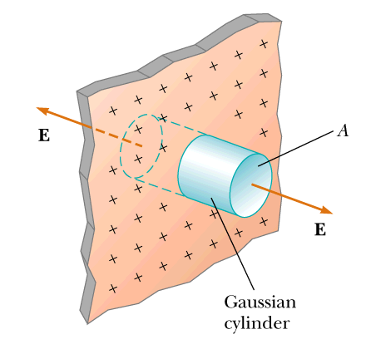
Electrostatic field from charged sheet
2 ends of cylinder
σ
permittivity constant =8.854x10⁻¹² C²/(Nm²)

Slide 18
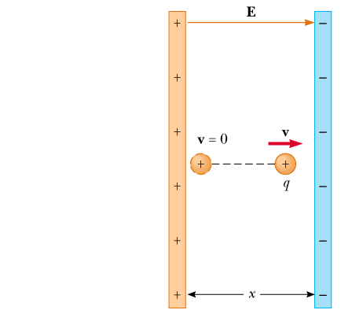
σ
−σ

Slide 20
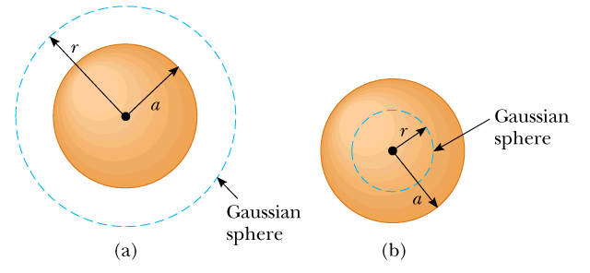
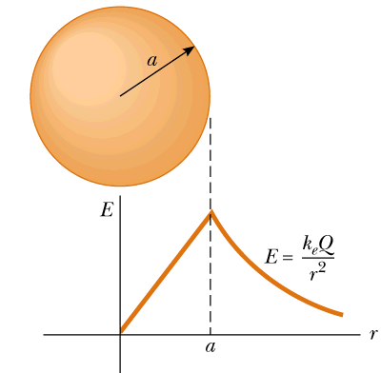
Electric field inside and outside uniformly charged sphere:

Slide 21
Summary – Gauss’s law
volume inside surface
closed surface

Slide 22
Consider a neutral (electrically isolated) metal sheet:

Slide 23
Consider a neutral (electrically isolated) metal sheet:
What happens when you bring a point charge +Q close to the sheet?
There is no force on the charge.
The charge is attracted to the sheet.
The charge is repelled from the sheet.
+Q

