Slide 1
PHY 114 A General Physics II
11 AM-12:15 PM TR Olin 101
Plan for Lecture 4:
Introduction to the electric potential
Relationship between the electric potential and the electric field

Slide 2
Announcements:

Slide 3
i-clicker question
Would you attend a review session for next Tuesday’s exam on
Monday afternoon at 4 PM
Monday evening at 5 PM
Sunday afternoon at 3 PM
Sunday evening at 5 PM
None of these

Slide 4
i-clicker registration problems:
Campbell, Thane
Dearmon, Jake
Klebous, Sandy
Samsel, David
Story, William

Slide 5
Consider a neutral (electrically isolated) metal sheet:
What happens when you bring a point charge +Q close to the sheet?
− − − − −
+ + + + +
+Q
x

Slide 6
Somewhat related question from homework:
Suppose an electrically neutral sheet of metal is placed in a uniform electric field. What is the resultant charge distribution on the surface of the sheet?

Slide 7
+ + + + + + + + +
− − − − − − − − −

Slide 8
Electric field inside an electric isolated, neutral ideal metal = 0.
E
+ + + + + + + + +
− − − − − − − − −

Slide 9
Review of work and potential energy
y
ds
r_{i}
F
r_{f}
F
x

Slide 10
Application of work principles to Coulomb’s law force
Q
q
r
r_{Q}

Slide 12
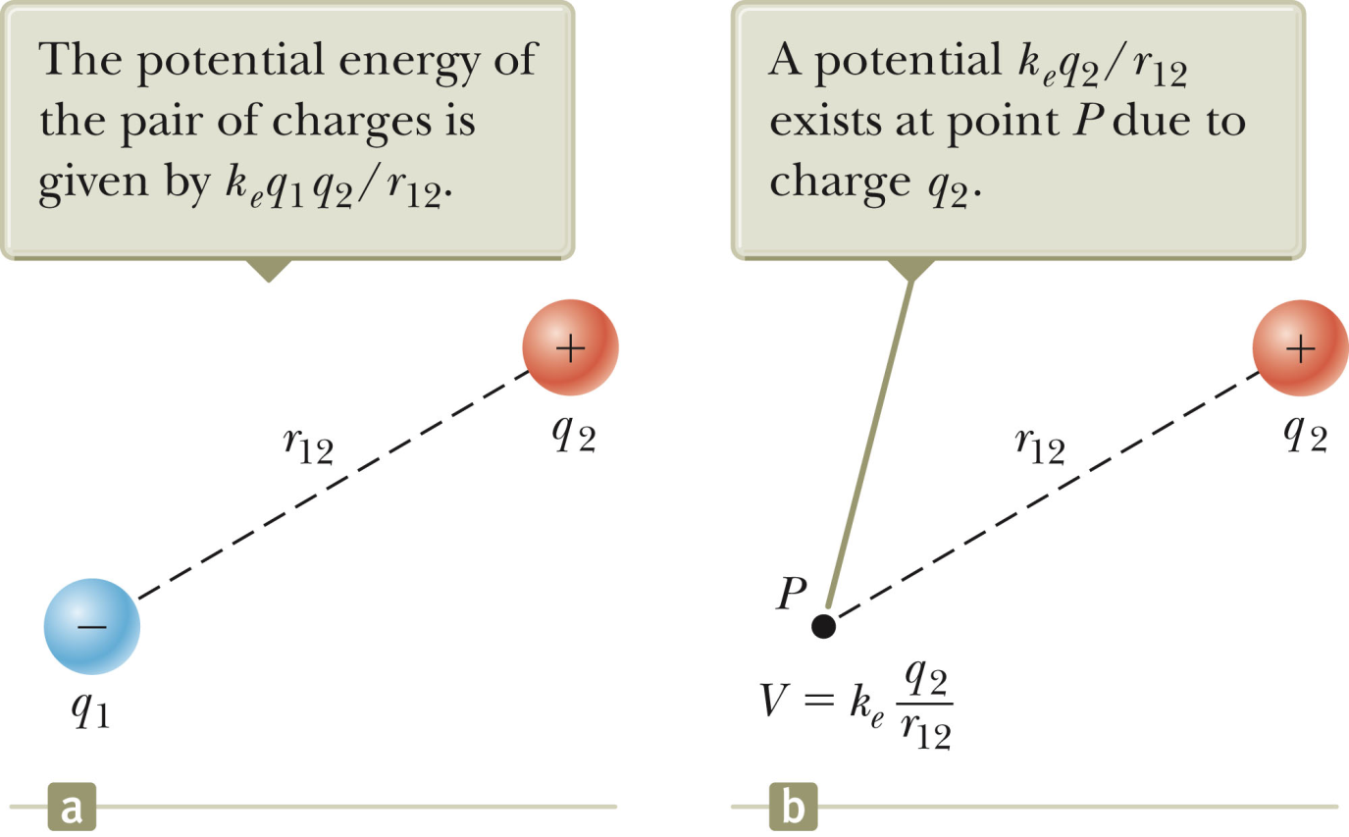

Slide 13
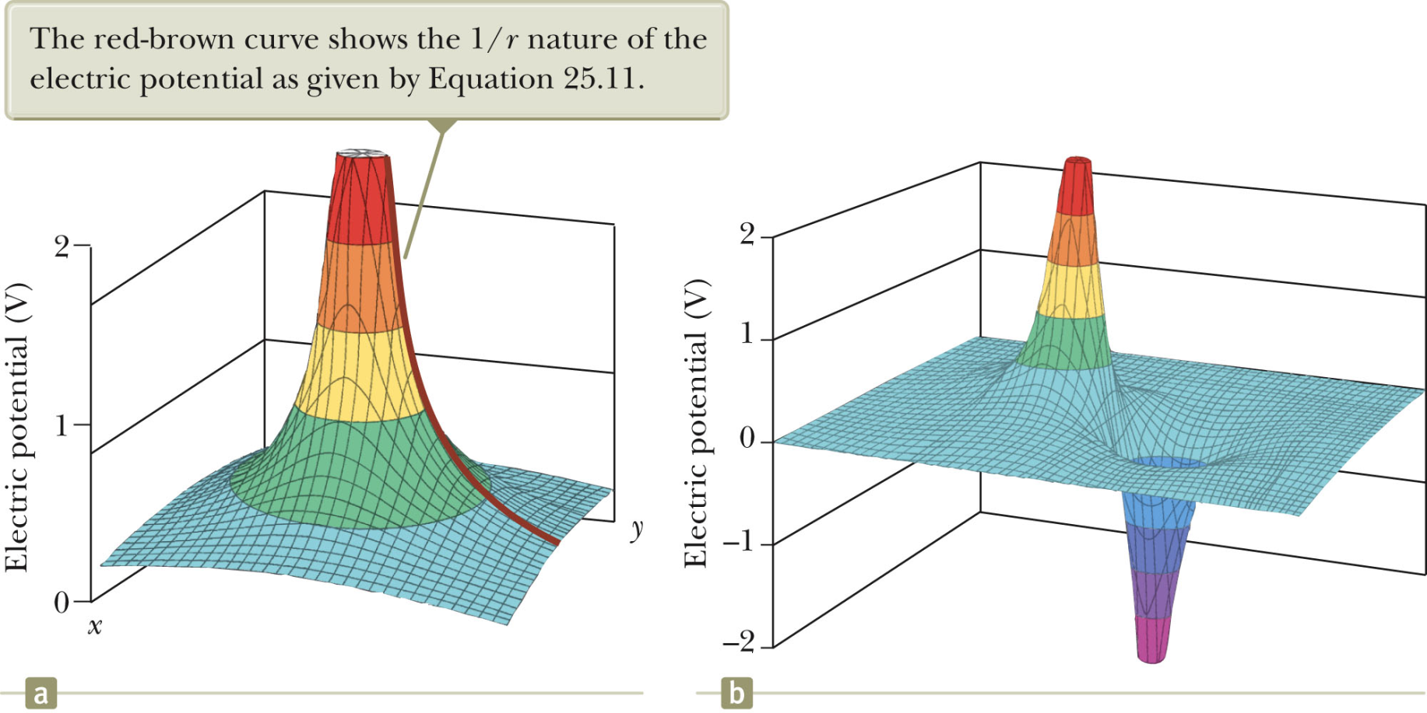
Examples of spatial distribution of electric potential

Slide 14
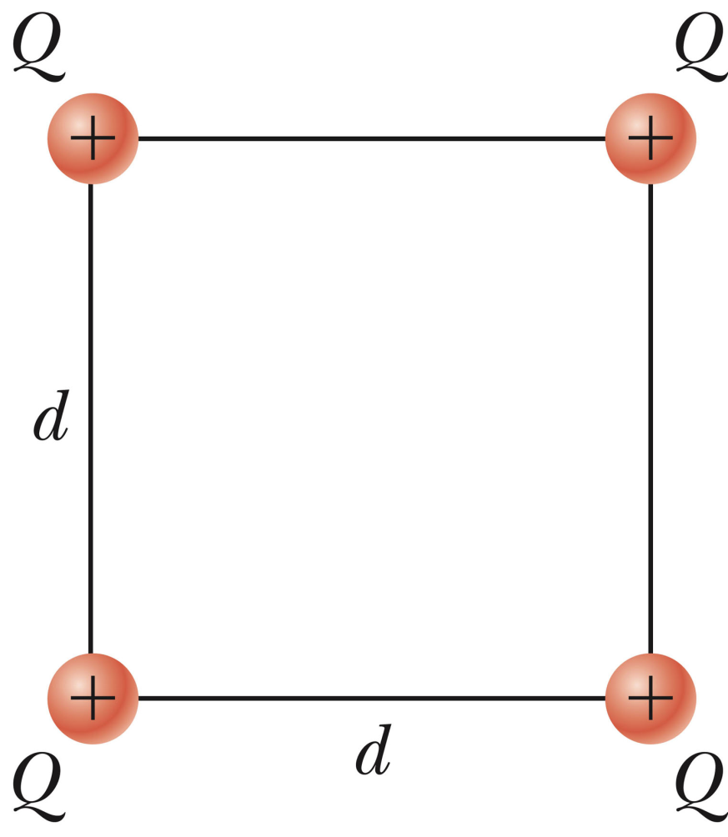
i-clicker exercise:
Choose the expression which corresponds to the value of the electrostatic potential at the center of the square in the diagram.

Slide 15
i-clicker exercise:
Choose the expression which corresponds to the value of the electrostatic potential at the center of the square in the diagram.
−
−
−
−

Slide 16
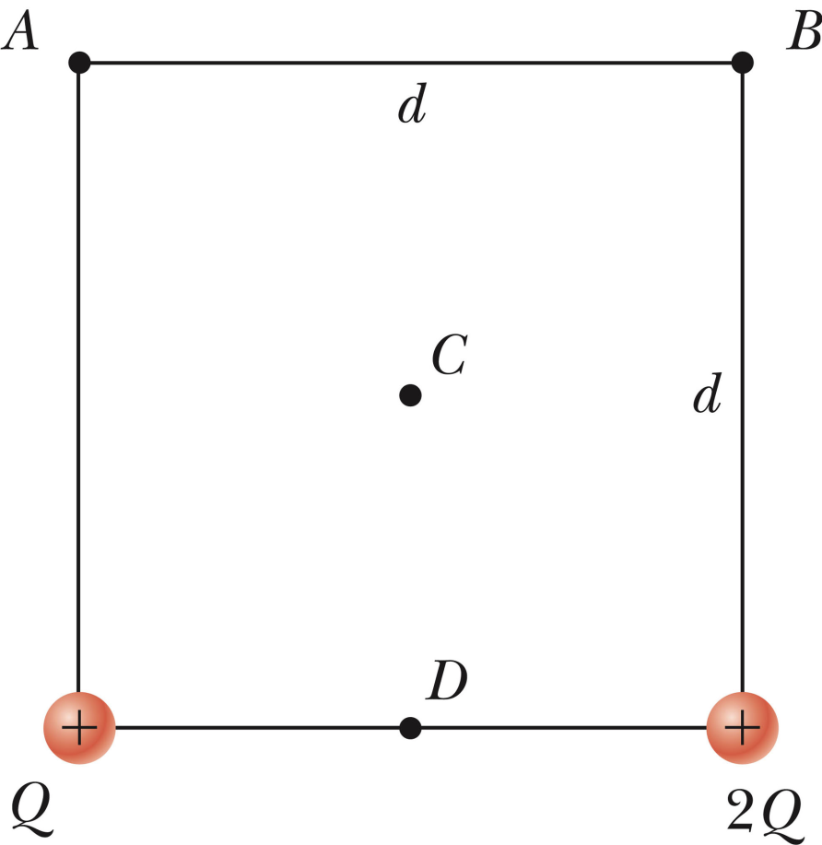
Calculation of the electrostatic potential at points A,B,C,D:

Slide 17
Relationships between electric potential and electric field:
E has units N/C
V has units J/C=Volt

Slide 18
y
r = (x,y)
Q
x

Slide 19
Electric potential for constant electric field:
+σ
−σ
x=0
x=d

Slide 20
Electric potential for constant electric field:
+σ
−σ
x=0
x=d

Slide 21
Electric potential for constant electric field:
+σ
−σ
Suppose a proton having charge e=1.6x10⁻¹⁹ C is initially at rest at x=0, what is its final kinetic energy at x=d?
0
-eσd/ε₀
+eσd/ε₀
2eσd/ε₀
x=0
x=d

Slide 22
Electric potential for constant electric field:
+σ
−σ
Suppose a proton is initially at rest at x=0, what is its final kinetic energy at x=d?
x=0
x=d

Slide 23
Uses for accelerated charges:
In an X-ray machine, electrons are accelerated before hitting a Cu or Mo target that produce X-ray radiation.
Note: An electron accelerated through a potential difference of 10V will have
K_{f} = 10eV = 1.6 x 10⁻¹⁸ J v_{f} = 2 x 10⁶ m/s
Electron beam microscopy (almost atomic resolution)
Accelerated electrons moving in a circle generate synchrotron radiation

Slide 24
Electric potential for constant electric field:
+σ
−σ
Suppose a molecule with positive and negative parts is placed in the field E as show.
It will move to the right
It will move to the left
It will not move
It will rotate
−
+
x=0
x=d

