Slide 1
PHY 114 A General Physics II
11 AM-12:15 PM TR Olin 101
Plan for Lecture 5:
More about electrostatic potentials
Review of Electrostatics (Chapters 23-25)
Advice about preparing/taking physics exams.

Slide 2
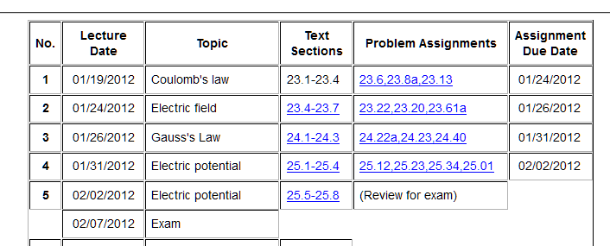
Announcements:

Slide 3
i-clicker question
  Would you attend a review session for next Tuesday’s exam on:
  Sunday afternoon at 3 PM
  Monday afternoon at 4 PM
  Would like a review session at a different time.
  Would not/could not attend a review session at any time.

Slide 4

More about electric potentials:
  Electrical ground
V=0
➔The symbol implies that the “grounded” object is supplied with any necessary charge to maintain voltage V=0.

Slide 5
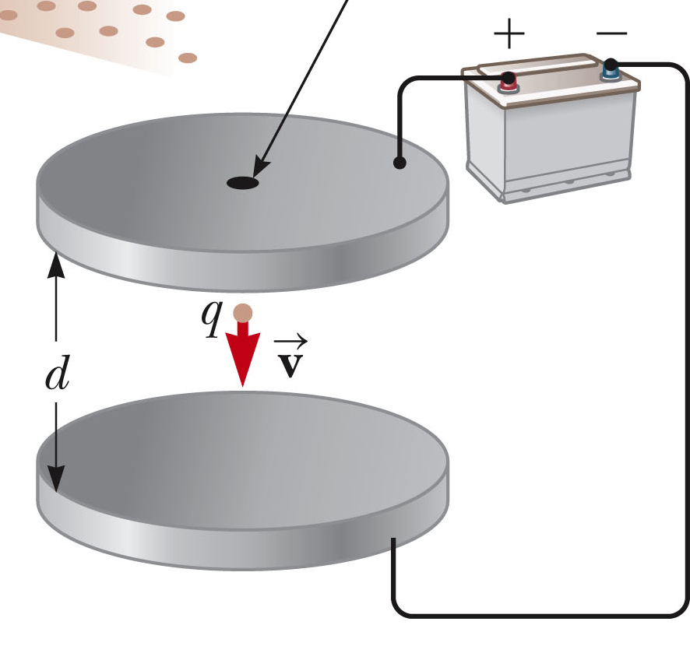
Millikan oil drop experiment
+σ
qE
E
mg
−σ

Slide 6
Van de Graaff generator
Uniformly charged spherical shell
Strong fields can break chemical bonds as does lightning.

Slide 7
Electrostatic potential due to continuous charge distributions
Can determine potential from electric field according to
Can perform integral over charge distribution directly

Slide 8
Example – consider a long thin uniformly charged rod:
E
E_{R}
E_{L}
P
y
-L
x
Q
L

Slide 9
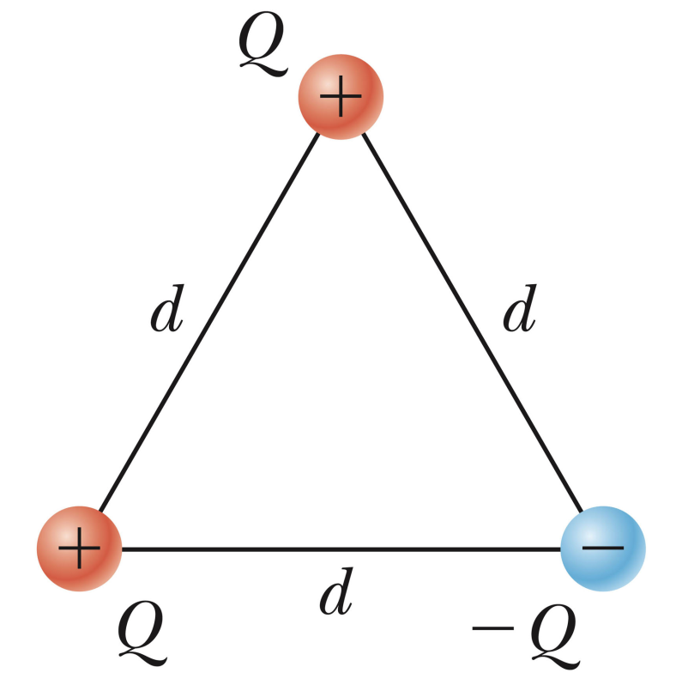
i-clicker question:
  Consider the distribution of charges shown below. Which of the following statements is most accurate.
This charge distribution was introduced by evil physics professor to torture their students.
This charge distribution is stable with no additional forces.
The charge distribution can be stable only with additional forces.

Slide 10
Reminder:
First exam – Tuesday, February 6, 2012 – covering Chapters 23-25.
  ~5 problems – show your work and reasoning for possible partial credit.
  Should bring 1 8½” x 11” sheet of paper to the exam (to be turned in with your exam papers).
  Should bring calculator for numerical work. Must not use cell phones or computers during the exam.

Slide 11
Problem solving skills
Math skills
Equation Sheet
Advice:
Keep basic concepts and equations at the top of your head.
Practice problem solving and math skills
Develop an equation sheet that you can consult.

Slide 12
Problem solving steps
  Visualize problem – labeling variables
  Determine which basic physical principle(s) apply
  Write down the appropriate equations using the variables defined in step 1.
  Check whether you have the correct amount of information to solve the problem (same number of knowns and unknowns).
  Solve the equations.
  Check whether your answer makes sense (units, order of magnitude, etc.).

Slide 13
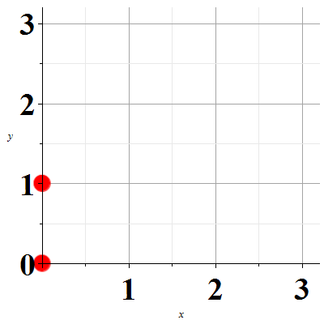
Example problem:
  Consider the following configuration of point charges q₁=2μC and q₂=4μC as shown. Determine the electric field E at the position (in meters)
y (m)
q₂
q₁
x (m)

Slide 14
Example problem:
  Consider the following configuration of point charges q₁=2μC and q₂=4μC as shown. Determine the electric field E at the position (in meters)
y (m)
q₂
q₁
x (m)

Slide 15
y (m)
q₂
q₁
x (m)

Slide 16
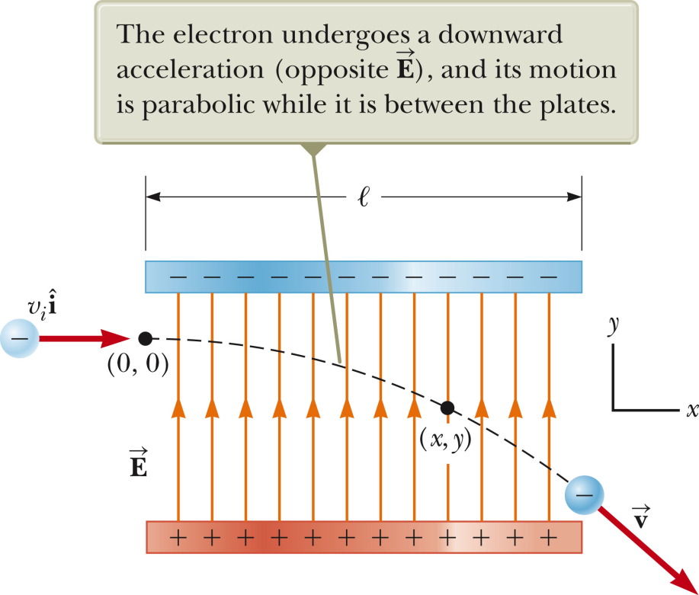
Example: An electron enters the region of a uniform electric field E=200 N/C as shown with v_{i}=3x10⁶ m/s . The horizontal length of the plates is l=0.1m. Find the vertical displacement y of the electron as it leaves the plates. (Ignor any field fringing effects.)
y

Slide 17
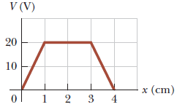
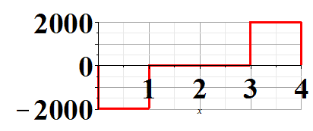
Integral-differential relationship between E and V in one dimension.
E(V/m)
x(cm)

Slide 18
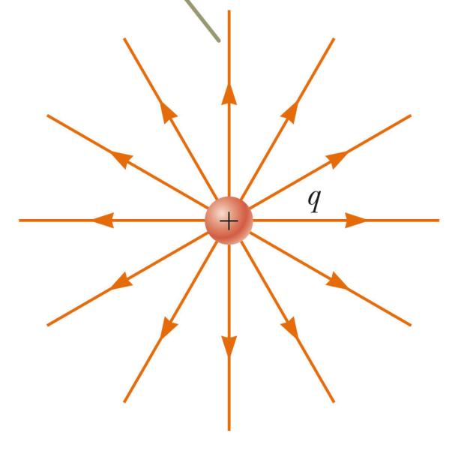
Review question
  The diagram below shows a point positive charge q placed at the center of an electrically isolated conducting shell. What is the magnitude of the field E measured at a radius r outside the shell?
E
E=0
E=k_{e} q/r²
Not enough information to solve this problem

Slide 19
Review question
  The diagram below shows a point positive charge q placed at the center of an electrically grounded conducting shell. What is the magnitude of the field E measured at a radius r outside the shell?
E
E=0
E=k_{e} q/r²
Not enough information to solve this problem

Slide 20
Summary of electric fields and potentials for special charge distributions:

