Slide 1
PHY 114 A General Physics II
11 AM-12:15 PM TR Olin 101
Plan for Lecture 6:
Electrostatic capacitance (Chapter 26)
Voltage and capacitance in circuits
Energy storage in capacitors

Slide 2
i-clicker exercise
Exam feedback
Exam was too easy
Exam was too hard
Exam was about right
i-clicker exercise
Would you like to schedule a session to go over the exam?
Yes
No
i-clicker exercise
On the possibility of an optional 4th exam
Would like to take a 4th exam
Would not like to take a 4th exam

Slide 3
Remember to send in your chapter reading questions…

Slide 4
First – a word from our sponsors:
http://www.wfu.edu/physics
The Physics Department will host a reception for all prospective Physics majors on Monday, February 13 from 3-4:30 p.m. in the Olin foyer.
http://college.wfu.edu/research-fellowship/

Slide 5
Electric potential for constant electric field:
+σ
−σ
x=0
x=d

Slide 6
Electric potential between parallel plates with charge Q
+Q
−Q
A
A
+
+
+
+
+
+
+
+
+
+
+
−
−
−
−
−
−
−
−
−
−
−
x=0
x=d

Slide 7
General formulation of capacitance
Ignoring sign:
Units:
Voltage drop across capacitor terminals
Charge on + and – terminals of capacitor
Depends on geometry and material composition of capacitor

Slide 8
Cylindrical geometry capacitor:
r
L

Slide 9
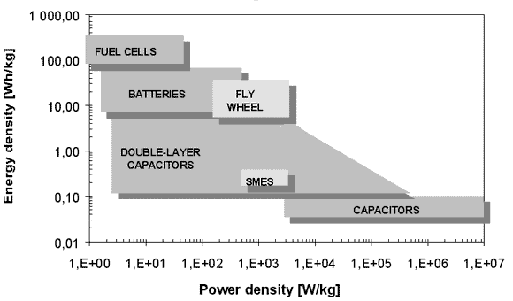
Capacitor usage in energy storage:
http://www.mpoweruk.com/alternatives.htm

Slide 10
Questions about usefulness of electric fields outside of physics class.
Example: ipad touch screen (from HowThingsWork web page)

Slide 11
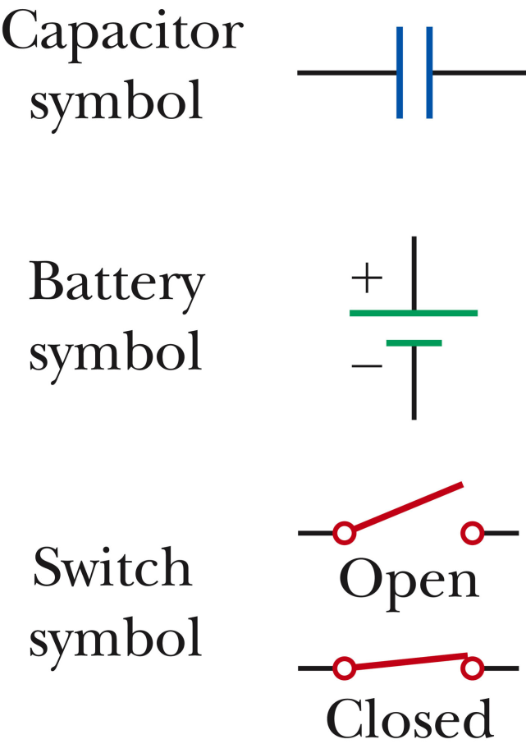
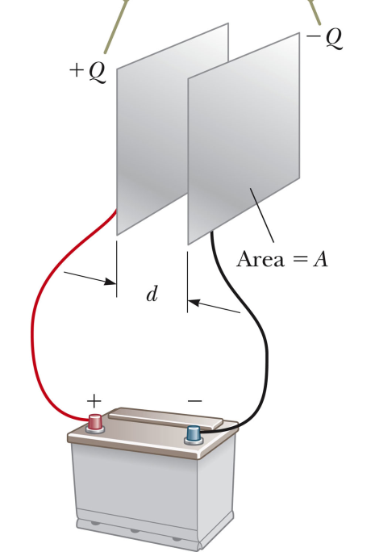
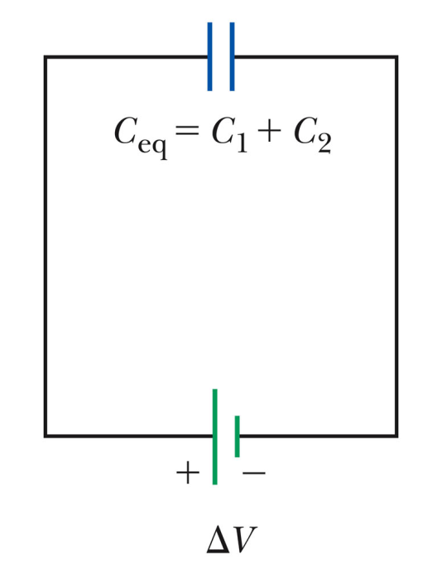
Electrical circuits using capacitors and voltage source
+Q -Q
C
Wire connection

Slide 12
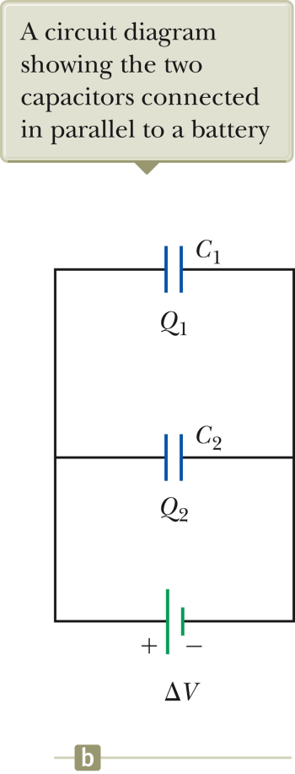
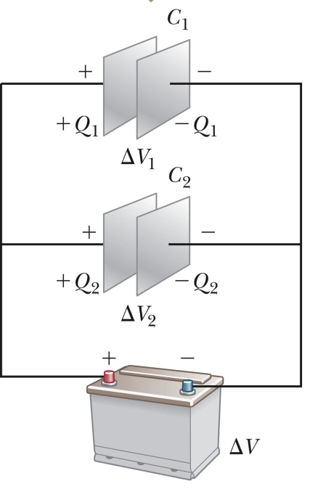
More complicated circuits –
Capacitors connected in parallel

Slide 13
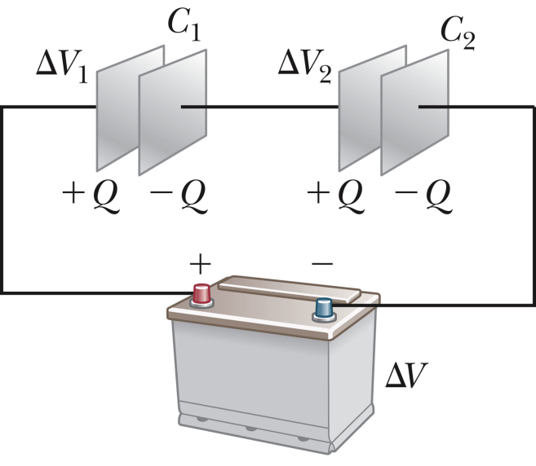
More complicated circuits –
Capacitors connected in series

Slide 14
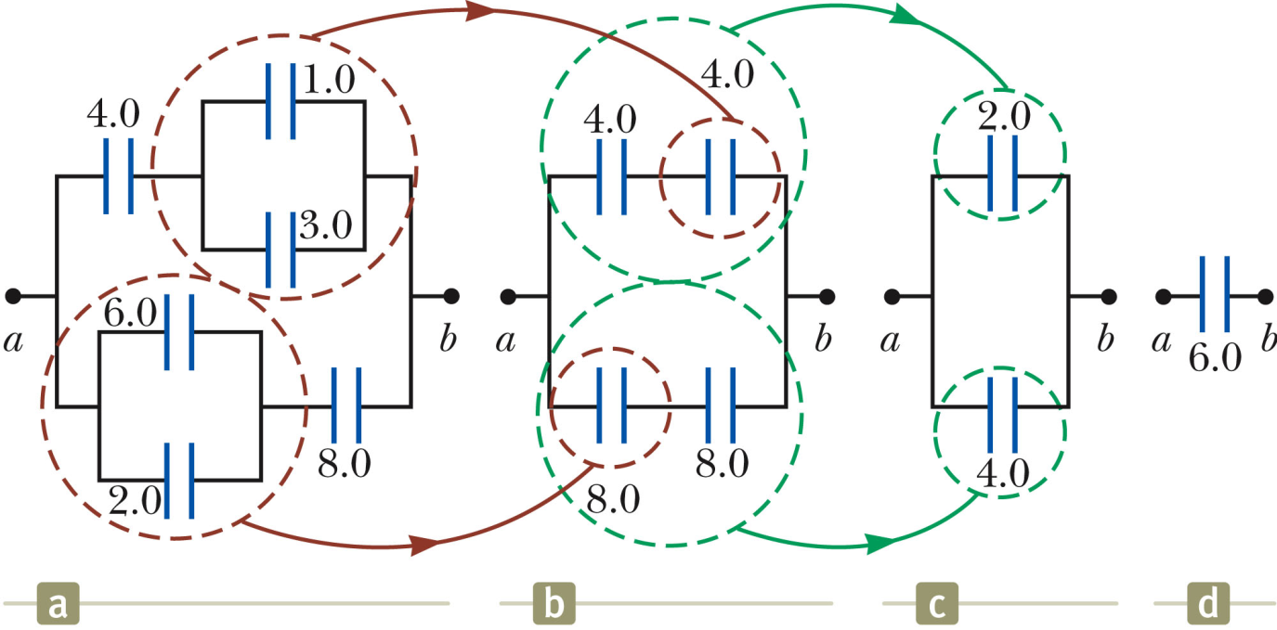
Equivalent capacitance circuits

Slide 15
i-clicker question
Consider the circuit diagrams shown below. In each the voltage is ΔV=100V and C₁=C₂=1μF. Which circuit can store the most total charge?
A.
B.

Slide 16
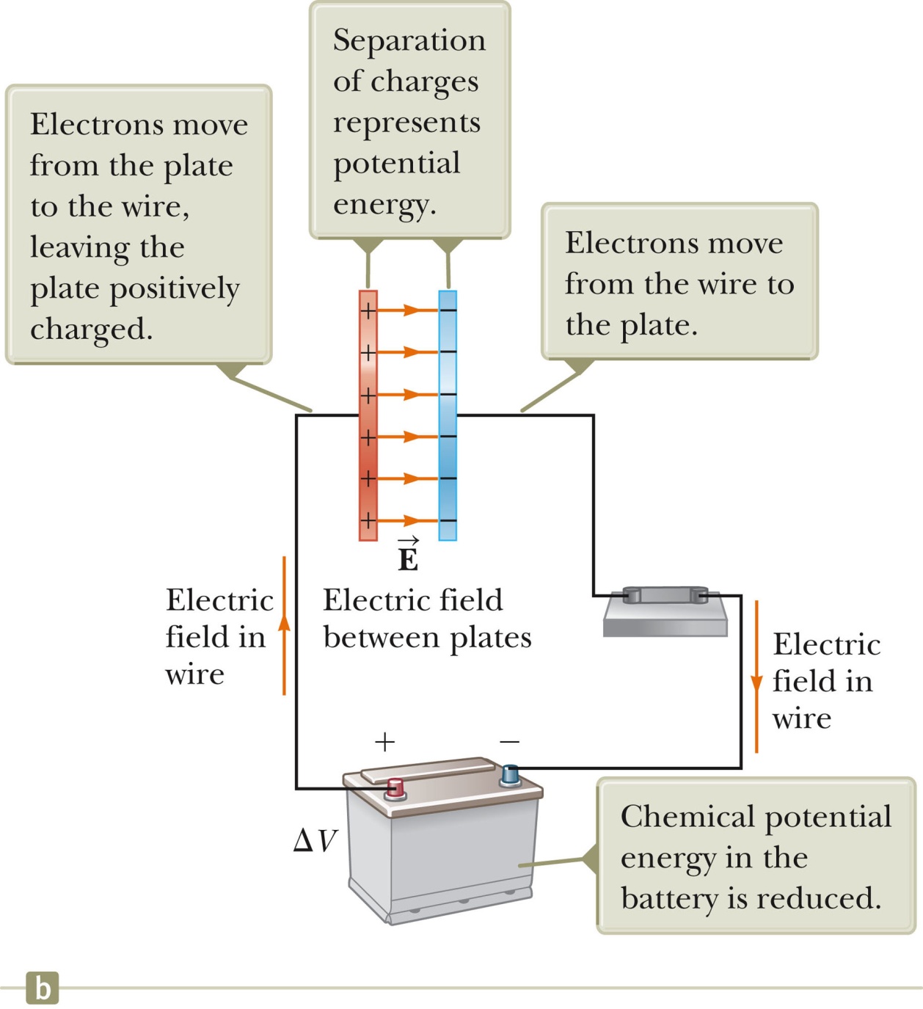
Energy storage within a capacitor

Slide 17
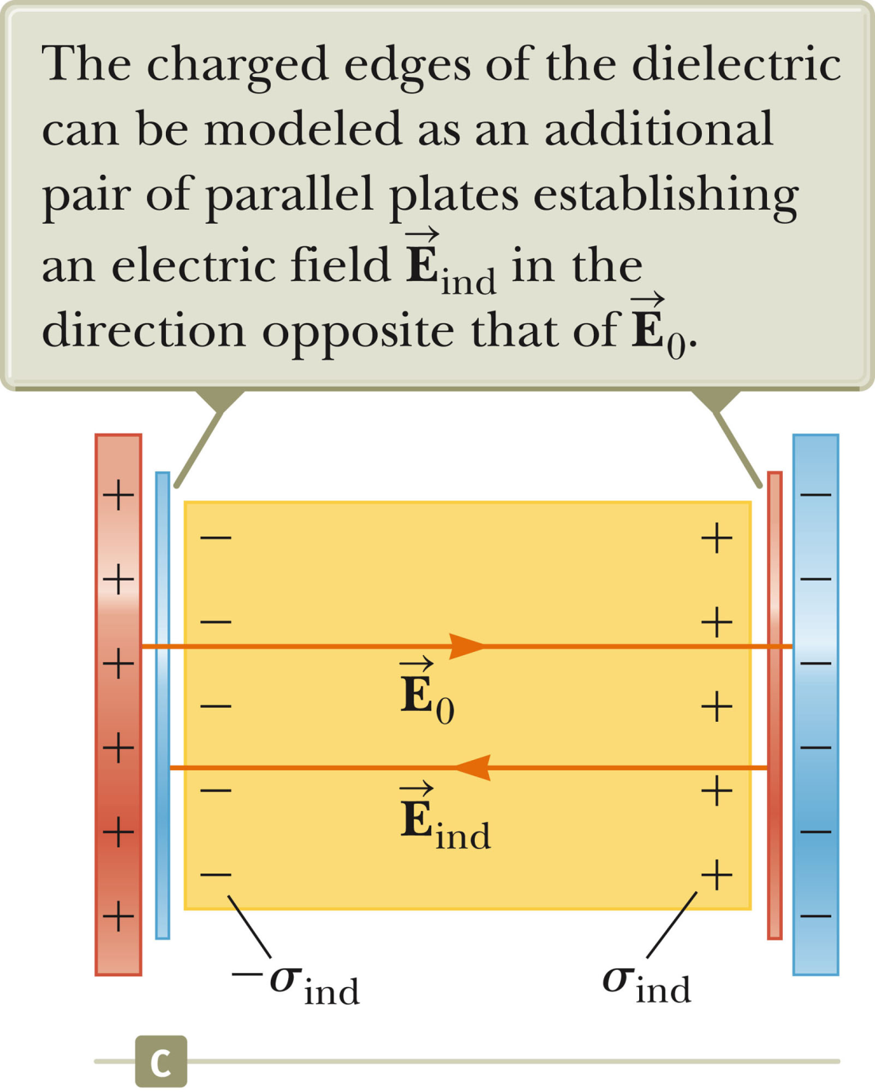
Effects of dielectric materials in capacitors

Slide 18
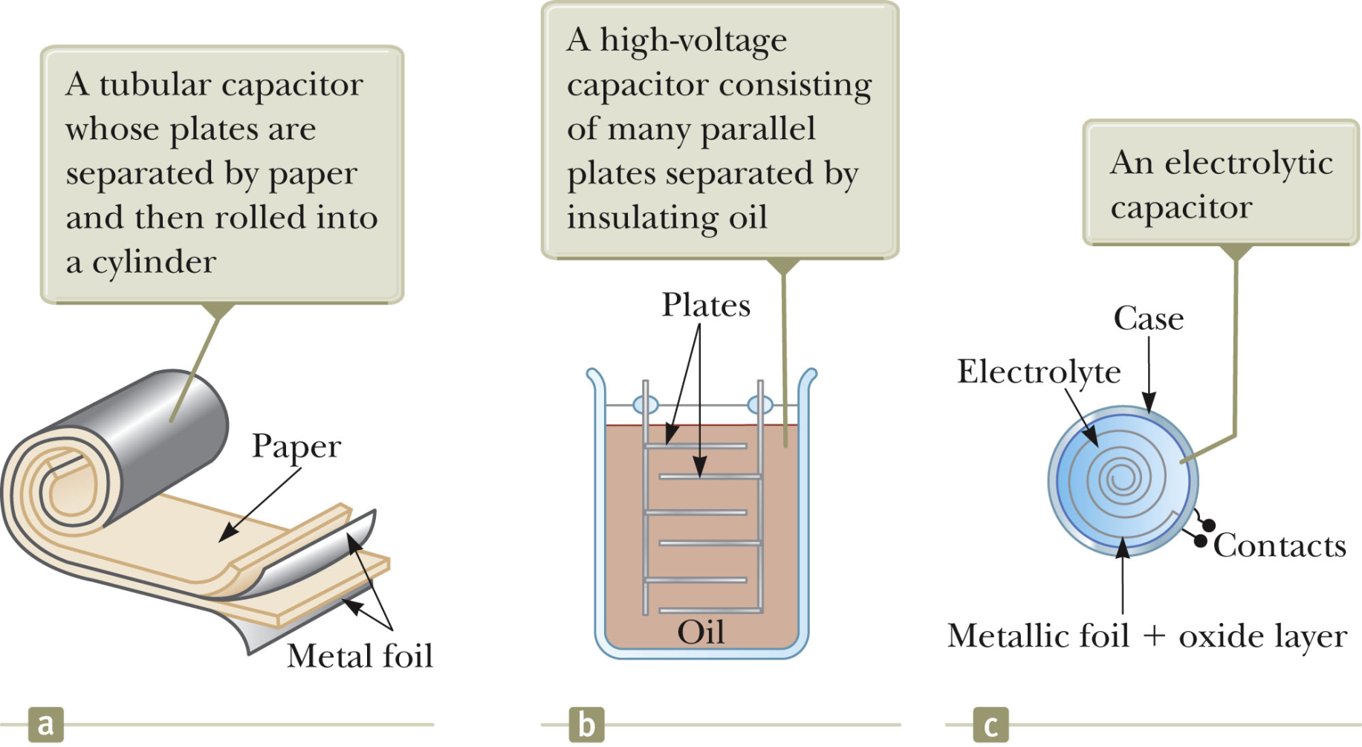

Slide 19
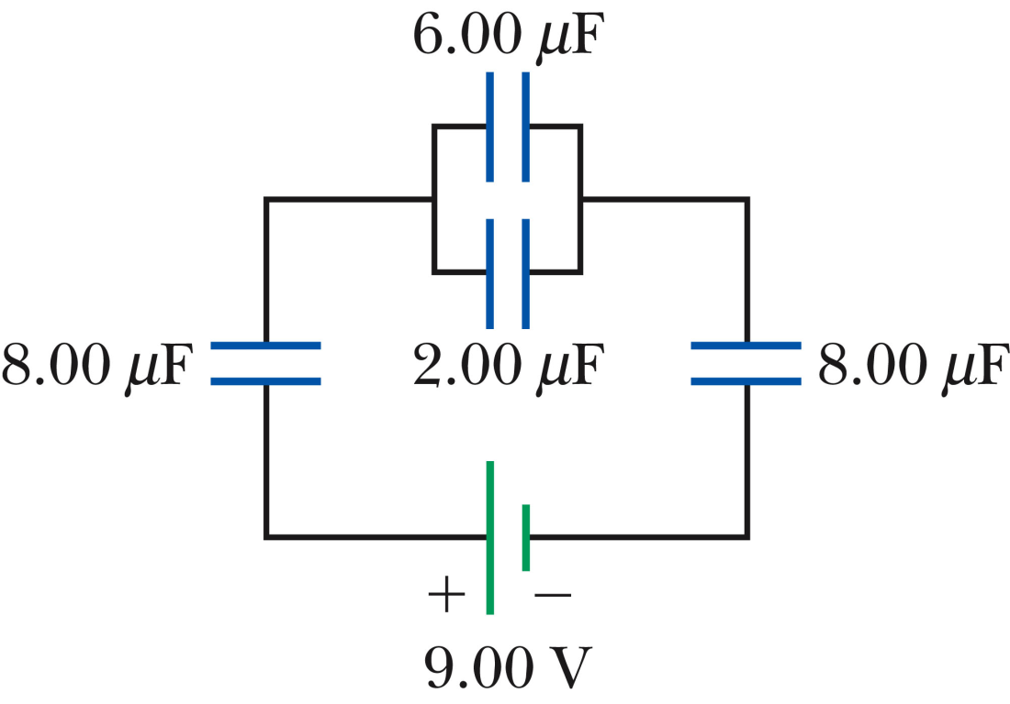
Example:
Find equivalent capacitance:
Find total charge:

Slide 20
